Slide 1
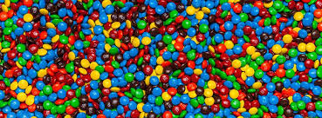
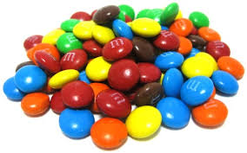
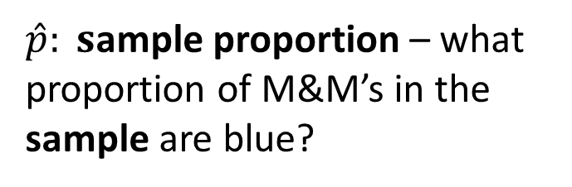
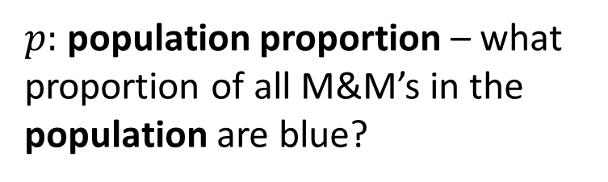
Population
Sample
All M&M’s in the world
A few randomly selected M&M’s
Take Sample
Calculate Sample
Statistic
Our Goal: Estimate the Population Parameter
Inference
$p:$population proportion – what proportion of all M&M’s in the population are blue?
$\hat{p}: s$ample proportion – what proportion of M&M’s in the sample are blue?

