Slide 1
Reconstruction of
Class Hierarchies for
Decompilation of C++ Programs
Alexander Fokin
Katerina Troshina
Under the supervision of Prof. Alexander V. Chernov
Notes:
@ISPRAS!

Slide 2
Purpose
Analysis and maintenance of legacy code.
Malware analysis.
Protocol reconstruction.

Slide 3
Problem statement
C++
code
Unknown
C++ compiler
ASM
Assembler
No assembler-level
obfuscation and runtime
code modification
Polymorphic
class hierarchy
reconstruction
Binary
code
C++
code
Decompiler
Polymorphic
class hierarchy
reconstruction
ASM
Disassembler
Notes:
We have different C++/ASM codes.
Only functional equivalence.

Slide 4
Plan
Analysis of RTTI structures
Analysis in case of absence of RTTI structures
  Reconstructing virtual table inheritance hierarchy
  Reconstructing polymorphic class hierarchy

Slide 5
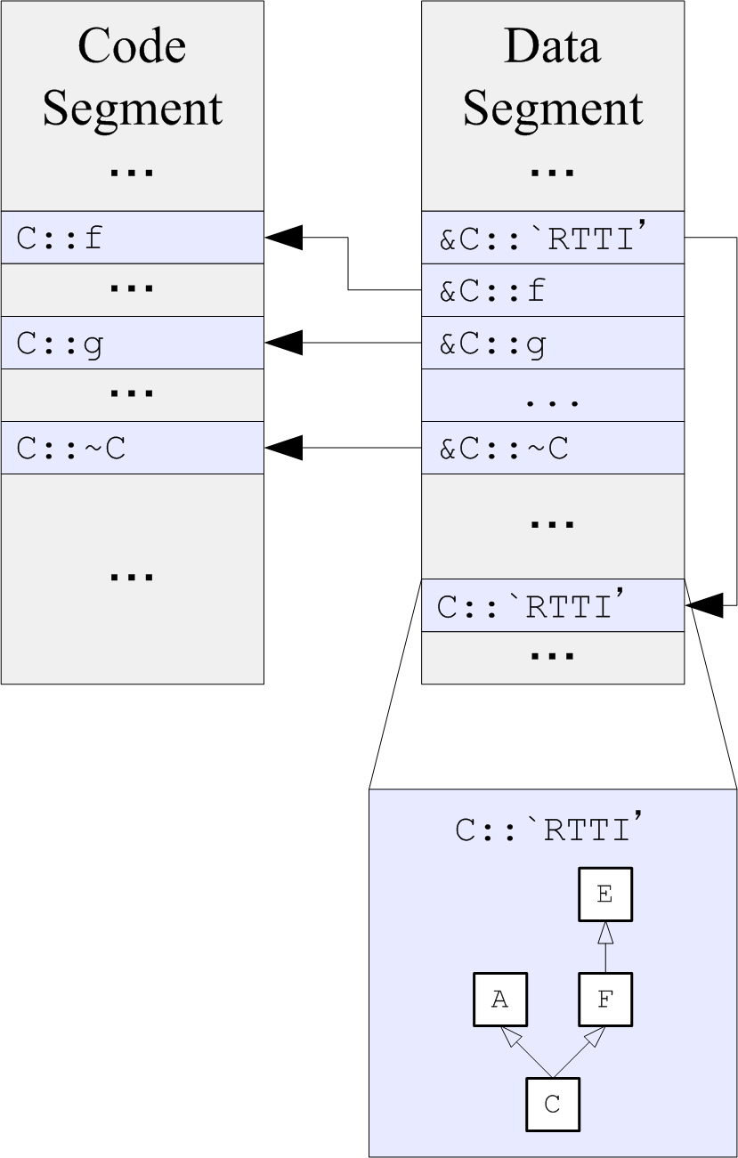
Analysis of RTTI structures
Locate RTTI structures
  Pointer to RTTI structure precedes the vtable.
  Vtables are arrays of pointers to functions.
  Only the first element of vtable is referenced from program code.
Analyze RTTI structures
Notes:
RTTI structure for a class contain information on all the parents of the class.
In all widely used ABIs...
So we need to find vtables...
Blabla in Ctor / Dtor
We're not the first ones who did that. See Sabanal/Yason @ IBM.

Slide 6
Reconstructing virtual table inheritance hierarchy
Vtable localization.
Collecting of information on vtable inheritance hierarchy using several rules.
Example rule. If the size of vtable B is less then the size of vtable D, then B cannot inherit from D.
Processing of the collected information to construct a set of vtable inheritance trees.
Notes:
We use 6 rules.

Slide 7
Reconstructing polymorphic class hierarchy
Interprocedural data flow analysis is used to detect code sites where pointers to vtables are written into memory locations differing by constant offset.
Example
mov [esi], offset A::'vtable'
; ...
mov [esi+8], offset C::'vtable'
; ...
mov [esi], offset B::'vtable'

Slide 8
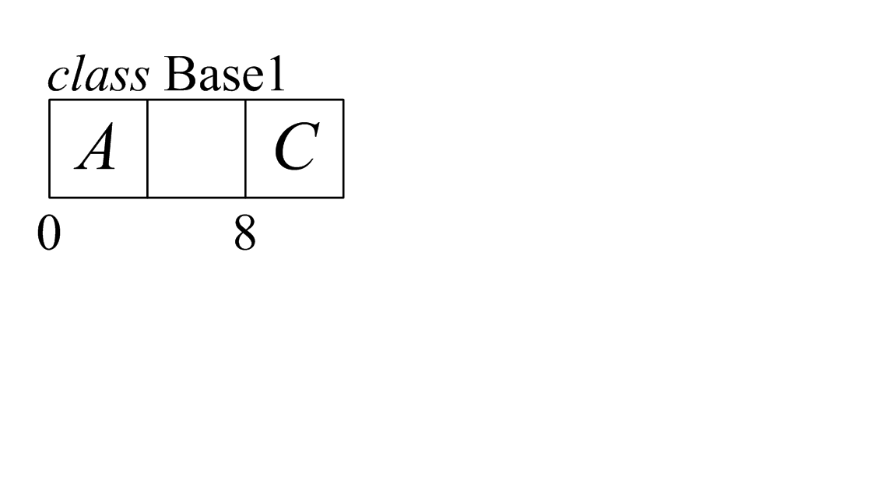
Reconstructing polymorphic class hierarchy
Each such vtable access site is associated with a set of (offset, vtable sequence) pairs.
Each such set determines a class.
Example
mov [esi], offset A::'vtable'
; ...
mov [esi+8], offset C::'vtable'
; ...
mov [esi], offset B::'vtable'
Set of (offset, vtable sequence)
pairs:
(0, [A, B]), (4, [C])

Slide 9
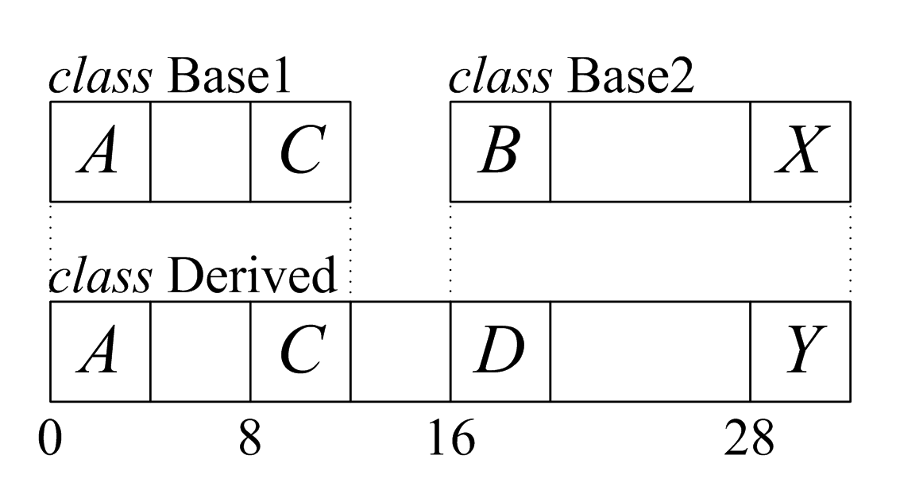
Reconstructing polymorphic class hierarchy
Class inheritance relation inference is performed. It uses previosly reconstructed vtable inheritance trees.
Here B is a direct base of D and X is a direct base of Y.

Slide 10
Test results
Application | doxygen | shareaza | notepad++
Vtables found | 415 | 1128 | 95
Vtable mismatches | 8.6% | 4.1% | 4.0%
Classes found | 401 | 1108 | 95
Non-classes | 0.9% | 0.6% | 0.0%
Class mismatches | 9.7% | 6.5% | 10.5%
Notes:
“Vtable mismatches” refer to vtables with
reconstructed parent vtable differing from the real one. “Nonclasses”
refer to reconstructed classes that were not present in
the source program. “Class mismatches” refer to classes with
associated vtables or parents reconstructed differently from the
real ones.

Slide 11
Results
Described approach was implemented in a plugin for IDA Pro interactive disassembler and is available for download at http://decompilation.info.

Slide 12
Questions?

Slide 13
