Slide 1
Let’s talk about it!!
Project one feedback discussion

Slide 2
What is sql?

Slide 3
What is sql?
(S)tructured (Q)uery (L)anguage
A programming language used to manipulate data stored in databases on a server.
Not a database

Slide 4
What is a database?

Slide 5
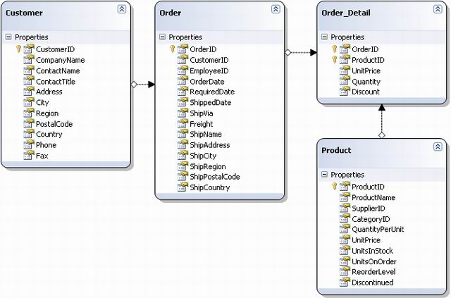
What is a database?
A collection of data stored in tables on the server, much like spreadsheets.

Slide 6
Benefits of using a database
Size
Ease of updating
Accuracy
Security & integrity
Redundancy
Importance
Relational

Slide 7
What is mysql?

Slide 8
What is mysql?
Open-Source (aka “Free”) software for managing data stored on a server.

Slide 9
What is mysql?
Open-Source (aka “Free”) software for managing data stored on a server.
MySQL Server is the engine that stores data and databases.
MySQL Workbench is a GUI for editing, searching and designing tables in a database. *All possible via the command line

Slide 10
Let’s practice!!
CREATE
USE
SELECT
INSERT
UPDATE
ALTER
ADD
DELETE
JOIN

Slide 11
SQL JOINS
INNER JOIN: Combines tables where the specified data-values within a column match one-another
LEFT JOIN: Combines tables and shows all of the values of the first table specified while only the values which match on the second side will be shown
RIGHT JOIN: Combines tables and shows all of the values of the second table specified while only the values which match on the first table will be shown

Slide 12
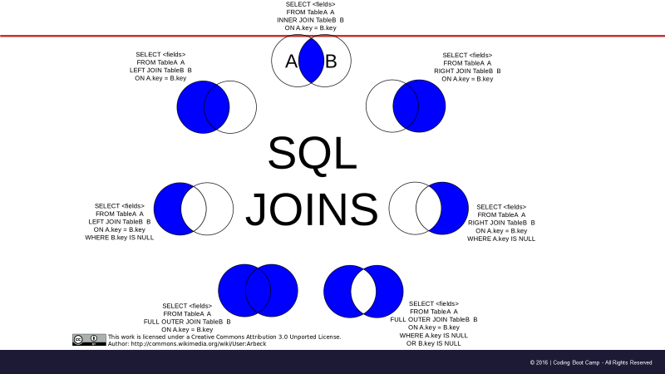

Slide 13
