Slide 1
Support Vector Machine
The Data Bootcamp |
<DATE GOES HERE>

Slide 2
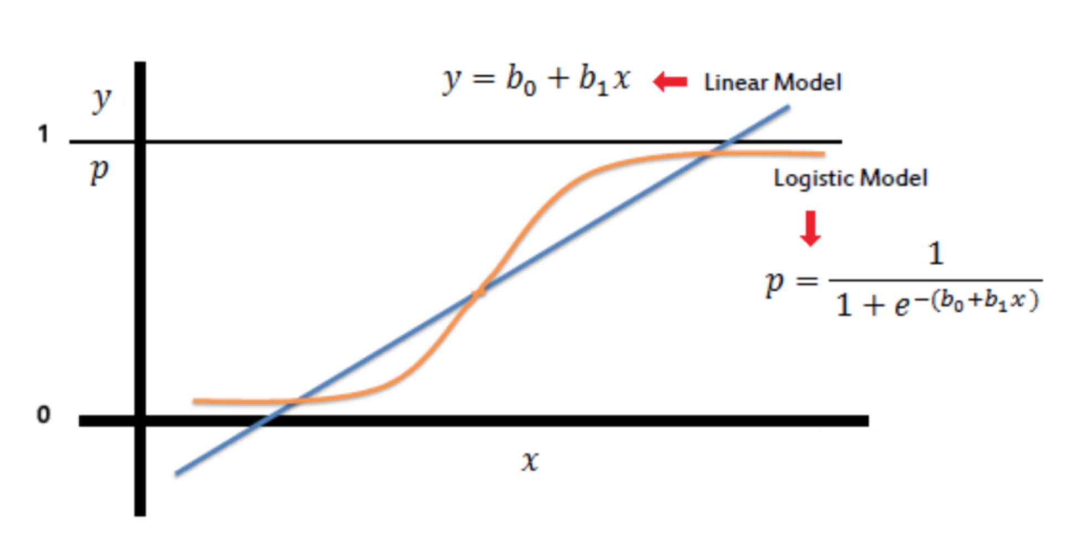
Logistic Regression
Logistic regression is a classification algorithm used to predict a discrete set of classes or categories (i.e. Yes/No, Young/Old, Happy/Sad).
Unlike linear regression which outputs continuous number values (for example, age), logistic regression applies an activation function, such as the sigmoid function, to return a probability value of 0 or 1. This can then be mapped to a discrete class like “Young” or “Old”.

Slide 3


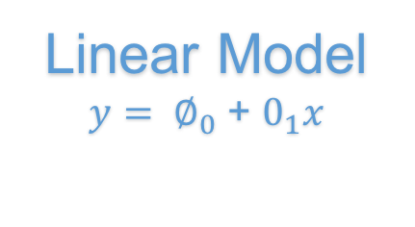
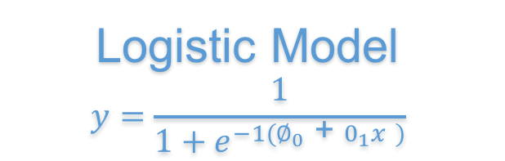
Logistic Regression
Logistic Regression is a statistical method to predict a discrete output or category.
Happy
😀
Bias
$$∅_{0}$$
Activation Function
X
$$∅_{2}$$
Sad
😭
Linear Model
$y= ∅_{0}$ + $0_{1}x$
Logistic Model
$$y=\frac{1}{1+e^{−1(∅_{0}\text{ + }0_{1}x )}}$$
Discrete Output
0 or 1
“Happy” or “Sad”

Slide 4
Questions / Discussion
Notes:
It’s important to keep in mind why you joined this class. Let’s talk about your goals.

