Slide 1

Assessing the Effectiveness of Inclusive Environment Trainings for Professionals Interacting with LGBTQ+ Youth
By Emma Sexton

Slide 2
Introduction & Methods
Trainings:
Any Which Way You Go and Creating Safer Spaces
Post-training surveys within one week of the training
Data cleaning and analysis using R/R Studio
Context: Lack of inclusive spaces contributes to experiences of discrimination for LGBTQ+ youth
Key Players:
Client: A large non-profit organization serving LGBTQ+ youth
Offers advocacy and capacity building training
Professional development workshops on inclusion and safety for LGBTQ+ youth
Evaluator: Strength in Numbers Consulting Group (SiNCG)
SiNCG evaluators enter
Evaluation Question: Was training effective in engaging and educating professionals on inclusive theoretical frameworks and tools that could be incorporated into their personal practice or adapted into their organizations policies?
Notes:
* Provides free year-round programs and services for LGBTQ+ youth and allies between 13 and 24 years old
* Programming and services include counseling and case management, arts and culture, academic enrichment, job readiness, outreach homeless services, and more.
* Also provide advice and resources to family members of LGBTQ+ youth
* Influence policy on local, national, and international level
* (e.g., school counselors, social workers, organization executives, etc.) to advocate on behalf of LGBTQ youth
Strength in Numbers
Social justice-oriented consulting firm that assists nonprofits, foundations, and government organizations
Prioritize work that supports autonomy of marginalized populations

Slide 3
RESULTS
Overview:
Successful engagement
Successful understanding of theoretical concepts (e.g., personal gender pronouns)
Difficulty relaying important aspects/tools to create a safer space and translating concepts into practice
Table 1. Number of Training Sessions, Attendees, and Surveys (FY22)
 | Number of Training Sessions | Number of Attendees | Number of Sessions Surveyed | Number of Attendees Surveyed | Percentage who received at least 75% on post-training survey
Any Which Way You Go | 28 | 553 | 26 | 333 | 84.1%
Creating Safer Spaces | 12 | 229 | 12 | 117 | 40.2%
Total | 40 | 782 | 38 | 450 | --
Notes:
Over 50% post-training survey response rate.

Slide 4
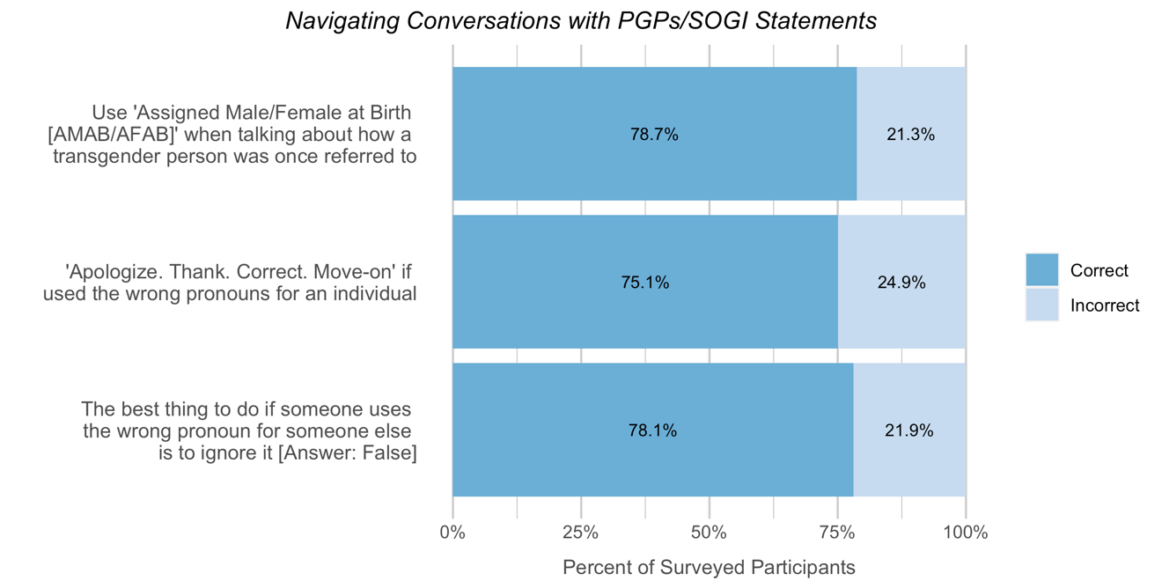
Any which way you go
Overview: Equip attendees with inclusive frameworks and tools to be incorporated into personal professional practices involving LGBTQ+ youth.
*PGP = personal gender pronouns; SOGI = sexual orientation and gender identity
Notes:
Participants demonstrated a strong understanding of biological sex as a concept that does not determine your gender identity and understood different personal gender pronouns and sexual orientations.
Although over three-quarters of participants felt comfortable navigating conversations that involved personal gender pronouns and sexual orientation, 20-25% of survey respondents struggled to translate the concepts into practice, particularly being unsure of what to do when the wrong personal gender pronouns are used.

Slide 5
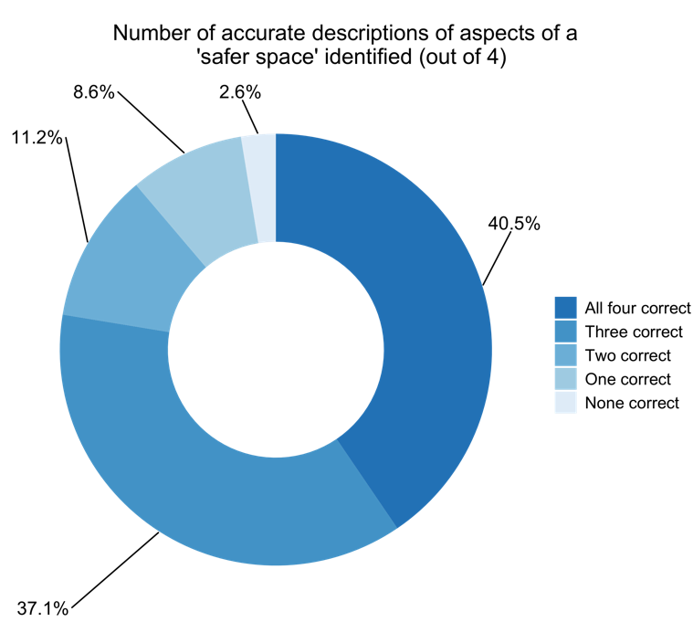
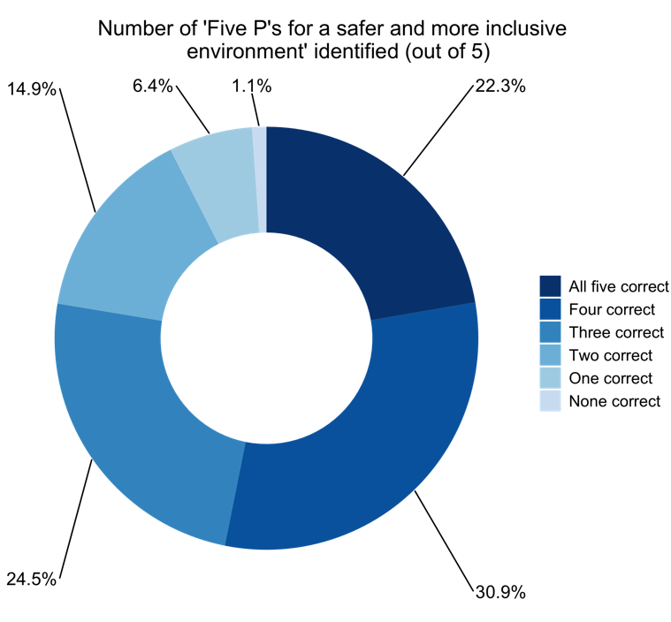
creating safer spaces
Overview: Educating professionals on frameworks and practices to be used to create and support safer environments for LGBTQIA+ youth at the organizational policy level.
Notes:
Two ‘select all that apply’ questions were asked to assess participants’ knowledge of aspects that make up safer spaces, as well as the ‘Five P’s’ detailed in the training that outline how organizations can create safer and more inclusive environments. As you can see, over 75% of participants correctly identified at least 3 out of 4 descriptions of aspects of a safer space, while a little over 50% of survey participants correctly identified at least 4 out of 5 ‘Five P’s’. As multipack questions, these two proved to be the most difficult for participants.

Slide 6
Any Which Way You Go
Incorporate more practice navigating situations related to using the wrong pronouns (role playing)
Creating Safer Spaces
Engage in brainstorming exercises/group discussion so participants within the same organization can interact more with the concepts and identify aspects of a safer space and best practices for creating a safer space
Overall
Re-evaluate questions in post-training surveys
Implement pre-training survey
Key findings & future directions
Notes:
Ultimately improve confidence
Concretely identify ways to incorporate safe space practices into their organizations
Improve evaluation efforts moving forward to better assess their training program.

Slide 7
Appendix
Creating Safer Spaces Post-Training Survey Answers
‘5 P’s’ for creating a safer and more inclusive environment:
Policy, Practice, Programs, Professional Development, & Physical Environment
Accurate descriptions of aspects of a ‘safer space’
A supportive, non-threatening environment for youth
A set of guidelines that include a clear statement of the importance of physical and mental safety
A space that is critical of the power structures that affect our everyday lives
Shared responsibility for everyone who enters the space to uphold the values of the space
Strength in Numbers Consulting Group: www.strengthinnumbersconsulting.com

