Slide 1
4tops Differential
7th August 2024
Adam Eaton, Ethan Simpson,
University of Manchester

Slide 2
Aim
Which observables are interesting?
How well can we reconstruct them?
What can we expect from Run3 (Run2?) sensitivities

Slide 3
New Physics Models
Indicate which distributions are sensitive to New Physics and therefore interesting to measure

Slide 4
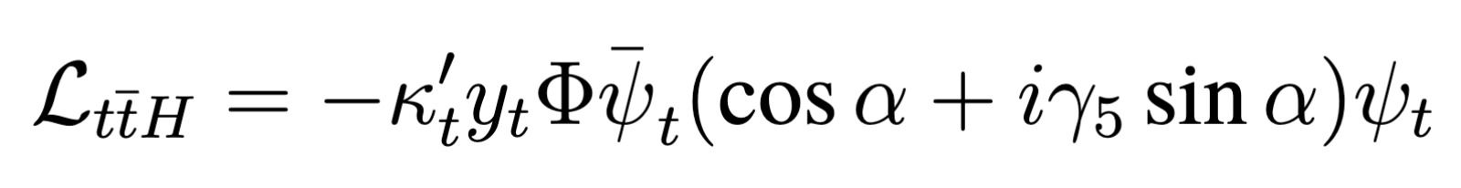
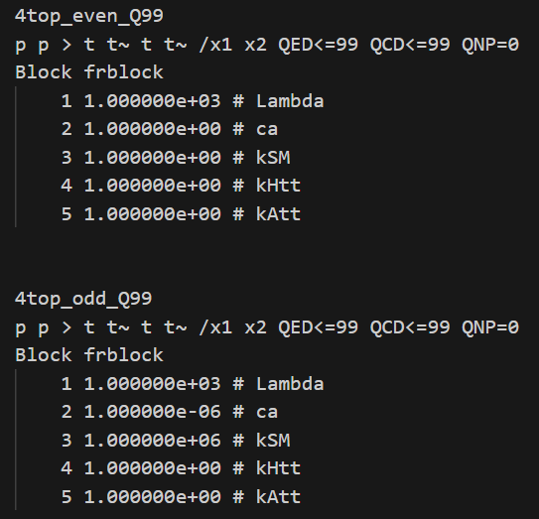
Higgs Characterisation Model
Introduce possible CP-odd Higgs (and mixing)

Slide 5
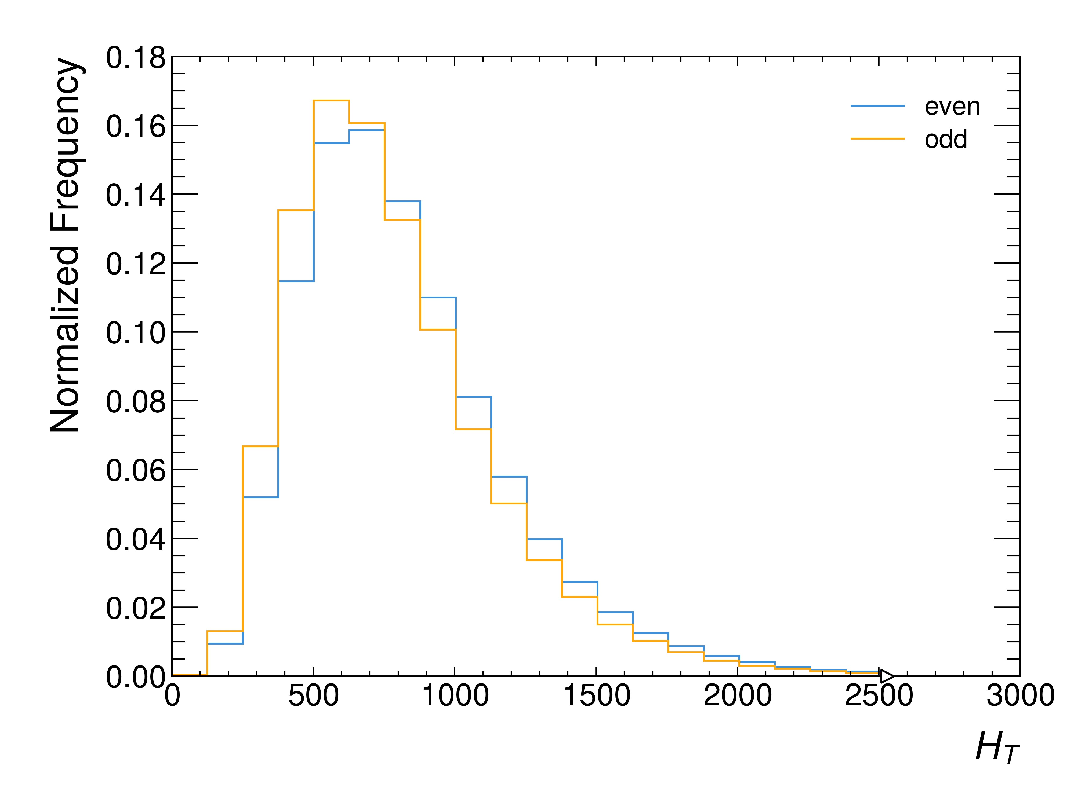
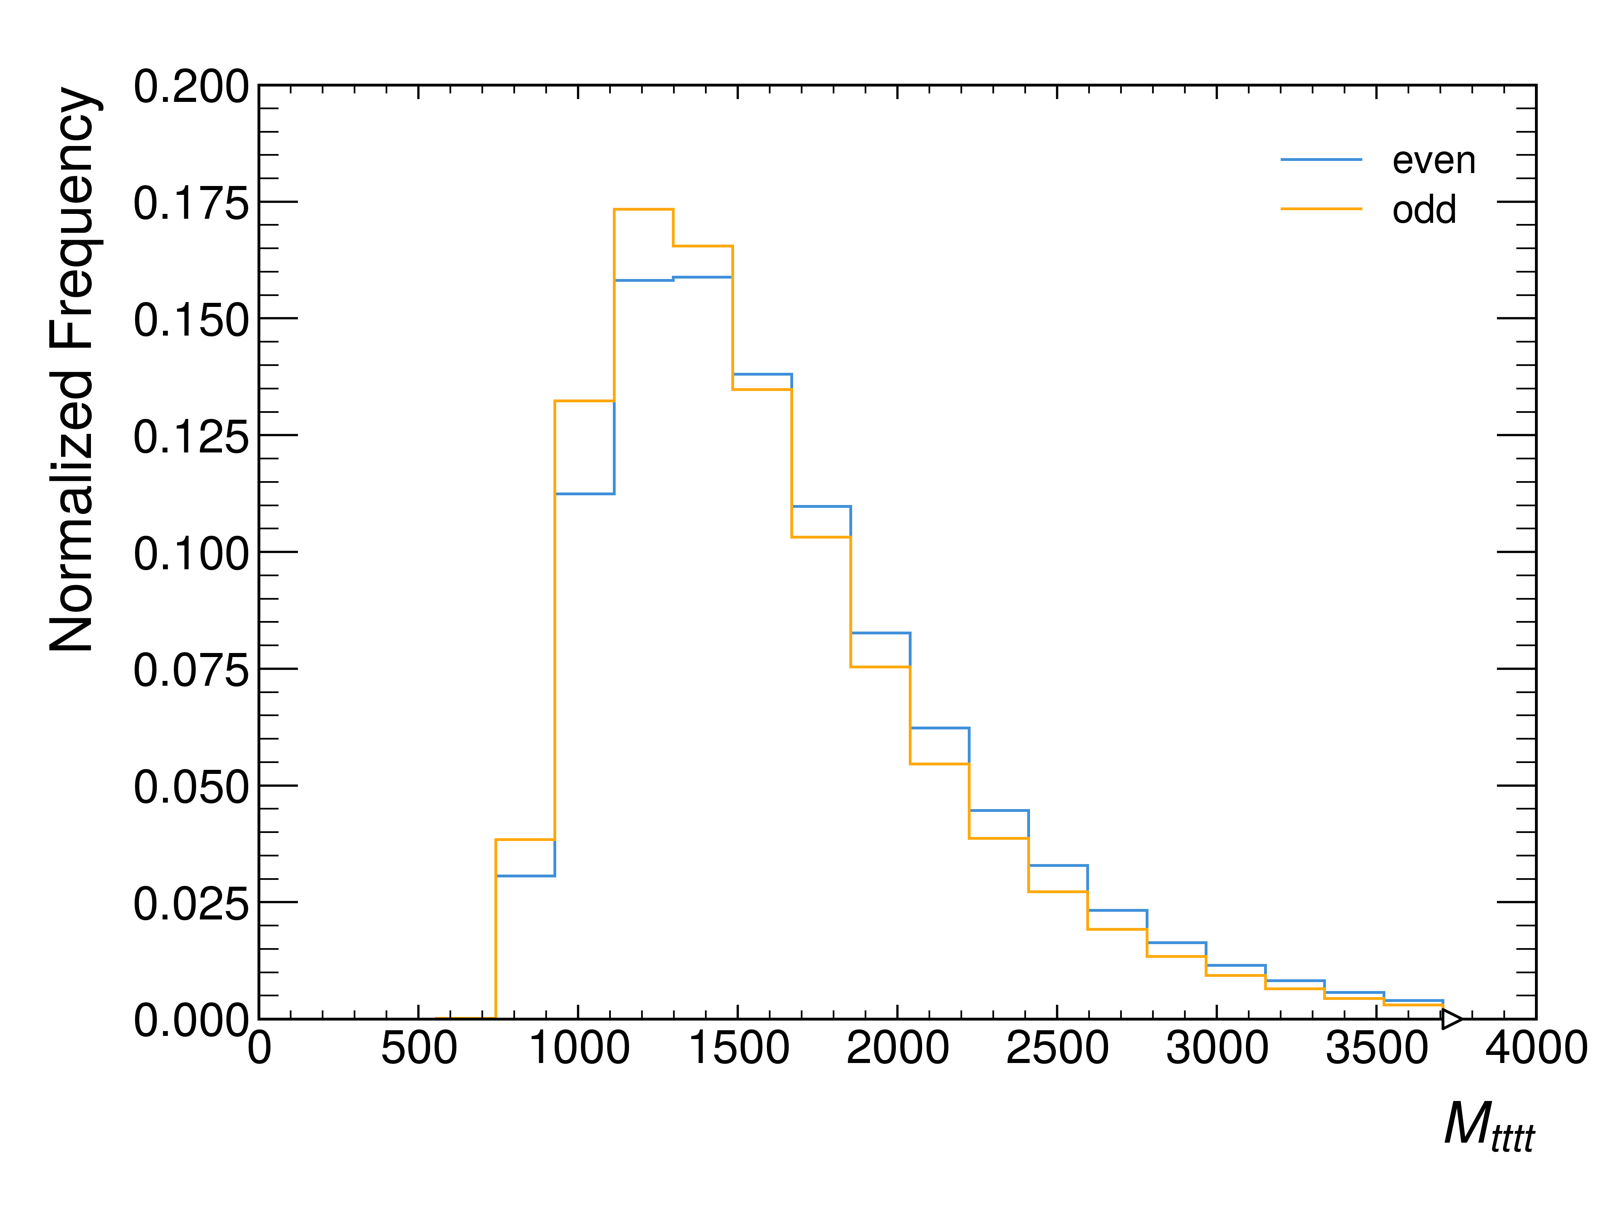
Higgs Characterisation Model

Slide 6
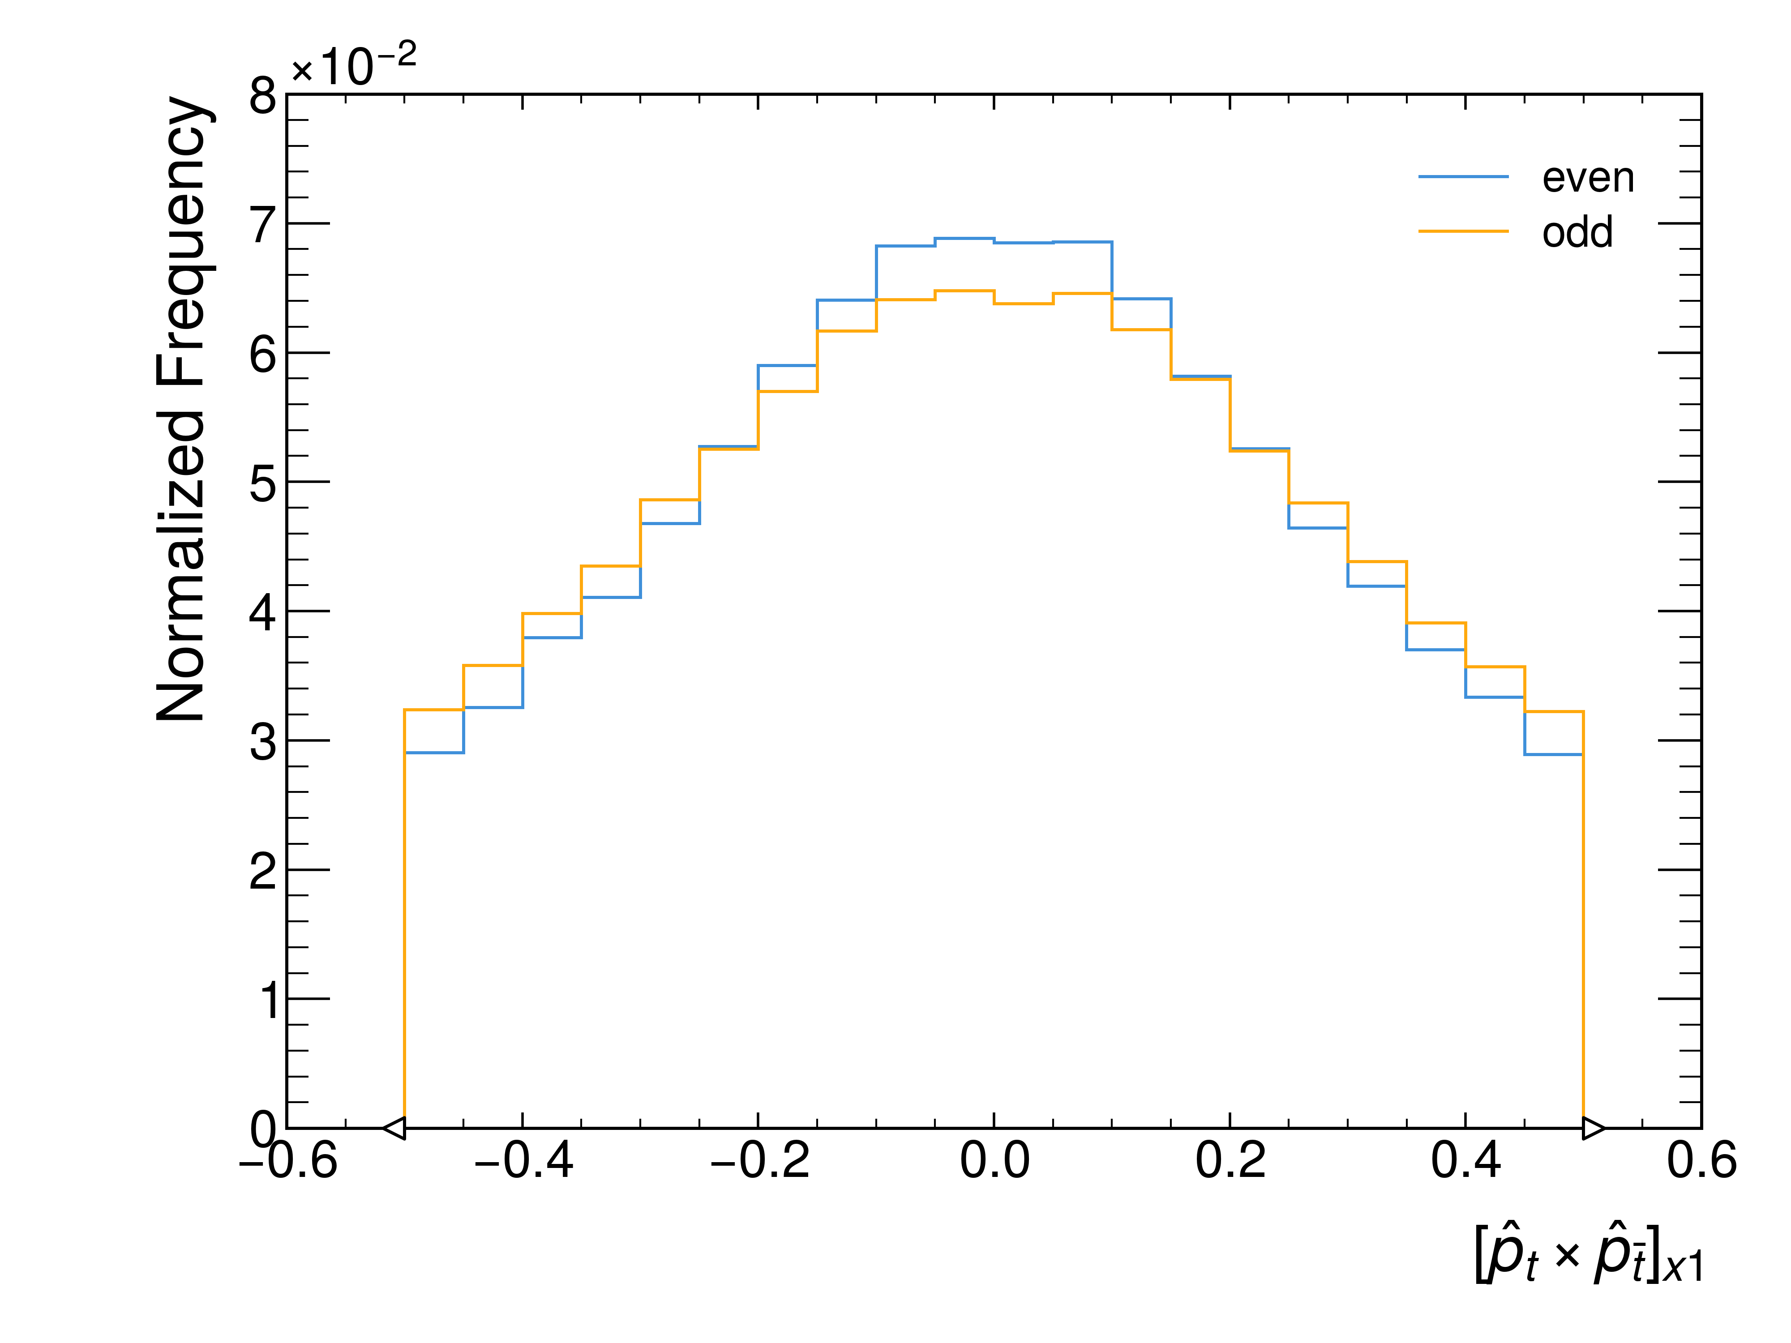
Higgs Characterisation Model
Find lowest delta R ttbar pairs
Boost to the frame of one of them and calculate variable

Slide 7
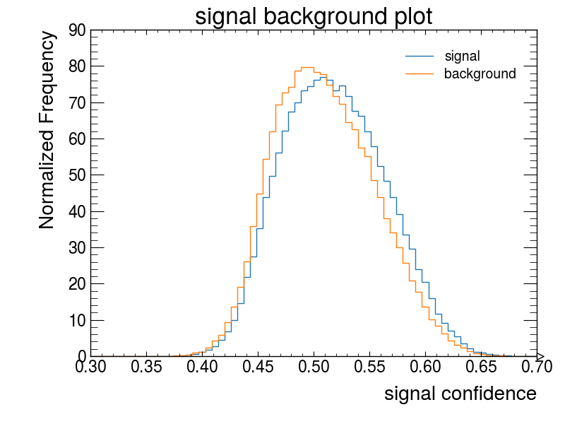
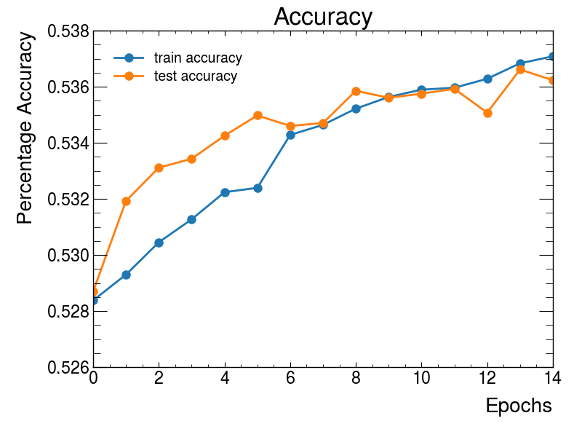
GNN (No)Discriminator?
SAGE conv, 3 layers, 64 dimensions

Slide 8
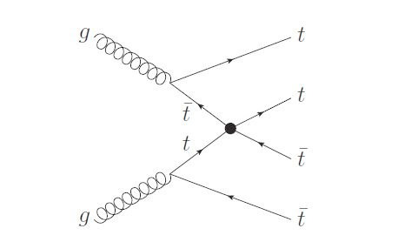
EFTs introduce new interactions between the existing SM particles
EFT
We studied “4-heavy operators”
cQQ1, cQQ8, cQt1, cQt8, ctt1

Slide 9
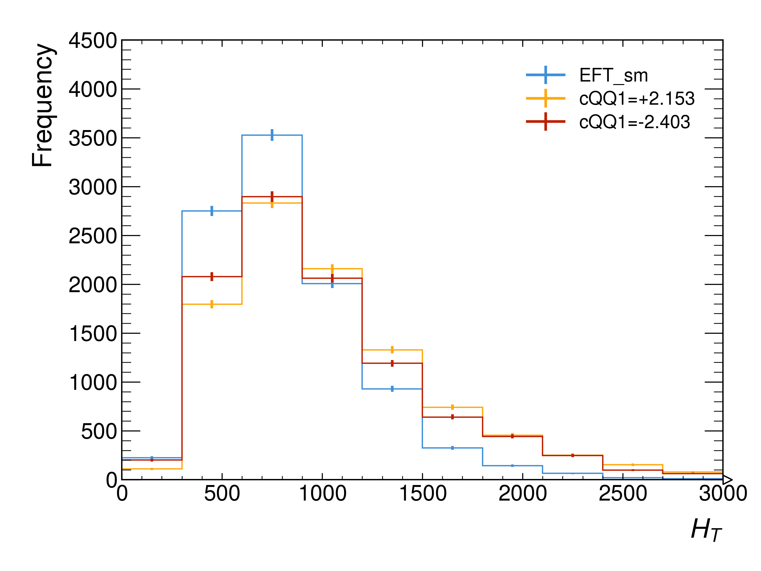
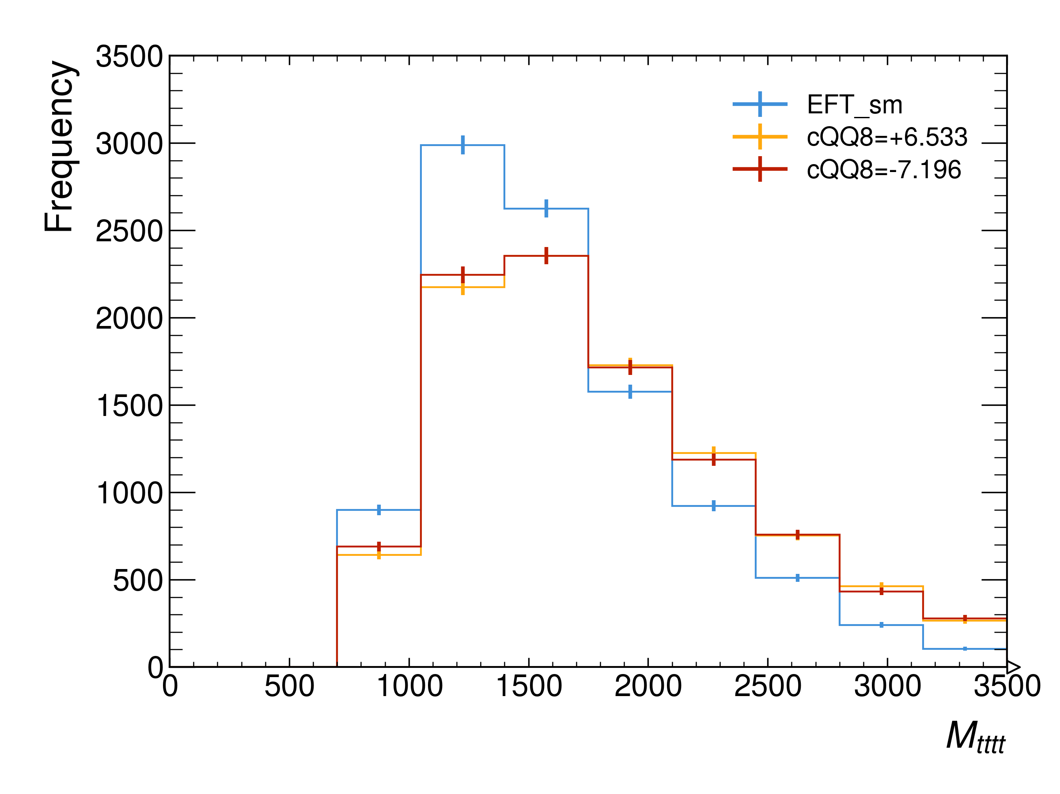
EFT

Slide 10
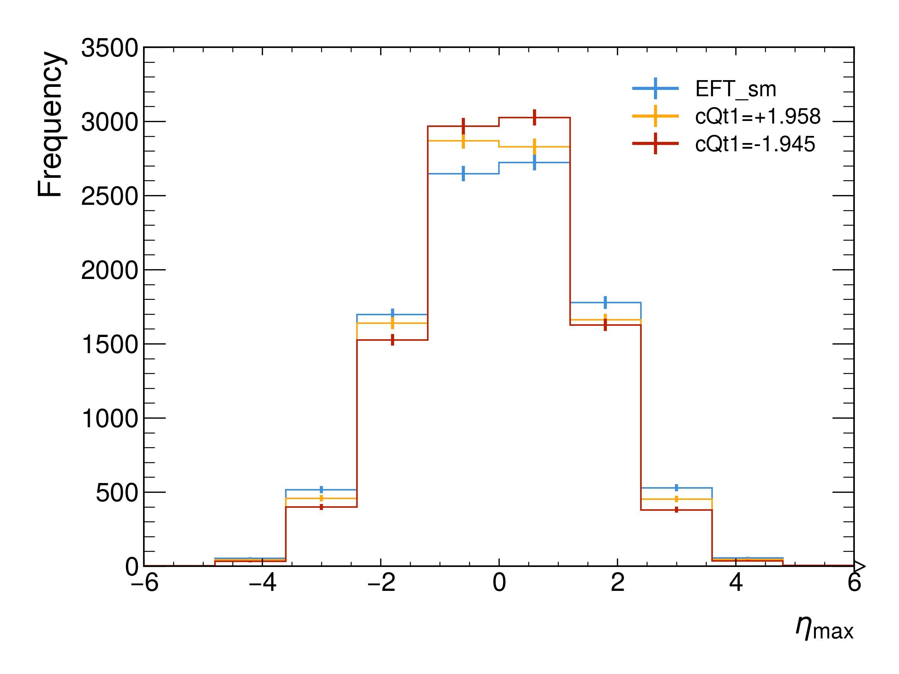
EFT

Slide 11
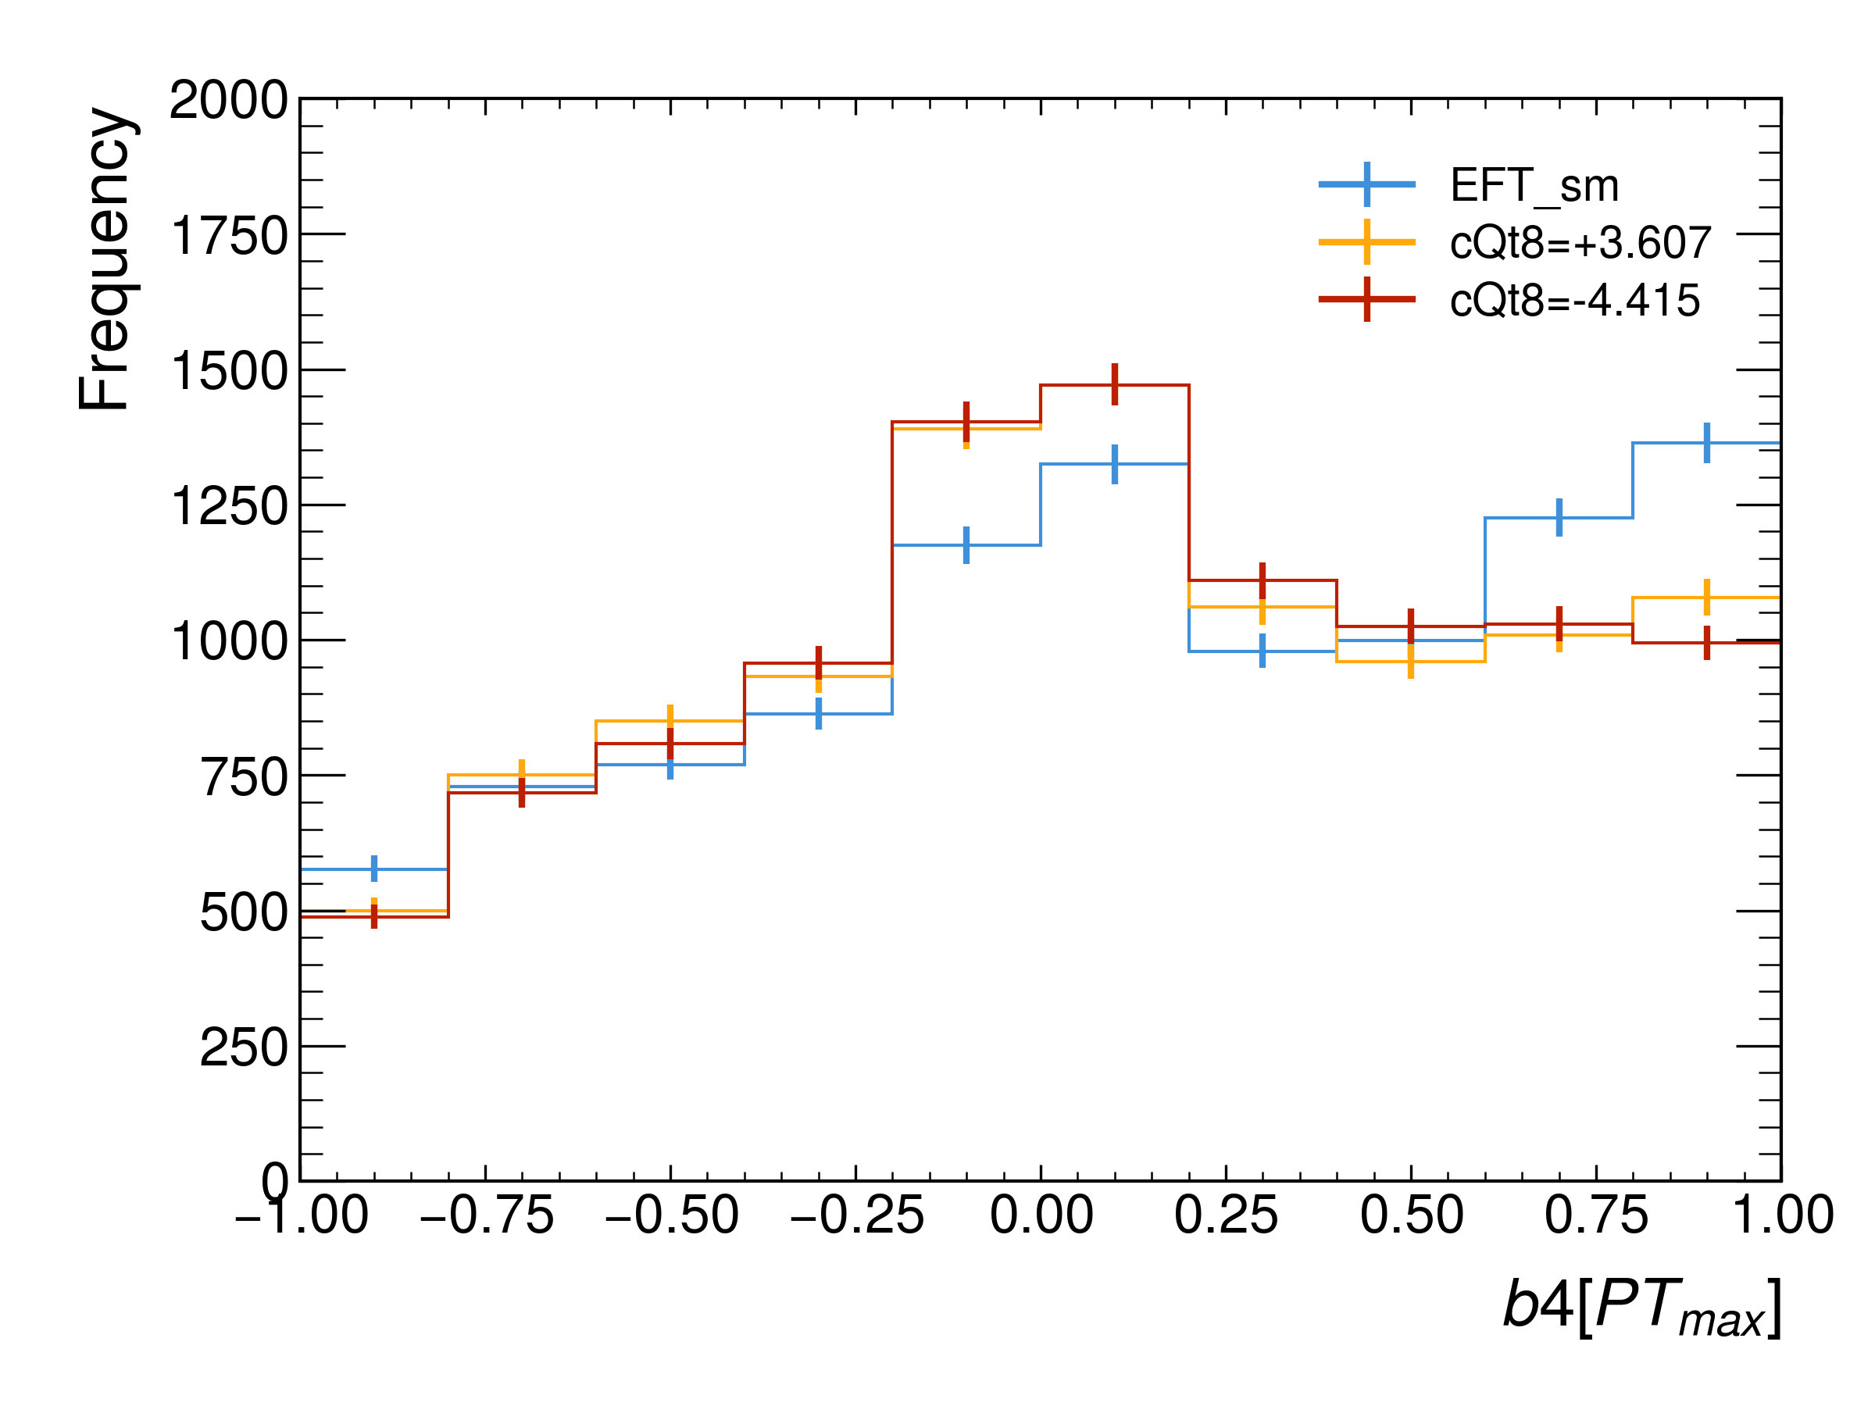

EFT

Slide 12
HyPER
HyPER is a GNN for reconstructing all-hadronic processes. We eventually wish to use it in leptonic channels too

Slide 13
HyPER
Training result

