Slide 1
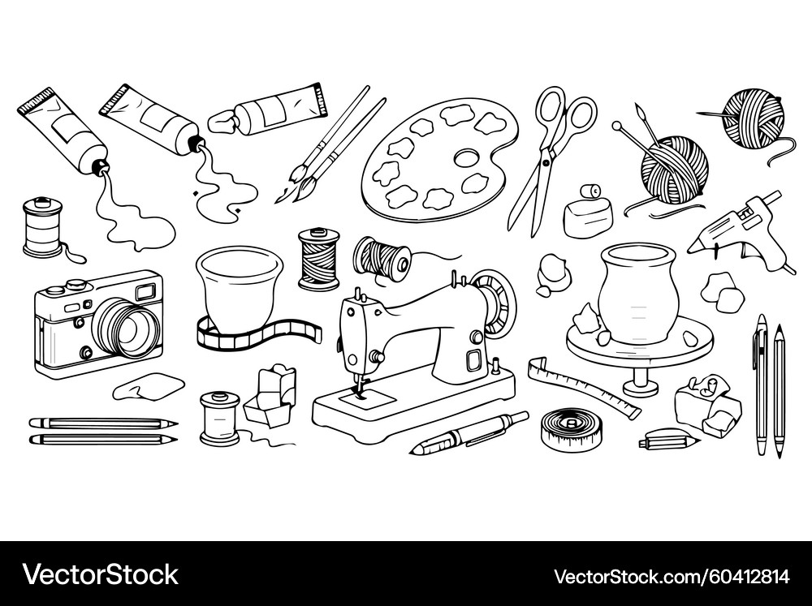
The Meaning of Crafts
✨ team whimsy ✨
Notes:
Image credit: https://www.vectorstock.com/royalty-free-vector/art-craft-supplies-sketch-vector-60412814
Hi! We’re team whimsy! And the domain we chose for meaningful work is crafts!

Slide 2
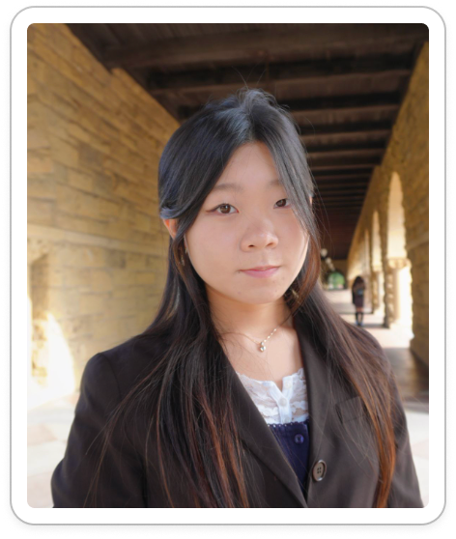
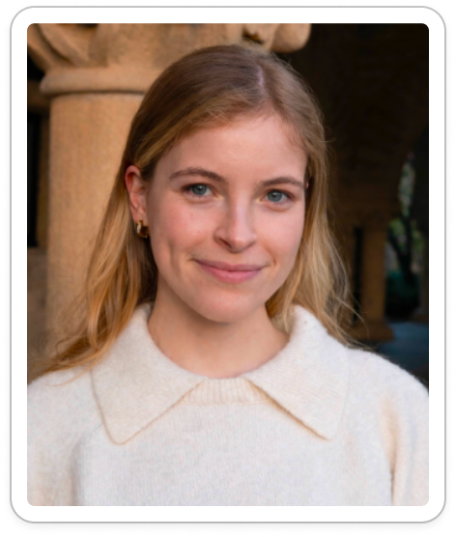
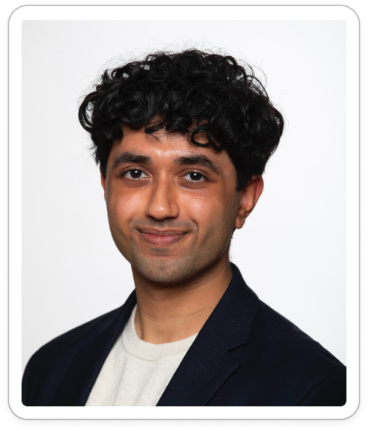
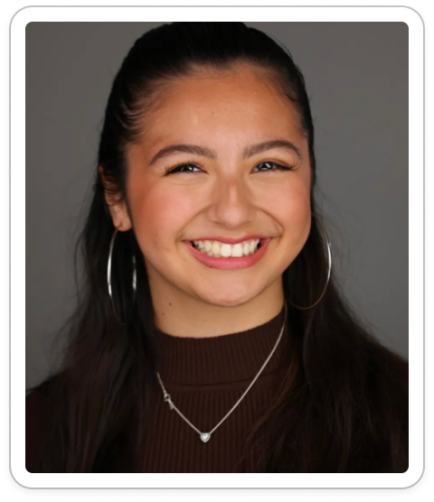
Who are we
✨ team whimsy ✨
Elsa
BS Design
MS HCI
Ahyan
BS Computer Science
Kelly
BS HCI
MS AI
Jia
BS Design
MS HCI
Notes:
I’m Jia, this is Elsa, Ahyan, and Kelly. And we’re a team that blends a mix of technical and design backgrounds.

Slide 3

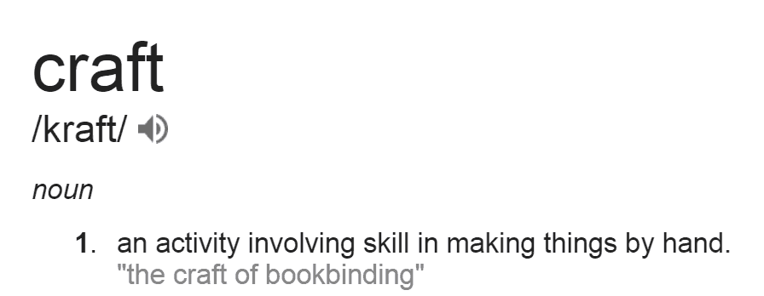

Domain we chose
Notes:
Image credit: https://abarabove.com/what-is-craft/
So how do we define craft. Craft can be very broad, it could range from crocheting, woodworking, baking, and so forth. Craft is what is defined by the crafter. But for the sake of scoping, we wanted to define craft as an activity where…

Slide 4


Understanding craft
Sense of Ownership
Unique Outcome
Craft
Requires Effort
Self Imposed
Notes:
Arrows: https://www.vecteezy.com/free-png/curved-arrow
There’s a sense of ownership. For example, the ikea effect, where consumers place higher value on things they make themselves. When there’s an outcome unique from the original sources. Like when you mix dry and wet ingredients together and then you get a cake. When there’s a level of effort involved in creating the outcome, whether it’s time or money. And when there’s intrinsic motivation rather, even if their craft is their profession, they still chose to do it.
With all the ways we were able to slice and interrogate craft, its richness drew us to choose it as our domain.
Then, we went out into the real world to find crafters! But there are so many types of crafters, and we wanted to make sure we had diversity in our interviewees.

Slide 5
Diverse participants are
Experience: beginners ↔ masters
Finance: hobby ↔ career
Frequency: low ↔ high
Barrier of Entry: easy ↔ hard
Why were they chosen?
Why are they appropriate?
How were they recruited/compensated?
Where were the interviews conducted?
Notes:
So we sought interviewees from a range of experiences. From Beginners to masters. There’s even a financial spectrum for crafts. Some people invest 6 figures into crafts like glass blowing, or they can pick up simple materials for crocheting at Michael’s. There are crafters who work on their craft everyday, and some who take breaks fo periods of months. And there’s also a skill barrier of entry. For example, beginner painting requires paintbrushes, a canvas, paint, but beginner ceramics requires access to a kiln, glay, wheels to wheel throw, tools, etc.
By defining these axes, we were able to define…

Slide 6
Extreme users are
Experience: beginners ↔ masters
Finance: hobby ↔ career
Frequency: low ↔ high
Barrier of Entry: easy ↔ hard
Why were they chosen?
Why are they appropriate?
How were they recruited/compensated?
Where were the interviews conducted?
Notes:
… extreme users as crafters who fall under the end of at least one of our axis’. This is because, if a crafter falls under the end of one of these, then that crafter has developed and sustained a deep relationship with a craft. It’s impossible to be on the end of these axis’ otherwise.

Slide 7
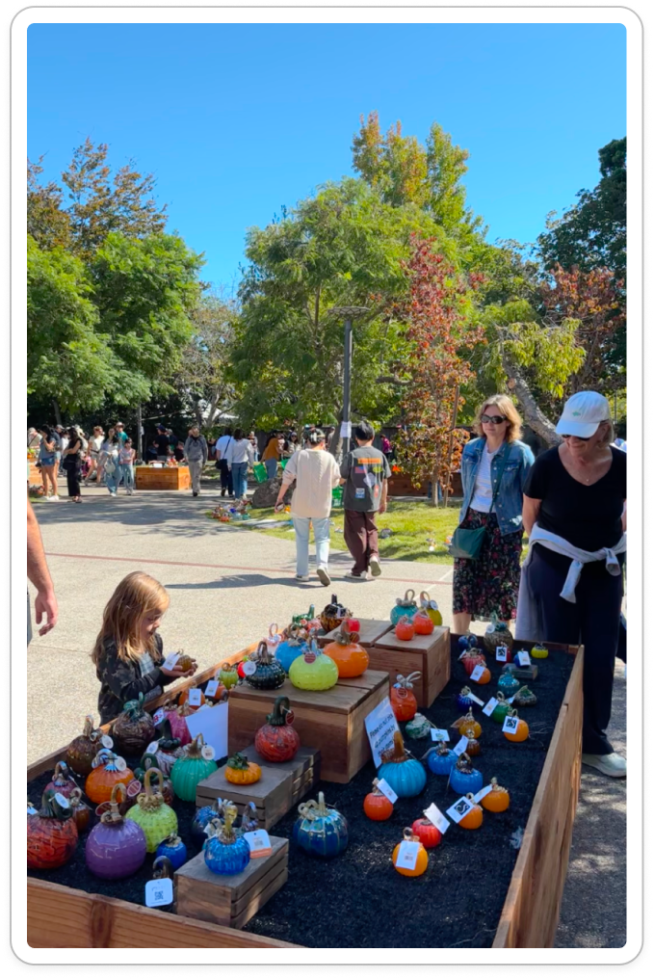
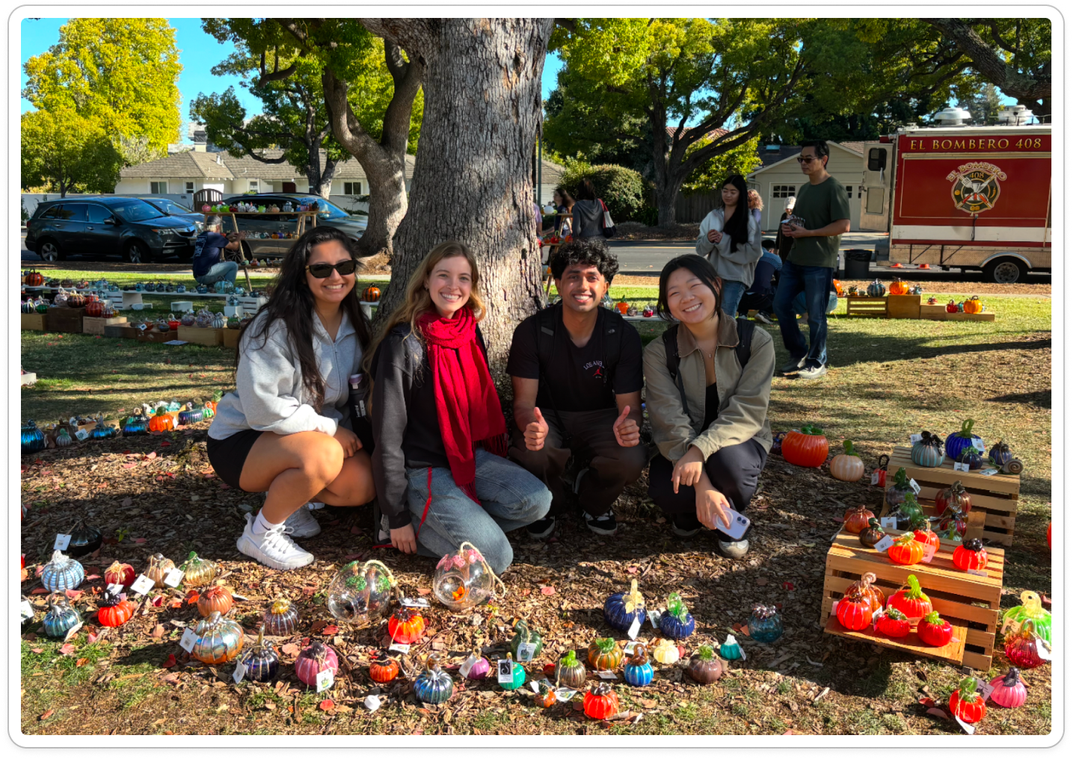
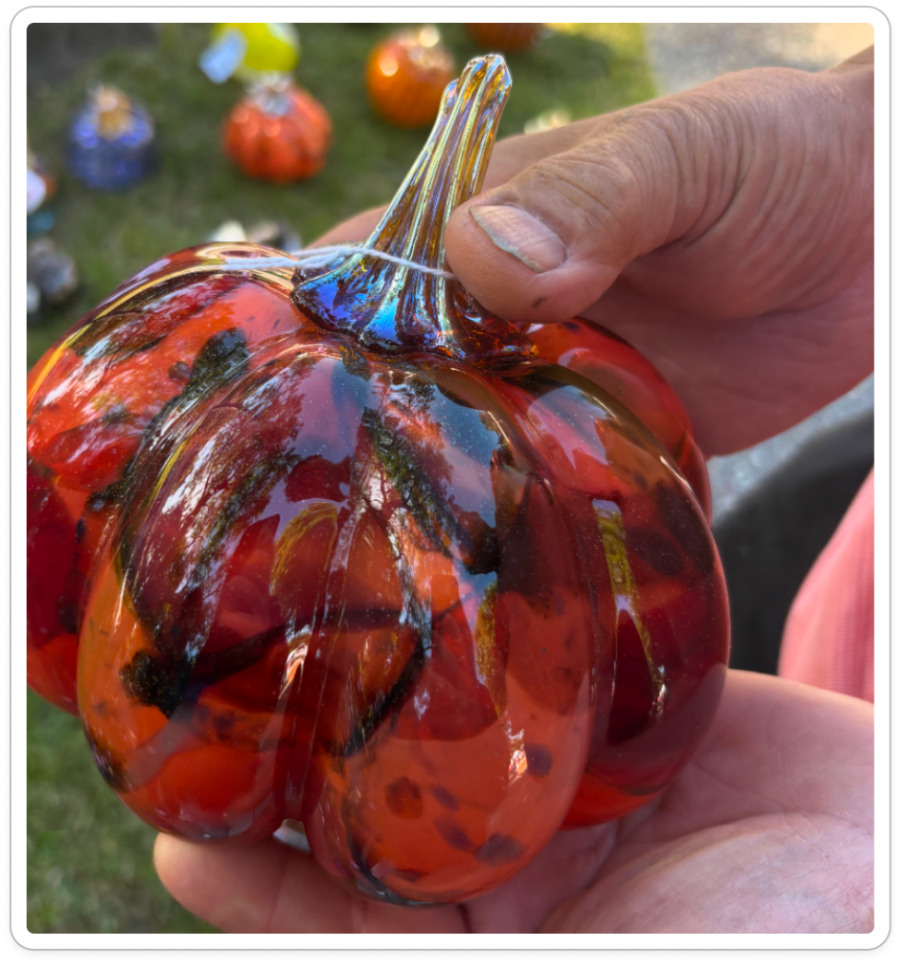
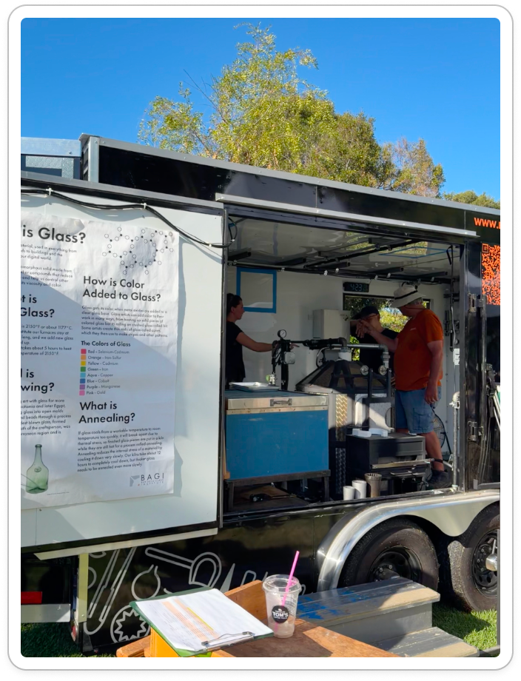

We recruited by
glass pumpkin patch @ south PA
Notes:
We recruited at Palo Alto's Great Glass Pumpkin Patch because of its inherent crafter density and diversity. Crafters demonstrate and sell their craft right next to non-crafters or even different crafters just browsing or buying. It allowed us to observe crafters at all stages of the craft process (collecting inspiration, crafting on site, evaluating craft) and attendees, having attended for craft, were naturally excited to discuss craft.

Slide 8
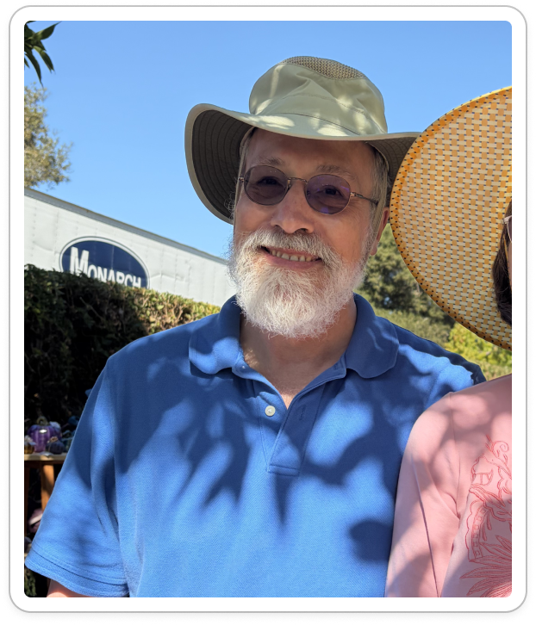
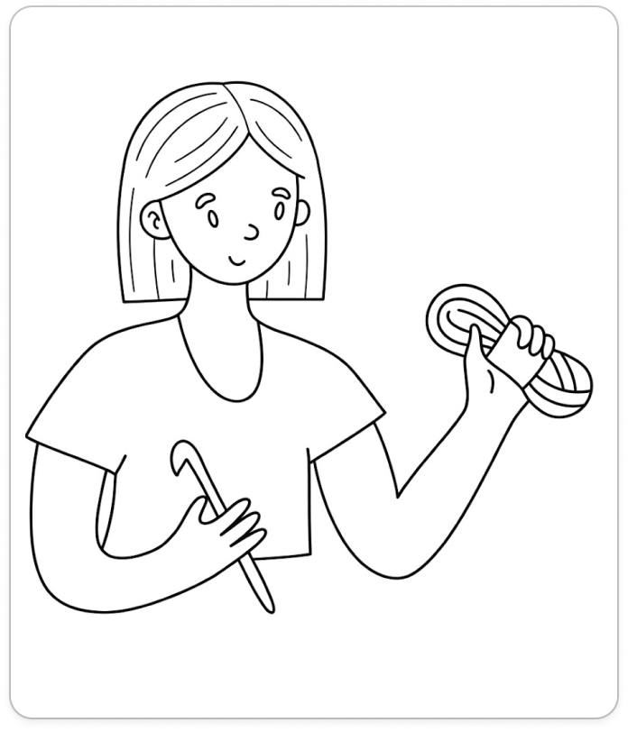
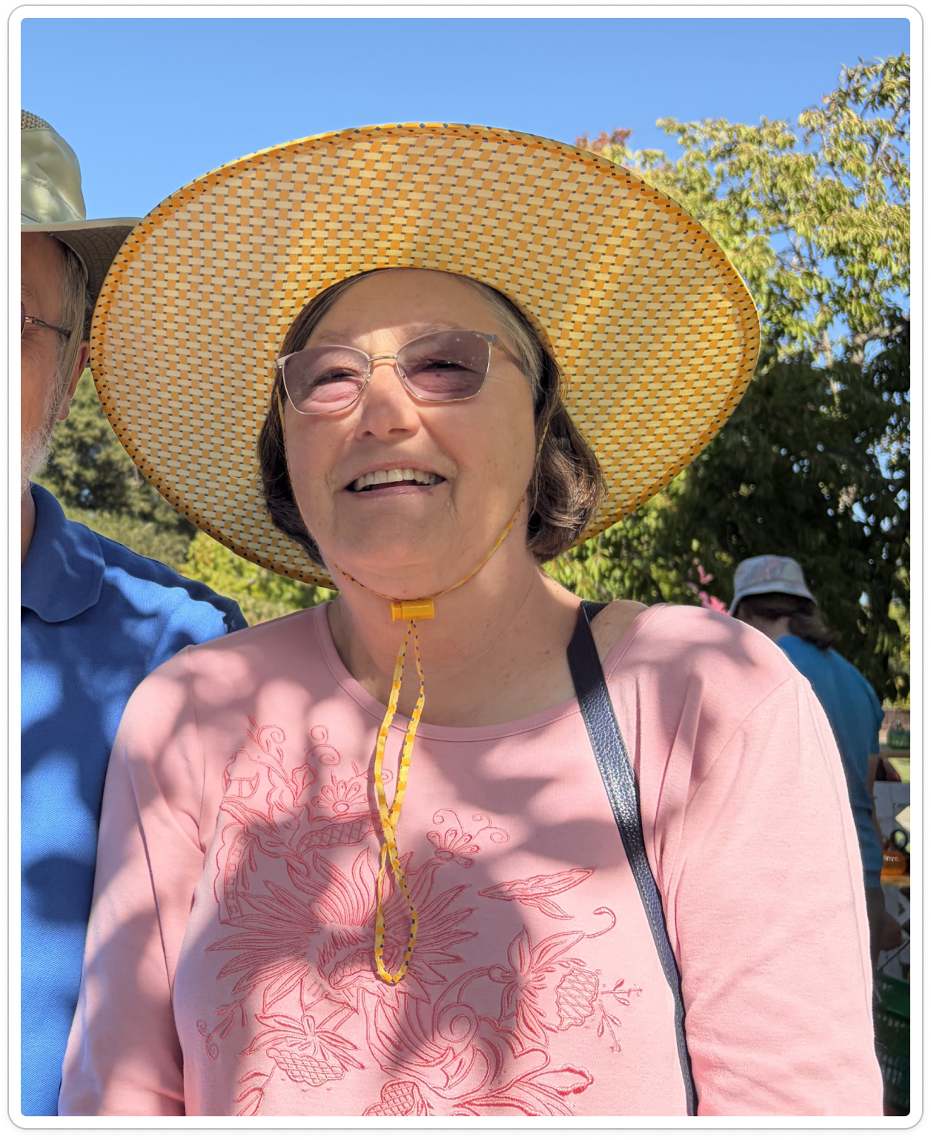
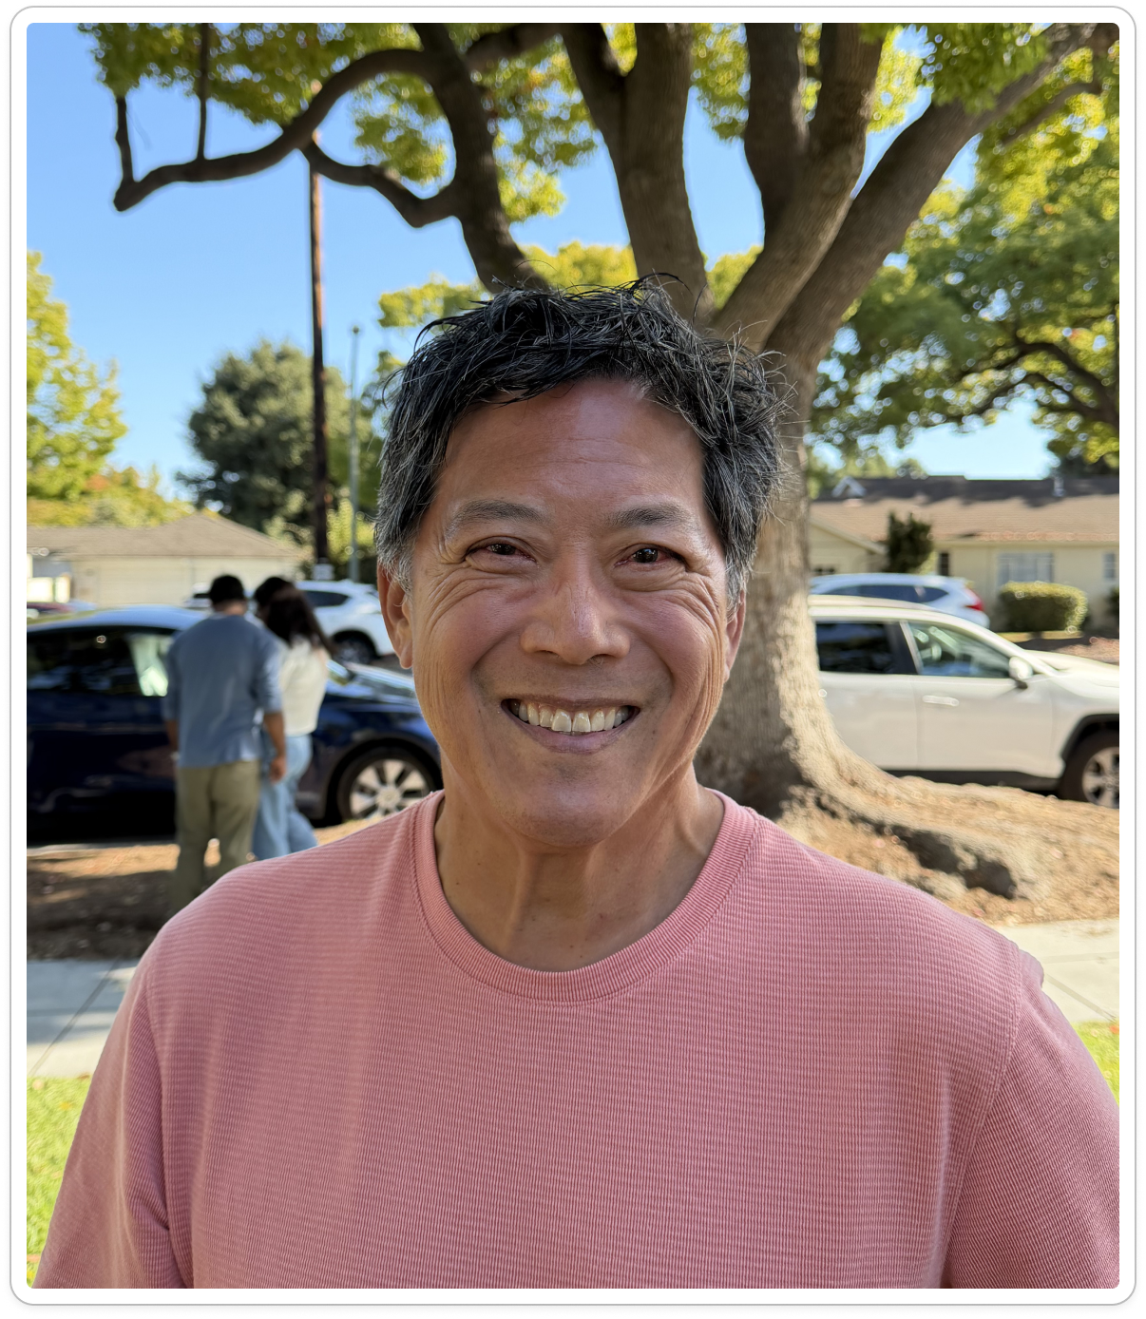
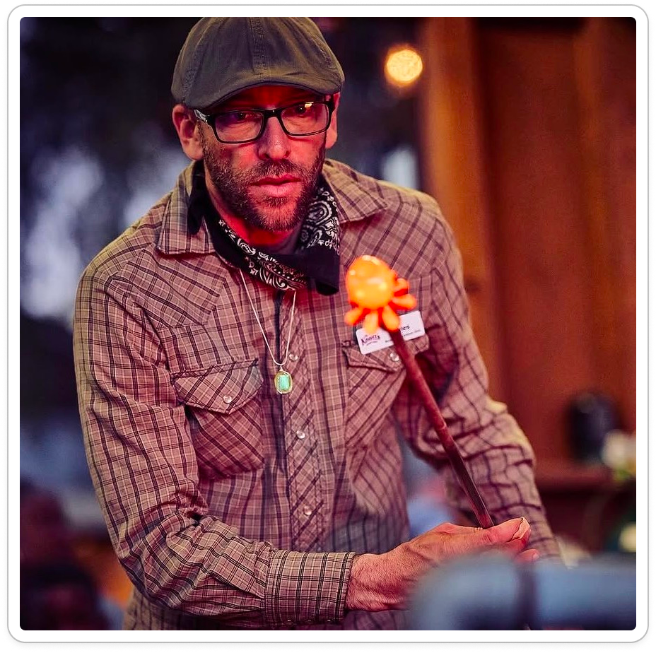
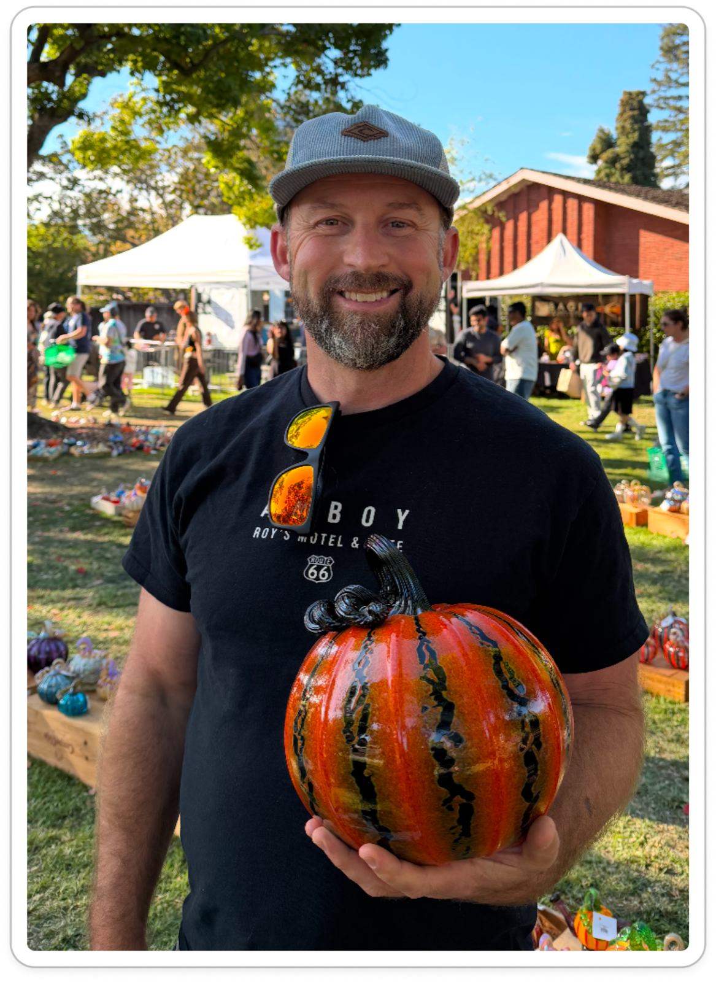

We met
beginner crafter
extreme crafters
An admirer becoming a maker
A hobbyist creating to unwind and connect
An experienced crafter choosing to begin again
A crafter who protects room for play
An artist who teaches and performs
An artist balancing livelihood and discovery
Why were they chosen?
Why are they appropriate?
How were they recruited/compensated?
Where were the interviews conducted?
Notes:
(Elsa) We met people with very different relationships to craft: Eddy, an admirer beginning to make; Dylan, a hobbyist creating to unwind and connect; Rosa, an experienced crafter becoming a beginner again; Ken, a professional protecting room for play; Manny, a glass artist who teaches and performs; and Noah, an artist balancing livelihood and discovery.

Slide 9
We met
beginner crafter
extreme crafters
An admirer becoming a maker
A hobbyist creating to unwind and connect
An experienced crafter choosing to begin again
A crafter who protects room for play
An artist who teaches and performs
An artist balancing livelihood and discovery
Why were they chosen?
Why are they appropriate?
How were they recruited/compensated?
Where were the interviews conducted?
Notes:
(Elsa) We met people with very different relationships to craft: Eddy, an admirer beginning to make; Dylan, a hobbyist creating to unwind and connect; Rosa, an experienced crafter becoming a beginner again; Ken, a professional protecting room for play; Manny, a glass artist who teaches and performs; and Noah, an artist balancing livelihood and discovery.

Slide 10
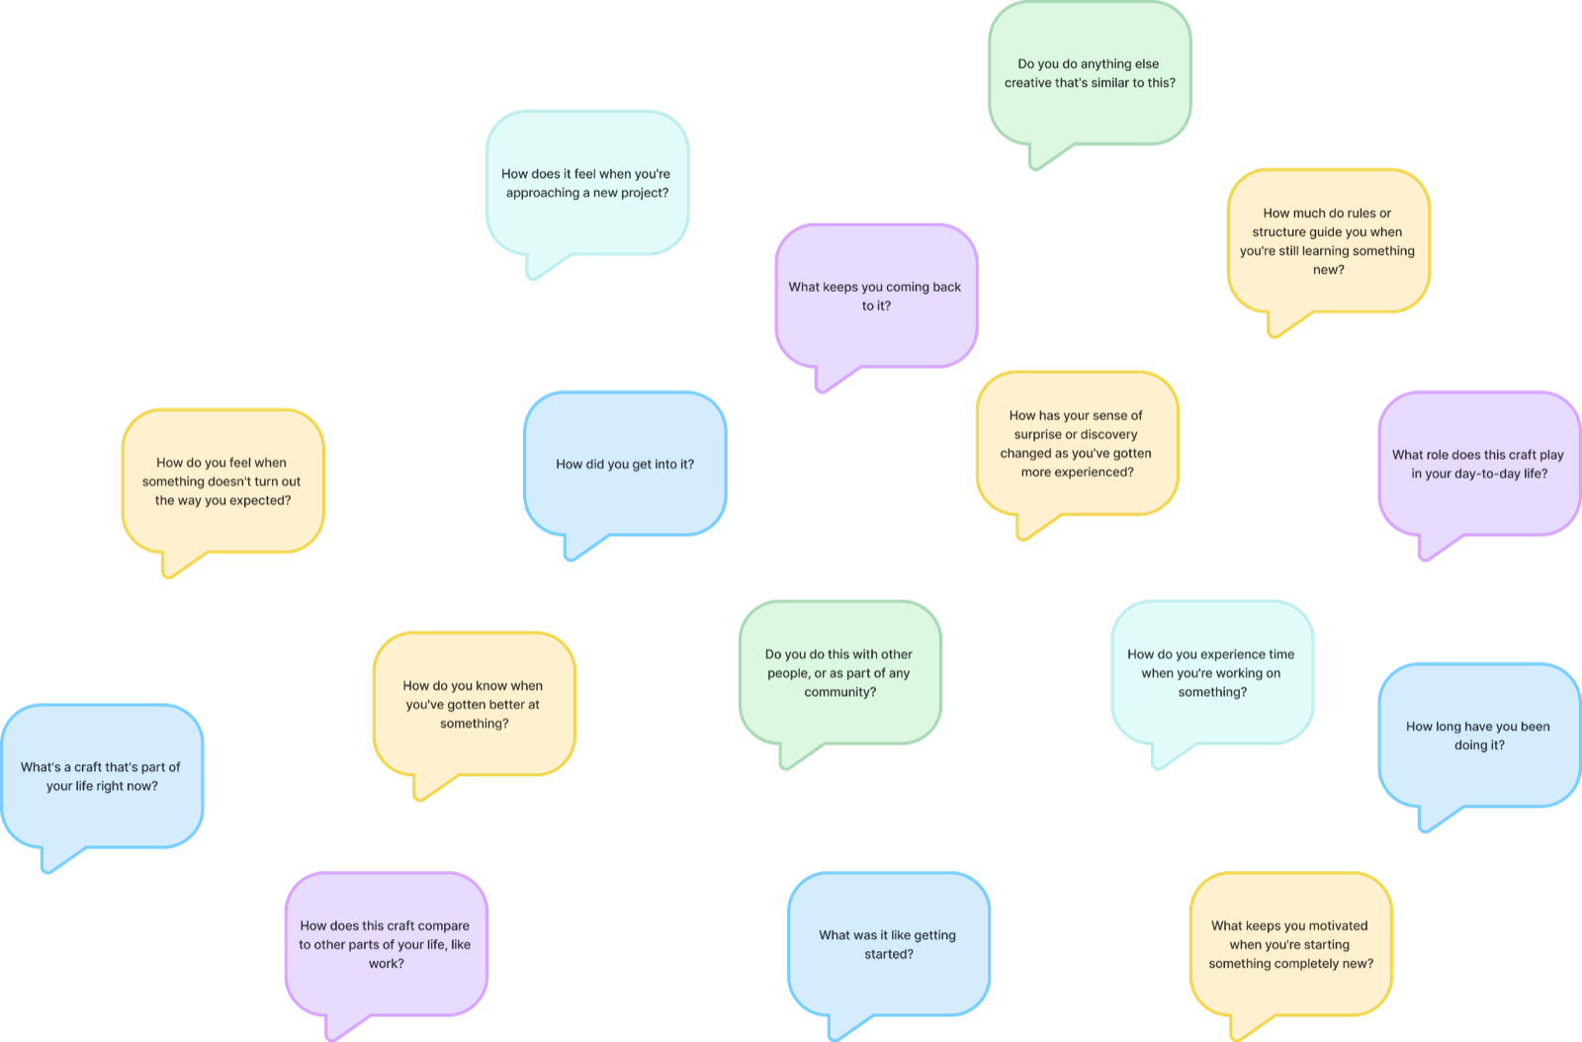
… and asked them
Notes:
We began with the big picture, tell us about your craft, allowing us to zoom in on the fine grained details of the craft making process itself. As we generated inferences and insights in real time, we carefully shared these with our interviewees so they could validate or redirect us

Slide 11
Eddy
An admirer becoming a maker
Recently retired software professional
Has admired and collected glass for decades
Taken two glassblowing classes while traveling
“It’s an opportunity to do something new and fun”
Notes:
(Elsa) Eddy is a recently retired software professional who has admired glass for decades. He describes making as an opportunity for something new and fun. Yet he still sees himself as transitioning from appreciating glass to becoming a maker.

Slide 12
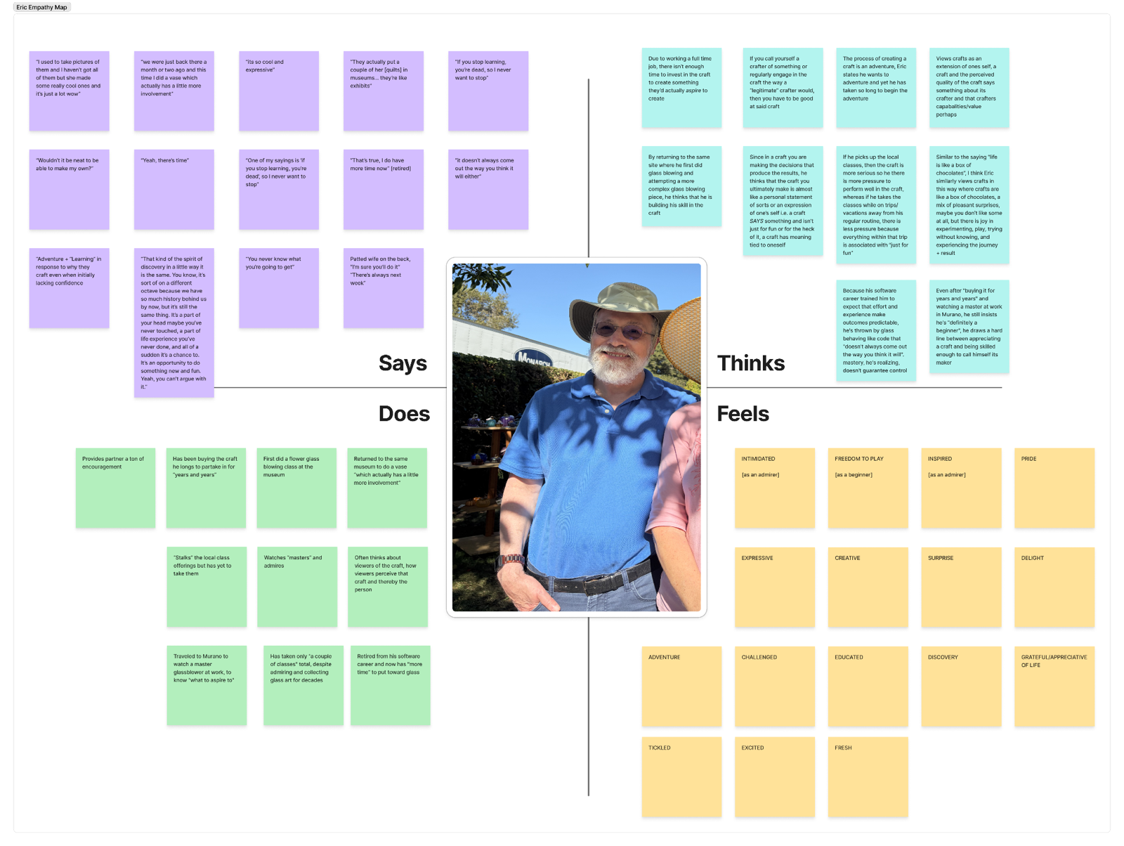
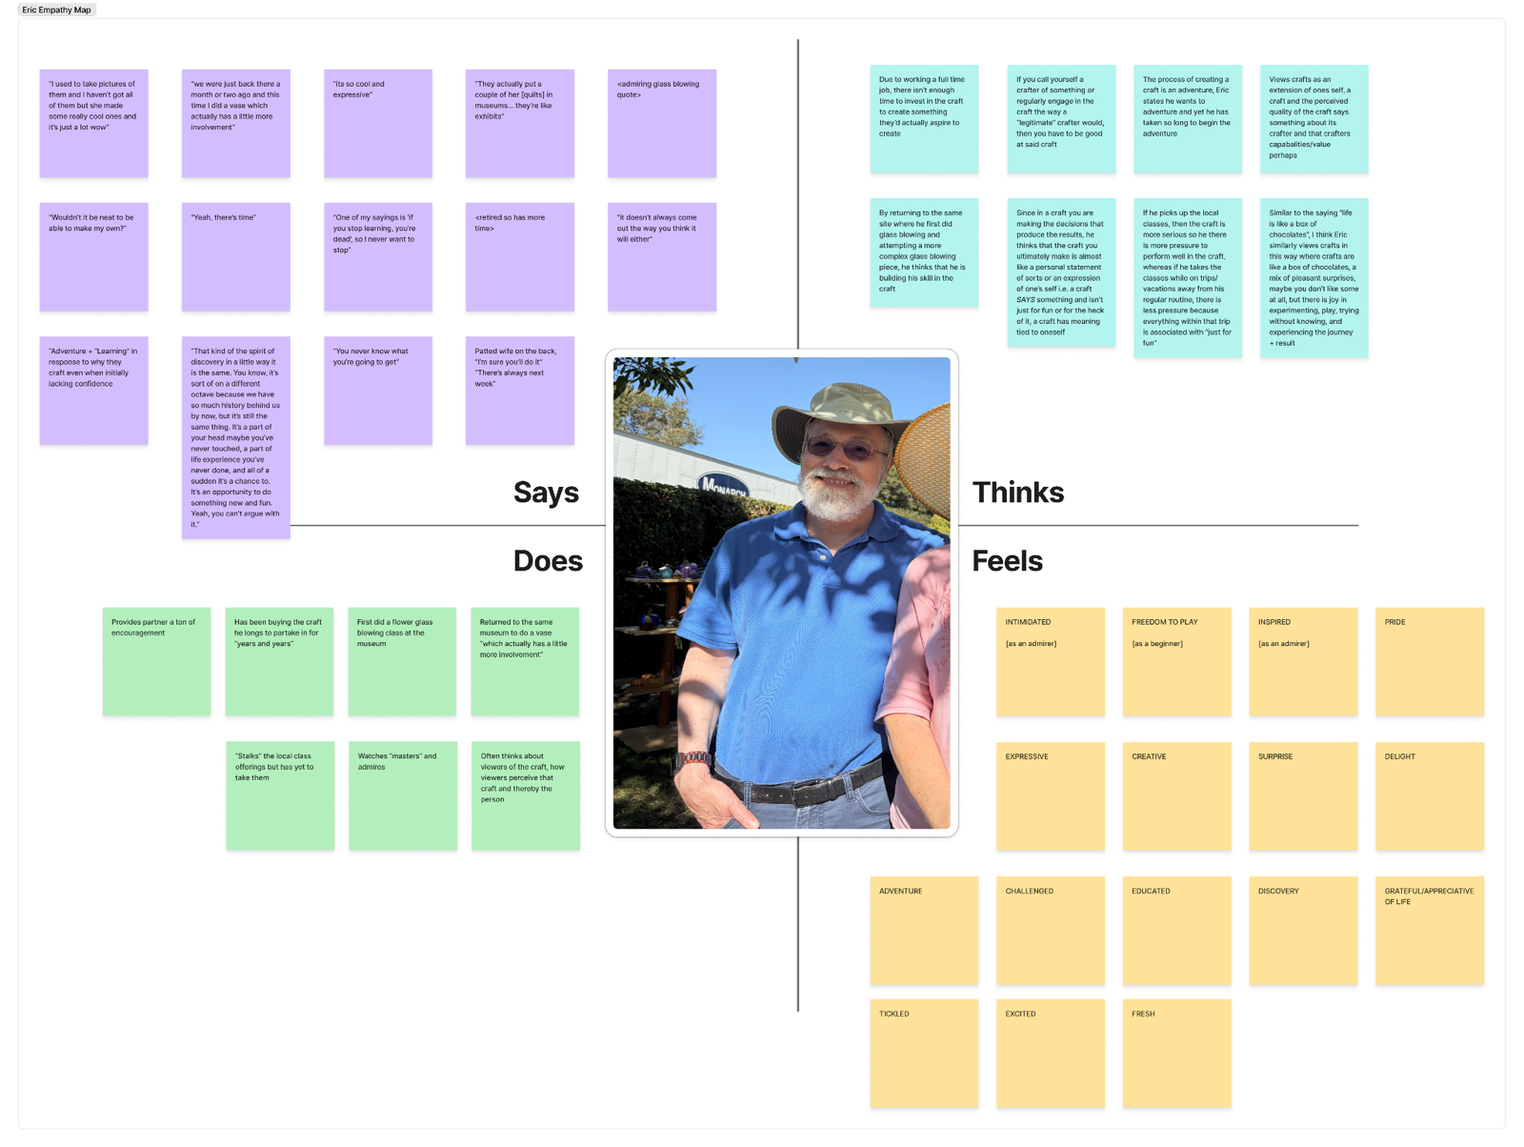

Slide 13
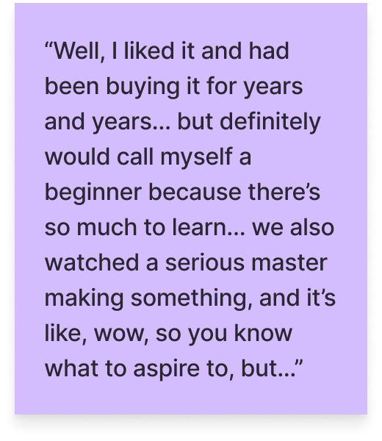
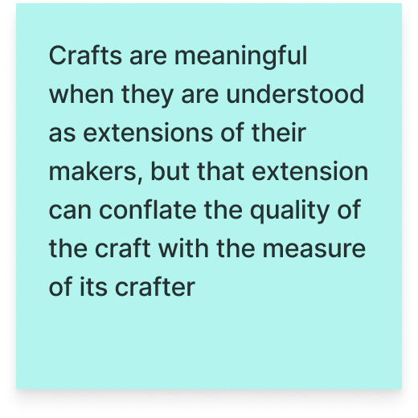
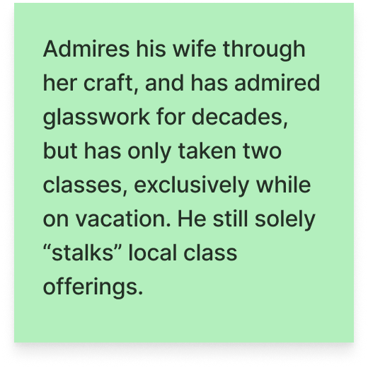
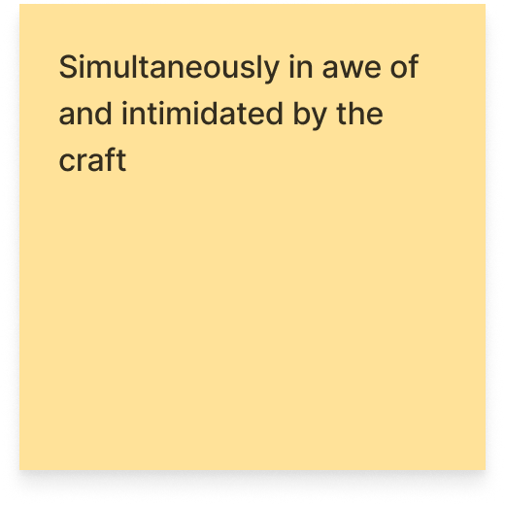
Surprised to notice
Eddy tries crafting while traveling, yet hasn’t made it part of his life back home
“I’m still stalking them [local glass blowing classes]”
“There’s always next week”
Notes:
(Elsa) What surprised us was the difference between contexts. Eddy has tried glassblowing while traveling, but is still following the local class offerings without signing up. This suggests interest alone is not the missing ingredient. We want to understand what makes a one-off experience easier to enter than an ongoing practice.

Slide 14
Finding
INSIGHT
Travel lets Eddy treat crafting as an adventure rather than a commitment to mastery. Calling himself a beginner eases the pressure to measure up to artists he admires
NEED
To experience crafting as an adventure he can try, without feeling he must prove an identity as a maker
Notes:
(Elsa) Our interpretation is that travel may frame crafting as a temporary adventure rather than a commitment to becoming good at it. Calling himself a beginner may similarly leave room to explore without measuring his work against the masters he admires. His need is not simply more class offerings, it may be a way to bring that low-pressure invitation into everyday life.

Slide 15
master; high
Rosa
An experienced crafter choosing to begin again
Retired nurse who has knitted for 60 years
Makes around 30 quilts a year for children through a charity
Became a beginner again through Japanese flower arranging
“I always want to have a tiny adventure with, you know, three flowers in a vase”
Notes:
(Elsa) Rosa is a retired nurse with decades of knitting experience who makes quilts for children through a charity. Yet she deliberately became a beginner again through Japanese flower arranging.

Slide 16
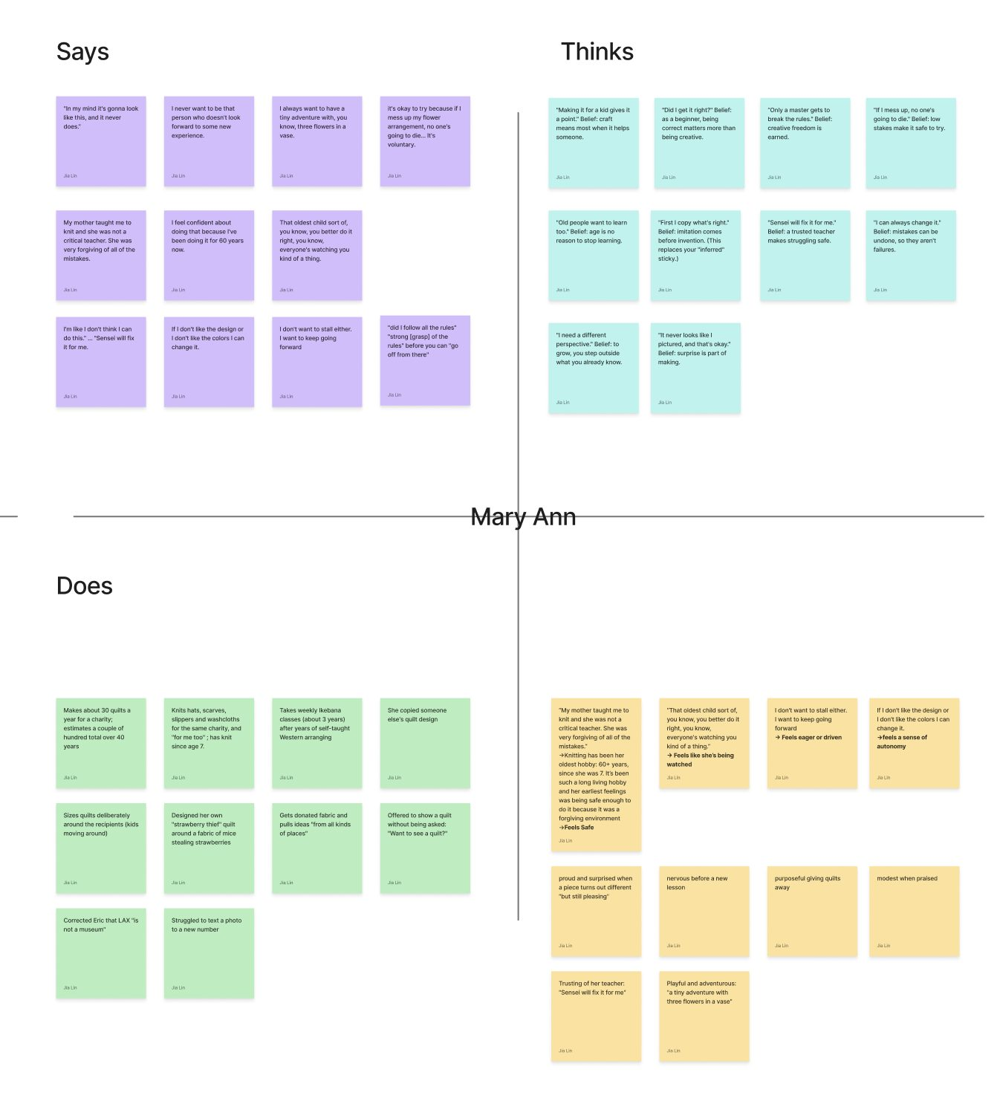

Slide 17
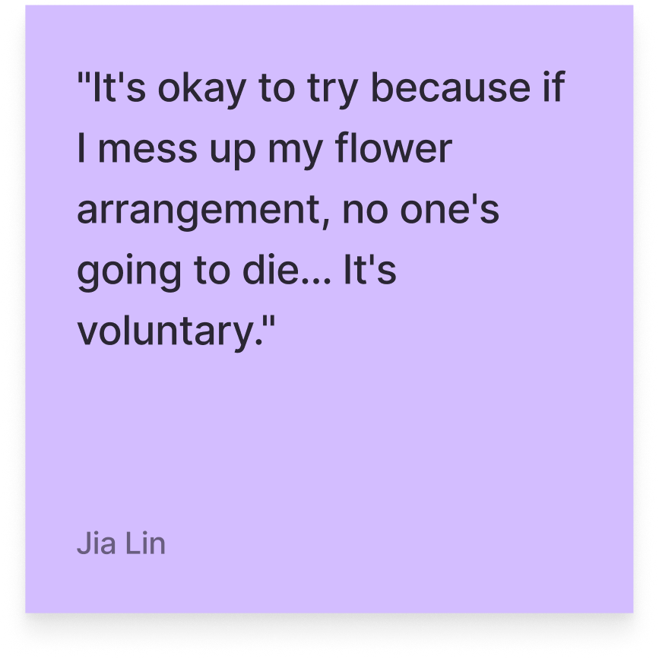
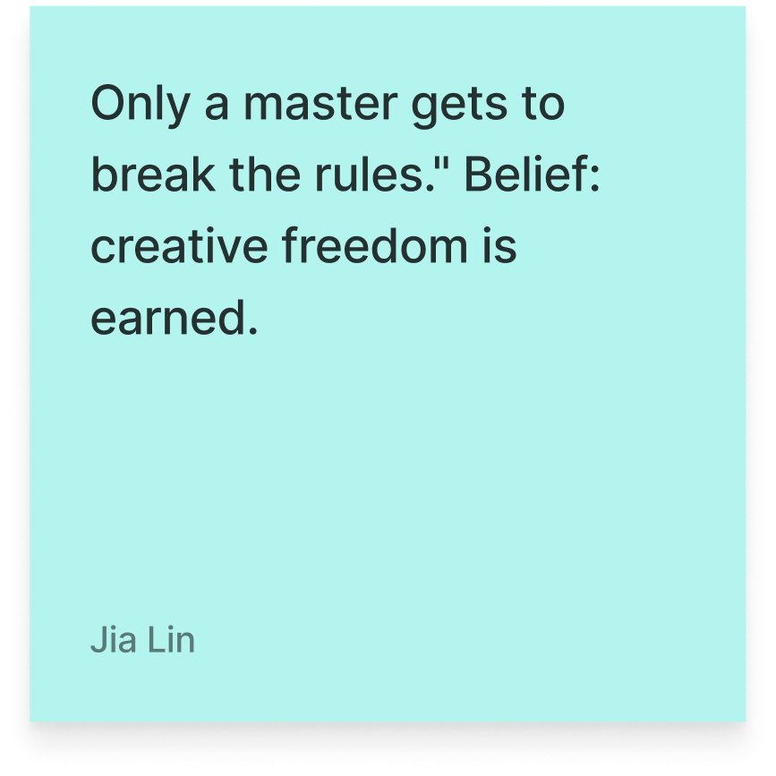
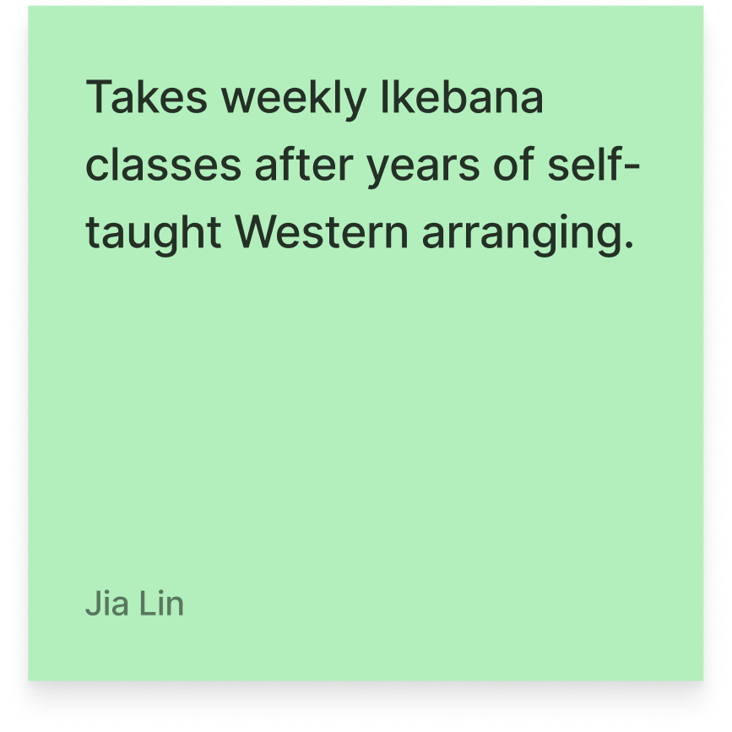
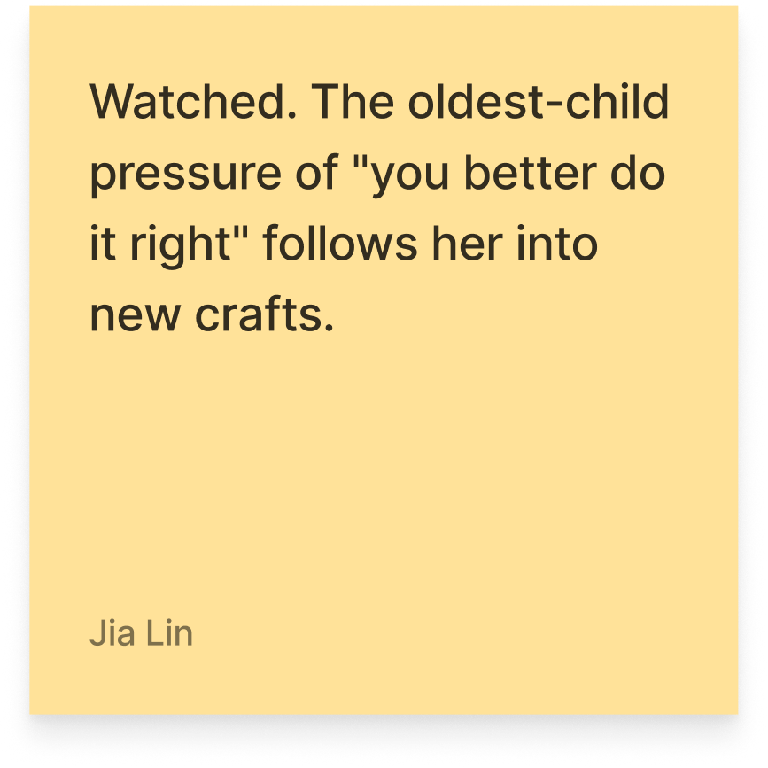
Surprised to notice
Rules that invite Rosa into a new craft can also make her hesitate to play within it
“First I copy what’s right”
“Sensei will fix it for me”
“But [the flowers] is pleasing. And then I worry, did I follow all the rules”
Notes:
(Elsa) The surprise is that structure can open the door to experimentation and then become the standard she worries about meeting.
She describes the beginning process of a craft as following a set of rules. She says “First I copy whats right”. And thats how you build your foundation for your craft. She describes her earliest memories of quilting “My mother taught me to quilt and she was not a critical teacher. She was very forgiving of all of the mistakes.” You copy patterns, you imitate the masters, and over time, the better you get at followings, you build this confidence to then break them. She describes after 60 years of quilting, that she can play with her designs more. And yet, even as a master of one craft, she gravitated towards starting a new one as a beginner. In ikebana flower arrganging is now back again at following strict rules, study her sensei carefully, understanding that sensei is a master and she is a beginner.

Slide 18
Finding
INSIGHT
Rules give Rosa a clear way into an unfamiliar craft, but they can shift her attention from enjoying what she discovers to checking whether she did it correctly
NEED
To feel that creative freedom is hers to explore before mastery, rather than a privilege she has to earn
Notes:
(Elsa) What we found is that Rosa does not simply need fewer rules. A trusted structure helps her enter unfamiliar territory; the difficulty comes when correctness becomes a sort of verdict on the experiment. The opportunity is to make rules a starting point for play, rather than a gate she must pass before playing.

Slide 19

master, career, high, hard
Ken
A professional who protects room for play
Professional neon artist and longtime glassblower
Builds much of his own studio equipment
Neon work funds his glassblowing experimentation
“I could just go in and play”
Notes:
POTENTIAL SPEAKER NOTES: “
<briefly introducing Ken>
Neon glass maker as his main job.
Pumpkin glass maker as a side hobby.
Owns his own studio.
Engineering background enables him to create studio tools”
(Elsa) Ken already has a creative career making neon, but he also pursues glassblowing as a place to play. His interest spans art and engineering: he builds much of his own equipment and enjoys solving technical problems. What stood out was not a move away from skilled work, but a continuing appetite for unfamiliar challenges within it.

Slide 20
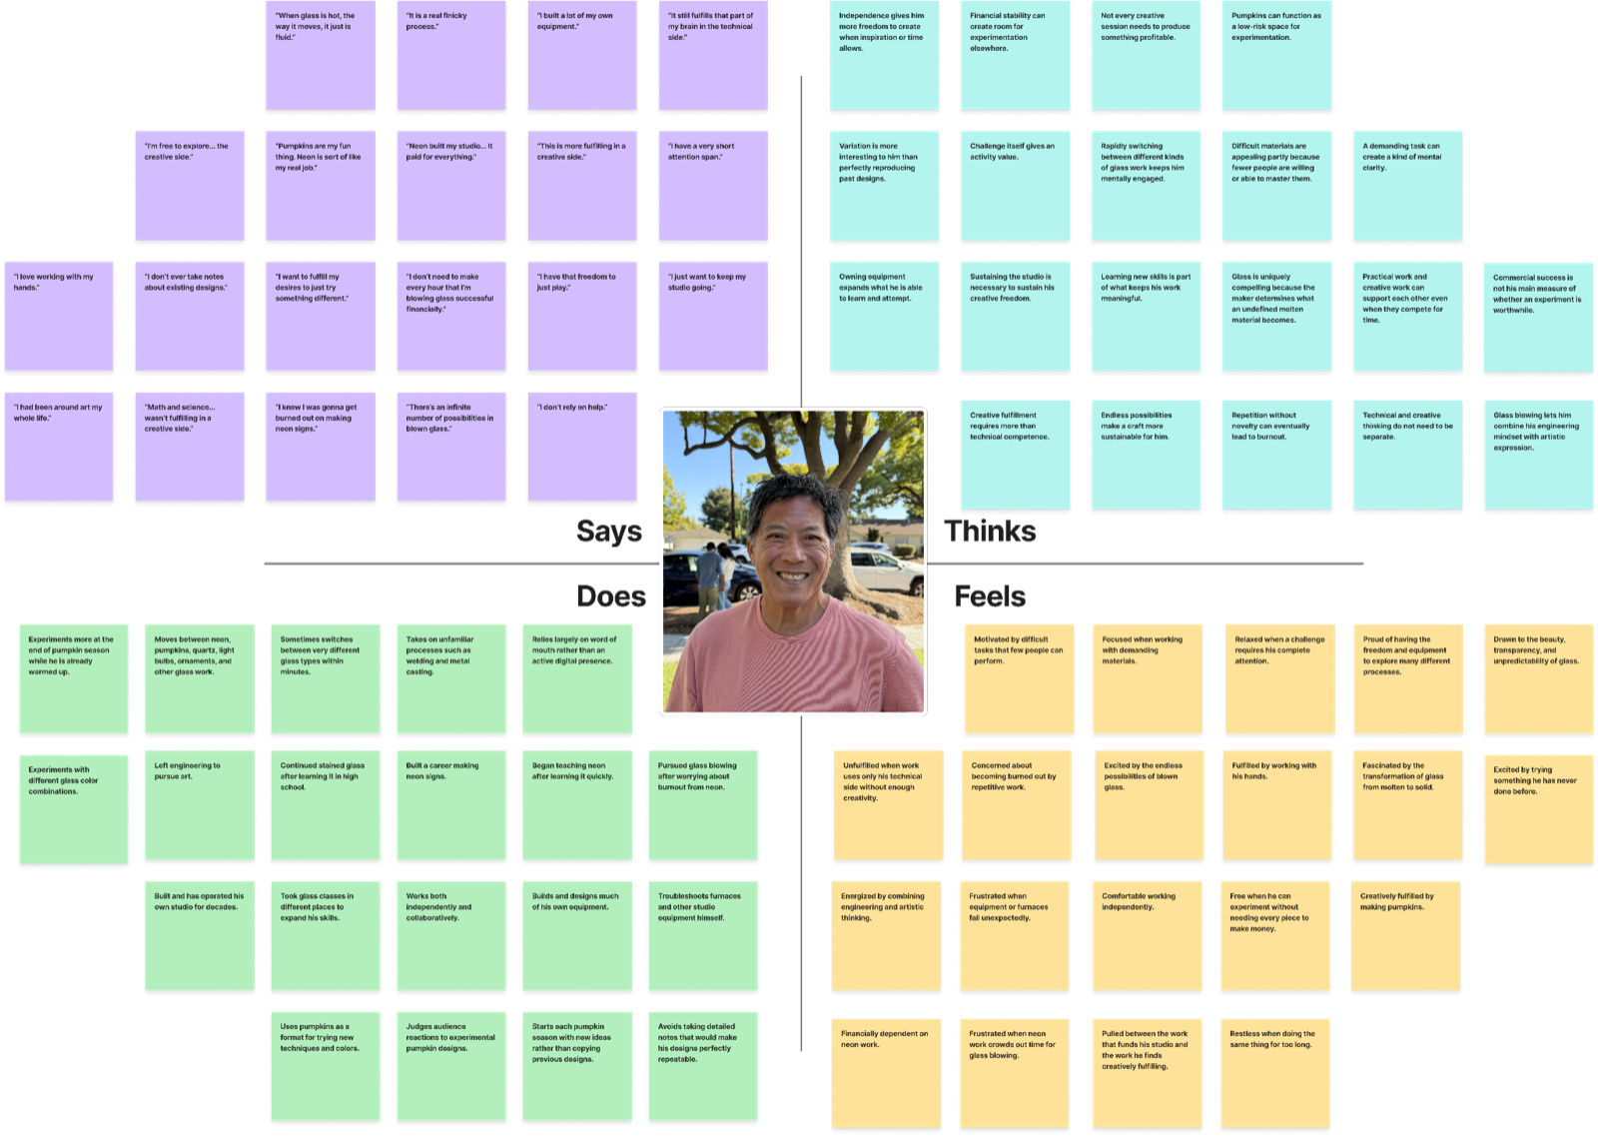

Slide 21
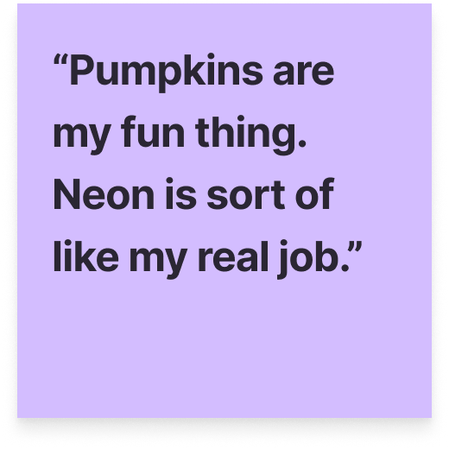
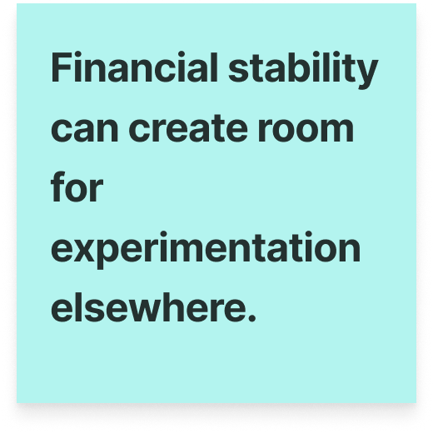
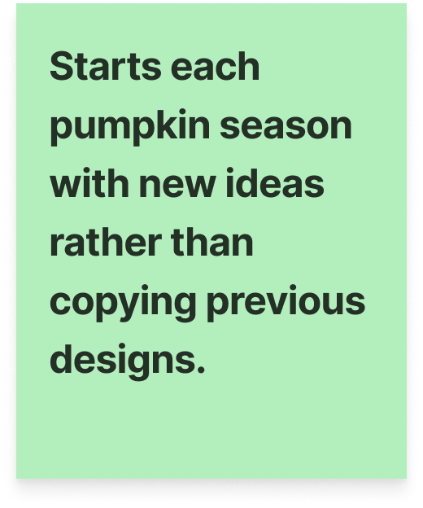
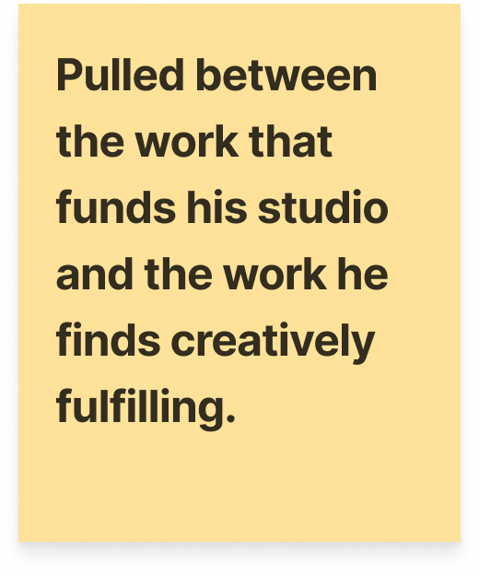
Surprised to notice
Ken makes his living through one craft, yet turns to another to feel free to play
“I don’t need to make every hour that I’m blowing glass successful financially.”
“Pumpkins are my fun thing. Neon is sort of like my real job.”
Notes:
(Elsa) We expected an established craft career to be the destination. Ken complicated that picture, even while making a living through neon, he seeks another craft where every hour does not have to pay for itself. Calling pumpkins his “fun thing” means the activity can be guided by curiosity, rather than commercial outcome

Slide 22
Finding
INSIGHT
Neon supports his creative life, but its demands also compete with it. Glassblowing gives him room to pursue unfamiliar ideas without every experiment needing to pay off
NEED
To protect opportunities for discovery from the demands of the work that funds them
Notes:
POTENTIAL SPEAKER NOTES: “His neon work acts as a safety net, letting him take creative risks in glass without worrying whether every experiment succeeds. That separation seems important because once experimentation becomes tied to income, it risks losing the freedom and enjoyment that make it meaningful.”

Slide 23
master, career, high, hard
Noah
An artist balancing livelihood and discovery
Self-employed glass artist for over 20 years
Creates glass pumpkins and intricate sculptural pieces
Balances reliable production with exploring original work
“I much prefer making my work and then selling it”
Notes:
(Elsa) Noah is a self-employed glass artist who makes everything from approachable pumpkins to intricate sculptures

Slide 24
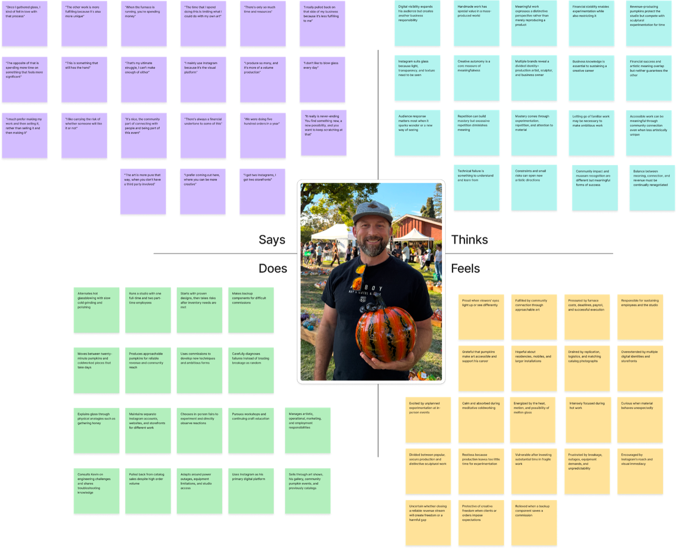
Notes:
(Elsa) Noah’s map shows that he isn’t simply choosing between meaningful art and meaningless production. Pumpkins provide income and community connection, beyond being a yearly tradition. But reproducing a specific design for an order leaves less room to follow an unexpected idea, the very thing that draws him to making

Slide 25
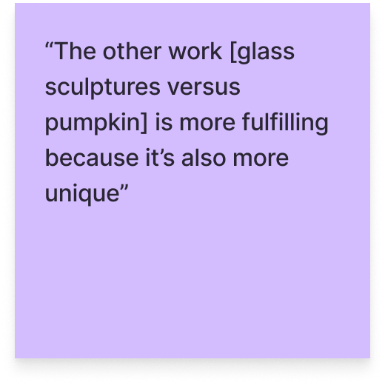
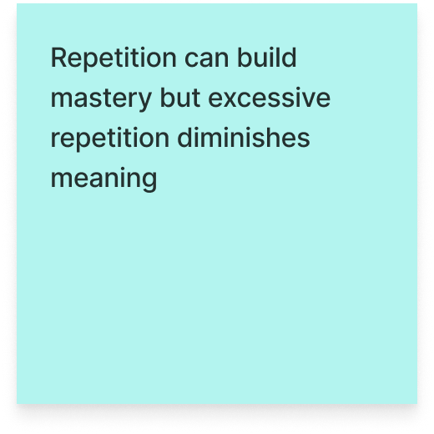
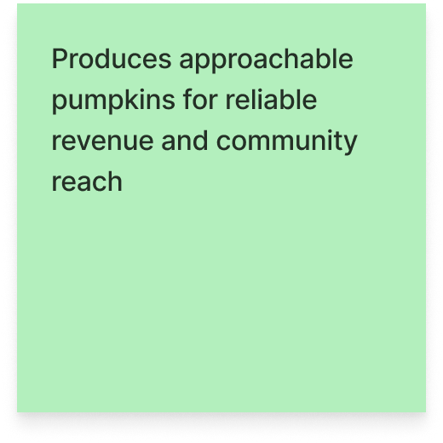
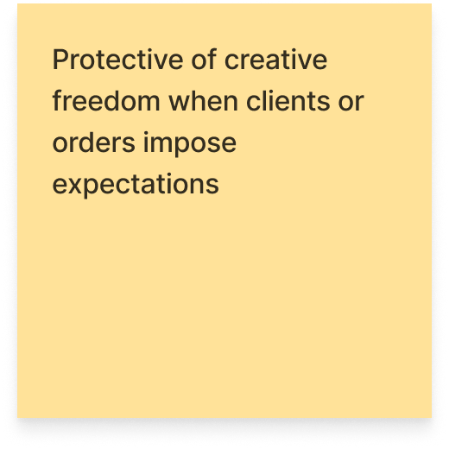
Surprised to notice
Noah pulled back from successful catalogue work to make pieces he wasn’t sure anyone would buy
“The other work is more fulfilling because it’s also more unique”
“I really pulled back on that side of my business [catalogue work] because it’s less fulfilling to me”
Notes:
(Elsa) We were surprised that Noah pulled back from successful catalogue work, even though it brought in orders. He prefers making a piece and then finding its buyer over taking an order and reproducing a promised design

Slide 26
Finding
INSIGHT
Noah welcomes uncertainty when it leaves room for discovery.
Reproducing a promised result builds his skill, but experimenting helps him discover what he wants to express as an artist
NEED
To let his artistic voice evolve beyond the work people already expect from him, while sustaining his livelihood
Notes:
(Elsa) Noah welcomes uncertainty when it gives him creative agency. Repeating a design can build skill, but discovering a new form helps him develop his artistic voice. He needs a way to let that voice evolve beyond what customers already expect, while still sustaining his livelihood. For Noah, growth may mean making something less predictable, not simply making more

Slide 27
Why choose to be a beginner all over again?

Slide 28
“If you stop learning, you’re dead”

Slide 29
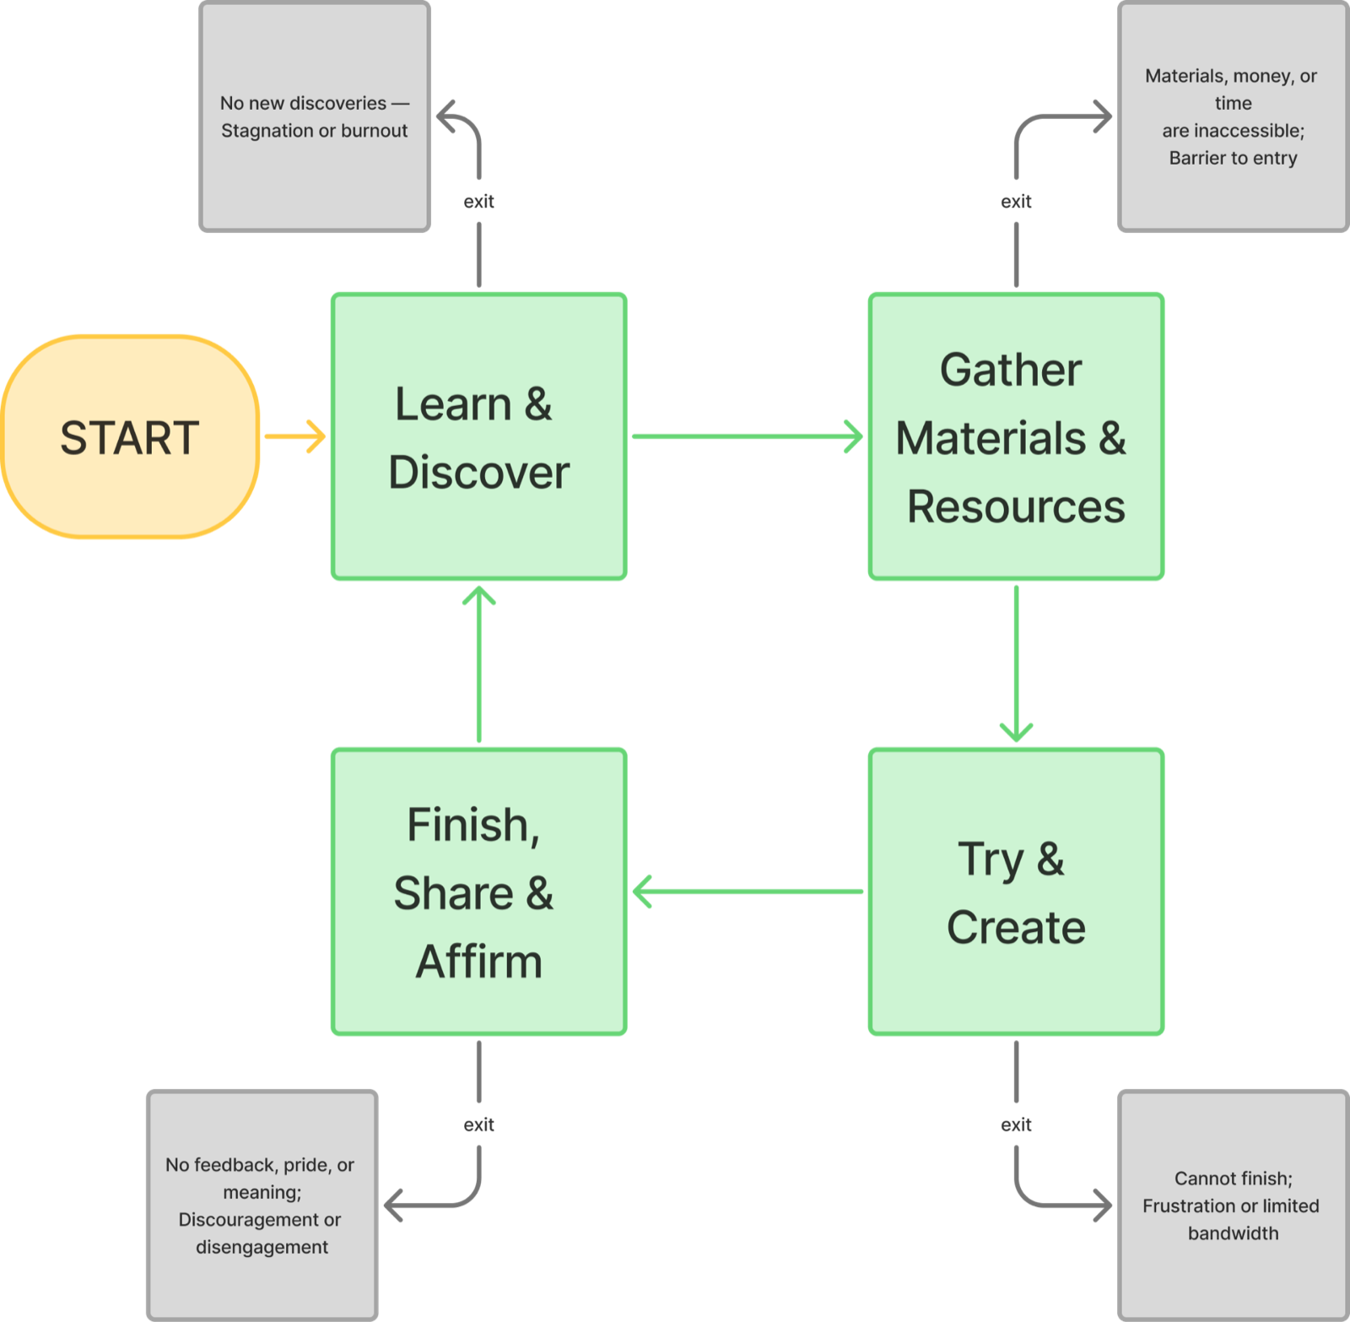
Notes:
POTENTIAL SPEAKER NOTES:
After interviewing these crafters, we saw a repeating theme in how each of them approach their work. From there, we’ve been able to build a framework highlighting the key steps that make up this cycle of crafting. To stay within the loop of crafting, our participants mentioned they begin by coming up with new ideas they want to experiment with. From there, they gather the required resources needed to aid them in moving this craft from an idea to the next step in the process: trying to create a prototype. From there, they work to complete their craft, getting any support or documentation they need along the way.
Pulling on previous experience from crafts or projects given up by these crafters, it’s important to note that each step in the cycle, there’s also a potential point of exit that leads to the crafters giving up their idea. This can include not being able to come up with new or exciting ideas, not being able to access the materials needed for the craft, not being able to follow-through with the time-consuming craft, or not getting the result or feedback they were looking for in their final piece.
The need for learning, discovering, the process, creation, and sharing, reminds us of something. It’s kind of like…

Slide 30
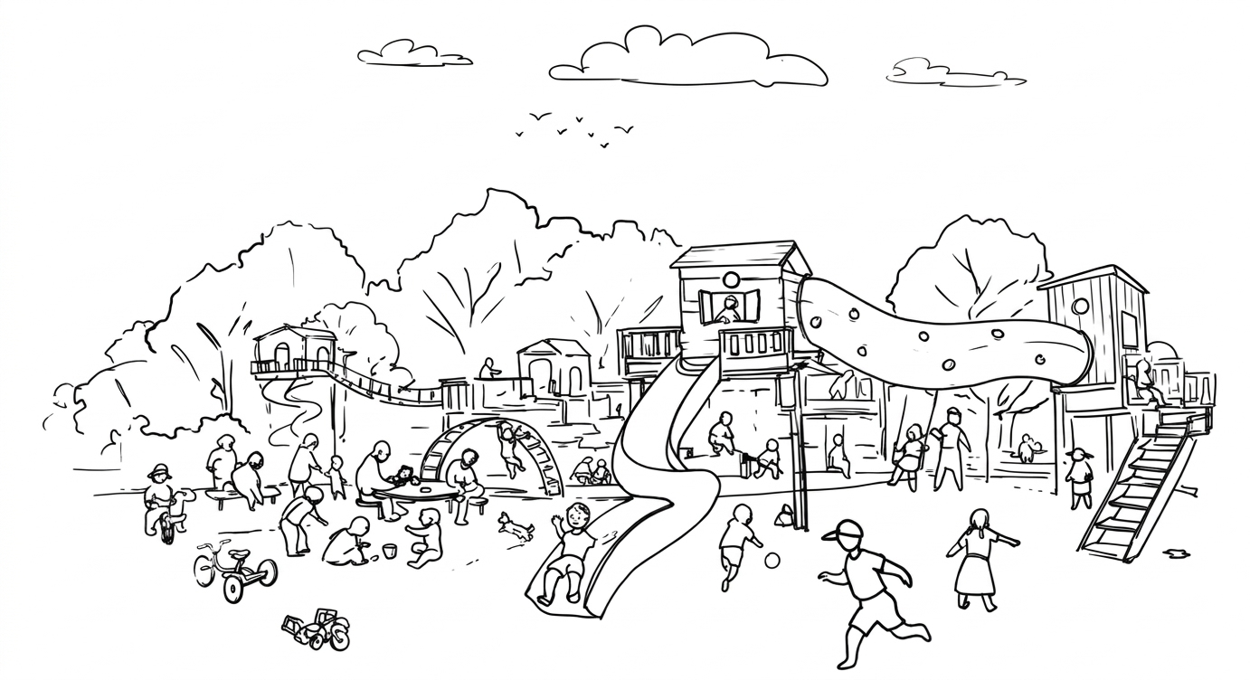
Notes:
Play.
And a place for us to play.

Slide 31
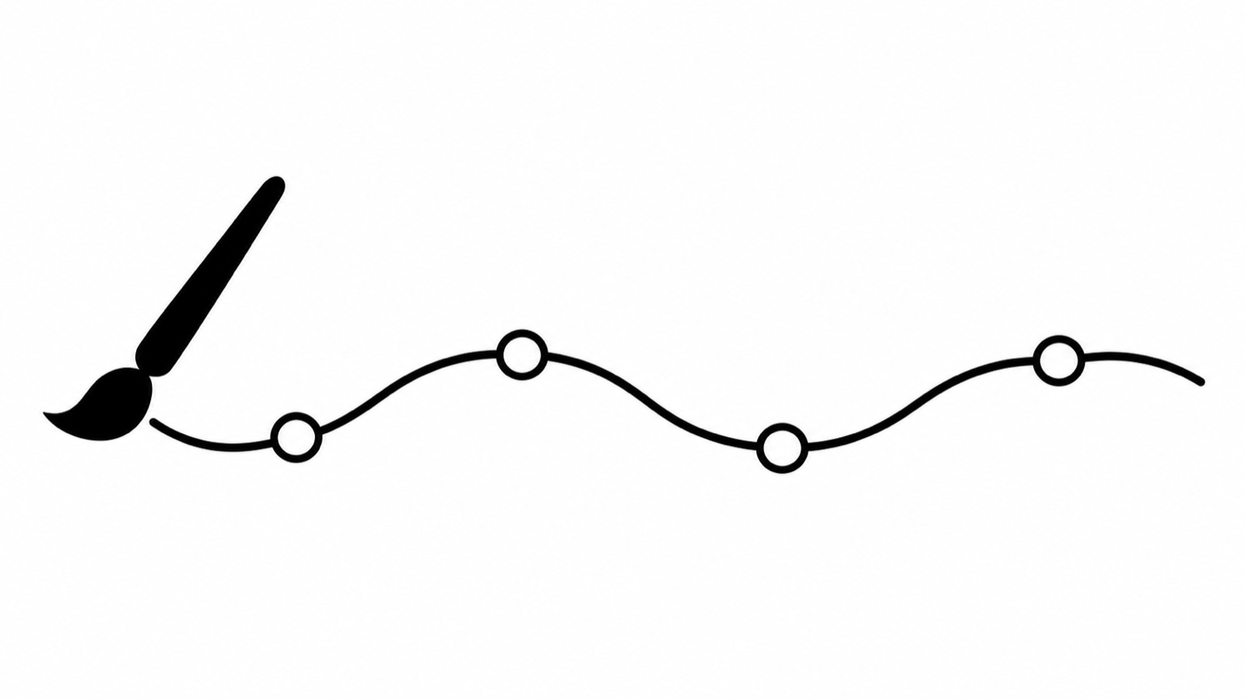
Next Steps
explore “quitters”
take inference leaps
x
x
directly observe craft
x
identify existing supports
x
Notes:
Observe crafting, master/apprentice -> direct observation of the craft making itself
Watch when guidance helps makers explore and when it makes them worry about correctness
Explore interruptions
Interview people who paused or abandoned a craft to understand what made returning difficult
Refine the opportunity
Identify what support helps people keep discovering without turning play into another obligation

Slide 32
Thank you!

