Slide 1
Meaning from Craft

Slide 2
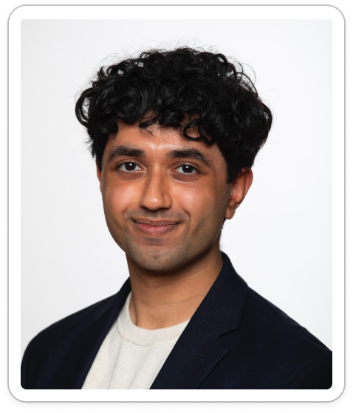
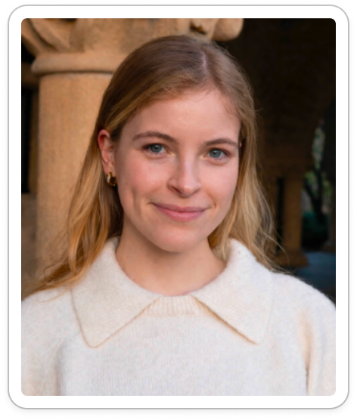
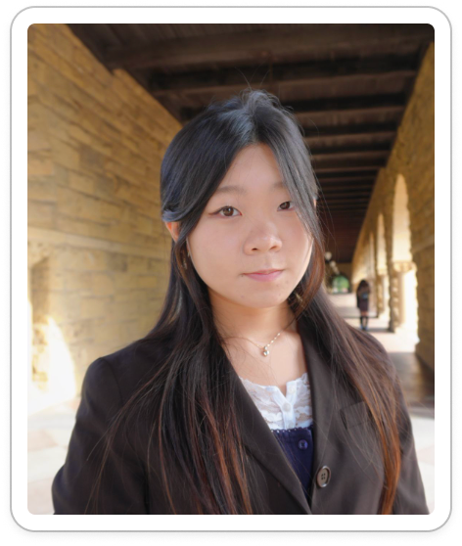
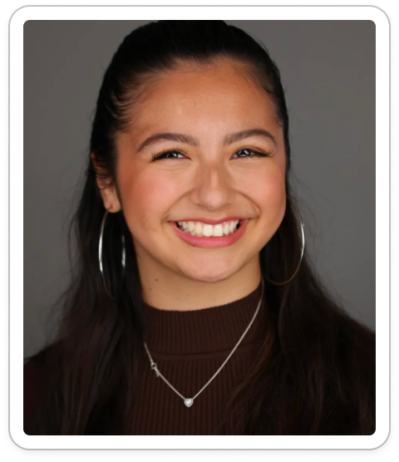
OUR TEAM
Ahyan
BS CS
Elsa
BS Design
MS HCI
Jia
BS Design
MS HCI
Kelly
BS HCI
MS AI

Slide 3
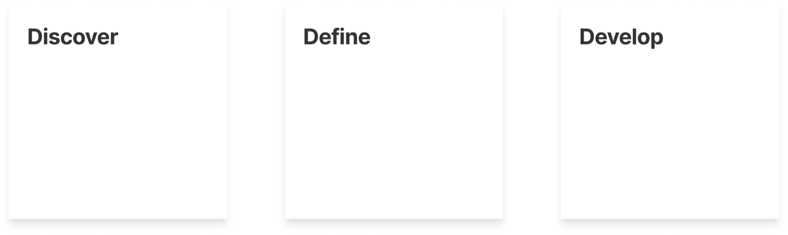
OVERVIEW OF SECTIONS

Slide 4
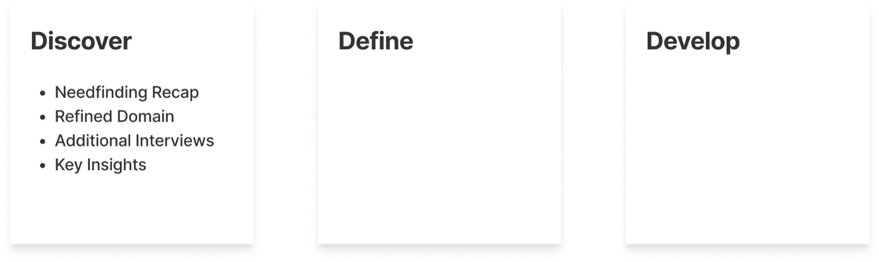
DISCOVER OVERVIEW

Slide 5
NEEDFINDING RECAP
What Makes Craft Meaningful?

Slide 6
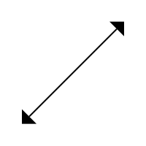
MEANING IS IN THE PROCESS
Meaningful Craft
Structure to start
Freedom to explore

Slide 7
ORIGINAL DOMAIN
“Meaning in craft”
We were initially searching to understand what makes craft feel meaningful.

Slide 8
REFINED DOMAIN
“Staying Engaged in Craft”
We now focus on what helps people sustain meaning throughout the crafting process.

Slide 9
ADDITIONAL NEEDFINDING
Our interviews from last week focused on
seasoned crafters
in their environment

Slide 10
ADDITIONAL NEEDFINDING
Now we wanted to look at
everyday people,
especially those experiencing challenges with starting or maintaining a crafting

Slide 11
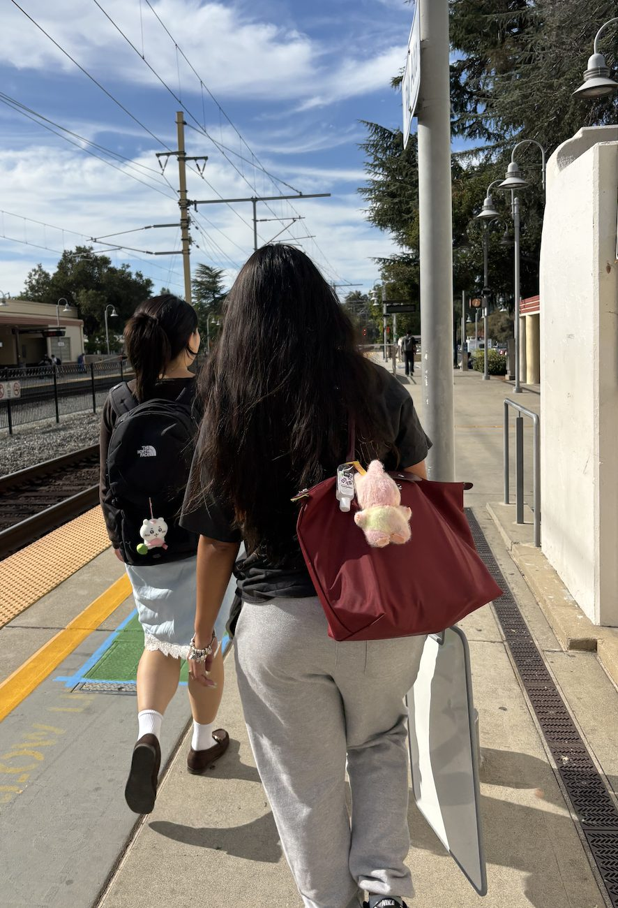
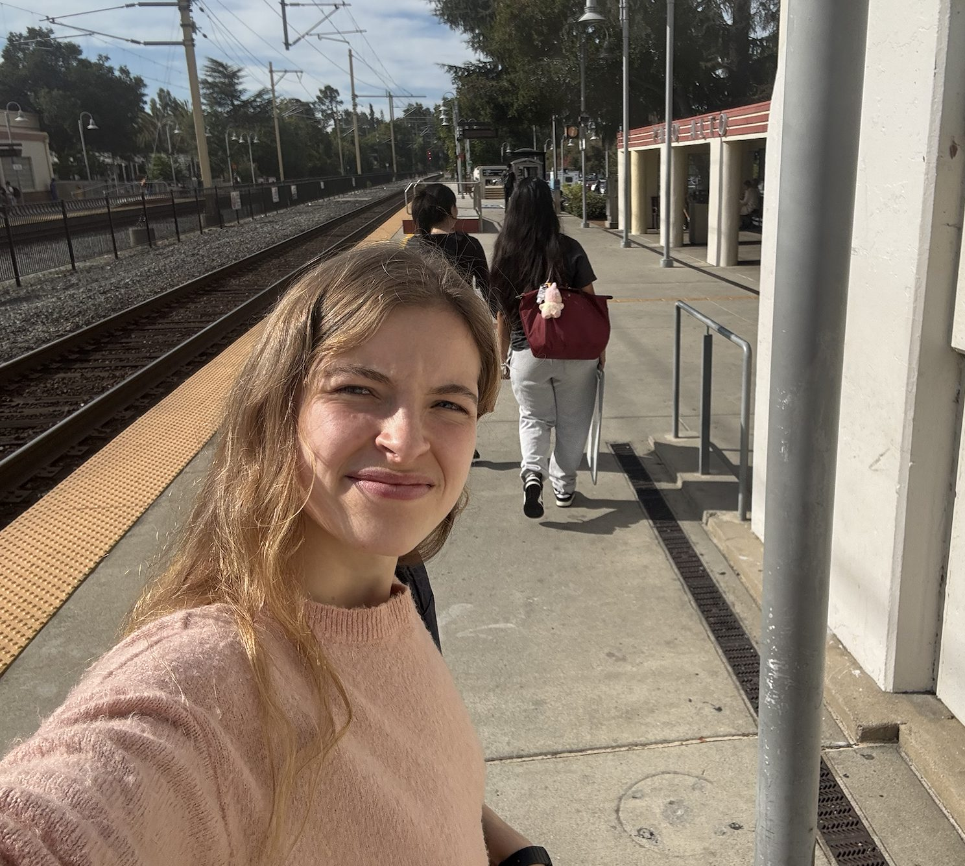
RECRUITMENT
To find “everyday people” we decided to recruit at the Caltrain
Asked
As there something you loved doing and then stopped?
What did making art look like before you stopped?
Can you walk me through how that happened? Were there moments when you noticed you were losing touch with your craft?
Held sign:
“What is something you used to love but stopped?”

Slide 12
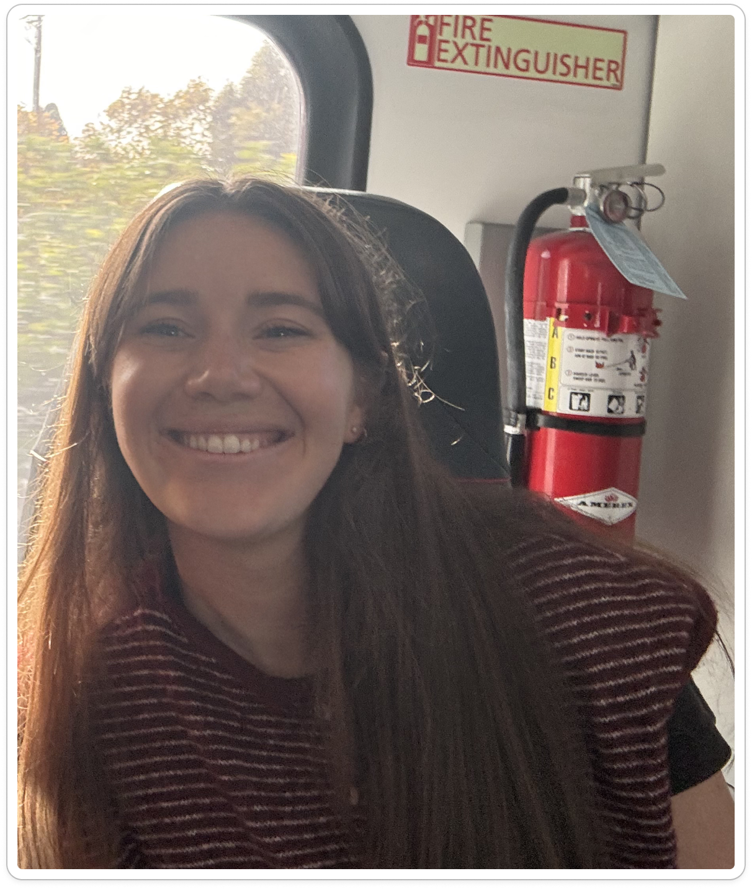

MEET LOLA!
Clinical dietitian and former watercolor artist.
Now rediscovering creativity through new crafts.

Slide 13
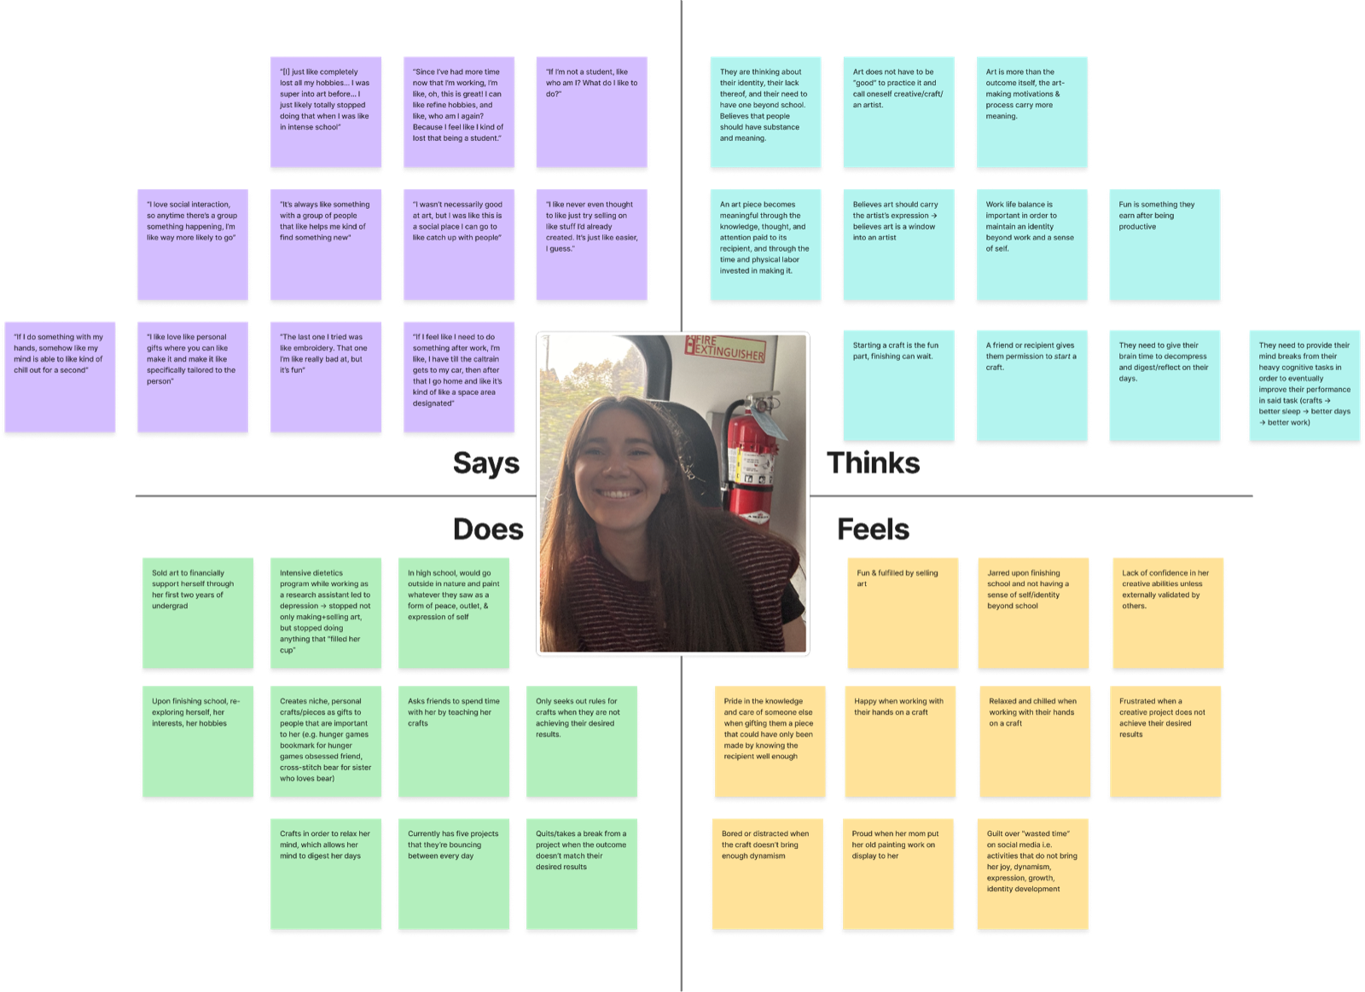

Slide 14
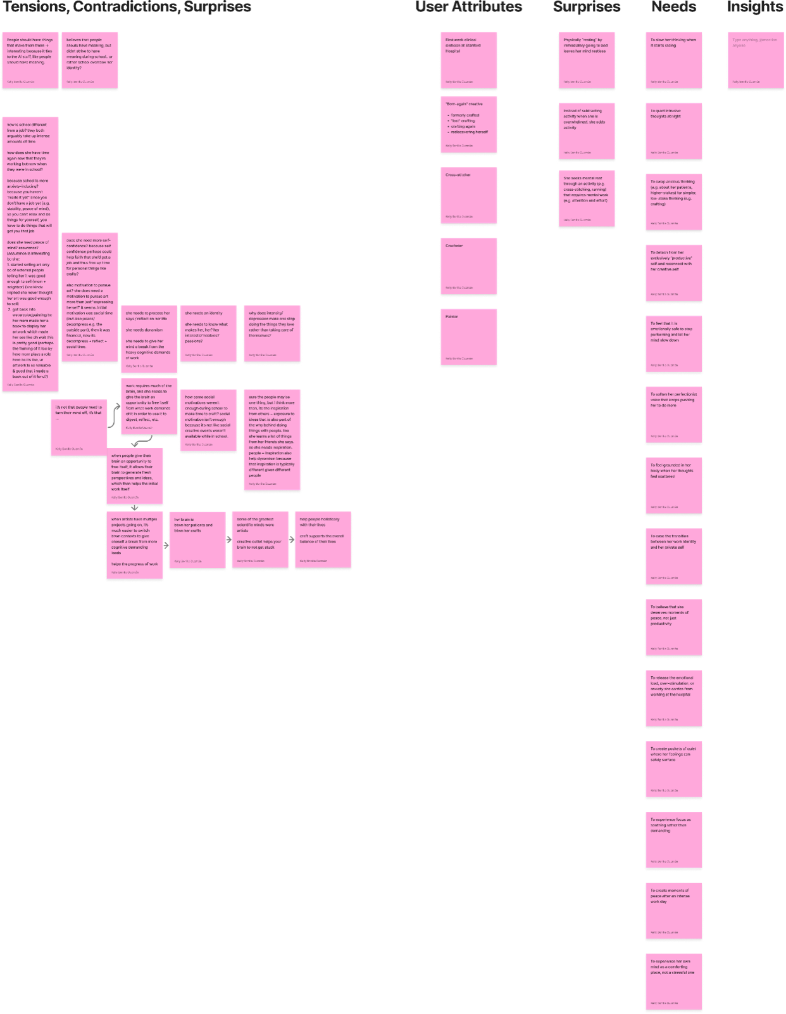

Slide 15
LOLA REFOUND HER LOVE
Mom gave her a book of her old paintings:
“I opened it and I was like, wait this actually looks pretty good. Why did I think this was terrible when I was doing this a few years ago? And I was like, wait, do I want to do this again? Like this is kind of fun.”

Slide 16
FINDING
INSIGHT
Seeing her old paintings helped Lola recognize her ability again and reconnect with the joy of creating
NEED
A way to remember what she loved about creating, as her craft may change or fall out of practice.

Slide 17
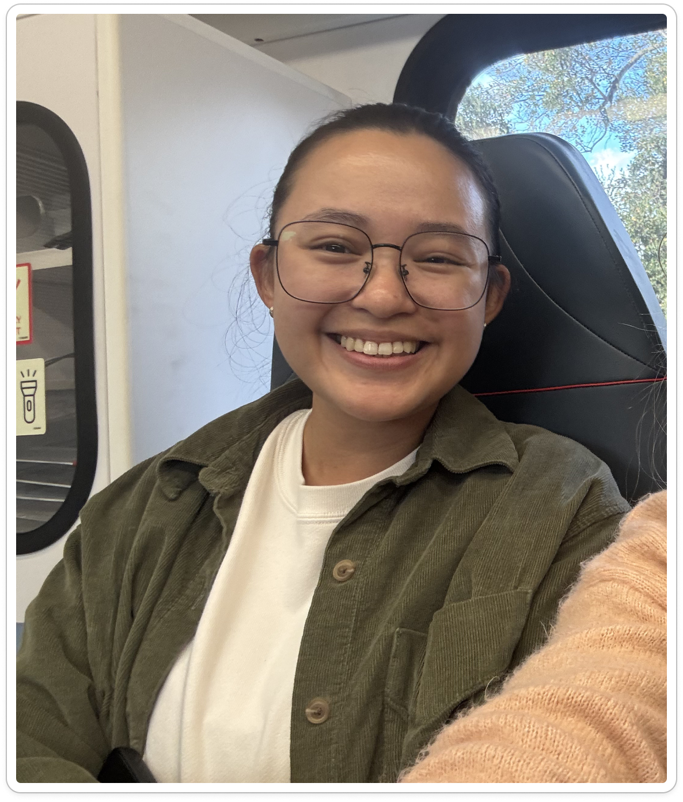
MEET CELI!
A working designer, also pursuing a masters in packaging
Becoming exhausted and drained from her design work

Slide 18
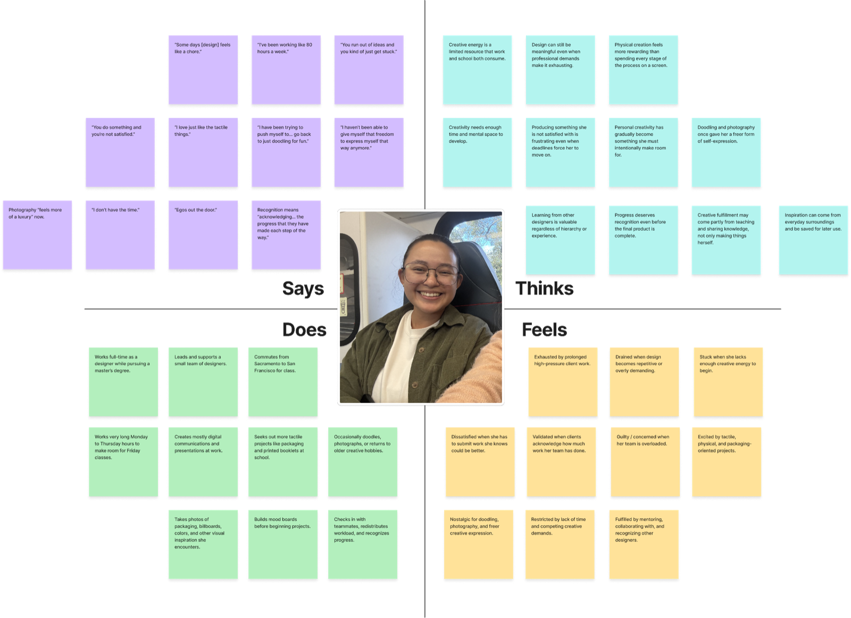

Slide 19
WHAT WE FOUND
After working “80-hour weeks” on a demanding client event, she turned to a hands-on booklet assignment:
“I was really excited for this one project … by the time I touched the project, it's just like I don't know what to do.”
“You're so exhausted. It's like … you run out of ideas and you kind of just like stuck.”

Slide 20
FINDING
INSIGHT
After generating ideas for clients all day, Celi’s personal creative work can feel like another demand, even when she’s excited about it
NEED
Space to enjoy making without pressure to generate a strong idea or prove her ability

Slide 21
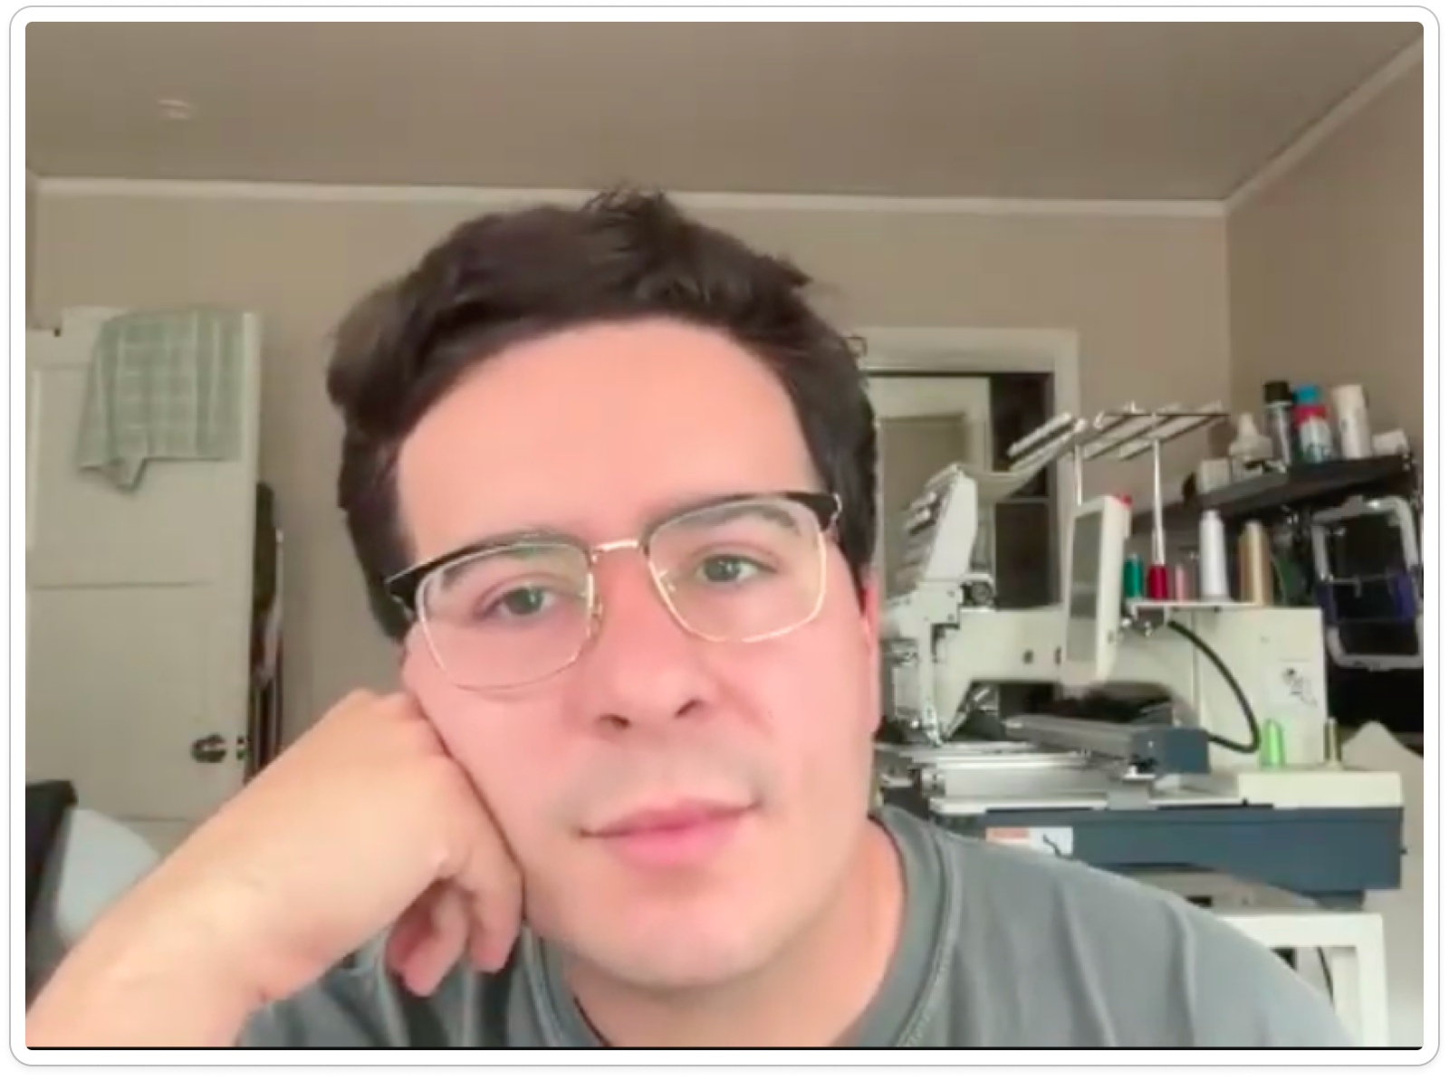
MEET JACOB!
Runs Stanford’s Makery and teaches craft classes.
Designs spaces and tools that make it easier for anyone to start making.

Slide 22
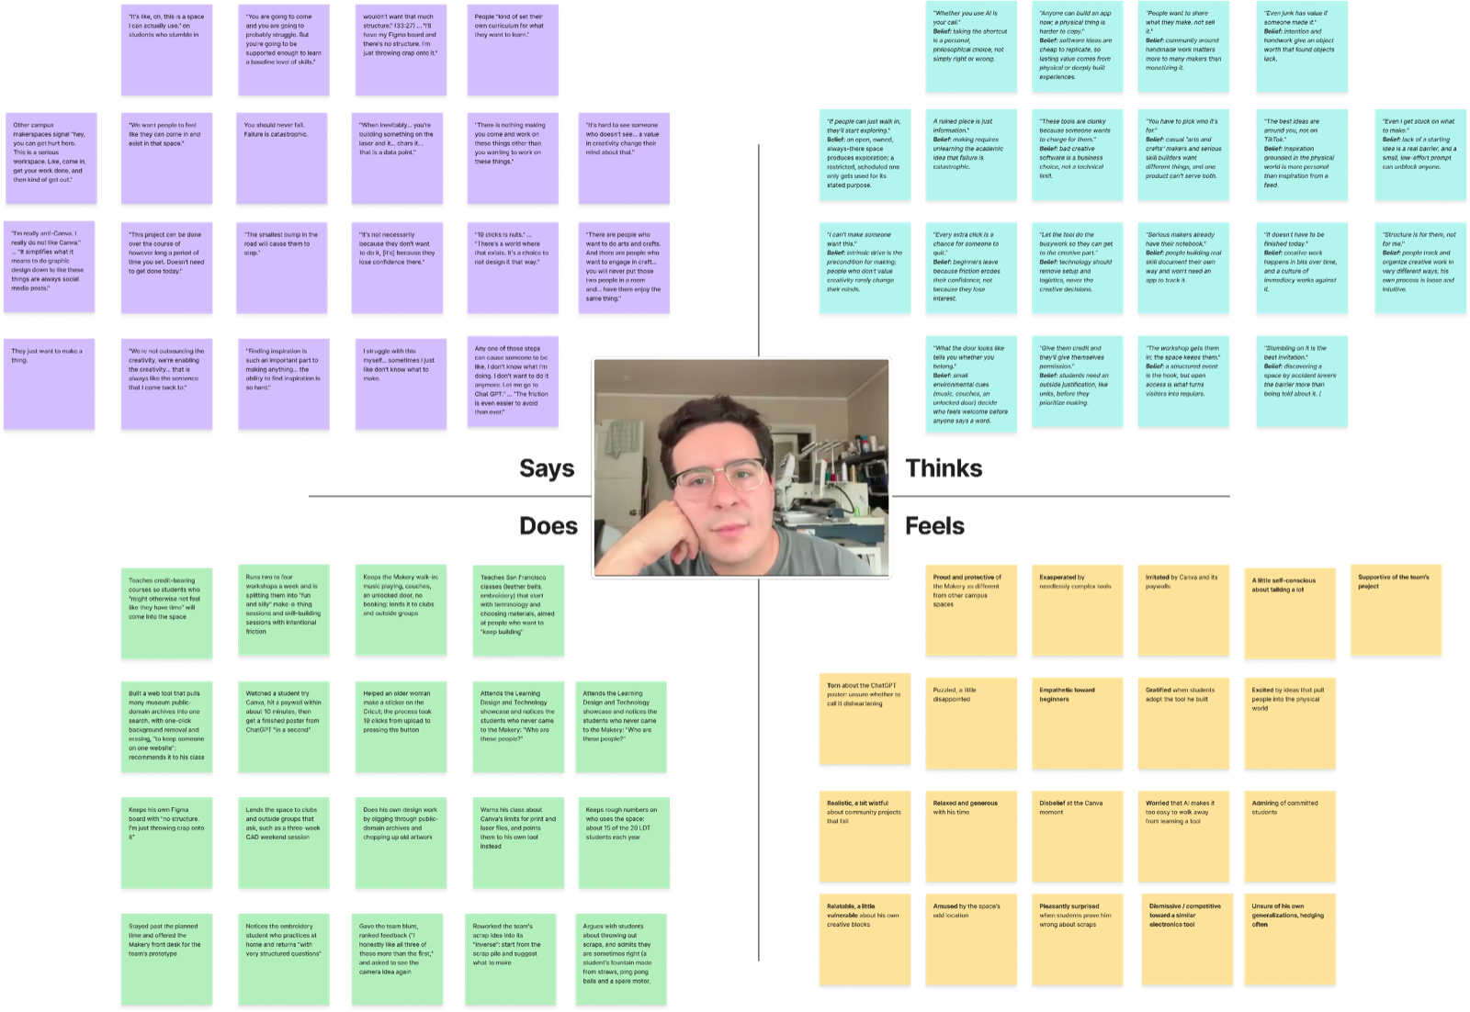

Slide 23
WHAT WE FOUND
INSIGHT
Beginners don’t quit from lack of interest. They quit when early friction and failure make it feel high-stakes
NEED
A low-pressure way to start making, where mistakes feel like part of the fun

Slide 24
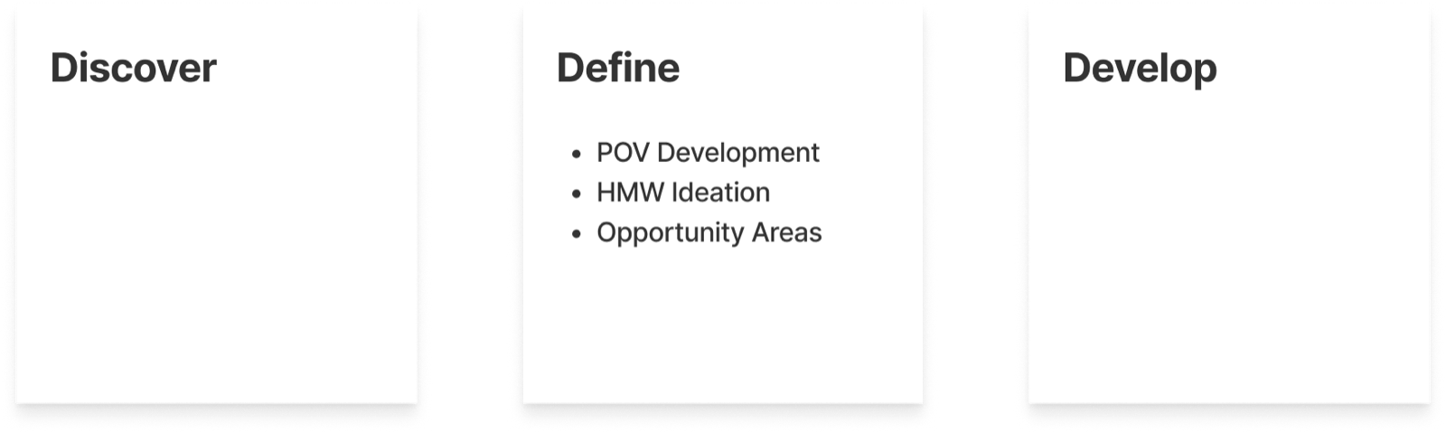
DEFINE OVERVIEW

Slide 25
Our Initial POVs
Initially, our POVs focused on how people start new crafts, embrace being beginners, and challenge themselves, drawing primarily from expert crafters

Slide 26
POV DEVELOPMENT
Now, we want to focus on POVs that highlight crafters most at risk of losing meaning in their creativity or struggling to sustain it in their lives

Slide 27
EDDY POV
We met Eddy, a recently retired software professional who has admired glass art for decades and enjoyed making crafts like glass blowing while traveling.
We were surprised to notice that he tries crafting while traveling, yet hasn’t made it part of his life back home, even though he’ll browse local glass blowing classes.
We wonder if this means that travel lets him experience crafting as an adventure, while calling himself a beginner eases the pressure to measure up to the artists he admires.
It would be game-changing to help Eddy experience crafting at home as an adventure he can try, without feeling he must prove an identity as a maker.
Notes:
HMW 1

Slide 28
NOAH POV
We met Noah, a professional glass artist who balances reliable catalogue sales with creating unique pieces.
We were surprised to notice that he pulled back from successful catalogue work to make pieces he wasn’t sure anyone would buy, because he found the unique work more fulfilling.
We wonder if this means that reproducing what already sells makes him feel confined by past successes, while uncertainty gives him room to discover what he wants to express as an artist.
It would be game-changing to help Noah feel free to let his artistic voice evolve beyond what buyers already expect from him, while sustaining his livelihood.
Notes:
HMW 2

Slide 29
LOLA POV
We met Lola, a newly hired clinical dietitian who once sold watercolor commissions but lost touch with her creative hobbies—and her sense of self—during intensive schooling
We were surprised to notice that she returned to creativity through unfamiliar crafts with friends, while seeing her old paintings reminded her of a creative side she had left behind
We wonder if this means that reconnecting with creativity involves both remembering who she was and discovering who she can become through new ways of making.
It would be game-changing to help Lola carry what she loved about past crafts into new creative experiences, without feeling she has to pick up exactly where she left off
Notes:
HMW 3
Rigorous reflection and introspection re-inspires crafters.

Slide 30
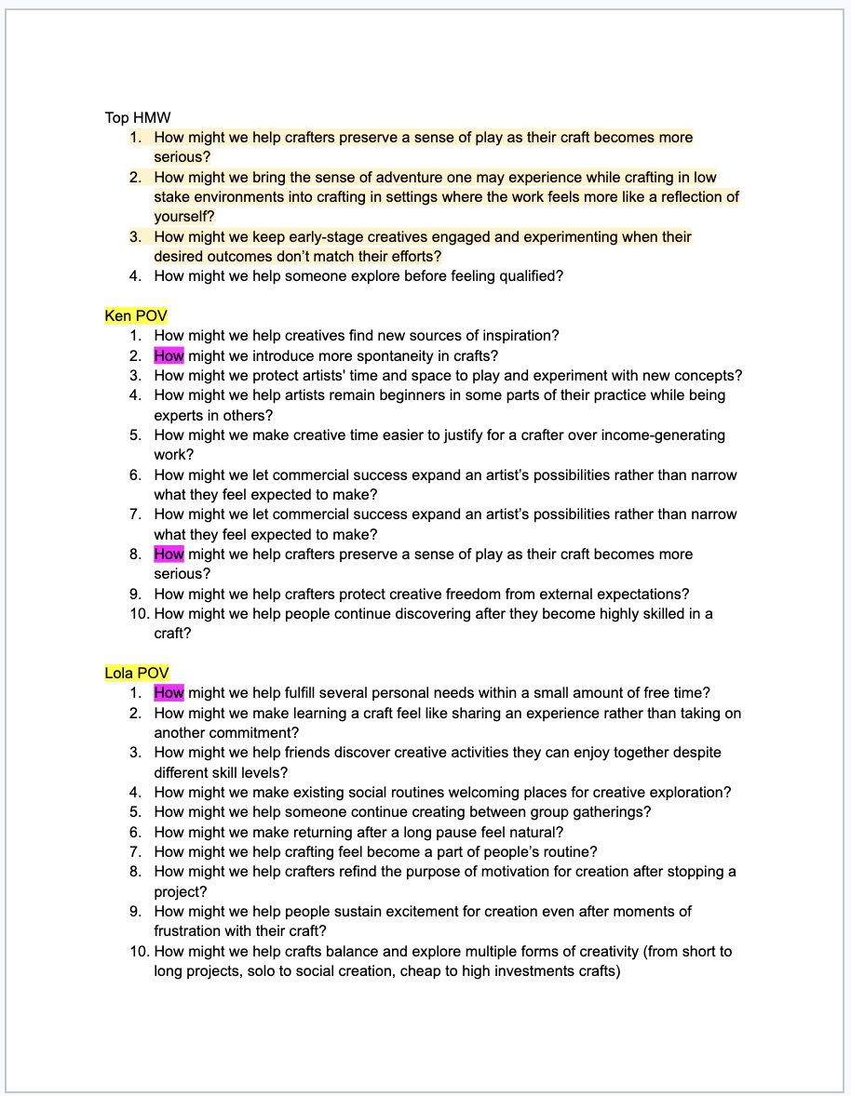
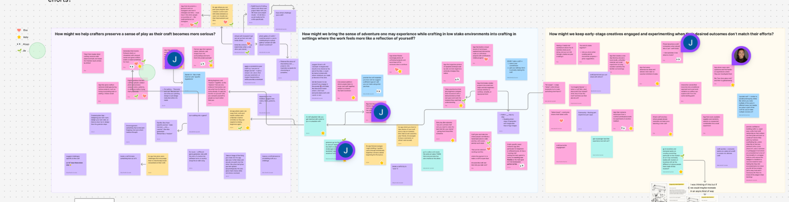
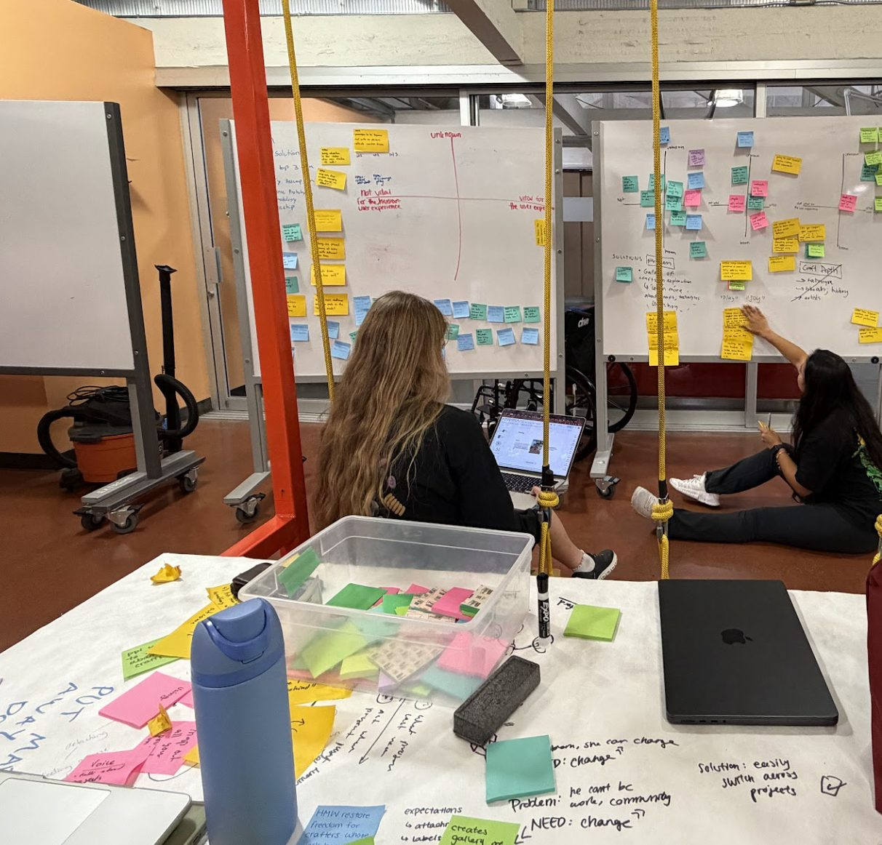
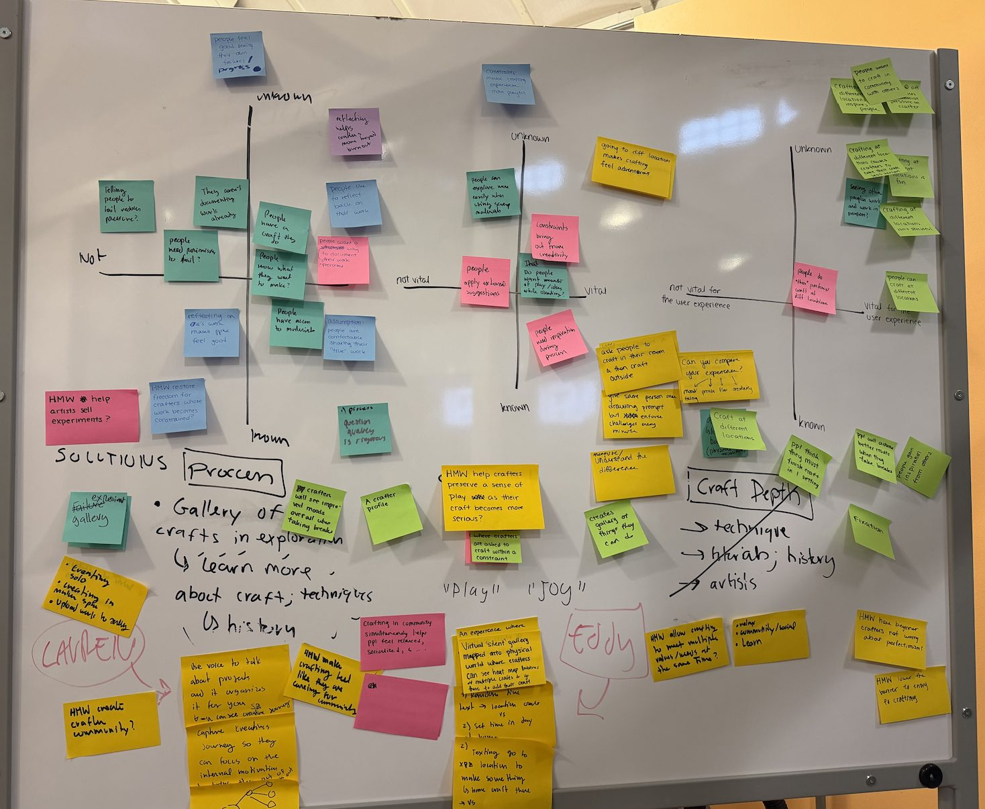
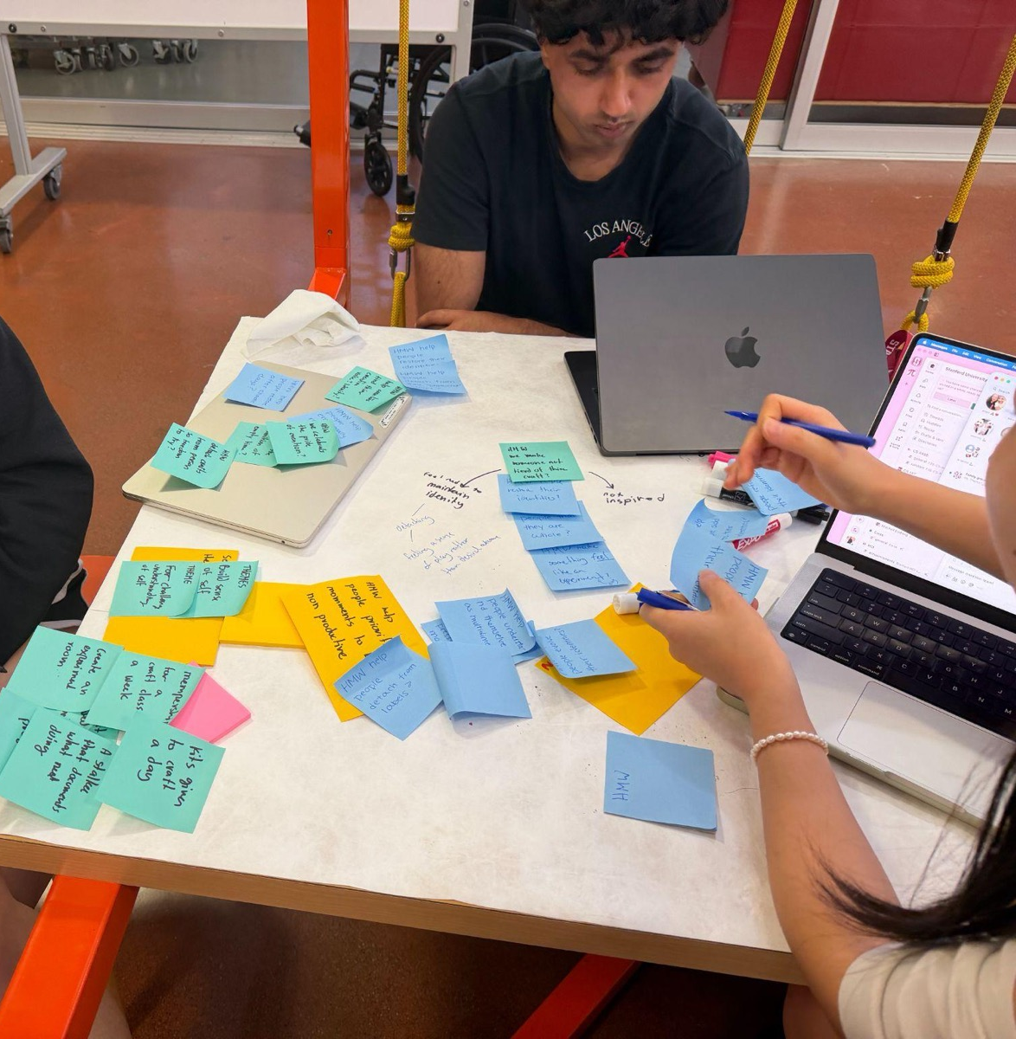
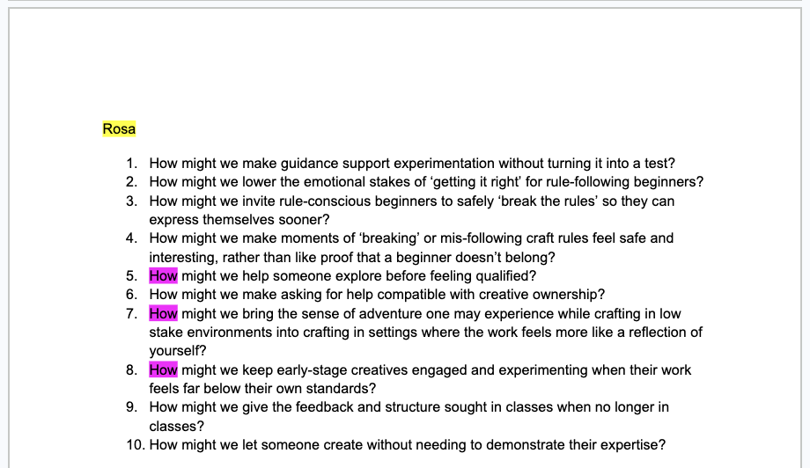
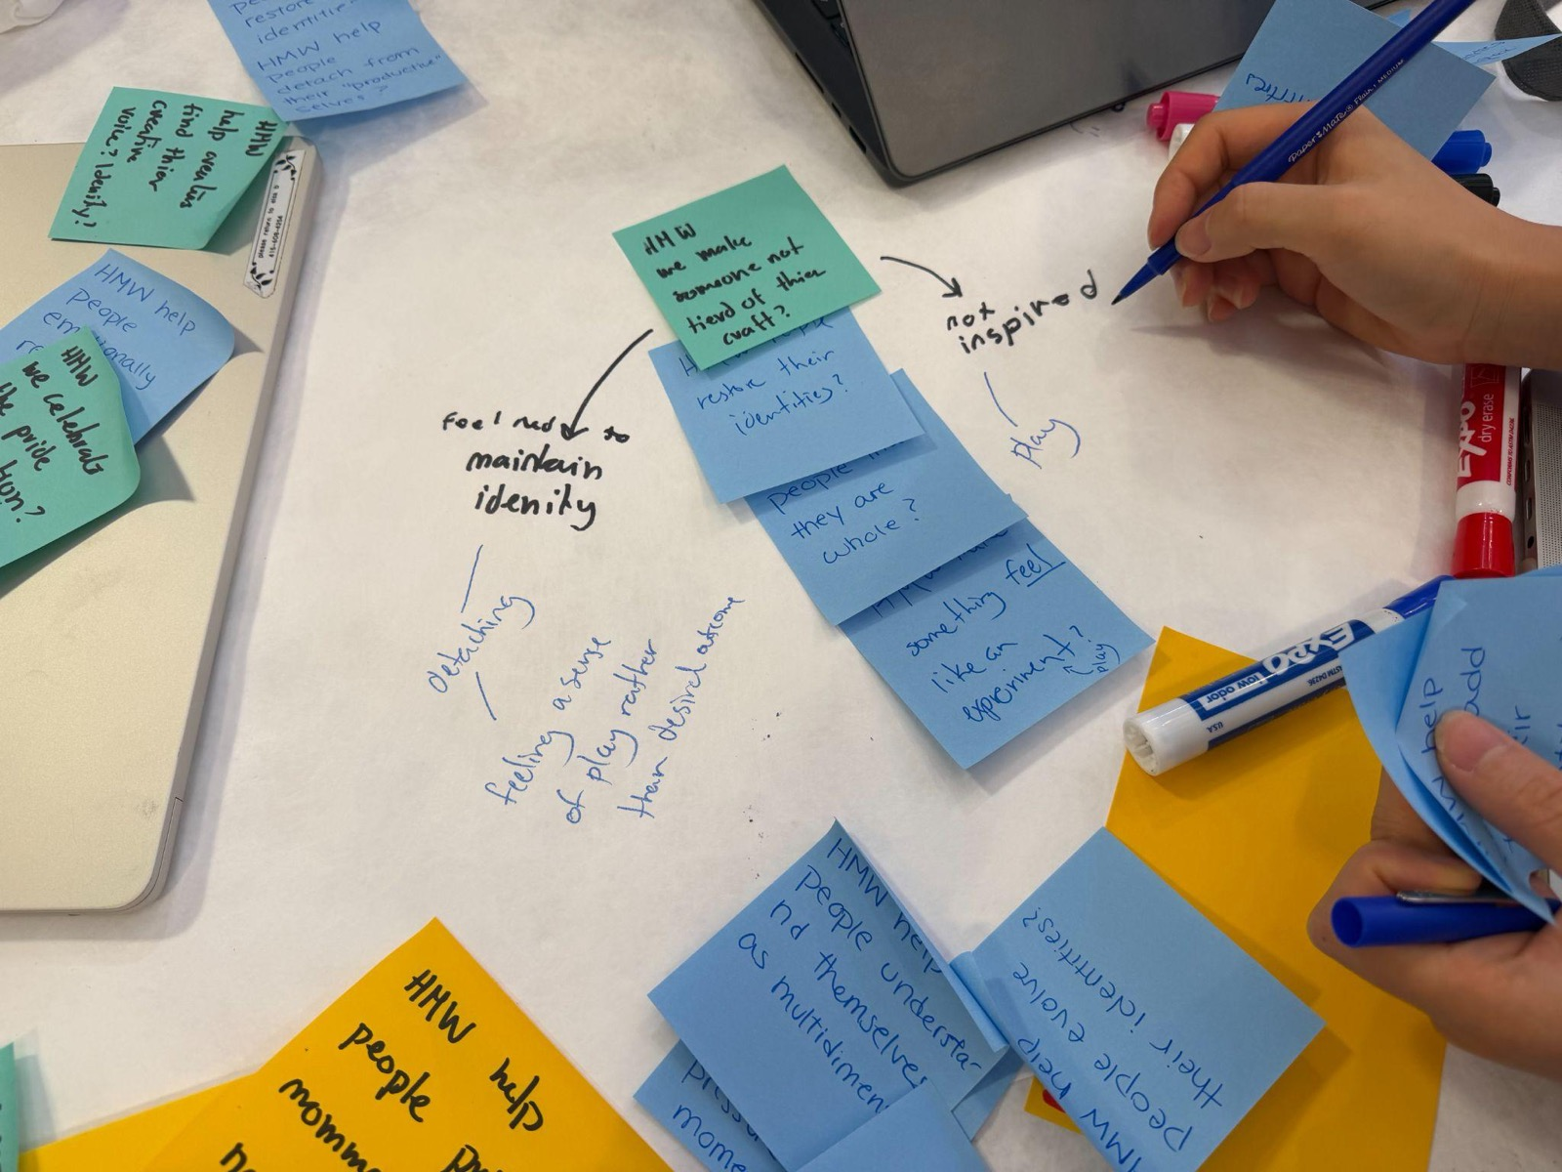
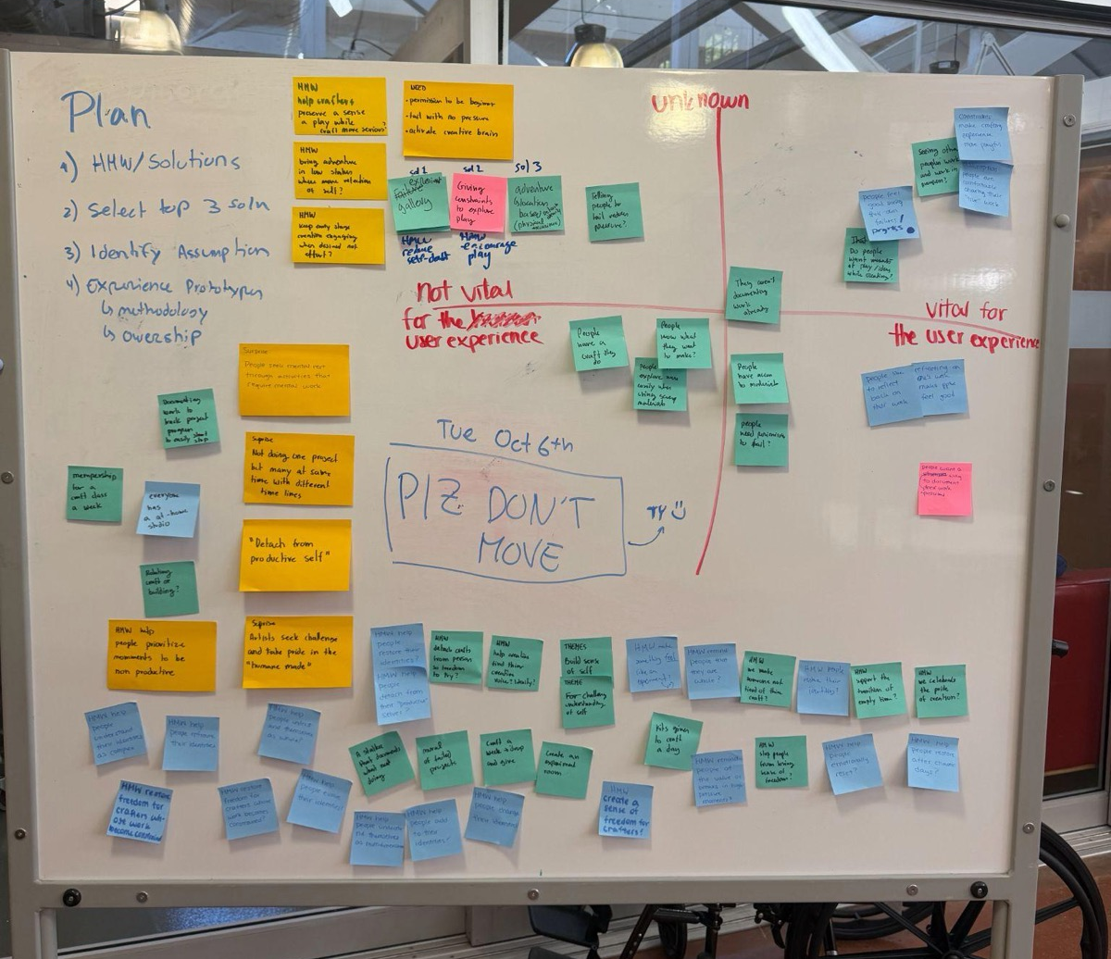
ITERATION CYCLE
Initial HMW
Solutions V1
Revised HMW
Solutions V2

Slide 31
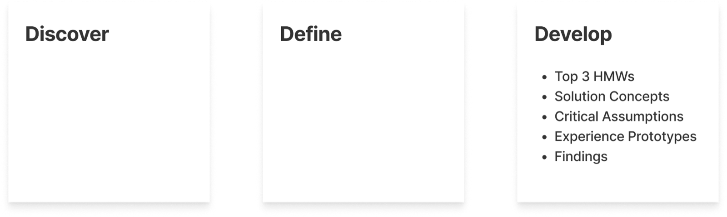
DEVELOP OVERVIEW

Slide 32
HMW 1
How might we help crafters preserve a sense of play to lower the stakes of entry into a craft?
From Eddy: “It’s an opportunity to do something new and fun.”
Notes:
EDDY POV.

Slide 33
SOLUTION 1
Gamify crafting by having crafters go to different locations and craft at that location

Slide 34
ASSUMPTION 1
Crafting in different locations makes the crafting experience feel more playful/adventurous

Slide 35
OTHER ASSUMPTIONS
Crafters would be willing to leave their usual workspace.
An unfamiliar location would feel inspiring rather than distracting.
The environment itself would influence what someone creates.
Portable materials would be sufficient for spontaneous crafting.
People would feel less perfectionistic outside their normal workspace.
The effect would come from the location itself, not simply from being given a new task.
Our key assumption includes the whole solution depending on location changing the emotional experience of making. If a new environment does not reduce pressure or increase playfulness, then sending crafters elsewhere adds friction without adding value. This assumption tests the core experience, not just whether the concept is convenient or usable.

Slide 36
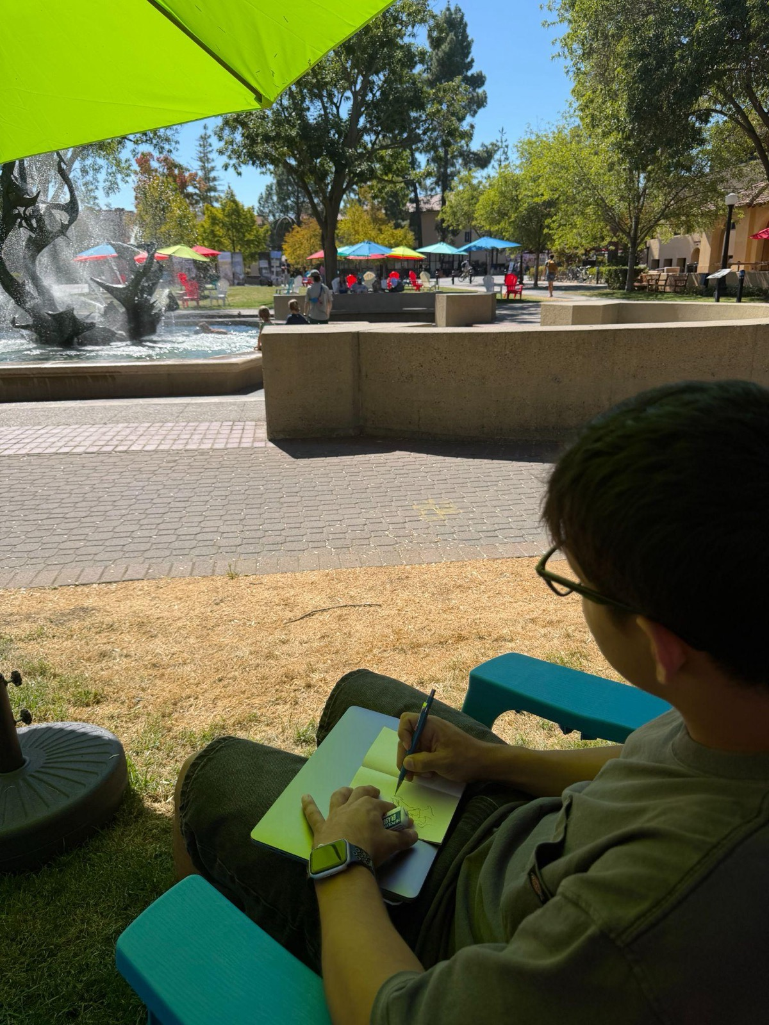
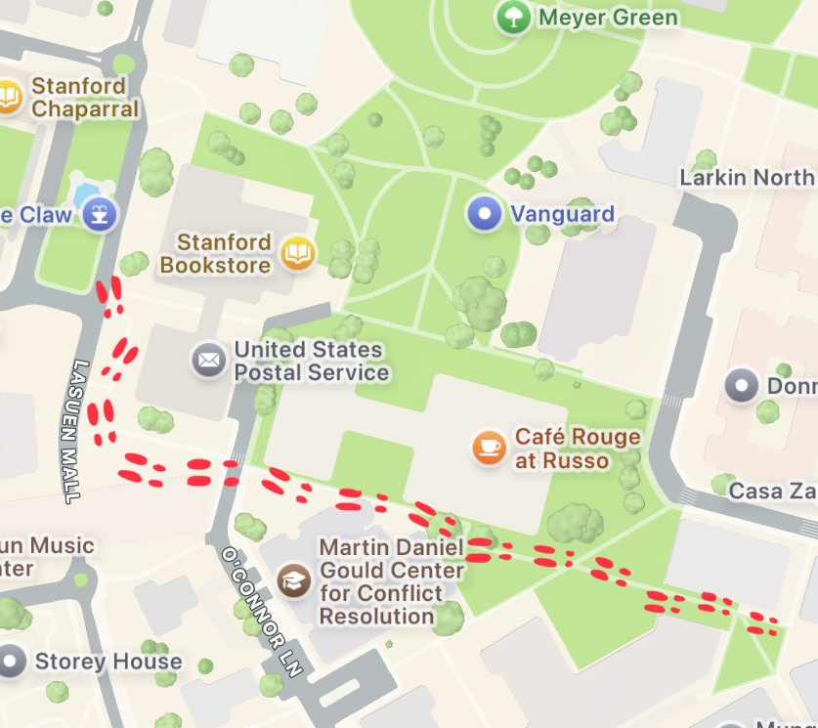
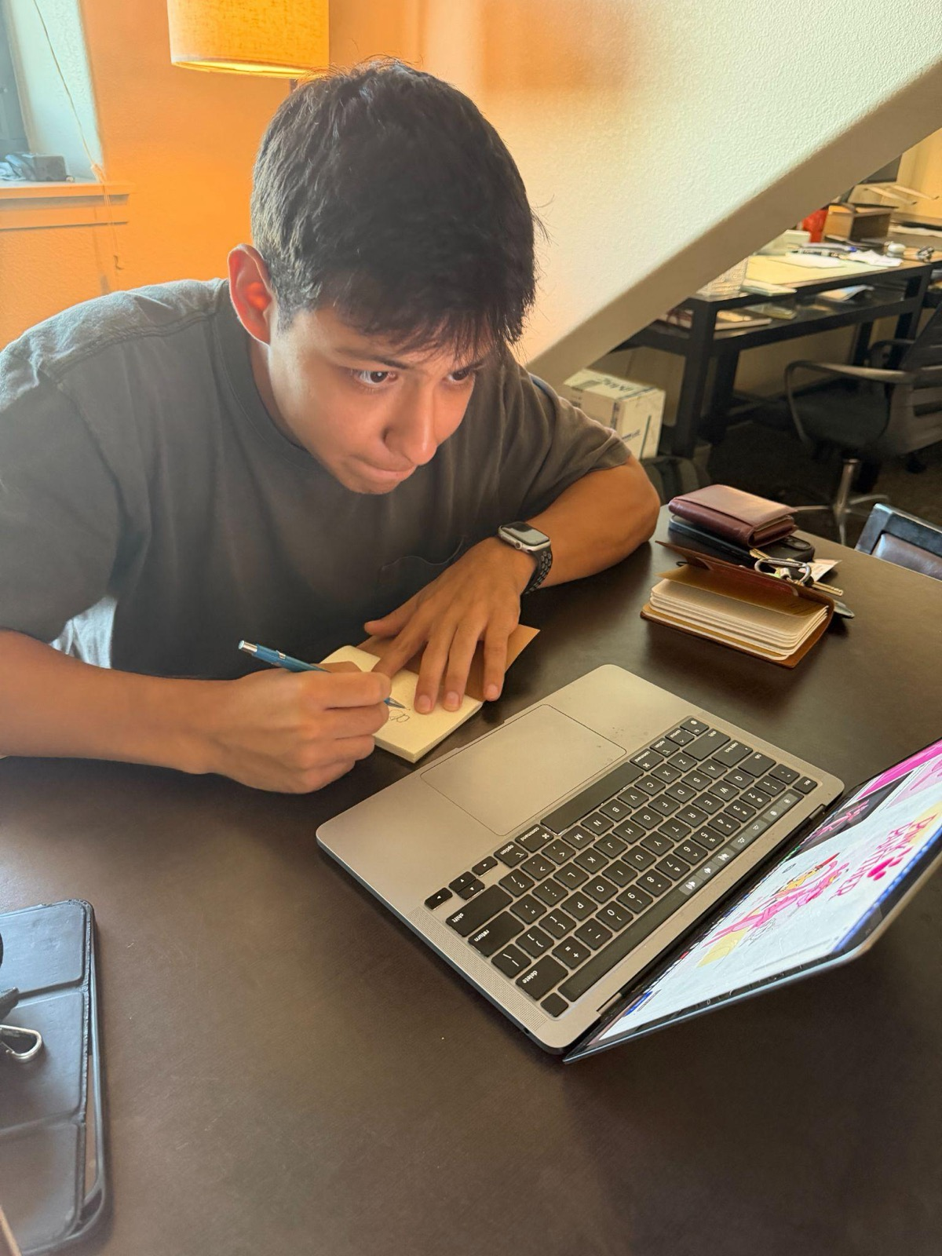
EXPERIENCE PROTOTYPE 1
Request a crafter to craft in their regular crafting space
Request the same crafter to follow us to an ~unknown~ location and craft there
📍
🏠
Notes:
Ask someone to create a quick craft at home, and then ask them to go to a fountain on campus and have them create a craft at that location inspired by water. Ask them to compare their experiences— how did they feel in one experience vs. the other?

Slide 37
PARTICIPANT INFO
Who: Crafter with prior drawing experience
Why relevant: Familiar with crafting, but still feels pressure around making something “good”
How recruited: Existing contact / convenience recruitment
Why useful: Let us compare the same person crafting in a familiar vs. unfamiliar environment

Slide 38
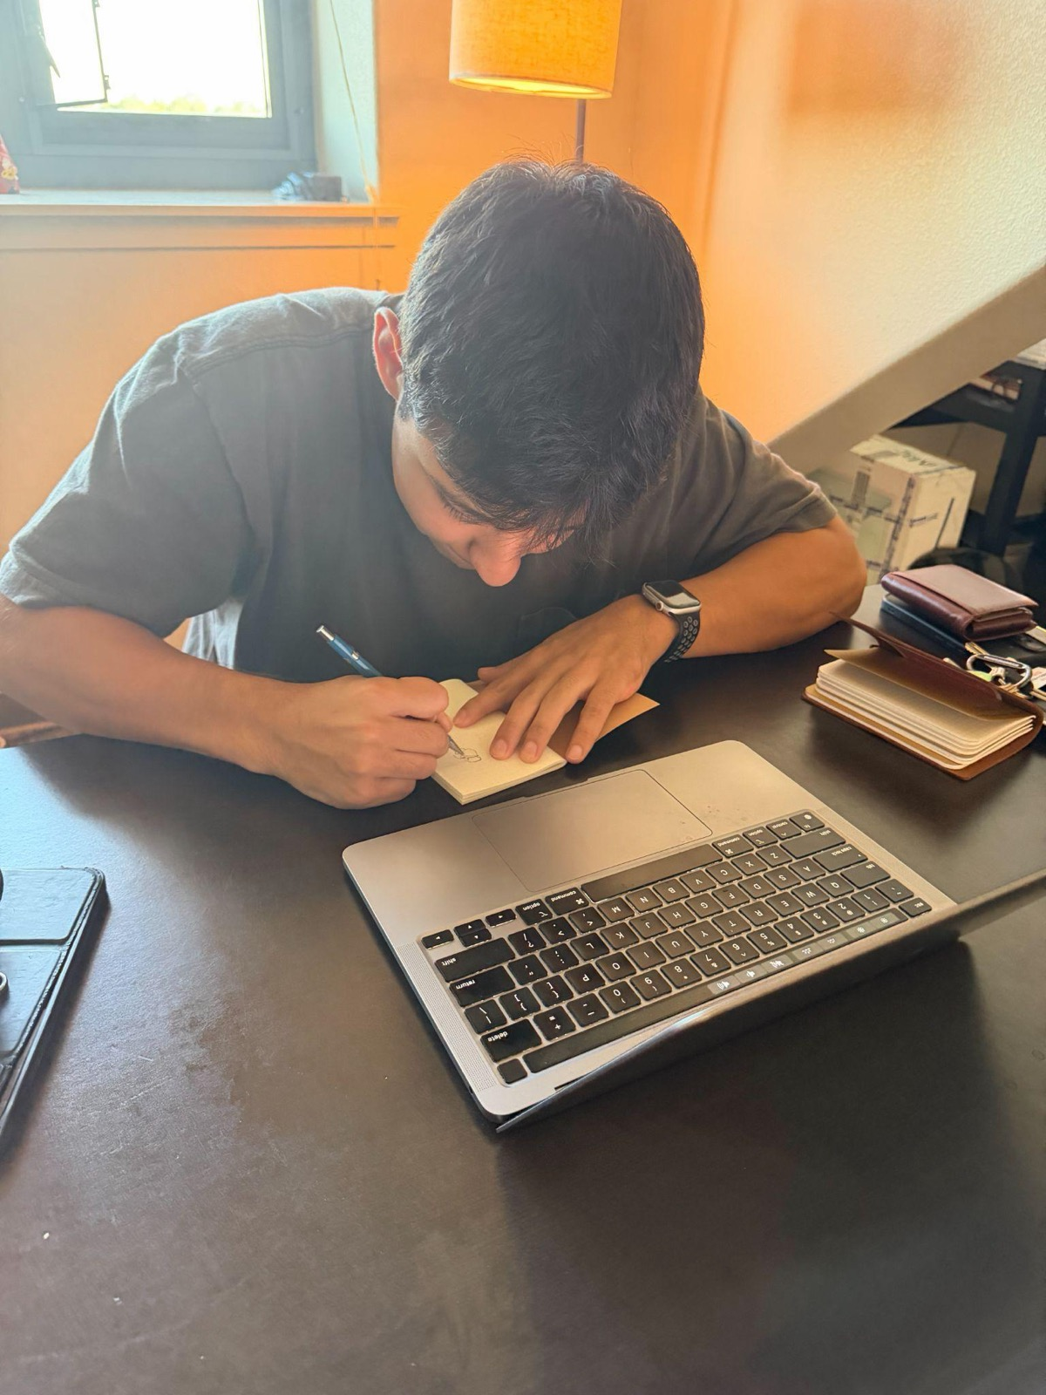
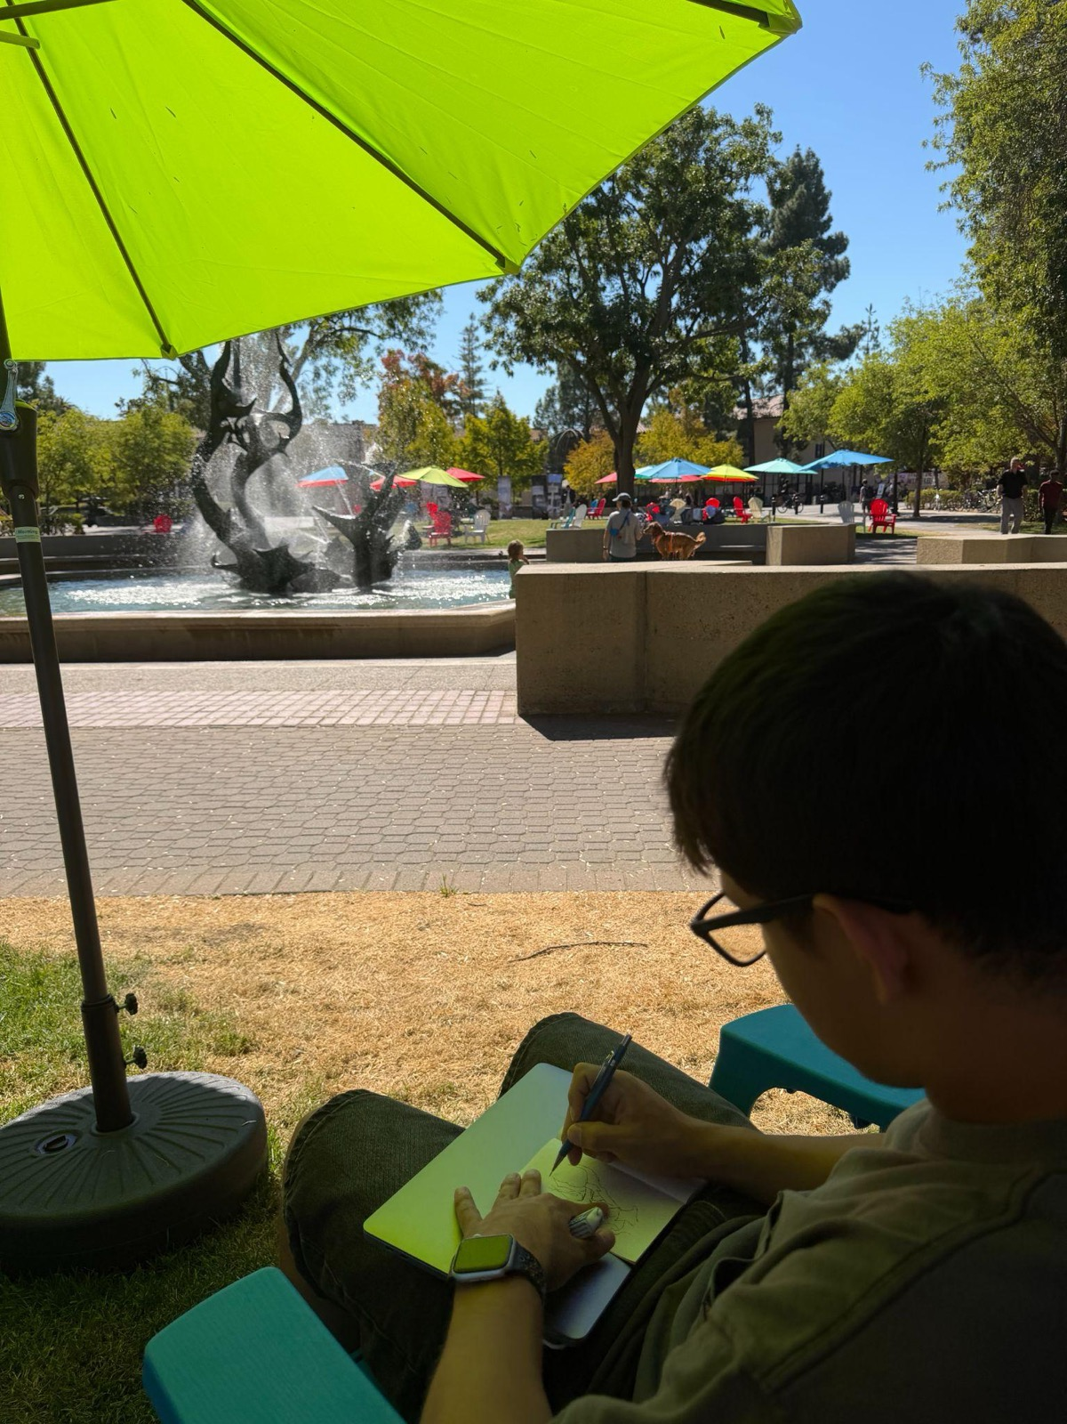
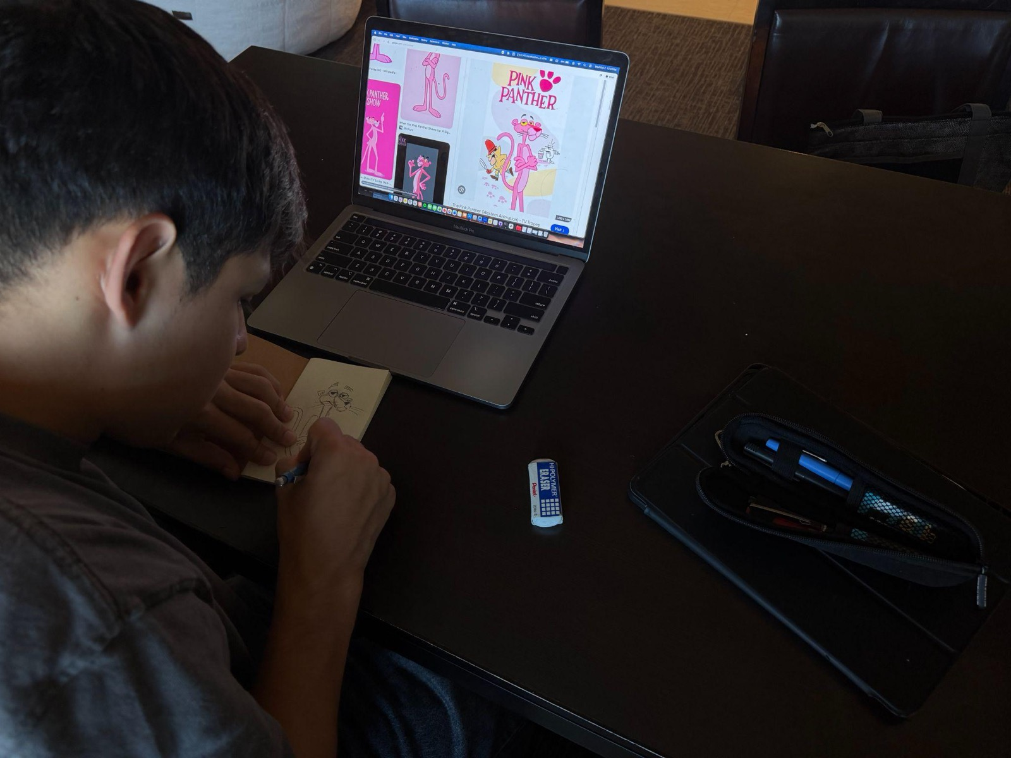
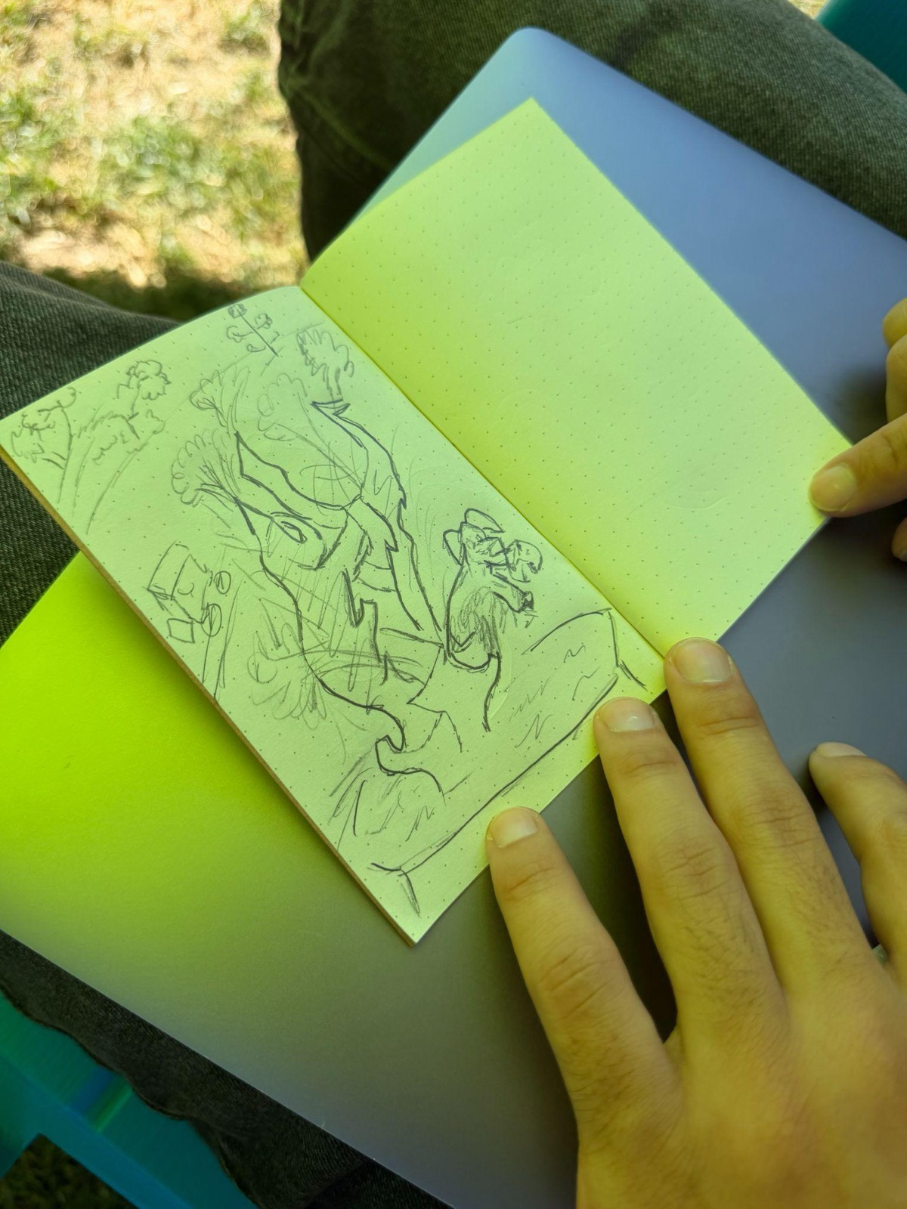
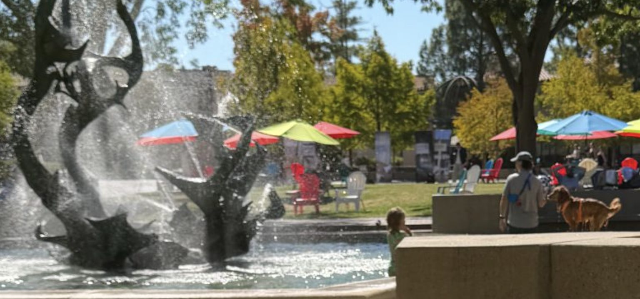

Slide 39
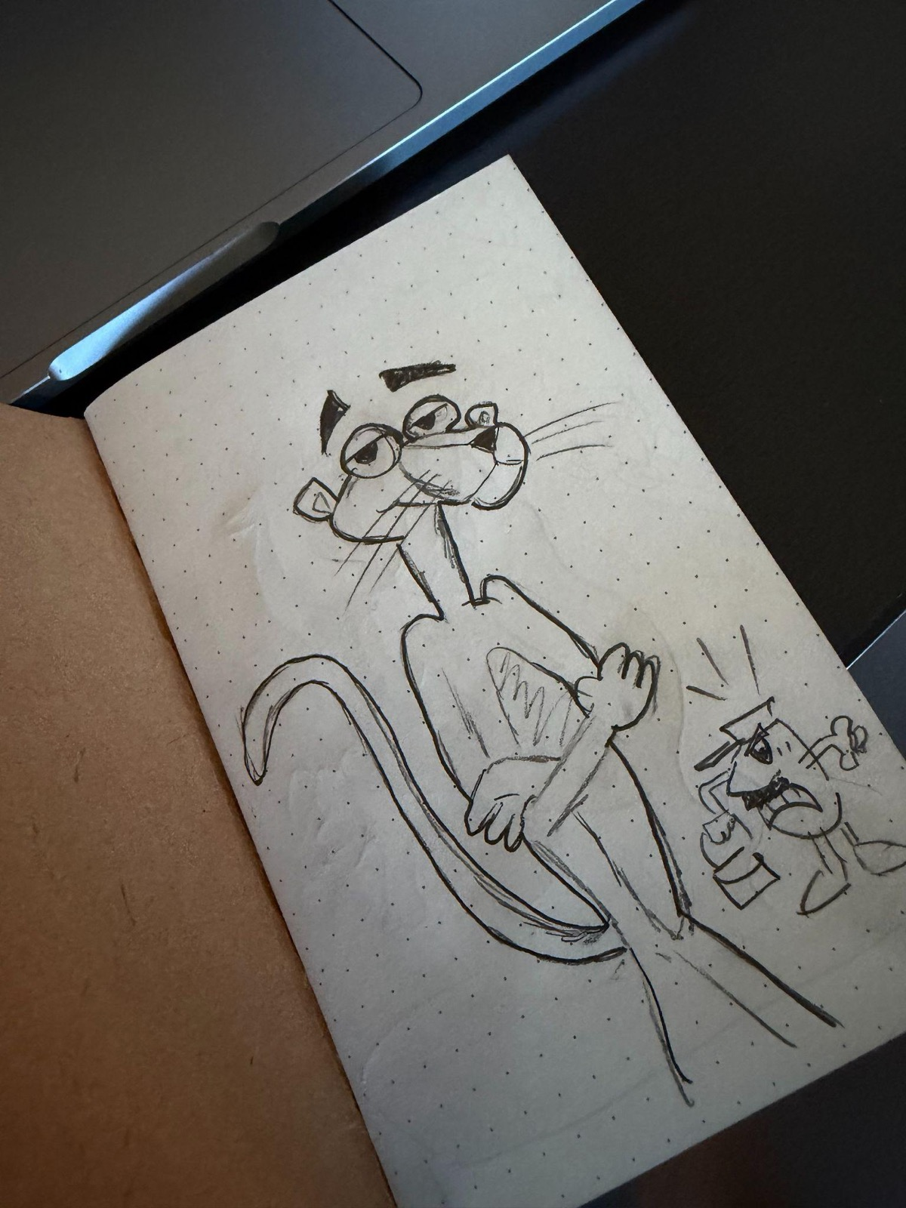
WHAT WE FOUND 1
Home
Unknown Location
“even though I think it ‘looks bad,' I liked doing it. I took in the vibe, and it was memorable.”
“this is your job, draw this to the best of your ability.”
crafting was about proving his skill as an artist
experience was rigid
crafting became about expressing himself
experience was meaningful

Slide 40
WHAT THIS MEANS
Traveling to a new location turned crafting into an adventure
Upon arriving at the new location, he explored, picked his own crafting spot for its "positive energy," and drew whatever caught his eye as it happened.
Adventure put the meaning back into the process
His first drawing felt "complete but not personally meaningful," like a job. The second one was rougher, but he called it "my own language on a piece of paper" and it's the one he'll remember, because it's tied to a real afternoon. Our solution should make the memory of making the keepsake, so the outcome never has to be "good."

Slide 41
ASSUMPTION SUPPORTED
Valid: Changing locations made crafting feel more adventurous, personal, and memorable.
Evidence: At home, he focused on doing it “to the best of [his] ability”; at the new location, he cared less about quality and more about the experience.
Implication: The environment can lower pressure and shift attention from performance to exploration.
New environments reduced pressure and made crafting feel more personal and adventurous.

Slide 42
ETHICAL IMPLICATIONS
if users are crafting @ different locations & bringing their crafting materials, it’s possible they leave trash/litter outside
our solution could remind users to clean up after themselves @ the end of a crafting session
Society
Sustainability
Persuasion
Ethical Implications
Gamify crafting by having crafters go to different locations & craft at that location
Accessibility
User
Involvement
assumes users can safely walk around where they live & pause at random, unknown locations
assumes users are physically mobile
consider a location, for example, that isn't wheelchair accessible. the experience of being navigated somewhere a wheelchair user can't access could feel exclusionary
perhaps we can adapt our solution by offering a virtual adventure experience? our solution also can take advantage of just identifying when a user "isn't" home to make the adventure more accessible
Usability
Focus
Privacy
when users add their art to a location, & eventually multiple locations, a map/track of their whereabouts is being built → what if this is exploited by a bad actor?
our solution should be considerate w/ how we store users' data. a bad actor shouldn't be able to track another user through our app. anonymization should hopefully aid w/ this
our solution should be wary of a Pokemon Go like addictiveness where users, for the thrill of the adventure, stop being aware of their surroundings
our solution can look @ what Pokemon Go did to mitigate the ethical problems they ran into & do the same
Analysis Framework from Ethical Design: What is it and why is it important for innovators?

Slide 43
HMW 2
How might we help crafters make room for creative discovery while financially sustaining themselves?
From Noah: “There’s always a financial undertone to some of this.”
Notes:
NOAH POV.

Slide 44
SOLUTION 2
Crafters offer $5 mystery boxes containing something they’ve made through creative experimentation.
Buyers embrace the surprise, giving crafters room to try new ideas beyond what customers usually expect while earning income from their explorations

Slide 45
ASSUMPTION 2
Artists will feel freer to experiment beyond what buyers expect when they can sell their creations through mystery boxes.

Slide 46
OTHER ASSUMPTIONS
Buyers would be willing to purchase art without knowing exactly what they will receive.
A low price point would make buyers more comfortable with uncertainty.
Artists would trust that experimental work still has market value.
Less buyer input would make the process feel more enjoyable.
Complete creative freedom would produce more meaningful work.
Artists could still balance personal expression with outside inspiration.
The mystery-box model could provide enough income to meaningfully support experimentation.
Our key assumption includes the solution only works if reducing buyer control actually creates more creative freedom. If artists still feel constrained by what will sell, then the mystery-box format does not solve the core tension from Noah’s POV. This tests whether the concept can preserve experimentation while still keeping a path to income.

Slide 47
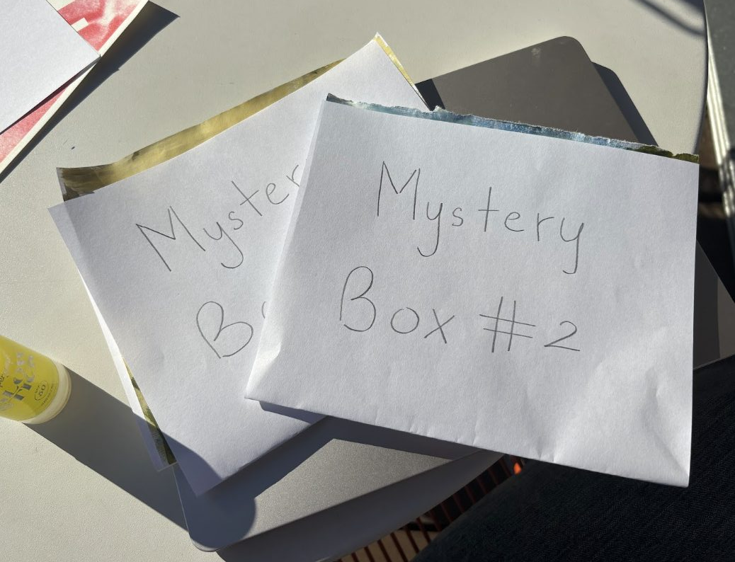
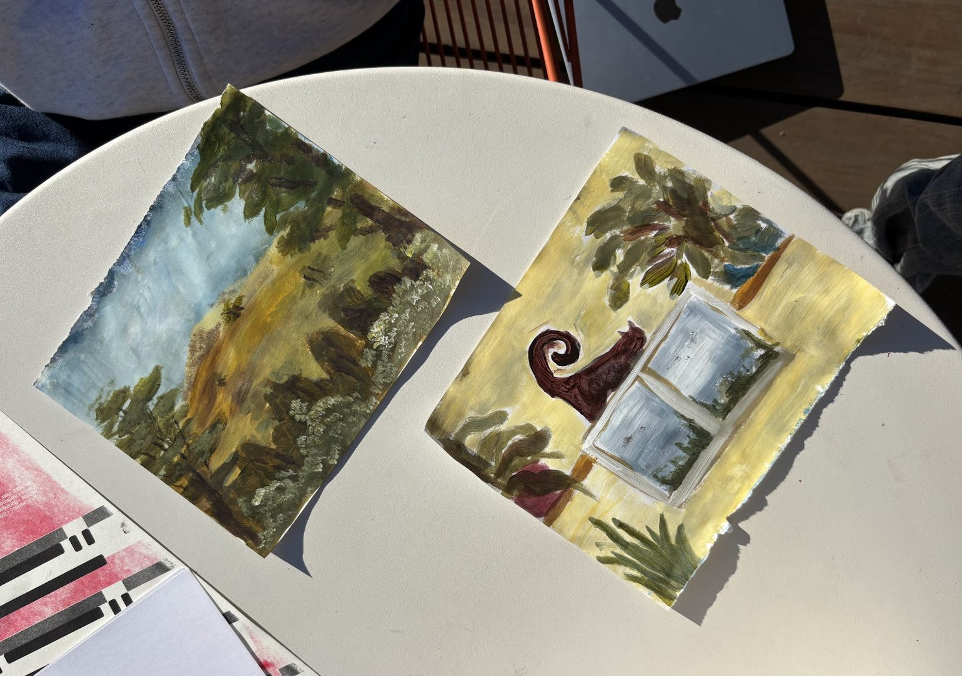
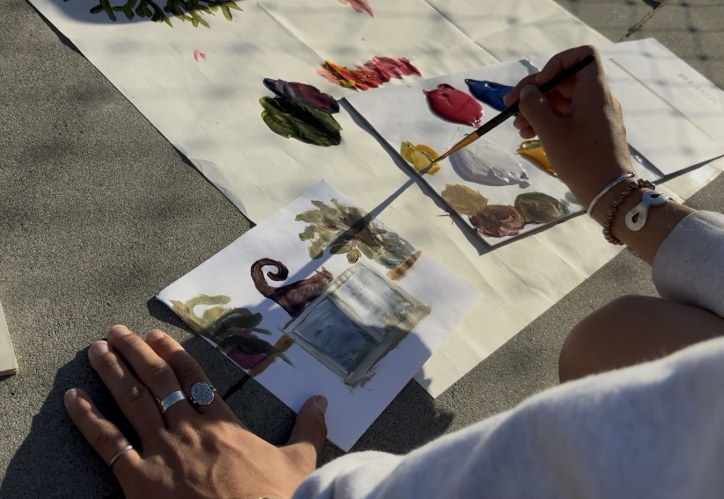
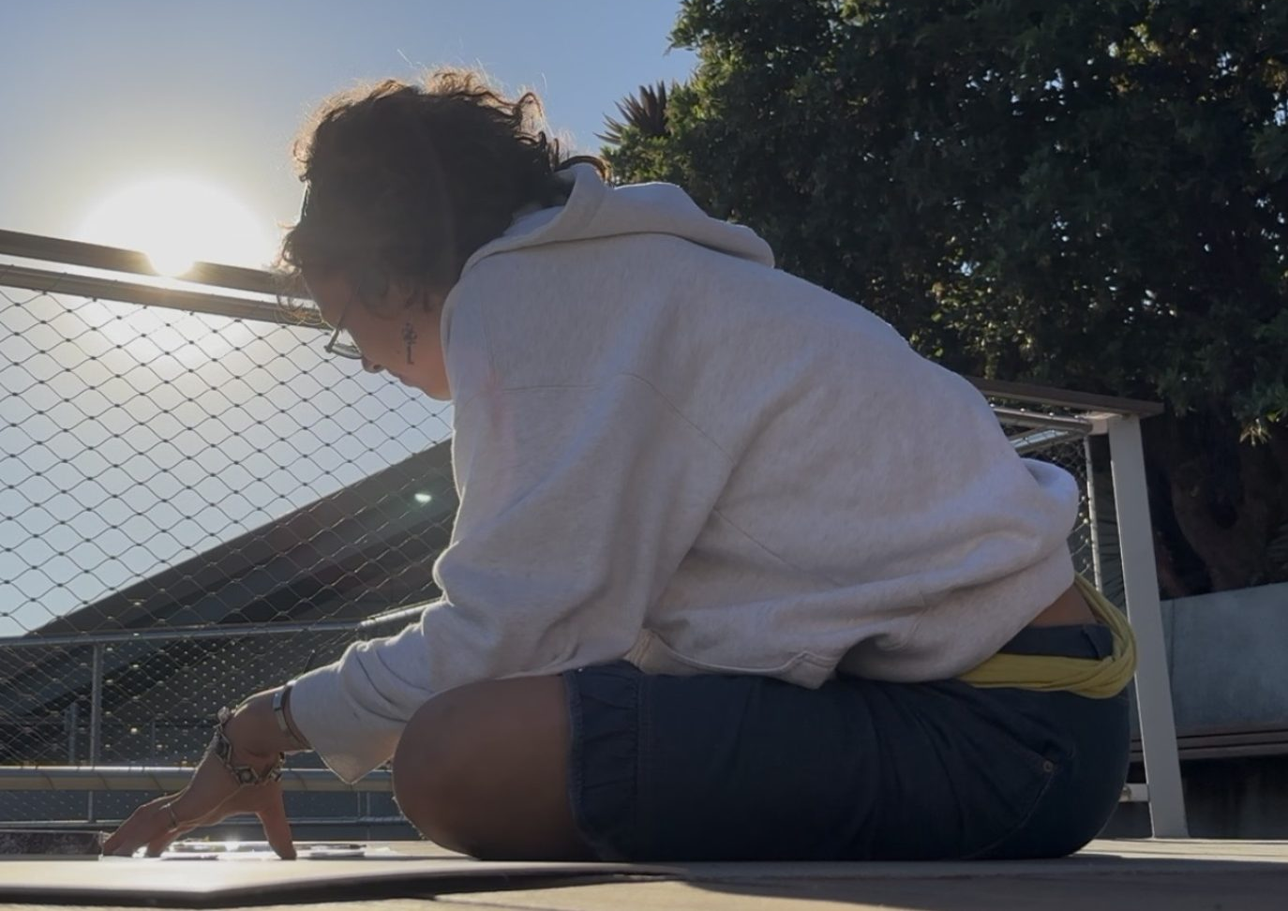
EXPERIENCE PROTOTYPE 2
Create two mystery artworks for buyers
based on a request from the recipient
“Cat by window”
without input from the recipient

Slide 48
PARTICIPANT INFO
Who: Crafter with painting experience
Why relevant: Familiar with making art and responding to creative prompts
How recruited: Existing contact / convenience recruitment
Why useful: Let us compare how the same artist creates with a buyer request vs. complete freedom

Slide 49
WHAT WE FOUND 2
Request (15min)
No input (25 min)
“There's more thought into it, so there's more of a relationship between making it, the thing, and me”
“felt like more about the action, like putting paint down”
more enjoyable since could turn off brain
made her explore a more novel subject
more meaningful since had to think harder and embed personal experiences
felt more experimative

Slide 50
WHAT THIS MEANS
Artists need a balance of personal and external inspiration.
Our solution should support dynamic creation space to draw on personal experiences, alongside outside inspiration when creating from within feels demanding. The push and pull between the two can encourage meaning, experimentation, and discovery.
Material access did not appear to be the main barrier for this participant. She wanted to make more art despite having free paint and paper available at Stanford. This suggests our solution should look beyond supplies to understand what helps her start and sustain creative practice.

Slide 51
ADDITIONAL TAKEAWAY 2
Academic pressure interrupts relaxation but friends mitigate it
“even if I'm like sitting down to make art I get this little voices that I have this essay to do versus if I'm hanging out with my friends I'm not thinking about that”
Wonder if
seeing others take a break and relax gives her permission to do the same

Slide 52
ADDITIONAL TAKEAWAY 2
Having materials nearby makes starting easier
[her girlfriend carries paint in her bag which] “reminds me that it's not that high activation energy of a thing to do [painting], which for some reason to me it is because I don't have them [paints] in my bag.”
Wonder if
making art supplies immediately available could help people begin by lowering activation barrier

Slide 53
ASSUMPTION PARTIALLY SUPPORTED
Valid: Less buyer direction did lead to more experimentation and a more personal result.
Invalid: The requested piece was actually more enjoyable/easier because the prompt reduced mental effort.
Implication: Creative freedom helps discovery, but some external direction can make starting easier.
Freedom increased meaning and experimentation, but prompts made creating easier.

Slide 54
ETHICAL IMPLICATIONS
the surprise is the hook, which is basically a loot box. buyers might keep buying for the thrill of the reveal, not bc they want the art
our solution could show what past boxes looked like & cap how many boxes one person can buy in a week
$5 is really low for handmade work. if this catches on, we could be teaching buyers that experimental art is worth less
artists should set their own price. $5 can be the entry point for small experiments, not the rule
Society
Sustainability
Persuasion
Ethical Implications
$5 mystery boxes of art crafters made through creative experimentation
buyers have zero say. what if they get something they don't like or find upsetting?
a short "no thanks" list gives buyers a little input. our prototype showed a small prompt made starting easier for the artist anyway
Accessibility
User
Involvement
Usability
Focus
Privacy
artists need an address to ship each box → strangers end up w/ each other's home addresses
our solution should handle shipping through the app so neither side sees the other's address
Analysis Framework from Ethical Design: What is it and why is it important for innovators?

Slide 55
HMW 3
How might we re-inspire crafters when they become tired of their craft?
From Lola: “This actually looks pretty good… why did I think this was terrible?”
Notes:
LOLA POV.
There’s a double edge sword of craft
The thing that makes a good crafter a good crafter can be the very thing that can kill them
So much passion and fiction can turn into tunnel vision
Making great art
And good crafters, receive praise and validation throughout their journey. And for a big part of the journey, it fuels the artist.
It only starts to hurt when you go from liking this validation to then needing it to continue. When they tie their self worth and value as an artist, to the validation from others that their art is good.

Slide 56
SOLUTION 3
An LLM that “interviews” a crafter (who they are, what they make, other crafts they've dabbled in), and build a mind map profile of all their creative ventures, so they can reflect on the craft and how it used to bring them joy.

Slide 57
ASSUMPTION 3
Rigorous reflection and introspection re-inspires crafters.

Slide 58
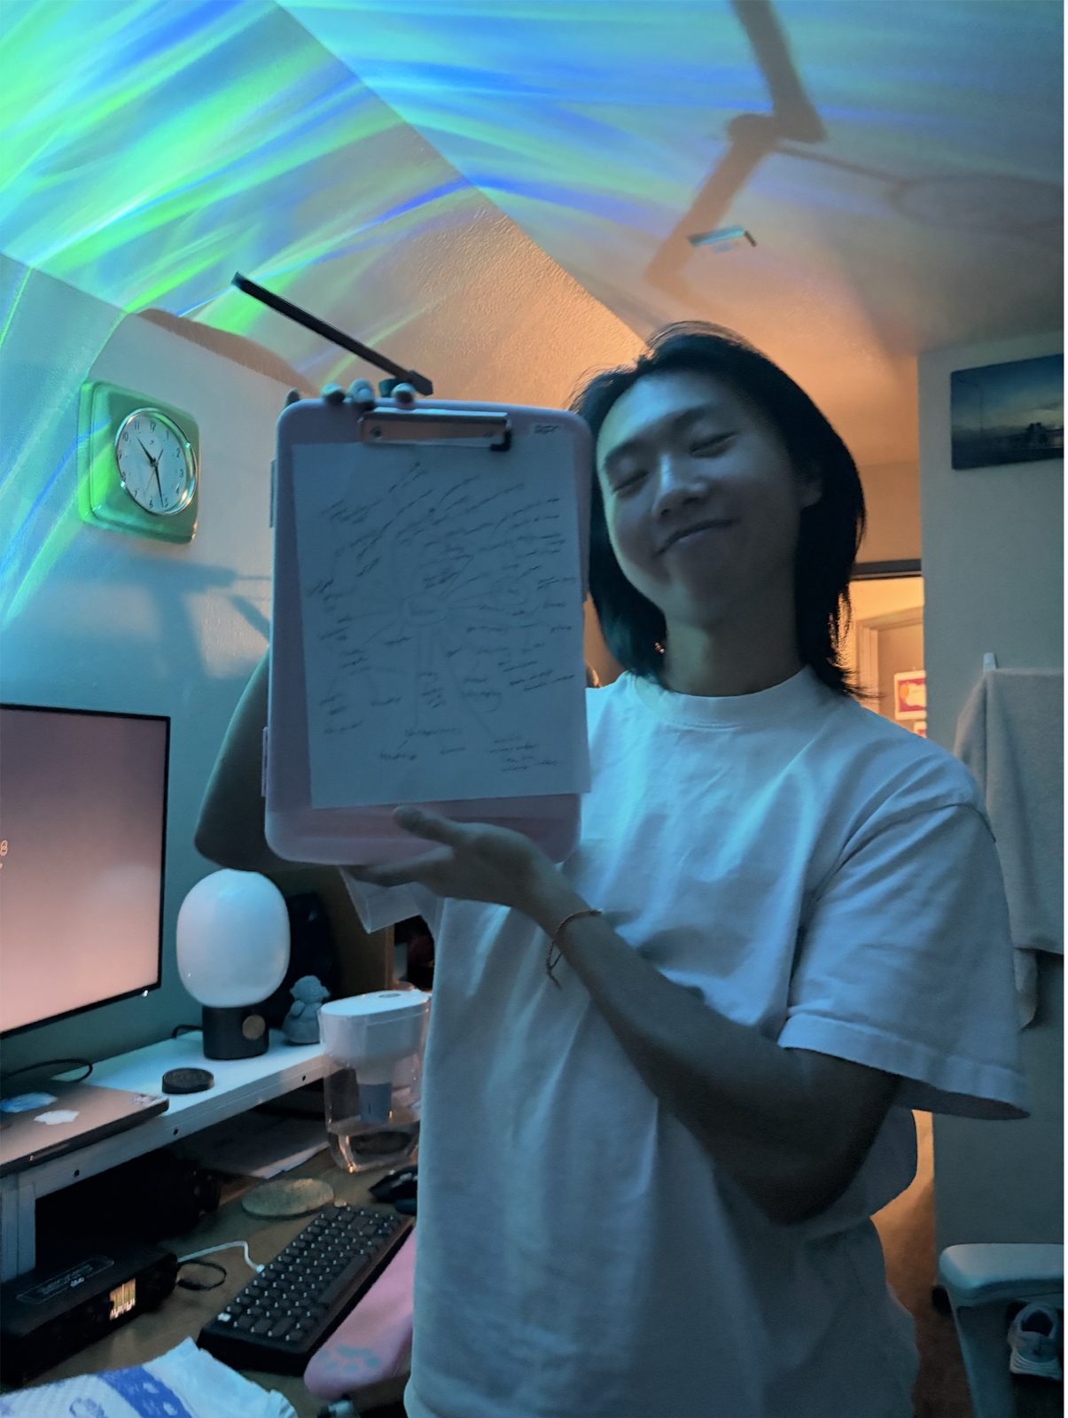
EXPERIENCE PROTOTYPE 3
Wizard of Oz: we played the LLM
Interview: ask a burnt-out filmmaker about every craft he’s ever tried
Map: build his creative mind map live as he talks
Reflect: hand him the map and ask what he’d return to
Follow up: text him days later to see if anything changed (without saying we’ll follow up)

Slide 59
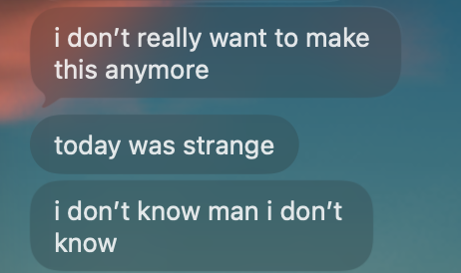
BEFORE
How Keenan Felt Going Into the Session:
"i don't really want to make this anymore"
"i'm just too affected by others' opinions"
"now i'm just tired"
His sense of self worth depends on validation from others in regards to his filmmaking

Slide 60
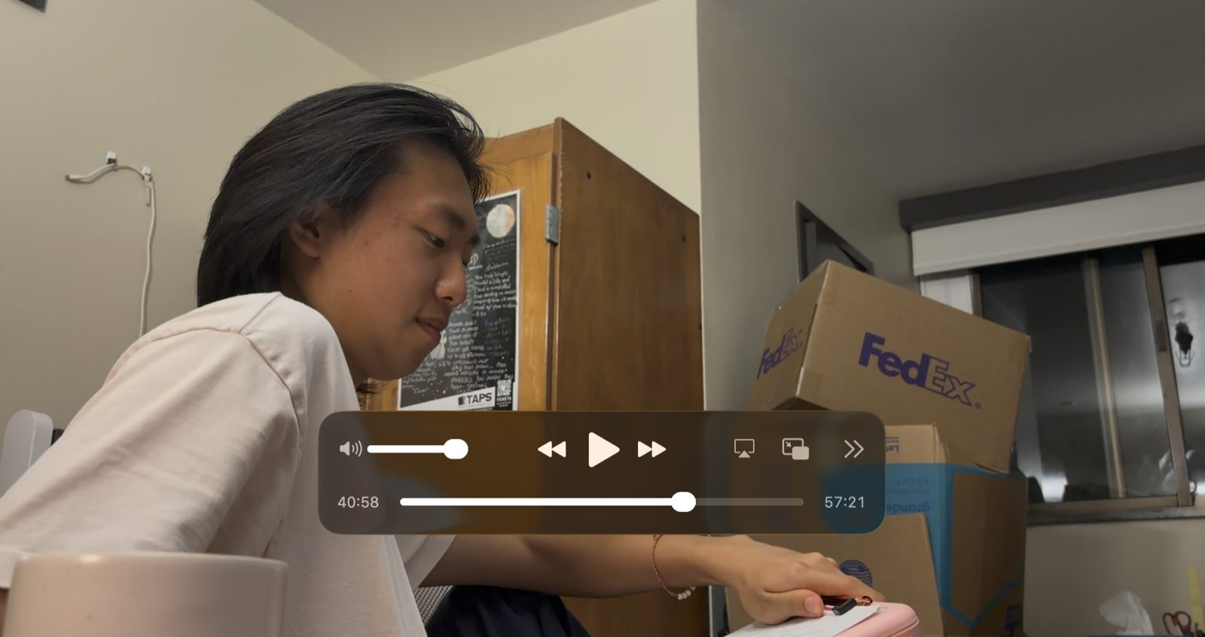
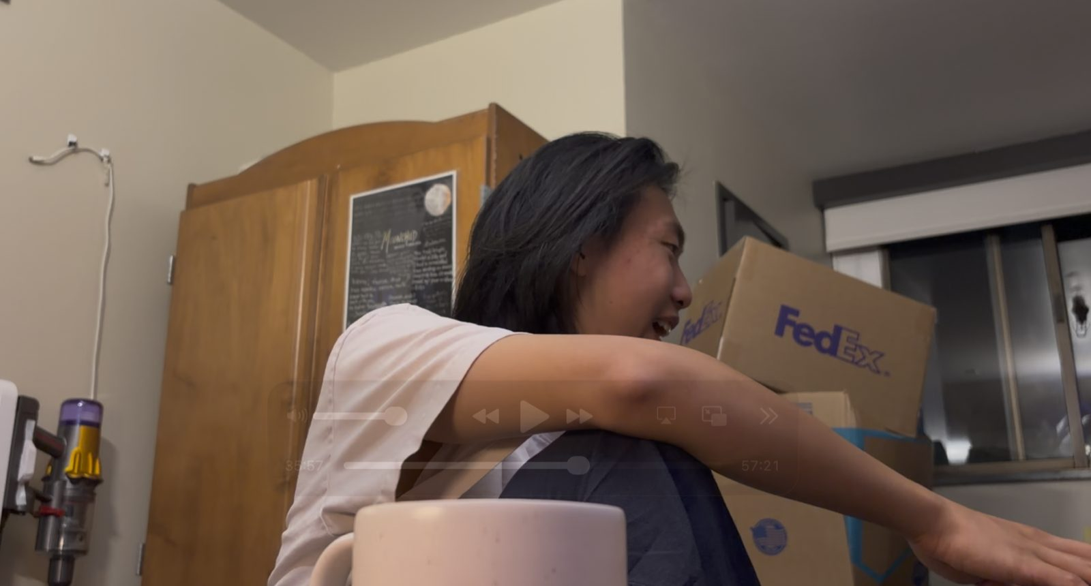
DURING
Ask: List every craft he’s ever done
Result: ““Damn, what happened to me? ...I started funneling into film”
He finds the real problem is validation, not tiredness: “Nothing I do is just for myself anymore”
He remembers crafts he’d forgotten: “I forgot I danced... I got multitudes”

Slide 61
TURNING POINT
Keenan reflected on his old crafts.
"poi [dance] was more like I want this to be good because I want it to be ******* cool"
"I just don't ******* want to think about external validation at all. I just want to make it because it's ******* cool for me."

Slide 62
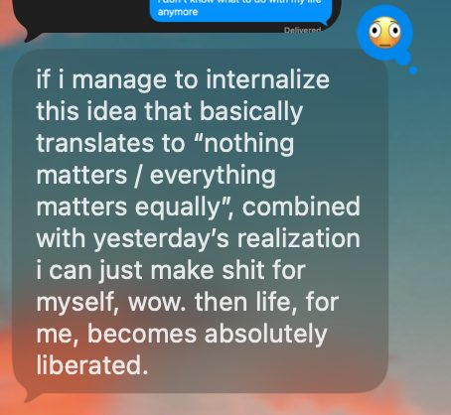
THE NEXT DAY
(surprise! completely unprompted)
“i can just make shit for myself”

Slide 63
MAIN TAKEAWAY
When we suggested a craft (“maybe try origami?”), he shut it down
“Nah... why would I do that?” “I don’t have time for that.”
But when he remembered his love for poi on his own, he lit up. It felt like his idea.
Wonder if
re-inspiration has to be discovered, not suggested: an LLM should lead crafters to their own ideas instead of handing them one.
Notes:
There’s a double edge sword of craft
The thing that makes a good crafter a good crafter can be the very thing that can kill them
So much passion and fiction can turn into tunnel vision
Making great art
And good crafters, receive praise and validation throughout their journey. And for a big part of the journey, it fuels the artist.
It only starts to hurt when you go from liking this validation to then needing it to continue. When they tie their self worth and value as an artist, to the validation from others that their art is good.

Slide 64
Why we tested "reflection re-inspires crafters"
Why we tested "reflection re-inspires crafters"
Why it's the make-or-break assumption: the whole solution rests on the interview itself doing the work. If reflecting on your creative history doesn't change how you feel, the mind map and suggestions are just a fancy list.
Where it came from: needfinding showed crafters forgetting why they started (Lola: "This actually looks pretty good... why did I think this was terrible?"). Looking back changed how she saw her own work.
Other assumptions we considered but didn't test:
  Crafters will open up honestly to an LLM. Not chosen: matters, but only if reflection works at all.
  Suggesting an old craft ("pick painting back up?") will get them to act. Not chosen as the main test, but we observed it anyway (see Main Takeaway).
  A mind map is the right way to show someone their creative profile. Not chosen: format can be iterated; the core value can't.

Slide 65
Methodology
Format: Wizard of Oz: a team member played the LLM. No app, no real AI.
Roles: Interviewer = "the LLM" (asks questions, builds the map). Participant = Keenan.
Artifacts: Hand-drawn mind map on a clipboard (built live), phone video recording, text messages for follow-up.
Environment: Keenan's own room in the evening: where he normally works on his films.
Script1) "Tell me about your current project." 2) "Take me through everything you've ever made." 3) Category by category: favorite Unity, Blender, drawing, drumming project. 4) Hand over the map: "Just look at it." 5) "When did you last make something just because you wanted to?" 6) "What would you pick back up?" 7) Text follow-up over the next few days.
How this tests the assumption: steps 2–5 are the "rigorous reflection." If the assumption holds, we should see re-inspiration during the session (new realizations, energy) and after it (a change in attitude or action days later). The follow-up is what makes it end-to-end rather than one conversation: it checks whether reflection carries over into his real life.
Why Wizard of Oz: the handout favors it, and a human "LLM" let us adapt questions live to see which kinds of prompts sparked reflection.

Slide 66
Participant
Who is Keenan, and why him?
Who: Stanford student filmmaker, making films since age 13 (first film in 2018), ~8 years in one craft. Currently directing a funded short film with a week-10 screening deadline.
Why relevant: he's in our exact target state, a crafter tired of his craft. Before the session he texted: "i don't really want to make this anymore... now i'm just tired."
Why he adds diversity / is an extreme user: our needfinding participants were hobbyists (retirees who quilt and glassblow, a makerspace manager). Keenan is the opposite end: young, his craft is tied to his career and self-worth, and he has a wide but abandoned creative history (game design, calligraphy, drums, poi, 3D printing). If reflection works for someone this deep in burnout, that's a strong signal.
How recruited: a friend who had been texting us about frustration with his film.
Familiarity caveat: he knew we were in CS 147 but not our solution or assumption. Because he's a friend, he may have been more open, and his answers may be more generous than a stranger's.

Slide 67
Results
Worked
Listing his whole history surfaced forgotten crafts: "Damn, what happened to me? ...I started funneling into film", "I forgot I danced... I got multitudes"
Suggesting a craft ("try origami") was rejected as pressure: "I'm forcing myself to do a little hobby"
Comparing film to other crafts exposed the real problem (validation): "Nothing I do is just for myself anymore"
Category-by-category listing felt like a survey: "Are you trying to make this comprehensive or like deep?"
Reflection led to his own reframe: "make it like poi... because it's cool for me"
Didn't work
Suggesting a craft ("try origami") was rejected as pressure: "I'm forcing myself to do a little hobby"
Category-by-category listing felt like a survey: "Are you trying to make this comprehensive or like deep?"
He disagreed with how we drew his map: "I wouldn't put that there"
Assumption: partly valid.
Valid: reflection did re-inspire him. He went from "don't want to make this anymore" to "life becomes absolutely liberated" the next day.
Invalid: it didn't re-inspire him toward a new or old craft, which is what the solution expects. It re-inspired him toward his current craft by changing why he makes it.
Going forward:
The LLM's job is to lead reflection, not hand out suggestions.
Ask fewer, deeper questions about how each craft felt, not a full inventory.
Let the crafter build or edit their own map.
Test with more participants and a longer follow-up (1–2 weeks) to see if behavior actually changes.

Slide 68
Could we have guessed this?
Could we have predicted this without the prototype?
No. What we expected vs. what happened:
We expected
Reflection reminds him of an old craft, he goes back to it
He's tired because he's done too much film
Re-inspiration comes from what we suggest
Effects fade after the session
What actually happened
He rejected every craft suggestion; he went back to film with a new motive
The root cause was validation, not tiredness ("every single one of these projects... I want someone else to see this and think that I'm good,")
It came from what he remembered on his own (poi)
The next day he texted, unprompted, that the realization was "absolutely liberating"
The surprise: re-inspiration can mean returning to the same craft for a different reason. Interviews alone wouldn't have shown that a suggestion backfires while a memory works.
Limits: one participant; he'd also been talking this through with friends and a book that week, so the prototype wasn't the only influence.

Slide 69
Ethics for Solution 3
when we suggested origami, he shut it down. an LLM that pushes crafts (or craft products) turns reflection into pressure
our solution should lead crafters to their own ideas instead of handing them one
reflection got heavy fast. keenan tied his films to his self-worth & brought up his therapist
the LLM shouldn't act like a therapist. it should notice when someone is struggling & point them to real support
Society
Sustainability
Persuasion
Ethical Implications
An LLM that interviews crafters & builds a mind map of all their creative ventures
keenan disagreed w/ how we drew his map ("I wouldn't put that there"). if the LLM decides what someone's history means, its putting words in their mouth
let crafters build or edit their own map
Accessibility
User
Involvement
assumes people reflect best by talking. beginners also don't have much history to reflect on
perhaps users could upload photos of old work or sketch instead of only answering questions?
Usability
Focus
Privacy
the map is a detailed profile of someone's creative life & insecurities. "nothing I do is just for myself anymore" is really personal
users should own their map & be able to delete it whenever. it shouldn't train models or go to craft brands for ads
Analysis Framework from Ethical Design: What is it and why is it important for innovators?

Slide 70
Ethics for Solution 3
Serves
Leaves Out
People uncomfortable sharing personal history with AI
Crafters without much past variety to reflect on (beginners)
People who reflect better nonverbally or by making than by talking
Anyone without access to the tool
Crafters with a long creative history who've lost motivation, especially people whose craft is tied to identity or career

Slide 71
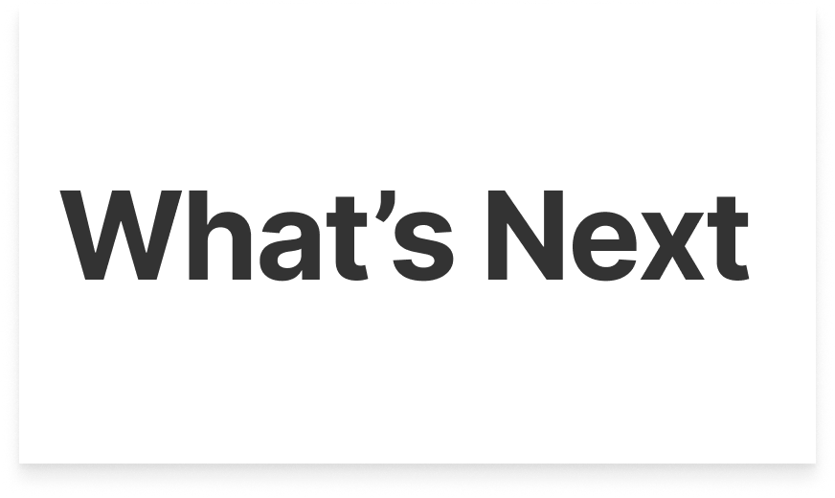

Slide 72
COMBINED TAKEAWAYS
Creating outdoors eases perfectionism
Being with or seeing other create gives permission to pause
Nearby supplies make spontaneous starts easier
Prompts offer direction; personal experiences offer meaning
Being initial about making for yourself rekindles joy beyond external validation

Slide 73
COMBINED TAKEAWAYS (LONG)
Creating while outdoors can ease the pressure to make something perfect
Seeing others create art can give permission to take a break
Having supplies close at hand lowers the effort of starting especially in moments of spontaneity and exploration
Artists benefit from both prompts that help them start and freedom to draw on personal experiences
Crafters need opportunities to reconnect with the joy of making for themselves, without seeking external validation

Slide 74
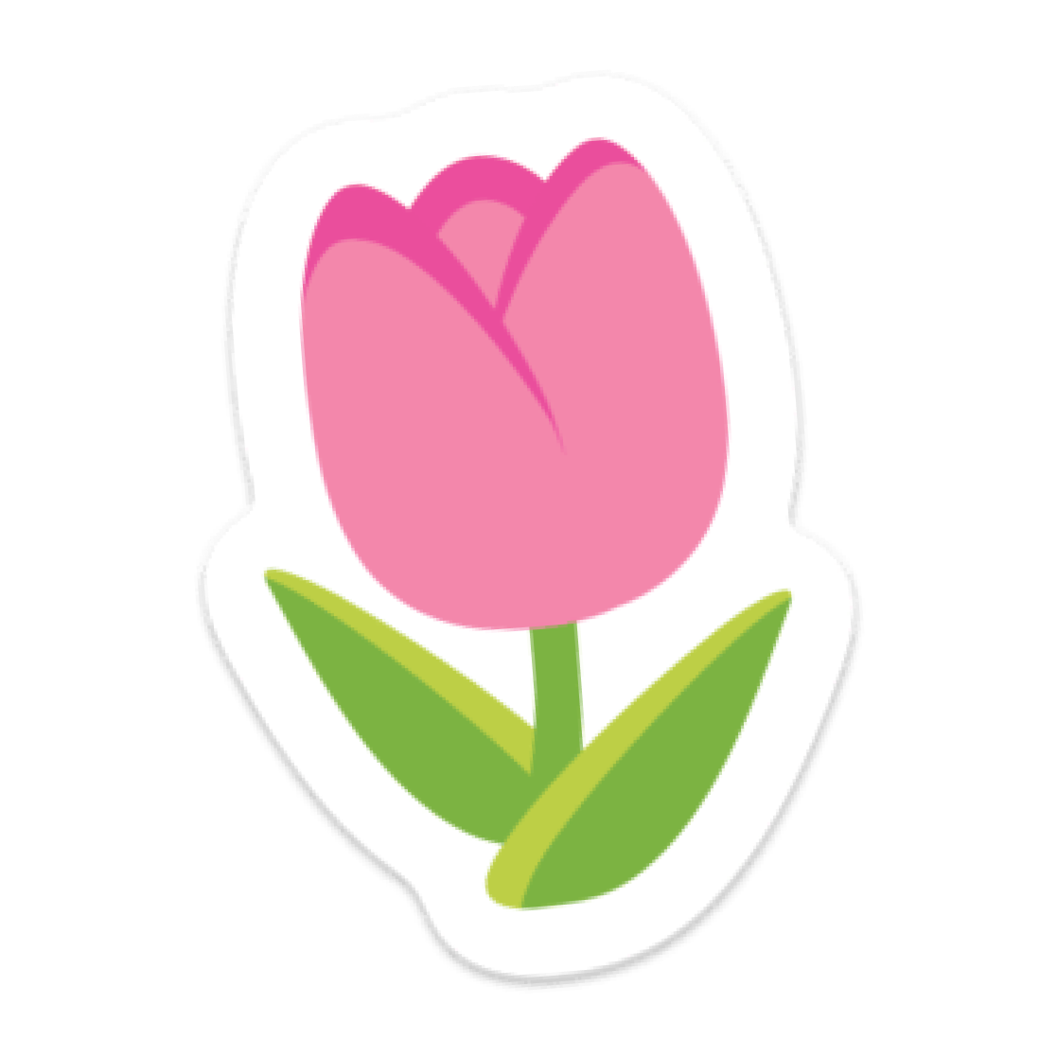
SOLUTION
A phone case with built-in paints and a brush, paired with a companion app make it easy to take creative breaks outdoors. Discover places where others have made art, follow a prompt or create freely, and share anonymously.
Create ephemeral art on seed paper, plant your work, and build a personal map of the places that inspire you, reconnecting with the joy of making for yourself without the pressure of a “good” artistic outcome

Slide 75
SOLUTION (Narrative)
On a walk, you’re notified when you pass a place where others have made art. Their anonymous creations inspire you to pause.
Pull paints and a brush from your phone case. Use a prompt or draw from your surroundings and memories, an easy break to try something new, without pressure to make it perfect.
Share anonymously, plant your seed paper, and save the location. Over time, your personal map shows how different places inspire your art and reminds you of the joy of creating for yourself.

Slide 76
SOLUTION (Long version)
You’re out for a walk and get a notification as you pass a place where others have created lots of art. You explore their anonymous artworks on a heat map. Seeing others take a moment to create encourages you to pause, too.
With paints and a brush tucked into your phone case, starting takes little effort—even if crafting isn’t part of your routine. You take out a piece of seed paper.
Ask for a prompt if you want help getting started, or draw from your surroundings and personal memories. Outside your usual workspace, you have room to play without needing to make something perfect. Even if painting isn’t your main craft, it offers a break to try something new and engage a different part of your creativity.
When you’re done, you can share a photo anonymously, then plant the paper and save its location. Your personal map lets you revisit the places you’ve planted your work and see how different environments inspire you.
Each piece becomes a connection between you and a place a reminder of the pleasure of making for yourself.

Slide 77
WHY
Creating while outdoors can ease the pressure to make something perfect and seeing others create art can give permission to take a break
You’re out for a walk and get notified when you pass a place where others have created a lot of art in this area.
You pull paints and a brush from your phone case and take out a piece of paper that has flower seeds embedded into it.
Ask for a prompt if you need a starting point, or paint whatever catches your attention.
When you’re done, you can add a photo of your artwork anonymously to the map. Then plant the paper and let what you made grow so you don’t overly focus on the end result .
Having supplies close at hand lowers the effort of starting especially in moments of spontaneity and exploration
Artists benefit from both prompts that help them start and freedom to draw on personal experiences
Crafters need opportunities to reconnect with the joy of making for themselves, without seeking external validation

Slide 78
ETHICAL IMPLICATIONS
seed paper planted anywhere could spread non-native plants, & paint can wash into the soil
our solution could use native seeds & non-toxic paint, & flag spots where planting isn't allowed
the heat map pulls people to the same popular spots → crowding small parks or someone's front yard
our solution should keep pins off private property & spread suggestions out
Society
Sustainability
Persuasion
Ethical Implications
A phone case w/ built-in paints + an app to make & plant seed paper art outdoors
Accessibility
User
Involvement
assumes users go on walks & have outdoor space nearby
the case still works on a balcony or by a window. the map shouldn't be the only way in
Usability
Focus
Privacy
the heat map & personal map show where people make art. even anonymous posts can be traced back by place & time
blur pins to a general area & delay when posts show up so no one can tell who was just there
the concept is about unplugging, but a phone notification interrupts the walk
notifications should be opt-in, or users just check the map when they want to
Analysis Framework from Ethical Design: What is it and why is it important for innovators?

Slide 79
ETHICAL IMPLICATIONS
Location Privacy — the app maps where people make art, and a map of meaningful places is sensitive data. Anonymous posts can still be traced back by place and time.
Focus — the concept is about unplugging, yet one of the mechanics is a phone notification interrupting an unplugged moment (e.g. a walk).

Slide 80
COMMUNITY CONSIDERATIONS
Serves
Leaves Out
Limited outdoor access
Privacy-conscious users
Tool-heavy crafts
Busy creatives
Returning crafters
Outdoor makers
Notes:
SERVES:
Busy or burned-out creatives
Casual / returning crafters
People who enjoy outdoor exploration
People who benefit from low-pressure prompts
LEAVES OUT:
People with limited mobility or outdoor access
People without smartphones
People uncomfortable with location sharing
Crafters whose materials aren’t portable

Slide 81
APPENDIX

Slide 82
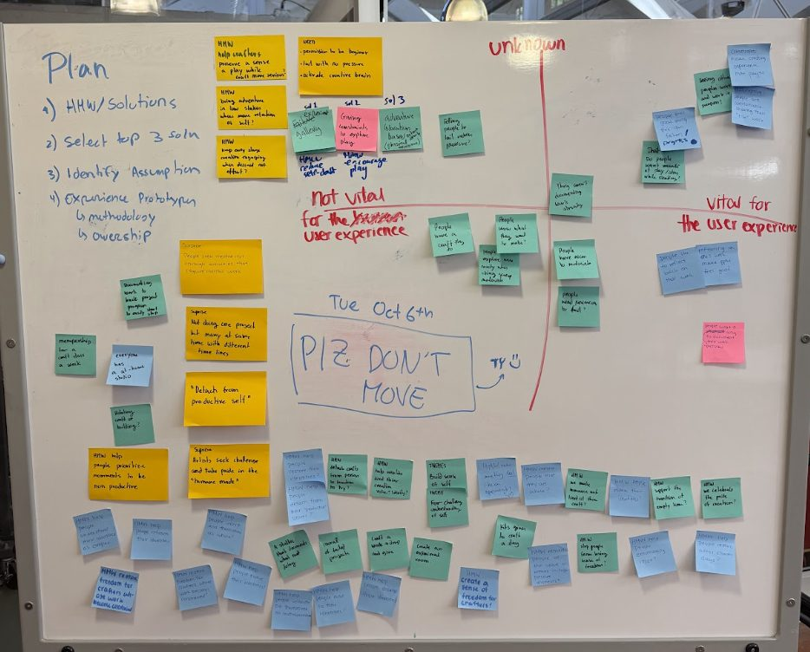
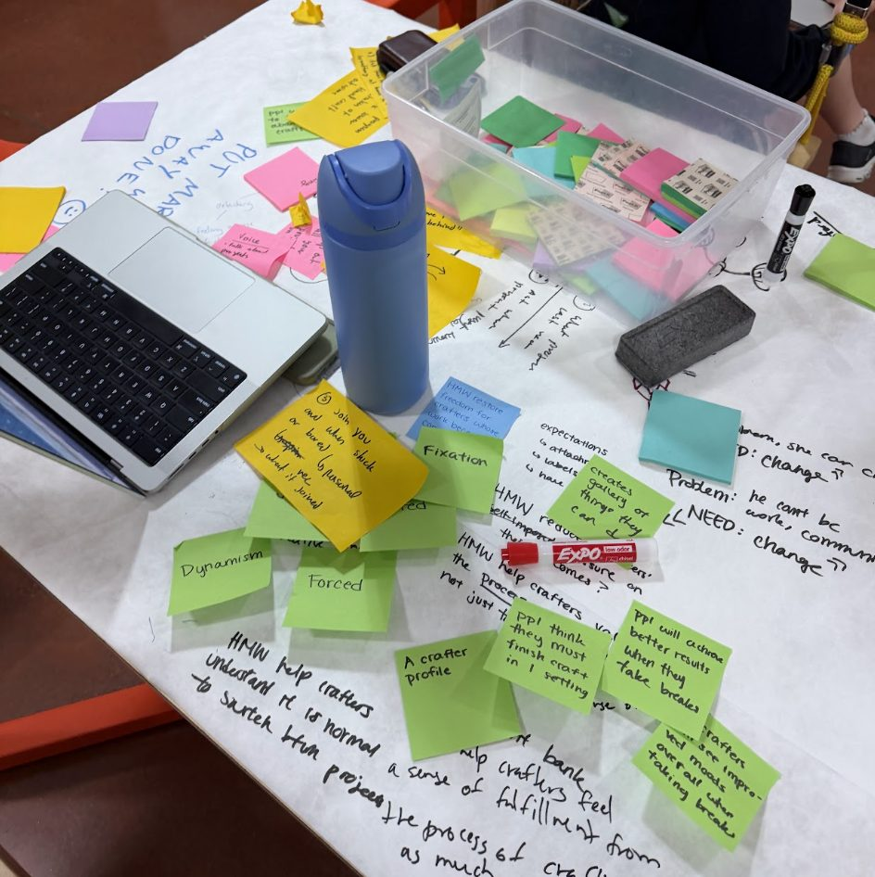
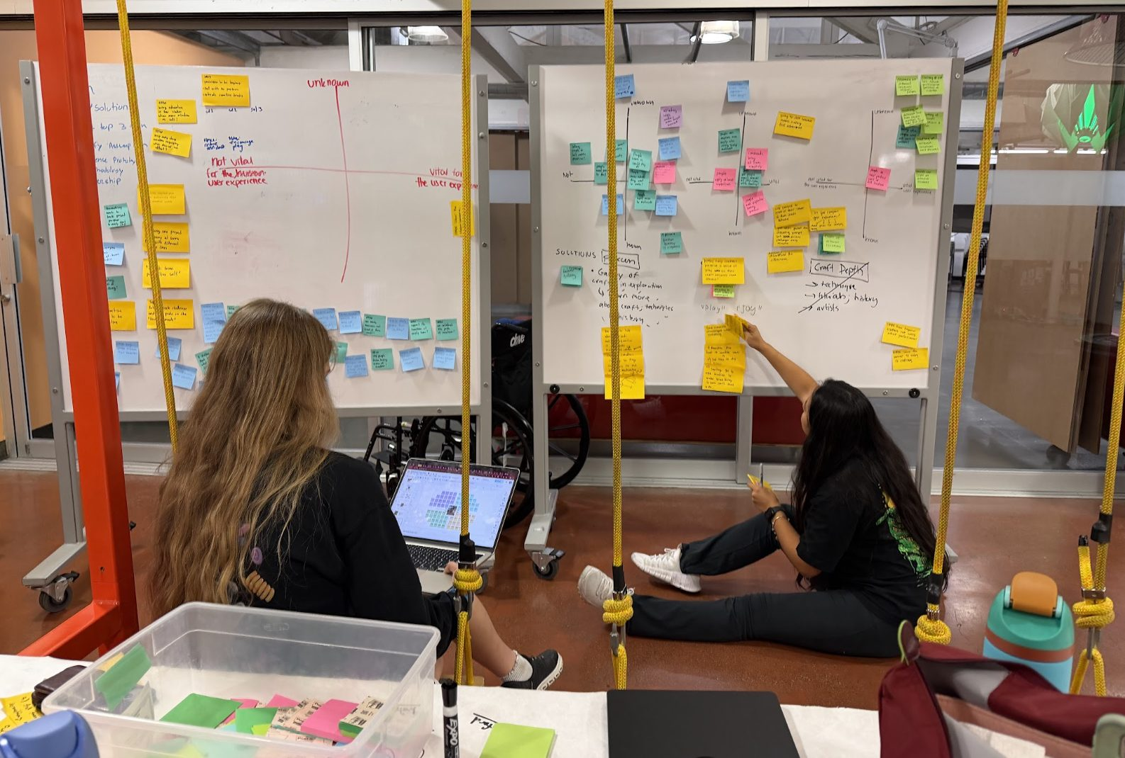

Slide 83
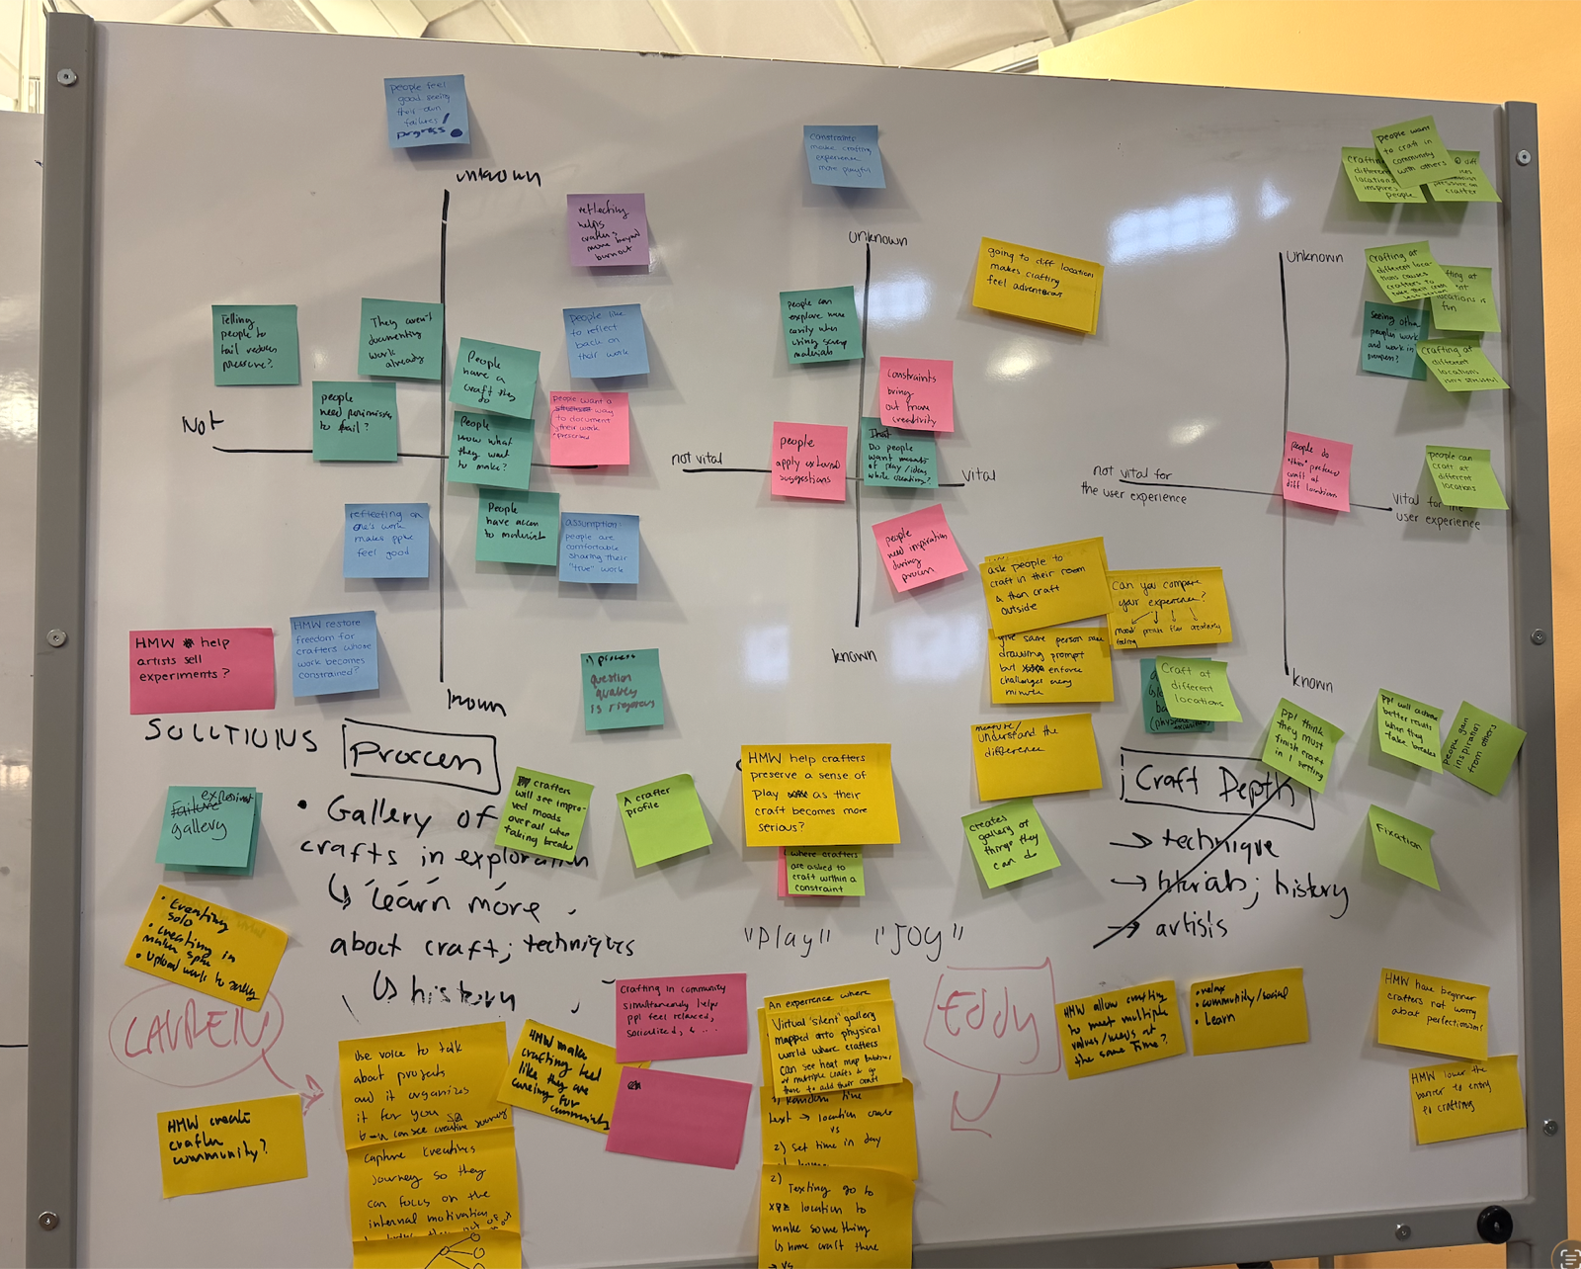


Slide 84



Slide 85




Slide 86




Slide 87



