Slide 1
Meaning from Craft

Slide 2


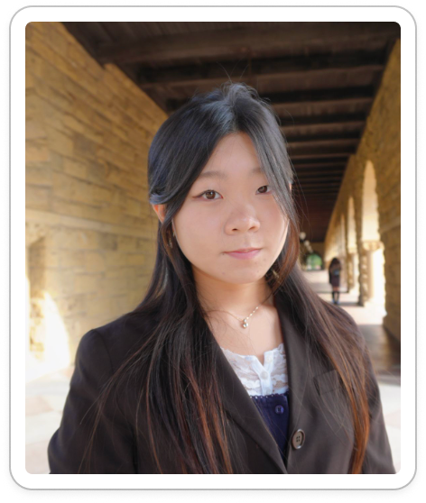

OUR TEAM
Ahyan
BS CS
Elsa
BS Design
MS HCI
Jia
BS Design
MS HCI
Kelly
BS HCI
MS AI

Slide 3
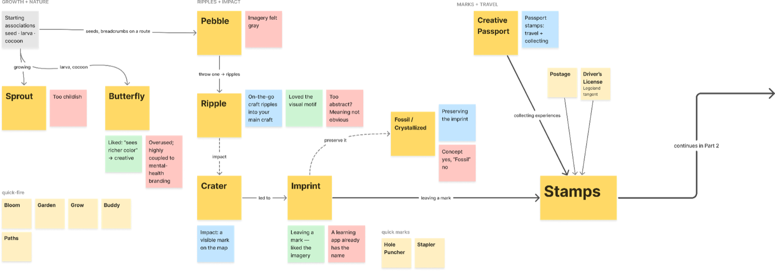
Name Brainstorm
Notes:
Sort and curate historical artworks to
Create social group to do art groups together

Slide 4
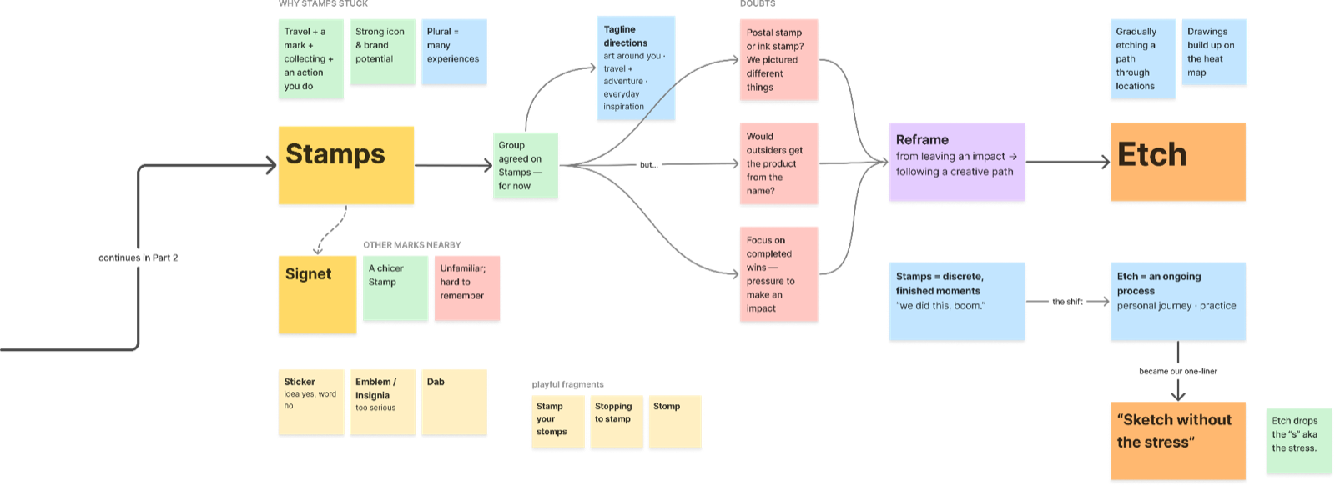
Name Brainstorm
Notes:
Sort and curate historical artworks to
Create social group to do art groups together

Slide 5
etch
Sketch Without The Stress
We chose our project name to showcase intentionality in the process of creating

Slide 6
VALUE PROPOSITION
Make creativity an adventure again with a low-pressure way to experiment and play, without expectations of polished work or a finished result

Slide 7
The Problem
& Our Solution

Slide 8
Problem/Solution/Primary User
Creative people whose craft has become tied to work or expectations often struggle to make room for experimentation and play. Our phone case with built-in sketch tools and a companion app makes outdoor creative breaks easy: seeing others’ art nearby encourages users to pause, create without pressure, and revisit their discoveries for inspiration in their main craft

Slide 9
Problem/Solution/Primary User
Creative people whose craft has become tied to work or expectations often struggle to make room for experimentation and play. Our phone case with built-in sketch tools and a companion app makes outdoor creative breaks easy: seeing others’ art nearby encourages users to pause, create without pressure, and revisit their discoveries for inspiration in their main craft

Slide 10
Problem
Creative people can struggle to make time for creating just for themselves. When making becomes tied to work, expectations, or proving their ability, even a creative break can feel like another task. They need an easy starting point and room to experiment, enjoy the process, and remember what they love about making

Slide 11
Solution
A phone case with built-in paints and a brush, paired with a companion app make it easy to take creative breaks outdoors. Discover places where others have made art, follow a prompt or create freely, and share anonymously.
Create ephemeral art on seed paper, plant your work, and build a personal map of the places that inspire you, reconnecting with the joy of making for yourself without the pressure of a “good” artistic outcome

Slide 12
Solution
User Journey
Creating while outdoors can ease the pressure to make something perfect and seeing others create art can give permission to take a break
You’re out for a walk and get notified when you pass a place where others have created a lot of art in this area.
You pull paints and a brush from your phone case and take out a piece of paper that has flower seeds embedded into it.
Ask for a prompt if you need a starting point, or paint whatever catches your attention.
When you’re done, you can add a photo of your artwork anonymously to the map. Then plant the paper and let what you made grow so you don’t overly focus on the end result .
Having supplies close at hand lowers the effort of starting especially in moments of spontaneity and exploration
Artists benefit from both prompts that help them start and freedom to draw on personal experiences
Crafters need opportunities to reconnect with the joy of making for themselves, without seeking external validation

Slide 13
Market research

Slide 14

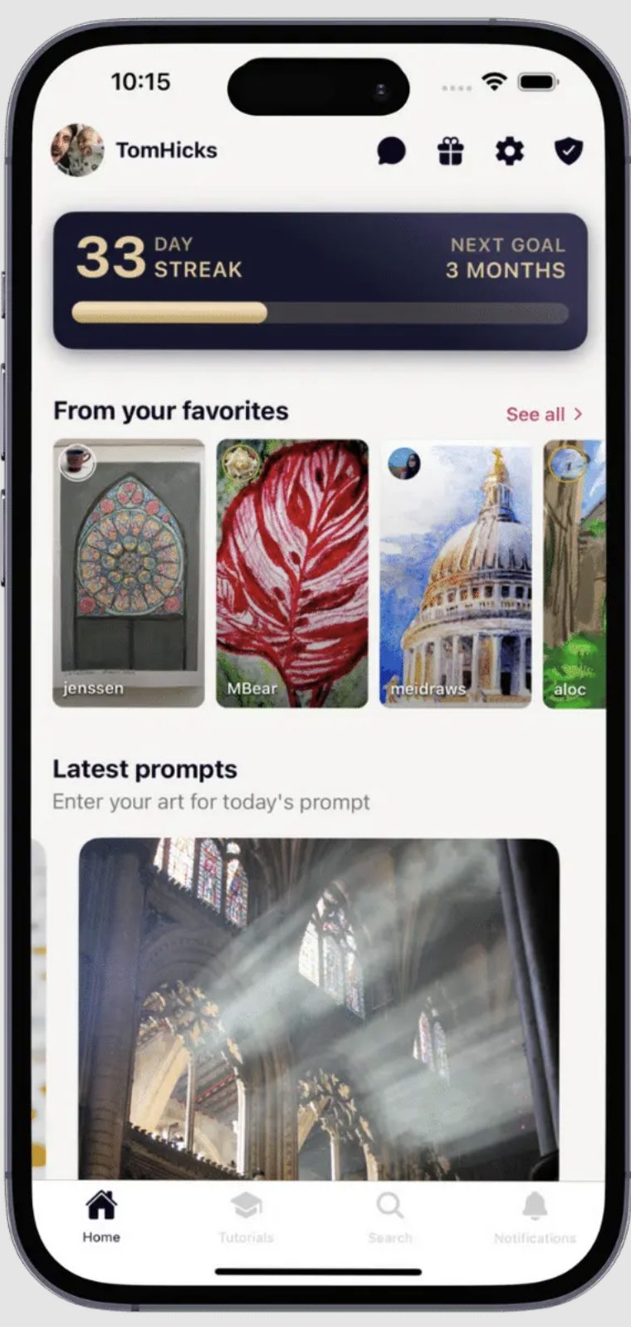
Sketch a Day
Daily drawing prompts and a community for sharing art
What works →
What falls short →
Daily prompts help with
“What should I draw?”
Different takes on a prompt spark ideas
A welcoming community makes starting easier
Likes and comparisons may bring back pressure
Streaks may turn a break into another obligation
The core experience isn’t tied to outdoor places

Slide 15
Sketch a Day
Daily drawing prompts and a community for sharing art
What we can take away →
Offer optional prompts when people need a starting point
Let people create freely and share anonymously, without likes or streaks
Help people discover art spots, add their own, and return over time
Build a personal record of moments that can inspire fashion, crafts, and other creative work

Slide 16
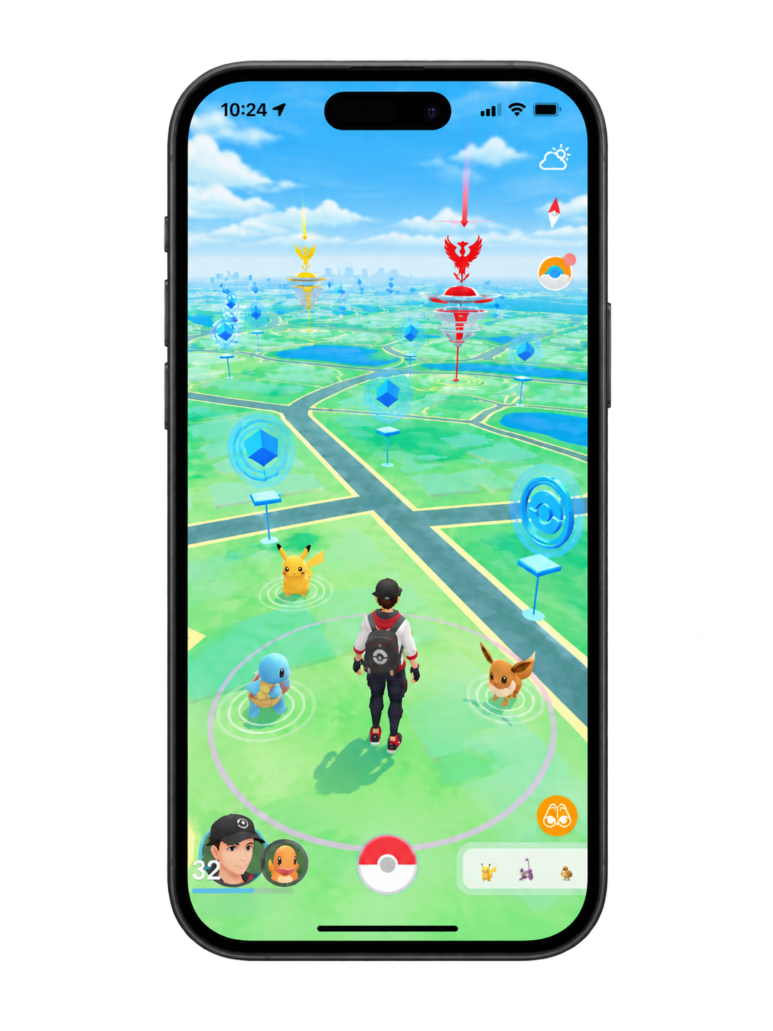

Pokémon Go
Location-based exploration through gamification
What works →
What falls short →
Turns ordinary locations into destinations
Rewards and collectibles motivate exploration
Community-created Routes encourage discovery
Rewards may shift focus toward achievement over experience
Engagement can fade as novelty wears off
Location tracking raises privacy and safety concerns

Slide 17
Pokémon Go
Location-based exploration through gamification
What we can take away →
Turn everyday locations into opportunities for creative discovery
Borrow playful exploration without competitive rewards or rankings
Let users unlock anonymous artwork by creating their own
Prioritize personal meaning, privacy, and different location vibes

Slide 18

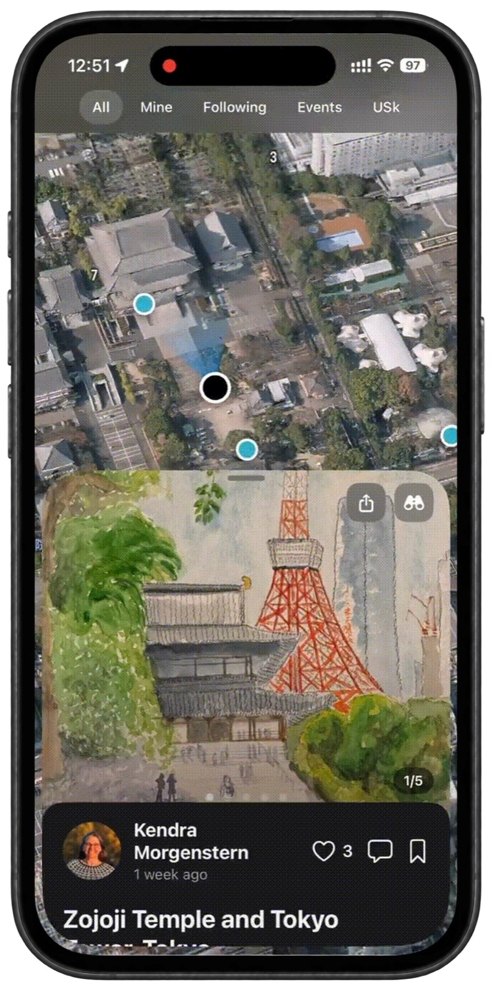
Sktchr
A field companion app for urban sketchers
What works →
What falls short →
Community map shows how others drew at the same spot
Personal archive keeps sketches by place and time
Cold start: map feels empty wherever few sketchers are active
Built for planned outings, not a spontaneous few minutes
Centered on finished, polished sketches more than low-stakes play
Planning tools for lighting, crowds, weather, & accessibility help
artists pick when/where to go

Slide 19
Sktchr
A field companion app for urban sketchers
What we can take away →
Keep a personal record of art and the places it was made
Seed the map with local art community so it isn’t empty on day one
Show nearby art as an invitation to pause, not a gallery to measure up to

Slide 20

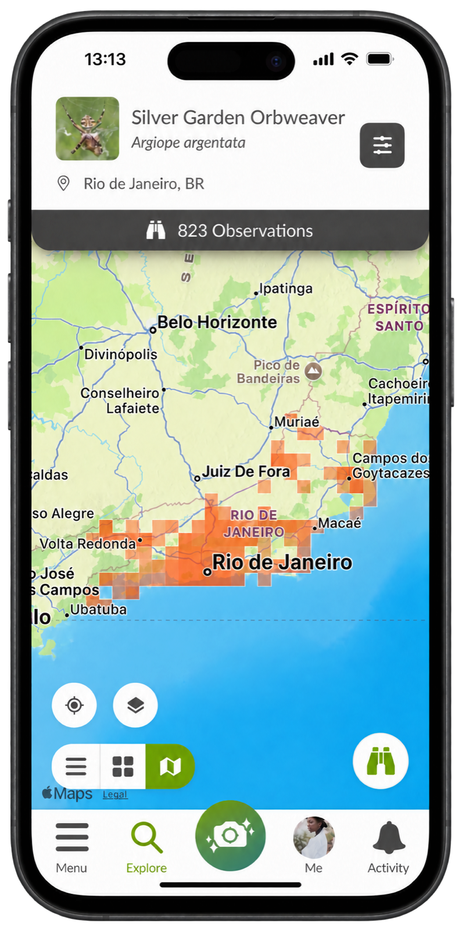
iNaturalist
Record wildlife you find and identify it with a community
What works →
What falls short →
Gives people a reason to stop and notice the ordinary
You can post without knowing what you found → super low barrier to participate and enjoy
Tension in values: one of nature’s meanings is to be basked in (without screens), but this app implicitly asks users to insert their devices into that process

Slide 21
iNaturalist
Record wildlife you find and identify it with a community
What we can take away →
Let people create and share without needing to get anything “right”
Incentivize users to get off the app and into their craft as soon as they’ve received what they need from the experience we are building for them (inspiration)
Design so that users don’t get stuck on their phones by scrolling through all the other art (i.e. rigorously consider how to not fall into addictive design)

Slide 22
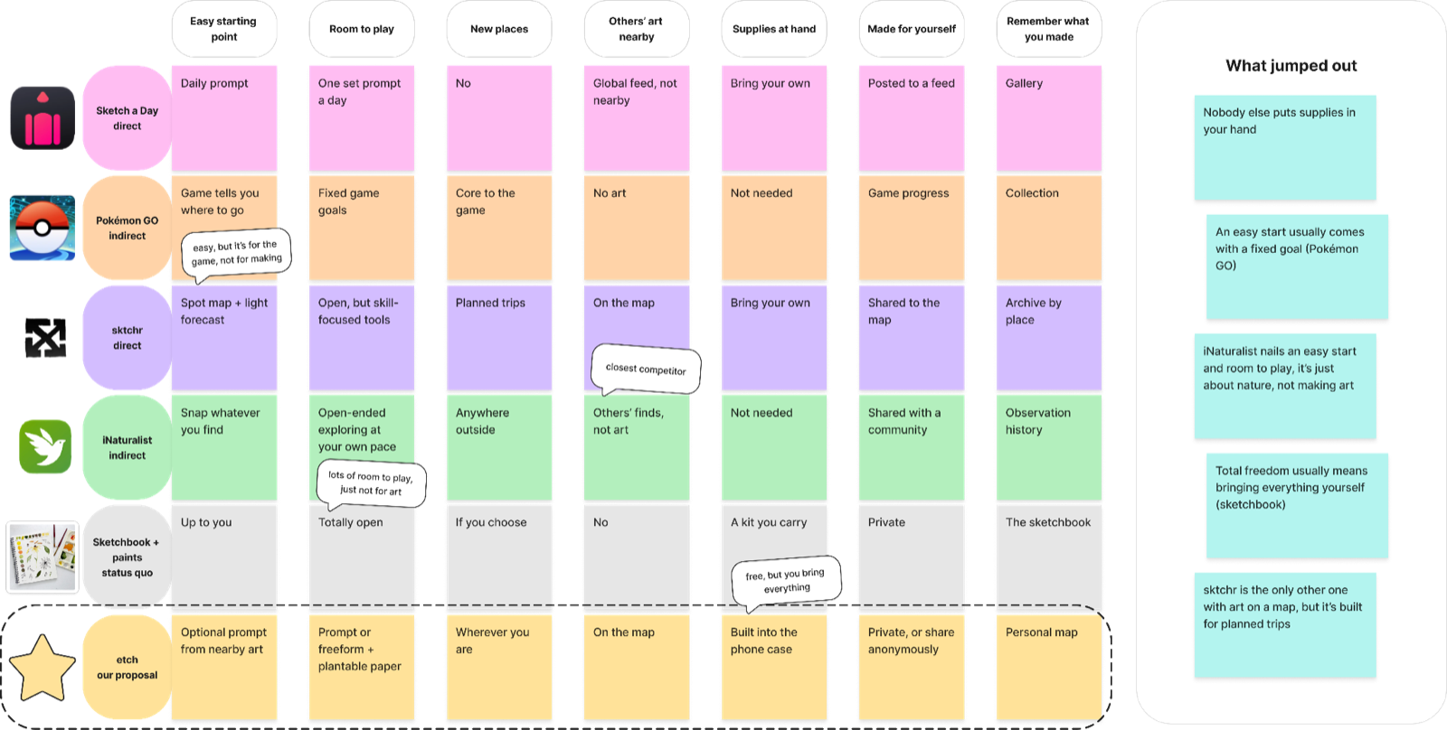
Feature Comparison

Slide 23
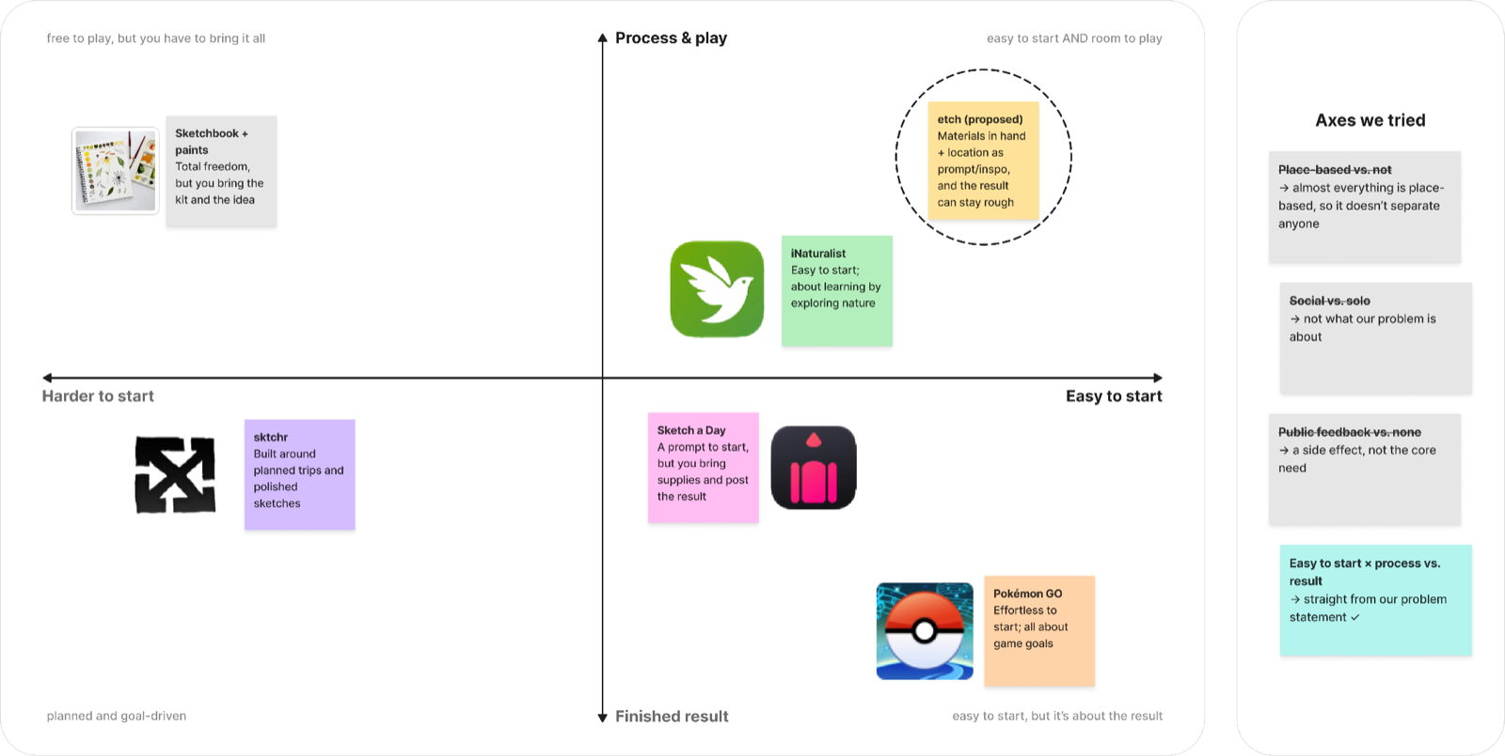
Where etch fits

Slide 24
Design Values

Slide 25
DIRECT STAKEHOLDERS
Beginners: Exploring art without pressure
Casual crafters: Seeking inspiration and creative breaks
Experienced artists: Finding new creative perspectives
Returning crafters: Reconnecting with abandoned hobbies
Art contributors: Sharing their creations to inspire other users

Slide 26
INDIRECT STAKEHOLDERS
Businesses: May gain foot traffic
Bystanders: May appear in shared artwork
Local residents: Affected by increased visitors
Environment: Affected by foot traffic or art waste
Property owners: Affected by activity at featured locations

Slide 27
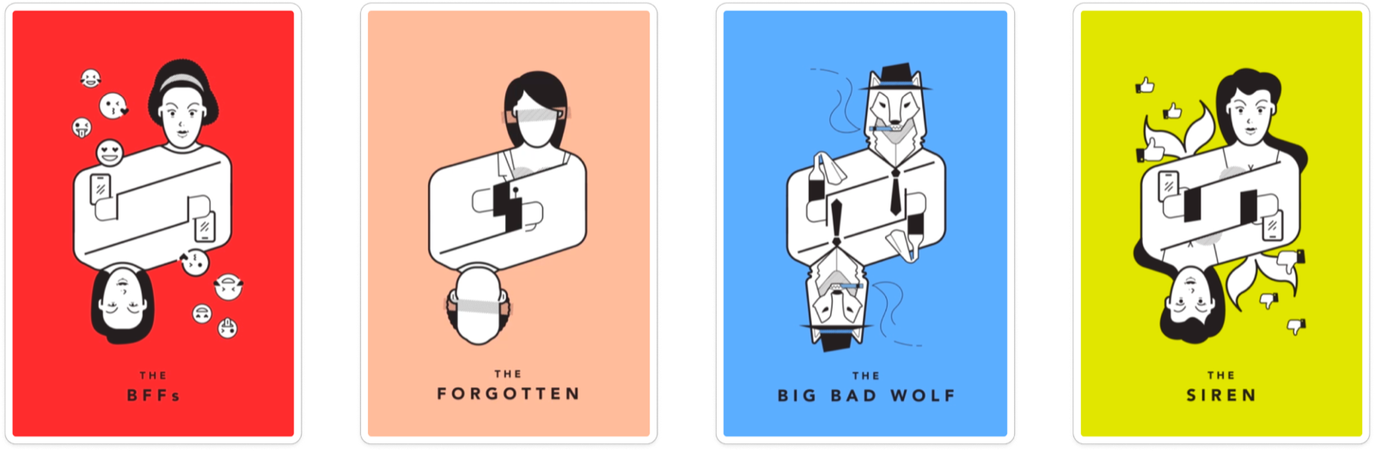
TAROT CARD ANALYSIS

Slide 28
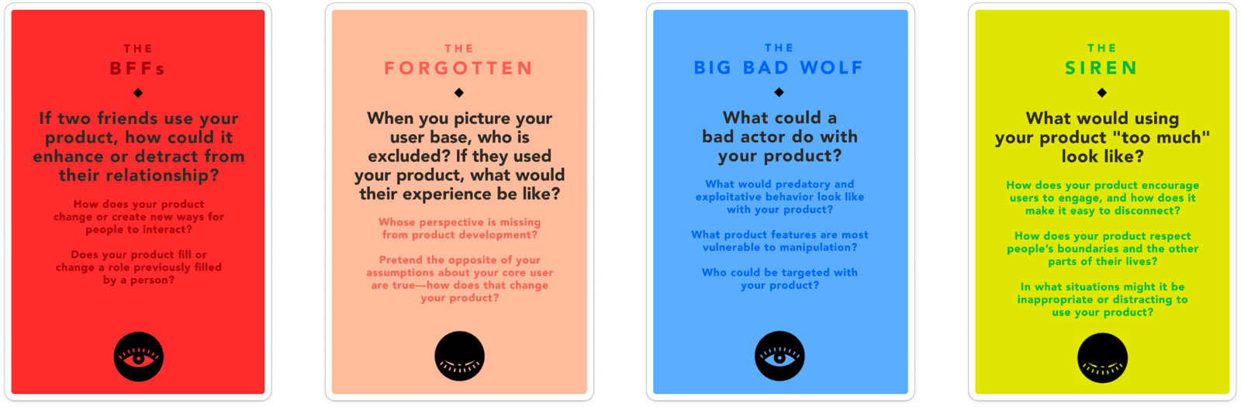
TAROT CARD ANALYSIS

Slide 29
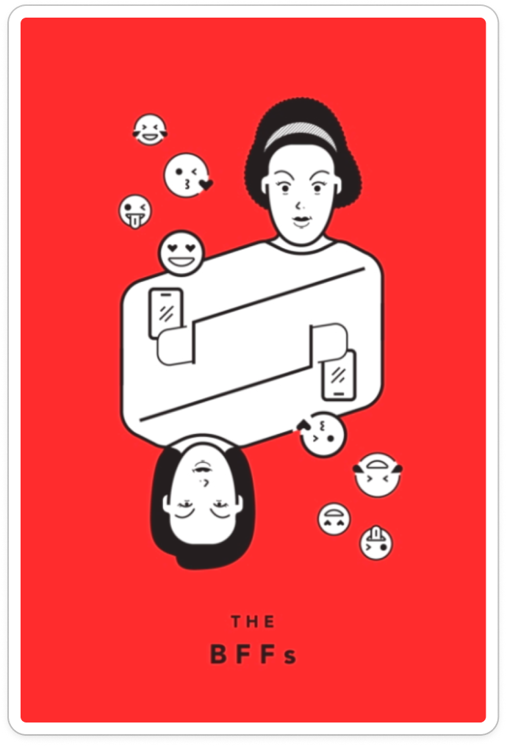
How does our app affect friendships?
Ethical Implications
Friends' artwork may create comparison pressure.
Anonymity limits connections between artists.
Design Responses
No likes, comments, or rankings.
Optional anonymous collaboration.
Value Tension: Community vs. freedom

Slide 30
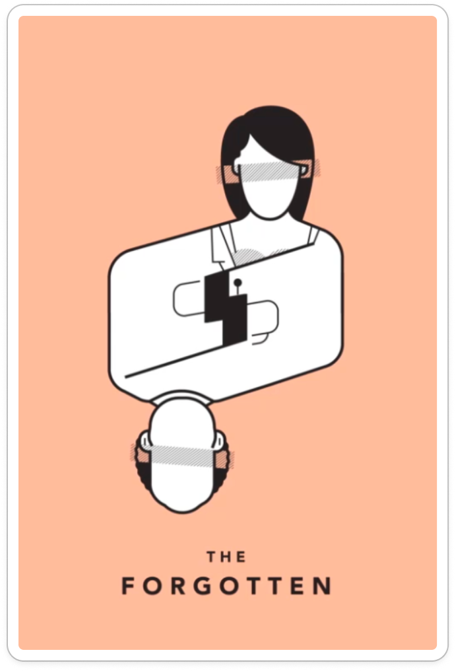
Who might our app exclude?
Ethical Implications
Users with mobility limitations may struggle to reach locations.
Beginners may feel uncomfortable creating art in public.
Design Responses
Recommend accessible, nearby locations.
Allow users to create privately after visiting.
Value Tension: Adventure vs. accessibility

Slide 31
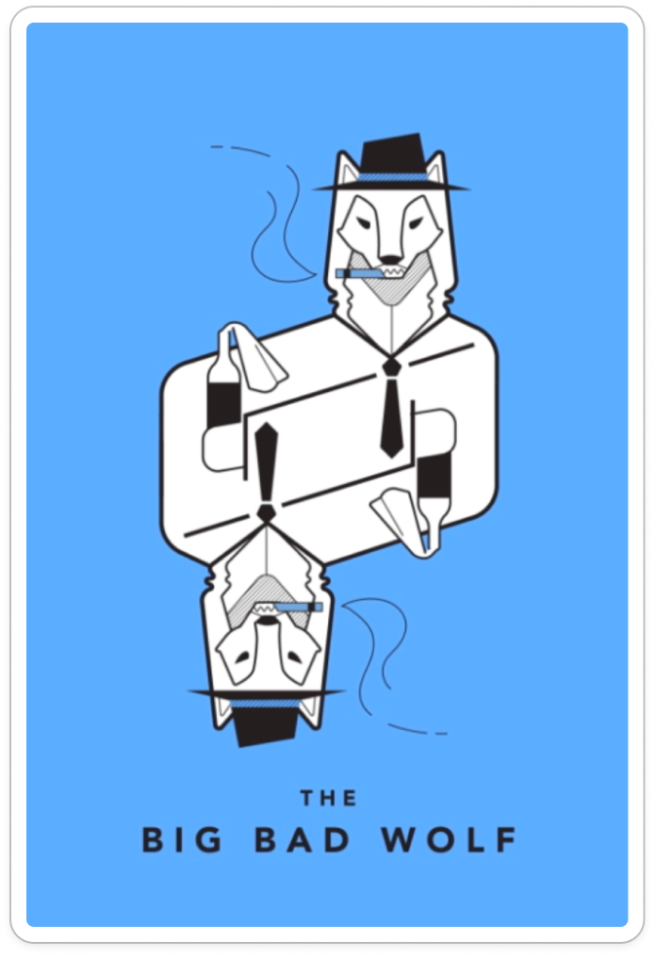
How could our app be misused?
Ethical Implications
Artwork posts could reveal users’ locations, enabling stalking.
Anonymous uploads may contain harmful or inappropriate content.
Design Responses
Hide artist identities and posting times to prevent tracking.
Moderate uploads and allow users to report harmful content.
Value Tension: Discovery vs. privacy

Slide 32
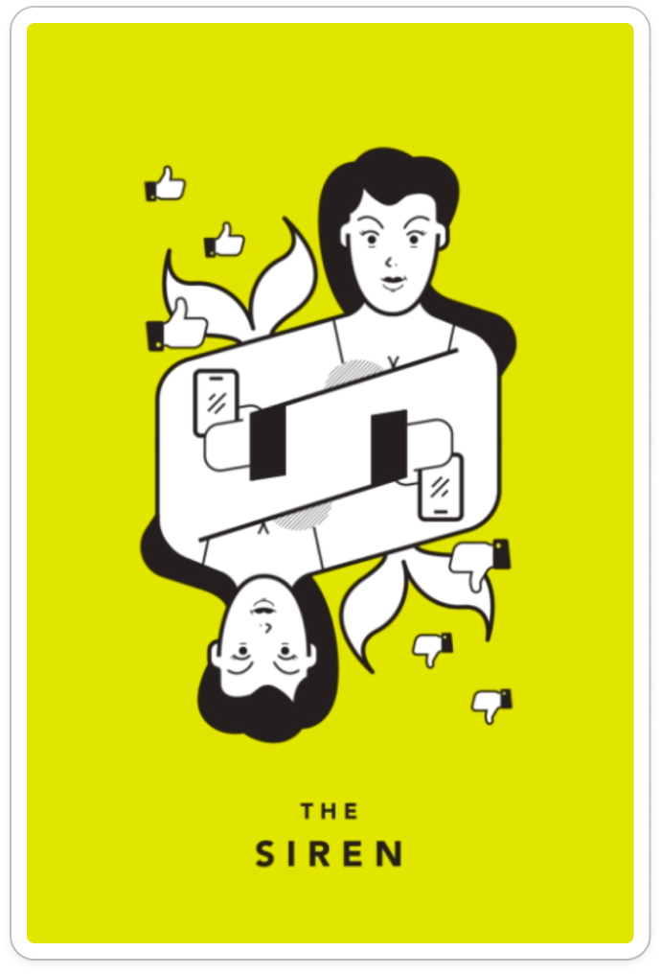
When does our app become distracting?
Ethical Implications
Frequent notifications may turn creativity into an obligation.
Users may feel pressured to visit locations or create constantly.
Design Responses
Allow users to customize or disable notifications.
Avoid streaks and time-sensitive rewards that create pressure.
Value Tension: Engagement vs. well-being

Slide 33
Tasks

Slide 34
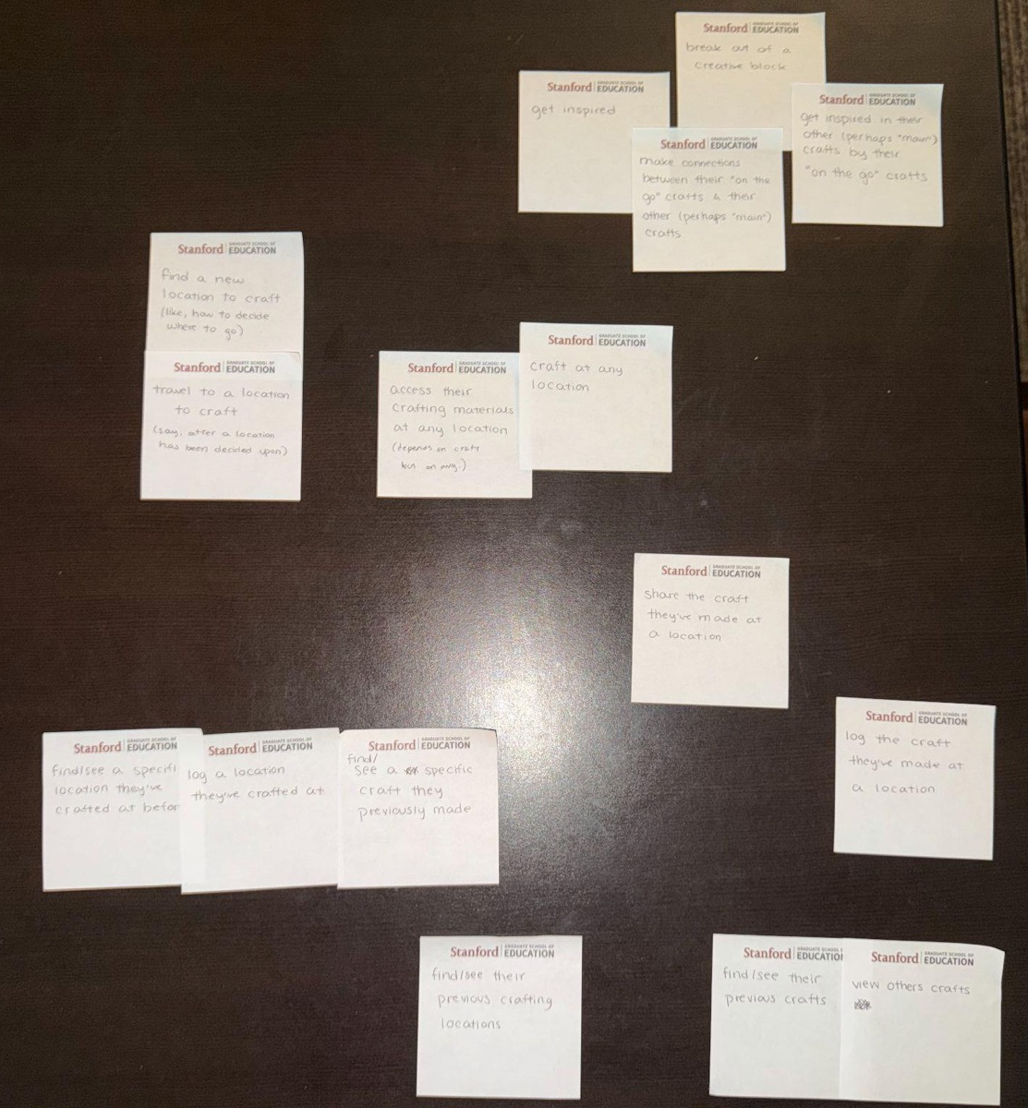
Brain
storm
complex
low priority for user
high priority for user
moderate
simple
Notes:
Sort and curate historical artworks to
Create social group to do art groups together

Slide 35
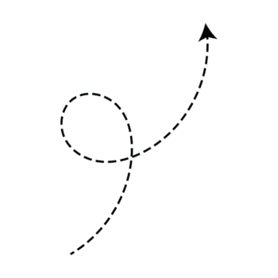
Brain
storm
complex
Task 3: Find connections to main craft
low priority for user
high priority for user
moderate
Task 2: Create and share crafts
Task 1: Discover inspiration
simple
Notes:
Sort and curate historical artworks to
Create social group to do art groups together

Slide 36
SIMPLE
Discover inspiration
Find nearby outdoor spots where others have made art
MODERATE
Create and share
Follow a prompt or paint freely, then share what you made
COMPLEX
Find connections to main craft
Find connections across your past “low stress” inspiration to shape a new project in your main craft
Notes:
Sort and curate historical artworks to
Create social group to do art groups together

Slide 37
Why Simple
SIMPLE
Discover inspiration
Find nearby outdoor spots where others have made art
This is simple because it is a focused, introductory goal that requires little prior experience or accumulated work
Notes:
Sort and curate historical artworks to
Create social group to do art groups together

Slide 38
Why Moderate
MODERATE
Create and share
Follow a prompt or paint freely, then share what you made
This is moderate because it extends discovery into a personal contribution, requiring the user to decide what they want to express and share
Notes:
Sort and curate historical artworks to
Create social group to do art groups together

Slide 39
Why Complex
COMPLEX
Find connections to main craft
Find connections across your past “low stress” inspiration to shape a new project in your main craft
This is complex because it involves drawing meaning from multiple previous experiences and bringing those connections into an ongoing creative practice, making it most relevant to returning, experienced users
Notes:
Sort and curate historical artworks to
Create social group to do art groups together

Slide 40
Storyboard

Slide 41
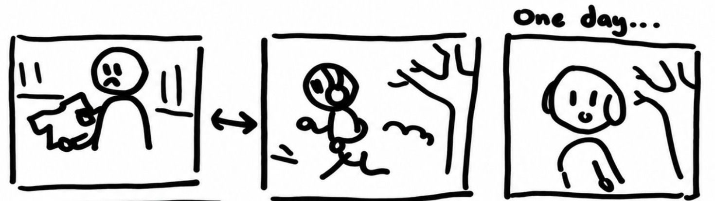
[ task 1 · simple ]
Discover an inspiring spot
[ mood shift ] stressed → curious
Pressure to produce
Tunnel vision routine
A spark of discovery

Slide 42
[ task 1 · simple ]
Discover an inspiring spot
Camera: Close-ups of frustration, wide shots of the workspace, and outdoor walking shots.
Transitions: Cuts from the indoor workspace to the outdoor environment.
Actions: The character struggles with creative work, leaves the workspace, and encounters an inspiring outdoor setting.
Visual effect: Muted indoor scenes contrast with brighter outdoor scenes.

Slide 43
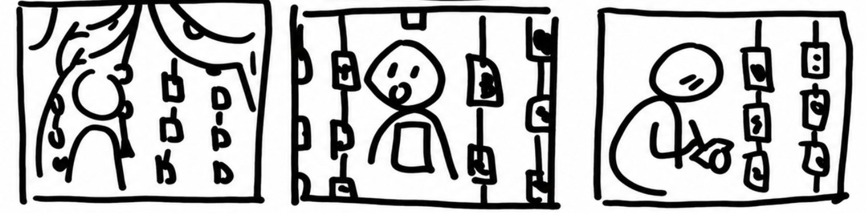
[ task 2 · moderate ]
Create freely and share
[ mood shift ] curious → inspired
Art invites her in
Permission to play
Making for herself

Slide 44
[ task 2 · moderate ]
Create freely and share
Camera: Close-ups of the sketchbook and hands, followed by medium shots in the fashion workspace.
Transitions: Cuts from outdoor sketching to indoor fashion design.
Actions: The character draws inspiration from her surroundings and incorporates ideas into a dress.
Visual effect: The outdoor discovery becomes a tangible fashion creation.

Slide 45
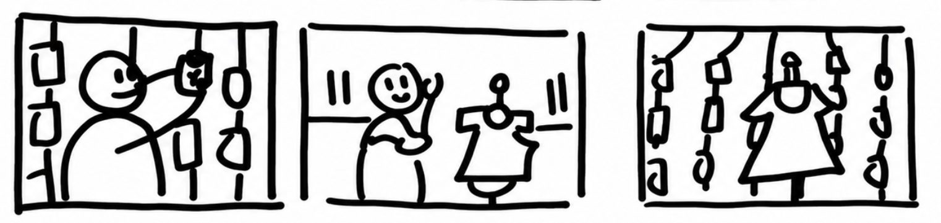
[ task 3 · complex ]
Find connections between the “low stress” inspiration and main craft
[ mood shift ] inspired → empowered
Share her work
Revisit her “low stress” creative explorations
Connect the “low stress”” inspiration to her fashion

Slide 46
[ task 3 · complex ]
Find connections between the “low stress” inspiration and main craft
Camera: Close-ups of the character drawing, sewing, and handling photographs; wide shot of the outdoor art display.
Transitions: Cuts between creative activities, ending with a reveal of photographs displayed outdoors.
Actions: The character sketches, develops her fashion design, and shares the finished creative journey through displayed images.
Visual effect: The final outdoor display reconnects her creative work with the original location.

Slide 47
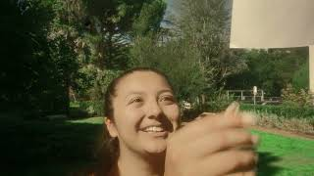
OUR CONCEPT VIDEO

Slide 48
OUR CONCEPT VIDEO
https://www.youtube.com/watch?v=fZAmPD2v1Gg
Task 1: Discover Inspiration (occurs at 0:40 timestamp)
Task 2: Create and Share (occurs at 1:28 timestamp)
Task 3: Find Connections to Main Craft (occurs at 1:10 timestamp)

Slide 49
Sound & Music Design
Opening (Loss of Inspiration):
Steve Lacy's Oh Yeah? starts slowly, creating feelings of sadness and nostalgia.
The music reflects how the character misses the excitement and joy she once felt when creating.
The slower pace highlights her frustration and lack of inspiration.

Slide 50
Sound & Music Design
Turning Point (Finding Inspiration):
As the character discovers the outdoor artwork and removes her headphones, the music fades out.
Birds chirping and nature sounds replace the music, helping the audience focus on her surroundings.
This shift shows her beginning to notice the beauty around her and feel inspired again.

Slide 51
Sound & Music Design
Resolution (Joy of Creating):
The music gradually returns, becoming louder and more upbeat as she starts creating again.
The happier, more energetic part of the song matches her growing excitement and confidence.
The change in music reflects how creating has become fun again rather than something stressful.

Slide 52
Acting & Character Emotions
Opening (Frustration):
The character throws papers, flips through books, and struggles to find ideas.
Her tired expressions, wandering eyes, and slow movements show boredom and frustration.
These actions emphasize how creativity has started to feel like a chore.

Slide 53
Acting & Character Emotions
Turning Point (Curiosity):
She notices the outdoor artwork and stops to look.
Her expression changes from tired to surprised as she explores the display.
Seeing someone else create art sparks her own excitement.

Slide 54
Acting & Character Emotions
Ending (Renewed Joy):
She returns to the design workspace with more energy and excitement.
Instead of struggling, she begins working on her dress with confidence.
The contrast shows how she has rediscovered the joy of creating.

Slide 55
Camera Angles & Framing
Close-Up Shots
Capture her facial expressions to emphasize frustration, surprise, and happiness.
Highlight small actions like flipping pages, pulling out sketching tools, and drawing.
Wide Shots
Establish the dull indoor workspace and the bright outdoor environment.
Zoom out to reveal the full artwork display and show its impact on her.
Over-the-Shoulder Shots
Show the artwork from her perspective as she approaches the display.
Help the audience experience the discovery alongside her.
Camera Movement
Follow her as she walks toward the artwork to build curiosity.
Move between wide shots and close-ups to show both the environment and what catches her attention.

Slide 56
Wardrobe & Color Grading
Opening (Dull Colors)
Gray and black clothing reflect her tired and uninspired mood.
Muted colors make the workspace feel repetitive and unexciting.
Transition (Changing Mood)
As she discovers the artwork, the outdoor environment introduces brighter colors.
The visual change reflects her growing curiosity and excitement.
Ending (Vibrant Colors)
She wears a bright red shirt when she returns to the design workspace.
The brighter outfit reflects her renewed energy and happiness.
More vibrant color grading reinforces the contrast between the beginning and ending.

Slide 57
Scene Transitions & Storytelling
Beginning and Ending Full Circle
The video begins and ends in the same design workspace.
Initially, she struggles to create; by the end, she is excited to work on her dress.
Returning to the same setting highlights how her mindset has changed.

Slide 58
Scene Transitions & Storytelling
Artwork Display Connecting the Story
The outdoor photographs introduce her to other people's creative experiences.
She finds inspiration in their work and begins creating something of her own.
The ending connects her creation back to the outdoor display, completing the creative journey.

Slide 59
Scene Transitions & Storytelling
Sketching Showing the Solution
Close-ups show her pulling out the notebook-style phone accessory and beginning to draw.
Tearing out a page and continuing her work demonstrates how easily creativity can fit into everyday life.
These moments show the value of the product through her actions rather than relying on a detailed interface.

Slide 60
APPENDIX

Slide 61
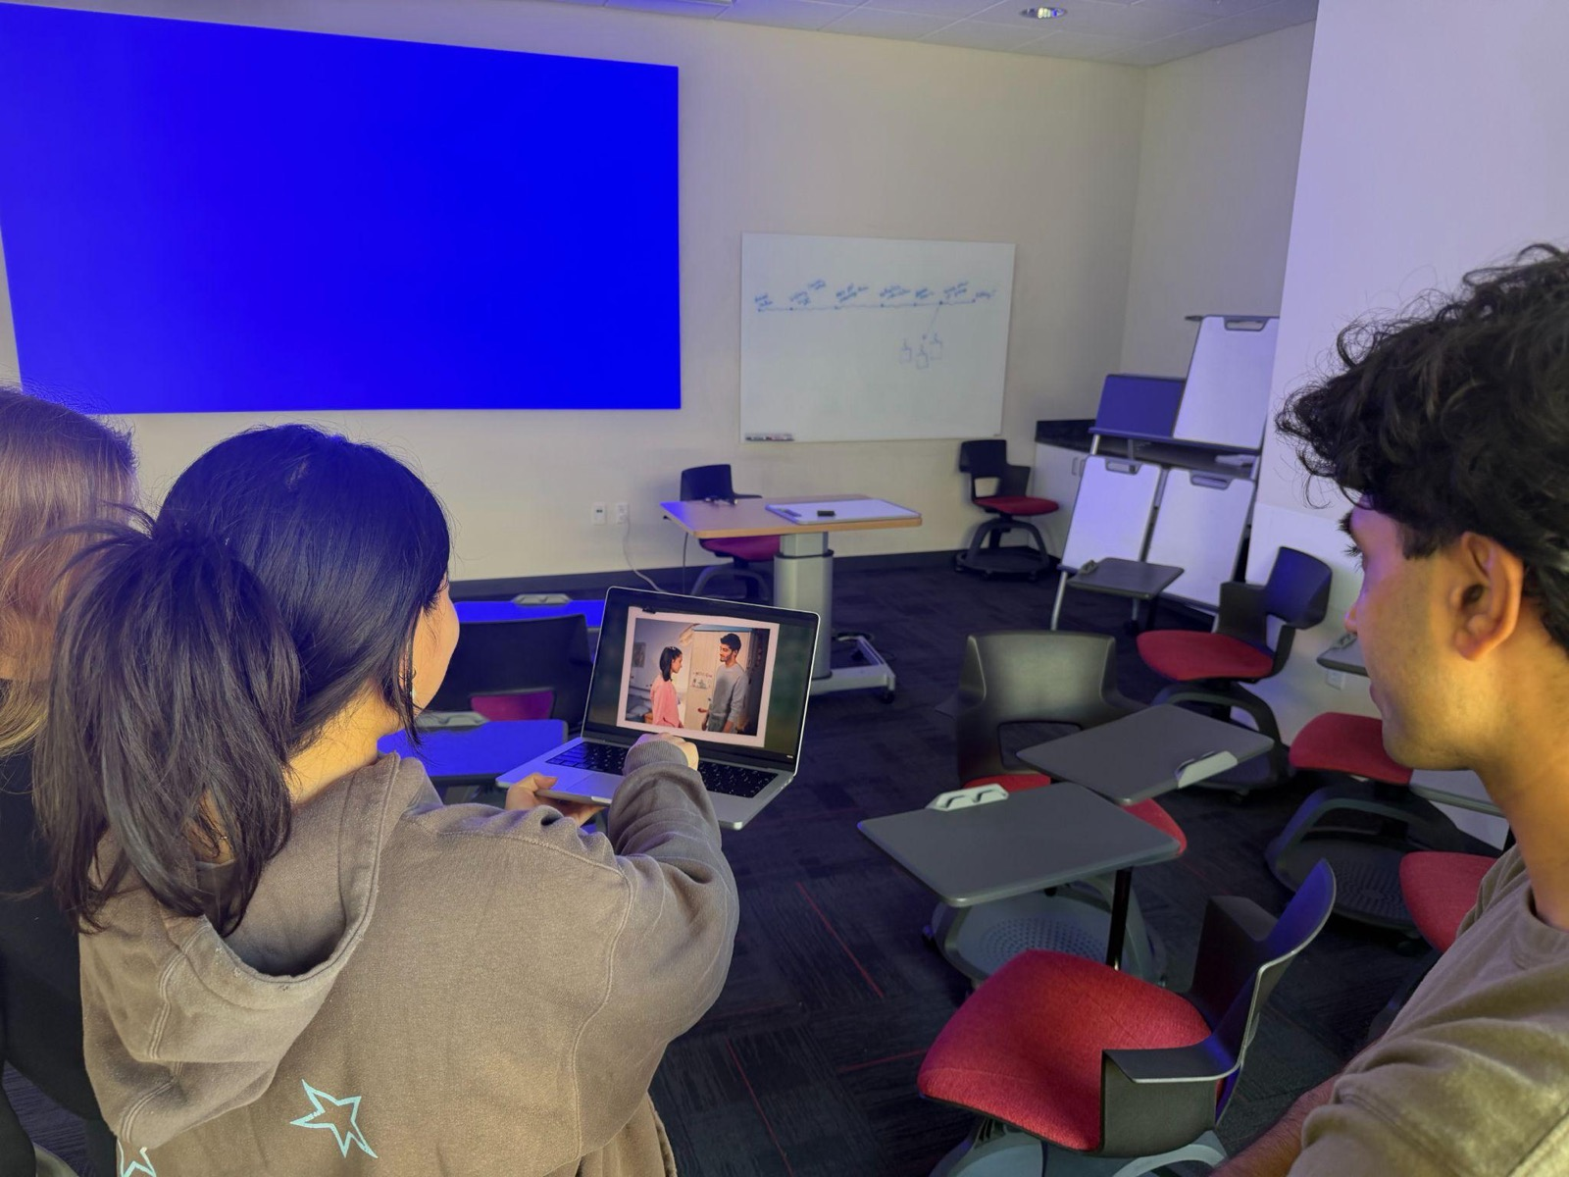
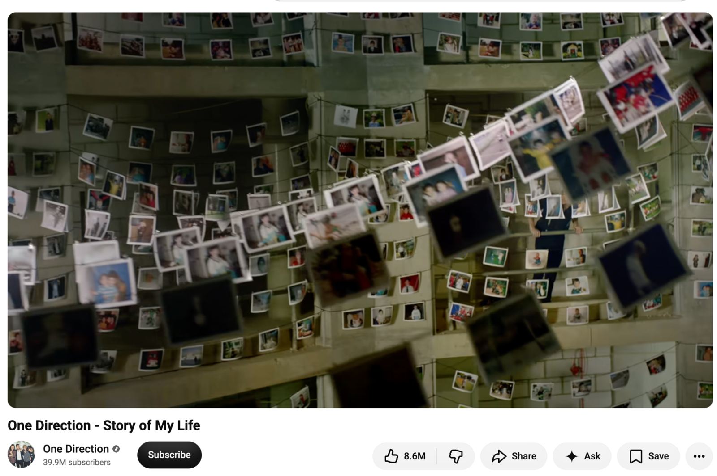
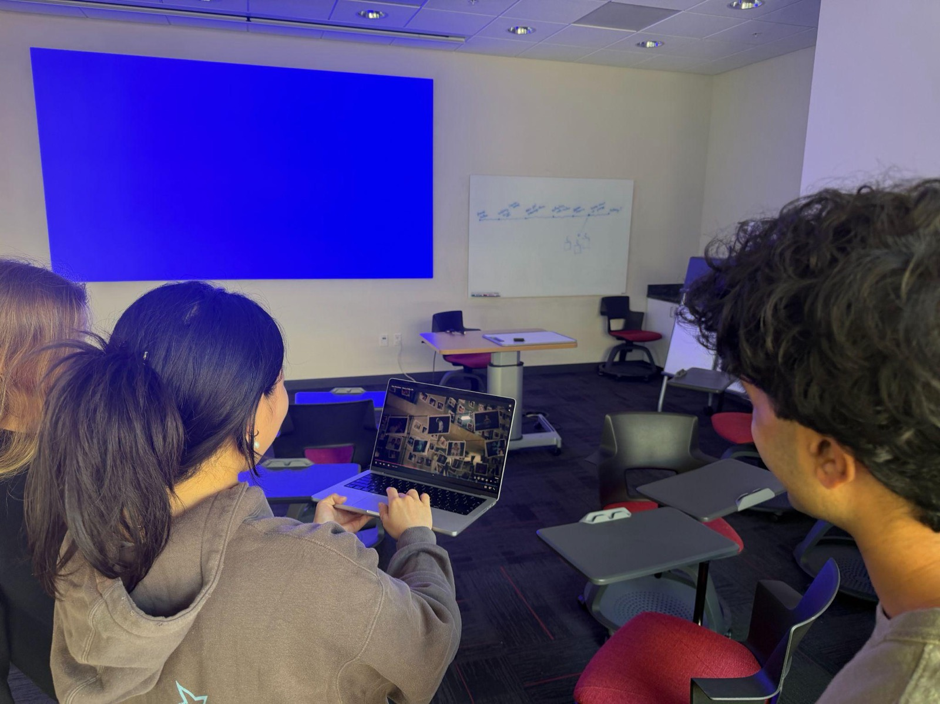
CONCEPT VIDEO BRAINSTORMING
key piece of inspiration for our concept video

Slide 62
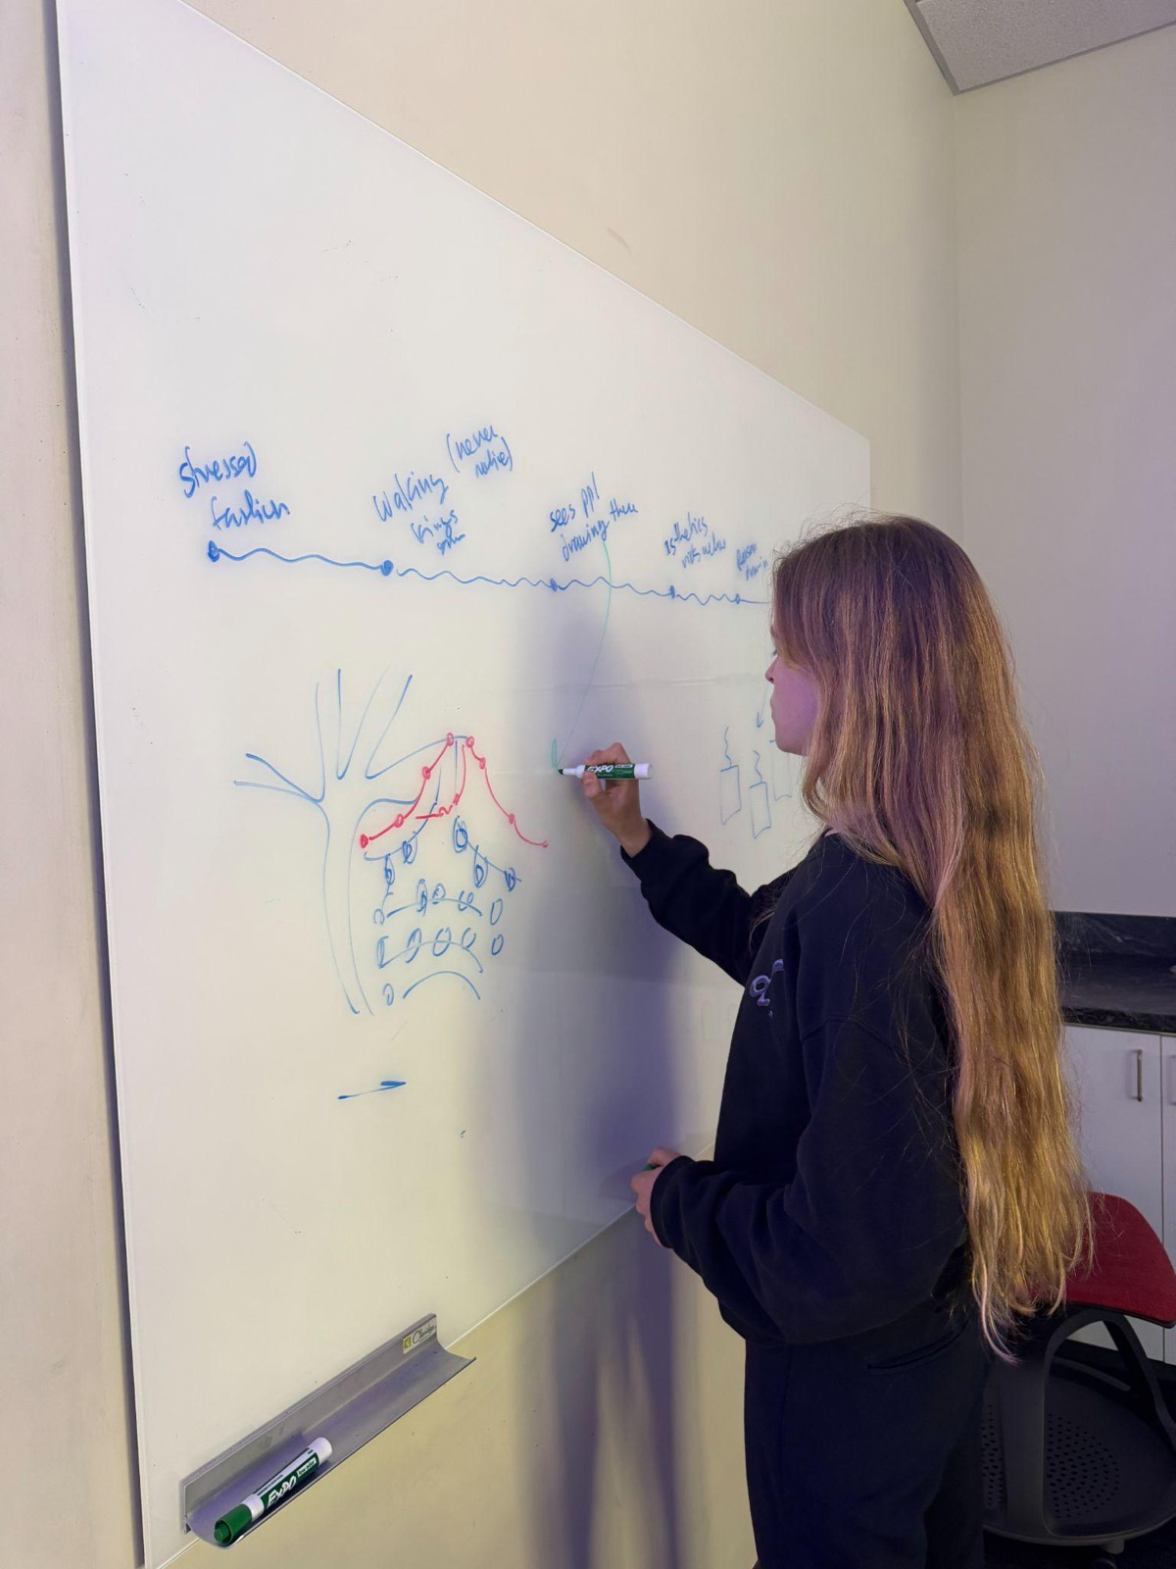
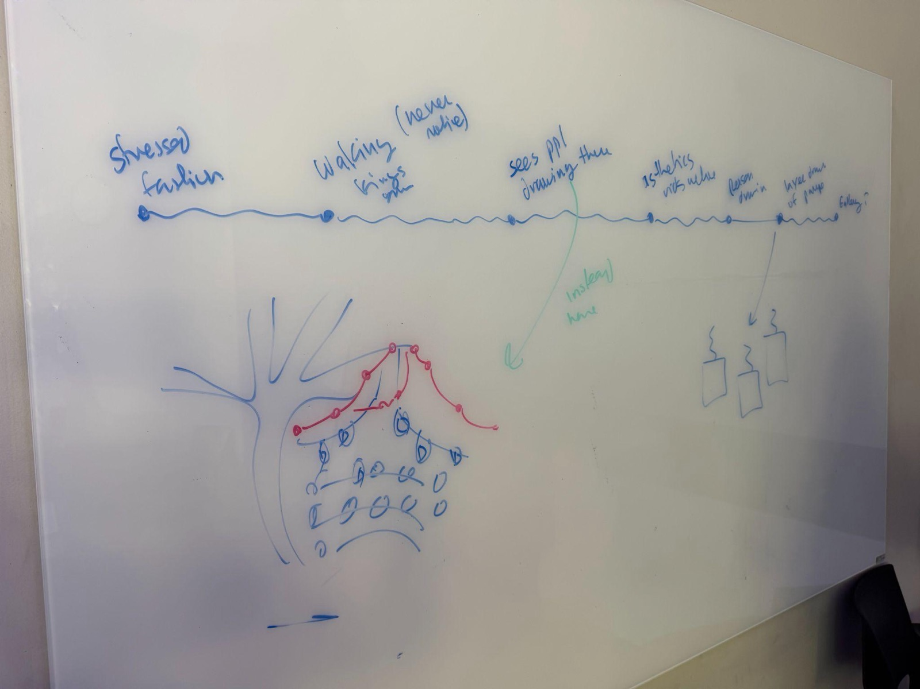
CONCEPT VIDEO BRAINSTORMING

Slide 63
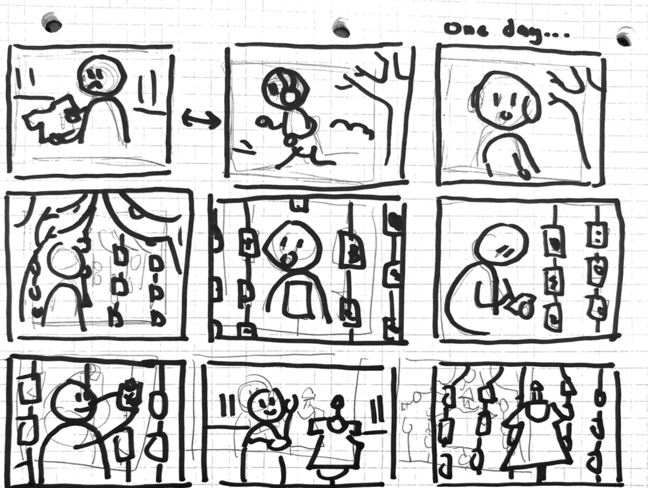
CONCEPT
VIDEO
STORYBOARD
[condensed]

Slide 64
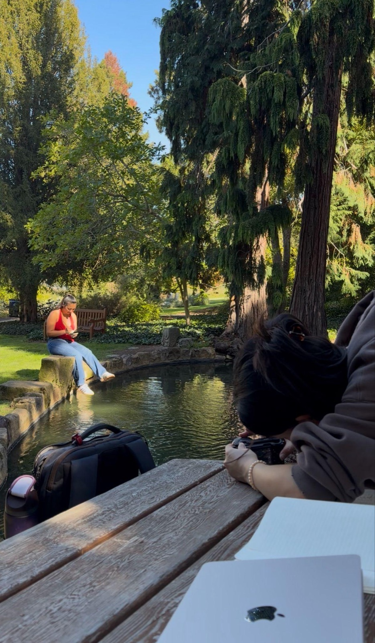
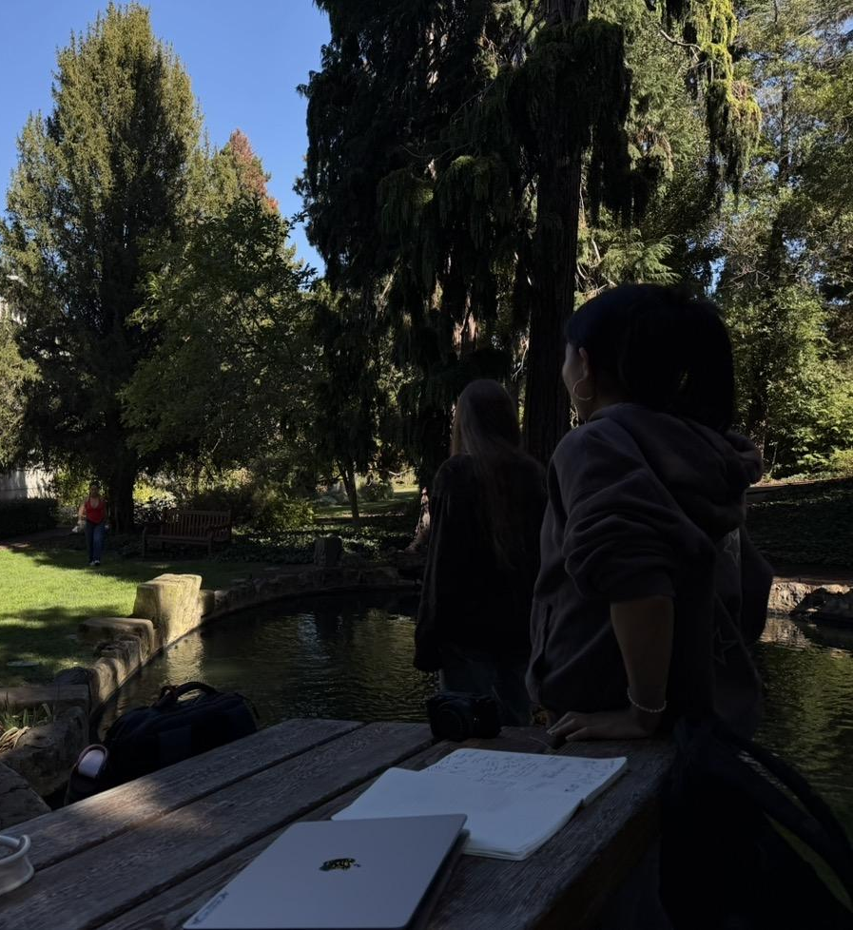
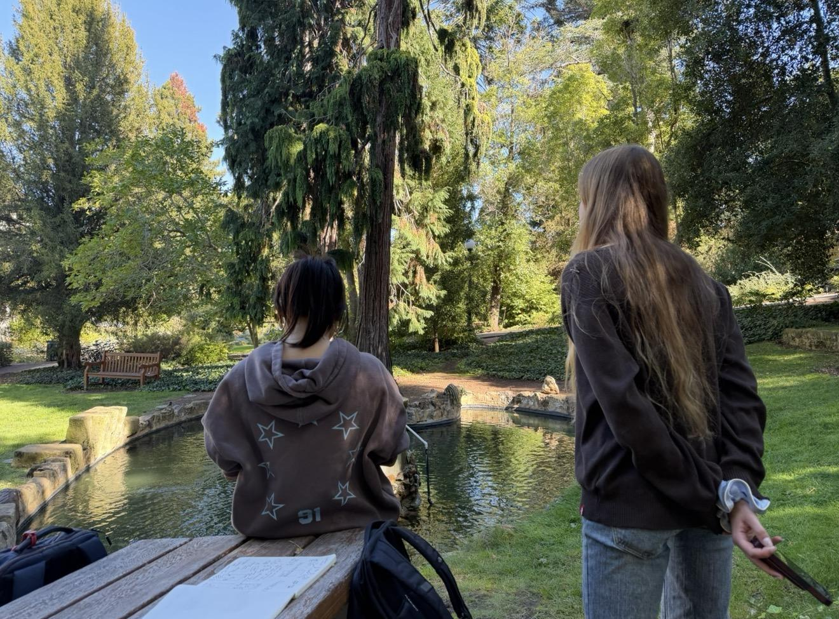
CONCEPT VIDEO SHOOTING

Slide 65
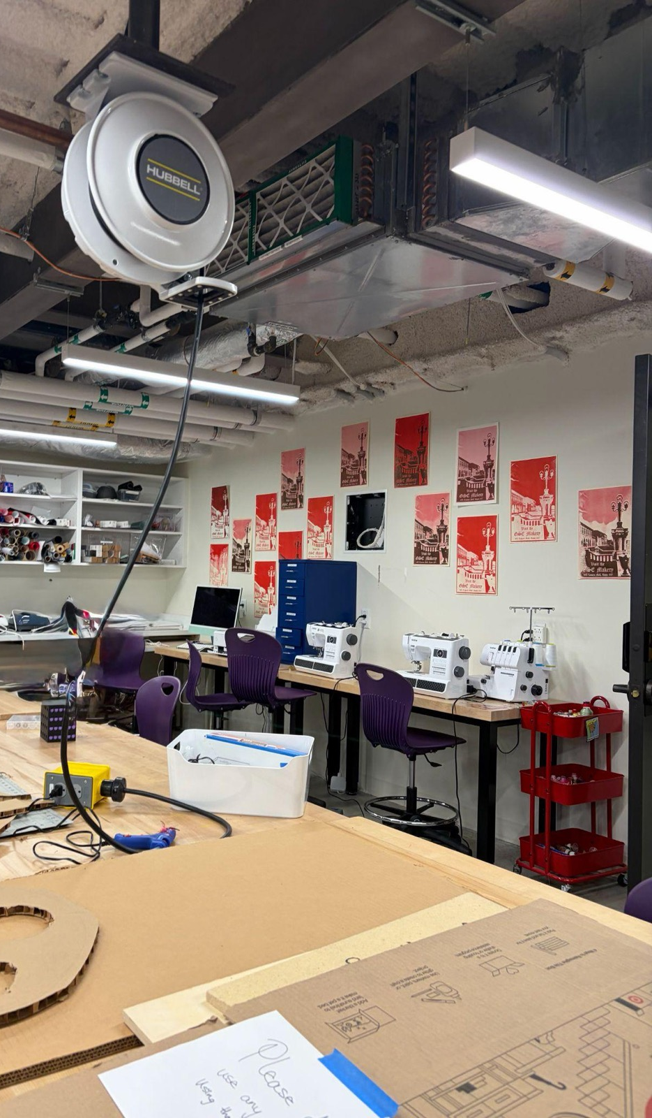
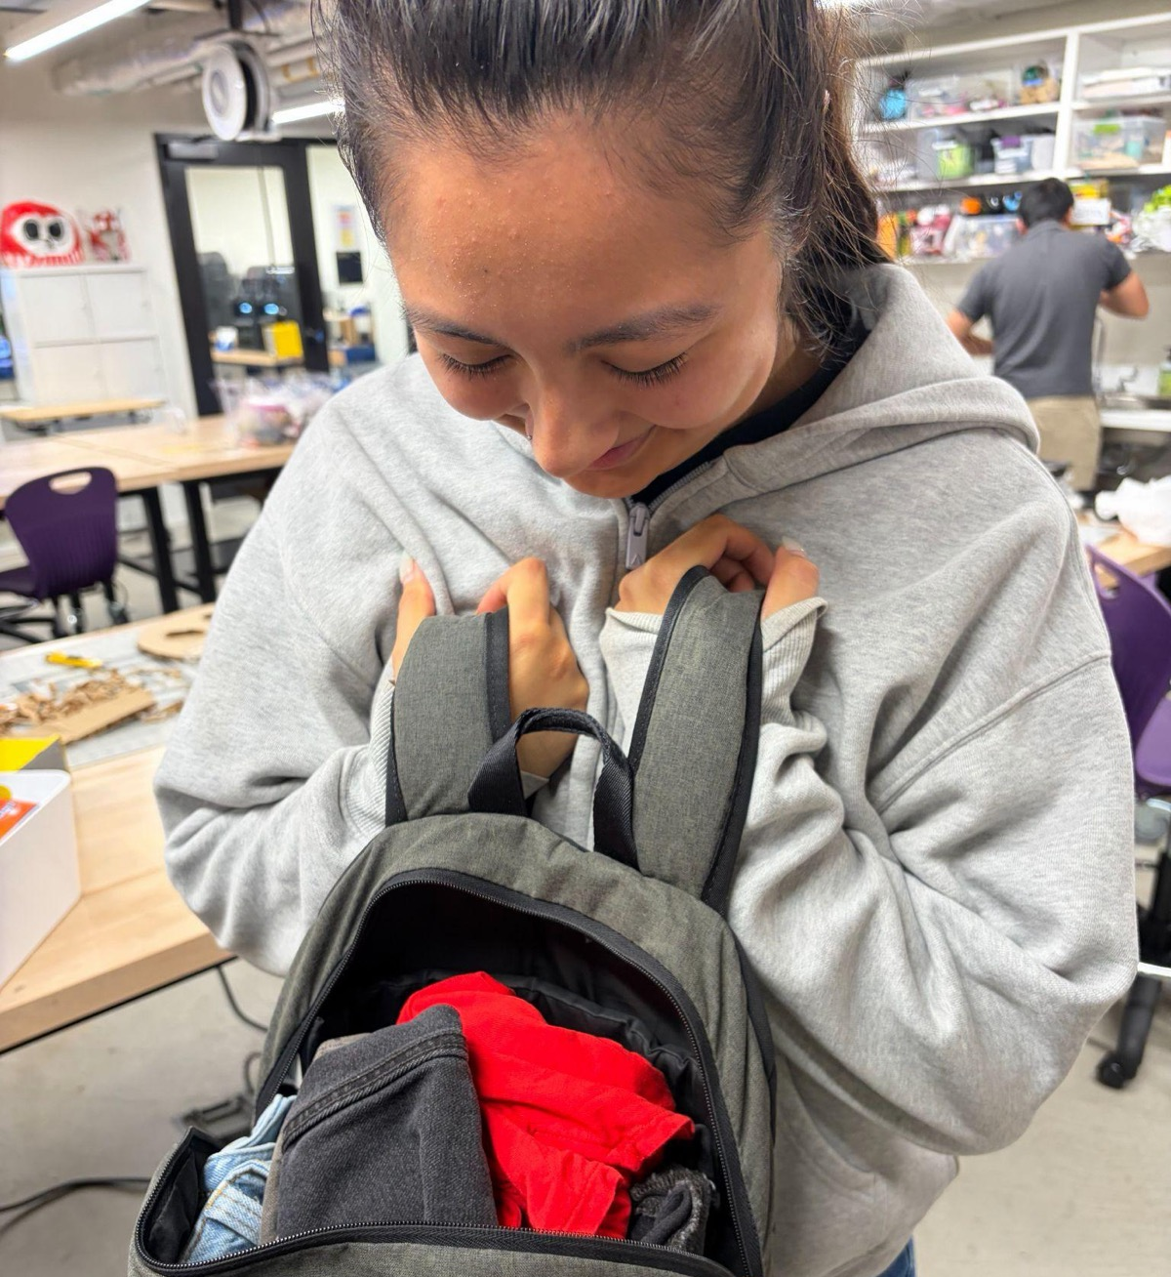
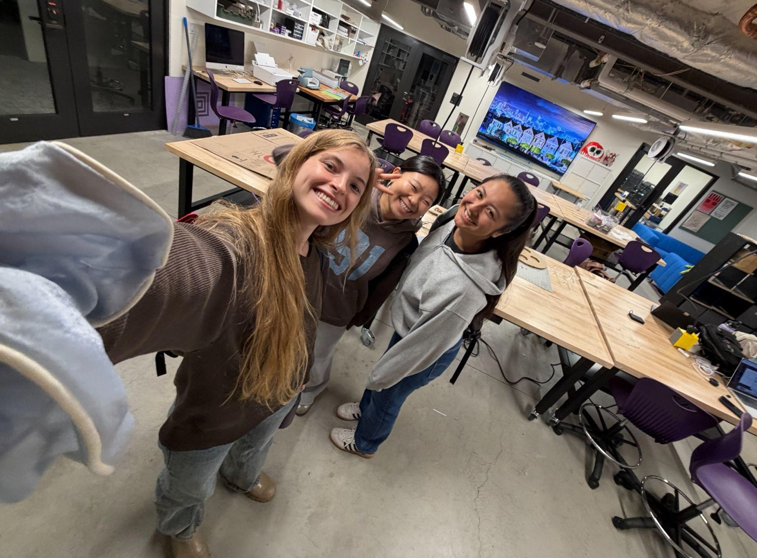
CONCEPT VIDEO SHOOTING
wardrobe
dull -> bright clothing color intentional to match the concept video mood switch

