Slide 1
etch
sketch without stress

Slide 2
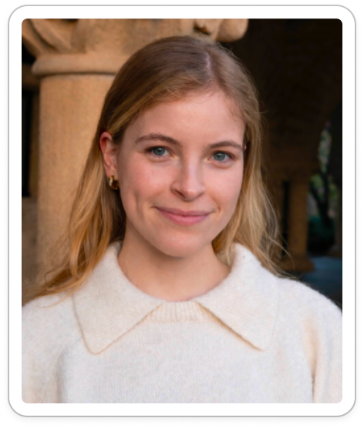
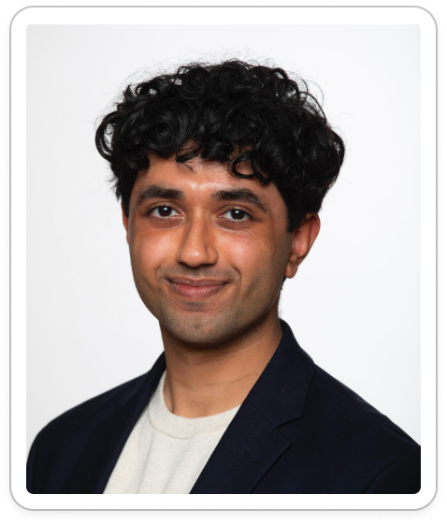
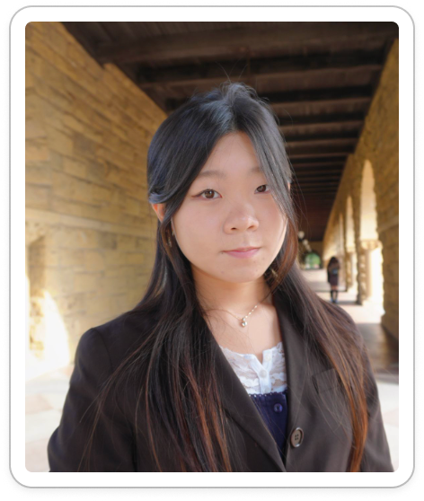
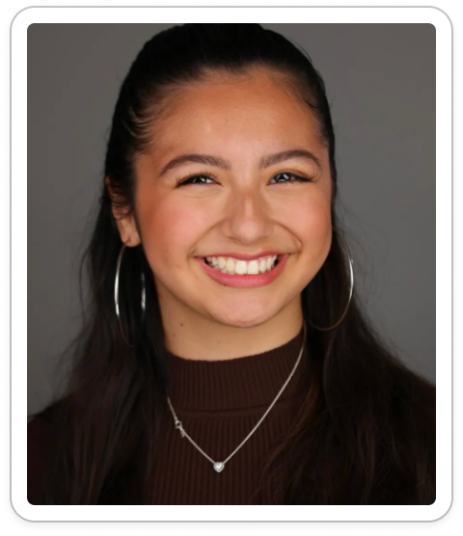
OUR TEAM
Elsa
BS Design
MS HCI
Ahyan
BS CS
Jia
BS Design
MS HCI
Kelly
BS HCI
MS AI

Slide 3
Agenda
Sketching explorations
Selected interface & rationale
Low-fi Paper Prototype Task Flows
Testing
Discussion

Slide 4
Our value
Make creativity feel like an adventure through low-pressure art-making that helps people rediscover inspiration during creative burnout

Slide 5
PROB -> SOLU
Creatives experiencing burnout due to external/ imposed pressure to perform and produce
Turn creativity into a low-pressure adventure that helps people rediscover inspiration through playful art-making

Slide 6
PROB -> SOLU
Creatives experiencing burnout due to external/ imposed pressure to perform and produce
Turn creativity into a low-pressure adventure that helps people rediscover inspiration through playful art-making

Slide 7
Primary User/Problem/Solution
Creative people whose craft has become tied to work or expectations often struggle to make room for experimentation and play. We make outdoor creative breaks easy: seeing others’ art nearby encourages users to pause, create without pressure, and revisit their discoveries for inspiration in their main craft

Slide 8
IDEATION

Slide 9
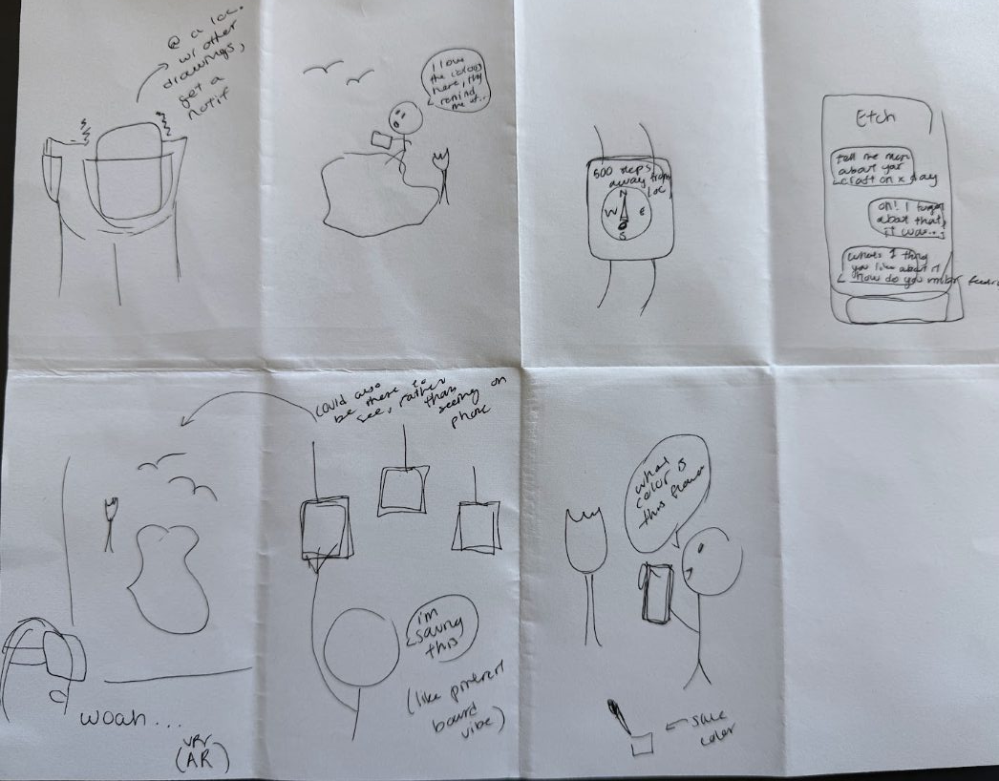
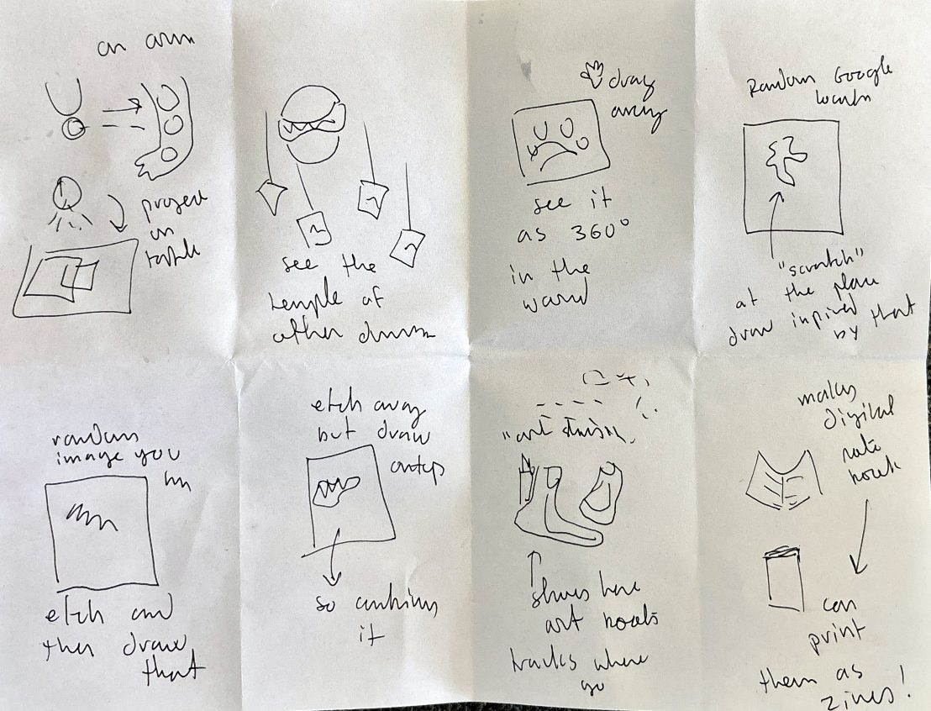
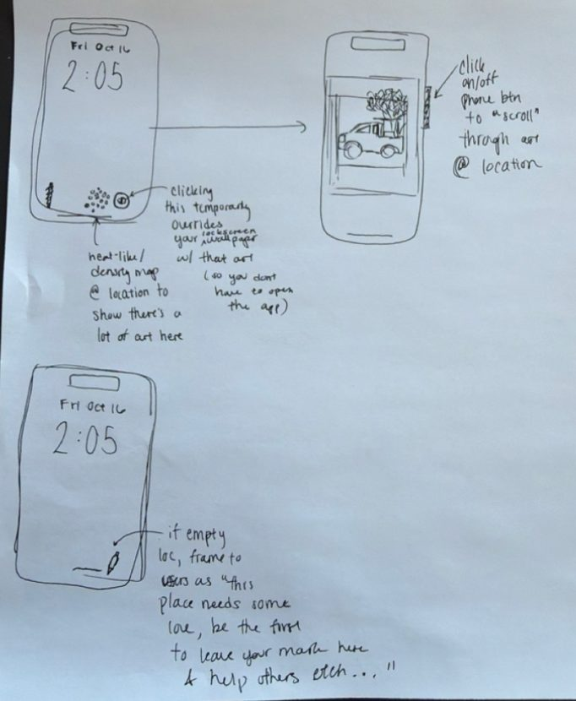
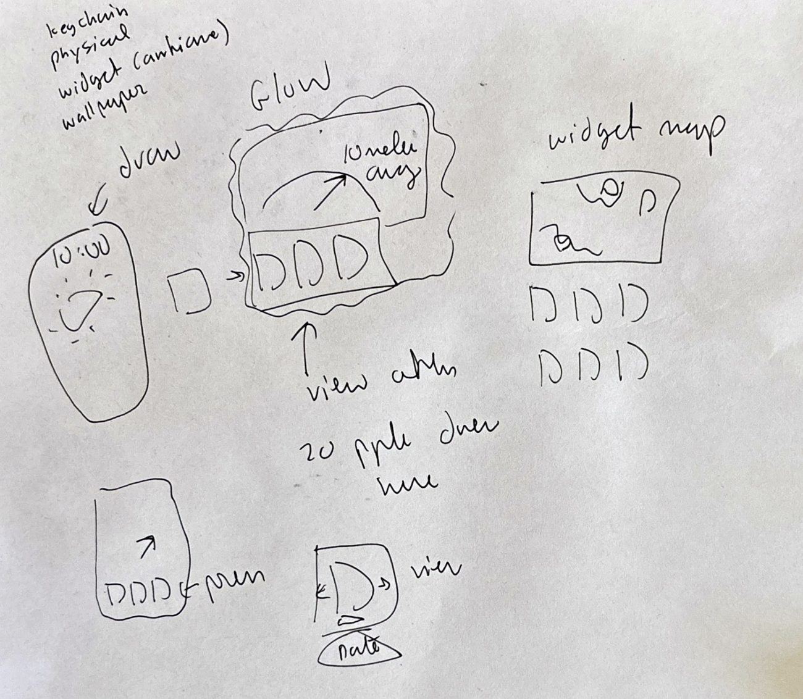
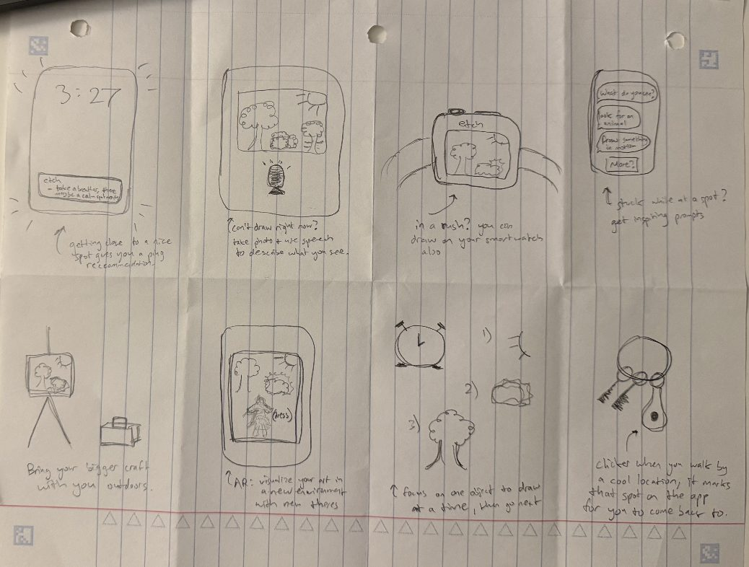
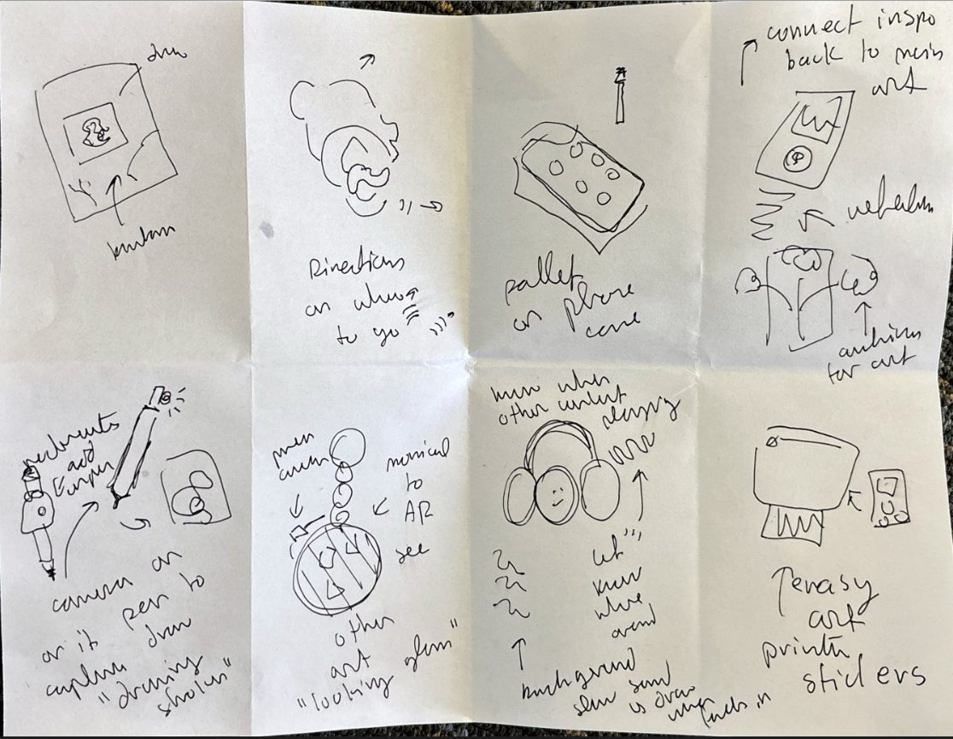
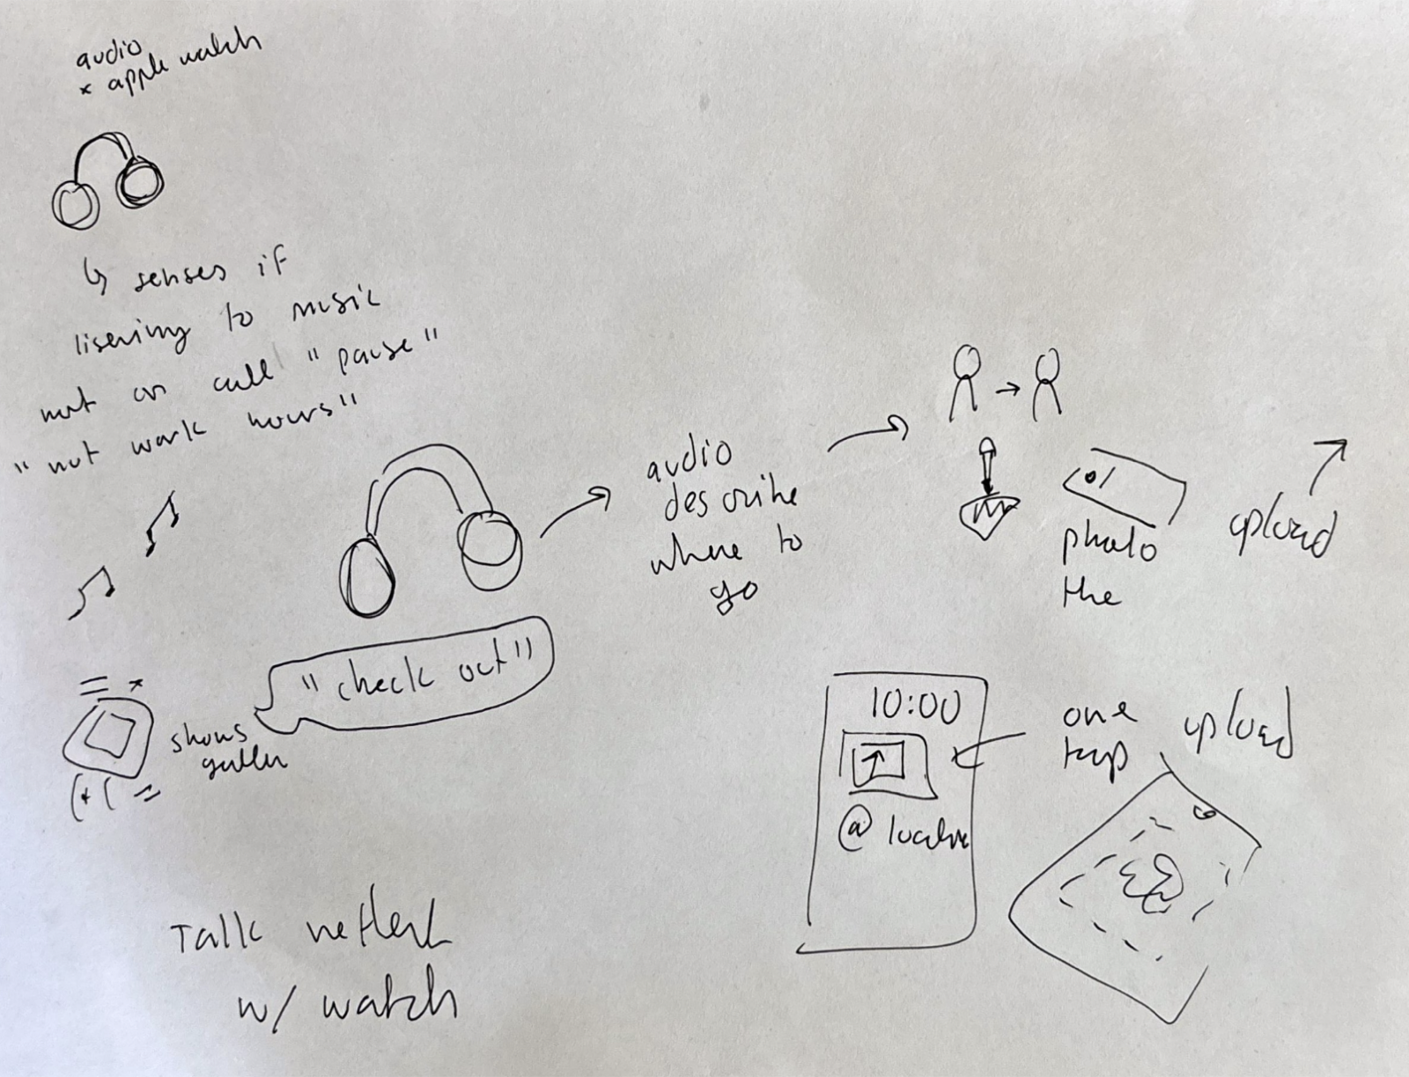
INITIAL BRAINSTORMING
34 solution idea sketches

Slide 10
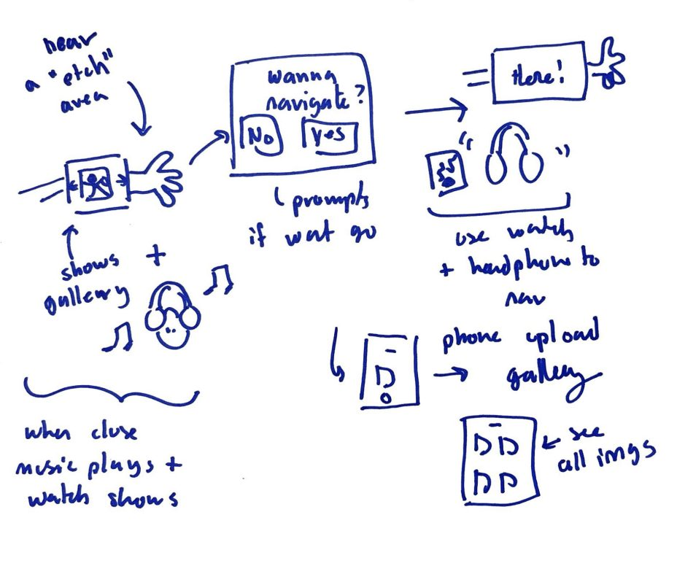
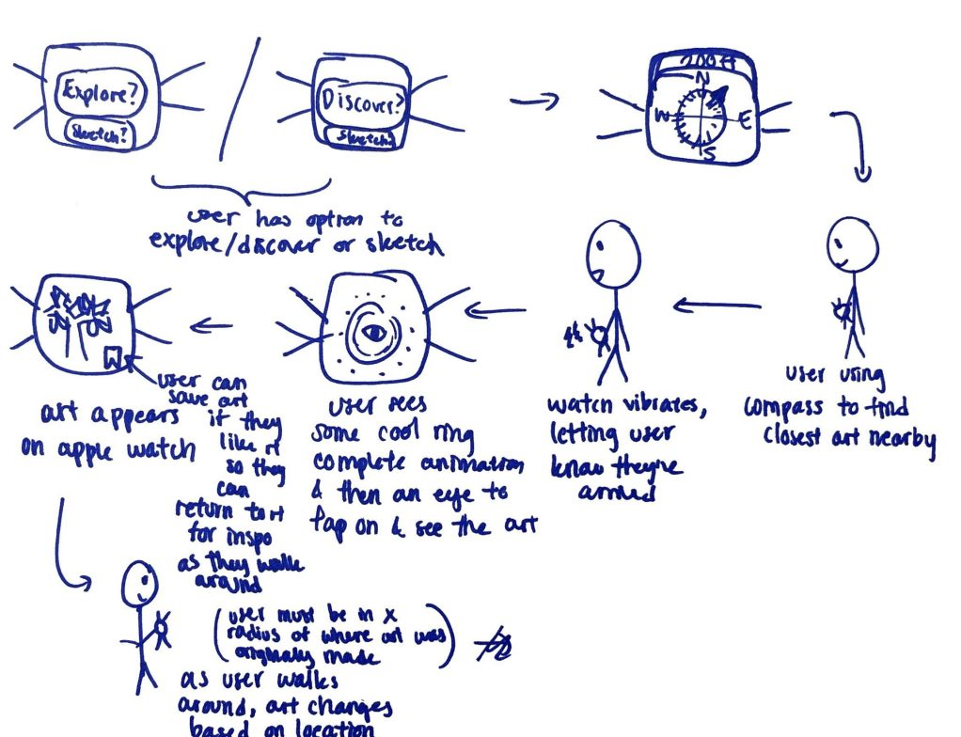
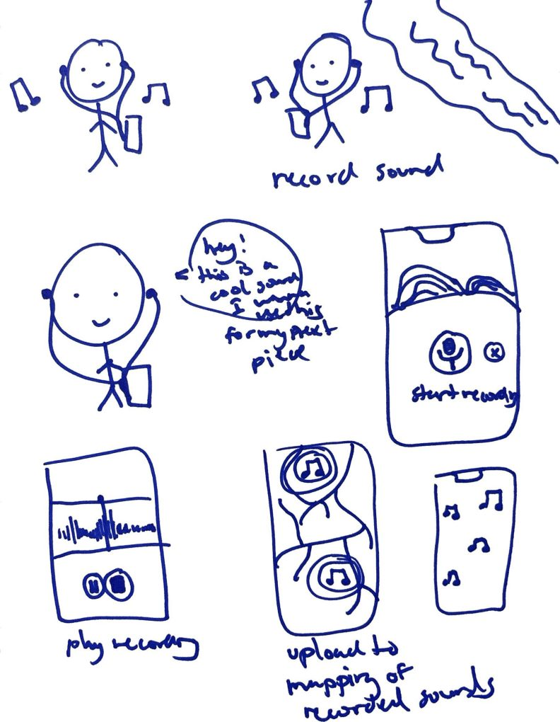
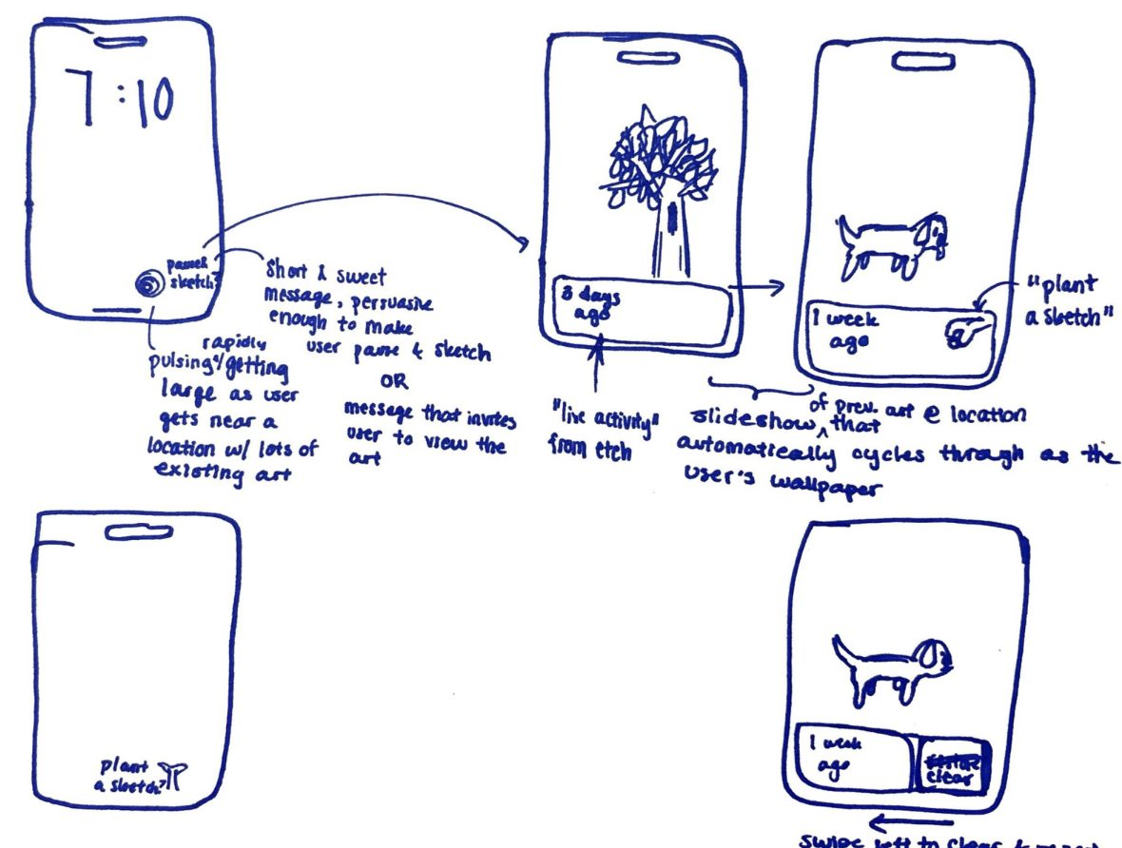
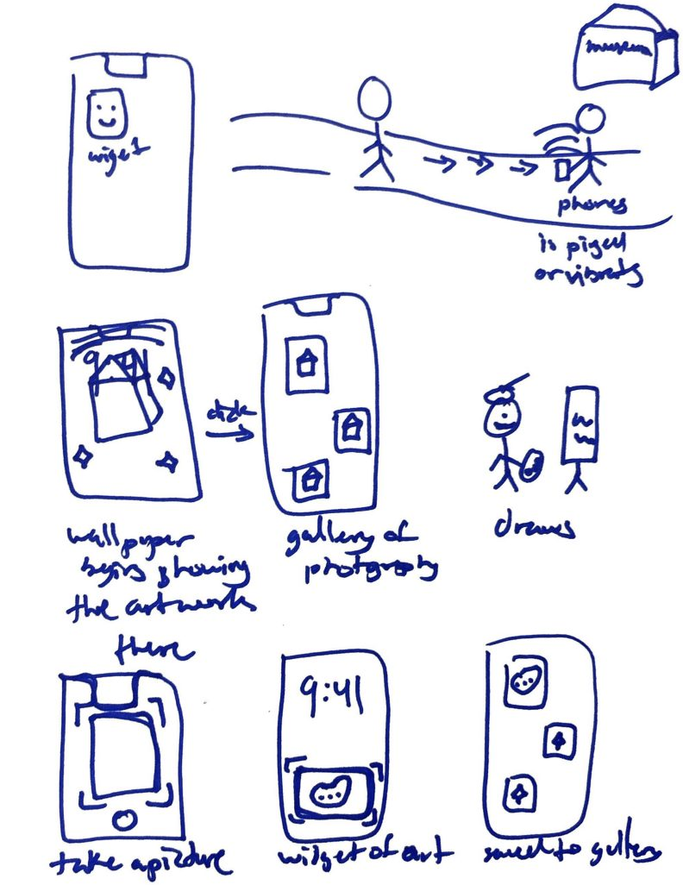
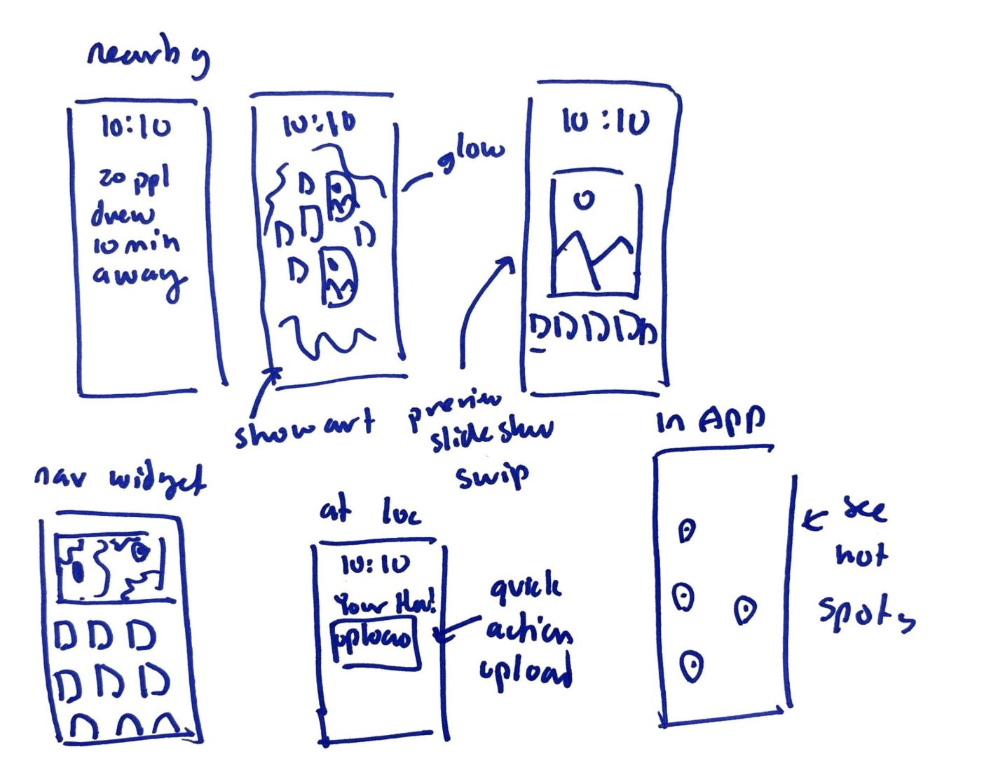
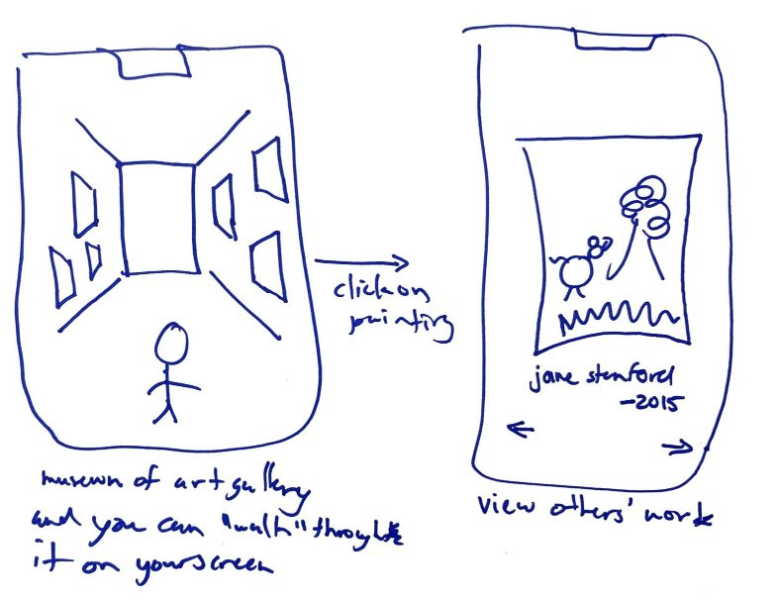
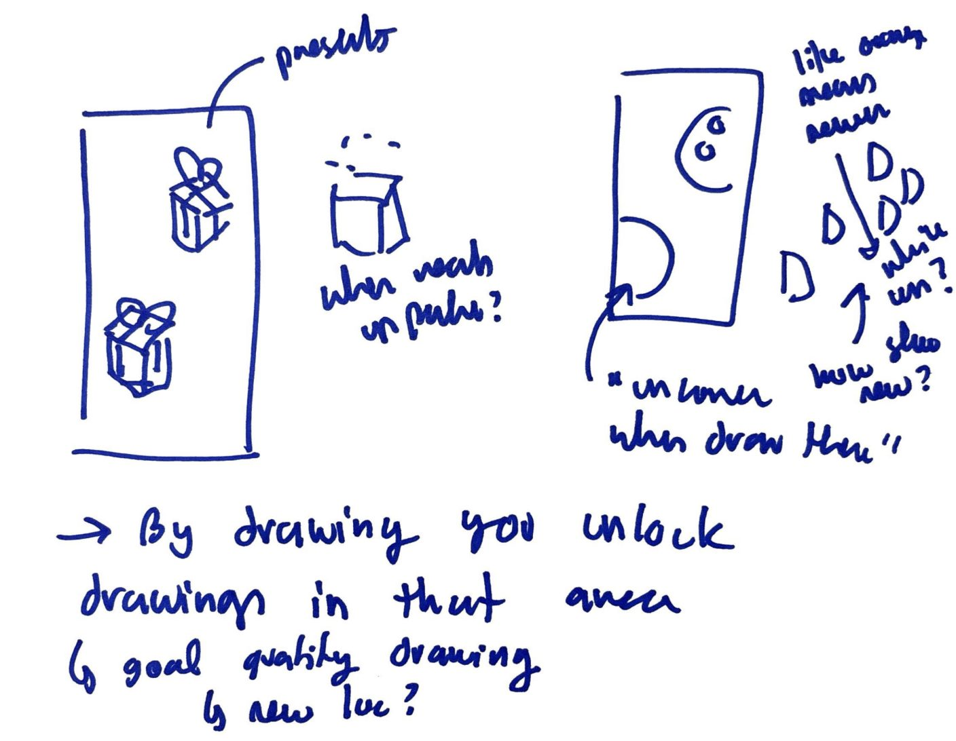
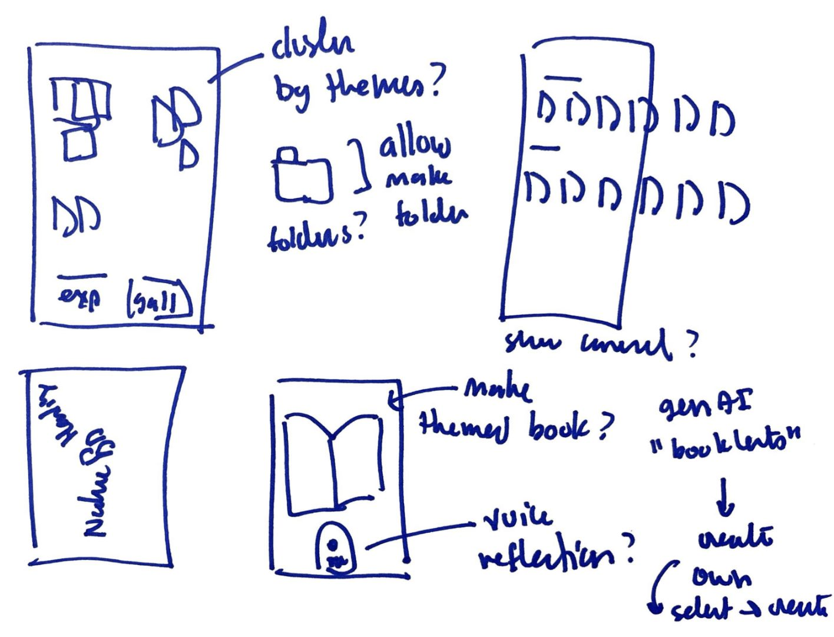
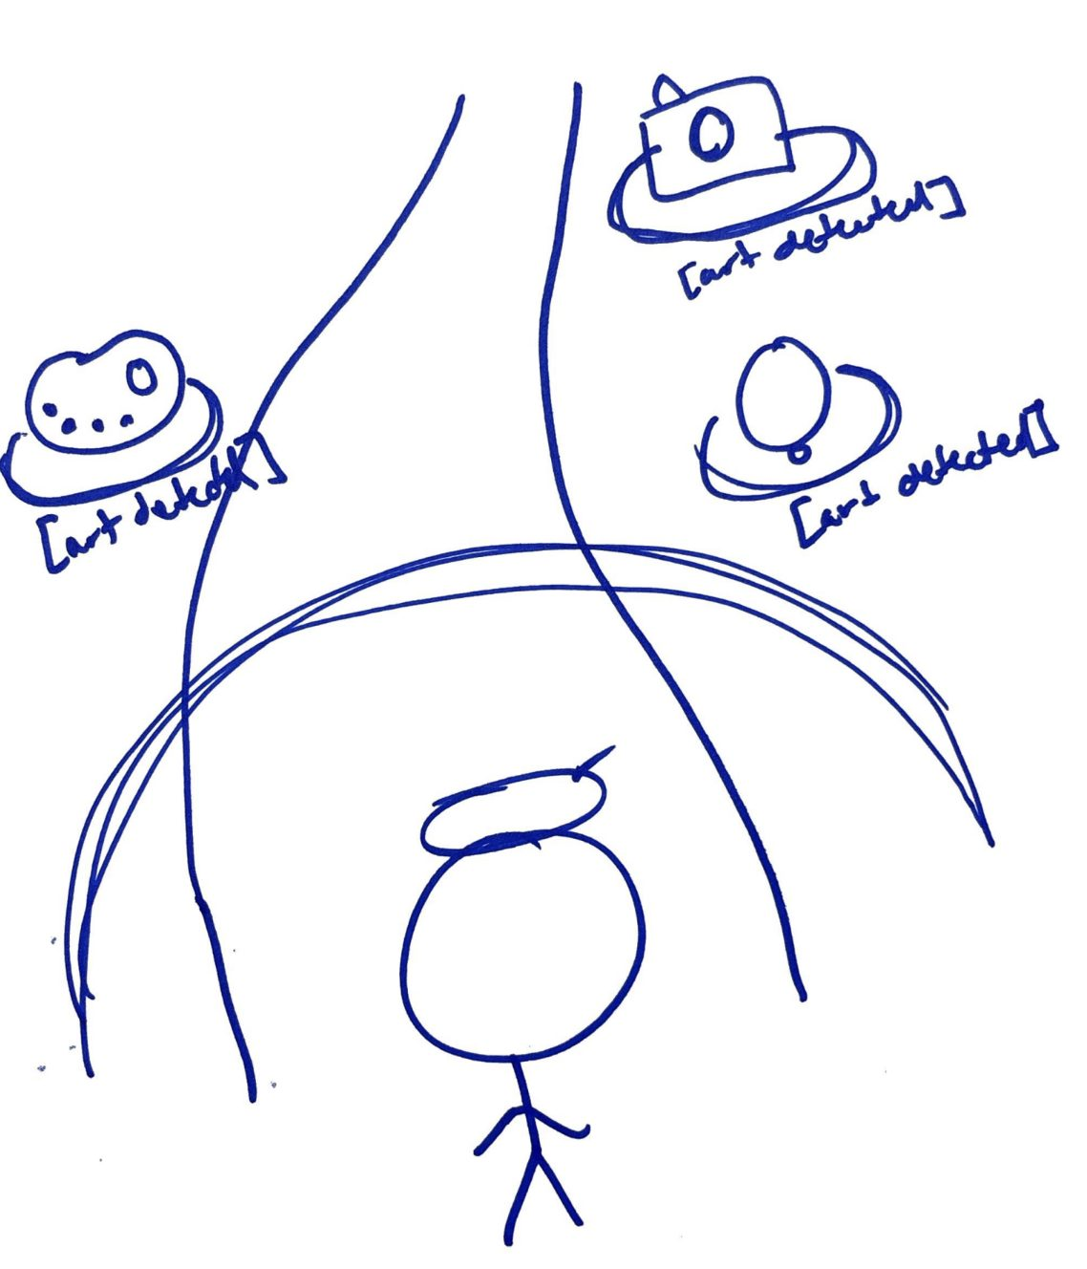
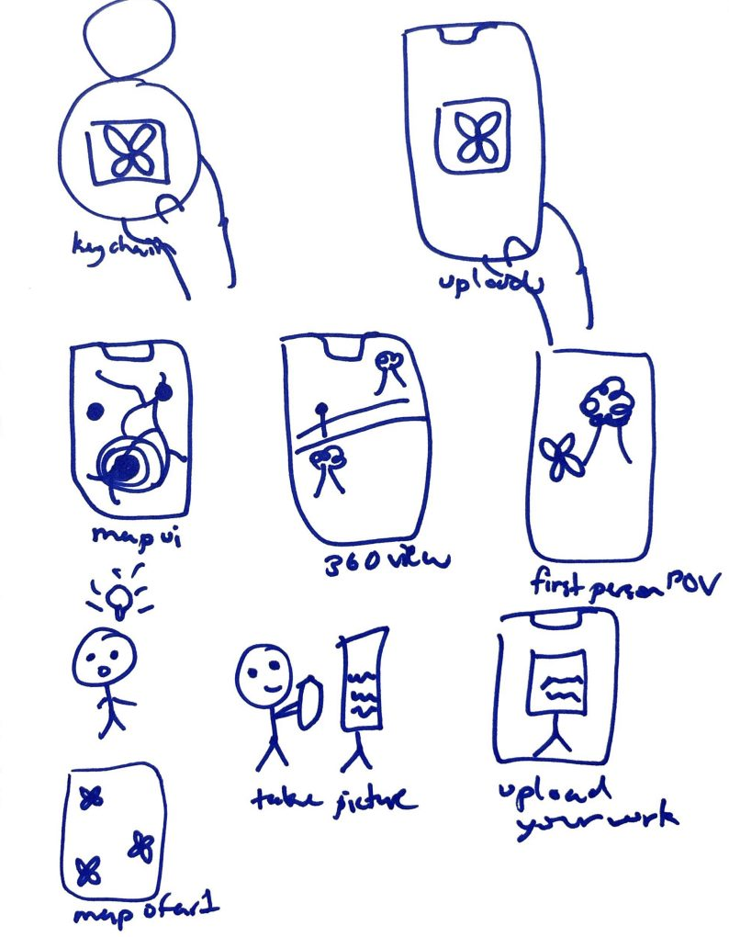
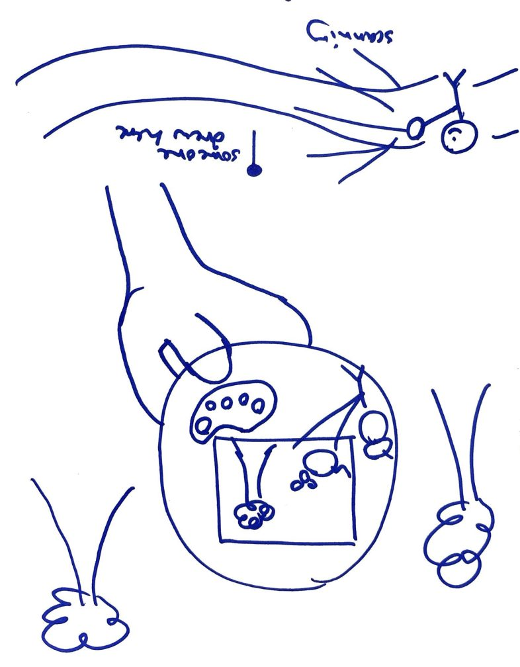
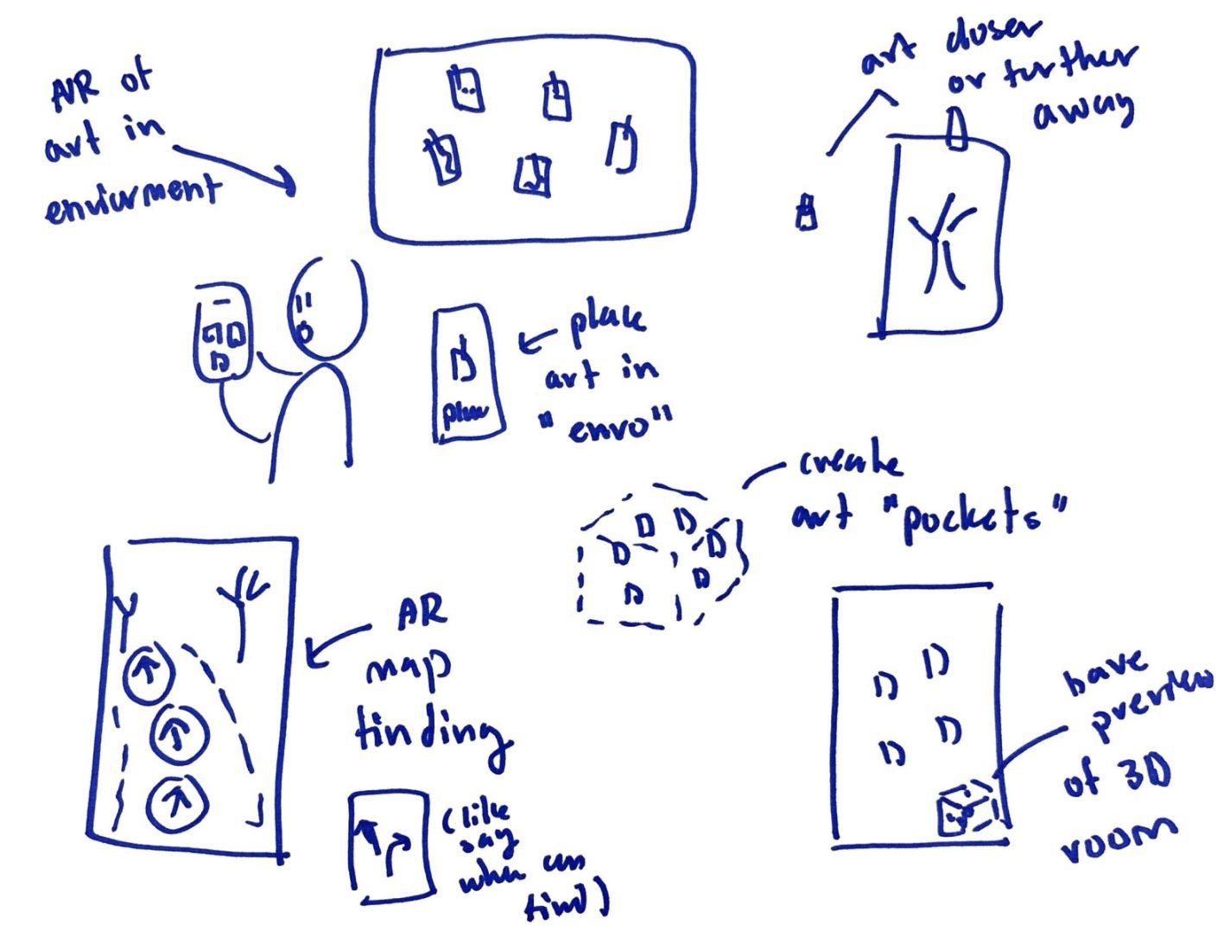
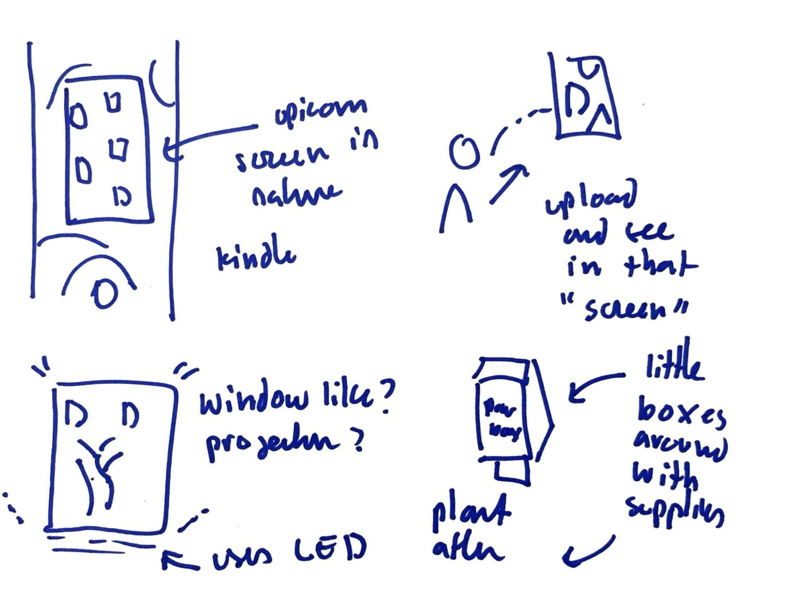
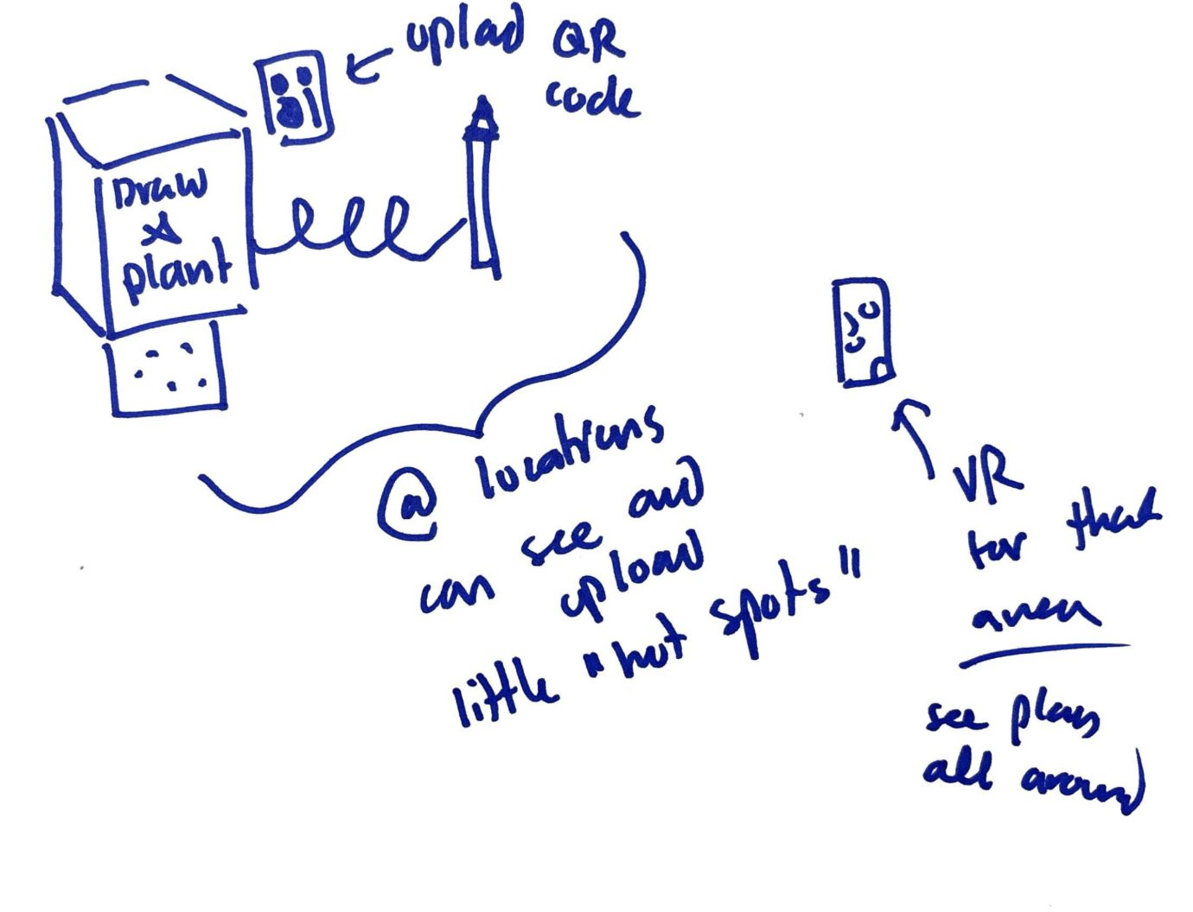
DISTINCT REALIZATIONS
Headphone + Smart Watch
3) Phone (App/Widget/Lockscreen)
2) Monocle/Keychain with AR

Slide 11
DISTINCT REALIZATION 1
Headphone + Smart Watch

Slide 12
DISTINCT REALIZATION 2
Monocle/Keychain with AR

Slide 13
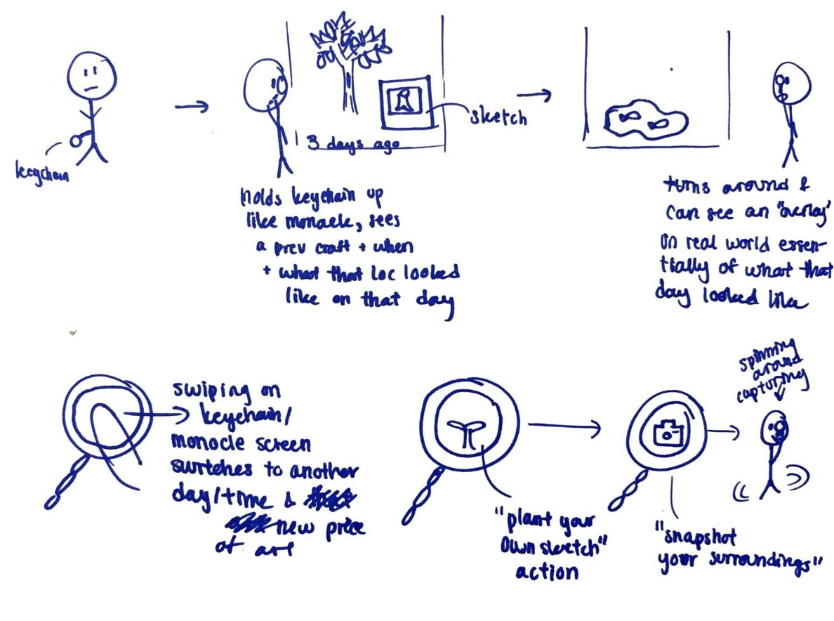
DISTINCT REALIZATION 2
Monocle/Keychain with AR

Slide 14
DISTINCT REALIZATION 2
Monocle/Keychain with AR

Slide 15
DISTINCT REALIZATION 3
Phone (App/Widget/Lockscreen)

Slide 16
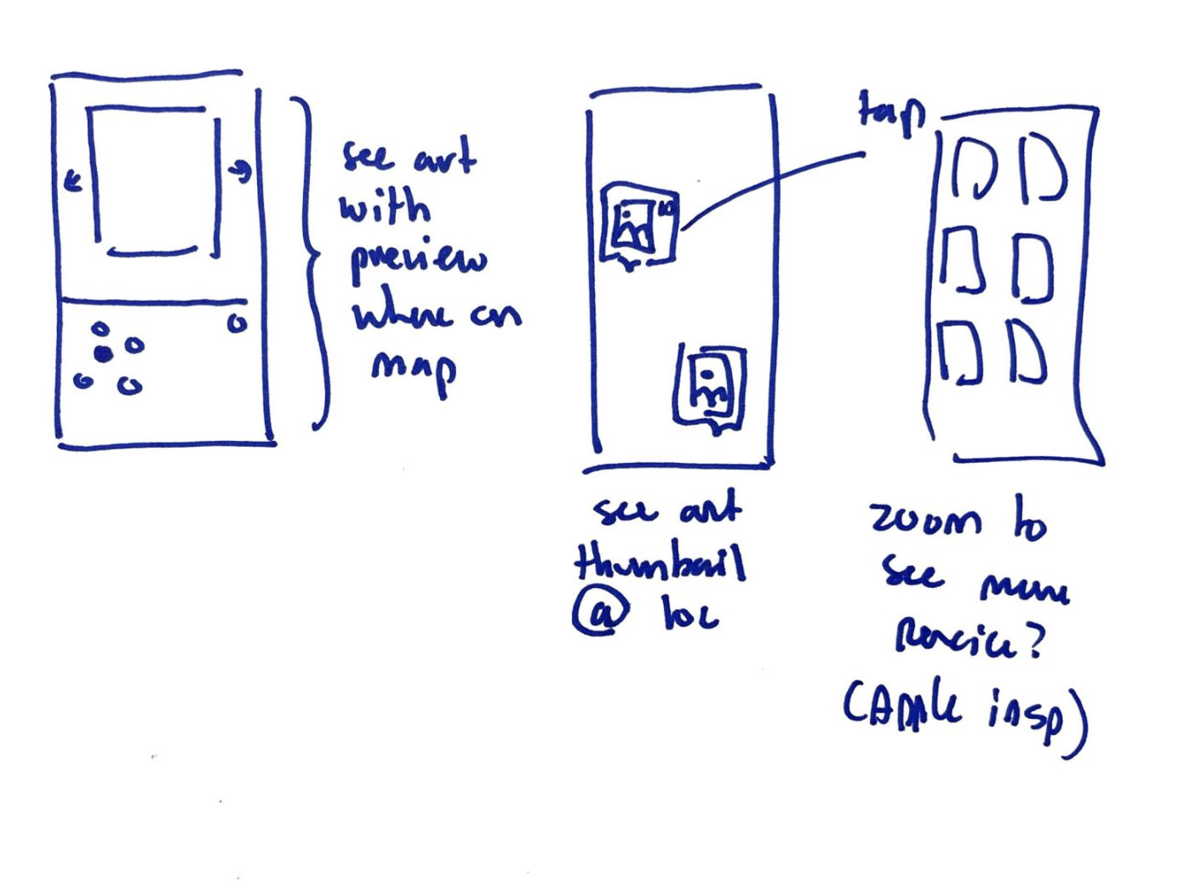
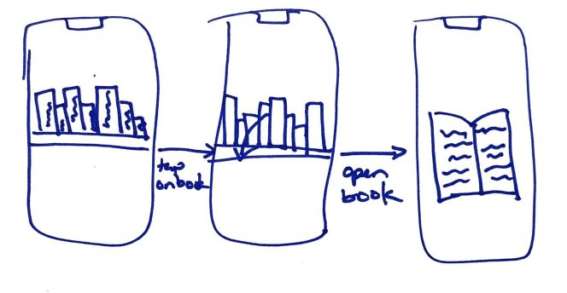
DISTINCT REALIZATION 3
Phone (App/Widget/Lockscreen)

Slide 17
DISTINCT REALIZATION 3
Phone (App/Widget/Lockscreen)

Slide 18
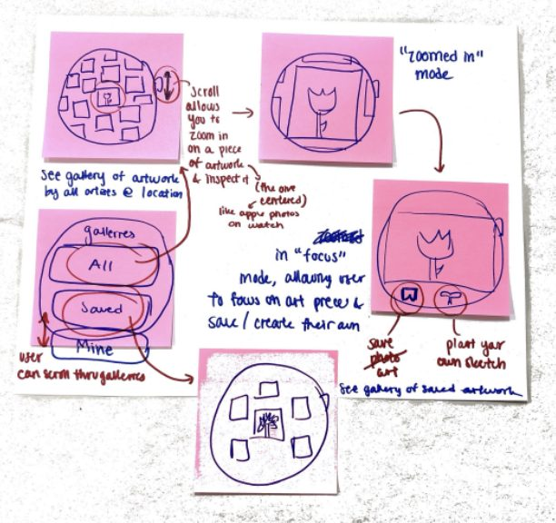
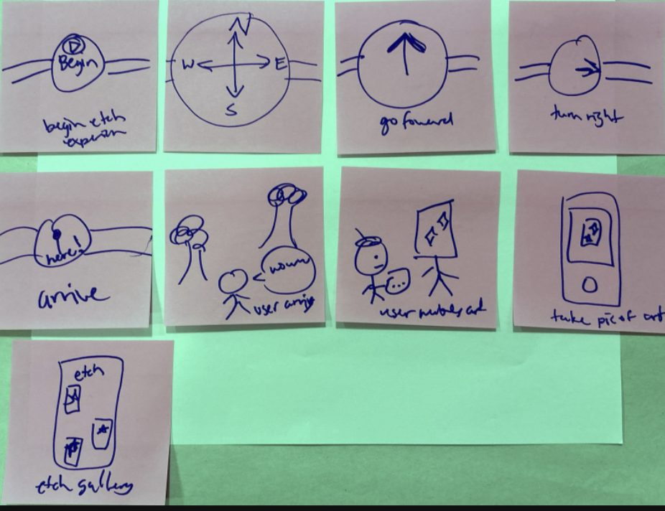
TOP REALIZATION 1
Smart Watch

Slide 19
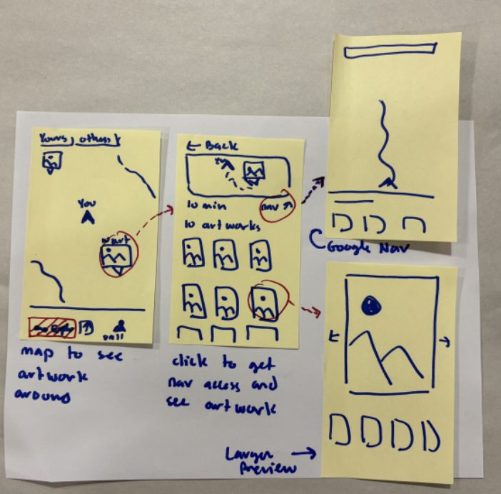
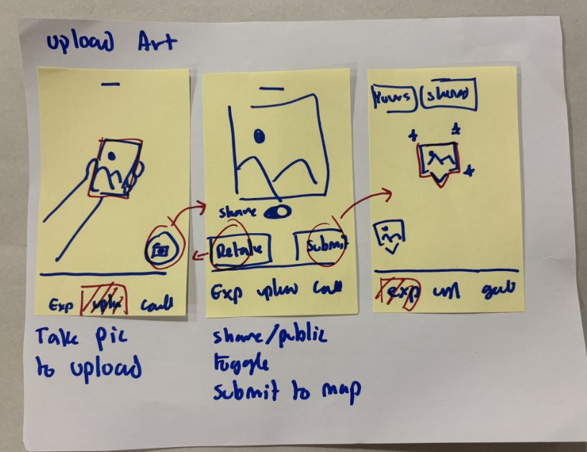
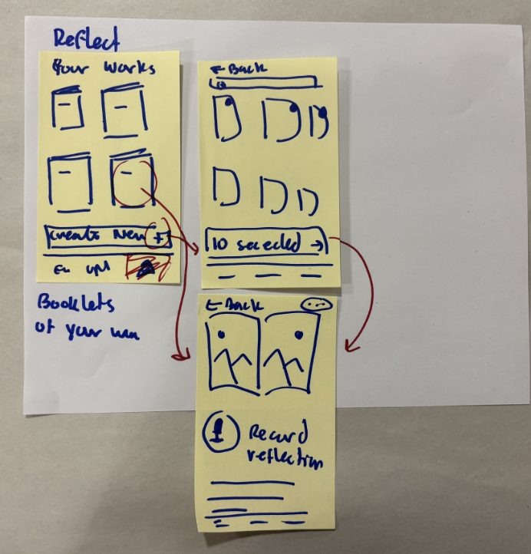
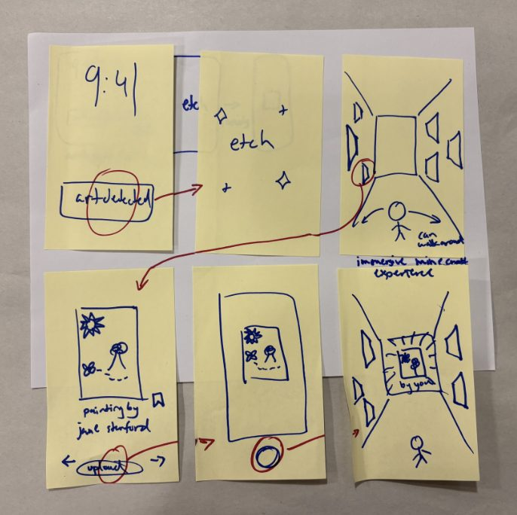
TOP REALIZATION 2
Phone

Slide 20
SMART WATCH VS. PHONE
What etch needs
Smart Watch
Phone
Easy to start
Separate from the supplies
The case holds the supplies
Eyes on surroundings
Haptic turns, no screen
A map pulls attention
Capture your piece
No camera
Built-in camera
Revisit past work
Too small to browse
Gallery and reflections
Process over result
Stays out of the way while you make
Camera pulls focus to the final photo

Slide 21
WHY PHONE?
The phone has the hardware etch needs. The watch's strengths were design choices we could keep.
Camera
Big screen
In hand
Watch's calm
PHONE
+
=
Capture each piece
Look back on past work
Already common to hold when commuting
Lock screen nudge, no map to follow

Slide 22
WHAT SHAPED OUR DECISION
Supplies close at hand: Having paints nearby lowered the barrier to start. Our supplies live on the phone case, so the interface should live on the phone too.
Revisiting old work: Seeing her old paintings helped Lola reconnect with making. Looking back at past pieces needs screen space.
Meaning is in the process: Needfinding showed the meaning of craft is in the process of making. The watch had the edge here, since it has no camera pulling focus toward a finished photo. We carried that over by keeping saving private and putting reflection after each session.
Staying aware outdoors We flagged the risk of people walking around glued to a screen, so discovery starts from a notification instead of a map you have to watch.
Platform constraints: A watch has no camera and a small screen. A phone has a camera, GPS, and room for a gallery, and most people already own one.

Slide 23
LOW-FI
PROTOTYPE

Slide 24
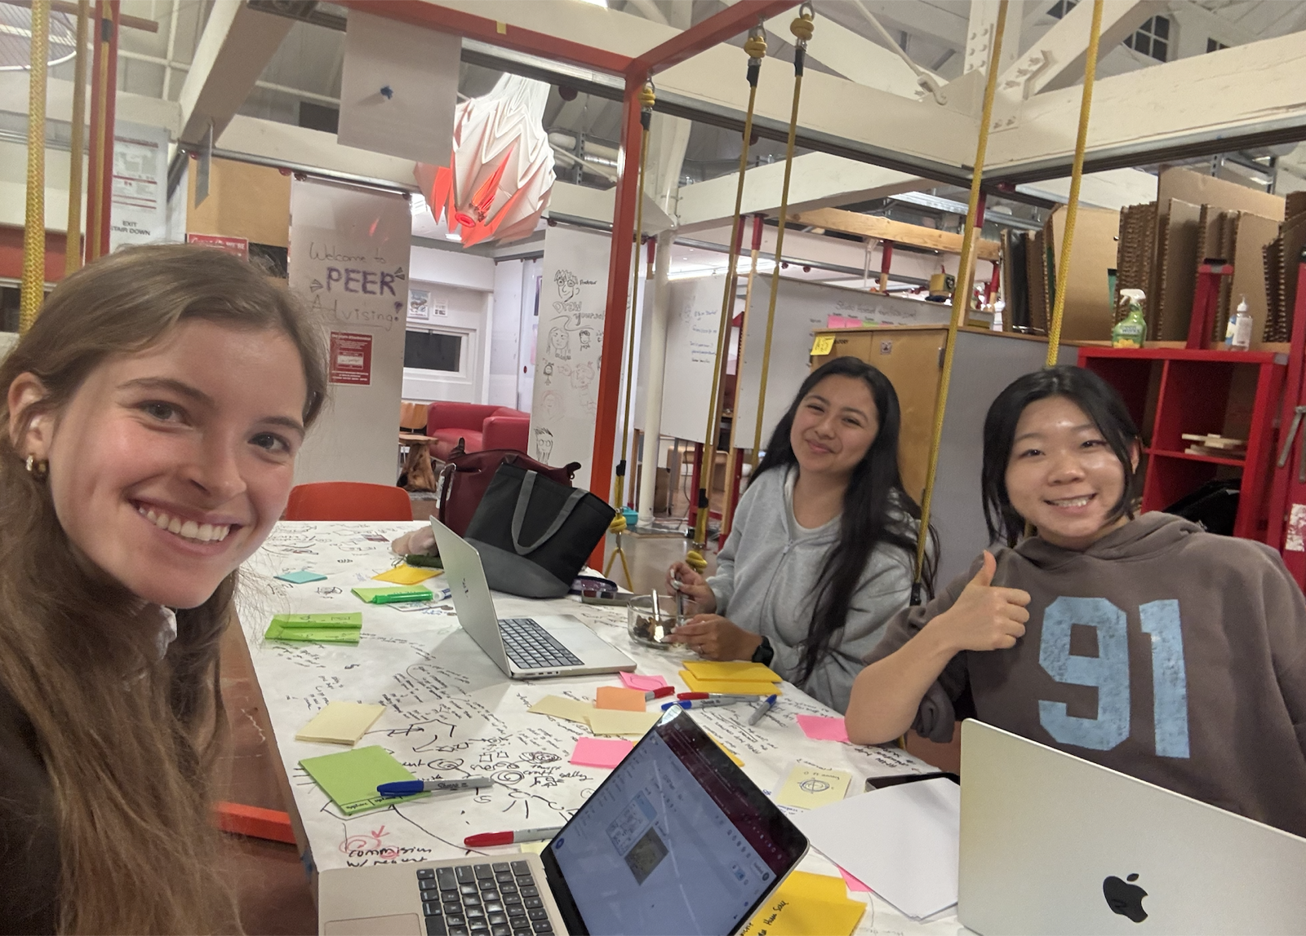
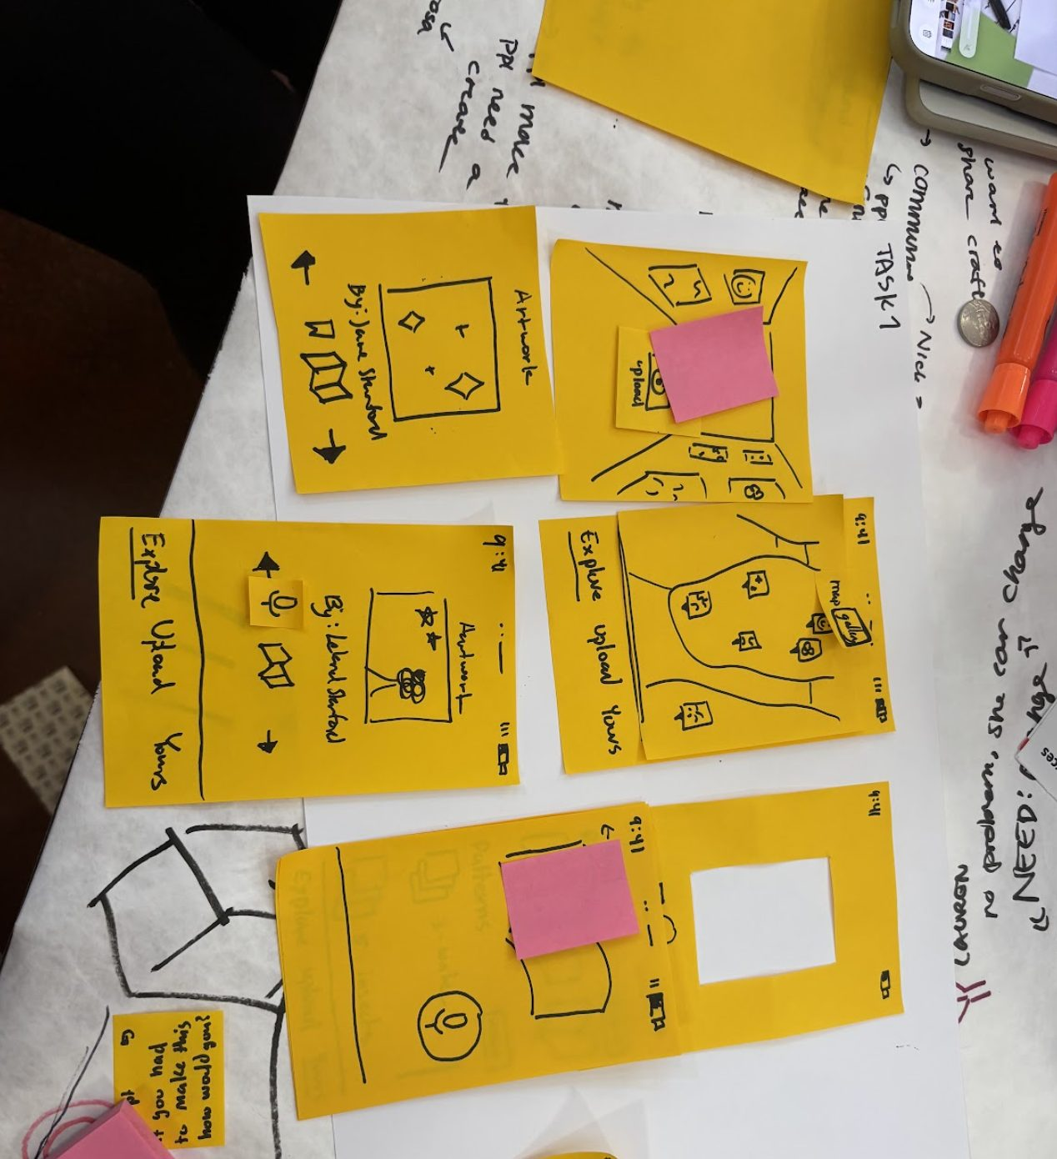
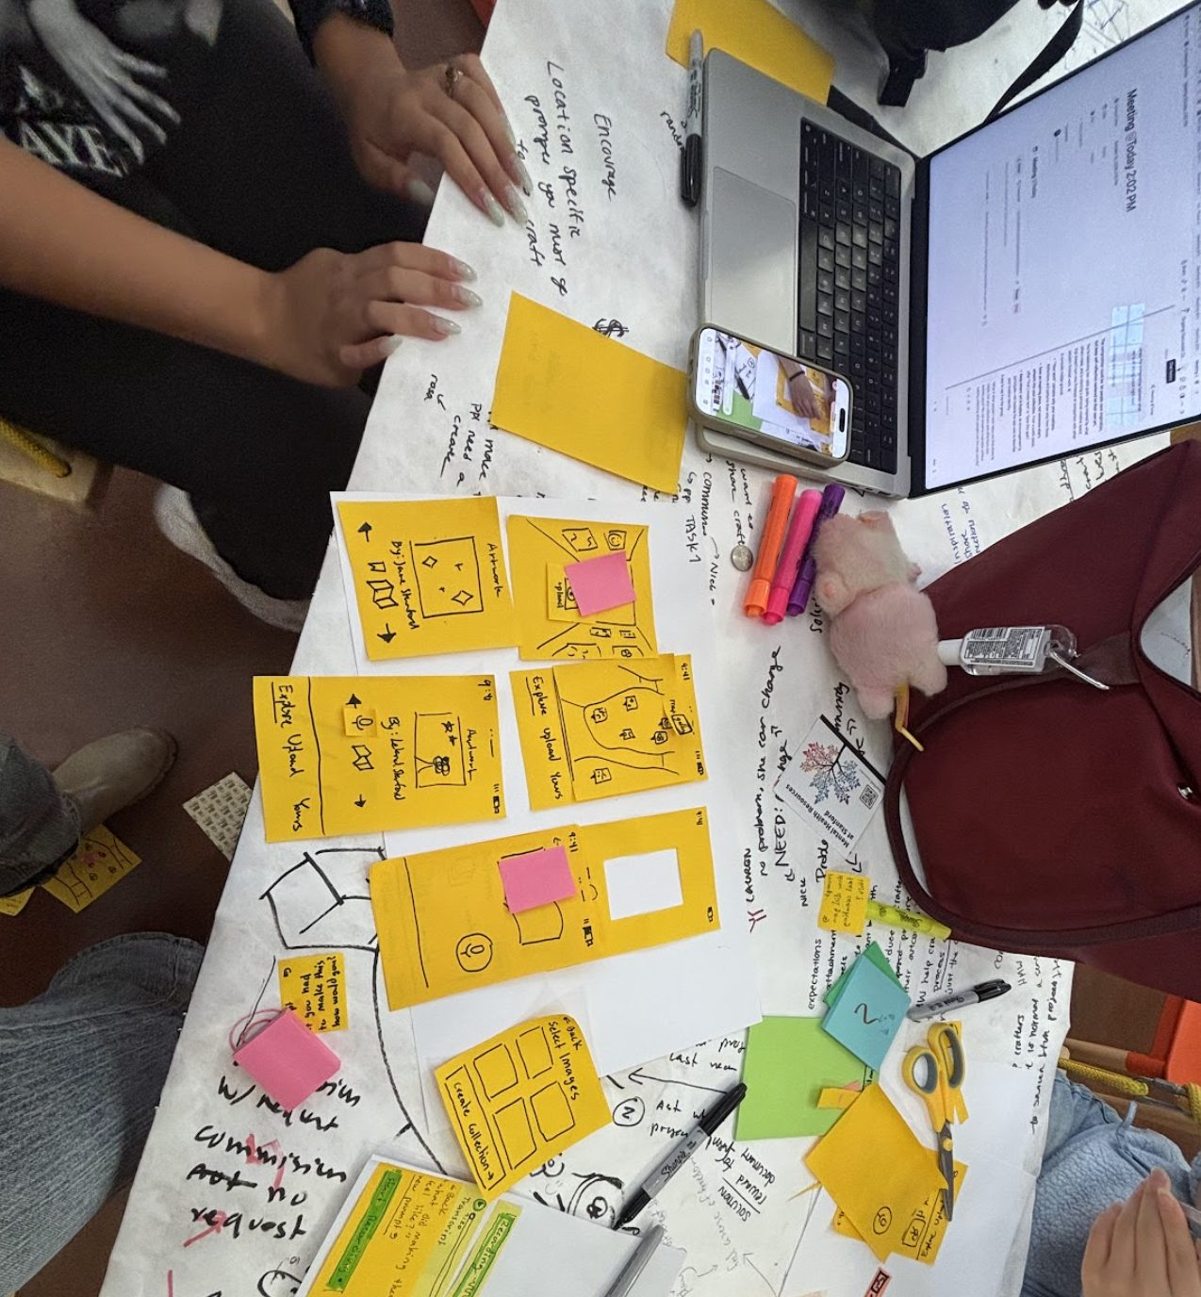
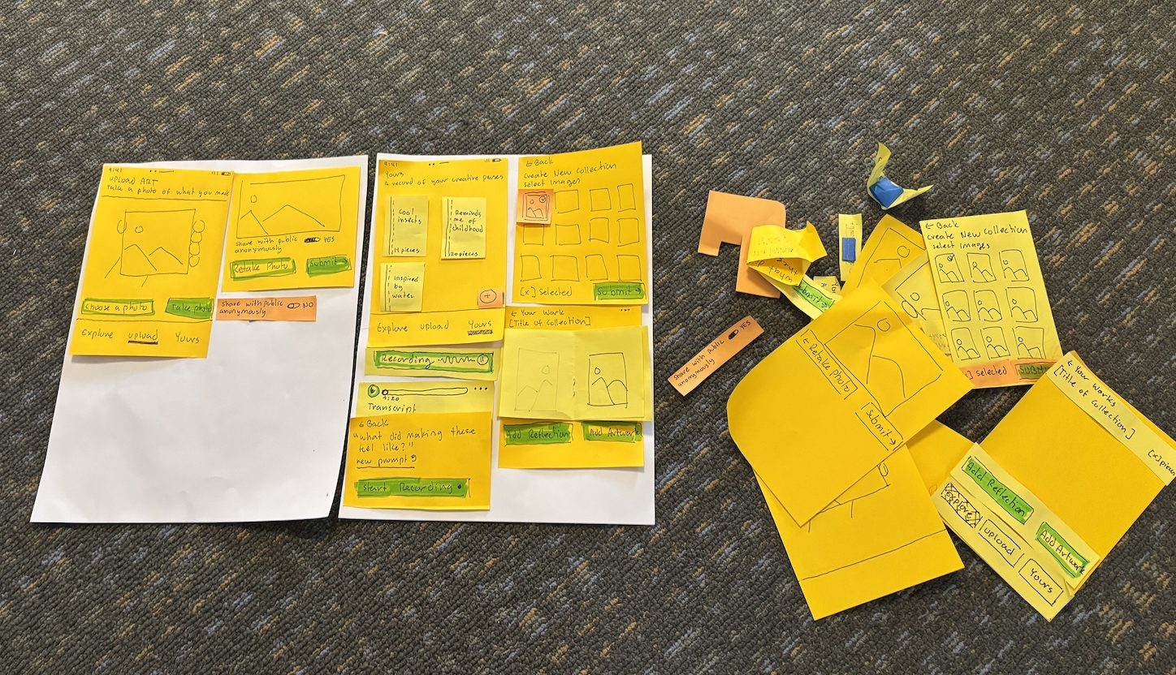
PAPER PROTOTYPE V1
BUILDING

Slide 25
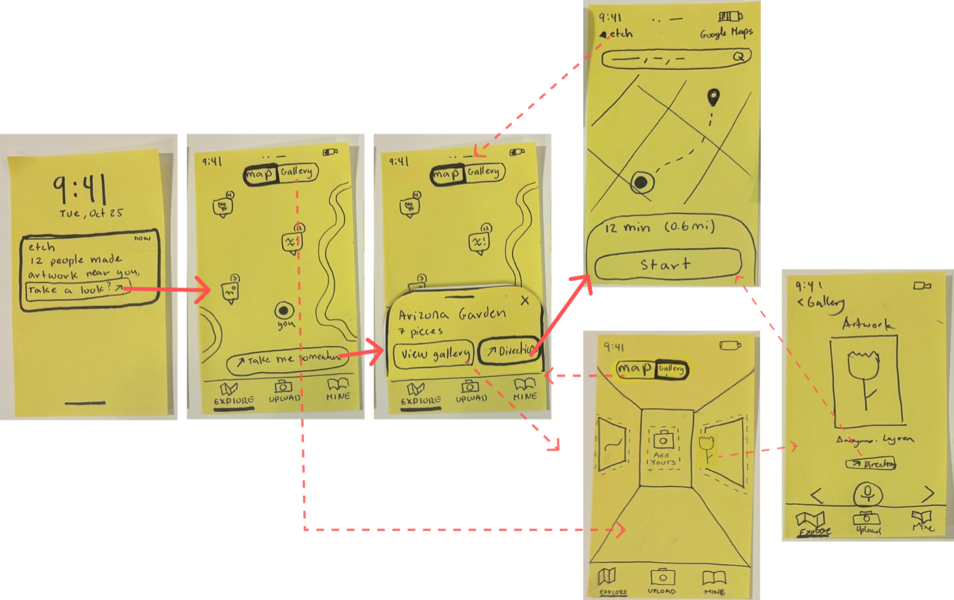
TASK 1
DISCOVER INSPIRATION
Get directions
Notice nearby art
Explore the map
Choose a spot
Preview artwork
Browse the gallery

Slide 26
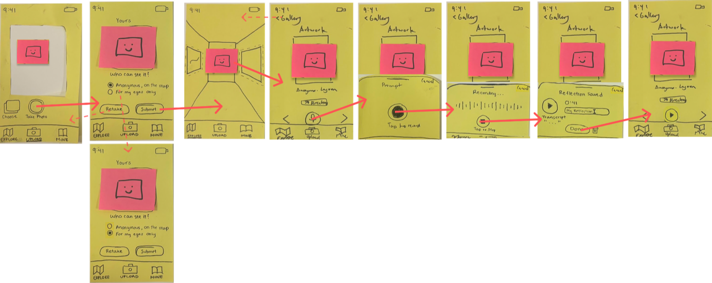
TASK 2
CREATE AND SAVE/SHARE
Choose visibility
Capture artwork
View gallery
Open artwork
Start reflection
Record audio
Review audio
Save reflection
Save privately

Slide 27
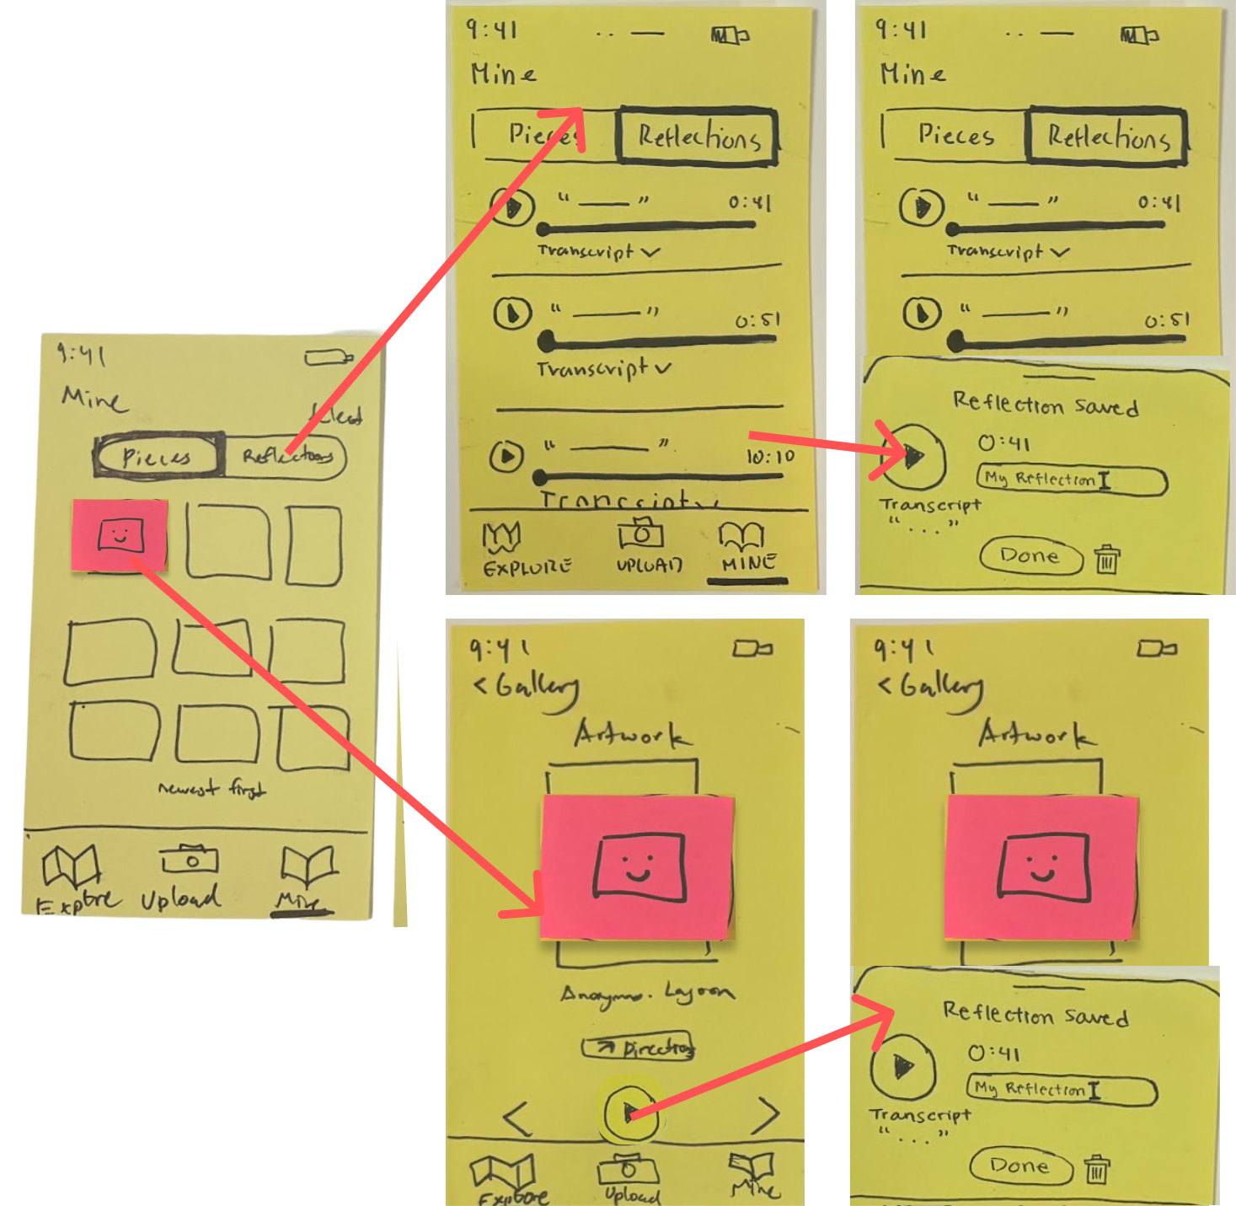
TASK 3
REVISIT AND CONNECT
Browse reflections
Replay or read
Open Mine
Open saved art
Revisit reflection

Slide 28
TESTING METHODOLOGY

Slide 29
HOW WE TESTED
We ran four in-person usability tests with our paper prototype. Each participant tried three tasks while thinking aloud, then rated each task for satisfaction and flexibility.

Slide 30
RECRUITMENT
Where: The Stanford d.school hosts a variety of craft and creative events that are open to the community. These events draw out different creative archetypes, from dedicated crafters to people who come because the event makes it easy to start. We attended one of these events and respectfully recruited after the programming ended.
Who: Creatives who either (a) placed the importance of creating in the process, (b) are struggling to make time for creating, or (c) both.
After recruiting: We saved each participant's contact information and met them later at a location that worked for them.
Compensation: Our verbal appreciation.

Slide 31
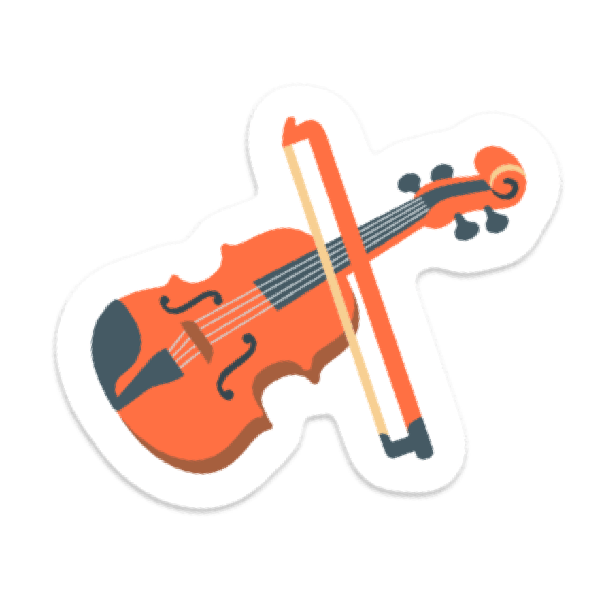



PARTICIPANTS
Booker
Software Developer
Writer (P1)
Jonas
Palo Alto Resident
Violinist (P2)
Cyrus
Palo Alto Resident
Journaler (P3)
James
Product Manager
Ideator (P4)
We sought creatives who either (a) placed the importance of creating in the process, (b) are struggling to make time for creating, or (c) both.

Slide 32
WHY THESE PARTICIPANTS
Booker (a, b): Writes in short sessions around a full-time job and struggles to find time for it.
Jonas (a): Plays violin for fun and learns new pieces by ear.
Cyrus (a): Journals for himself and goes on walks to get unstuck.
James (b): Sketches ideas at work but doesn't call himself an artist, and rarely makes things just for fun despite his desire to.
Different crafts: We recruited across writing, music, journaling, and sketching to see if etch meets the needs of diverse crafters.

Slide 33
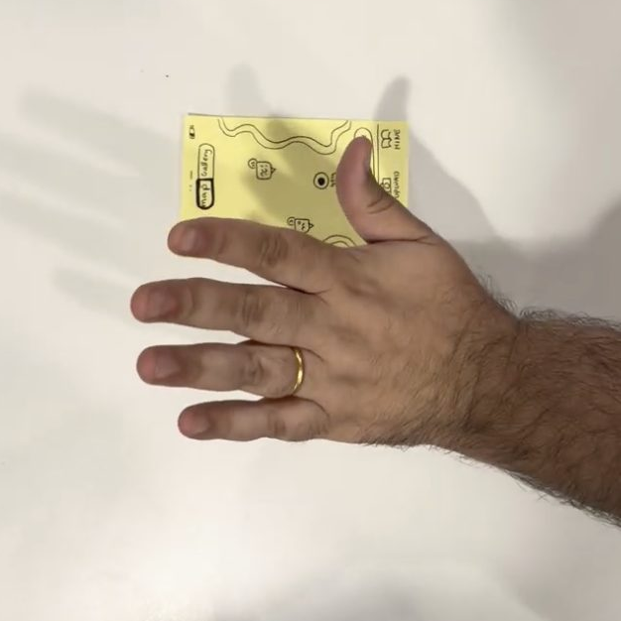
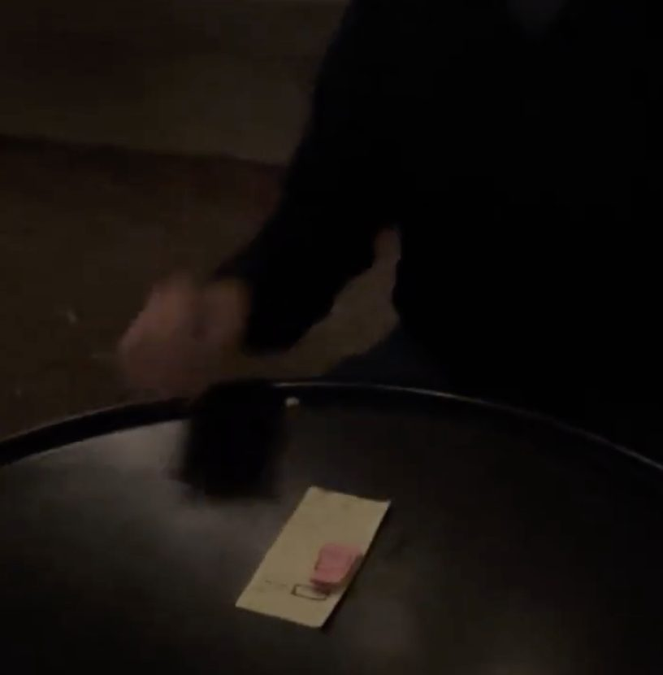
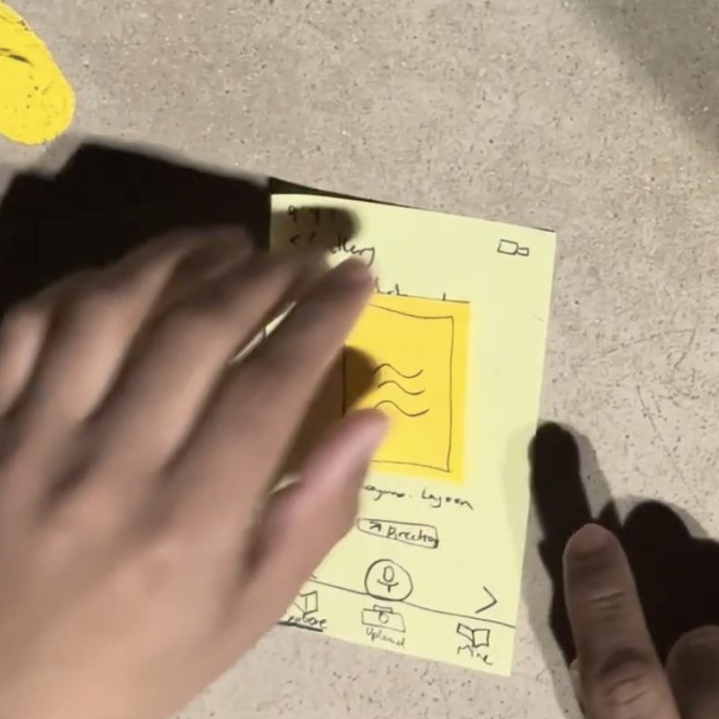
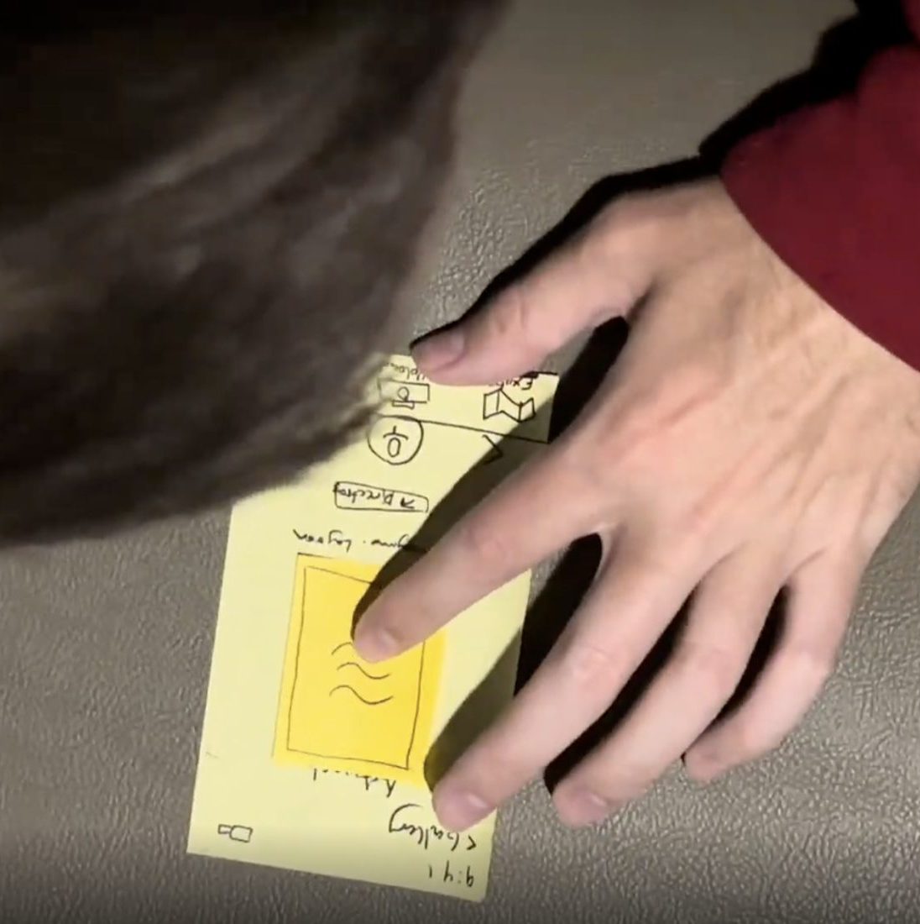
ENVIRONMENT
Indoor table
Test 1
Outdoor patio
Test 2
Outdoor pavement
Test 3
Lounge bench
Test 4
We met each participant at a location that worked for them. Two tests were indoors and two were outside.

Slide 34
APPARATUS
Paper prototype: We built our screens out of sticky notes on paper the size of an average phone, to best simulate using etch on a real phone. Pink and yellow overlays stood in for pop-ups and artwork.
Human computer: Manually simulated etch's responses, swapping screens after each tap.
Recording: Held the phone above the table and recorded the participant's hands and the screens.
Consent form: Each participant signed one before we started recording.

Slide 35
PROCEDURE
Consent: The participant signs the consent form
Context: We explain that etch helps creatives who are experiencing burnout find inspiration
Demo: We show how to use the paper prototype and how to think aloud, without showing any of the tasks
Tasks: We give one task at a time, from simple to complex. After each task, the participant gives both ratings and explains them
Wrap-up: We ask what was most frustrating and most enjoyable, then answer any questions

Slide 36
PROCEDURE - Team Member Roles
Elsa (Test 1), Jia (Tests 2-4)
Facilitator
Read the script, gave one task at a time, and conducted the post-test verbal collection of metrics, feedback, and follow-ups.
Kelly
Computer
Swapped the paper screens in response to each tap.
Jia (Test 1), Elsa (Tests 2-4)
Recorder
Held the phone above the table and recorded the participant's hands and the screens
Ahyan
Notetaker
Recorded critical incidents and quotes with timestamps.

Slide 37
THE THREE TASKS
SIMPLE
Discover inspiration
“Imagine you're taking a short break and want to find inspiration outside. Use the app to find a place to create.”
MODERATE
Create and save
“You've arrived at that spot and made a piece of art. Use the app to save it.”
COMPLEX
Revisit and connect
“You've made several pieces with etch. Use them to reflect on or find inspiration for your own craft.”

Slide 38
EACH TASK
Facilitator reads the task
Participant tries it while thinking aloud
Participant rates satisfaction and flexibility (1-7)
Facilitator asks why
→
→
→
The note-taker records positive and negative critical incidents throughout each task

Slide 39
KEY MEASUREMENTS
USABILITY GOAL
Pleasing
High user satisfaction
Our users are burnt out, so using etch should feel like a break
USABILITY GOAL
Flexible
Multiple ways to complete tasks
Needfinding showed creatives need both structure to start and freedom to explore
Key Measurement
Satisfaction rating (1-7)
Key Measurement
Flexibility rating (1-7) and unassisted completion

Slide 40
KEY MEASUREMENT
USABILITY GOAL 1
Pleasing
high user satisfaction
Why Pleasing
Etch aims to make creativity feel delightful again, helping people move from burnout toward curiosity and inspiration. A pleasing experience is central to that goal → should leave people feeling refreshed and excited to create.
Process data: Positive and negative critical incidents (mistakes, quotes, emotions), each given a 0-4 severity rating.
Bottom-line data: “How satisfied were you with this experience?” from 1 (very dissatisfied) to 7 (very satisfied), after each task.
Why this measure: Adapted from the After-Scenario Questionnaire (Lewis, 1991), a standard post-task satisfaction scale that also runs 1 to 7.
Initial target: An average of 5 or higher on each task (4 is neutral).

Slide 41
KEY MEASUREMENT
USABILITY GOAL 2
Flexible
multiple ways to complete tasks
Why Flexible
Interviews showed creativity follows different paths. Etch must support different workflows so people can follow their own creative process
Process data: Which path each participant chose (e.g. notification or map), and any time they looked for an option that wasn't there (e.g. misclicks or expressions to do something in a different way than the app supported).
Bottom-line data: “How well did etch let you complete this task in the way you preferred?” from 1 (not at all) to 7 (completely), plus unassisted completion rate for each path.
Why this measure: The rating is our own question, so we pair it with completion rate as a behavioral check.
Initial target: An average of 5 or higher on each task, and 80% unassisted completion for each path.

Slide 42
TESTING RESULTS

Slide 43
BOTTOM-LINE DATA
Task | Satisfaction / 7 | Flexibility / 7 | Misclicks | Time
1) Discover | 4.6 | 4.6 | 0.5 | 3:31
2) Save/share | 4.9 | 4.0 | 1.0 | 1:51
3) Connect | 5.3 | 4.1 | 0.25 | 4:07

Slide 44
TASK 1
DISCOVER INSPIRATION
“I’d like to envision myself … in this area not just see what someone drew in an area”
— James
Findings
Familiar map UI brought expectations for previews (i.e. surroundings, live activity)
Others artwork alone is not enough to make a place worth visiting

Slide 45
TASK 1
DISCOVER INSPIRATION
“I would have liked to have seen a list and … compared multiple things … instead of getting one.”
— James
Findings
Wanted to see multiple artworks at once versus one by one

Slide 46
TASK 1
DISCOVER INSPIRATION
“I try to make them all go away as much as possible [notifications]”
— Booker
Findings
Notifications were easy to dismiss
App must earn attention before asking people to go

Slide 47
TASK 2
CREATE AND SHARE
“Why do I want to share it?”
— Booker
Findings
Participants understood uploading, but questioned the benefit of sharing personal artwork
Private creation needs its own clear value. Sharing should feel like a choice

Slide 48
TASK 2
CREATE AND SHARE
“Only I can view it, which is a nice option to have”
— Cyrus
Findings
Booker and Jonas chose “For my eyes only.” Anonymity did not replace desire to keep for oneself

Slide 49
TASK 2
CREATE AND SHARE
“If I was looking for inspiration, I’d want to keep it to myself a little bit, so I can think about what I’ve done” — Jonas
Findings
“Submit” made saving feel like sending work to someone else
Users wanted to keep their artwork private so they could think about it before optionally sharing.

Slide 50
TASK 3
CONNECT TO A CRAFT
“What am I doing?”
– Booker
Findings
Found it hard to complete task - unclear how result would connect back to main craft
Had to re-ask for task goal

Slide 51
TASK 3
CONNECT TO A CRAFT
“Then I’d realize my art probably doesn’t inspire me that much”
— James
Findings
Looking back at past artwork did not always help users find inspiration for their main craft or current projects

Slide 52
TASK 3
CONNECT TO A CRAFT
“I appreciate that there’s a transcript and an audio … I can just read it”
— Jonas
Findings
Two participants mentioned liking the transcript option for voice recordings.

Slide 53
DID WE MEET OUR GOALS?
Pleasing
Partly met
Flexible
Partly met
target 5
target 5
4.9
5.3
4.6
4.6
4.0
4.1
Task 1
Task 2
Task 3
Task 1
Task 2
Task 3
Average satisfaction out of 7, after each task
Average preferred-way rating out of 7
Unassisted completion: 100%, 100%, 25%

Slide 54
SAID VS RATED: (they sometimes contradict)
Scores ran higher than what people said while giving them
6
out of 7
TASK 1, Cyrus (P3)
“I didn't quite understand the change from the waves to the mountain”
Missed that swiping showed a new artwork
7
out of 7
TASK 2, James (P4)
“Uploading our work, that's like a seven”
Then: “I'd like to save my art myself, to my camera”
5
out of 7
TASK 3, Booker (P1)
“Often the end result does not actually matter much to me”
Task 3 asked them to look back at finished pieces
Testing one design inflates ratings (Tohidi et al., CHI 2006)

Slide 55
DID WE MEET OUR GOALS? (Long)
Pleasing, satisfaction (target 5+): Task 1 averaged 4.6, Task 2 4.9, and Task 3 5.3. Only Task 3 reached the target.
Flexible, preferred-way rating (target 5+): Task 1 averaged 4.6, Task 2 4.0, and Task 3 4.1. No task reached the target.
Flexible, unassisted completion (target 80%): All four finished Tasks 1 and 2 on their own. In Task 3, P1, P2, and P4 needed the task re-explained, so only 25% finished unassisted.
What the numbers hide: P4 rated the upload itself a 7 but Task 2 a 2.5 overall, because there was no way to save to the camera roll. P1 rated Task 3 around 5 while saying the end result “does not actually matter much.”
How much to trust this: Participants rated out loud to the team and saw only one design. Testing a single design inflates ratings and reduces criticism compared with showing several (Tohidi et al., CHI 2006, building on Wiklund, Thurrott and Dumas, 1992), so we weigh what people said over the scores.

Slide 56
DISCUSSION

Slide 57
RETHINKING OUR IDEA
People wanted to see the place itself
->
Going somewhere new felt like too much work
->
Making mattered more than the finished piece
->

Slide 58
RETHINKING OUR IDEA
People wanted to see the place itself.
->
This made us ask:
Could we bring some of that environment to people while they’re already making?
Going somewhere new felt like too much work.
->
Making mattered more than the finished piece.
->

Slide 59
RETHINKING OUR IDEA
People wanted to see the place itself
–>
The environment is the inspiration
Going somewhere new felt like too much work
->
Bring the environment to the person
Making mattered more than the finished piece
->
Center the act of making

Slide 60
What Made Us Rethink Our Idea
People wanted to see the place itself.
P4 wanted to picture being there, not just see artwork someone had made there
Going somewhere new felt like too much work.
P4 wanted to browse more freely. Going somewhere else wasn’t helpful when they wanted inspiration right then
Making mattered more than the finished piece.
P1 questioned why they would share, and P1 and P2 chose to save privately
The environment is the inspiration
P4 wanted to understand the environment and access inspiration without traveling elsewhere.
→ Explore bringing the surroundings into the user’s creative space.
Bring the environment to the person
P4 wanted to browse multiple images without repeated clicks.
→ Offer quick environment previews and fewer steps before starting.
Center the act of making
P1 questioned sharing; P1 and P2 chose private saving. Reflection preferences also varied.
→ Make the experience useful without requiring an upload, a recording, or public sharing.
->
->
->

Slide 61
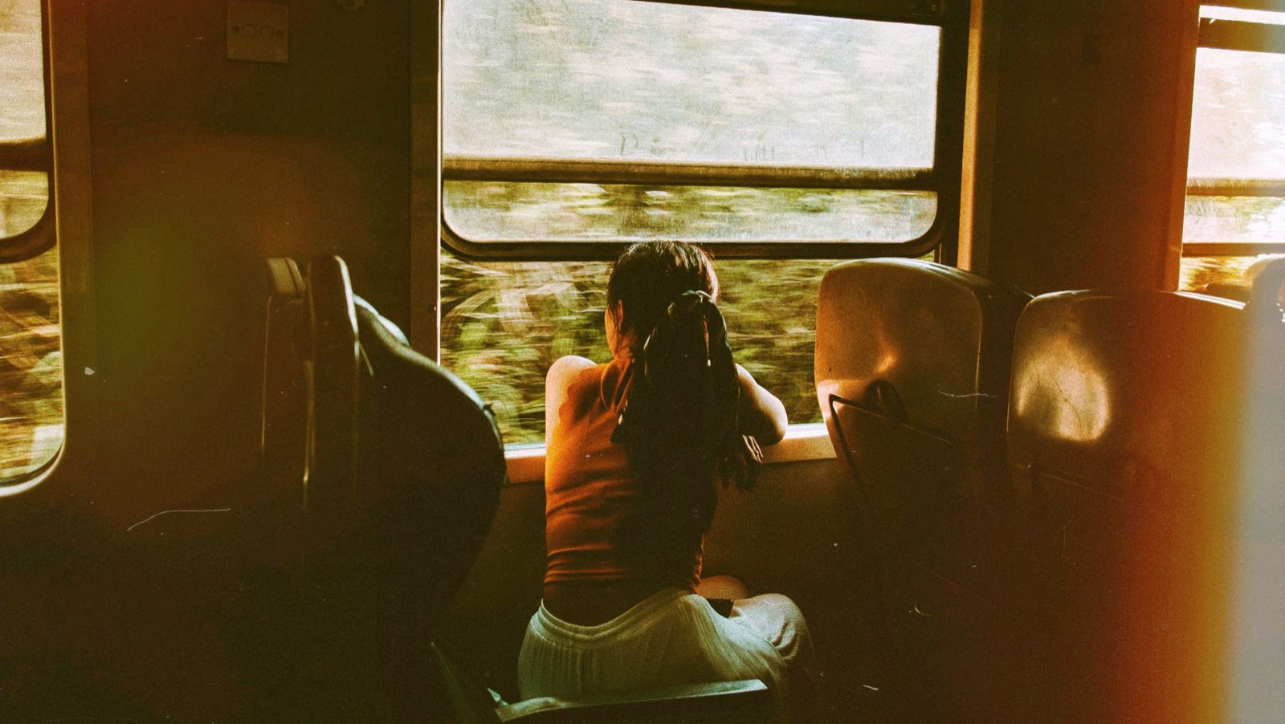
What We Want to Try Next
Think about sketching in a park or looking out the window on a train. Your surroundings keep changing, and you can look up whenever something catches your attention

Slide 62
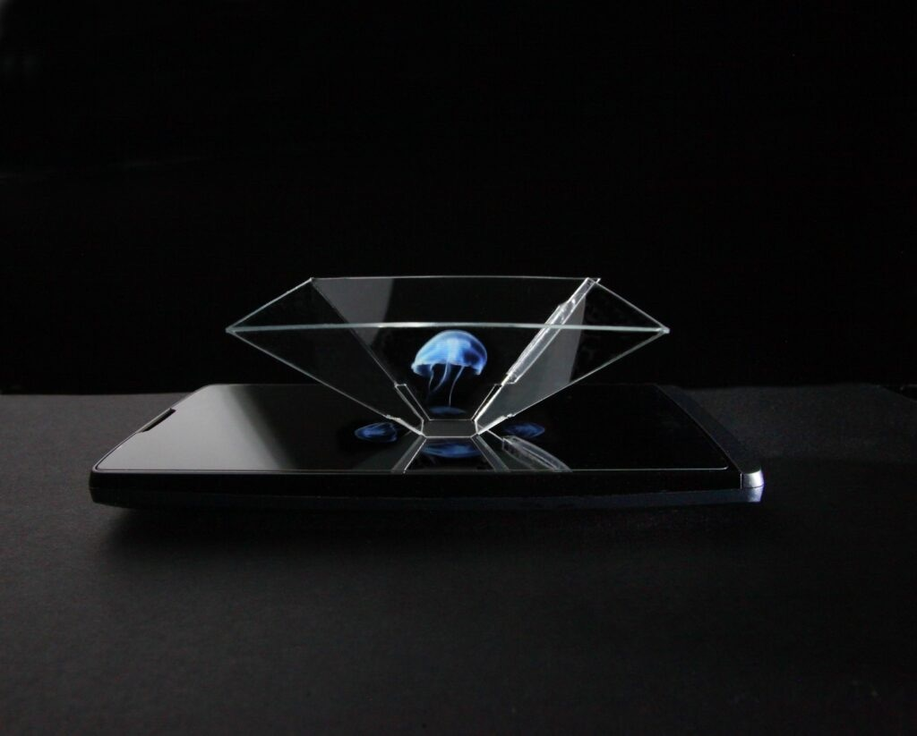
TRY NEXT
We want to bring that feeling to someone’s workspace
Hologram video + spatial sound → to create immersive observation for creation

Slide 63
IDEA
An ambient window into another place
Inspired by painting in a museum, sketching in a park, and watching scenery pass from a train.
A phone-and-plastic display creates a floating-image effect
A one-way environmental view provides changing scenery
Optional spatial audio adds a sense of place
Simple controls let the user choose a scene, adjust it, and return to making
Our hypothesis: changing surroundings can support creative exploration without demanding sustained attention

Slide 64
UNKNOWNS
Our tests showed where people got confused and what they wanted more control over. They didn’t show whether our idea actually helped someone with their craft.
We also changed how we explained Task 3, so those results are harder to compare.
Next, we’ll try the ambient prototype while people are actually making something. We’ll look for when they pause, what draws their attention, and whether they find the scene enjoyable or distracting.
We still need to find out:
Does the floating display add anything over a regular phone screen?
Does live footage feel different from recorded footage?
Would people keep using it after the novelty wears off?

Slide 65
STILL NEED TO TEST
What we could not establish: whether the experience supports someone’s minecraft. Task 3 instructions were reframed, and the paper prototype did not simulate actual making
Next: test an ambient prototype while participants do a familiar craft
Compare making with and without the scene. Observe interruptions and ask about enjoyment, distraction, and sense of presence.
Then test separately: whether the floating display adds value, and whether live footage differs from recorded footage.

Slide 66
APPENDIX

Slide 67
ALL WATCH PROS AND CONS
Pros
Haptic turn-by-turn directions let people find a spot without staring at a screen (A2 ethics)
A glance at the wrist fits a short break better than unlocking a phone
Without a camera, there's less pull toward a polished final photo (A2: meaning is in the process)
Following a compass to an unknown spot makes discovery feel like an adventure (A2 experience prototype 1)
Wrist notifications get noticed while walking, even with the phone put away
Hands stay free while painting
Cons
No camera, so saving art means switching to the phone anyway
Small screen makes others' art hard to see, and small targets are slower to hit (Fitts's law)
Too little room to browse past work or record and review reflections (needfinding, Lola)
Splitting one break across two devices adds handoffs and steps (gulf of execution)
Fewer people own a smartwatch, which limits who can use etch (accessibility)
Haptic patterns have to be memorized (recognition over recall)
The supplies live on the phone case, so the phone comes out regardless

Slide 68
ALL PHONE PROS AND CONS
Pros
The phone case holds the paints and brush, so the phone is already in hand when someone starts (A2, supplies close at hand)
The camera is built in, so capturing and saving art happen on one device
Room for both a map and a gallery, giving more than one way to explore
The whole loop fits on one device: discover, create and save, then reflect
Big enough to look closely at others' art, and seeing others create gives permission to take a break (A2 takeaway)
Most people already own one, so no extra hardware is needed (accessibility)
Voice and text reflections capture how a session felt, along with the piece
Lock screen notifications reach people as they pass a spot
Cons
Following a map while walking competes with noticing the surroundings and can be unsafe (A2 ethics)
A camera-first flow can put the focus on a polished final photo (A2: meaning is in the process)
Less novel than a wearable
Opening the phone makes it easy to drift into other apps
More screen time works against the feeling of taking a break
A public gallery invites comparing your piece to others' (value proposition)

Slide 69
SCRIPT
Introduction and brief demo
Thanks for helping us test Etch! Etch supports low-stress creative breaks outdoors and helps you carry inspiration back to your main craft. We’re testing a low-fi design so there are no right or wrong reactions, and honest feedback will help us improve.
This is a paper prototype. You can tap buttons and features will be simulated with moving paper screens. As you use it, please think aloud by telling us what you’re looking at, what you expect, and anything that feels confusing or enjoyable.

Slide 70
SCRIPT
Task 1 — Discover inspiration
Imagine you have a short break and want to spend some time outside. You’d like to find somewhere nearby where other people have made art.
Use Etch to find a spot you’d consider visiting to create artwork. Tell us when you feel finished.
After completion metrics:
How satisfied were you with that experience, from 1 to 7, where 1 is very dissatisfied and 7 is very satisfied? What contributed to your rating?
On a scale of 1 to 7, where one is not at all and 7 is completely, how well did Etch let you complete this task in the way you preferred? What contributed to your rating?

Slide 71
SCRIPT
Task 2 — Create and save
Imagine you’ve arrived at an outdoor spot and created an artwork inspired by the location. Now you want to share what you make with others, use the app to do this
After completion metrics:
How satisfied were you with that experience, from 1 to 7, where 1 is very dissatisfied and 7 is very satisfied? What contributed to your rating?
On a scale of 1 to 7, where one is not at all and 7 is completely, how well did Etch let you complete this task in the way you preferred? What contributed to your rating?

Slide 72
SCRIPT
Task 3 — Connect inspiration to your main craft
What is a creative craft or practice you enjoy?
Imagine you’re starting a new project in that craft. You’ve made several small pieces during past creative breaks, and you want to see whether anything in them could inspire this project.
Use app to revisit your past work and reflect on how it can connect to your craft and how you might use it. Tell us when you feel finished.
After completion metrics:
How satisfied were you with that experience, from 1 to 7, where 1 is very dissatisfied and 7 is very satisfied? What contributed to your rating?
On a scale of 1 to 7, where one is not at all and 7 is completely, how well did Etch let you complete this task in the way you preferred? What contributed to your rating?

Slide 73
SCRIPT
Observer notes
For each task, record:
Whether the participant finishes independently or needs assistance
  Number of times they need assistance and where/when
The path they choose, any switching between approaches, and alternatives they look for
Positive incidents, clear expectations, successful discoveries, delight, or relief
Negative incidents, mistakes, backtracking, confusion, frustration, or unexpected behavior
Exact quotes and the screen or action associated with each incident
Satisfaction rating and the participant’s explanation
Flexibility rating and the participant’s explanation

Slide 74
TASK 1

Slide 75
HOW WE MEASURED MISCLICKS
We measured misclicks as instances when a participant selected an option that led to an unintended outcome, or became confused and backtracked after entering a path they did not mean or want to follow.
We did not count intentional departures from our expected task flow when the app supported the participant’s intention.

Slide 76
TASK 1 RATING BREAKDOWN
Participant | Satisfaction / 7 | Flexibility / 7 | Misclicks | Time
P1 | 4 | 5 | 1 | 3:22
P2 | 5 | 5 | 0 | 1:57
P3 | 6 | 4.5 | 0 | 2:27
P4 | 3.5 | 4 | 1 | 6:16
Average | 4.6 | 4.6 | 0.5 | 3:31

Slide 77
P1 TASK 1 EXPERIENCE
Incident | Severity
Recognized the local map and chose the closest place | 0
Praised the small number of taps and absence of extra screens | 0
The experience required effort before its value became clear | 2
Would probably dismiss notifications; questioned their usefulness | 2
Didn’t know you could tap on other people’s art to see more. Accidentally tapped on it | 3
Time spent: 3:22 [1:15–4:37]
Number of misclicks: 1
Rating Satisfaction: 4 / 7
Rating Flexibility: 5 / 7
“It’s taking some cognitive effort. It’s not rewarded in some very obvious way. It’s not aggravating me… It’s not showing me an extraneous amount of screens” [5:02]

Slide 78
P2 TASK 1 EXPERIENCE
Incident | Severity
Asked whether the map showed artwork made nearby (shows that not very clear) | 2
Did not understand the artwork-detail screen | 2
Expected artwork to open; initially read Directions as “directory” | 1
Controls felt natural and the experience straightforward | 0
Time spent: 1:57 [2:08–4:05]
Number of misclicks: 0
Rating Satisfaction: 5 / 7
Rating Flexibility: 5 / 7
“It seems pretty straightforward”; buttons “seemed natural.”[04:36–04:51
“I don’t know what this is” [referring to the wave artwork in the detail page, not aware it’s someone else's art] [2:57]

Slide 79
P3 TASK 1 EXPERIENCE
Incident | Severity
Did not realize changing pictures meant browsing different artworks | 3
Could not tell how artwork related to the actual surroundings | 3
Read Directions as “directory” → so accidentally found the directions page | 1
Found the interface easy to navigate after explanation | 0
Time spent: 2:27 [0:46–3:13] (they got to map pretty fast but then kept going and explored that app)
Number of misclicks: 0
Rating Satisfaction: 6
Rating Flexibility: 4.5
“The interface is pretty easy to navigate.”
[04:43]

Slide 80
P4 TASK 1 EXPERIENCE
Incident | Severity
Read map counts as people currently drawing | 2
Asked whether microphone recordings were private personal notes | 3
Wanted to compare locations and see shade or table availability | 3
Liked seeing artwork others made at the same location | 0
Time spent: 6:16 [0:41–6:57]
Number of misclicks: 1 (felt like he messed up by going to gallery view and not the take me somewhere)
Rating Satisfaction: 3.5
Rating Flexibility: 4
“I would have liked to have seen a list… and compared multiple… options.”
[07:40–07:55]
“Where is this going? [the recording on the detailed artwork page]”

Slide 81
TASK 2

Slide 82
TASK 2 RATING BREAKDOWN
Participant | Satisfaction / 7 | Flexibility / 7 | Misclicks | Time
P1 | 4 | 1 | 1 | 2:21
P2 | 7 | 7 | 1 | 1:06
P3 | 6 | - | 2 | 3:28
P4 | 2.5 | 4 | 0 | 0:28
Average | 4.9 | 4.0 | 1.0 | 1:51

Slide 83
P1 TASK 2 EXPERIENCE
Incident | Severity
Chose private saving rather than public sharing | 0
Initial questions around “should I upload?” when given the task, but quickly figured it out | 1
Submit sounded like sending to someone despite the private choice | 3
Could imagine keeping a daily art habit and personal record | 0
Unclear what saving in Etch offered over existing alternatives | 2
Time spent: 2:21 [7:01–9:22]
Number of misclicks: 1 (did not find the reflection page for uploaded image)
Rating Satisfaction: 4 / 7
Rating Flexibility: 1 / 7
“Why do I have to share it?” [7:01]
“Am I saving this for myself or am I submitting this to someone? [referring to the “submit” button text] [8:22]
“I’m not sure what doing this in the app gave me that I would have gotten had I not done it in the app” [9:48]

Slide 84
P2 TASK 2 EXPERIENCE
Incident | Severity
Completed the familiar capture-and-private-save sequence | 0
Immediately went to upload when given task | 0
Liked the gallery presentation | 0
Thought the gallery was only his drawings and not other peoples art. After explained concept, said he would want a version where it is just his art. | 2
Private saving supported wanting time to think about inspiration | 0
Time spent: 1:06 [6:11–7:17]
Number of misclicks: 1 (did not find the reflection page for uploaded image)
Rating Satisfaction: 7
Rating Flexibility: 7
“Seemed really easy to do. Pretty straightforward, stuff I’ve done before” [8:20]

Slide 85
P3 TASK 2 EXPERIENCE
Incident / reflection | Severity
Could not find audio creation after uploading an image; hard to know you could click main artwork in the gallery | 3
Asked whether X was the cancel control | 2
Valued the option to keep journal entries private | 0
Could not add a reflection from the “Reflection” page in mine section | 3
Time spent: [7:14–10:42]
Number of misclicks: 2 (not able to make a reflection; wanted to make new reflection from “mine” page)
Rating Satisfaction: 6
Rating Flexibility: Not recorded
“I want to upload an audio pertaining to the image I uploaded” [9:05]
“I don’t really see the option to do that [to record a reflection after sharing an artwork]”
[08:53]

Slide 86
P4 TASK 2 EXPERIENCE
Incident | Severity
Completed the anonymous public-upload flow independently | 0
Could not save to the camera roll; proposed screenshotting and cropping | 3
Liked seeing the artwork displayed and shared | 0
Rated upload mechanics highly, despite unmet personal-saving needs | 0
Time spent: 0:28 [10:19–10:47]
Number of misclicks: 0 (reached the artwork detail page; did not try to record anything)
Rating Satisfaction: 2.5
Rating Flexibility: 4
“The not being able to save it for myself [on his camera roll]… really bugged me.”
[12:39–12:44]

Slide 87
TASK 3

Slide 88
TASK 3 RATING BREAKDOWN
Participant | Satisfaction / 7 | Flexibility / 7 | Misclicks | Time
P1 | 5 | 4 | 0 | 2:49
P2 | 5 | 5 | 0 | 3:45
P3 | 6.5 | 6 | 1 | 3:53
P4 | 4.5 | 1.5 | 0 | 6:00
Average | 5.3 | 4.1 | 0.25 | 4:07

Slide 89
P1 TASK 3 EXPERIENCE
Incident | Severity
Valued having a gallery or record of things made | 0
Wanted clearer purpose and context for making and keeping artwork, the app didn’t provide that motivation | 3
Imagined seeing older work differently beside a newer piece | 0
Said the interface felt familiar and nothing was very frustrating | 0
Time spent: 2:49 [13:39–16:28]
Number of misclicks: 0
Rating Satisfaction: 5
Rating Flexibility: 4
“There is a value in the process that I’m getting as a person that I’m not getting in the product [of the art he creates]” [14:33]

Slide 90
P2 TASK 3 EXPERIENCE
Incident | Severity
Could not find how to create a new reflection from an artwork | 3
Appreciated access to both audio and a readable transcript | 0
Wanted video capture to support music as a creative practice | 2
The gallery helped the piece feel more like an artwork | 0
Time spent: 3:45 [8:55–12:40]
Number of misclicks: 0
Rating Satisfaction: 5
Rating Flexibility: 5
“If I’m in a place that I can’t listen to it [the recording], I can just read it [referring to the reflection transcripts].” [10:24–10:30]

Slide 91
P3 TASK 3 EXPERIENCE
Incident | Severity
Could not find a clear route back from the gallery to directions | 3
Wanted surroundings previews and information about local activity | 2
Enjoyed spontaneous exploration and nature as inspiration | 0
Requested a short introduction to explain the artwork’s purpose | 3
Time spent: 3:53 [12:20–16:13]
Number of misclicks: 1 (didn’t have a back option from gallery directions to map)
Rating Satisfaction: 6.5
Rating Flexibility: 6
“I would go to explore, and then I would go to “take me somewhere…I get inspo not from algorithms but from spontentity” [13:00]
“Want to see the end destination like 360 view” [15:00]

Slide 92
P4 TASK 3 EXPERIENCE
Incident | Severity
Disliked the idea of hearing their own voice in reflection playback | 2
Wanted many images to scan instead of repeated clicks to reach one | 3
Walking elsewhere did not meet the immediate inspiration need | 3
Eventually found attractive art that “maybe” inspired them | 0
Time spent: 6:00 [14:43–20:43]
Number of misclicks: 0 (but did not find seeing his artwork or reflections inspired him)
Rating Satisfaction: 4.5
Rating Flexibility: 1.5
“Then I’d realize seeing my art doesn’t inspire me that much so I would go back to the explore button” [18:30]
“There’s way too much click, click [when wanting to look at multiple images to get inspiration]”
[23:06]
“Either that pictured unblocked me or I’m going to have to find another app” [19:00]

