Slide 1
ELSA
STUDIO
01
/ 06
Customer quote
REQUEST
POST /workflows/http/quotes
A customer
and a total
Customer lookup
→
Calculate
→
Return
Local API · C-1042
40 + 2 → 42
HTTP 200
Protected customer lookup
JSON RESPONSE
Reusable calculation
{"customerId":"C-1042","name":"Alex Morgan","total":42}
One JSON response
Synthetic local customer fixture
01
Customer quote
02
API access
03
Reusable calculation
04
Quote workflow
05
Runtime diagnosis
06
Secret rotation

Slide 2
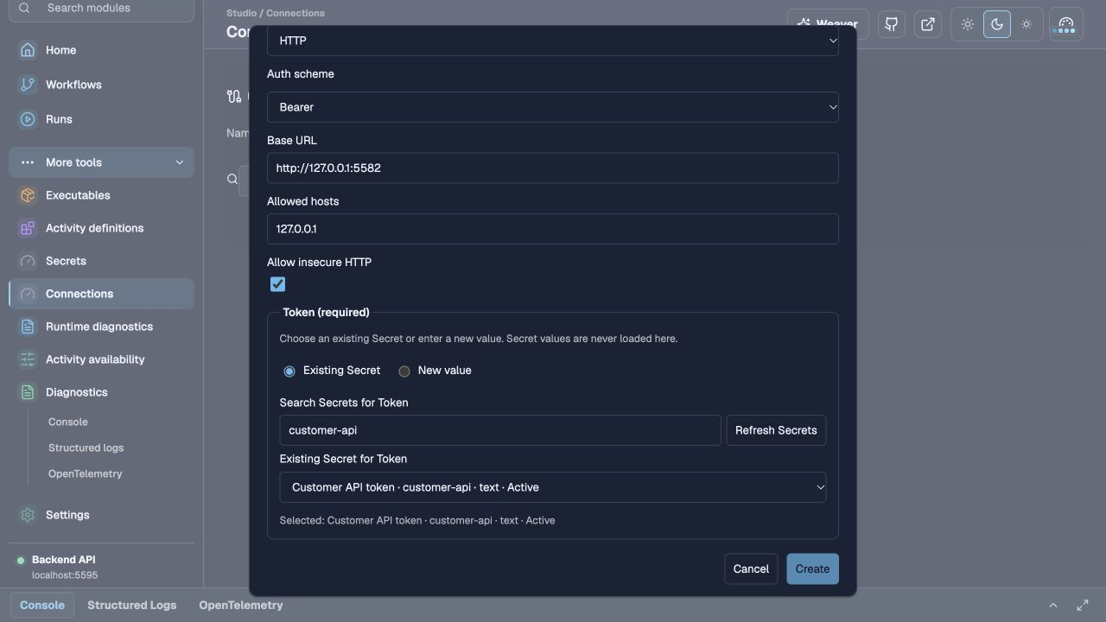
ELSA
STUDIO
02
/ 06
API access
A Secret and a
Connection
Secret: customer-api
HTTP Connection with Bearer authentication
The workflow uses the Connection
Existing Secret selected for the Bearer Connection
Value hidden
01
Customer quote
02
API access
03
Reusable calculation
04
Quote workflow
05
Runtime diagnosis
06
Secret rotation

Slide 3
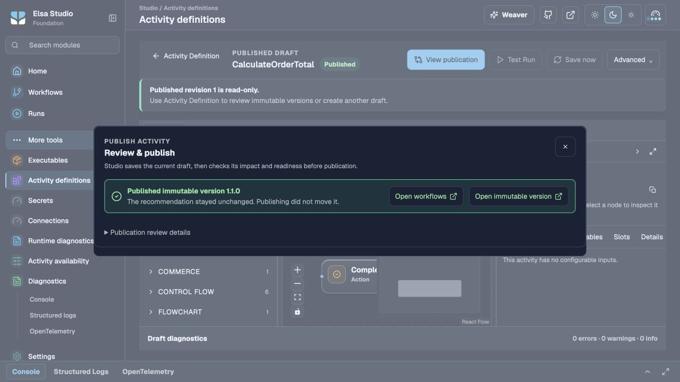
ELSA
STUDIO
03
/ 06
Reusable calculation
40 + 2 = 42
Inputs: Subtotal and Shipping
Output: Total
Outcome: Calculated
TEST RUN
40 + 2 = 42
Calculated
CalculateOrderTotal
Published · version 1.1.0
01
Customer quote
02
API access
03
Reusable calculation
04
Quote workflow
05
Runtime diagnosis
06
Secret rotation

Slide 4
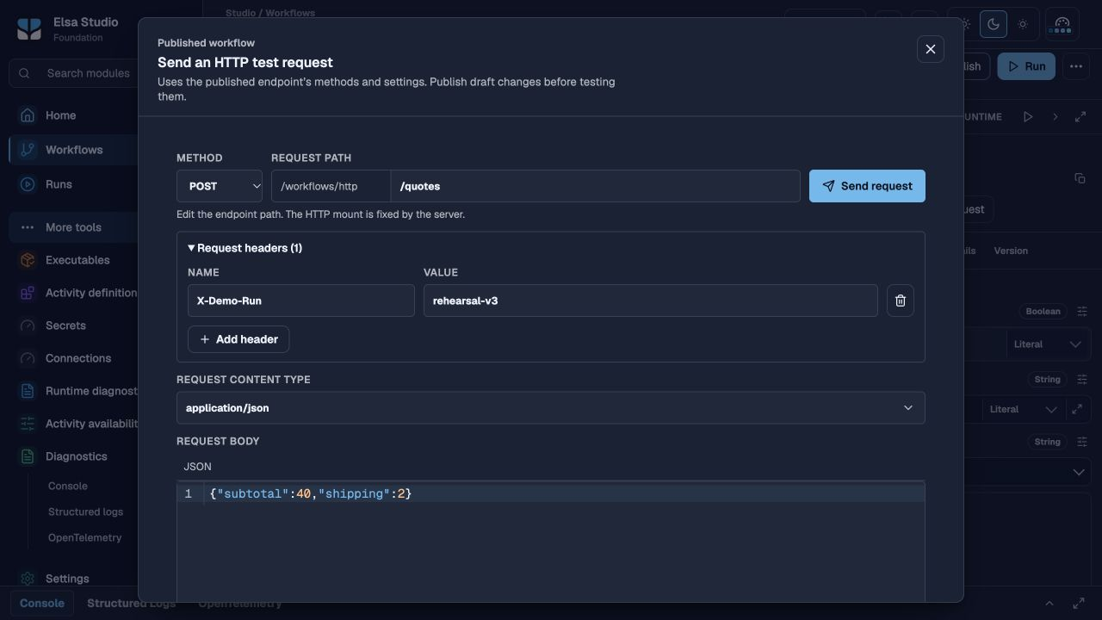
ELSA
STUDIO
04
/ 06
Quote workflow
One request,
one quote
Look up the customer
Calculate the total
Return the response
POST /workflows/http/quotes
Request and synchronous response in Studio
Customer ID from lookup route
Customer
C-1042 · Alex Morgan
Total
42
01
Customer quote
02
API access
03
Reusable calculation
04
Quote workflow
05
Runtime diagnosis
06
Secret rotation

Slide 5
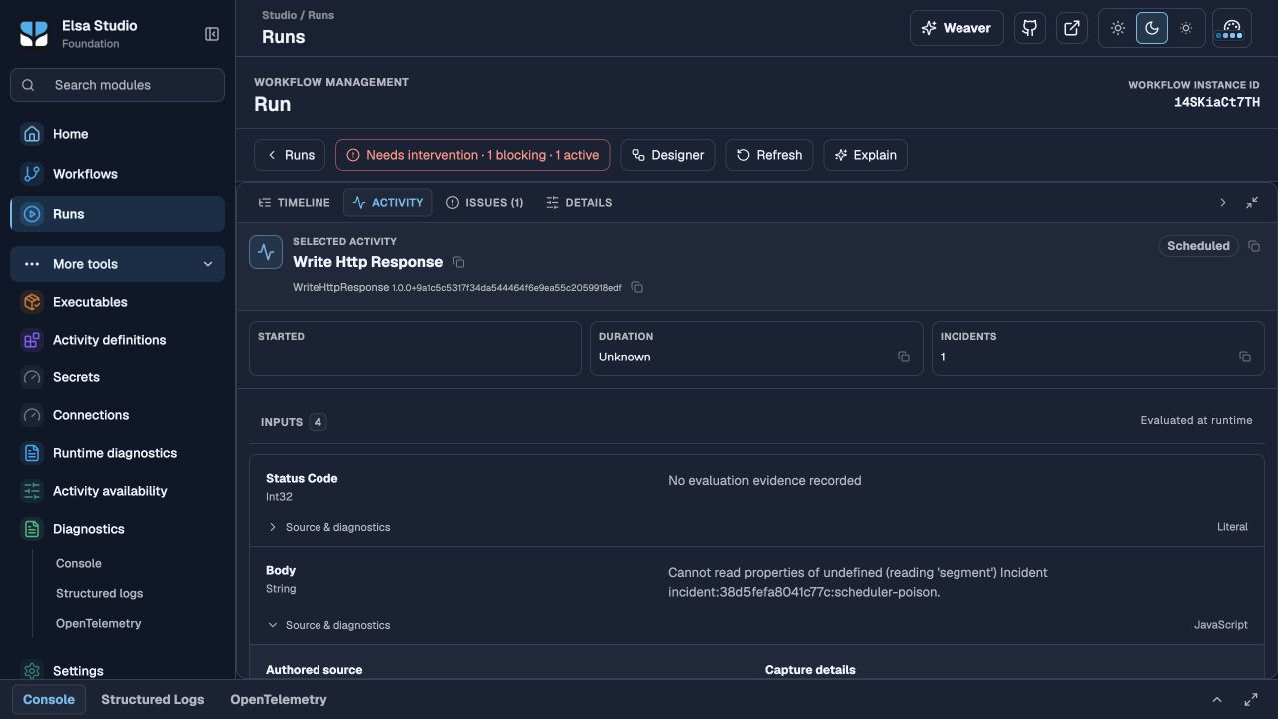
ELSA
STUDIO
05
/ 06
Runtime diagnosis
The failed
Body input
Inspect the incident
Read the input and its error
Fix, publish and retry
Run inspector · Write HTTP Response
Body input failed
BODY
profile.segment
Cannot read properties of undefined (reading 'segment')
01
Customer quote
02
API access
03
Reusable calculation
04
Quote workflow
05
Runtime diagnosis
06
Secret rotation

Slide 6
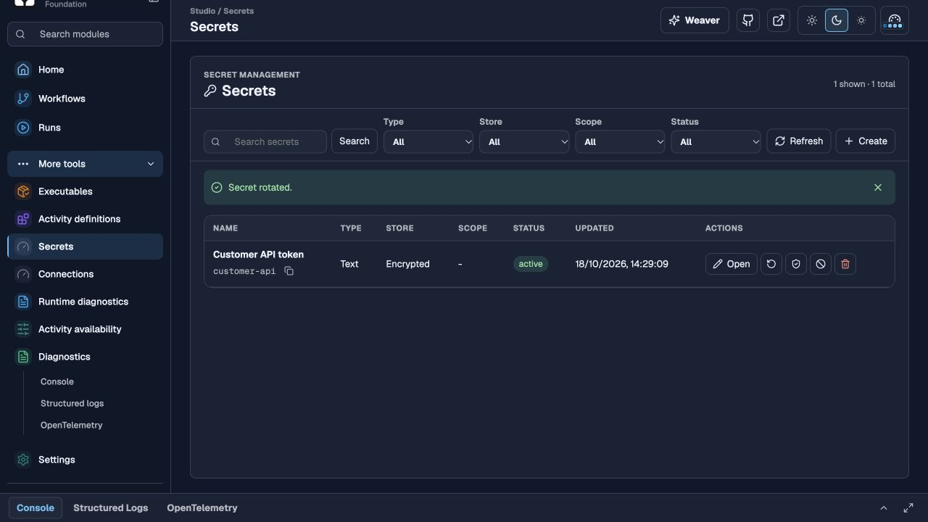
ELSA
STUDIO
06
/ 06
Secret rotation
SAFE API RECEIPT
The workflow stays
the same
WORKFLOW
Same publication · 3.0.0
SECRET
Version 2
Update the existing Secret
Send the same request
RESPONSE
HTTP 200 · total 42
Confirm 200 and total 42
Secret rotated in Studio
Credential hidden
01
Customer quote
02
API access
03
Reusable calculation
04
Quote workflow
05
Runtime diagnosis
06
Secret rotation

