Slide 1
CSS
(Cascading Style Sheets)
Edited from Chris Sanyk and CSS presentation from Bahrain University

Slide 2
Apakah itu CSS ?
CSS memungkinkan kita membuat sebuah aturan yang mengatur tentang bagaimana sebuah konten sebuah elemen html ditampilkan.
Contoh:
  Background sebuah halaman berwarna kuning.
  Tulisan dari sebuah paragraph berwarna biru.
  Sebuah paragraph menggunakan tipe huruf Arial
  Sebuah headings berwarna biru, miring, dan menggunakan tipe huruf Times typeface.
Notes:
Read title skeptically. Why this class? After all… (bullet points)

Slide 3
Brief History
Sebelum digunakan CSS, HTML menggunakan kombinasi tag <elements> dan attributes=“ ” untuk mengatur presentasi halaman web.
Contoh: <h1 bgcolor=“red”>
Hal ini sangat menyusahkan.

Slide 4
History
Pada tahun 1996, CSS 1 direkomendasikan oleh W3C. Meskipun masih sangat awal dan belum didukung oleh banyak web browsers.
Pada tahun 1999 akhirnya CSS 1 didukung oleh web browser.
Akhirnya sekarang berkembang dan didukung serta digunakan secara luas.

Slide 5
Browser Support
Dukungan browser untuk CSS sering tidak konsisten.
Sering terjadi, CSS menghasilkan tampilan yang berbeda pada browser yang berbeda.
You may not always be able to.
Notes:
It’s usually best to code to w3c standards, and let the browser do with it what it will. Eventually browser developers catch up and get the w3c recommendation right, and once that happens all is well. When they do not, you may have problems. If they are minor, it’s best to accept them. But occasionally, they may be major, in which case it’s justifiable to implement a workaround or “hack” to fix the problem for some non-compliant browser. Dealing with browser (mis)behavior is costly, however, and should be avoided. If you are developing for a client who insists that you support every browser and that the site look pixel perfect in every browser, it’s a recipe for insanity. Expect very long development and testing time, and be sure that the client is willing to pay for what you’re going to put him through. If you can present the business case logically, you may be able to get a “sadistic stickler” to back down and accept reasonable concessions. Use web server logs to show that no one uses Netscape Navigator anymore.

Slide 6
HTML + CSS
Dengan menggunakan CSS, maka kita tidak perlu menggunakan HTML untuk beberapa aspek.
Gunakan HTML untuk struktur logikal, dan gunakan CSS untuk mengatur presentasi.

Slide 7
Why use CSS? Advantages of CSS
Reusability. Dengan membuat aturan style, maka akan dapat digunakan kembali.
Mengurangi beban web server dengan menggunakan kode yang lebih ringan dan sedikit.
Pemeliharaan lebih mudah.
HTML menjadi lebih mudah dibaca.
Notes:
It’s not like you really have a choice. I’m not here to persuade you that you should be using CSS instead of an approach like HTML 3.2 took. That’s been settled and done for about 6 years and counting. No, this slide is here to explain why they invented CSS in the first place.

Slide 8
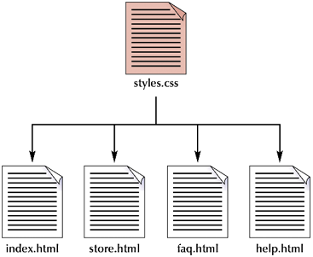
Applying a single style sheet to multiple documents

Slide 9
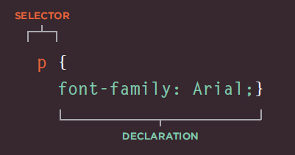
Basic Structure
(Selector & Declaration)
Source: Duckett, HTML&CSS, Wiley 2011
Selector berfungsi menunjukkan aturan css akan diterapkan di mana (di elemen html apa).
Declaration berfungsi menentukan bagaimana sebuah elemen akan ditampilkan.

Slide 10
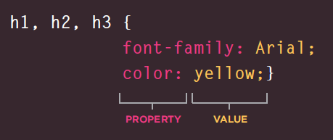
Basic Structure
(Property & Value)
Source: Duckett, HTML&CSS, Wiley 2011
Property → aspek apa dari sebuah elemen yag akan diatur.
Value → Nilai dari property yang akan digunakan
Semicolon (;) → Digunakakan untuk memisahkan aturan (rule)

Slide 11
Cara Menggunakan
(di dalam html)
External style sheet
Embedded styles
Inline styles

Slide 12
Tipe: Inline
Inline styles
  Add styles to each tag within the HTML file
  Use it when you need to format just a single section in a web page
Example
  <h1 style=“color:red; font-family:sans-sarif”>
  Berita Utama
  </h1>

Slide 13
Tipe: Embedded / Internal
Embedded or internal styles
  A style is applied to the entire HTML file
  Use it when you need to modify all instances of particular element (e.g., h1) in a web page
Example
  <style>
    h1 {color:red; font-family:sans-serif}
  </style>

Slide 14
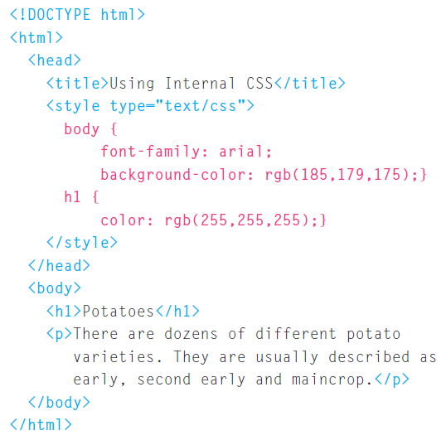
Tipe: Embedded /Internal
Source: Duckett, HTML&CSS, Wiley 2011

Slide 15
Tipe: External
External style sheets
  An external style sheet is a text file containing the style definition (declaration)
  Use it when you need to control the style for an entire web site

Slide 16
Creating an External Style Sheet
Open a new blank document in Notepad
Type style declarations
  h1 {color:red; font-family:sans-serif;}
Do not include <style> tags
Save the document as filename.css

Slide 17
Linking to Style Sheets
Open an HTML file
Between <head> and </head> add
  <link href=“URL” rel=“relation_type” type=“link_type”>
    URL is the file.css
    relation_type=“stylesheet”
    link_type=“text/css”
Save this file and the .css file in the same web server directory

Slide 18
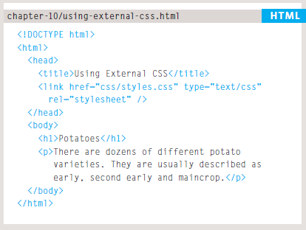
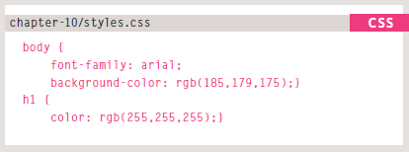
Tipe: External
Source: Duckett, HTML&CSS, Wiley 2011

Slide 19

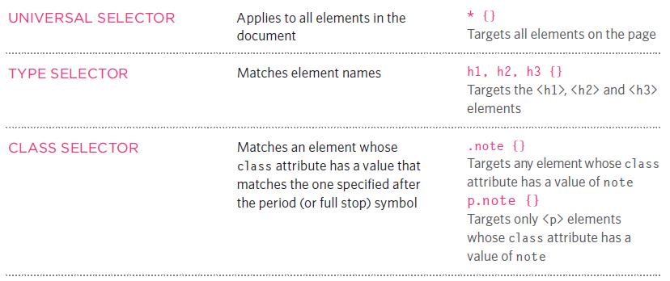
Selectors
Source: Duckett, HTML&CSS, Wiley 2011

Slide 20
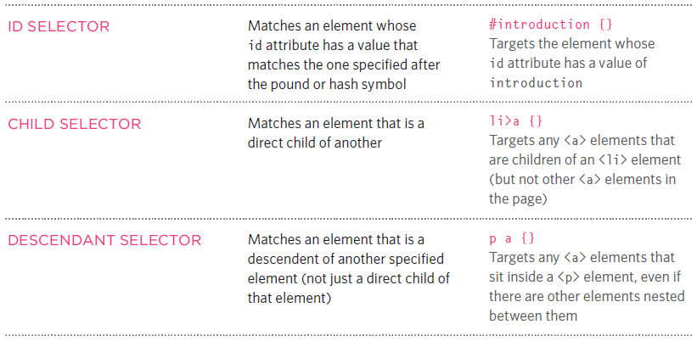
Selectors
Source: Duckett, HTML&CSS, Wiley 2011

Slide 21
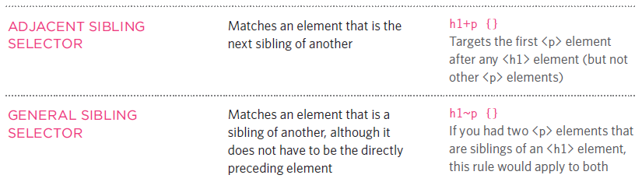
Selectors
Source: Duckett, HTML&CSS, Wiley 2011

Slide 22
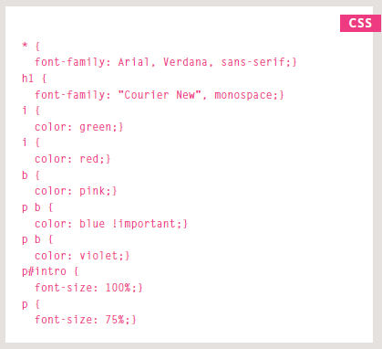
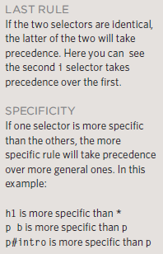
CSS Rules Cascade
Source: Duckett, HTML&CSS, Wiley 2011

Slide 23
Inside The Box
The key to understanding how CSS works is to imagine that there is an invisible box around every HTML element.

Slide 24
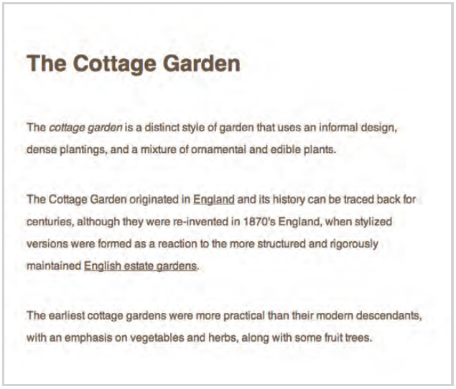

Slide 25
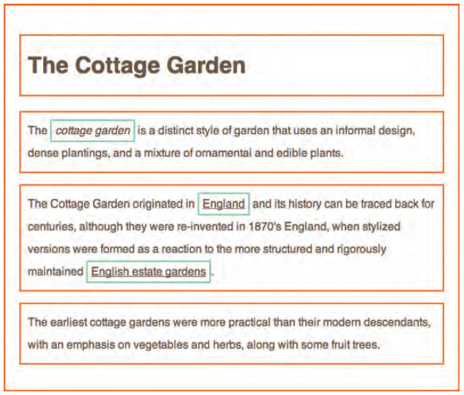

Slide 26
Recommended resources
The Web
  W3Schools.com
  W3C.org
  www.css3.info
  www.d.umn.edu/itss/support/Training/Online/webdesign/css.html
  A slew of web developer blogs, YMMV. Google & bookmark.
  Duckett, Jon. 2011. HTML&CSS. Wiley. Canada.

Slide 27
Recommended resources
Print
  Web Design in a Nutshell 3rd Edition (O’Rielly)
  CSS pocket reference (O’Rielly)
  HTML Utopia: Designing Without Tables Using CSS ISBN0-9752402-7-7
  CSS: The Missing Manual
  CSS: The Definitive Guide

