Slide 1
Motivation
Target Audience
First-time Boston visitors, especially international tourists and newcomers who are unfamiliar with the city, especially parents of international students visiting Boston for May graduation ceremonies who want to take short, meaningful trips around the city
Learning Goal
Identify major Boston neighborhoods, landmarks, and cultural sites.
Understand basic historical and cultural context behind selected places.
Make informed decisions about transportation, time, budget, restaurants, and souvenir options.
Feel more confident navigating Boston independently.
Problem We Are Solving
First-time and international visitors often face more than a navigation problem when visiting Boston. They need to learn how to understand the city’s geography, transportation system, cultural landmarks, local history, budget expectations, and everyday travel decisions.
Most travel tools help users find places, but they do not always help users learn how to plan a meaningful, realistic, and culturally informed trip.

Slide 2
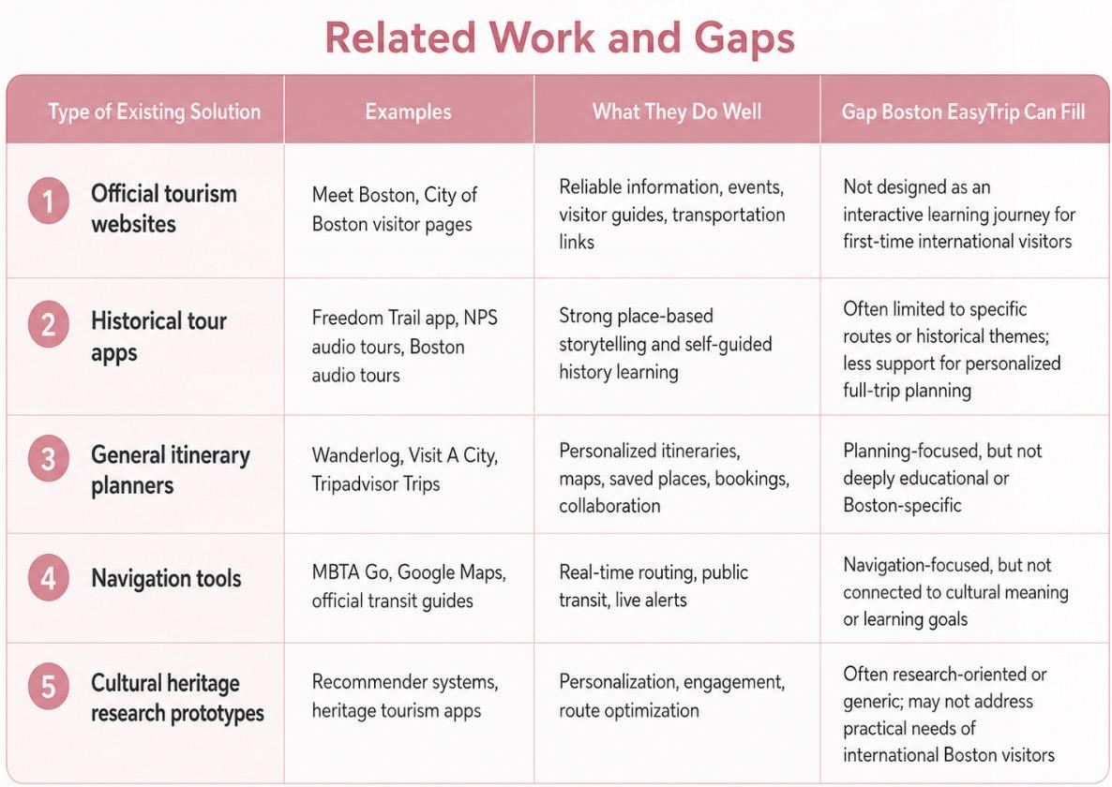
Related Work and Gap
Gap
These tools often separate learning, navigation, and planning. First-time international visitors need one place to connect Boston’s culture and history with practical travel decisions.
Boston EasyTrip fills this gap by combining:
Cultural learning + interactive map + personalized planning + practical support + multilingual access
Deep Research by ChatGpt: https://chatgpt.com/share/69fbf7d0-2c3c-83ea-b512-018dc0e16166

Slide 3
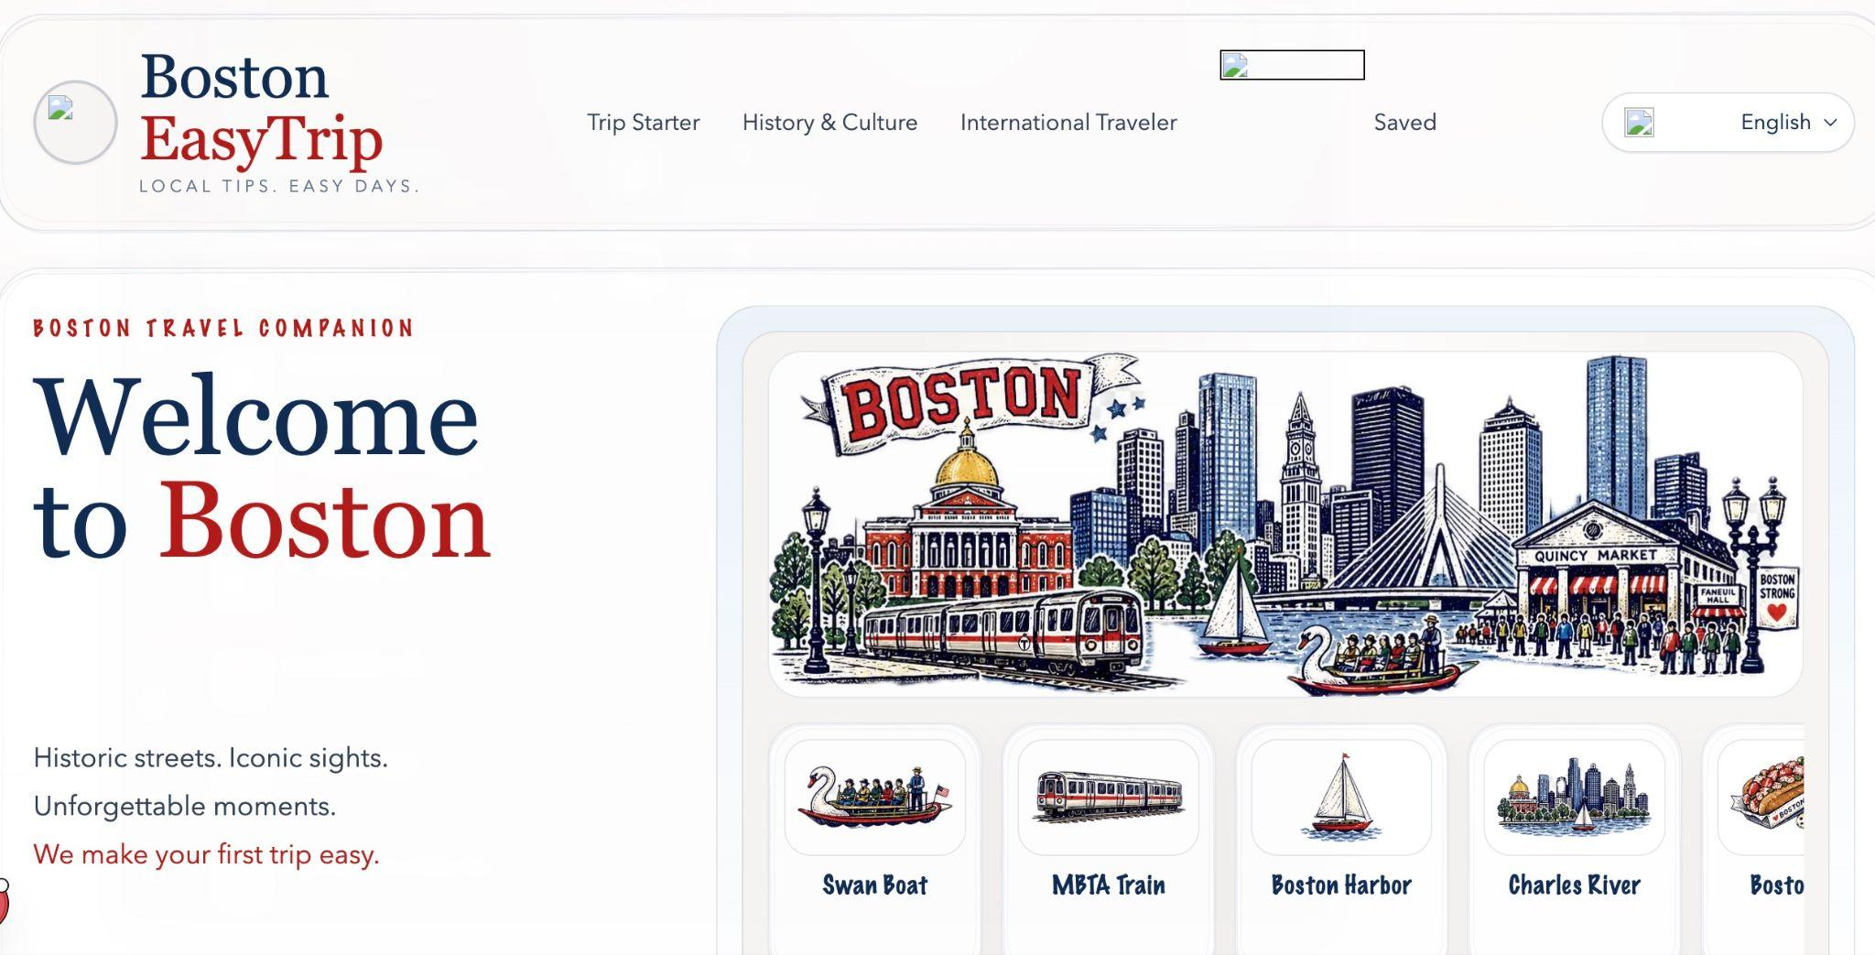
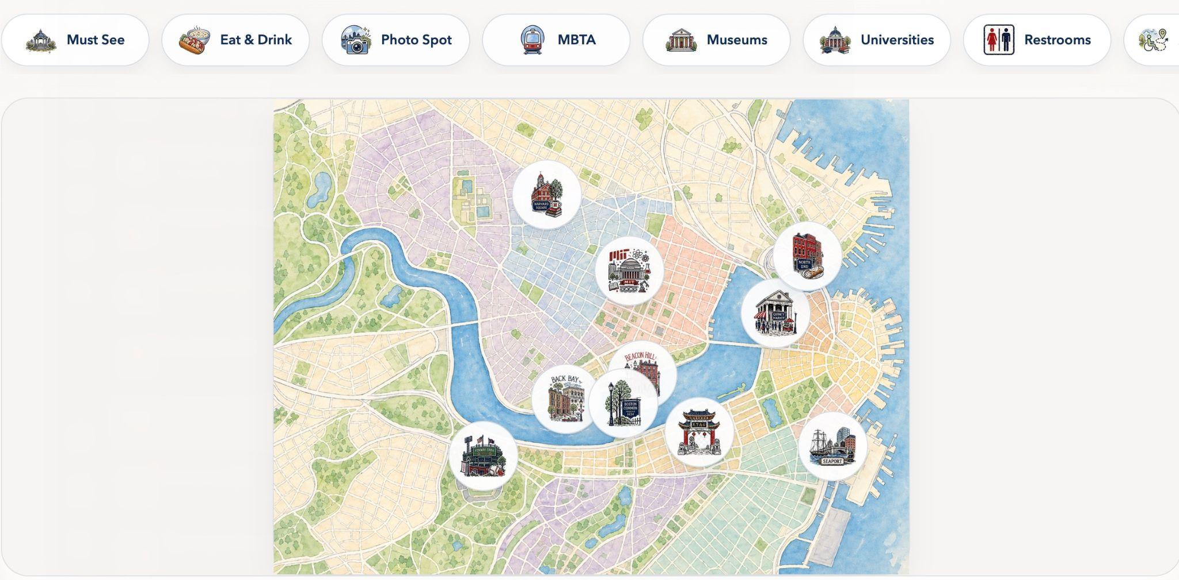
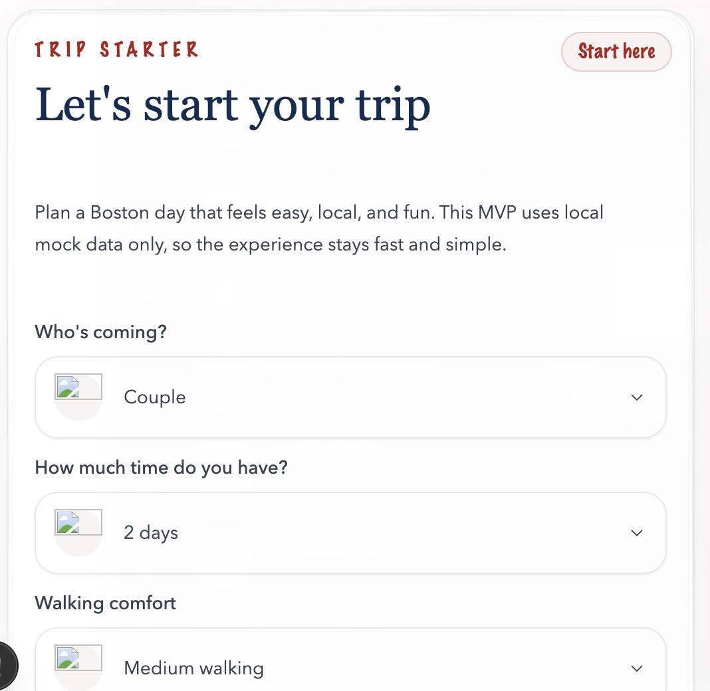
Design Process - Low-Fi Prototype (Codex)
Focused on homepage, map, landmark pages, Trip Starter, and saved places
Challenges: poor flow, incorrect proportions, inconsistent structure, and wrong landmark placement
This stage helped us clarify the basic components we needed, but it also showed that the prototype tool was not reliable enough for building a clean and accurate interaction flow.

Slide 4
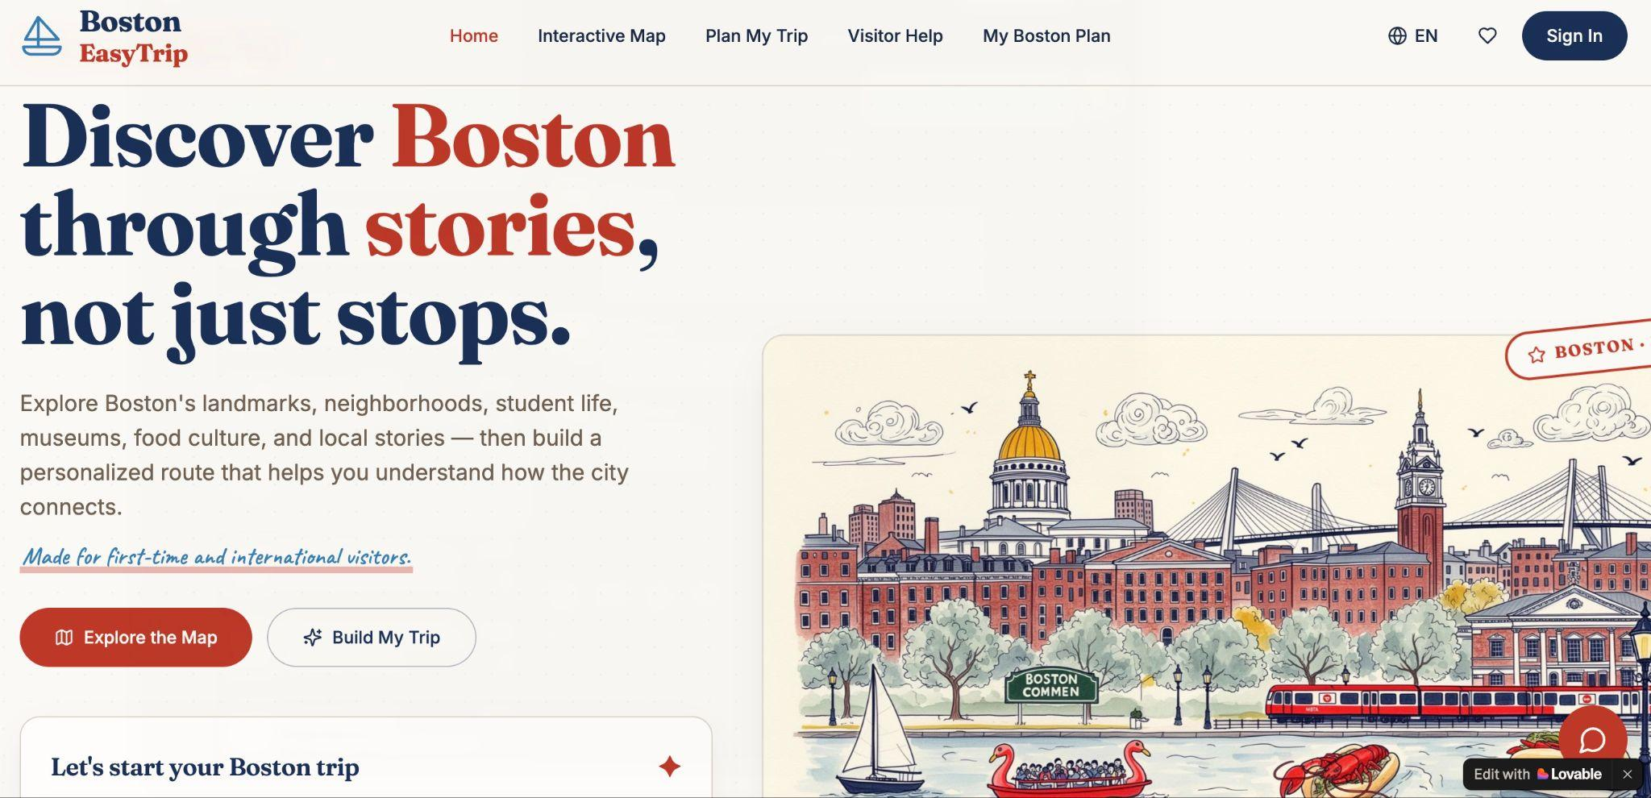
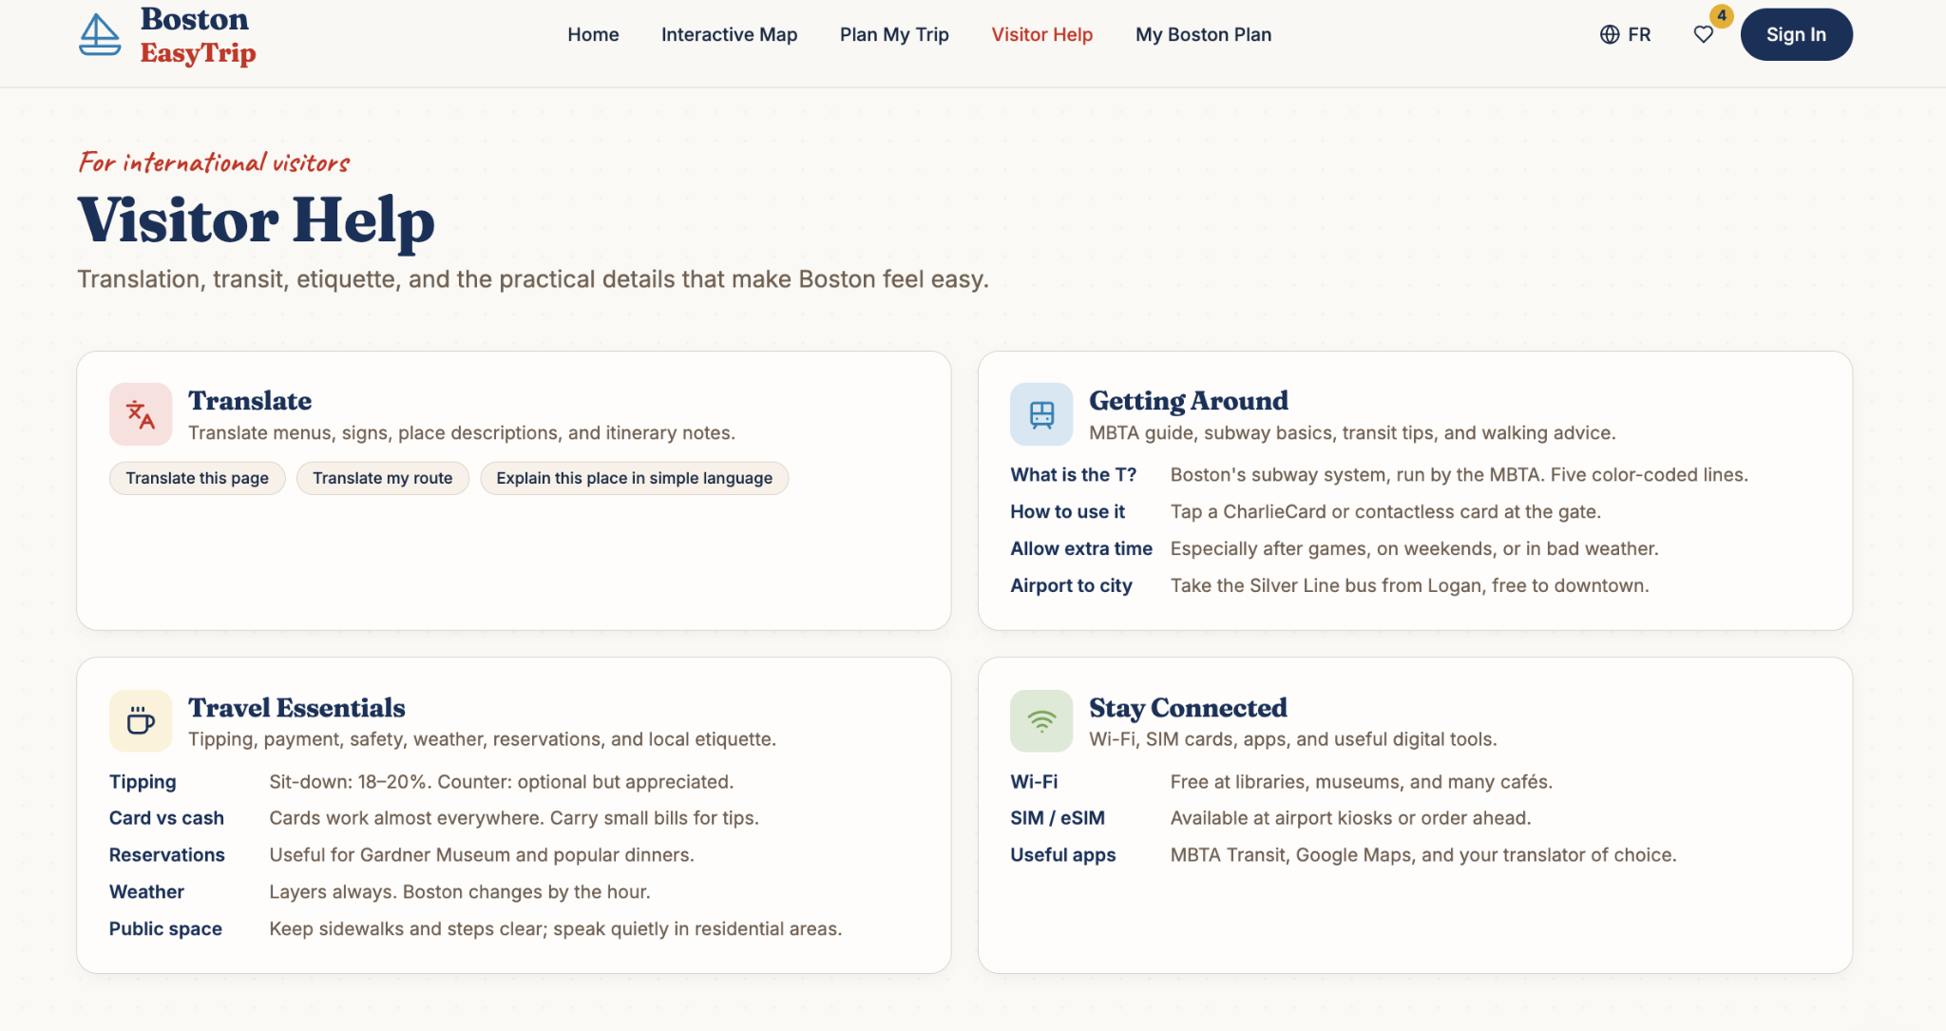
Design Process - Mid-Fi Prototype (Lovable)
Travel Planning + Cultural Learning + Personalized Guidance
Improved visual map, menu structure, categories, and early AI plan flow
Helped create a clearer and more connected user experience
Notes:
In the mid-fidelity prototype, we improved the visual and interaction design by creating a more polished map, a clearer menu structure, better feature categories, and an early AI-generated planning flow. This stage focused on organizing the site structure more clearly, improving visual, and making the travel-planning process easier to follow. It also helped show how map-based exploration could connect more directly to personalized trip planning.

Slide 5

Final Design
Refinement:
Expand the interactive map by adding more Boston attractions and souvenir shops.
Unify “My Favorites” and “Saved Places” to reduce confusion and keep all saved locations in one place.
Add 7-language translation support for international visitors.
Build customizable travel plans from users’ saved places, including budget options and recommended nearby food spots.
Add a multilingual AI chatbot to answer travel questions, suggest routes, and explain cultural or historical information.
Add interactive learning features, including pre/post surveys and a travel diary for reflection.
User-testing Feedback
Unify repeated buttons that lead to the same page or feature to reduce confusion.
Need a way to evaluate users learning outcomes
Add practical travel information, including budget and souvenir options
Support manual/customized planning

Slide 6
Conclusions & Future Work
Conclusion:
Boston EasyTrip addresses a gap in travel tools: visitors can often find places, but still struggle to understand the city and plan confidently.
Our final design turns trip planning into a learning experience by connecting map exploration, landmark stories, favorites, customized planning, practical support, translation, and reflection.
Future iteration:
Expand the “Visitor Help” tab by adding more practical functions, such as transportation tips, emergency information, accessibility guidance, and FAQs.
Expand the interactive map by including more attractions, neighborhoods, food spots, and souvenir shops.
Conduct user testing with parents and family members attending Harvard Commencement this month to collect feedback and improve the website based on real visitor needs.

Slide 7
Reference
Lave, J. (1991). Situating learning in communities of practice. In L. B. Resnick, J. M. Levine, & S. D. Teasley (Eds.), Perspectives on socially shared cognition (pp. 63–82). American Psychological Association.
Ertmer, P. A., & Newby, T. J. (2013). Behaviorism, cognitivism, constructivism: Comparing critical features from an instructional design perspective. Performance Improvement Quarterly, 26(2), 43–71. https://doi.org/10.1002/piq.21143
Gronseth, S. L., Michela, E., & Ugwu, L. O. (n.d.). Designing for diverse learners. LibreTexts.
Schwartz, D. L., Tsang, J. M., & Blair, K. P. (2016). The ABCs of how we learn: 26 scientifically proven approaches, how they work, and when to use them. W. W. Norton & Company.
Van Damme, D. (2026). Technologies smarter, humans “dumber”? How technological advances improve and diminish human cognition and what this means for education. Center for Curriculum Redesign.

