Slide 1

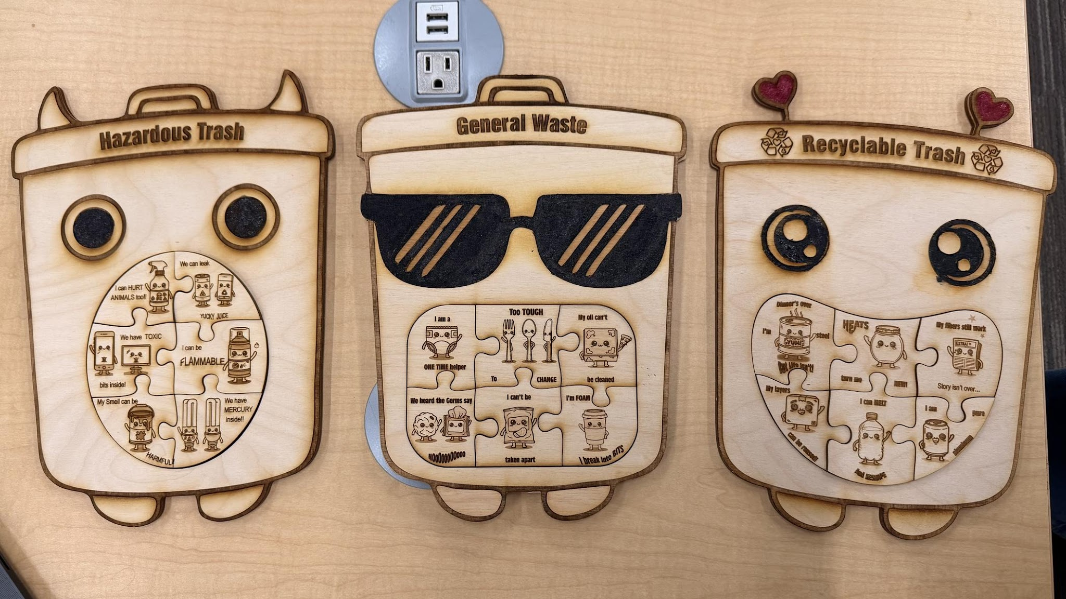

Trash Buddies
Designed by. Yuzhi, Irene, Helen
Learning Goals: Learn waste sorting in a fun way.
Children feel like they are helping trash find friends and teaming up to clear levels, while practicing real sorting decisions.
Designed to:
Target Audience
Strengthen pattern recognition and coordination skills
Build sustainability awareness through waste sorting
Age ~5: focus on correct sorting + trial “tossing” mechanics
Age ~9: deepen understanding of ecosystem sustainability and how waste impacts the environment

Slide 2
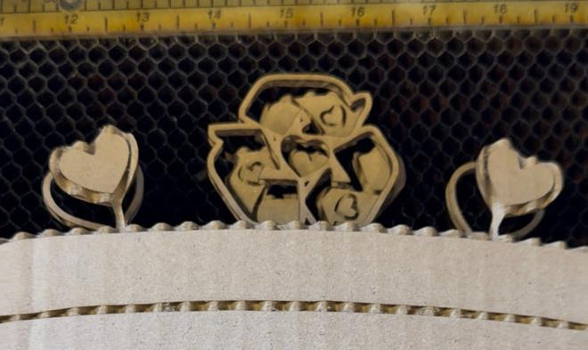
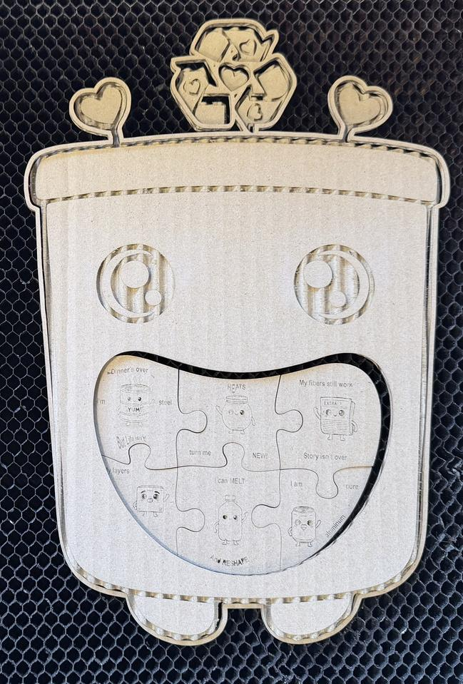
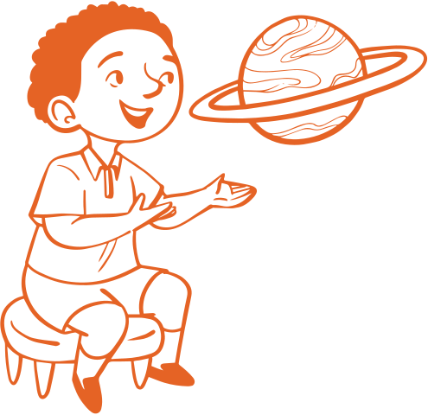
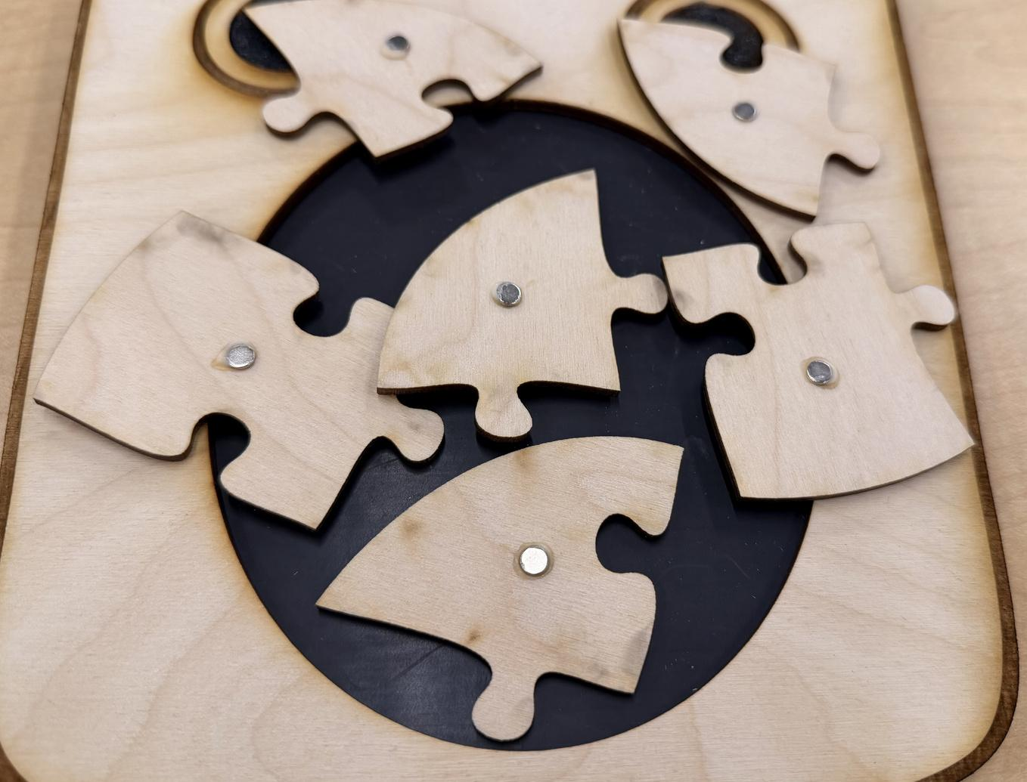
Design Process: Iterations
+Struggles
Inspiration: Transforming a jigsaw puzzle into an educational “mission game.”
Core design choice: No big labels like “Plastic / Organic / Recycle.”
Each item has a fun hint so kids must think and infer.
Prototype structure:
24 wooden puzzle pieces total
4 trash cans × 6 items (Recyclables / Composable / General / Hazardous).
Iteration
Used adhesive magnet sheets on trash cans + magnetic trash pieces
Kids can “feed” trash into the bin’s mouth (easy + satisfying)
Struggle
In the cardboard laser-cut test, we mistook the image border, so the outline got cut twice and looked like an unwanted frame.
The magnet sheets only stick well at certain angles, so placement needed careful alignment.

Slide 3
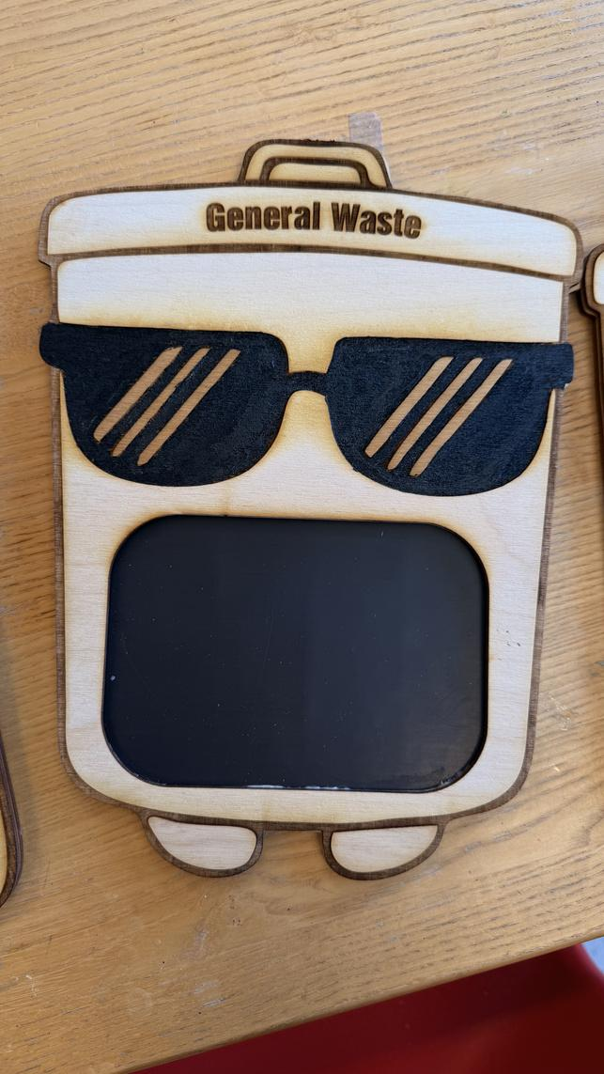
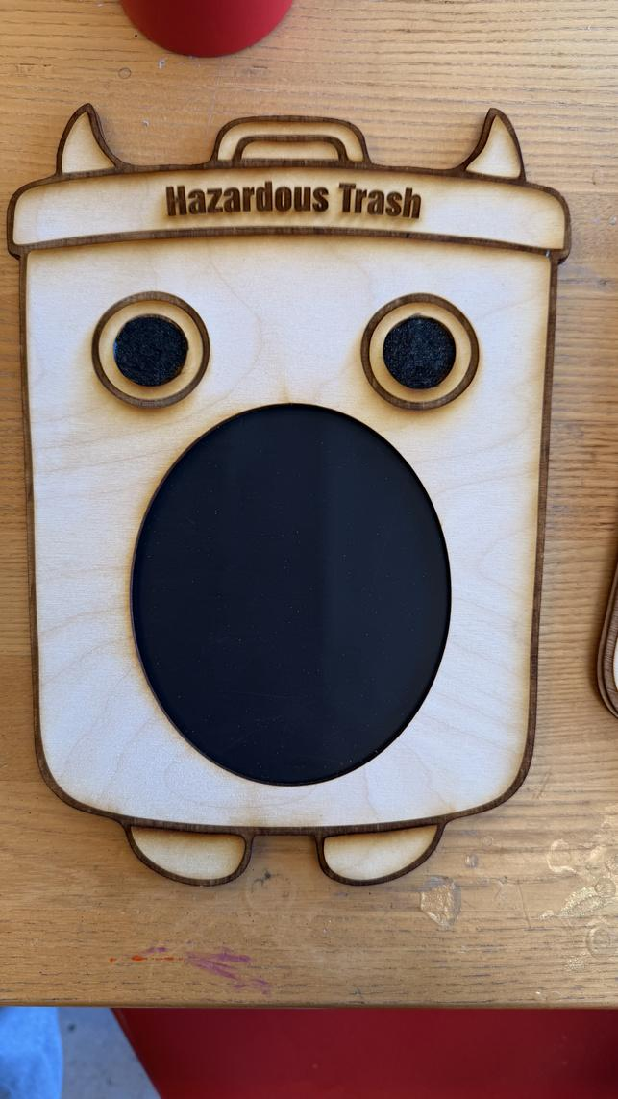
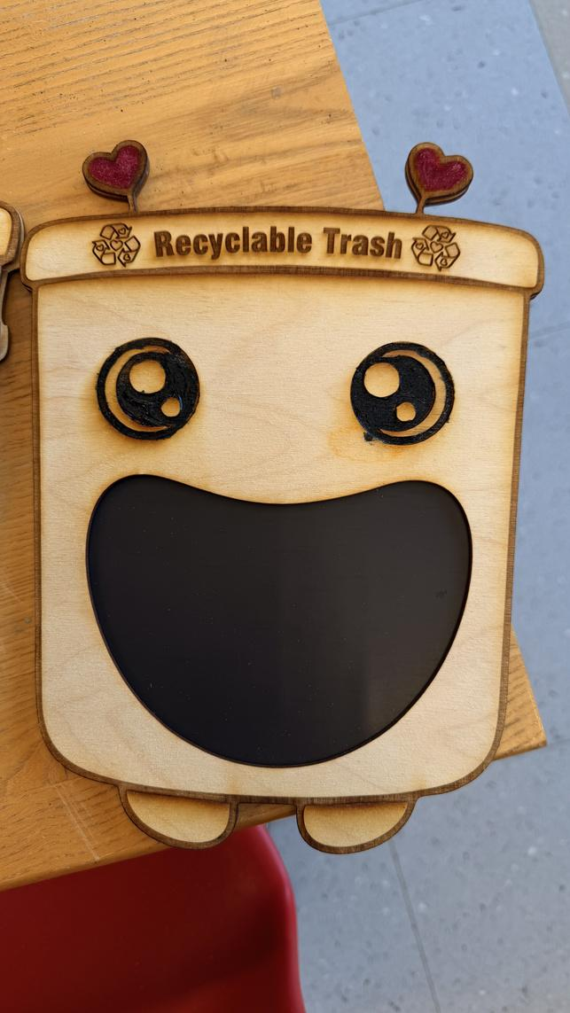
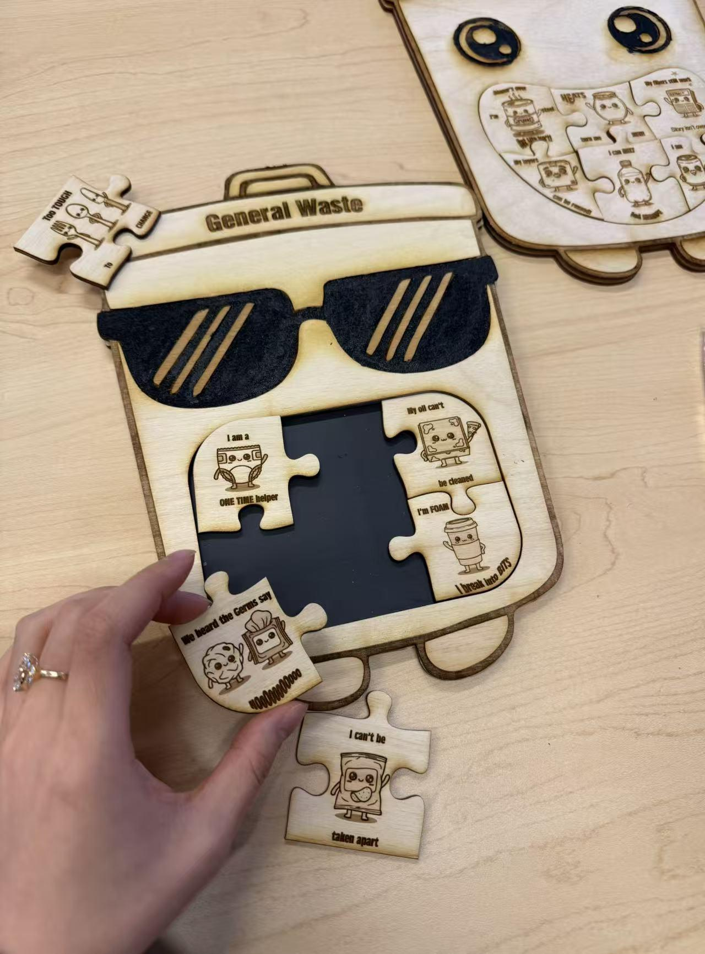
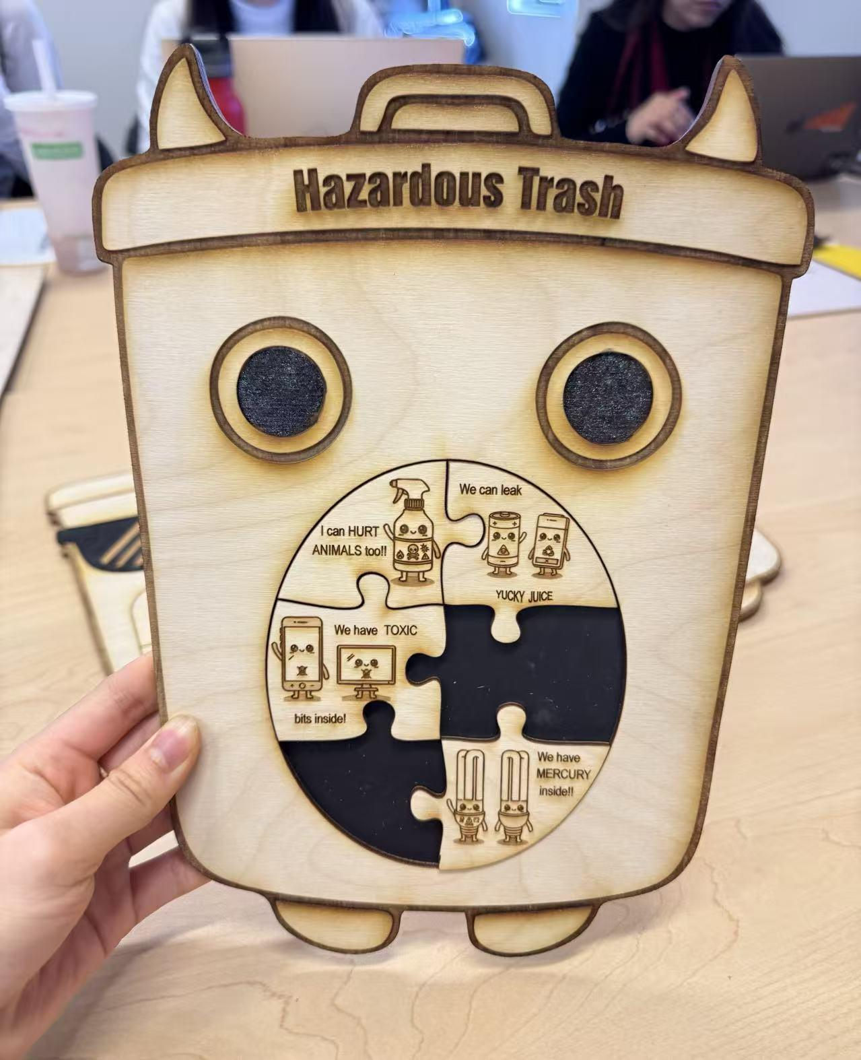
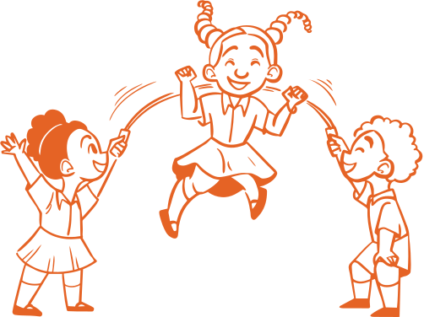
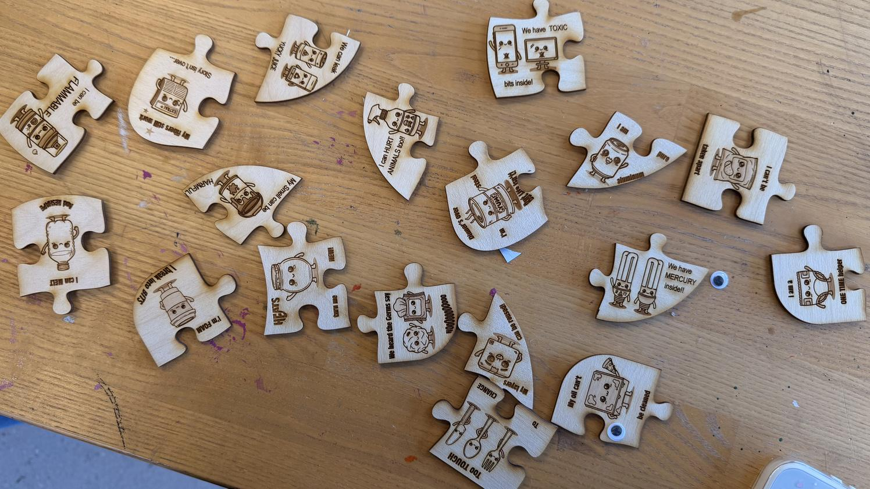
Current Prototype
How to Play
Step 1: Kids pick a “trash buddy” piece and read the hint.
Step 2: They decide which trash can board it belongs to (Recyclables / Composable / General / Hazardous).
Step 3: They place the piece onto the correct trash can board.
Step 4: They “feed” the trash buddy into the bin’s mouth area (magnetic stick-in), and fill the board.
Win: Clear the level when they correctly fills all four trash can boards.
Solving the puzzle with the hints! Can be showcased too!

Slide 4
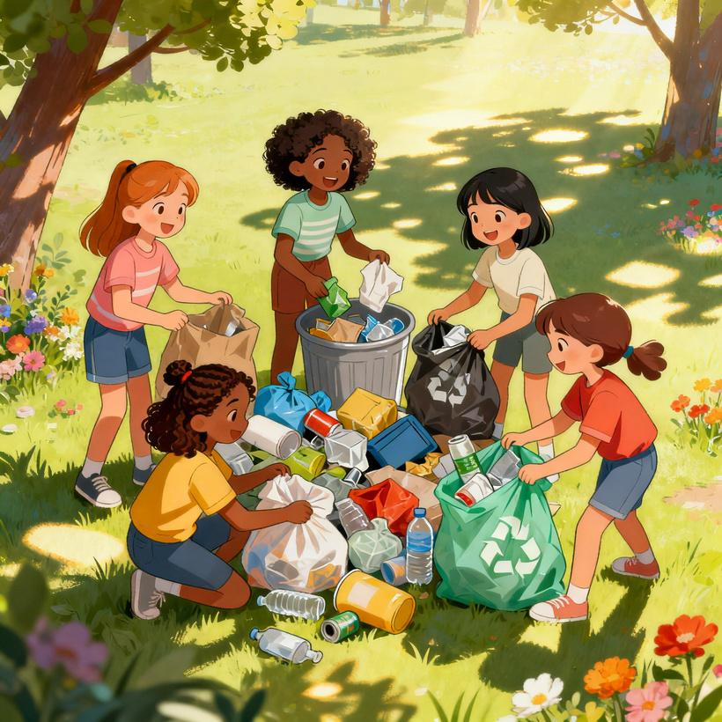
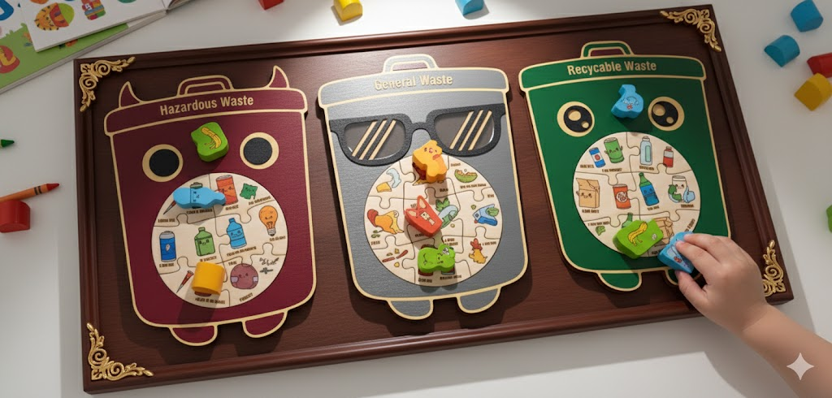
Future Version
Better visuals 🎨
Fully colored, stronger characters for each trash buddy, clearer icons for “clean/dry/food/danger.”
Expanded Content
Add more puzzle pieces by including more real-life items in each category (more variety + more challenge)
Stronger sustainability connection
Design a handbook for children to learn better about each categories and game elements.
Especially for age 9:
Simple cause–effect feedback (e.g., wrong sorting → “pollution meter”; right sorting → “garden grows / city gets cleaner”).

