Slide 1
Word Cross“Wordy”- Yuzhi, Fengyi, Mary
Rationale for the AI experiences
Started with a basic crossword concept → redesigned into an AI-assisted learning tool for english learners. Transforms a traditional crossword into a multi-sensory learning experience (text + audio + visual). Players solve crossword clues, and after they correctly complete a word, the app instantly shows the word’s audio pronunciation, meaning, visual images and example sentences. The word is then saved into the learner’s personal Word Note in their profile for review.
Target Audience: English learners and young children (approx. ages 6–12, beginner–intermediate).
Learning goals:
Build vocabulary through gameplay.
Enhance visual-word connections using image support for each word
Improve pronunciation using audio support.
Strengthen word understanding and usage with examples.
Support retrieval through “saved” word notebook / review journal.

Slide 2
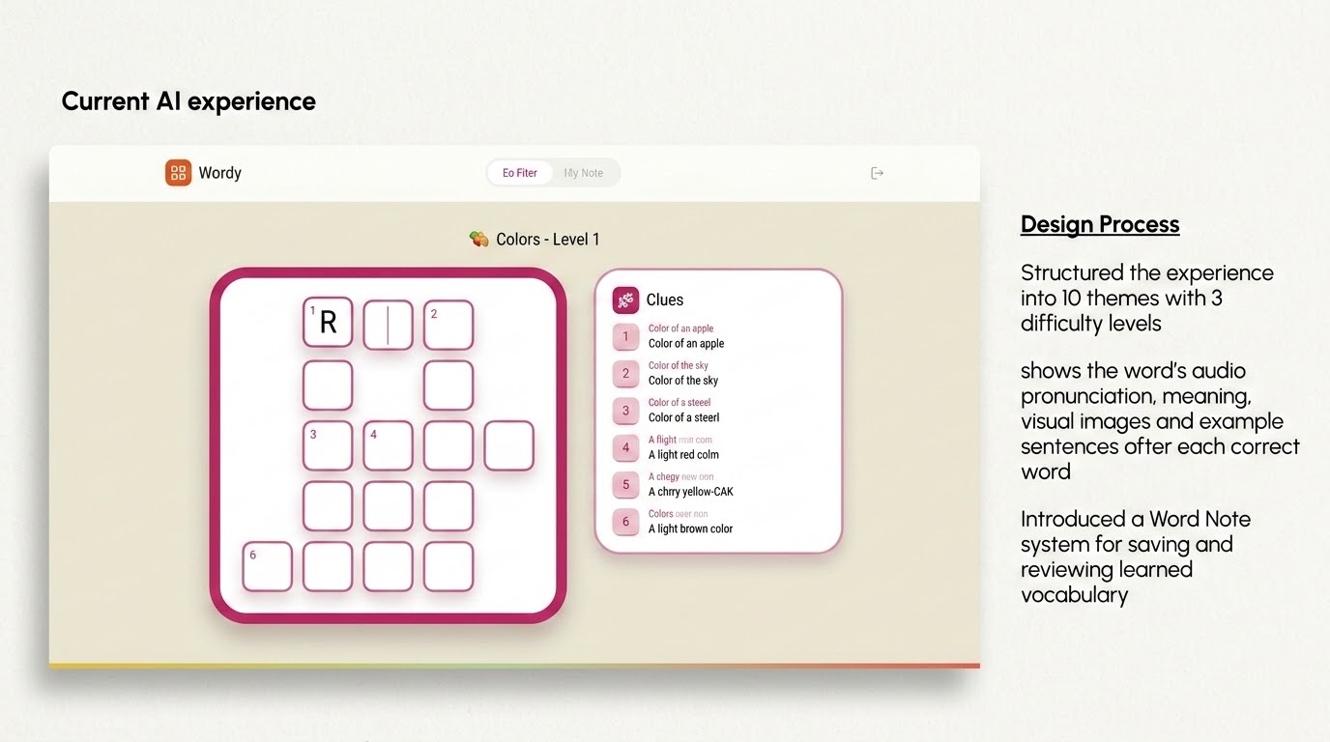

Slide 3
Key Iterations
Grid layout design: Adjusted for different word lengths across levels → improved spacing and readability
Visual design: Shifted from low-contrast grids to more saturated, clearer colors for better usability
UX flow: Refined to keep experience mostly on one screen (minimal scrolling)
Technical & Design Challenges
Image integration via API
API (getWordImage(word))
Handling missing images with AI-Generated Illustration
Grid layout::
that adapt to different word lengths and difficulty levels
Word Note system
still needs improvement (real-time updates, better review experience)

Slide 4
What would the final version look like after 1 year?
A fully developed AI-powered vocabulary learning platform for children and English learners
Expanded content with more themes, levels, and personalized word selection based on learner progress
A stronger Word Note system with saved vocabulary, spaced review, mini quizzes, and pronunciation practice
Added progress tracking and a simple parent/teacher dashboard to monitor learning and review needs
Overall, a shift from a creative prototype to a complete educational product that supports both engagement and long-term vocabulary growth

