Slide 1
- an overview of the work you did which includes the question or problem statement you were addressing with your research/work- the methods you used and sources
your research findings/results
conclusions drawn
limitations you encountered

Slide 2
Community Well-Being (CWB) Index
The CWB index is made up of the following four components,
The Community Well-Being (CWB) index is a means of examining the well-being of individual Canadian communities.
The index is calculated using four components:
Income (income per capita)
Education (number of community members with higher edication levels)
Housing (number of community members living in good house conditions)
Labour (employment rates)
What are the differences between First Nations and non-aboriginal communities across time at a province level
How the CWB index for non-aboriginal communities differs between provinces

Slide 3
Methods:
Csv files were available for 1996, 2001, 2006 and 2011
Each csv file had the CWB index calculated per census subdivision
Csv files were cleaned and merged the files into a unique dataframe, using census subdivision as the index
Census subdivision’s code were splitted to show the province part of the code (first and second character), which I've used to group census subdivision per province
Each Census subdivision is classified as "First Nation communities" or "non-aboriginal communities“
I used groupby function to group the table by Province, and then type of community
Calculated the weighted average CWB for each province, for first nation and non-aboriginal communities

Slide 4
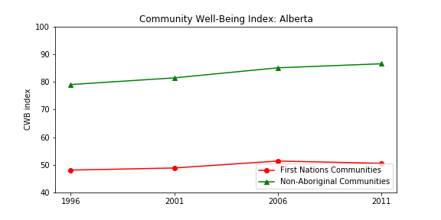
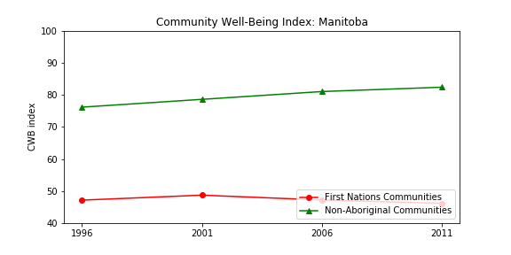
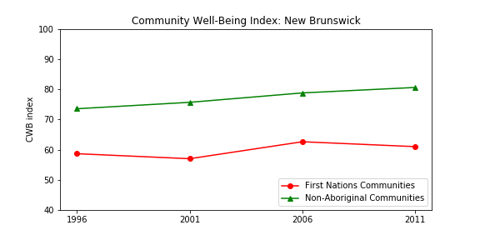
Increasing differences

Slide 5
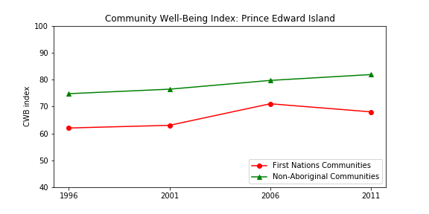
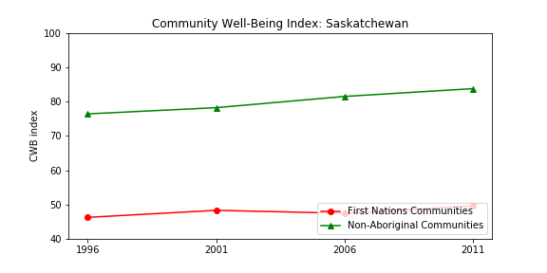
Increasing differences

Slide 6
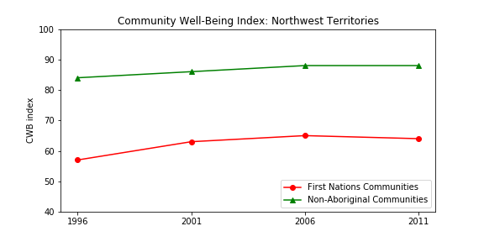
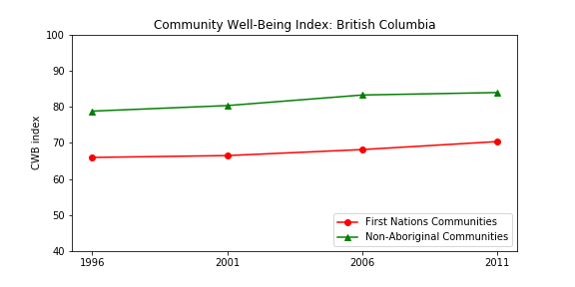
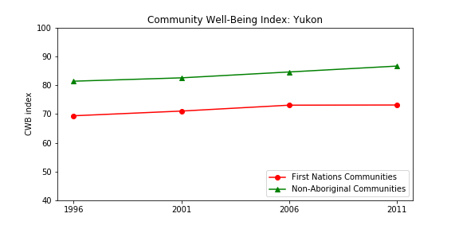
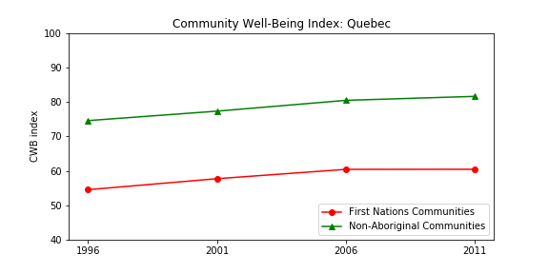
Differences are stable

Slide 7
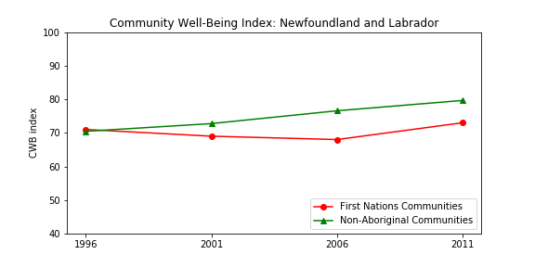
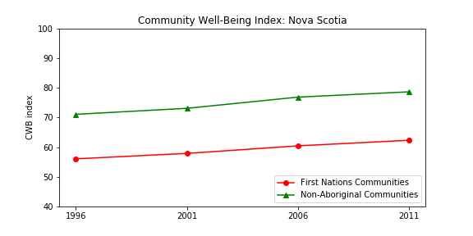
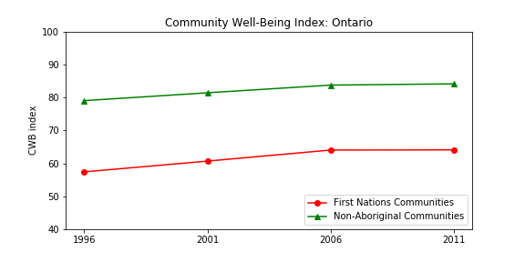
CWB indices are improving

Slide 8
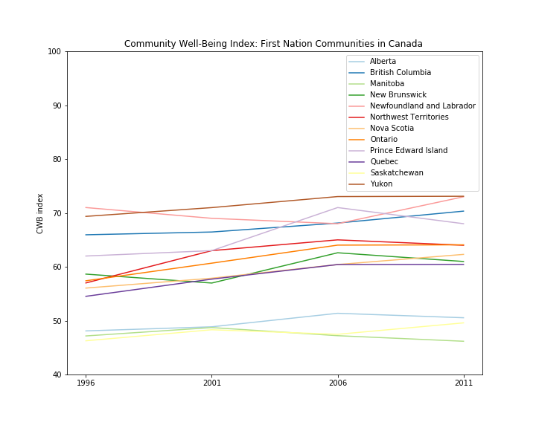
Comparing First Nations CWB Index Scores across Time
Yukon has the best CWB index for all provinces
Followed by Newfoundland and Labrador and British Columbia
Manitoba has the worst index
Second worst index was calculated for Saskatchewan

Slide 9
Health indicators: Heavy Drinking
As a result of a history of colonization, isolation, poverty and language barriers, abuse of substances — especially alcohol and solvents — is more common in First Nation Communities
What are the differences between First Nations and non-aboriginal population in terms of alcohol abuse?

Slide 10
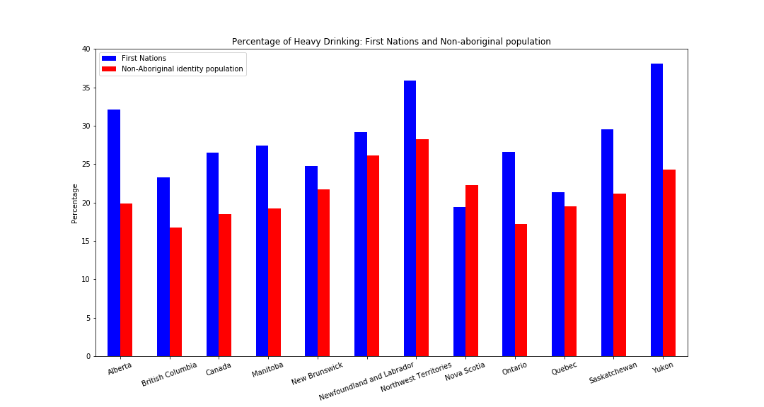
Health indicators: Heavy Drinking

Slide 11
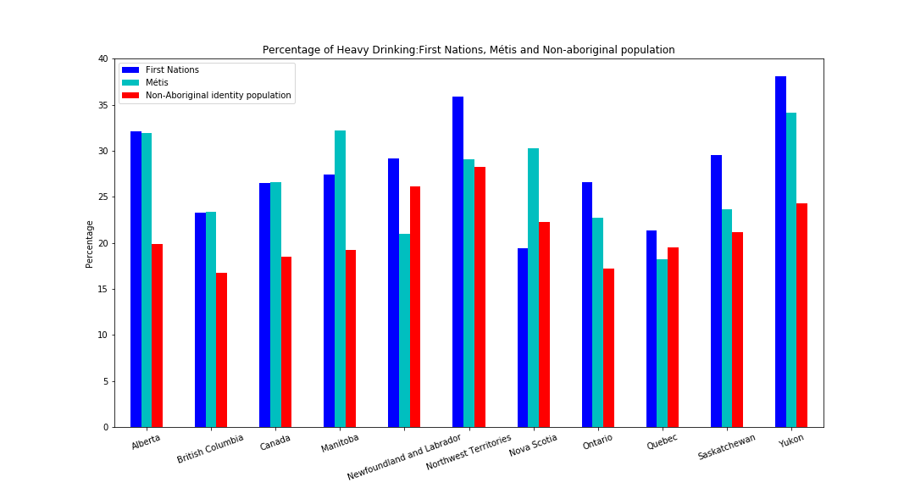
Health indicators: Heavy Drinking

Slide 12
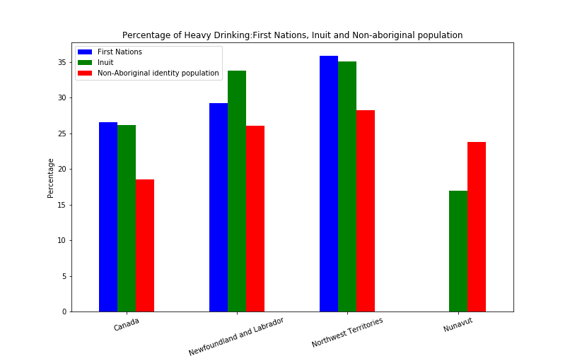
Health indicators: Heavy Drinking

