Slide 1


Google Meet’s Performance Across Variety of Internet Condition
Austria Vince, La Concepcion College, 2022
Icons by Flat Icon; fair use

Slide 2
Special thanks to...
Honorable Panelist
To Ms. Nelyn (Research adviser)
My Family <3 (health and funding)
To my allies (internet and unwinding)
My classmates :) (peer review)
TaktusCat
u/xxEvieEvelyn #reddit
Dave Warren (statistics and programming support)
LinusTechTips FB group (technical and network support)
R statistical software FB group (R programming and data visualization support)

Slide 3
Opening Remarks

Slide 4
Introduction

Slide 5

There’s an ever growing need for reliable video conferencing software than ever before

Slide 6



Google Meet position

Slide 7

But our network
Infrastructure is
Not ready...

Slide 8

User Frustration

Slide 9
Objectives
Postulate a testing principle
Evaluate Google Meet performance
Determine variables that greatly affect Meet
Develop a working theory based on this effect
Establish the adverse impact of slow internet speed and high latency on Meet
Discussing the positive effect of slow internet speed and latency on Meet

Slide 10




Data Collection
1st
2nd
3rd
4th
5th

Slide 11
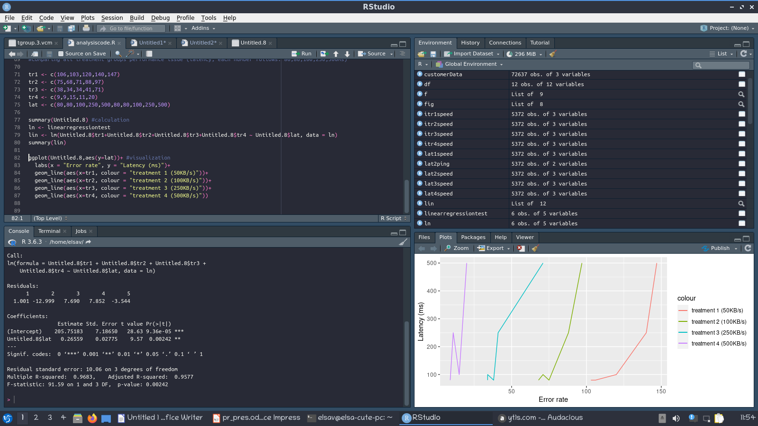
R Statistical Software

Slide 12
Variables
Latency
Internet
Speed
upload+download
Performance
Total Drop Time
Audio Cache Miss
Video Cache Miss
FPS Drop
Total Data Usage

Slide 13
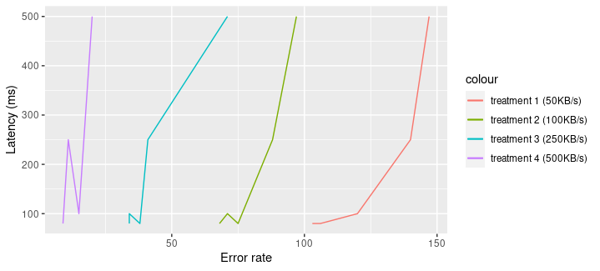
Overall Results
Positive trend in error rate as latency increased combined with internet speed dropping
R = 0.9683, p = 0.0024; (327,753 data points)

Slide 14
Study’s Limitation
Single point sampling (limiting the scope to individual performance)
Non linear behaviour of the dependent variable pass the performance of plateau (refer to theoretical framework)
Hardware limitation (1 Million datapoints and beyond requires a better computer)

Slide 15
Conclusion

Slide 16
1. Google Meet Resiliency

Slide 17


2. Synthetically slowing down internet speed might lead to data and electrical savings...

Slide 18
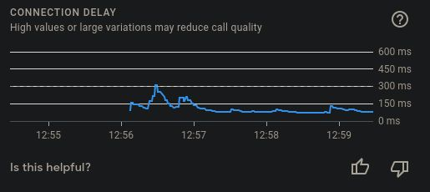
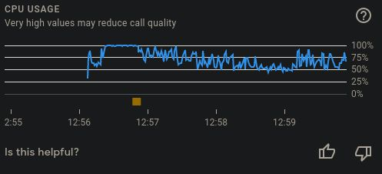
Induced delay will result in smoother graph
And Lower CPU usage
*feature only available on Chrome

Slide 19
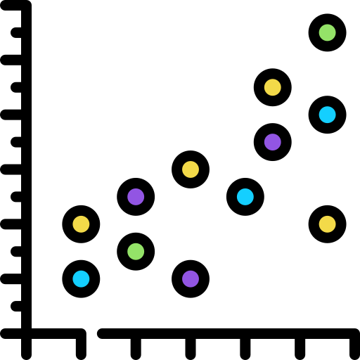

3. Google Meet performance is influenced by the independent variables in a non linear way (curve)

Slide 20
The END :)

