Slide 1
Presentation
Arduino Menu on a Nokia 5110 LCD Using a Rotary Encoder

Slide 2

Arduino Menu AbdElrahman Ahmed 205035 Marwan Mahmoud 205037 Elsayed Elmandoh 205038 Aalaa Badawy 205047 Ahmed Tarek 205043 AbdElrahman Amer 205055 Habiba Ahmed 205056

Slide 3

Components of project
Arduino Uno : slide that enter the code .
Nokia 5110 LCD : screen show menu .
Rotary Encoder : can control the choice of the menu and scroll up or down .
Breadboard : link component together .
Jumper : some of wires connect together .

Slide 4
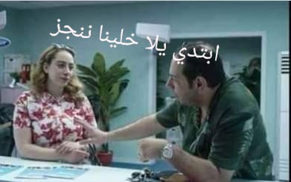


Introduction
2
1
This is the project we are going to build. A simple menu appears in the screen, with the help of the rotary encoder I can scroll up or down and select a menu item by pressing the rotary encoder button. When you press the middle button on the rotary encoder .
….
another screen appears and we can change the value of the variable. If we press the rotary encoder button again, we return to the main menu screen. The list contains many items, we can scroll down or up the list and the items on the screen will change accordingly .

Slide 5
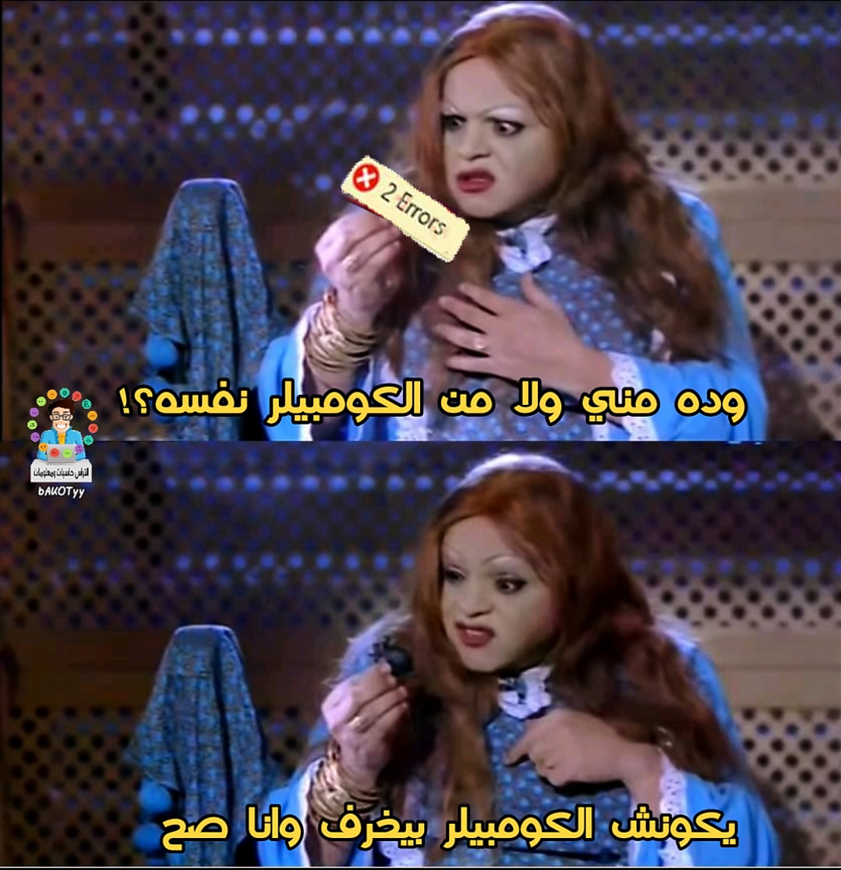
Software
Code of Arduino
#include <Adafruit_GFX.h>#include <Adafruit_PCD8544.h>#include <ClickEncoder.h>#include <TimerOne.h>int menuitem = 1;int frame = 1;int page = 1;int lastMenuItem = 1;String menuItem1 = "Contrast";String menuItem2 = "Volume";String menuItem3 = "Language";String menuItem4 = "Difficulty";String menuItem5 = "Light: ON";String menuItem6 = "Reset";boolean backlight = true;int contrast=60;int volume = 50;String language[3] = { "EN", "ES", "EL" };int selectedLanguage = 0;String difficulty[2] = { "EASY", "HARD" };int selectedDifficulty = 0;boolean up = false;boolean down = false;boolean middle = false;ClickEncoder *encoder;int16_t last,
Code

Slide 6
Video slide
Coding
}else if (up && page == 2 && menuitem==1 ) { up = false; contrast--; setContrast(); } else if (up && page == 2 && menuitem==2 ) { up = false; volume--; } else if (up && page == 2 && menuitem==3 ) { up = false; selectedLanguage--; if(selectedLanguage == -1) { selectedLanguage = 2; } } else if (up && page == 2 && menuitem==4 ) { up = false; selectedDifficulty--; if(selectedDifficulty == -1) { selectedDifficulty = 1; } } if (down && page == 1) //We have turned the Rotary Encoder Clockwise { down = false; if(menuitem==3 && lastMenuItem == 2) { frame ++; }else if(menuitem==4 && lastMenuItem == 3) { frame ++; } else if(menuitem==5 && lastMenuItem == 4 && frame!=4) { frame ++; } lastMenuItem = menuitem; menuitem++; if (menuitem==7) { menuitem--; } }else if (down && page == 2 && menuitem==1) { down = false; contrast++; setContrast(); } else if (down && page == 2 && menuitem==2) { down = false; volume++; } else if (down && page == 2 && menuitem==3 ) { down = false;
value;Adafruit_PCD8544 display = Adafruit_PCD8544( 5, 4, 3); //Download the latest Adafruit Library in order to use this constructorvoid setup() { pinMode(7,OUTPUT); turnBacklightOn(); encoder = new ClickEncoder(A1, A0, A2); encoder->setAccelerationEnabled(false); display.begin(); display.clearDisplay(); setContrast(); Timer1.initialize(1000); Timer1.attachInterrupt(timerIsr); last = encoder->getValue();}void loop() { drawMenu(); readRotaryEncoder(); ClickEncoder::Button b = encoder->getButton(); if (b != ClickEncoder::Open) { switch (b) { case ClickEncoder::Clicked: middle=true; break; } } if (up && page == 1 ) { up = false; if(menuitem==2 && frame ==2) { frame--; } if(menuitem==4 && frame ==4) { frame--; } if(menuitem==3 && frame ==3) { frame--; } lastMenuItem = menuitem; menuitem--; if (menuitem==0) { menuitem=1;

Slide 7
display.drawFastHLine(0,10,83,BLACK); if(menuitem==1 && frame ==1) { displayMenuItem(menuItem1, 15,true); displayMenuItem(menuItem2, 25,false); displayMenuItem(menuItem3, 35,false); } else if(menuitem == 2 && frame == 1) { displayMenuItem(menuItem1, 15,false); displayMenuItem(menuItem2, 25,true); displayMenuItem(menuItem3, 35,false); } else if(menuitem == 3 && frame == 1) { displayMenuItem(menuItem1, 15,false); displayMenuItem(menuItem2, 25,false); displayMenuItem(menuItem3, 35,true); } else if(menuitem == 4 && frame == 2) { displayMenuItem(menuItem2, 15,false); displayMenuItem(menuItem3, 25,false); displayMenuItem(menuItem4, 35,true); } else if(menuitem == 3 && frame == 2) { displayMenuItem(menuItem2, 15,false); displayMenuItem(menuItem3, 25,true); displayMenuItem(menuItem4, 35,false); } else if(menuitem == 2 && frame == 2) { displayMenuItem(menuItem2, 15,true);
selectedDifficulty++; if(selectedDifficulty == 2) { selectedDifficulty = 0; } } if (middle) //Middle Button is Pressed { middle = false; if (page == 1 && menuitem==5) // Backlight Control { if (backlight) { backlight = false; menuItem5 = "Light: OFF"; turnBacklightOff(); } else { backlight = true; menuItem5 = "Light: ON"; turnBacklightOn(); } } if(page == 1 && menuitem ==6)// Reset { resetDefaults(); } else if (page == 1 && menuitem<=4) { page=2; } else if (page == 2) { page=1; } } } void drawMenu() { if (page==1) { display.setTextSize(1); display.clearDisplay(); display.setTextColor(BLACK, WHITE); display.setCursor(15, 0); display.print("MAIN MENU");

Slide 8
displayMenuItem(menuItem3, 25,false); displayMenuItem(menuItem4, 35,false); } else if(menuitem == 5 && frame == 3) { displayMenuItem(menuItem3, 15,false); displayMenuItem(menuItem4, 25,false); displayMenuItem(menuItem5, 35,true); } else if(menuitem == 6 && frame == 4) { displayMenuItem(menuItem4, 15,false); displayMenuItem(menuItem5, 25,false); displayMenuItem(menuItem6, 35,true); } else if(menuitem == 5 && frame == 4) { displayMenuItem(menuItem4, 15,false); displayMenuItem(menuItem5, 25,true); displayMenuItem(menuItem6, 35,false); } else if(menuitem == 4 && frame == 4) { displayMenuItem(menuItem4, 15,true); {
displayMenuItem(menuItem5, 25,false); displayMenuItem(menuItem6, 35,false); } else if(menuitem == 3 && frame == 3) { displayMenuItem(menuItem3, 15,true); displayMenuItem(menuItem4, 25,false); displayMenuItem(menuItem5, 35,false); } else if(menuitem == 2 && frame == 2) { displayMenuItem(menuItem2, 15,true); displayMenuItem(menuItem3, 25,false); displayMenuItem(menuItem4, 35,false); } else if(menuitem == 4 && frame == 3) { displayMenuItem(menuItem3, 15,false); displayMenuItem(menuItem4, 25,true); displayMenuItem(menuItem5, 35,false); } display.display(); } else if (page==2 && menuitem == 1) { displayIntMenuPage(menuItem1, contrast); } else if (page==2 && menuitem == 2) { displayIntMenuPage(menuItem2, volume); } else if (page==2 && menuitem == 3)

Slide 9
displayStringMenuPage(menuItem3, language[selectedLanguage]); } else if (page==2 && menuitem == 4) { displayStringMenuPage(menuItem4, difficulty[selectedDifficulty]); } else if (page==2 && menuitem == 4) { displayStringMenuPage(menuItem4, difficulty[selectedDifficulty]); } } void resetDefaults() { contrast = 60; volume = 50; selectedLanguage = 0; selectedDifficulty = 0; setContrast(); backlight = true; menuItem5 = "Light: ON"; turnBacklightOn(); } void setContrast() { display.setContrast(contrast); display.display(); } void turnBacklightOn() { digitalWrite(7,LOW); } void turnBacklightOff() { digitalWrite(7,HIGH); } void timerIsr() { encoder->service();}void displayIntMenuPage(String menuItem, int value){ display.setTextSize(1); display.clearDisplay(); display.setTextColor(BLACK, WHITE); display.setCursor(15, 0); display.print(menuItem); display.drawFastHLine(0,10,83,BLACK);
display.setCursor(5, 15); display.print("Value"); display.setTextSize(2); display.setCursor(5, 25); display.print(value); display.setTextSize(2); display.display();}void displayStringMenuPage(String menuItem, String value){ display.setTextSize(1); display.clearDisplay(); display.setTextColor(BLACK, WHITE); display.setCursor(15, 0); display.print(menuItem); display.drawFastHLine(0,10,83,BLACK); display.setCursor(5, 15); display.print("Value"); display.setTextSize(2); display.setCursor(5, 25); display.print(value); display.setTextSize(2); display.display();}void displayMenuItem(String item, int position, boolean selected){ if(selected) { display.setTextColor(WHITE, BLACK); }else { display.setTextColor(BLACK, WHITE); } display.setCursor(0, position); display.print(">"+item);}void readRotaryEncoder(){ value += encoder->getValue(); if (value/2 > last) { last = value/2; down = true; delay(150); }else if (value/2 < last) { last = value/2; up = true; delay(150); }}

Slide 10

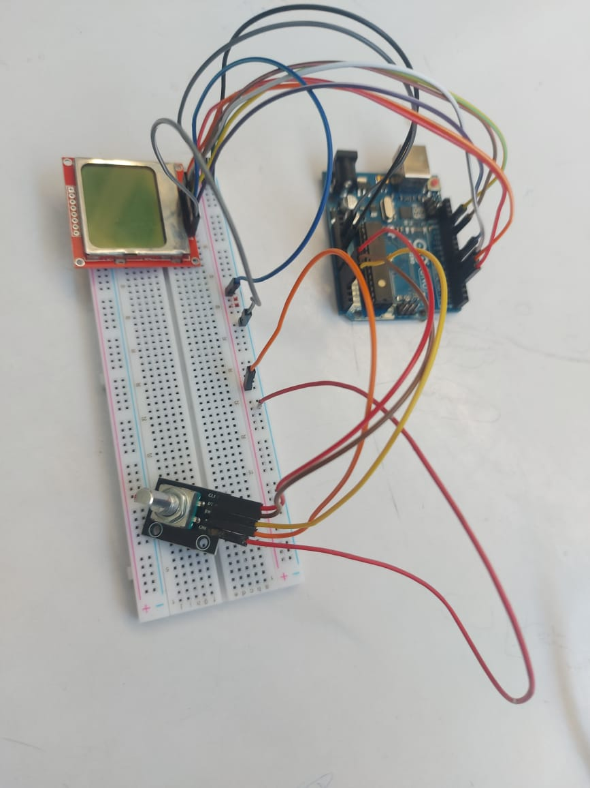
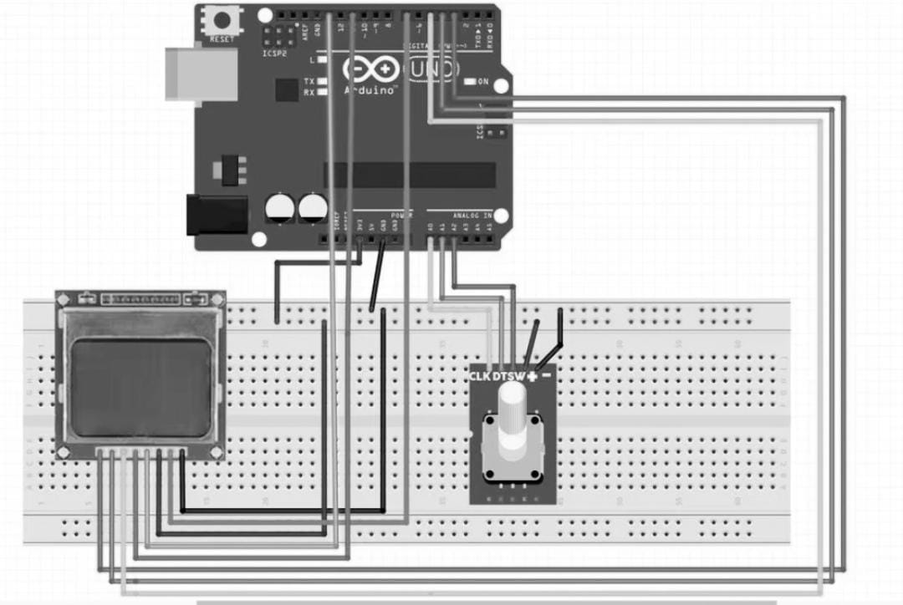
System Diagram

Slide 11
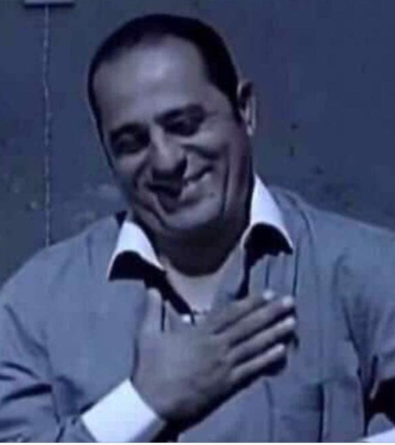

Thank You
Jens Martensson
jens@bellowscollege.com

