Slide 1
Optical Character Recognition
Deep learning
Dr. Sameh Zarif
Eng. Mohamed Abdaym
Eng. Shimaa Hessen

Slide 2
Team
Elsayed Mohamed 205038

Slide 3
Introduction
The OCR (Optical Character Recognition) project developed with Keras, TensorFlow, and Deep Learning is an image processing application that recognizes alphanumeric characters. This project is designed to extract text from images.

Slide 4
Data Preprocessing:
The first step in building this project is to preprocess the data. The images are loaded and resized to 28x28 pixels. The images are then converted to grayscale with depth 1 and normalized to values between 0 and 1.

Slide 5
Model Architecture:
The model architecture used in this project is a Convolutional Neural Network (CNN) model. The model consists of convolutional layers, max-pooling layers, a flatten layer, two dense layers, and a softmax activation function and ReLU activation function. The model is compiled using the Adam optimizer, categorical cross-entropy loss, and accuracy as a metric.

Slide 6
Training:
The model is trained on the preprocessed data for 10 epochs with a batch size of 32.

Slide 7
Model Evaluation:
The trained model is evaluated using the test set. And calculate the accuracy and loss. The confusion matrix is also generated to show the true positive, true negative, false positive, and false negative values.

Slide 8
Results
The trained model achieved an accuracy of 98% on the test set.
The confusion matrix shows that the model has good performance in recognizing alphanumeric characters.
The text extraction and recognition functions successfully extract text from the input image and recognize the characters.

Slide 9
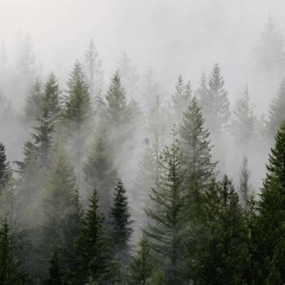
Conclusion
The OCR project developed with Keras, TensorFlow, and Deep Learning is an effective application that can accurately recognize alphanumeric characters and extract text from images. This project can be used in various applications such as document digitization, license plate recognition, and handwriting recognition.
I will use it as a feature in the chatbot.
Take images using a camera and extract text from images and display in the input box to use in various orders such as summarization.
Photo by Dave Hoefler on Unsplash

