Slide 1
Sentiment analysis
Machine learning & NLP
Dr. Esraa Afify
Eng. Mostafa Gamal

Slide 2
Team
Elsayed Mohamed 205038
Abdelrahman Amer 205055
Nourhan Fareed 205077

Slide 3
Abstract
This presentation focuses on sentiment analysis, specifically building a text classification model for emotion prediction based on textual data.
The dataset used in this project consists of text samples labeled with 9 emotions into 3 classes: negative, neutral, and positive.
The presentation covers various steps involved in the project, including data preprocessing, balancing the classes, building a pipeline with TF-IDF vectorization and Naive Bayes classifier, hyperparameter tuning using randomized search, training the model, evaluating its performance, visualizing the results, and saving the pipeline for future use.
The presentation also includes the development of a graphical user interface (GUI) using Streamlit.

Slide 4
Introduction
Text classification is a common task in natural language processing (NLP) that involves categorizing text into 3 classes into negative, neutral, and positive.
Emotion classification is one such application of text classification, where the goal is to identify the emotions expressed in textual data.
We focus on building a text classification model to predict emotions based on text samples.
We explore the process step-by-step, starting from data loading and visualization to data preprocessing, model training, evaluation and GUI.

Slide 5
Text data and known labels
Reading the dataset and visualizing it using pandas, matplotlib, and seaborn libraries.
Displaying its information and shape and description.
The missing data is handled by dropping the rows with missing values.
Solve imbalance between classes is visualized using a countplot.

Slide 6
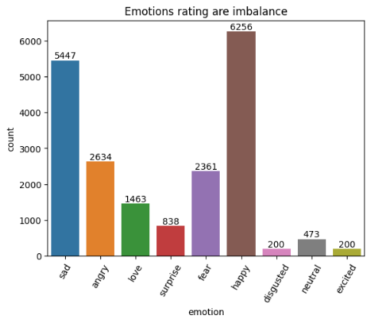
9 Classes!

Slide 7
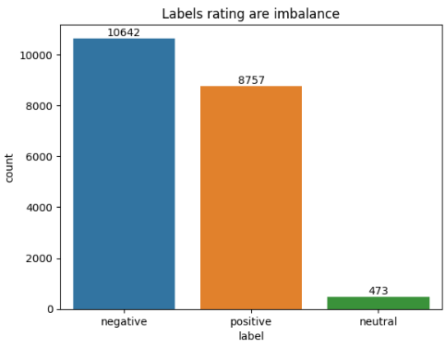
Merge to 3 Classes!

Slide 8
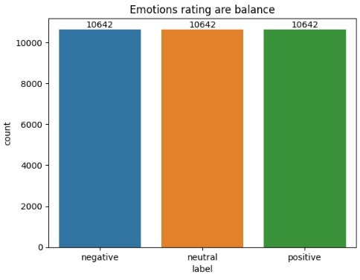
Resample method!
Text data and known labels

Slide 9
Data preprocessing
The project highlights the importance of data preprocessing in cleaning and preparing textual data for analysis:
+ Noise removal:
- stop words
+ Tokenization :
- word tokenize
+ Word normalization:
- PorterStemmer
- WordNetLemmatizer.

Slide 10
Build Pipeline
- The pipeline is built to simplify the training and evaluation process.
+ The pipeline includes the
- TfidfVectorizer for feature extraction
- the Naive Bayes classifier for training.
- RandomizedSearchCV is used to find the best hyperparameters for the pipeline

Slide 11
Training machine learning model
+ The Naive Bayes model is trained on the training data using the pipeline with the best hyperparameters.

Slide 12
Evaluation
+ The performance of the model is evaluated using
- accuracy score:
93%
- classification report:
precision recall f1-score support
-1 0.98 0.88 0.93 1598
0 0.87 1.00 0.93 1583
1 0.95 0.92 0.93 1613

Slide 13
Visualization
- A heatmap of the confusion matrix is plotted to visualize the performance of the model.

Slide 14
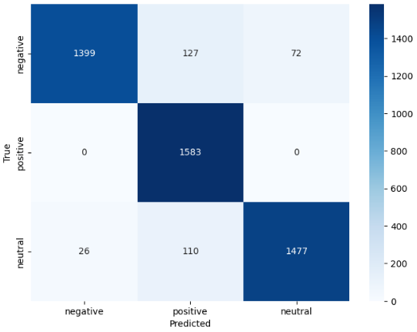
- confusion matrix
Confusion matrix

Slide 15
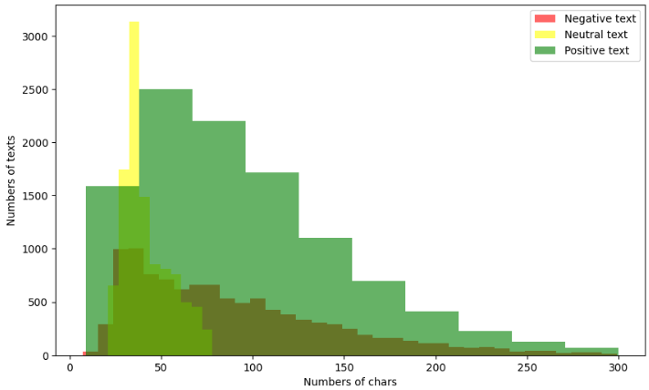
Number of chars

Slide 16
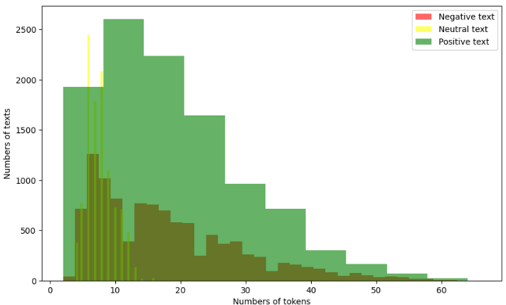
Number of tokens

Slide 17
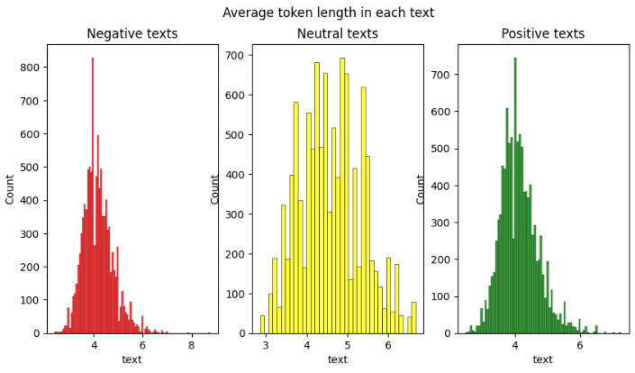

Slide 18
Save the pipeline
- The trained pipeline is saved using the joblib library for future use.

Slide 19
Build GUI
- This part involves building a graphical user interface (GUI) using the Streamlit library.
- Load model from the saved pipeline.
- A function is defined to preprocess the input text.
- The GUI allows users to input text and get predictions from the model.

Slide 20
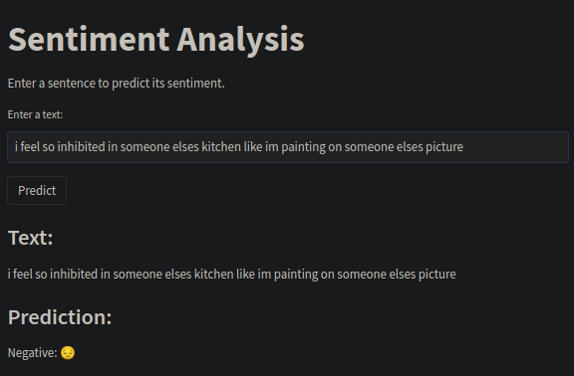
Build GUI

Slide 21
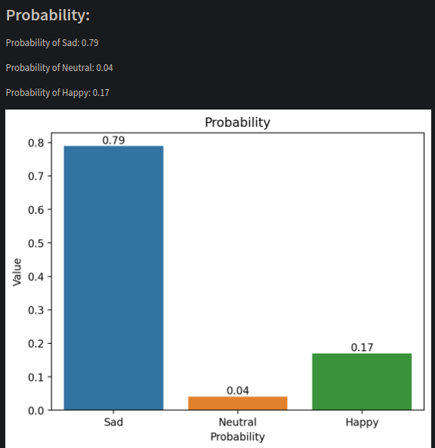

Slide 22
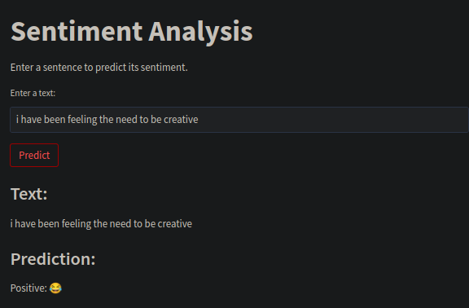

Slide 23
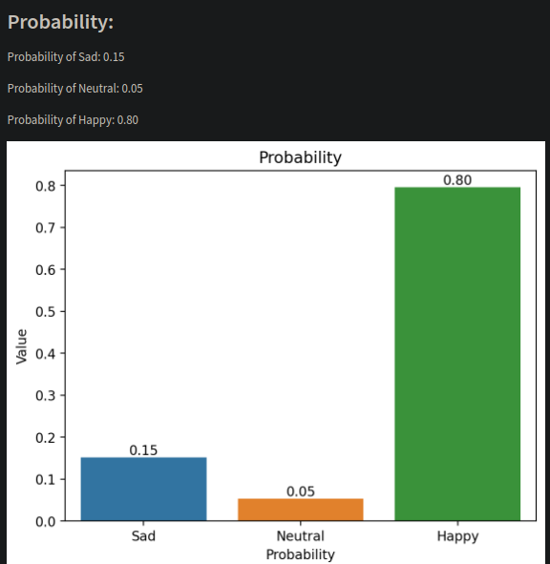

Slide 24
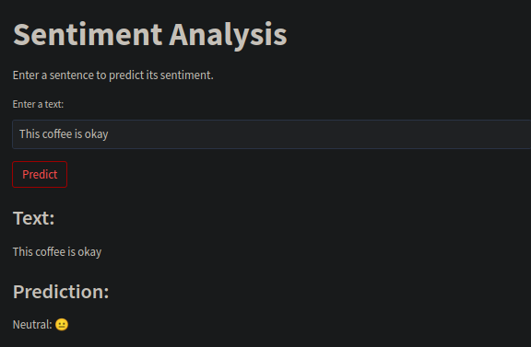

Slide 25
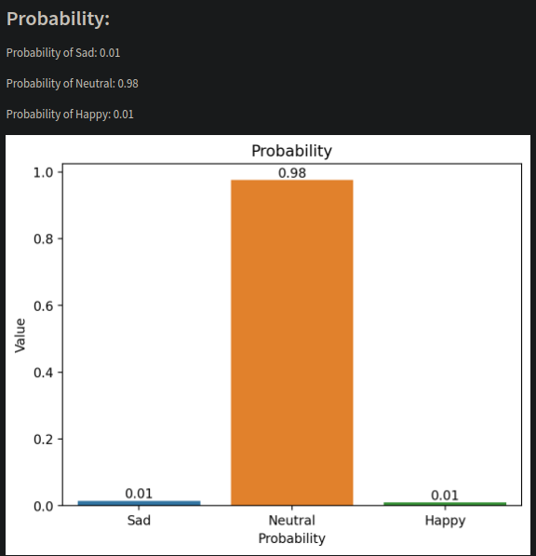

Slide 26
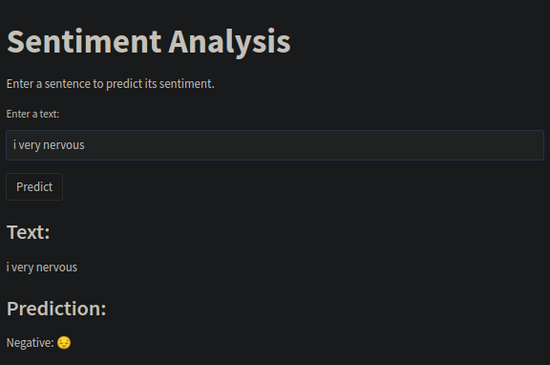

Slide 27
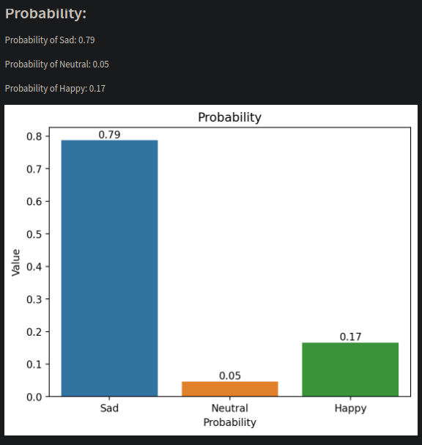

Slide 28

Conclusion
This project contributes to the field of natural language processing by providing insights into sentiment analysis and emotion prediction. The demonstrated techniques and methodologies can be applied in various domains, such as social media sentiment analysis, customer feedback analysis, and market research.
Future research can focus on exploring advanced techniques and incorporating additional features to further improve the model's performance and expand its applicability
Photo by Dave Hoefler on Unsplash

