Slide 1


SpaceEye GeoAI
New Capital Radar: a company that owns a city.
Supervisor: Dr. Nadim Abdin - Partner & VP Business Development
Team: Elsayed Elmandoh, Verina Fouad, Ahmed Abdelhameed, Nada Shady, Salma Magdy
Notes:
Speaker note: 0:30 · opening. Name the project and the slogan, thank the supervisor, introduce the team in one line.

Slide 2
Problem in numbers
>500
>600
3 months
7-8%
6
developers
projects
between field reviews
of developers seriously late
mutual terminations
More than 600 projects, and a field review every 3 months
Which compounds come first?
A short cycle list, with reasons
A committee cannot visit everything every cycle: whom to visit first? These are the chairman's statements, not our measurement.
The gap: ACUD's data (plot boundaries, handover dates, supervisor reports, field review records) is what would turn our public-data screening into operation.
Source: statements by the ACUD chairman, as recorded in docs/requirements/01-specs.md (section 12, slide 1 and the data request list).
Notes:
Speaker note: 0:30 · criterion 1. A committee cannot visit everything every cycle, so the question is whom to visit first.

Slide 3
The question and the decision
Today (as-is): every one of the 12 compounds gets a field review every 3 months, 4 visits a year each.
Tomorrow (to-be): a cycle list of at most 4 compounds from levels 1-3, each with a reason sentence. The committee decides.
12 R7 compounds in scope
4 visits per cycle
Capacity 4 of 12 compounds, from levels 1-3
Question: which R7 compounds should the committee visit first next cycle, and why?
The observatory ranks; the committee decides.
Scope: R7 only, 12 coded compounds, reporting quarter 2026Q3, cycle capacity 4.
ACUD has not given us visit times or missed cases, so the as-is pain is not measured.
Wording rule: the list says "no building activity since X" or "passed its first date by Y", never a label on a developer.
Frame: preventive · Buildings & Facilities · normal conditions · stability. Affected: buyers (6,474 homes in the five late public cases). Why now: C18 is 57 months past its first announced handover date.
Source: configs/cost_assumptions.yaml (projects: 12, visits_per_year: 4), docs/requirements/01-specs.md (sections 0, 2, 7 and 12); docs/deliverables/decision-memo.md (6,474 homes, why now).
Notes:
Speaker note: 0:30 · criteria 1, 2, 3. The question and the scope; say the frame, who is affected and why now in one line. The new process follows on slide 2b and the decision on slide 11.

Slide 4
As-is: how R7 is followed today
Press and portals
read by
Site supervisor
public statements: launch, progress, promised dates
quarterly progress report, Law 119 art. 54
half-yearly financial report, Decree 2184 art. 3
field review of every compound, every 3 months
Developer
ACUD planning body
Field team
warnings, new deadlines, terminations
visit notes
Today: the same field review every 3 months for every compound, 48 reviews a year in R7 (12 x 4). 5 of the 6 public late cases ran 18 to 33 months past the original promise (median 25).
Three causes: effort is not matched to risk; progress comes from the developer's own statements; nobody compares pace with the promised date.
Evidence: C19 claimed 70% while 28% of its built area was 20 m or taller that year (a reason to look, not proof); C14 reported 35% three months before its promised date and moved it; activity ranges 0.03 to 0.90 around a 0.61 mean.
Rebuilt from public sources; ACUD's workflow was not observed and must be confirmed.
Source: docs/deliverables/as-is.md (process map, baseline, root causes).
Notes:
Speaker note: 0:45 · criteria 2, 1. The process map is rebuilt from public sources and must be confirmed with ACUD. The effort is the same for every compound.

Slide 5
To-be: the new process
Public satellite data, every quarter
levels 1-4 with a written reason
Committee decides
Pipeline and quality gates
Priority list, capacity 4
Published developer statements
counts false alarms and misses
visit
no visit
result recorded on the Compound file screen
Visit log
Field visit
Watch next quarter
Roles: the Track A owner runs the pipeline and gates each quarter (second reviewer); the committee decides; the field visit lead records the result; the ACUD data custodian keeps the code-to-name mapping.
Targets (proposed): every level 1-2 compound visited (31 of 31 quarters covered); 12 of 12 results recorded.
ISO 37122 and U4SSC have no matching project-level indicator; targets rest on R7 data. S3 tests load above capacity.
Proposed by the team, not approved by ACUD. The system recommends; the committee decides.
Source: docs/deliverables/to-be.md (the new process, roles and proposed targets).
Notes:
Speaker note: 0:45 · criteria 3, 5. Walk the loop once from satellite data to the visit log; stress that the committee decides and every visit result comes back as ground truth. Targets are proposals, not approved by ACUD.

Slide 6
From Data Scarcity to Data Intelligence
How can we monitor construction without ACUD's internal developer records?
1 · OBSERVE
Satellite imagery and land-cover change
What is physically changing on site?
🟢 public imagery → 🔵 derived signals
2 · CONTEXTUALIZE
Published dates, announcements and regulations
What was publicly promised, and when?
🟢 real, with source and publish date
3 · SIMULATE
Synthetic finance and operations records
How would the system behave with ACUD's own data?
🟠 generated · training and testing only
Fused per compound and quarter → Track A. An announcement is context, never field proof.
Track B only, every number marked 🟠
12
43
516
57
compounds in R7
quarters, 2016Q1 to 2026Q3
compound-quarter observations
public statements, each sourced
Source: app_data/real (compounds 12, sat_quarterly 516 rows = 12 x 43 quarters, statements 57); SPACEEYE_DATA_REFERENCE.md sections 4 and 13.
Notes:
Speaker note: 0:30 · criteria 2, 8. Open with the constraint: we have no access to ACUD's internal developer records, so we built the evidence from public sources instead of waiting for them. Complementary evidence: the satellite tells us what may have changed on the ground; statements tell us what the developer announced and when. We link the two in time per compound and quarter, and we never treat an announcement as proof of work on site. Provenance: every value keeps its origin (green real, blue derived, orange generated), so fact and assumption never mix; the key is used on every later slide. Generated data exists only because finance, supervisor reports, meters and complaints are held by ACUD; it trains and tests Track B and never sets a Track A level. Backup if asked: the spec states 1,009 of 1,026 documented facts passed independent review (spec section 12; a stated figure, not our recount); the v7 release rebuilds from 84 frozen inputs listed in data/REBUILD_INPUTS.csv; 7,716 Dynamic World images; 372 KPI rows. Transition: so what do we actually extract from the satellite images?

Slide 7
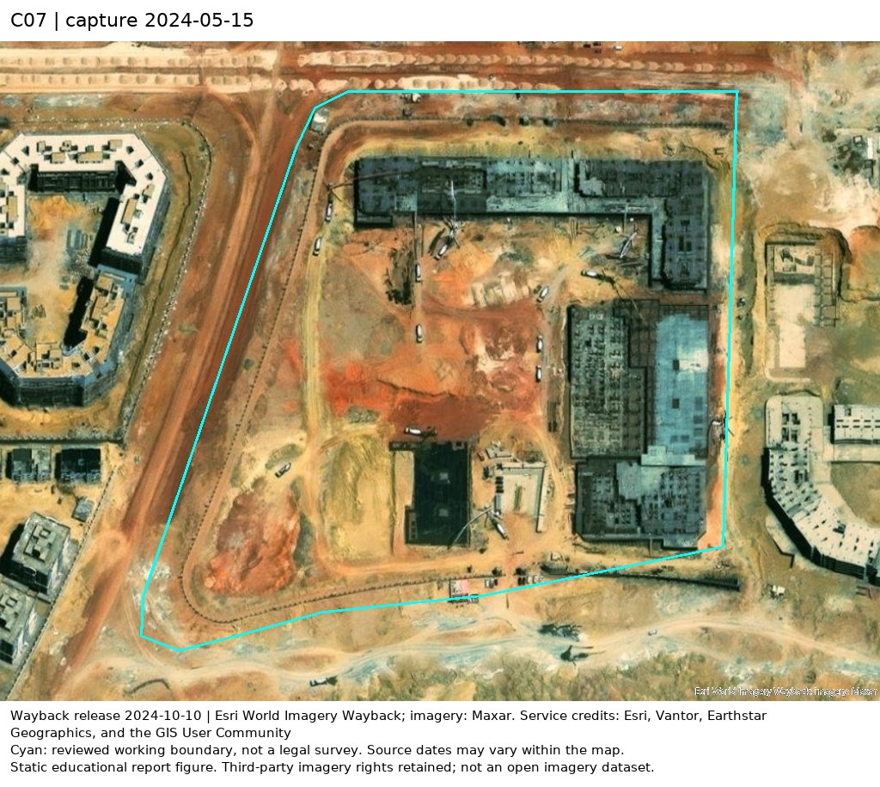
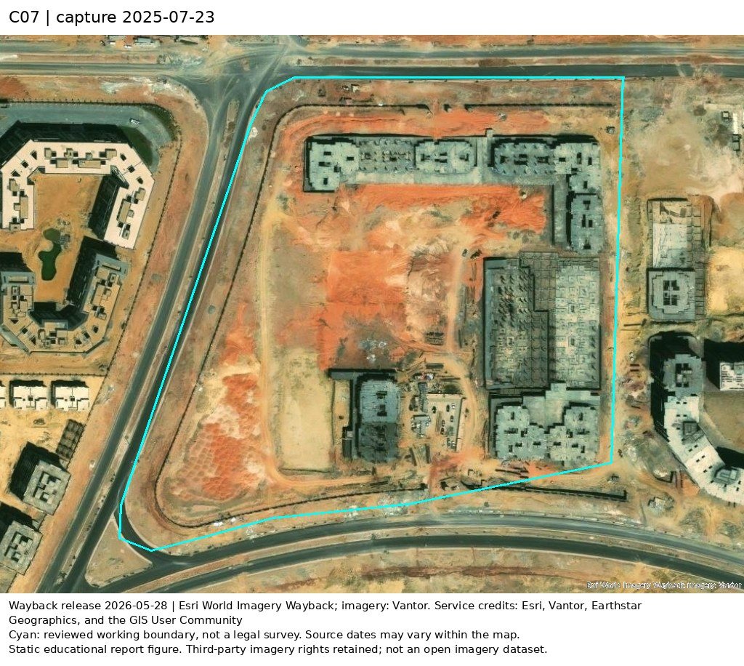
From Pixels to Construction Signals
1 · Define the site
Compound boundary polygon
2 · Measure each quarter
Dynamic World + Sentinel-2
3 · Estimate activity
Gradient boosting → score A
4 · Check by eye
Dated Esri Wayback before / after
C07 · Before · 2024-05-15
C07 · After · 2025-07-23
2026Q2-Q3: below the threshold after the start → K2 = 2
Satellite signals indicate activity and change, not verified completion or handover.
Source: app_data/real/sat_quarterly.parquet (C07 activity score A); model/activity_meta.json (threshold 0.42); Esri World Imagery Wayback (imagery: Maxar 2024-05-15, Vantor 2025-07-23; Esri, Vantor, Earthstar Geographics, GIS User Community).
Notes:
Speaker note: 0:30 · criteria 2, 6. Tell the process, not the tool list. Spatial: every measurement is aggregated inside the compound's own boundary, not over the whole district. Temporal: we compare the same site quarter by quarter from 2016Q1, and ask whether the built signal is rising and whether activity is observed. Model: the activity score A is not read straight from Dynamic World. A gradient-boosting model takes 12-month window features from Dynamic World and Sentinel-2 (built-probability trend, land-cover and spectral index changes) and was trained on 806 windows over 207 plots labelled with Google Open Buildings temporal labels; out-of-fold balanced accuracy 88.6%; the active threshold 0.418 is the out-of-fold optimum. The current mode carries each mid-year window for four quarters, which is why the curve moves in steps. Visual check: Esri Wayback pairs let an inspector see the change between two dated captures; they are not model inputs. Uncertainty: a quarter counts only with at least 6 Dynamic World images (K4); boundaries carry a confidence label (C18 is low); we separate observed activity from completion or handover, which satellites cannot see. Example on screen: C07 was active from 2024Q2 to 2026Q1, the Wayback pair shows the structures rising, then the score fell below the threshold for 2026Q2 and Q3. Backup if asked: 7,716 Dynamic World images; 100 Wayback frames at 0.31 to 0.5 m; Open Buildings heights to 2023. Transition: now we have activity signals and published dates. The committee does not need curves; it needs to know whom to visit first.

Slide 8
From Evidence to Inspection Priorities
Three questions. One transparent decision.
Has it started?
K6 · time since launch or promise, no observed start
Explainable rule
The most urgent condition that applies sets the level. No weights, no black box.
Safeguard: "may be complete" holds it at level 3 until a site check.
1 Inspect now
2 Inspect this cycle
Has it stopped?
K2 · consecutive inactive quarters after the start
3 Document review
Is it past its announced date?
K3 · months past the first published handover date
4 Routine
Real examples · 2026Q3
C18 → Level 1
Still active (K2 = 0), yet 57 months past its first announced handover date (Dec 2021).
C07 → Level 2
2 inactive quarters in a row, with no published handover date at all.
C03 → Level 3
6 inactive quarters, but a handover was announced: may be complete, confirm on site.
The system prioritizes inspections. The committee makes the decision.
Source: configs/data.yaml (thresholds fixed before any score was seen); app_data/real/kpi_values.parquet (levels and reasons at 2026Q3).
Notes:
Speaker note: 0:45 · criteria 3, 4. Three different failures need three different clocks: a project that never started (K6), one that started and stopped (K2), and one past its first announced handover date (K3). This is an explainable decision-support rule, not a black-box score: each level comes with the sentence that produced it. C18 shows one signal is not enough: the site is still active, yet it is 57 months past the date first announced, so it is level 1. C07 reaches level 2 from inactivity alone, without any published date. C03 shows the safeguard honestly: six quiet quarters would mean level 1, but a handover was announced, so the rule holds it at level 3 and asks for a site check; this can lower urgency, which is why it needs field confirmation. Backup if asked: level 1 = K2 >= 4, or K3 > 24, or K2 >= 2 with K3 > 12, or K6 > 24; level 2 = K2 2-3, K3 13-24, or K6 13-24; level 3 = K2 = 1 or K3 1-12; may be complete = handover announced or vegetation share >= 0.10 (2026Q3: C03, C12, C21 held at 3). Legal context: 12-month handover grace and the 24-month refund right in Decree 2184/2022. K5 (months eligible for contract review) is illustrative and never sets a level; plan gap B5 is generated and appears only in Track B. At 2026Q3 no compound gets its level from K6, because all 12 have an observed start. Transition: Nada will now show this decision working live.

Slide 9
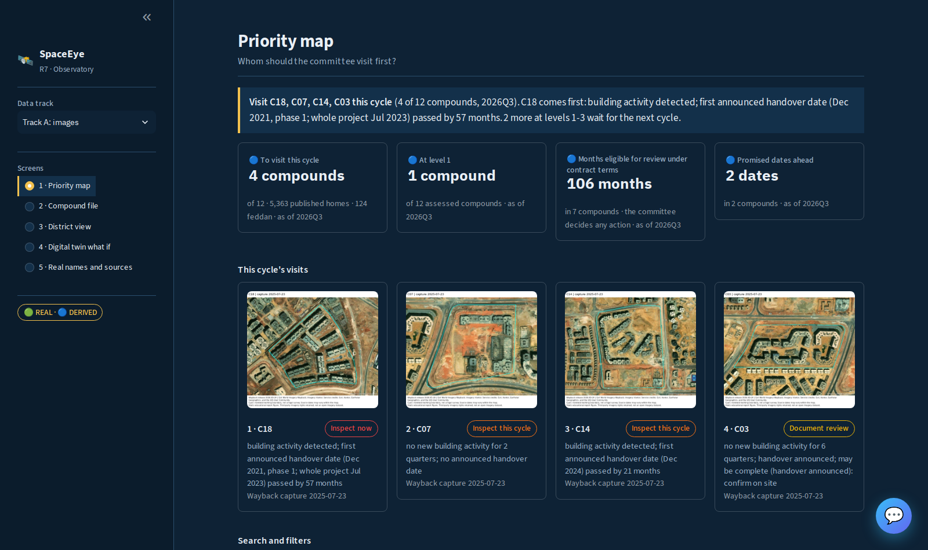
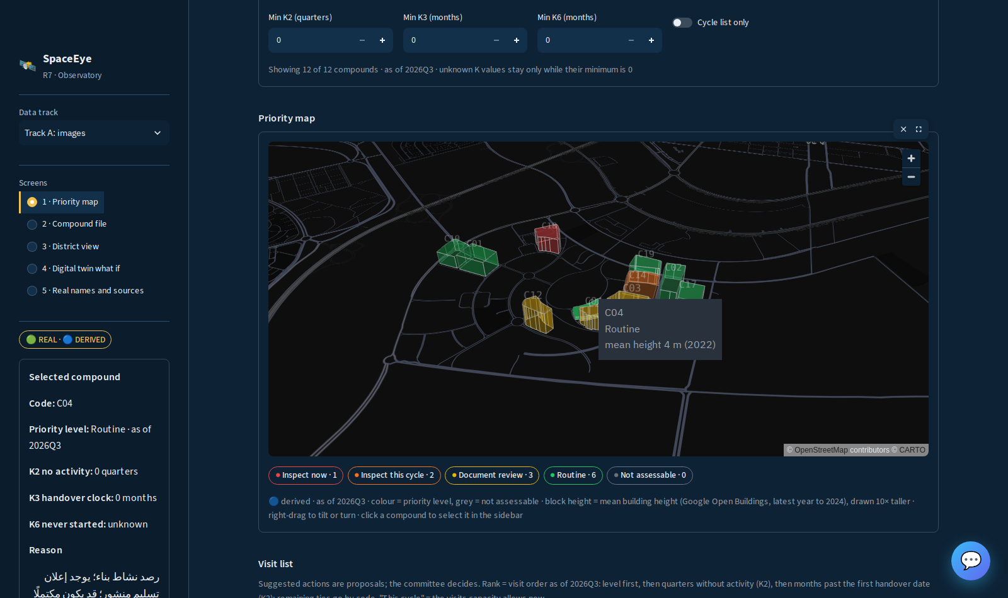
Live demo (Track A)
Priority map
Cycle list (capacity 4, levels 1-3)
Compound reason sentence
Inspection file
Visit result recorded
Dashboard screenshot · Priority map
Dashboard screenshot · Priority map, selected compound
Track A on screen is real or derived, no generated number on the map. Run: make run (T-AH-19), from stored files.
Source: docs/deliverables/user-guide.md; board task T-AH-19 in docs/requirements/02-team-roles-and-tasks.md.
Notes:
Speaker note: 1:00 · criterion 4. Follow the alert to the action: level, cycle list, inspection file, visit form.

Slide 10
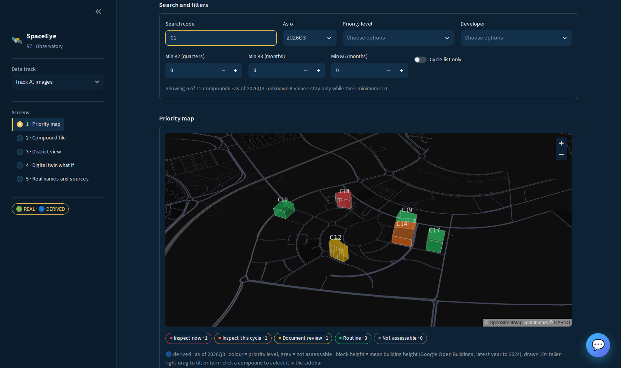
Search, filters and map click
One search box: a compound code (C..) or developer code (D..); a prefix works. "C1" shows 6 of 12 compounds.
Filters: as-of quarter, priority level, developer, minimum K2 / K3 / K6, cycle list only.
Rank stays the quarter's visit order when you filter.
Click a block on the map: the sidebar shows that compound. "Clear selection" resets. Codes only.
Dashboard screenshot · Priority map, search and filters
Dashboard screenshot · Priority map, selected compound
Source: app.py (render_filters, open_clicked_compound, render_selected_compound_panel), src/dashboard/insights.py (filter_compounds); board tasks T-NA-11, T-NA-12, T-NA-13 and T-EL-21 in docs/requirements/02-team-roles-and-tasks.md.
Notes:
Speaker note: 0:30 · criterion 4. Live: type C1 in the search, set a priority level filter, click a block on the map, show the sidebar panel, then Clear selection.

Slide 11
Four screens, one path from alert to action
1 · Priority map
Whom first?
2 · Compound file
Why this one?
3 · District view
What does the system give, and when does it fail?
4 · Digital twin what if
Who changes if costs, collections or capacity change? Track B, generated
Level
Cycle list
Compound file
Visit form
Recorded visit
Alert to action: the level sets the cycle list, the compound file gives the reason, the visit form records the result.
Audience test: the teammate reviews changed the screens (audience-test.md). The supervisor took an unrecorded ten-second test; a recorded one with a committee member is still to be run.
Source: docs/deliverables/user-guide.md (screen subtitles), docs/deliverables/audience-test.md, docs/deliverables/display-rules-check.md.
Notes:
Speaker note: 0:30 · criterion 4. Name who uses each screen, follow the alert to the action, and say the committee-member test is still to be run.

Slide 12
Track B: generated data
🟠 Synthetic - for training only
Target: distressed / not_distressed in the next six months. Completion prediction is out of scope.
96 training rows, 48 test rows; only 4 test rows are distressed, so power is very low.
Boosting 4 of 4 rests partly on height; without height (v2a) it is 1 of 4.
Random top-4 baseline: mean 0.335, 95% interval 0.000 to 0.750 (2,000 draws).
With 4 cases the methods cannot be separated, and combining ACUD-style data did not clearly help. Scores are diagnostic, not real-world accuracy.
Source: docs/deliverables/complaints_eval.csv, data/EW_V2A_VS_V1.md.
Notes:
Speaker note: 0:45 · criterion 6. Generated data only; with 4 test cases the methods cannot be separated. For questions, complaints classifier: the keyword baseline scored 0.27 accuracy on the 104-row benchmark and 0.37 on the 30-item check set; TF-IDF plus logistic scored 0.22 and 0.30, respectively. Accuracy on texts written by the team does not prove accuracy on real complaints.

Slide 13
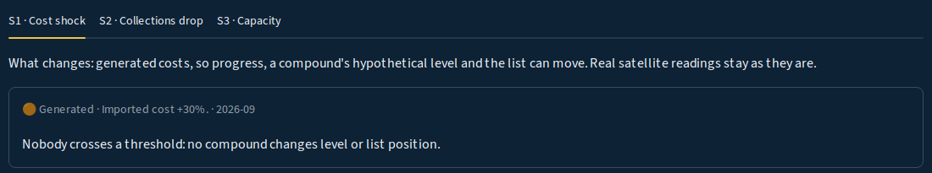
The observatory: one what-if scenario
🟠 Synthetic - for training only
Scenario | What changes | Rows that change list membership
S1 | Dollar shock | 0 of 216; levels never change
S2 | Collections drop | 0 of 216; levels never change
S3 | Inspection capacity 2 or 6 instead of 4 | 45 of 744 (28 at capacity 2, 17 at capacity 6); levels never change
Light compound-level observatory: observed state from satellites and statements, simulated hidden state from the generator.
Demo S3 live. Say plainly that S1 and S2 change nothing in the list or levels.
Orange banner on screen, no map. Not a 3D or real-time observatory.
Dashboard screenshot · Digital twin what if
Source: logs/review-05.md (scenario row counts).
Notes:
Speaker note: 0:30 · criterion 6. Show S3 only; say S1 and S2 change nothing.

Slide 14

Ask the project: the chatbot
Question
Intent router (10 intents)
Hybrid retrieval: DuckDB facts + Chroma search
Answer: Gemini if approved and within budget, else local
Sources shown
Opens from the dashboard's 💬 button (port 8001).
Follow-up questions keep the last compound code.
Generated items stay labelled "Synthetic - for training only": complaints and visit records are synthetic.
Retrieval reads the v7 release facts and the statements, complaints and knowledge documents.
Dashboard screenshot · Chatbot, start screen
Source: chatbot/app/retrieval/router.py (intents), chatbot/app/retrieval/hybrid.py, chatbot/app/api/main.py (session context), chatbot/app/generation/gemini_client.py, configs/ai.yaml, README.md.
Notes:
Speaker note: 0:45 · criterion 4. Live: open the 💬 button, ask one question, show the cited sources; say generated items stay labelled.

Slide 15
What the chatbot knows, and its limits
8 of 8
5 of 5
Call budget: 200 model calls in total (approved by the project owner on 2026-11-04), then local answers
intent tests passed (2026-11-03)
retrieval checks passed
Knowledge: 9 sourced documents (ACUD site, Decree 2184/2022, Building Law 119/2008 art. 54, Law 151/2020, Dynamic World, Open Buildings, Esri Wayback, ISO 37120/37122, team SLA note) plus the project's data.
The tests are the team's own and small. They are not an accuracy claim.
Model calls only with approval in configs/ai.yaml (chatbot.approval: approved), then local answers.
Codes only. Not legal advice.
Source: chatbot/knowledge/SOURCES.csv, chatbot/evaluation_results.json, chatbot/retrieval_evaluation_results.json, configs/ai.yaml.
Notes:
Speaker note: 0:30 · criteria 8, 9. Say the tests are the team's own and small; model calls need the owner's approval and stop at 200, then local answers. Codes only, not legal advice.

Slide 16
Risks and responsible use
A level is not a finding
It says whom to visit first; it is not misconduct, legal distress, breach or a verified fine. No automatic sanction.
Owner: Track A owner
Unknown stays unknown
Missing evidence is never read as negative. K3 relies on developer statements, not independent measurement.
Owner: Track A owner
Generated data
Never mixed with real data; Track B is marked and hidden from the map. It shows nothing about real accuracy or fairness.
Owner: Track B / AI owner
Small samples
6 real cases and 4 test cases: counts only, no percentages.
Owner: Field visit lead
Complaint text
Masking does not prove every real name is removed; real text needs further review. The chatbot sees only generated complaints.
Law 151/2020
Interpretation needs the data custodian's review. Not legal advice.
Owner: ACUD data custodian
Handover
Guides, method card and checklist are in the repo; no one outside the team has rebuilt the system from them yet.
The committee decides
Every visit result is recorded to build real ground truth.
Owner: Committee
Each risk has an owner role and an early sign in governance.md (proposed, not signed by ACUD).
Source: docs/deliverables/responsible-ai.md, docs/requirements/01-specs.md (Law 151/2020). | (knowledge transfer) docs/deliverables/technical-track-a.md, docs/deliverables/user-guide.md, docs/deliverables/knowledge-transfer.md, docs/deliverables/method-card.md, docs/deliverables/final-checklist.md.
Notes:
Speaker note: 1:00 · criteria 8, 9. A level sets the visit order and finds nothing against anyone. Then give one line on the handover documents. The committee decides, and every visit result is recorded to build real ground truth. The user guide was checked against the code, not in a browser.

