Slide 1

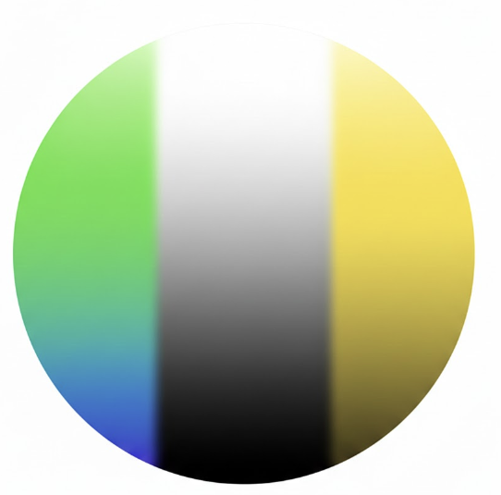
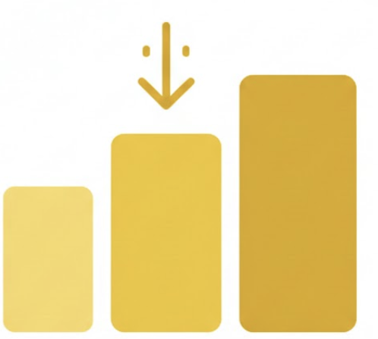

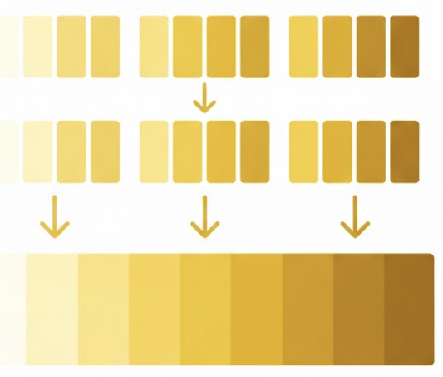
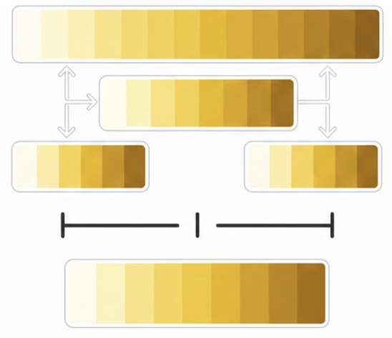
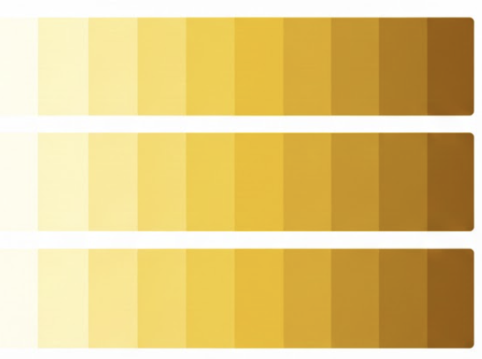
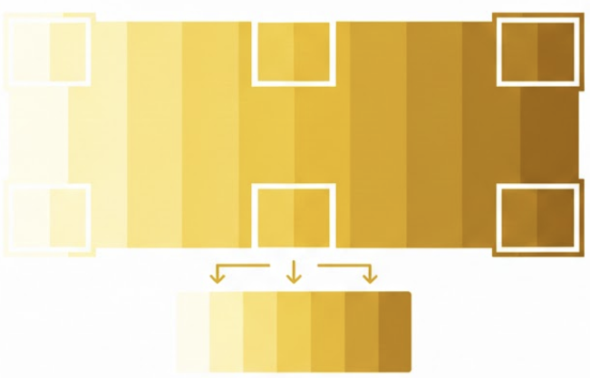
SHADE MASTER ALGORITHIM
Teeth regions
Shade regions
1
2
3
4
A
B
C
D
Do the following process for each region
Do the following process for each region
RGB Colors
CIELAB Colors
Sort by lightness
(select median color)
Prune
outlier colors
RGB Colors
CIELAB Colors
Sort by lightness
(select median color)
Prune
outlier colors
Region A
Get the average
size of all shade
regions
Region B
Merge all regions into one
Then sort the resultant palette by lightness
Region C
Taking out an even sample
Out of the big palette
Similar in size to the shade regions
Running the comparison
Unified teeth region
Shade region A
Δ = 2
Shade region B
Δ = 1.5
WINNER!
Shade region C
Δ = 2.2
Compare each sorted shade region against the unified tooth baseline through one-to-one color mapping. We calculate the average delta for each pairing; the region demonstrating the highest color fidelity (the lowest delta) is selected as the winner.

