Slide 1
ClojureScript starter project

Slide 2
Getting started
Clone the repo
TBD
What’s included:
Figwheel Main - Development tooling
Reagent - ClojureScript interface to React
Antizer - ClojureScript interface to Ant Design React component library
Accountant - ClojureScript single-page application navigation
Secretary - ClojureScript routing

Slide 3
Figwheel Main
Auto-reloading of code in the browser when files change
Auto-running of unit tests in the browser when files change
Highly configurable
https://figwheel.org/docs/hot_reloading.html

Slide 4
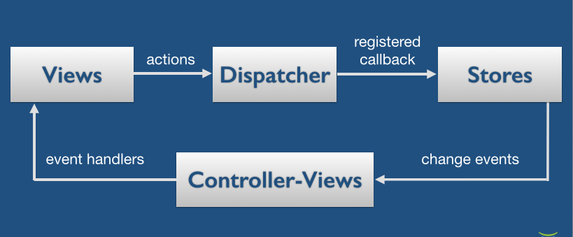
Reagent - ClojureScript interface to React
Architecture:
Views - UI components which pull their data from the state
Stores - State of the application which functions can update
Events - User actions which trigger updates to the state

Slide 5
Reagent - Views
Simple DSL for constructing HTML
Can be nested and parameterised
Works just like functions
(defn page-description [title description]
[:div
[:h2 title]
[:p description]])

Slide 6
Reagent - Stores
State is stored in a Reagent atom
Identical semantics to a Clojure atom, so standard functions like update, swap, etc., just work
Updating the contents of a Reagent atom triggers re-rendering of all components which de-reference that atom
Only components whose inputs have changed are re-rendered
Storing everything in a single global atom is still efficient

Slide 7
Reagent - Event handlers
Just functions attached to components which update the state
[ant/button {:on-click #(swap! state assoc :text "Goodbye")}
"Click me"]

Slide 8
Reagent - Basic example
(defonce state (reagent/atom {:text "hello"}))
(defn page-view []
[:div
[:p (:text @state)]
[ant/button {:on-click #(swap! state assoc :text "Goodbye")}
"Click me"]])

Slide 9
Unit tests
Figwheel Main runs ClojureScript unit tests in the browser
Results can be viewed at http://localhost:9500/figwheel-extra-main/auto-testing
You’ll need a “test-runner” file
This should require all the namespaces containing tests
It needs to be referenced in the project.clj for the fig:test target
Figwheel Main will auto-run all tests affected by code changes
Accept notifications from the page to get nice warnings when you break stuff

Slide 10
Integration tests
Use etaoin for Selenium-style end-to-end testing
Tag interesting UI elements with IDs
Navigate to the elements by finding the IDs then trigger clicks, read values, etc.
Tests are written in Clojure rather than ClojureScript
Need to launch the server and the UI, then run the tests
Currently done with a stub test fixture to launch a Jetty server
In a real project the makefile would probably be responsible for launching the server, running the tests, then tearing it all down

Slide 11
JavaScript interop - JSON data
Simple JSON data can be transformed between representations with the standard ClojureScript functions
(clj->js {:x 23})
(js->clj some-js-data :keywordize-keys true)

Slide 12
JavaScript interop - objects
JavaScript objects need the goog.object library to access properties
(goog.object/getValueByKeys a-js-object "props" "children")

Slide 13
Gotchas - Broken files do not reload
Figwheel Main autoloads files when they change
If a file is generating compiler warnings then it will not autoload the file
Optional and can be turned off, but this is usually the behaviour you want
However, you will forget about it and occasionally wonder why the changes you’re making aren’t reloading
Usually catches me when I’m fixing warnings incrementally
Manually refresh to get back to the true state of the world

Slide 14
TBD - Best practice for state 1
Atoms can be global...
(defonce state (reagent/atom {:x 23}))
...or local
(defn ui-widget []
(let [state (reagent/atom {:x 23})]
(fn [] [:h1 (:x @state))))

Slide 15
TBD - Best practice for atoms 2
Unsure what best practice is:
Global state for everything?
Global state for shared information, local state for page-specific information?
Experiment and see what works

Slide 16
TBD - Browser local storage
It’s possible to store state in the browser local storage, so it is retained across page loads
Highly useful for a number of things
Remember settings
Keep a user logged in
Etc
Haven’t investigated yet but I’d expect it to be straightforward

Slide 17
TBD - CSS auto-reloading
Figwheel Main can do this
https://figwheel.org/docs/live_css.html
Haven’t investigated yet but I’d expect it to be straightforward

