Slide 1


Coopbank Farm Pass
Transforming Agriculture

Slide 2
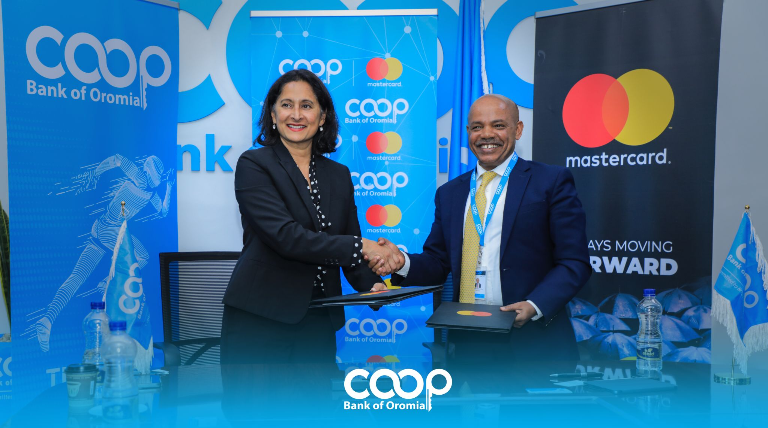



Farm Pass Agreement Signing (Feb, 2023)

Slide 3

Why we need FarmPass
We are Farmer’s Bank, established to serve their needs.
Farmers lack Access to Loans.
Digital is the Future.
Farmers and Cooperatives are not incentivized to use Digital Payments / Channels.
Focus on Agriculture sector will enable the bank to reach the mass.
FarmPass

Slide 4
Why we need FarmPass
There exists a large number of unbanked and underbanked population in Ethiopia, and the Coopbank shall work on it and improving financial inclusion.
Emphasis shall be given to empowering rural areas and cooperatives through adopting fitting operating models and digital banking modalities.
Coop Bank's Strategic Direction
The strategy has taken into account a wide range of technological advancements and innovative solutions which thereby enables efficient operations and extraordinary value propositions.
Focus to MSMEs; By benchmarking global best practices the bank shall work on this sector especially by creating access to finance (micro and small loans), job creation, and BDS.

Slide 5



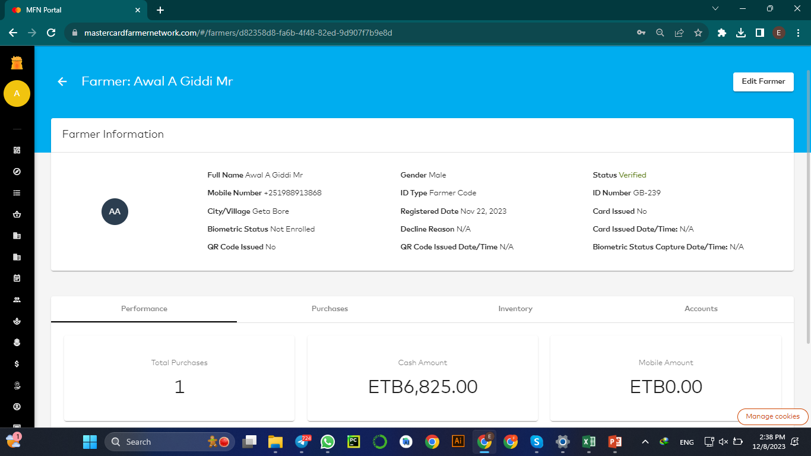
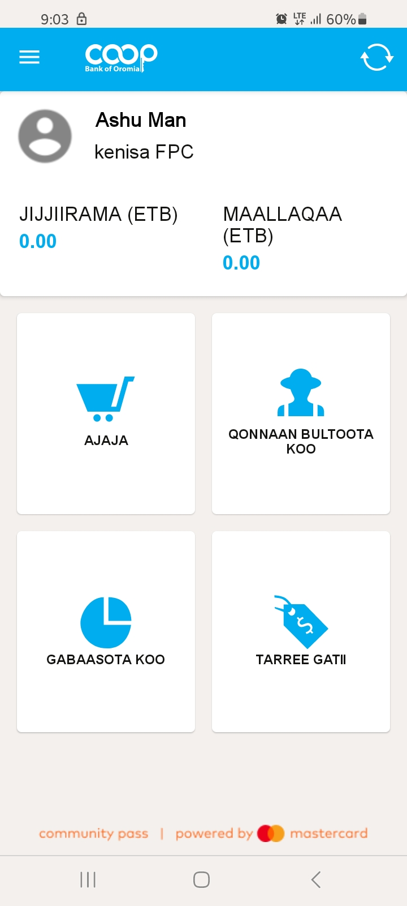

Simple and Easy to Use platform
( Made Considering the Agri-sector)
Coopbank Farm pass - powered by Mastercard's renowned Community Pass platform, it is an Eco-system that seamlessly connects farmers, cooperatives, aggregators, buyers, agricultural input/service providers, financial institutions, and other service providers.
Offline Mobile App
Language support in :
Afaan Oromo
Amharic and
English
Web
&
* Farmers do not directly use the platform, they access it through their Cooperative, Cooperative Agents or any other organization they are under.

Slide 6

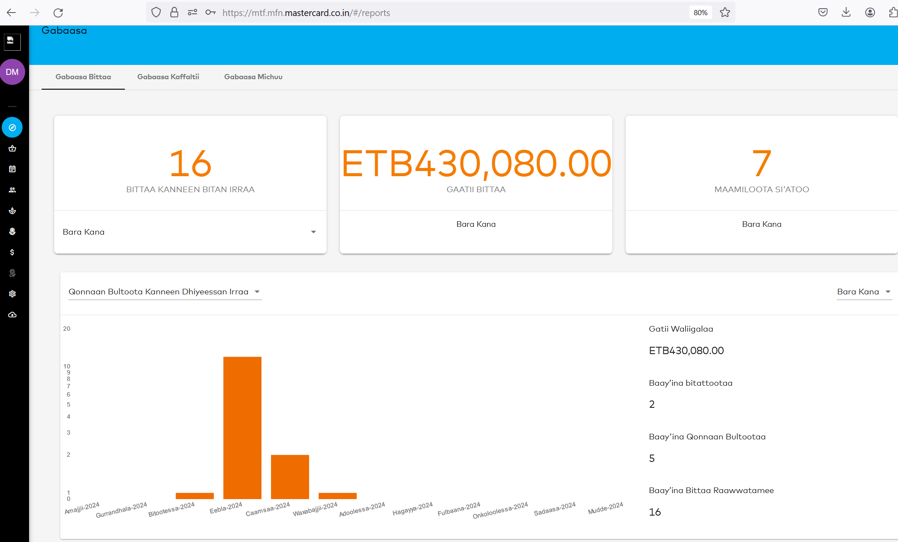
Farm Pass Services
Farmer Data Management
Digitize Cooperatives member Farmers profile and Keep Track of their overall interactions with their cooperative.
Enable Cooperatives to Manage their Farmers data
Upload existing Farmer list, going directly from manual to Digital.
Reduce paper cost and increase efficiency.
Cooperatives can send SMS announcements for Farmers.
Create Visibility of overall Cooperative performance for Bank
Dashboard and Reporting
Cooperatives can now see all their transactions at one place

Slide 7
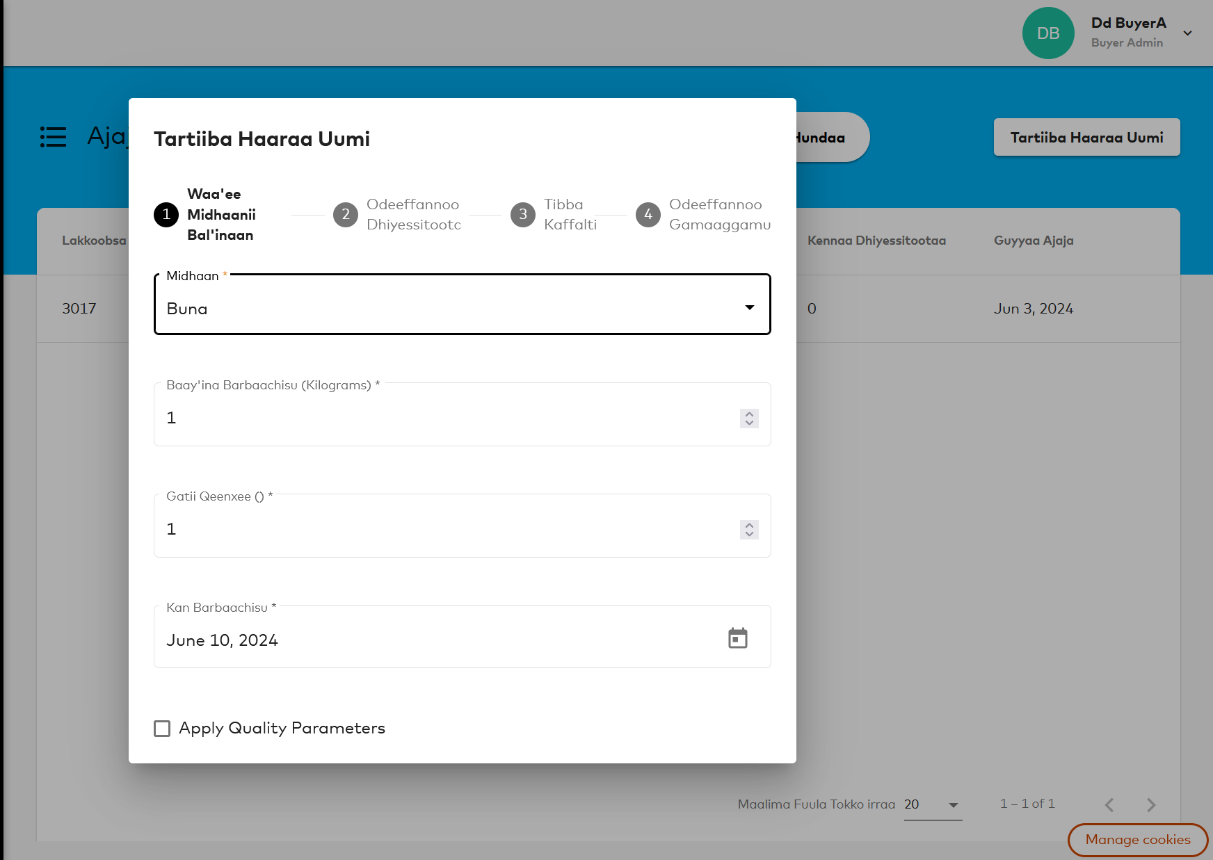
Farm Pass Services
Buyer Order Management
Buying and Selling made Digital, Efficient and Simpler.
Digitize supply chain, including Payments :
Farmer to Collection Sites to Primary Cooperative
Primary Cooperative to Cooperative unions
Producer to Aggregator to End Buyer
Cooperative Unions can see what's available at Primary Cooperative level
Primary Cooperatives can see what's available at Agent or Collection Sites Level
Suppliers / Aggregators can Manage their Agents or Collection Sites Digitally.
* Farm Pass also enables to onboard other agricultural Buyers that collect produce from farmers. Example : Malt Factories, Food Processor and etc.…

Slide 8
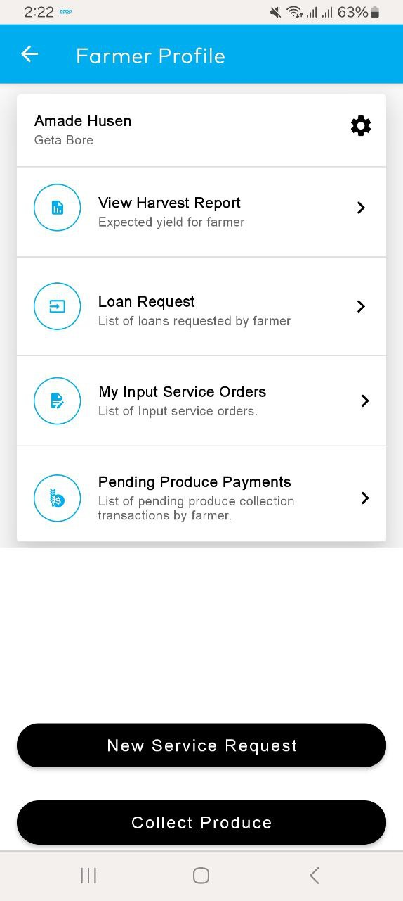
Farm Pass Services
Harvest Projection and Produce Collection
Farm Pass Enables Cooperatives to know their estimated yield at cooperative level and at individual farmers level, enabling them to prepare for the next season. It also Enables Cooperative to digitize the produce collection process even in places there is no network connection
Farm Pass digitizes collection process of cooperatives.
Payments will be made by simply inputting the kilograms and selecting the crop.
During Collection if a farmers has an outstanding loan Farm Pass enables to automatically deduct the loans and pay the rest to the farmers.
Farmers will receive SMS every time the sell with all information(how many Kg they sold, payments made and other details)

Slide 9
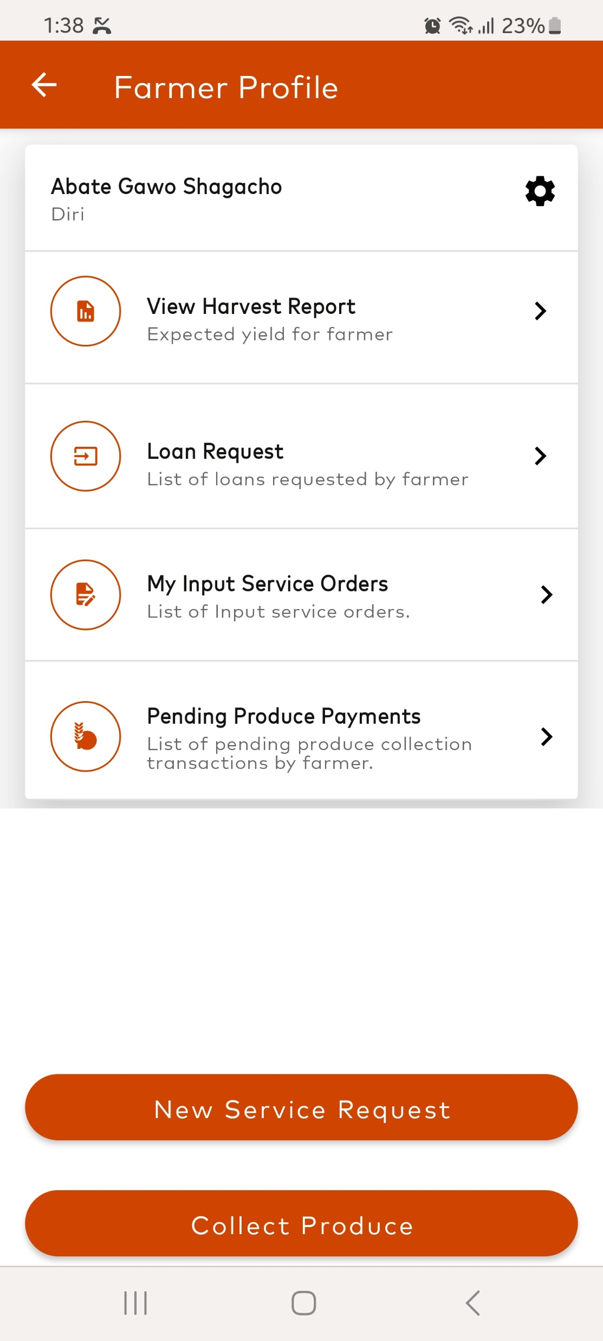
Farm Pass Services
Input Demand Aggregation
Using this platform farmers can submit their input needs through the cooperative users and cooperatives can digitally share the requests to input providers registered in Farm Pass platform.
Farmers can share their Agricultural inputs need through their Cooperative
The Cooperatives can Aggregate their members requests
The cooperatives can review and share the requests to Input providers
Farmers can Apply for Input for which they have option to
Pay in cash
In advance , or
Request a loan for the inputs they want
Incase of loan the cooperative can forward that request to the Bank

Slide 10
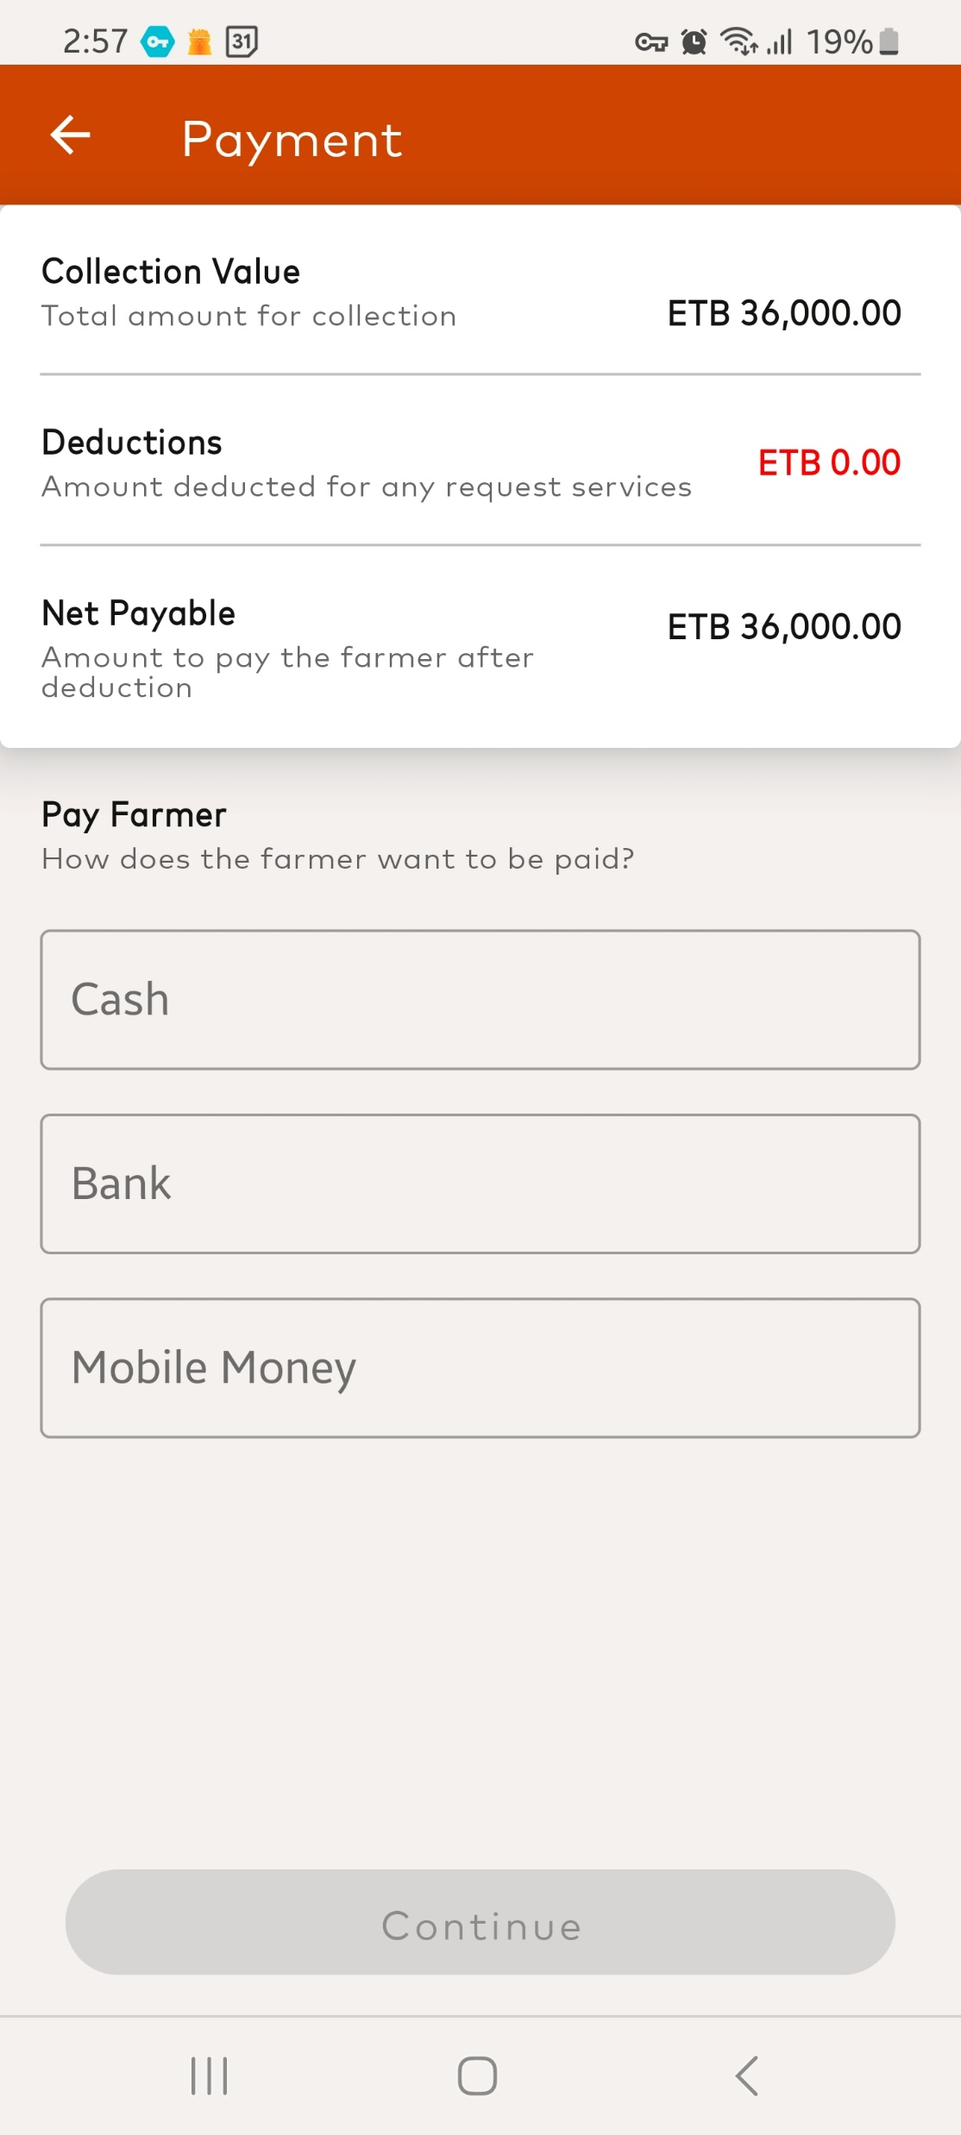
Farm Pass Services
Digital Payment
This Platform Supports a fast and secure payment for cooperatives for the payment they make to farmers and their Unions
Cooperative representatives can directly pay for farmers through Farm Pass
The cooperative can set & Manage buying prices for Agents and Collection Sites
Enables to track cash / digital payment from cooperatives to individual farmers
Provide detailed reports for cooperatives on all the purchases they made
Enables Cooperative to remotely see how much cash and digital float is available at their sites
Supports Bulk Payments for Farmers

Slide 11
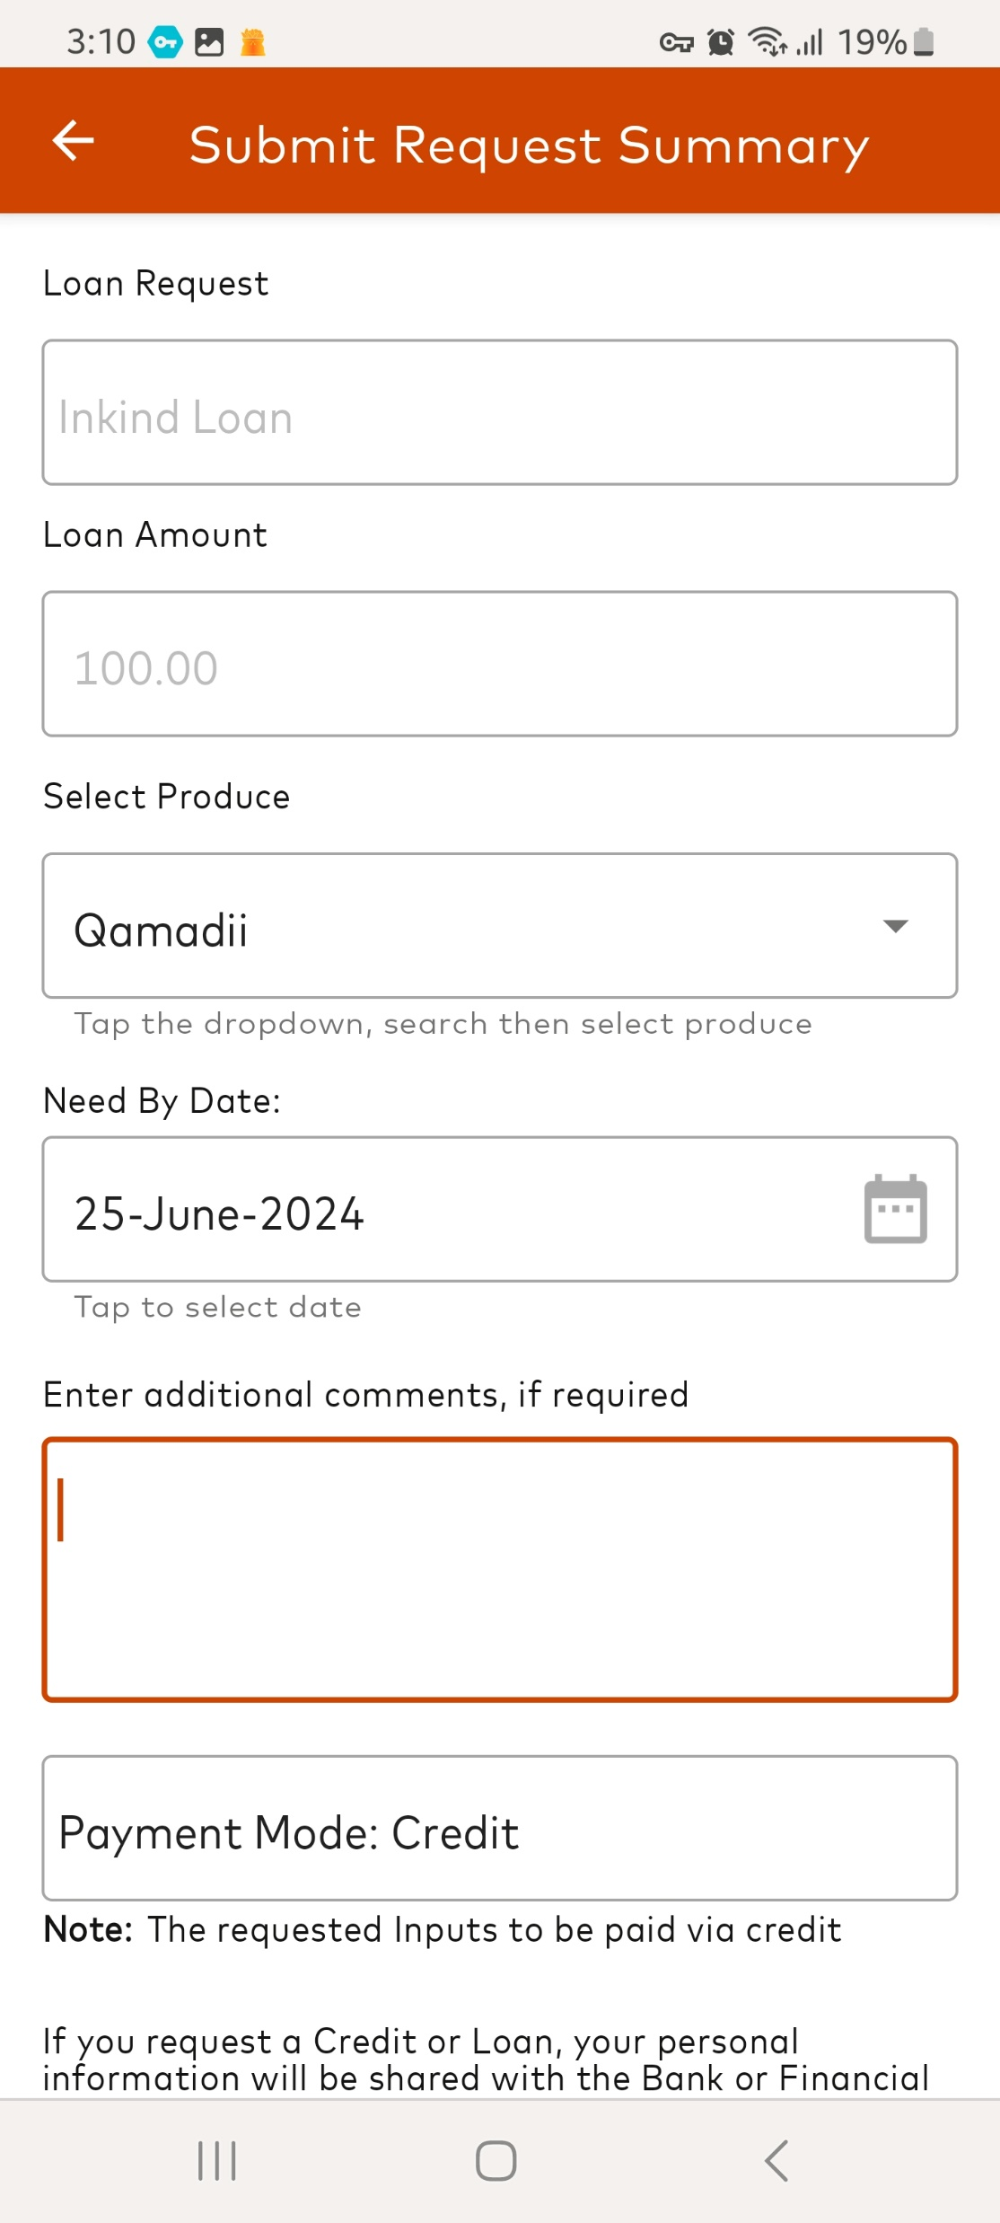
Farm Pass Services
Credit Enablement
Coopbank of Oromia will provide credit to Farmers under cooperatives using this platform based on their transaction on Farm Pass.
Access to Loans for Farmers
Farm Pass enables to view Individual farmers and cooperatives overall performance.
The above enables Loans based on credit score, not collateral.
Farmers can apply for Loans through their primary cooperative user.
Farm Pass can support 3 Types of Loan application
Farmer Direct Application
Primary Cooperative Loan Application
Aggregated Primary Cooperative Application

Slide 12

Value Proposition Farm Pass to Cooperatives and other Actors
Generate Revenue by providing services to their members.
Cooperative using farm Pass, the bank opens access to finance for their farmers.
Digitization of their payments and operations.
Access to Devices to utilize the platform.
Using Farm Pass Cooperatives can now propose value to their members, If a member sells to them he/she has access to credit and inputs service.
Traceability and EUDR Compliance issues will be handled.
FarmPass

Slide 13


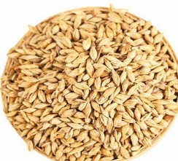
Current Status
567,454+
1,100 +
55+
Farmers Onboarded
Primary Cooperatives
Cooperative Unions
1.1 + Billion ETB
12 + Million Kg of Coffee transaction digitized
Gujii- 150 Million Jimma - 900 + Million
100,368,320 Million ETB
1 Million + Kg of Barley, Wheat, Bean transaction digitized
Active Value Chains
Coffee
Barley
Wheat
Horticulture
Poultry
Bean
Honey
Dairy (Pilot with IFC)
Onboarded Farmers in 6 Regions in Ethiopia
Onboarded Big Off-takers and Processors
Empowering Communities, Transforming Lives!

Slide 14



