Slide 1
BIXI Montreal- Bike sharing system
Portfolio Project- Using SQL
Created by Elshaddai Harris

Slide 2
About BIXI
BIXI Montréal is a non-profit organization created in 2014 by the city of Montreal to manage its bike-sharing system.
The BIXI network has more than 9,000 bikes and 680 stations spread out across the areas of Montreal, Laval, Longueuil, Westmount, Town of Mount Royal and Montreal East.
Data related info:
Data is taken from Open Data available from bixi.com
Data source: https://bixi.com/en/open-data
Data timeline: May-2014 to June 2014 (2 months)

Slide 3
Business questions
Q1. How many total trips were made by members and casuals what is percent membership?
Q2. What is the average trip duration for members and casual users? What is the maximum trip duration for casual and member?
Q3. What is the total number of trips each month?
Q4. What is the % increase of trips from May to June?
Q5. Give the top 5 station names where trips are starting the most?
Q6. What is the usage ratio of members and casual users in weekdays and weekends?
Q7. What is the time where most number of trips are made?

Slide 4
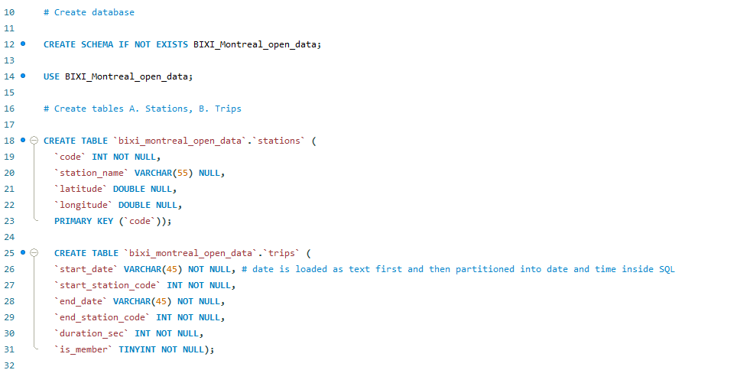
Step-1 Create database and tables in SQL server

Slide 5
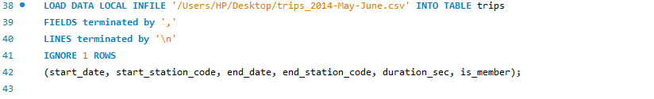
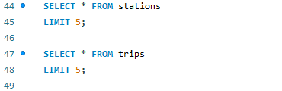
Step-2 Import/ load tables into SQL server
There are two tables being used in this project: 1. Stations, 2. Trips
Stations table imported with import wizard- Rows: 459
Since trips table is very large (Rows: 981,124), we load the data with below command:
Data preview:

Slide 6
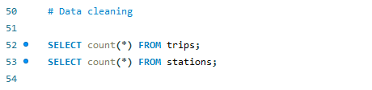
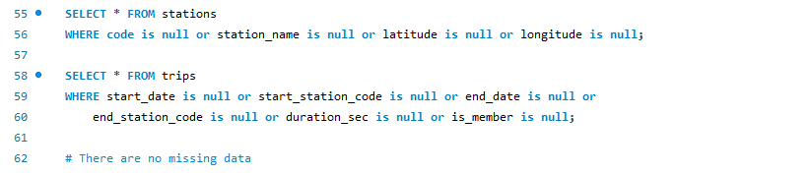
Step-3 Understanding data and data cleaning
From the above query, we find that there are a total of 459 stations and 981,124 trips were made between May 2014 and June 2014
From the above queries made for two tables, we have successfully checked data for any discrepancies or missing values. Data is good and ready for analysis.

Slide 7
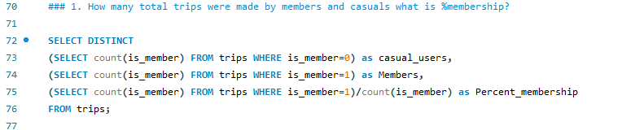
Step-4 Answering Business questions
Q1. How many total trips were made by members and casuals what is percent membership?
Inference:
From the above query, we find that number of casual users are 124,538 and members are 856,586. Hence, 87% of the users are members.

Slide 8
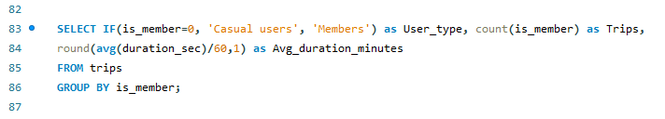
Step-4 cont.,
Q2. What is the average trip duration for members and casual users? What is the maximum trip duration for casual and member?
Inference:
We find even though 87% of the trips are made by members, average trip duration of members is almost 12 minutes and 30 seconds whereas casual members have trips of average 21 minutes

Slide 9
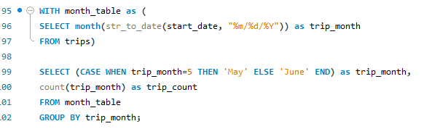
Step-4 cont.,
Q3. What is the total number of trips each month?
Inference:
May- 455,261 trips; June- 525,863 trips

Slide 10
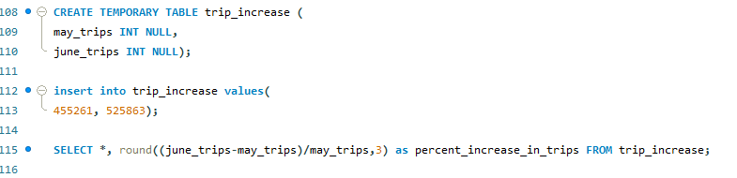
Step-4 cont.,
Q4. What is the % increase of trips from May to June?
Trips in May | Trips in June | % increase in trips
455261 | 525863 | 15.50%
Inference:
There is 15.5% increase in trips from May to June month

Slide 11
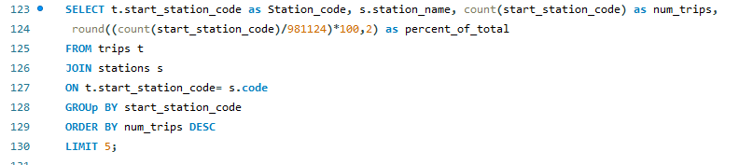
Step-4 cont.,
Q5. Give the top 5 station names where trips are starting the most?
Inference:
Station code | station name | number of trips | % of total
6184 | MÃ©tro Mont-Royal (Rivard / du Mont-Royal) | 14727 | 1.5%
6078 | de Maisonneuve / de Bleury | 10662 | 1.1%
6064 | de Maisonneuve / Stanley | 9876 | 1.0%
6214 | Square St-Louis | 8491 | 0.9%
6100 | Mackay /de Maisonneuve (Sud) | 8296 | 0.8%

Slide 12
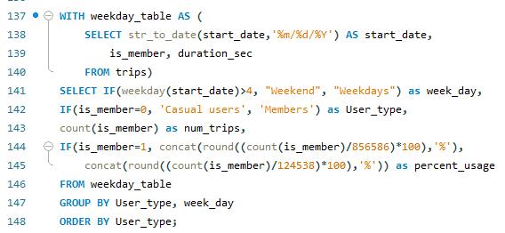
Step-4 cont.,
Q6. What is the usage ratio of members and casual users in weekdays and weekends?
Inference: Thus, from this we see that casual users use almost equally on weekdays and weekends whereas members use 75% of their trips on work days.

Slide 13
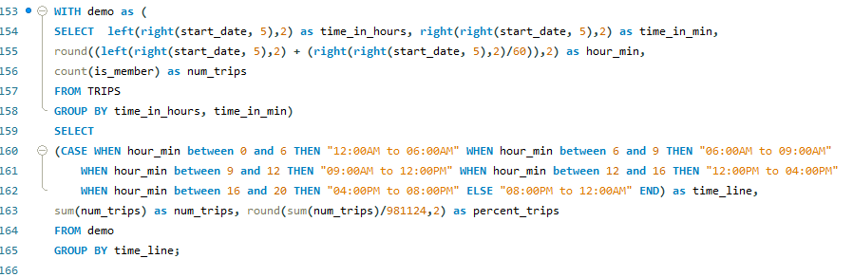
Step-4 cont.,
Q7. What is the time where most number of trips are made?
Inference: 55% of the trips take place between 12:00PM and 08:00PM due to lunch time and errands while returning home

Slide 14
Thank You

