Slide 1
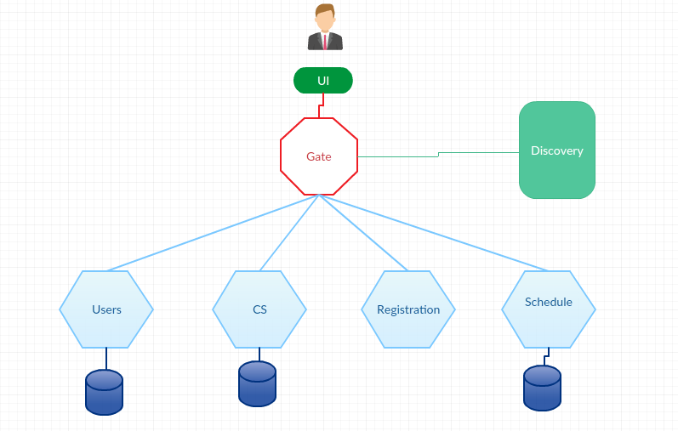
React JS
Spring Rest
Spring Data
Spring Boot
Spring Cloud ( Netflix cloud tools , Zuul , Eureka , Hystrix , Ribbon )

