Slide 1

GRADUATION PROJECT · AI / DATA SCIENCE
Hospital Multi-Model AI
Diagnostic & Cost Prediction System
One login. Two AI-powered decision-support tools: insurance cost prediction and chest X-ray disease screening.
Waled Saied · Yossef Abdellatif Elshamey
Data Team

Slide 2
WHY THIS PROJECT
From manual bottlenecks to instant, model-backed answers
THE PROBLEM
THE SOLUTION
Insurance pricing
A single Streamlit portal, gated by login, with two independent tabs
Flat actuarial tables miss interaction effects — e.g. a smoker with high BMI costs far more than the sum of each factor alone.
Login (hashed credentials)
X-ray screening
First-pass reads depend entirely on radiologist availability, creating bottlenecks and fatigue-related error risk.
Tab 1 — Insurance Cost Prediction (Regression)
No shared tool
Staff juggle disconnected, manual processes instead of one data-driven portal.
Tab 2 — Chest Disease Detection (YOLO11s)
Hospital Multi-Model AI Diagnostic & Cost Prediction System
2

Slide 3
UNDER THE HOOD
Two independent ML pipelines, one CRISP-DM process
TAB 1
TAB 2
Insurance Cost Prediction
Chest Disease Detection
Task
Regression (target: annual medical cost)
Task
Object detection (multi-class)
Dataset
Medical insurance records — 100,000 patients, 54 raw columns
Dataset
ChestX-Det — 3,025 train / 553 test images
Feature scope
37 features, after removing the ID, 4 leakage columns, and low-value fields
Classes
13 pathologies, incl. 611 “no finding” images
Models compared
Linear · Ridge · Lasso · Polynomial · Random Forest · XGBoost
Model
YOLO11s (Ultralytics)
Result (test)
Linear Regression · R² 0.180 · RMSE $2,840 · MAE $1,769
Result (test)
mAP50 0.360 · mAP50-95 0.194 · P 0.41 · R 0.38
Explainability
Coefficient-based top factors per prediction
Output
Bounding box + class + confidence
Hospital Multi-Model AI Diagnostic & Cost Prediction System
3

Slide 4
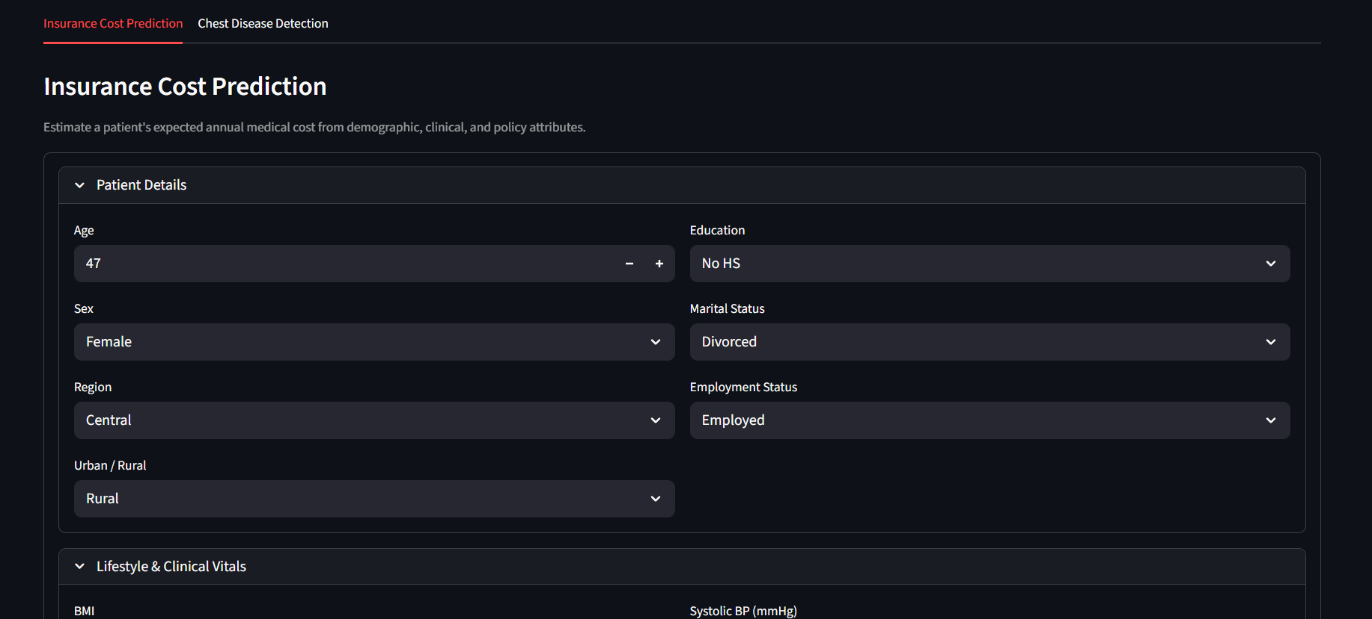
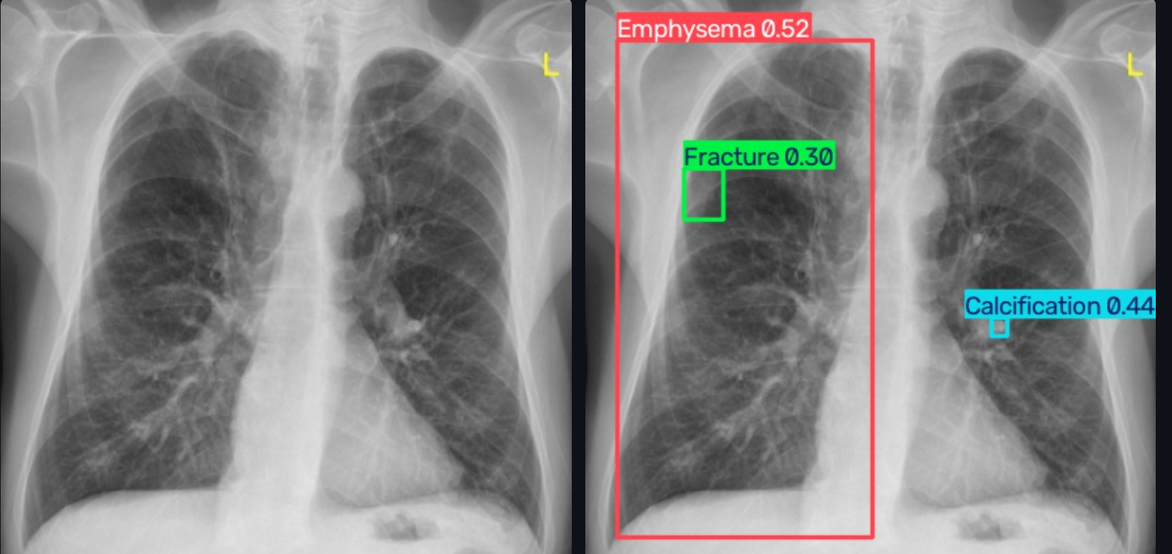
THE APP
One Streamlit portal, two tools
Tab 1 — Insurance Cost Prediction
Tab 2 — Chest Disease Detection
Patient form in, predicted annual medical cost out — with the top contributing factors and the model's test metrics.
Upload an X-ray, get bounding boxes with class and confidence — or “No abnormal finding detected”.
Hospital Multi-Model AI Diagnostic & Cost Prediction System
4

Slide 5
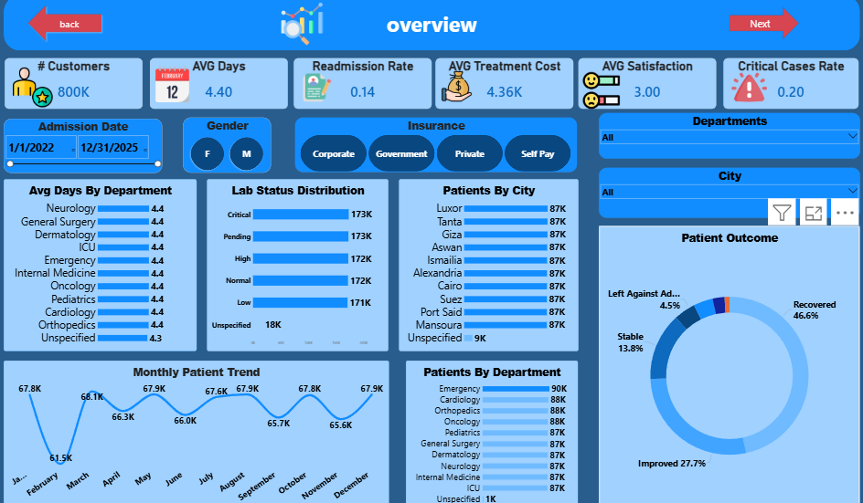
POWER BI DASHBOARD
800K patient records, two decision-support pages
800K
patient records across 10 Egyptian cities and 10 departments (+ Unspecified)
2 pages
Operational Overview + Financial & Clinical Quality
5 slicers
Date range, City, Department, Insurance Type, Gender
18.8%
of satisfaction scores were missing — cleaned & tagged, not dropped
Hospital Multi-Model AI Diagnostic & Cost Prediction System
5

Slide 6
QA REVIEW
What we checked — and what still needs work
Notebooks vs. BRD
Dashboard vs. BRD
Detection metrics must be identical in the README, the notebook, and the app metadata (mAP50 0.36)
“Avg Satisfaction by Department” shows 0.00M for every row — format bug
Class imbalance was addressed with augmentation-based oversampling, but rare classes stay weak (Pneumothorax, Nodule, Mass AP50 ≤ 0.20)
Chart types and placement of Patient Outcome & Lab Status are inconsistent across pages
Insurance R² is low (0.180) for every model tried — the dataset signal is weak; explain this limitation in the report
BRD text says 15 departments; the dashboard shows 10 + Unspecified
Hospital Multi-Model AI Diagnostic & Cost Prediction System
6

Slide 7
NEXT STEPS
Recommendations before final submission
1
Improve rare-class detection
Pneumothorax, Nodule and Mass are still weak — add targeted augmentation or more labeled examples.
2
Fix the satisfaction-by-department formatting bug
Remove the millions (M) suffix from a 1–5 scale metric.
3
Harden the Streamlit login
Add a password-change flow and multi-user roles.
4
Reconcile the department count
Confirm 10 vs. 15 departments against the source data before the final report.
5
Upgrade Tab 1 explainability
Move from linear coefficients to full SHAP values.
Hospital Multi-Model AI Diagnostic & Cost Prediction System
7

Slide 8

Thank You
Questions & discussion welcome
Yossef Abdellatif Elshamey
elshameyyossef@gmail.com | linkedin.com/in/yossef-elshamey-539a802ba

