Slide 1
+
GRADUATION PROJECT · AI / DATA SCIENCE
Hospital Multi-Model AI
Diagnostic & Cost Prediction System
One login. Two AI-powered decision-support tools: insurance premium prediction and chest X-ray disease screening.
Waled Saied · Yossef Abdellatif Elshamey
Data Team

Slide 2
WHY THIS PROJECT
From manual bottlenecks to instant, model-backed answers
THE PROBLEM
THE SOLUTION
Insurance pricing
A single Streamlit portal, gated by login, with two independent tabs
Flat actuarial tables miss interaction effects — e.g. a smoker with high BMI costs far more than the sum of each factor alone.
Login (hashed credentials)
X-ray screening
First-pass reads depend entirely on radiologist availability, creating bottlenecks and fatigue-related error risk.
Tab 1 — Insurance Premium Prediction (Regression)
No shared tool
Tab 2 — Chest Disease Detection (YOLO11s)
Staff juggle disconnected, manual processes instead of one data-driven portal.

Slide 3
UNDER THE HOOD
Two independent ML pipelines, one CRISP-DM process
TAB 1
TAB 2
Insurance Premium Prediction
Chest Disease Detection
Task
Regression
Task
Object detection (multi-class)
Dataset
Medical Insurance Cost Prediction
Dataset
ChestX-Det13 — 3,025 train / 553 test images
Feature scope
Signup-only — 38 features known at application time
Classes
13 pathologies, incl. 611 “no finding” images
Models compared
Linear Regression · Random Forest · XGBoost
Model
YOLOv8n (Ultralytics)
Result (test)
Linear Regression · R² 0.180 · RMSE $357 · MAE $1768
Result (test)
mAP50 0.360 · mAP50-95 0.194 · P 0.41 · R 0.38
Explainability
SHAP / coefficient-based top factors
Output
Bounding box + class + confidence + location

Slide 4
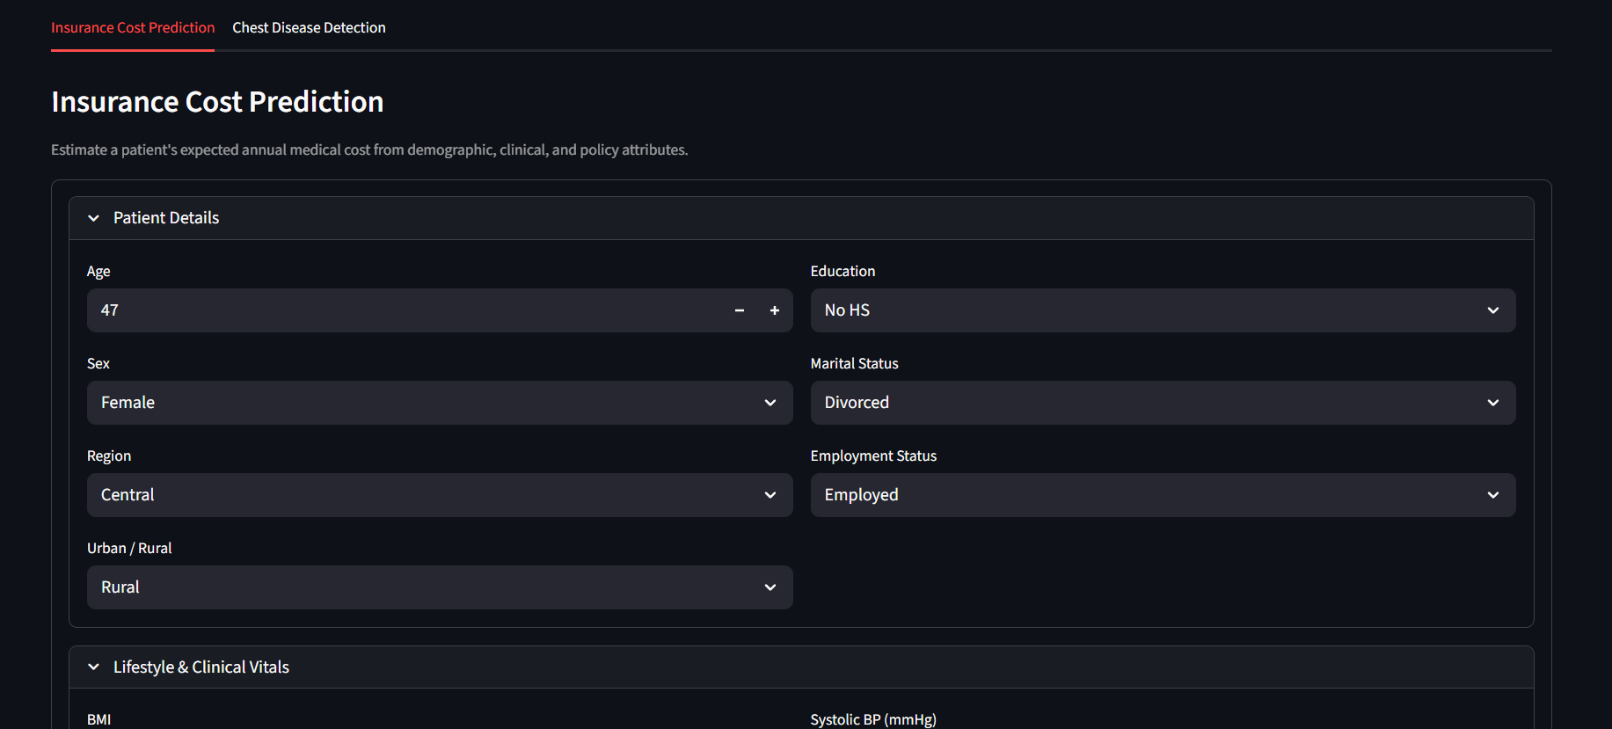
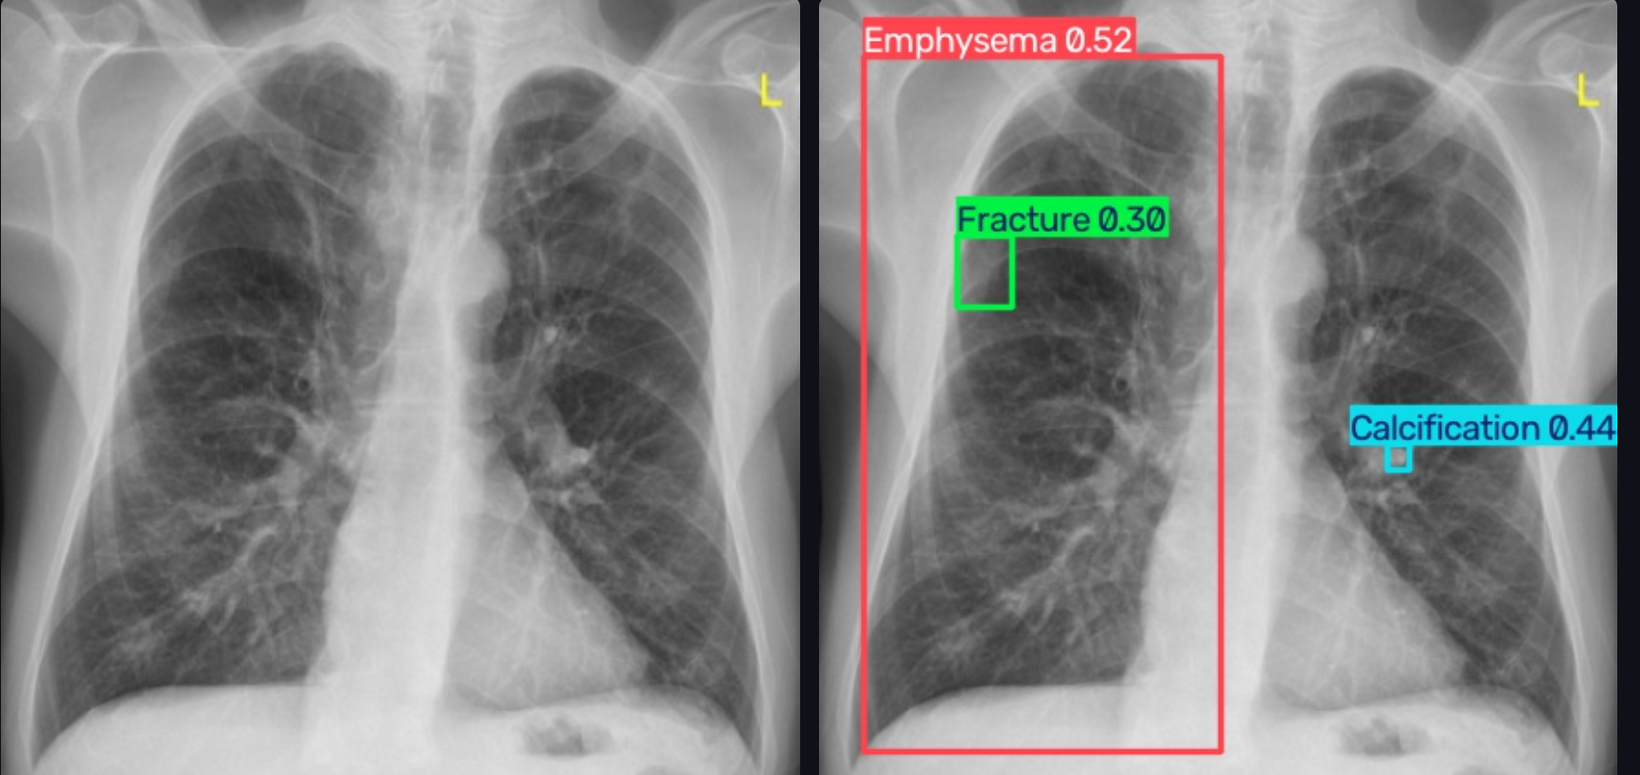
APP

Slide 5
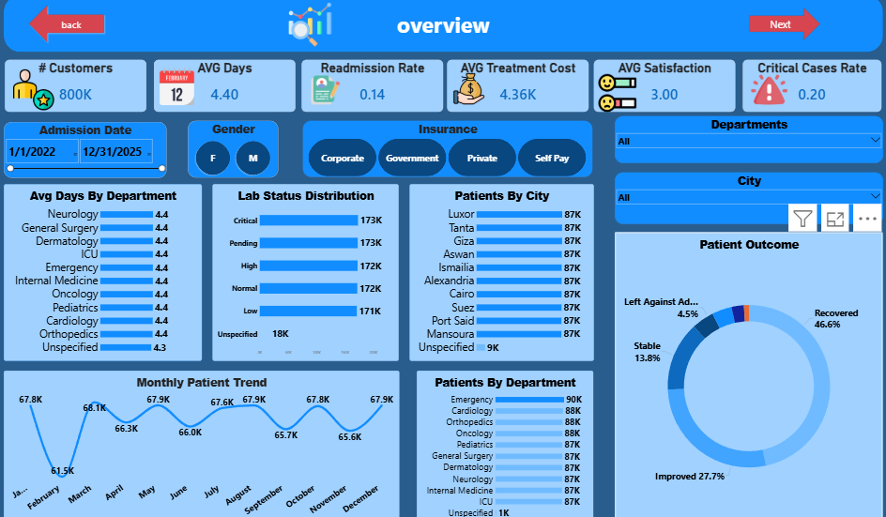
POWER BI DASHBOARD
800K patient records, two decision-support pages
800K
patient records across 10 Egyptian cities, 15 departments
2 pages
Operational Overview + Financial & Clinical Quality
5 slicers
Date range, City, Department, Insurance Type, Gender
18.8%
of satisfaction scores were missing — cleaned & tagged, not dropped

Slide 6
QA REVIEW
What we checked — and what still needs work
Notebooks vs. BRD
Dashboard vs. BRD
Metrics now documented, but README says mAP50 ≈0.38 vs 0.36 in the notebook — align them
“Avg Satisfaction by Department” shows 0.00M for every row — format bug
Rare classes weak (Pneumothorax, Nodule, Mass AP50 ≤ 0.20); imbalance not addressed
Chart types/placement of Patient Outcome & Lab Status inconsistent across pages
Insurance R² is low (0.198) for all 3 models — explain signup-only trade-off in report
BRD text says 15 departments; dashboard shows 10 + Unspecified

Slide 7
NEXT STEPS
Recommendations before final submission
1
Fix class imbalance
Collect more photos
2
Fix the satisfaction-by-department formatting bug
Remove the millions (M) suffix from a 1–5 scale metric.
3
Add a password-change flow and multi-user roles to the Streamlit login
Maintain the code
4
Reconcile the department count
Confirm 10 vs. 15 departments against the source data before final report.

Slide 8

Thank You
Questions & discussion welcome
Yossef Abdellatif Elshamey
elshameyyossef@gmail.com | linkedin.com/in/yossef-elshamey-539a802ba

