Slide 1
K-means Clustering Algorithm

Slide 2
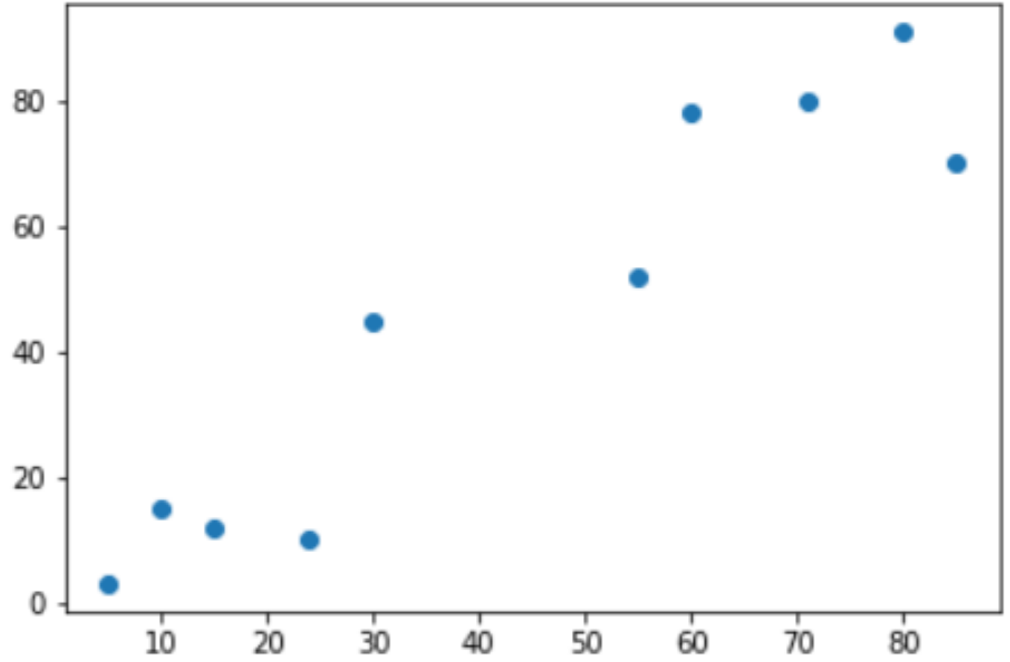
Problem Statement
Split the data into two clusters
Input data = { (5,3), (10,15), (15,12), (24,10), (30,45), (85,70), (71,80), (60,78), (55,52), (80,91) }
Similarity criteria?

Slide 3
Algorithm
Step #1: Randomly initialize values for centroids of both clusters (Cl#1, Cl#2)
Step #2: Find Euclidean distance between all the point and centroid c1
Step #3: Find Euclidean distance between all the point and centroid c2
Step #4: Assign clusters based on Euclidean distance between the two cluster centroids
Step #5 Update centroids (c1 and c2)

Slide 4
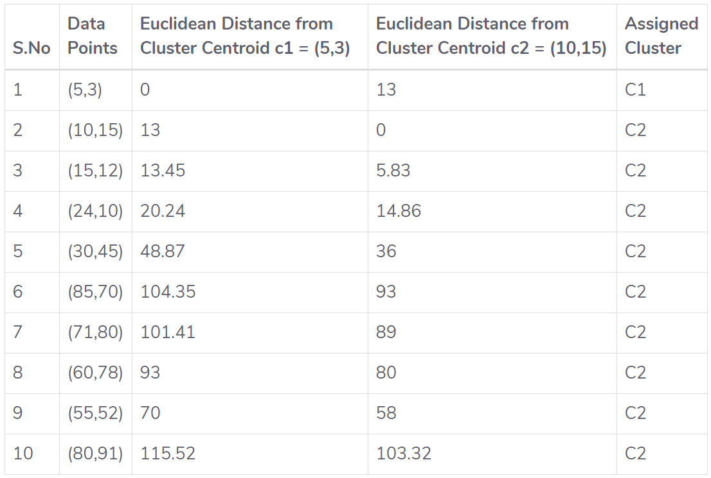
Initialization of centroids (c1, c2) and Clustering
Iteration #1
c1 = c1
Area of interest (c2) = {[2, 10]}
c2(x) = sum (x(2):x(10)) / 9 = 47.77
c2(y) = sum (y(2):y(10)) / 9 = 50.33
Result:
c1 = (5,3)
c2 = (47.77, 50.33

Slide 5
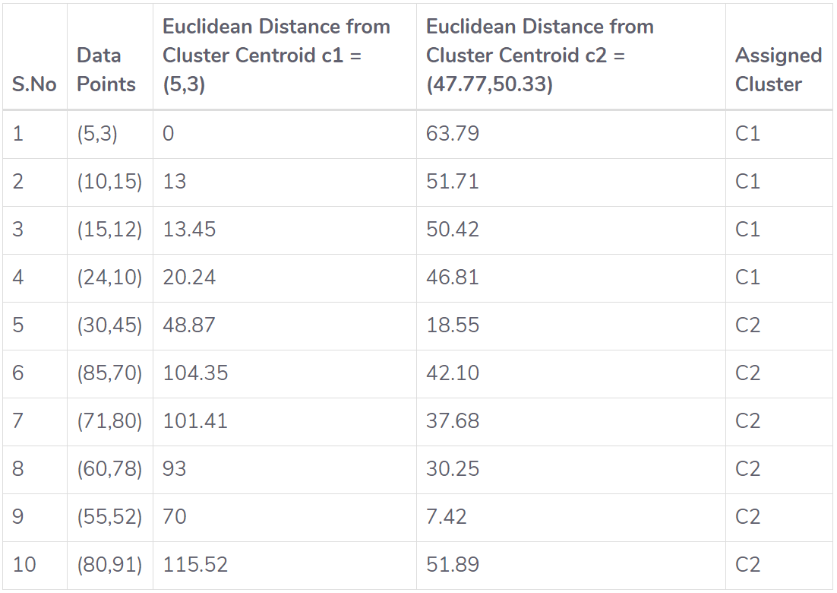
Iteration #2
c1(x) = 13.5
c1(y) = 10.0
c2(x) = 63.5
c2(y) = 69.33

Slide 6
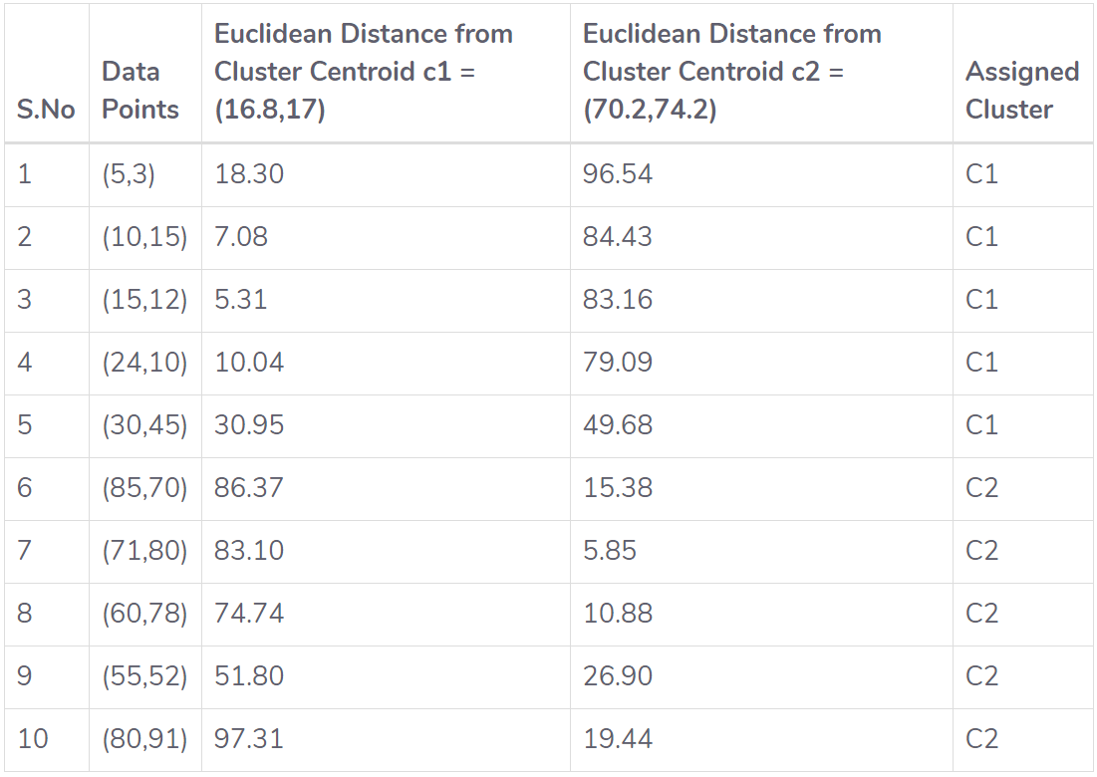
Iteration #4
c1(x) = 16.8
c1(y) = 17.0
c2(x) = 70.2
c2(y) = 74.2

Slide 7
K-means Clustering with Scikit-Learn
Matplotlib
Numpy
Scikit-Learn

Slide 8
import matplotlib.pyplot as plt
import numpy as np
from sklearn.cluster import Kmeans
X = np.array([[5,3], [10,15], [15,12], [24,10], [30,45], [85,70], [71,80], [60,78], [55,52], [80,91]])
plt.scatter(X[:,0],X[:,1], label='True Position')
kmeans = KMeans(n_clusters=2)
kmeans.fit(X)
print(kmeans.cluster_centers_)
print(kmeans.labels_)
plt.scatter(X[:,0],X[:,1], c=kmeans.labels_, cmap='rainbow')
plt.scatter(X[:,0], X[:,1], c=kmeans.labels_, cmap='rainbow') plt.scatter(kmeans.cluster_centers_[:,0] ,kmeans.cluster_centers_[:,1], color='black')

