Slide 1
K-Nearest Neighbors

Slide 2
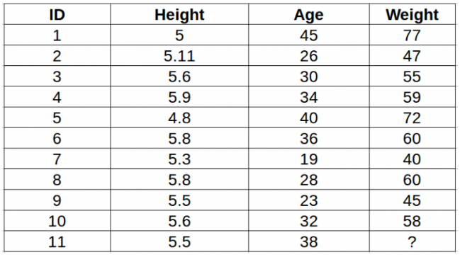
Problem Statement
Data

Slide 3
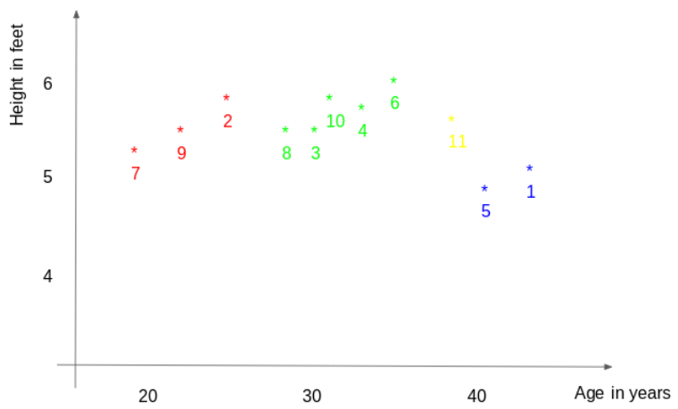

Slide 4
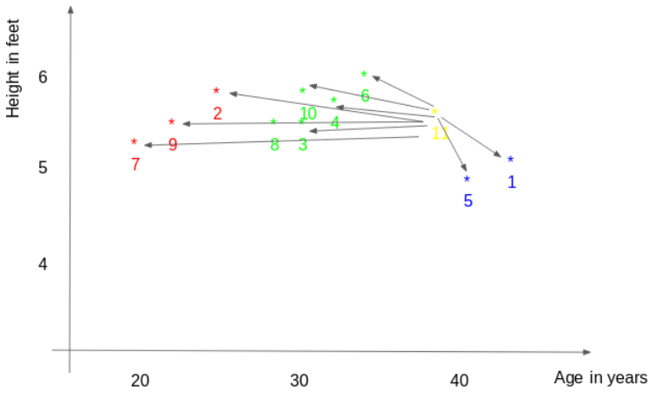

Slide 5
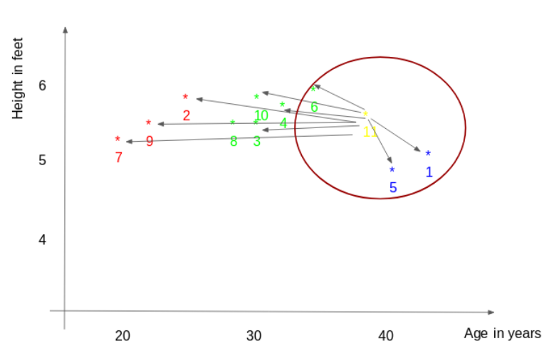
ID11 = (77+72+60)/3
ID11 = 69.66

Slide 6
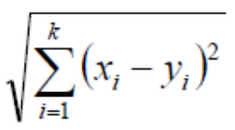
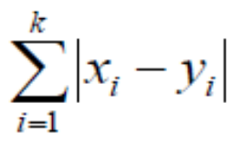
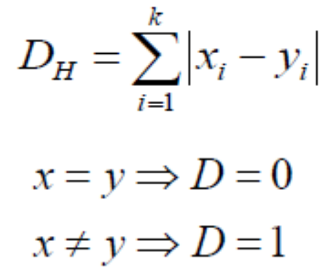
Methods of calculating distance between points
Euclidean
Manhattan
Hamming

Slide 7
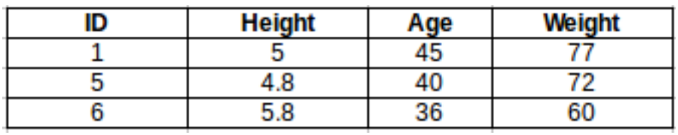
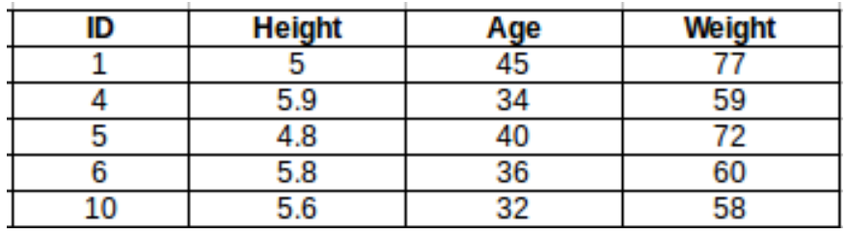
How to choose the k factor?
K = 3
ID11 = 69.66
K = 5
ID11 = 65.2

Slide 8
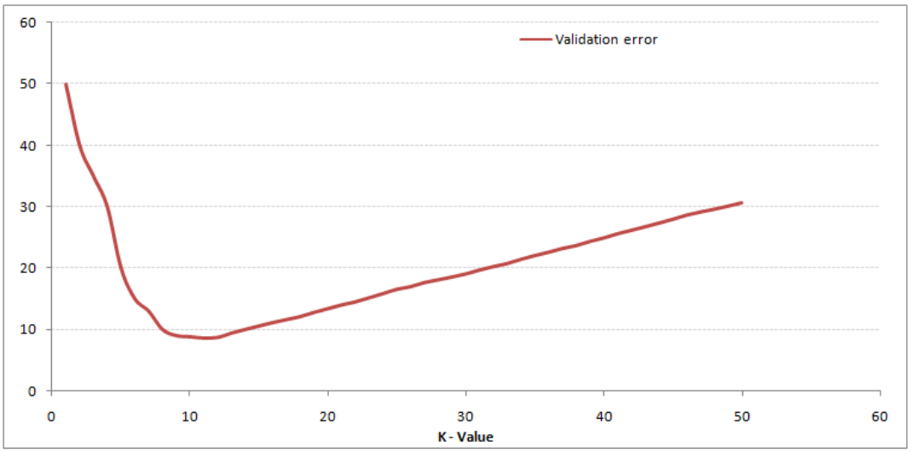
Validation Error

