Slide 1

Life Expectancy
Elsheikh Zumrawi

Slide 2
Data Source
- The Global Health Observatory (GHO).

Slide 3
Problem Statement
Develop a regression model to analyse factors affecting life expectancy across 193 countries from 2000 to 2015.

Slide 4
Goals
Identify key predictors significantly impacting life expectancy.

Slide 5
Objective
- Suggest areas of focus for improving life expectancy efficiently.

Slide 6
Methodology
- The methodology used for this project includes regression analysis using an Ordinary Least Squares (OLS) model.

Slide 7
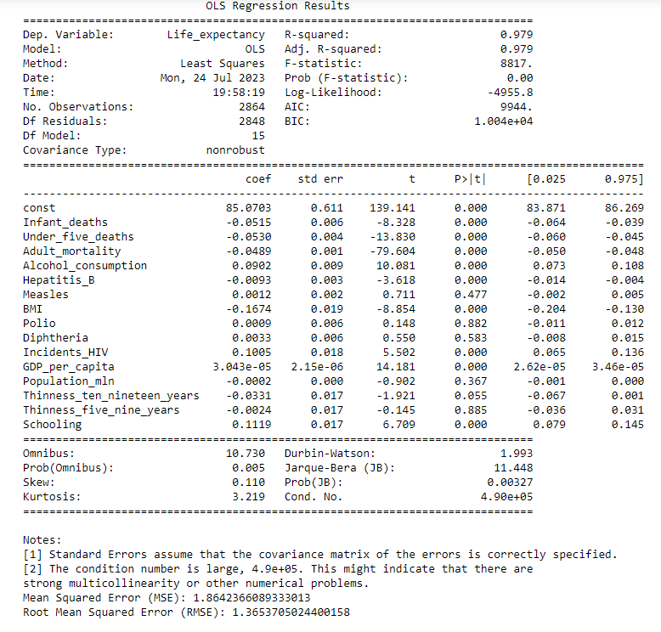
Iteration 1- Baseline

Slide 8
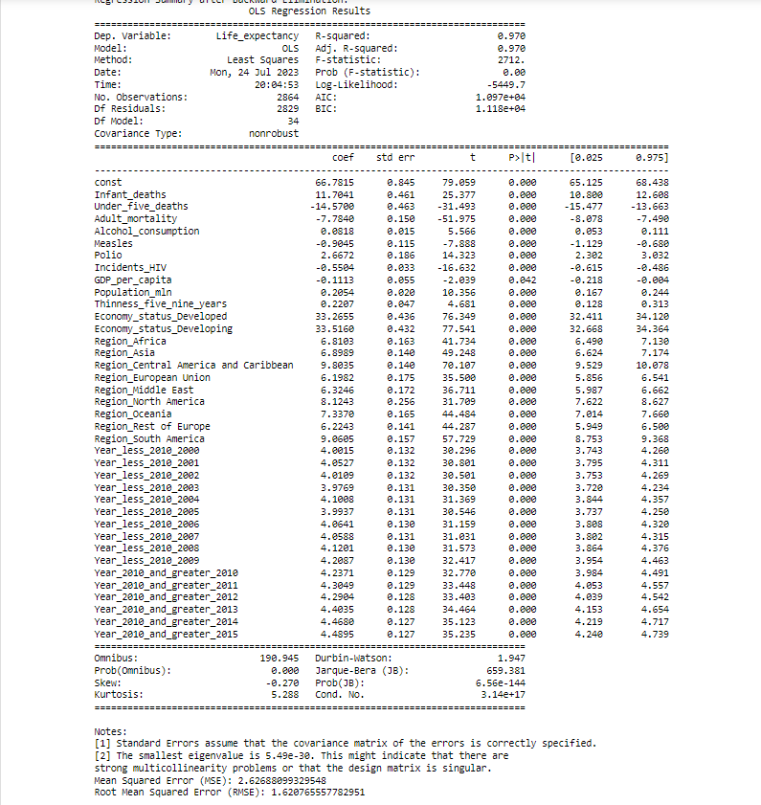
Iteration 2

Slide 9
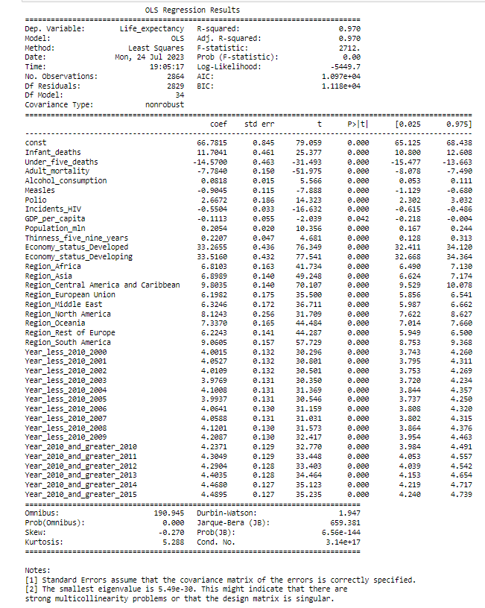
Iteration 3

Slide 10

Key Predictors Impacting Life Expectancy
Positive Impact:
Infant Deaths: Positive
Alcohol Consumption: Positive
Population: Positive
Polio: Positive
Thinness (5-9 years): Positive
Negative Impact
Under-five Deaths: Negative
Incidents of HIV: Negative
Measles: Negative
Adult Mortality: Negative
GDP per Capita: Negative

Slide 11

Recommendations
Reduce Infant and Under-Five Deaths
Address Adult Mortality
Encourage Responsible Alcohol Consumption
Improve Immunization Coverage (Measles, Polio)
Combat Incidents of HIV
Strengthen Healthcare Infrastructure in Developing Countries
Consider Regional Differences in Health Interventions
Monitor and Address Economic Status
Pay Attention to Time-Specific Factors

Slide 12

Conclustion
Understanding the significant factors influencing life expectancy is crucial.
Implementing targeted interventions can lead to improved health outcomes globally.
Collaboration between governments and global health organizations is key.

Slide 13
Thank you
Elsheikh Zumrawi
0450060508
elsheikhz@hotmail.com
https://github.com/elsheikhz1

