Slide 1
King County House Sales
By Elsheikh Zumrawi

Slide 2
Problem Statement
Stakeholder: Real estate agency.
Business problem: Need to offer guidance to homeowners regarding home renovations.
Goal: Provide advice on how certain renovations can enhance the estimated value of a home and determine the extent of the value increase.
Importance: Empower homeowners with valuable insights and recommendations.
Outcome: Enable homeowners to make informed decisions about renovations and potentially maximize their property's value in the market.

Slide 3
Methodology
The methodology used for this project includes regression analysis using an Ordinary Least Squares (OLS) model.

Slide 4
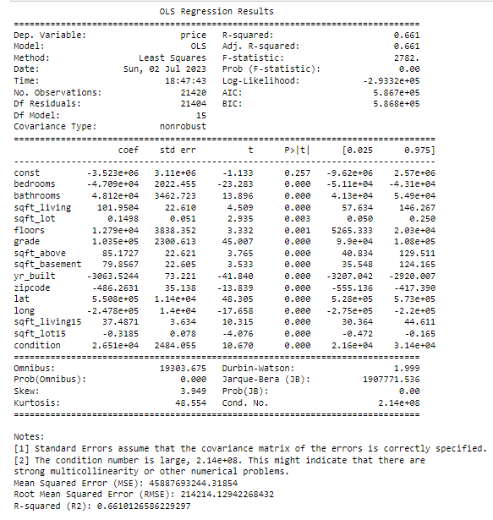
Iteration 1

Slide 5
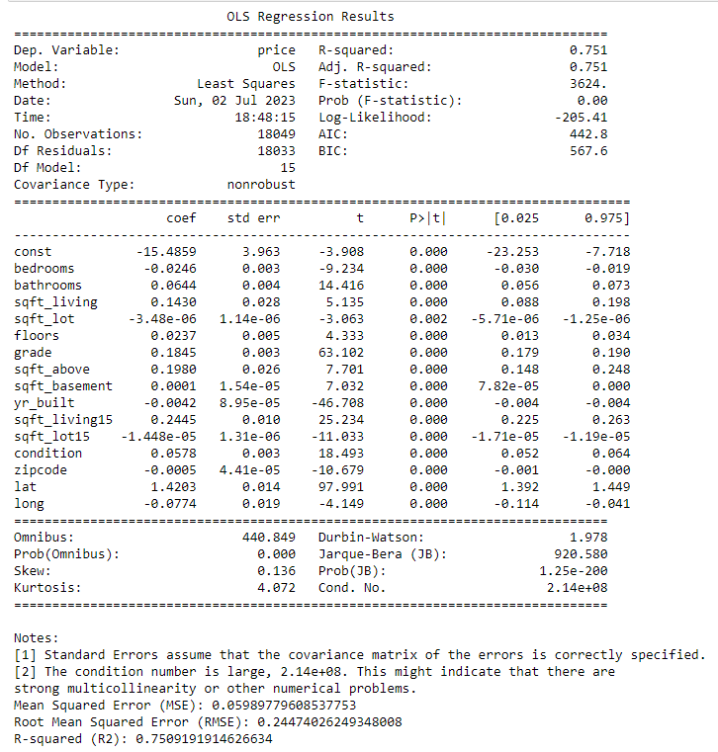
Iteration 2

Slide 6
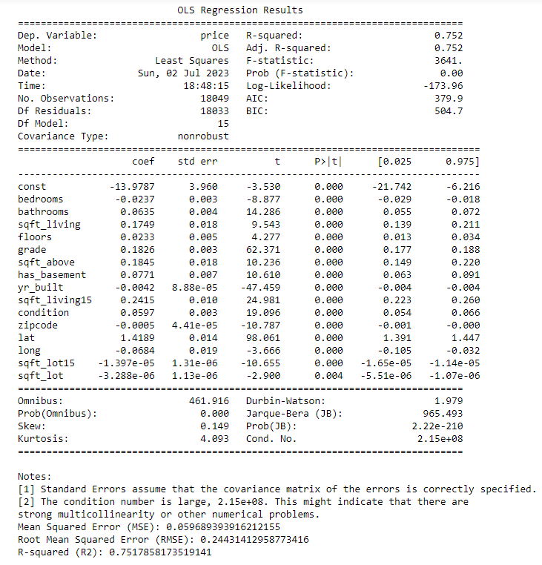
Iteration 3

Slide 7
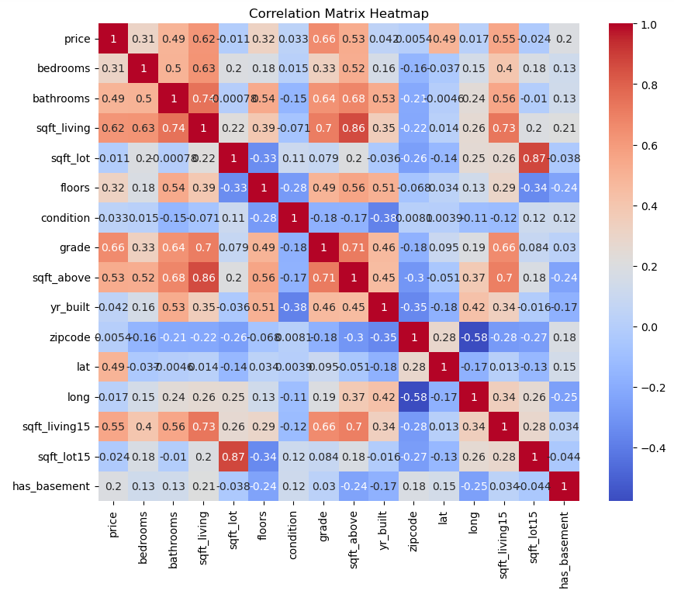
Correlation Matrix

Slide 8
THANK YOU!
ELSHEIKH ZUMRAWI

