Slide 1
Practical Deep Learning
Chapter 9 - 10

Slide 2
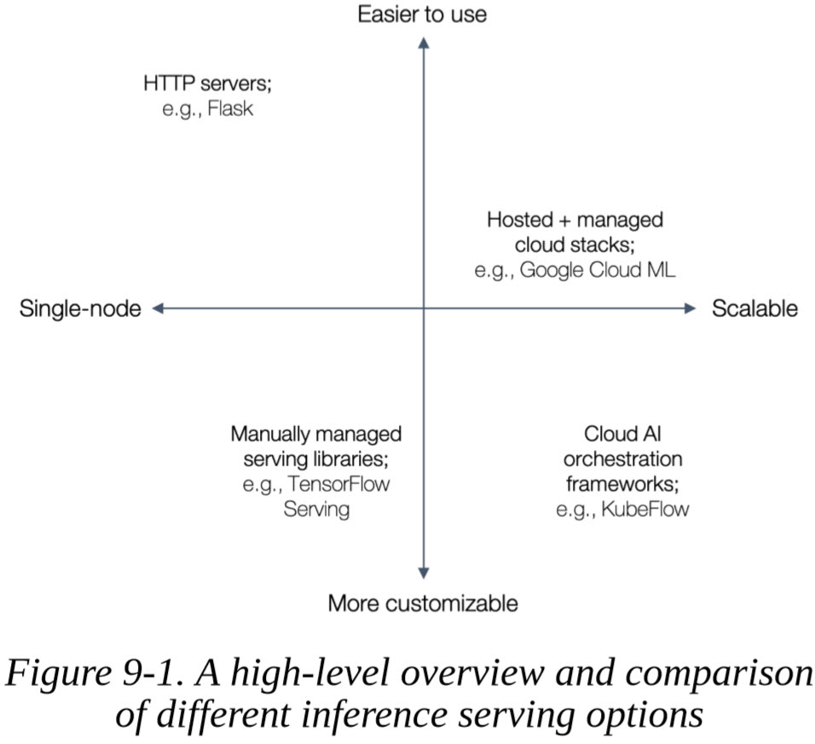
Scalable Inference Serving

Slide 3
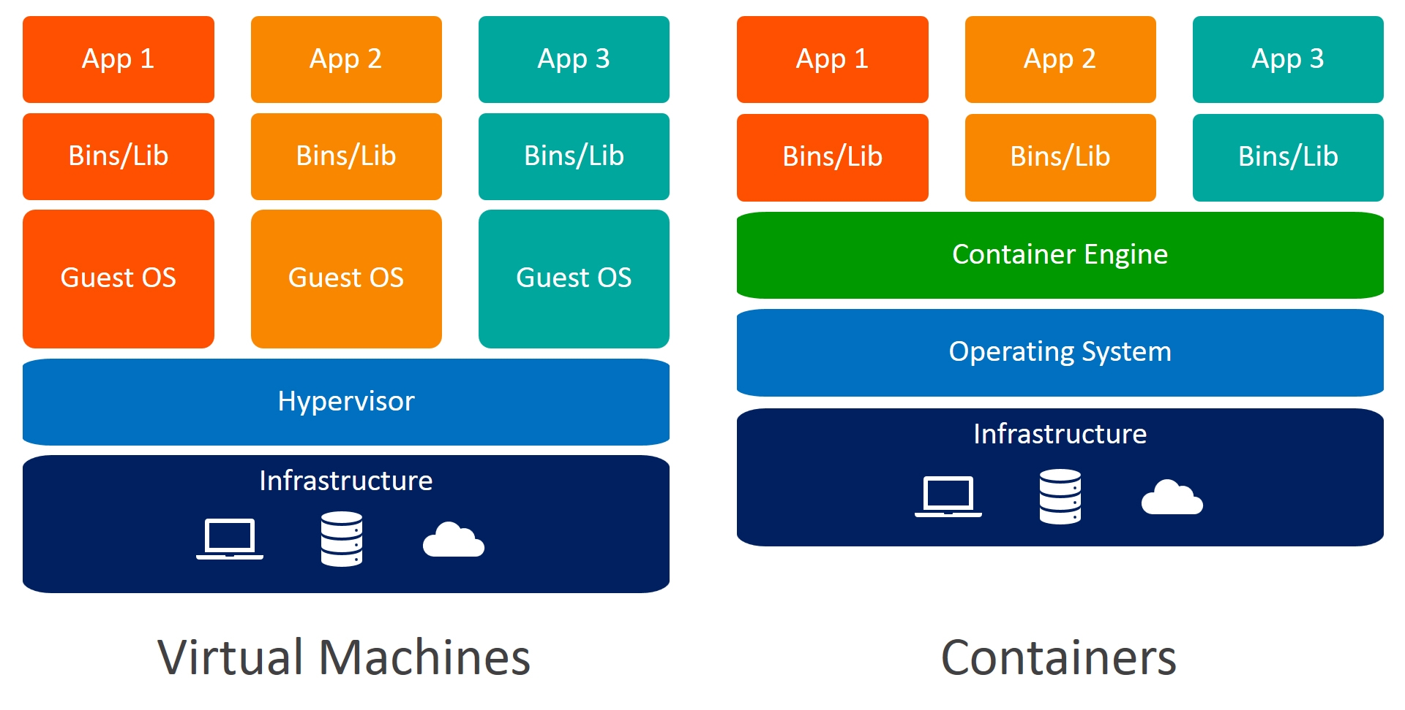
VMs VS. Containers

Slide 4
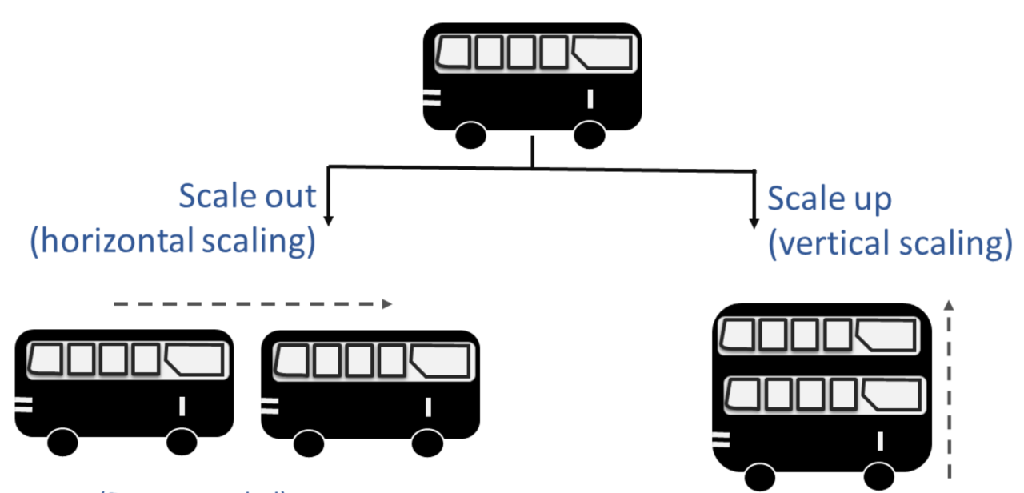
Scaling

Slide 5
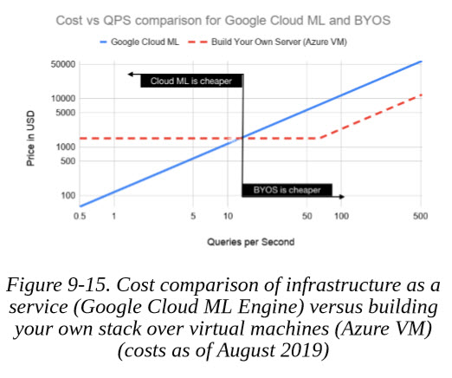
Cost VS. QPS

Slide 6
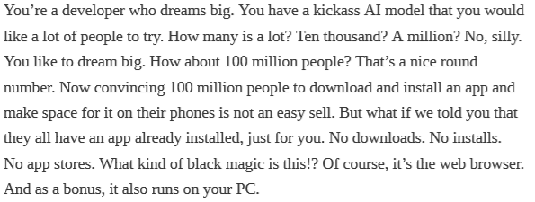
AI in the Browser?
But why?

Slide 7
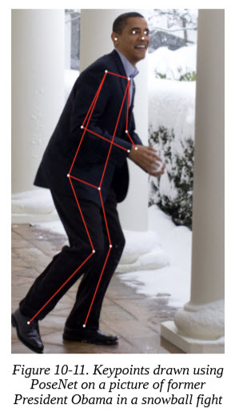
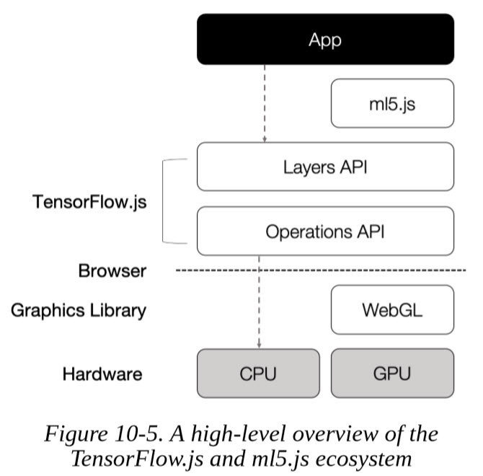
TensorFlow.js and ml5.js

