Slide 1
Seq2Seq
“Times, they’re a changing.”

Slide 2
Why Seq2Seq?
Machine Translation
Speech Recognition
Image Captioning
Video Activity Recognition

Slide 3
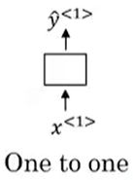
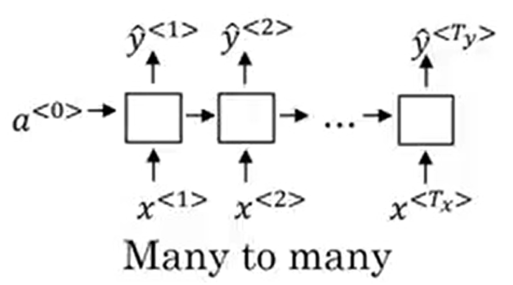
RNN Types

Slide 4
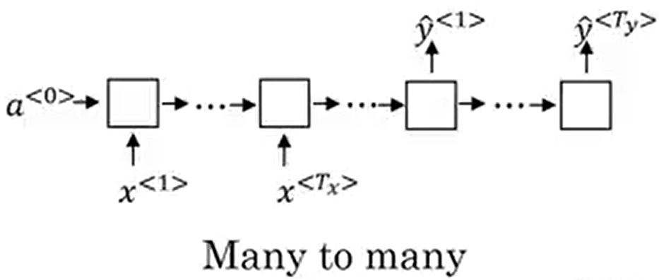
RNN Types

Slide 5
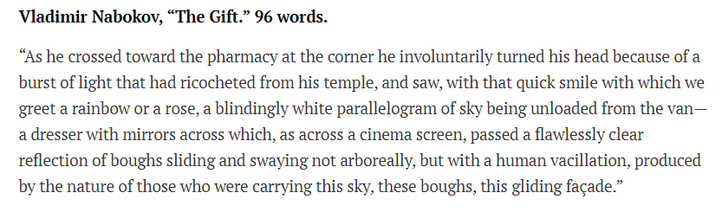
Why GRU? LSTM?

Slide 6
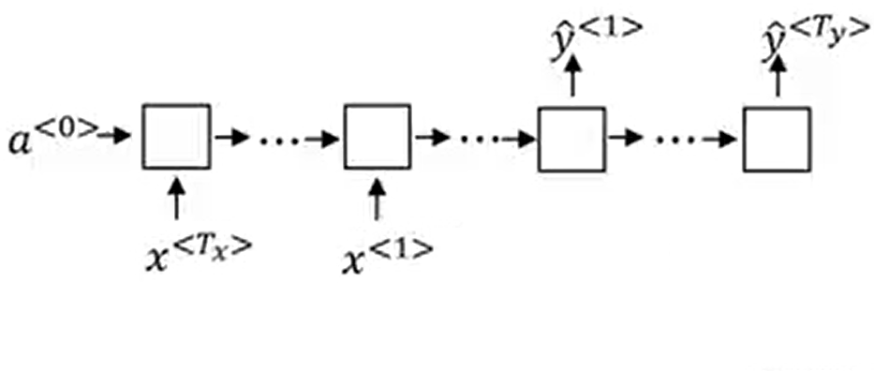
Reversed Input

Slide 7
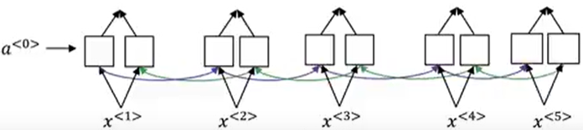
BIRNN

Slide 8
Why BIRNN?
“This is Teddy, he’s our AI expert.”
”This is a Teddy bear, would you like to play with it?”

Slide 9
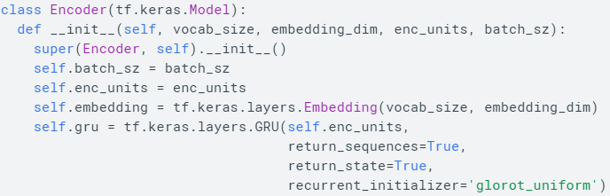
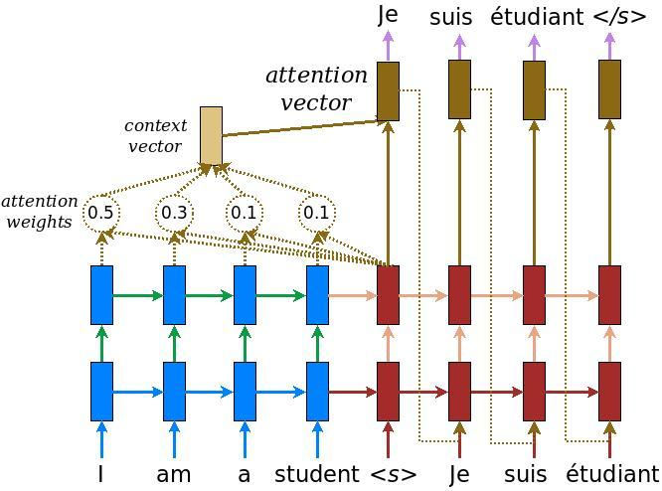
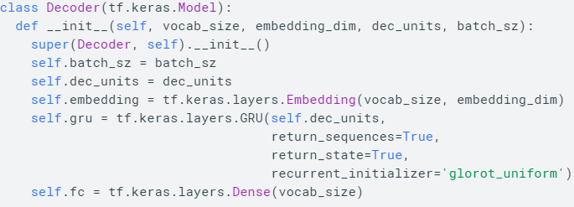
NMT with Attention

Slide 10
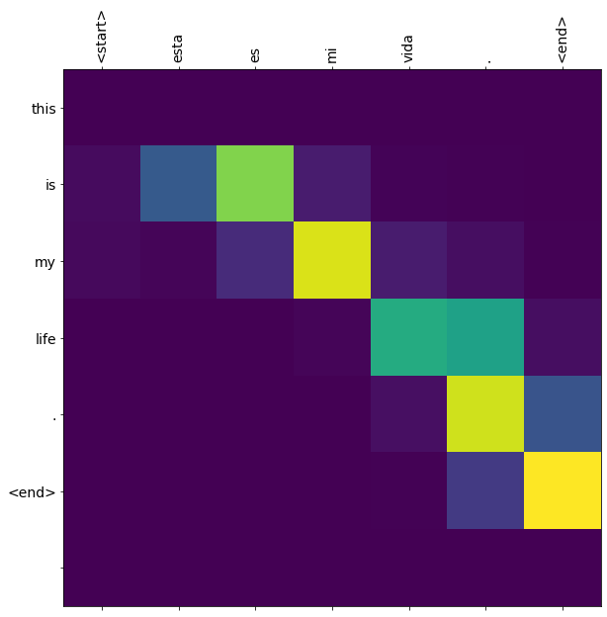
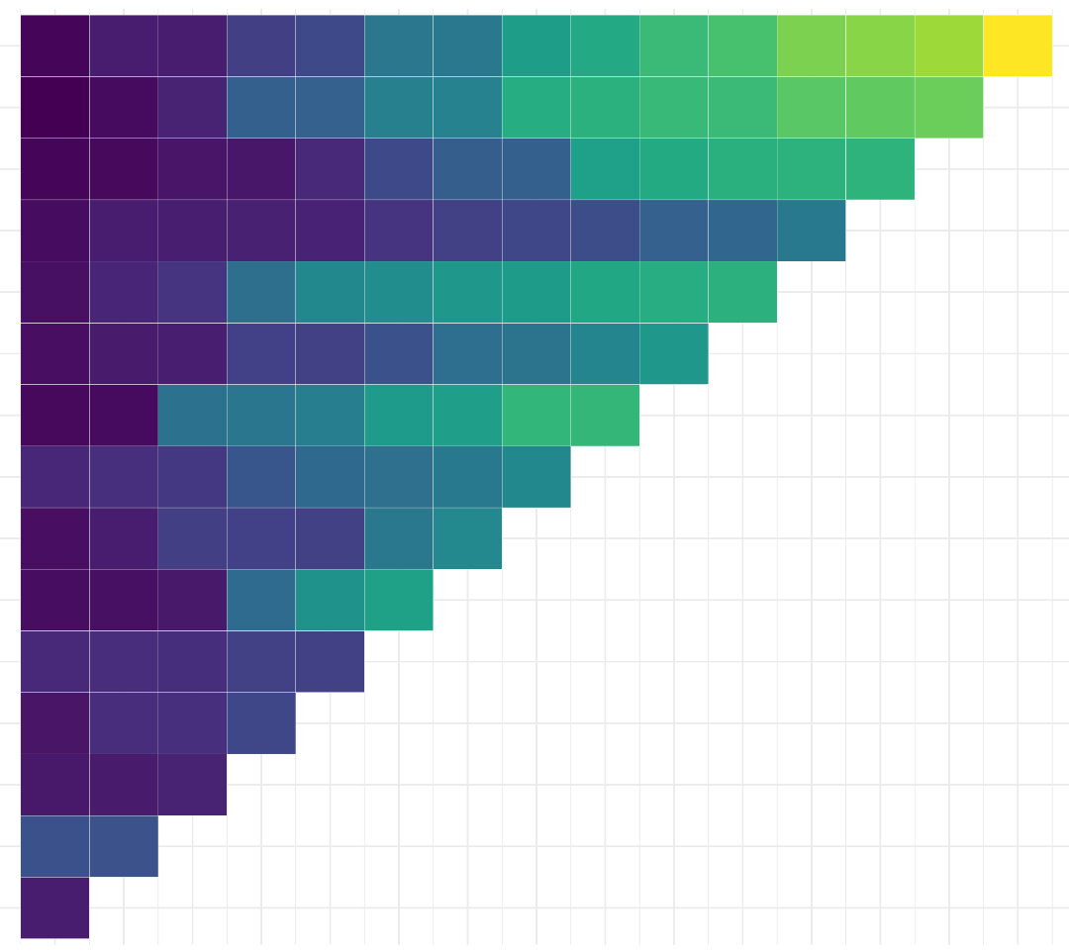
Attention is an Eye Candy

Slide 11
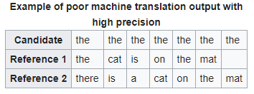
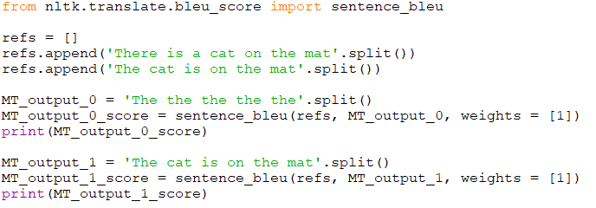



BLEU

Slide 12
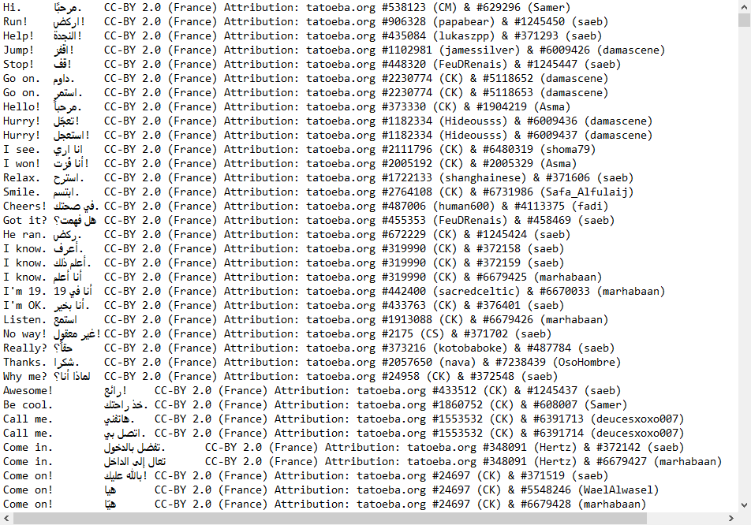

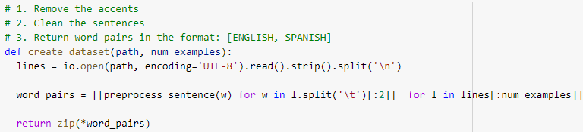
Experiments?
Different Languages: Arabic and Swedish.

Slide 13
Experiments?
Reverse Words?

