Slide 1
Embedded Concepts
Insert an image through the Insert menu at the top

Slide 2

AGENDA
Part 1 : Bare Metal Programming Vs OS
Part 2 : Timers
Part 3 : Software Hardware Synchronisation
Part 4 : Interrupts
Part 5 : Simple Scheduler
Part 6 : Hands On Example (C coding)
Callbacks
Simple Scheduling
configuration (PreCompile - Linking - Postbuild)
Setters and Getters
Component Integration
State machines
Development Error Tracing
Basic Debugging Skills
N°
N°
N°
N°
N°
N°

Slide 3
AGENDA
Part 7 :C Exercise
N°

Slide 4
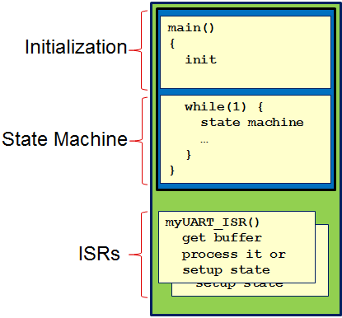
Bare Metal Programming Vs OS
Bare Metal Programming is a term for programming that operates without various layers of abstraction or an operating system supporting it. it interacts with a system at the hardware level, taking into account the specific build of the hardware.
Generally bare metal programs will have minimal bootloader to initiate the processor,clock and memory and jump to main program.
Usage of Bare Metal Applications:
Development of simple systems with limited-resource microcontrollers with no enough memory or CPU for loading OS, Code is running inside an infinite loop.
When Developing systems with direct control on every piece of hardware and register to meet timing requirements.
For reduction of operating systems and additional required tools costs.

Slide 5
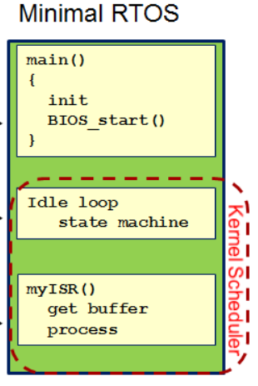
Bare Metal Programming Vs OS
OS Based Applications is the opposite of Bare-metal were the application is developed using the interfaces of the operating system and underlying modules, which isolate the application from the hardware and get advantage of powerful features offered by the OS reducing the development effort significantly.
Usage of OS Based Apps:
abstraction from underlying hardware and removing the overhead of developing schedulers, memory management or threads management modules, etc.
Developing much more modular and reusable Applications.

Slide 6
Timers
Timer is simply a counter that increase/decrease with a fixed time interval so that the number of counts can represent a specific amount of time equals these counts multiplied by the fixed time interval.These fixed time intervals can be achieved by a lot of means like a superman start counting up from 1 every one second, or an electric motor with a gear box making one revolution per minute or maybe a counter register that counts up by the rising edge of a 1 HZ square wave clock. (a superman, a watch and a microcontroller timer).
Usage of timers
Measure time between external events.
Synchronisation of Software with real time.
Implementation of Schedulers or RTOS.
Generation of PWM signals.
Used as counter for external events

Slide 7
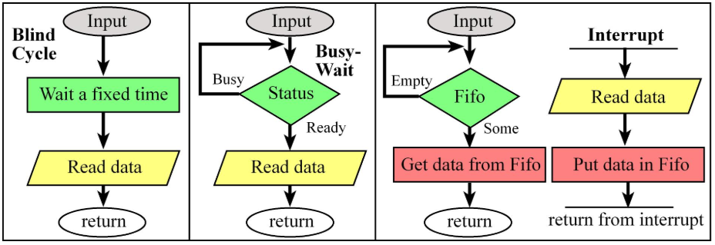
Software Hardware Synchronisation
Software Hardware Synchronisation is the methods that could be done by the software to always detect the changing hardware events and respond accordingly.
Five Mechanisms for Synchronization:
Blind: fixed delay in software.
Polling: software checks a status flag in the device
Interrupt: hardware triggers software when hardware is ready
Periodic polling: software in a periodic interrupt checks a status flag
Direct memory access (DMA): hardware automatically transfers data when hardware is ready

Slide 8
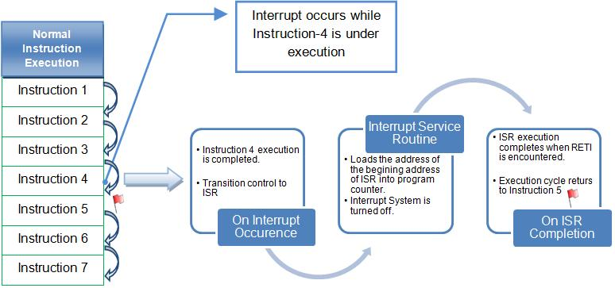
Interrupts
Interrupt is the automatic transfer of software execution in response to a hardware event that is asynchronous with the current software execution. This hardware event is called a trigger. This trigger can be external (ex. a rising edge on a GPIO pin) or internal (ex. a timer overflow event).
Common Interrupt Process:

Slide 9
Simple Scheduler
Scheduler in the simplest form is a piece of code used to schedule tasks and execute them with defined periodicities.
To implement a simple Scheduler you need to:
Define your System Tick. This means that you need to define the minimum amount of time that a task can be called periodically.
Use a timer. This is required to keep track of time and generate an interrupt periodically after each System tick.
A software counter. Which will increment every system tick representing your system watch.
Understand the modulo operator (%). As it will be used for the calculation of an interval.
Let’s Implement a simple one...

