Slide 1
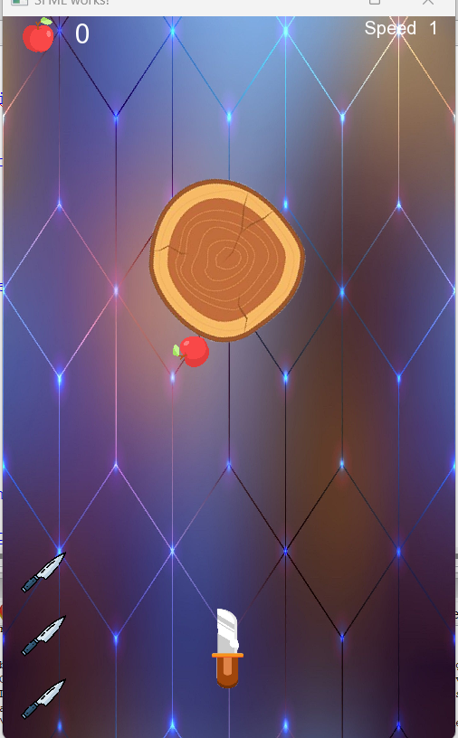
Knife Hit Game ☺

Slide 2
Game description
Our knife challenge is here!!
the game looks like shooter games. There are a spinning apple and you are given a knife.
the goal is to hit the apple in each level.
As you hit apples, the score, level, and speed are increased. so challenging 😎!!…
You have just three trials. So, don’t lose them 😉.
If unfortunately you lost all the trials, It will be ‘Game Over’.

Slide 3
How To play ?
All you need to do is to focus and wait till the appropriate moment then you are ready to shoot the knife.
You can shoot the knife by simply pressing on the ‘Space’ key.
Enjoy…:””)

Slide 4
Thank you!
By:
Al-Shaimaa
Salma
Hasnaa
Rowan

