Slide 1
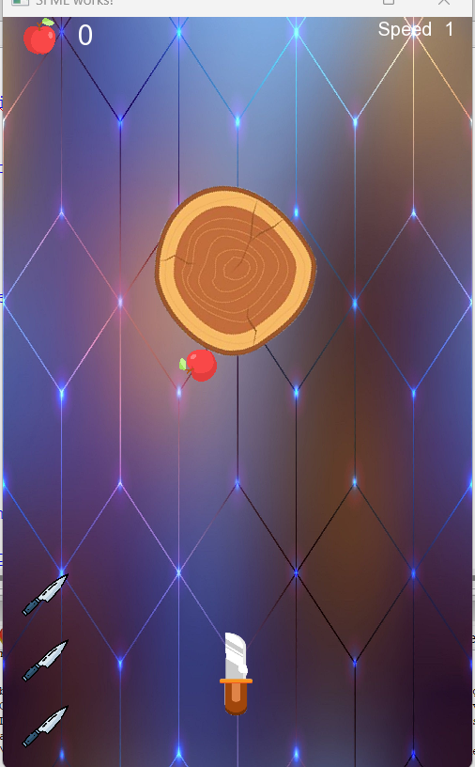
Knife Hit Game ☺

Slide 2
How To play ?
this game likes shooter games , so you can press space button to shoot our knife.
When the knife hit an apple , your score and tour level will increase by one .
You have 3 attempts ,after that you will lose!
Enjoy…:””)

