Slide 1
MACHINE LEARNING PROJECT
12,205
Predicting Online Purchase Intention
shopping sessions analysed
0.927
Classifying shopping sessions with XGBoost on the UCI Online Shoppers Purchasing Intention dataset
ROC-AUC of the final XGBoost model
80%
Team: [Add team member names]
of actual purchasers identified (recall)
Notes:
[~20 sec] Introduce the project and team. We built a classifier that predicts whether an online shopping session ends in a purchase, and we use its probabilities to segment visitors by purchase intent. Headline numbers on the right: 12,205 cleaned sessions, ROC-AUC 0.927, and 80% of actual purchasers identified by the final XGBoost model.

Slide 2



Project Overview
The problem
POTENTIAL IMPACT
Only 15.6% of online shopping sessions end in a purchase, yet every session is treated the same way.
15.65%
The ML task
purchase rate across all test sessions
Binary classification of Revenue: 0 = No Purchase, 1 = Purchase, using session behaviour and context.
vs
65.87%
Objective
Estimate purchase likelihood with a tuned XGBoost model and turn it into Low / Medium / High intent segments.
purchase rate in sessions the model flags as High Intent
Notes:
[~45 sec] Business problem: most sessions do not convert, so treating them all equally wastes marketing effort. ML task: predict the Revenue flag. Objective: build a classifier, tune XGBoost, and use predicted probabilities to segment sessions. The impact box compares the 15.65% baseline purchase rate with the 65.87% purchase rate observed in the High-Intent segment on the held-out test set. These are predictive associations, not proven causal lift; A/B testing would be needed to confirm.

Slide 3
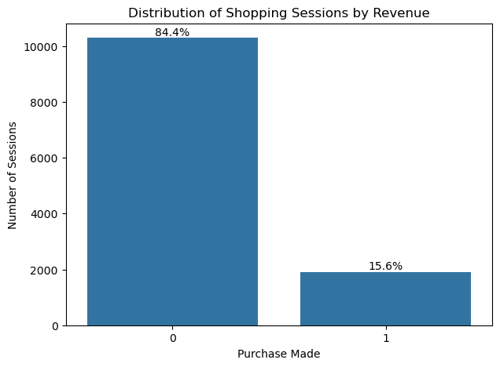
Data Selection & Preparation
UCI Online Shoppers Purchasing Intention dataset: 10 behavioural + 7 contextual features, target = Revenue.
12,330 × 18
12,205
raw sessions × columns
sessions after cleaning
1
No missing values in any of the 18 columns
2
Removed 125 exact duplicate rows
3
OperatingSystems, Browser, Region, TrafficType are integer codes, so treated as categories
84.4% of sessions end without a purchase. Accuracy alone is misleading, so precision, recall, F1 and ROC-AUC are tracked.
4
Stratified 80/20 split: 9,764 train / 2,441 test (15.63% vs 15.65% purchases)
Notes:
[~60 sec] Dataset: UCI Online Shoppers Purchasing Intention, 12,330 sessions and 18 columns. Data quality was good: zero missing values. We removed 125 exact duplicates, leaving 12,205 sessions. Four integer-coded columns are really categories, so they are one-hot encoded later. We split 80/20 with stratification so both sets keep about 15.6% purchases. The chart shows the key challenge: heavy class imbalance, 84.4% vs 15.6%. That is why we do not rely on accuracy.

Slide 4
Feature Engineering
17
13
30
87
+
=
→
original features
engineered features
predictors
after one-hot encoding
Session engagement
Product focus
Design choices & challenges
TotalPages, TotalDuration
ProductPageShare, ProductDurationShare
Leakage-safe: bounce (0.0167) and exit (0.0481) thresholds come from training data only; encoders are fit on train only.
Collinearity kept: ProductRelated vs duration r = 0.86, Bounce vs Exit r = 0.91. Tree models cope well.
Model-specific scaling: raw numerics for trees; StandardScaler only for the SGD baseline.
Signal check: PageValues correlates most with Revenue (r = 0.49).
Engagement depth
Risk flags
AvgTimePerProductPage, AvgTimePerPage
IsBouncer, HighExitRisk
Page value
Season & visitor
HasPageValue, LogPageValues
IsHolidaySeason, NearSpecialDay, IsNewVisitor
Notes:
[~60 sec] We expanded 17 original features to 30 by adding 13 session-level features in six groups: overall engagement, product focus, time per page, bounce and exit risk flags, PageValues transforms, and seasonal or visitor indicators. One-hot encoding of the 7 categorical columns then gives 87 model-ready features. Innovative/careful points: thresholds for the risk flags use the 75th percentile of the TRAINING data only, and the preprocessor is fit on train only, so there is no leakage. Challenge: strong collinearity between counts and durations and between bounce and exit rates; we kept them because XGBoost handles it. PageValues shows the strongest correlation with Revenue at 0.49.

Slide 5


Models & Evaluation Strategy
SGDClassifier
Random Forest
XGBoost
LINEAR BASELINE
NON-LINEAR BENCHMARK
FLAGSHIP MODEL
Logistic-loss SGD on standardised inputs. A simple, fast reference point.
100 bagged trees (min split 5, min leaf 2). Tests whether non-linearity and interactions help.
Gradient-boosted trees. Handles skewed, collinear features and interactions; tuned three ways.
Metrics
Validation
ROC-AUC (primary, threshold-free), Purchase precision / recall / F1 and the confusion matrix. Accuracy is context only: always predicting 'No Purchase' already scores about 84%.
Stratified 80/20 hold-out, with the test set untouched during tuning. 4-fold (Random) and 5-fold (Grid) cross-validation on training data only. Fixed seed = 1.
Notes:
[~55 sec] Three models of increasing power. SGDClassifier is a linear baseline. Random Forest tests non-linear structure. XGBoost is the flagship because gradient boosting handles skewed, collinear features and interactions well, and has a rich set of hyperparameters and an imbalance parameter, scale_pos_weight. Evaluation: because only 15.6% of sessions are purchases, accuracy is not enough, so ROC-AUC is the primary metric alongside Purchase-class precision, recall and F1. Validation: stratified hold-out test set plus cross-validation on training data only.

Slide 6
Hyperparameter Tuning
Random Search
1
10 candidates × 4-fold CV = 40 fits. Best CV ROC-AUC 0.9350: depth 6, lr 0.01, 300 trees, subsample 0.7, colsample 0.6, λ 1.
Grid Search
2
54 candidates × 5-fold CV = 270 fits. Best CV ROC-AUC 0.9367: depth 5, lr 0.01, min_child_weight 7, 435 trees.
Manual Search
Tuning cut overfitting (train accuracy 97.41% → 92.94%) and lifted test ROC-AUC 0.9212 → 0.9285. Class weighting then raised Purchase recall from about 60% to 80%.
3
scale_pos_weight at 0.6 / 0.8 / 1.0 × the class ratio (5.40). Chosen: 0.8 × = 4.32 (ROC-AUC 0.9272).
Notes:
[~70 sec] We used three complementary techniques. Random Search explored a wide space: 10 candidates with 4-fold CV, 40 fits, best CV ROC-AUC 0.9350. Grid Search then refined around that region: 54 candidates with 5-fold CV, 270 fits, best CV ROC-AUC 0.9367. Finally a manual search over scale_pos_weight, at 0.6, 0.8 and 1.0 times the class ratio of 5.40. The chart shows the precision-recall trade-off: more weight on purchases raises recall from 78% to 82% but lowers precision from 58% to 53%. Impact: tuning reduced the training-test gap (train accuracy fell from 97.41% to 92.94%) and improved test ROC-AUC from 0.9212 to 0.9285. Note for Q&A: the 0.8 multiplier was picked from test-set results; ideally it would be chosen by cross-validation.

Slide 7
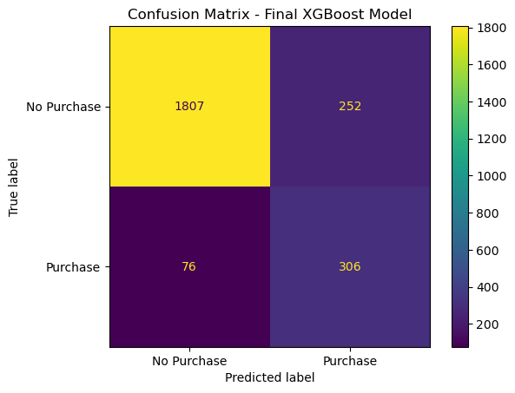
Model Comparison
Model | Test acc. | Precision | Recall | F1 | ROC-AUC
SGDClassifier | 87.51% | 68% | 37% | 48% | 0.8083
Random Forest | 89.88% | 71% | 59% | 65% | 0.9204
XGBoost baseline | ≈90% | 70% | 60% | 65% | 0.9212
XGBoost: Random Search | 89.88% | 72% | 58% | 64% | 0.9285
XGBoost: Grid Search | 89.76% | 70% | 60% | 65% | 0.9273
Final XGBoost (class-weighted) | 86.56% | 55% | 80% | 65% | 0.9272
Final model: 306 of 382 purchasers caught, 252 false positives.
Precision, recall and F1 are for the Purchase class on the held-out test set (2,441 sessions).
37% → 80%
0.808 → 0.927
55%
Purchase recall, SGD to final XGBoost
ROC-AUC, SGD to final XGBoost
Purchase precision: the price of catching more buyers
Notes:
[~65 sec] This is the recap table from the notebook. The linear SGD baseline has decent accuracy, 87.51%, but catches only 37% of purchasers. Tree models lift ROC-AUC from 0.808 to about 0.92. Tuned XGBoost variants reach 0.9273 to 0.9285 ROC-AUC. Our final model adds class weighting: accuracy dips to 86.56% and precision to about 55%, but recall jumps to 80%, so the model catches 306 of 382 real purchasers (confusion matrix on the right). That is a deliberate trade-off: in marketing, missing a buyer can cost more than contacting an extra non-buyer. Note: the default-threshold tuned models look similar to each other on ROC-AUC; the difference is where each sits on the precision-recall curve.

Slide 8
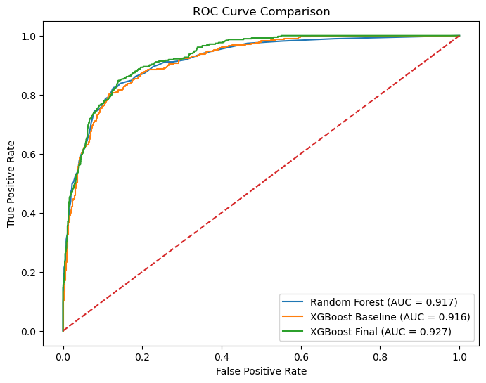
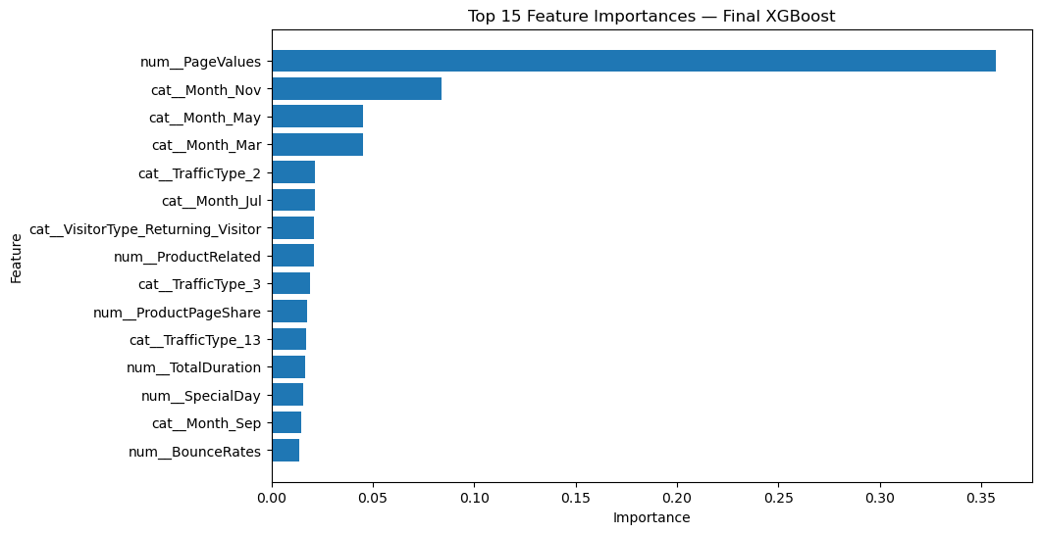
Key Findings: What Drives Purchases
Final XGBoost (AUC 0.927) beats Random Forest (0.917) and default XGBoost (0.916).
PageValues dominates: importance 0.357 vs 0.084 for the next feature (November).
27.26 vs 2.00
25.5% vs 1.7%
24.9% vs 14.1%
average PageValues: buyers vs non-buyers
purchase rate: November vs February
purchase rate: new vs returning visitors
Notes:
[~60 sec] Left: ROC curves. The final class-weighted XGBoost has the highest AUC, 0.927, versus 0.917 for Random Forest and 0.916 for XGBoost at default settings (these two are the untuned default-parameter versions from the notebook's results section). Right: feature importance from the final model. PageValues is by far the strongest signal at 0.357, far ahead of November at 0.084. The strip underneath comes from our EDA: buyers average PageValues of 27.26 vs 2.00 for non-buyers; November converts at 25.5% versus 1.7% in February; new visitors convert at 24.9% versus 14.1% for returning visitors. Caveat: feature importance describes model behaviour, not causation.

Slide 9
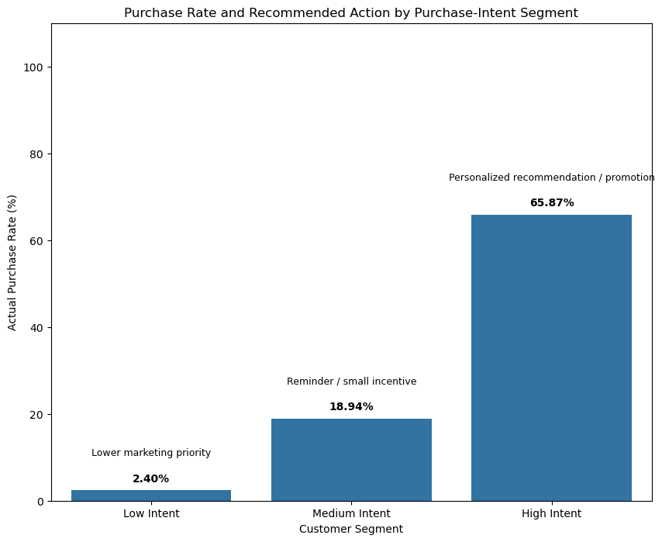
Key Findings: From Predictions to Action
Segment | Sessions | Purchases | Purchase rate
Low (<30%) | 1,666 | 40 | 2.40%
Medium (30–70%) | 359 | 68 | 18.94%
High (>70%) | 416 | 274 | 65.87%
89.5%
of all purchases (342 of 382) come from the Medium + High segments, which are only 31.8% of sessions.
Without ML: all sessions look alike (15.65% purchase rate).
With XGBoost: High-Intent sessions convert at 65.87%. Thresholds are illustrative; an A/B test is needed to prove lift.
Notes:
[~55 sec] We converted the model's predicted probabilities into three business segments using illustrative 30% and 70% cut-offs. Observed purchase rates rise sharply: 2.40% for Low, 18.94% for Medium and 65.87% for High Intent. The Medium and High segments are only about 32% of sessions but contain 342 of the 382 purchases, 89.5%. Recommended actions: personalised recommendations or promotions for High, reminders or small incentives for Medium, lower marketing priority for Low. These are predictive associations; A/B testing is needed to show causal uplift.

Slide 10
Future Work & Improvements
1
Deployment threshold
Choose the cut-off from validation data and the business cost of a missed buyer.
2
Model without PageValues
Check how much power remains if it is unavailable at decision time.
3
Session sequence models
Use event-level clickstream data to capture order and timing of actions.
4
Probability calibration
Apply Platt scaling or isotonic regression before allocating budget.
5
A/B test interventions
Confirm that targeting High-Intent sessions actually lifts conversion.
A 0.35 threshold gave F1 68.5% and recall 73.0%, but it was picked on the test set, so it must be re-validated.
Notes:
[~45 sec] Five next steps. 1) Deployment threshold: the chart shows how precision, recall and F1 move as the cut-off changes. A 0.35 threshold gave the best F1 of 68.5% with 73% recall, but we chose it on the test set, so it must be re-validated on separate data with business costs. 2) Retrain without PageValues to see how much predictive power remains. 3) Sequence models on clickstream data. 4) Calibrate probabilities. 5) A/B test the marketing actions to prove causal lift.

Slide 11
Thank you
Questions?
Key takeaways
0.927
PageValues
65.87%
ROC-AUC and 80% purchaser recall from the final class-weighted XGBoost.
is the strongest driver, followed by seasonality (especially November).
purchase rate in High-Intent sessions vs 15.65% overall.
Notes:
[~20 sec] Wrap up with the three takeaways: the final XGBoost model separates buyers from non-buyers well (ROC-AUC 0.927) and catches 80% of purchasers; PageValues and seasonality drive predictions; and segmenting by predicted intent lets marketing focus on the High-Intent group, which converts at 65.87% versus 15.65% overall. Invite questions.

