Slide 1
MACHINE LEARNING PROJECT
Credit Card Default
Risk Analysis
& Prediction
BANK / CREDIT
•••• •••• •••• 4829
CREDIT RISK MODEL
From predictive modeling to actionable risk decisions
On the UCI Default of Credit Card Clients
EDA → ML → BUSINESS IMPACT
Data Analyst:
AILIXIER KUERBAN

Slide 2
Project Overview
30,000
22.12%
Next month
Credit card clients
Actual default rate
Prediction target
Business problem
End-to-end workflow
Late payments create financial risk. Banks need to identify customers likely to default before the next billing cycle.
DATA QUALITY
EDA + FEATURES
Project objective
MODEL TRAINING
Build an interpretable classifier and evaluate how risk scores could guide customer reviews and interventions.
RISK DECISIONS

Slide 3
Exploratory Data Analysis (EDA)
Default Rate by Age Group
Default Rate by Recent Repayment Status
Highest default rate: 61+ (~27%); lowest: 31–40 (~20%).
Recent repayment status is strongly associated with default risk.
KEY TAKEAWAYS
1
Default rates vary across age groups, with the highest observed rate among customers aged 61+
3
Recent repayment status is strongly associated with default risk.
4
Higher delinquency levels (especially PAY_0 = 2, 3, 4, and 7) correspond to much higher default rates.
2
Customers aged 31–40 show the lowest default rate (~20%).
5
Customers with normal or better recent repayment status (-2 to 0) have much lower default rates.

Slide 4
Preprocessing & Feature Engineering
From raw customer records to model-ready credit risk signals
23
original predictors
+
6
engineered features
=
29
before encoding
→
39
after one-hot encoding
BILL BEHAVIOR
PAYMENT BEHAVIOR
REPAYMENT COVERAGE
avg_bill_amount
Mean bill balance across 6 months
avg_payment_amount
Mean payment across 6 months
payment_to_bill_ratio
Payments ÷ positive bill totals
CREDIT EXPOSURE
DELINQUENCY SEVERITY
DELINQUENCY FREQUENCY
credit_utilization
Recent bill ÷ credit limit
max_payment_delay
Maximum repayment-status code
months_with_delay
Number of months with delay > 0
Leakage-safe preprocessing pipeline
Train-only preprocessing → Median / mode imputation → StandardScaler + One-Hot Encoding
DATA QUALITY — No missing or infinite values after transformation • Preprocessing fitted on training data only

Slide 5
Models & Evaluation Strategy
Three complementary classifiers • Stratified evaluation • F1-led model selection
SGDClassifier
Random Forest
XGBoost
SGD
RF
XGB
LINEAR BASELINE
NON-LINEAR BENCHMARK
BOOSTED TREES
Fast logistic-loss classifier trained with stochastic gradient descent.
Ensemble of 200 decision trees using bootstrap aggregation.
Sequential gradient-boosted trees for binary default prediction.
Standardised numeric inputs • interpretable linear decision boundary
Captures nonlinear patterns and feature interactions.
Models complex interactions; supports parameter search and class weighting.
A simple reference model for evaluating added complexity.
Compare predictive gains against the risk of overfitting.
Chosen for further tuning and cost-sensitive evaluation.
◉ Evaluation Metrics
▣ Validation Design
F1-score • primary tuning objective: balances Precision and Recall.
80 / 20 stratified train–test split
Recall measures detected defaults; Precision limits false alerts.
ROC-AUC checks probability ranking; confusion matrix reveals FN/FP.
Accuracy is secondary: only 22.12% of customers default.
24,000 training rows | 6,000 held-out test rows
3-fold Stratified CV for Random & Grid Search (F1).
5-fold Stratified CV to assess tuned-model stability.
Training-only CV for tuning; final performance reported on held-out test set.
Credit card default prediction • Target: 1 = Default / 0 = No Default

Slide 6
Hyperparameter Tuning & Class Weights
XGBoost optimisation | Stratified cross-validation | F1-score selection
Randomized Search
CV Precision vs Recall by Class Weight
1
20 candidates × 3-fold CV = 60 fits
Default class (5-fold CV) • Percent
Best CV F1: 0.4751 • depth 3, learning rate 0.10
300 trees • subsample 0.8 • colsample 1.0
Grid Search
2
36 candidates × 3-fold CV = 108 fits
Best CV F1: 0.4776 (+0.0025)
depth 4 • learning rate 0.10 • min_child_weight 3
Manual Class-Weight Search
3
7 weights tested • 5-fold CV
Best weight: 2.50 • CV F1: 0.5451
CV Precision 52.61% • CV Recall 56.56%
KEY RESULT
Class weighting improved default Recall from 37.30% to 57.12%,
while test F1 reached 0.5457 (vs 0.4790 unweighted).
Selected: scale_pos_weight = 2.50 • Test ROC-AUC = 0.7818
Source: project notebook • CV metrics are training-only; final metrics use the held-out test set.

Slide 7
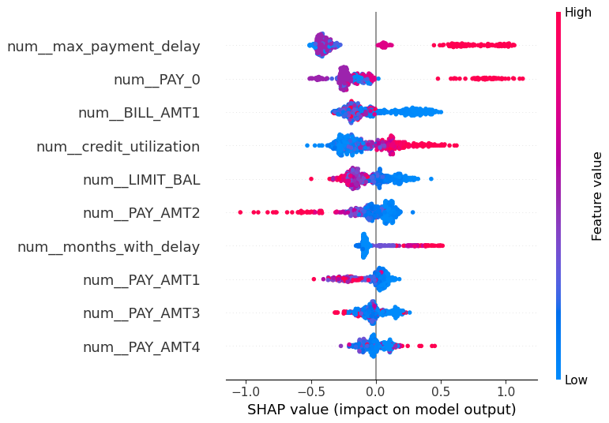
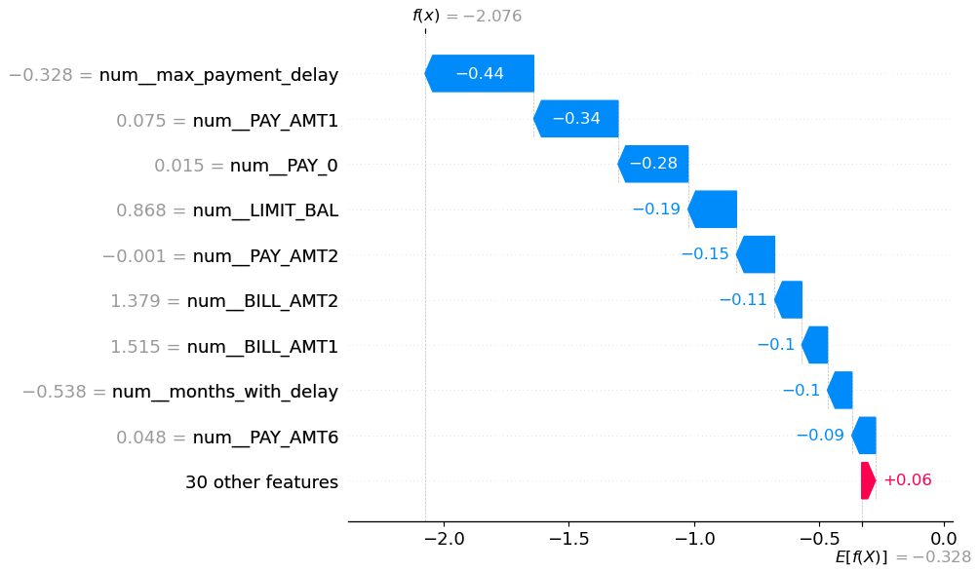
Model Interpretation
GLOBAL EXPLANATION
LOCAL EXPLANATION
SHAP Summary Plot
SHAP Waterfall Plot
Global view: the model is driven mainly by repayment-delay history, credit utilization, and bill/payment variables.
Local view: SHAP values explain how individual features shift the model output from its baseline prediction.
Business Meaning
Credit utilization and billing behavior provide additional risk signals, supporting earlier monitoring and intervention.
Credit utilization and billing behavior provide additional risk signals, supporting earlier monitoring and intervention.
SHAP supports more transparent risk assessments and targeted customer reviews.

Slide 8
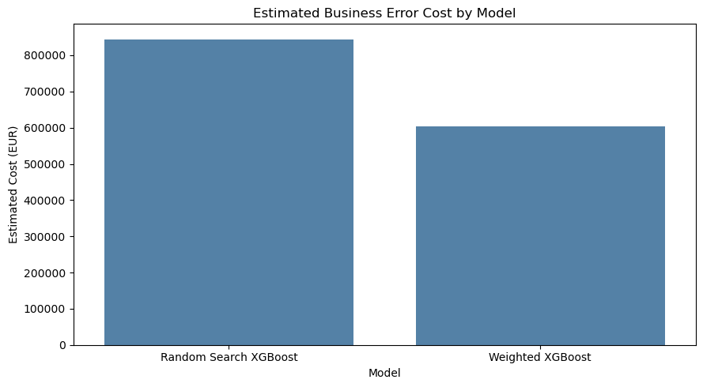
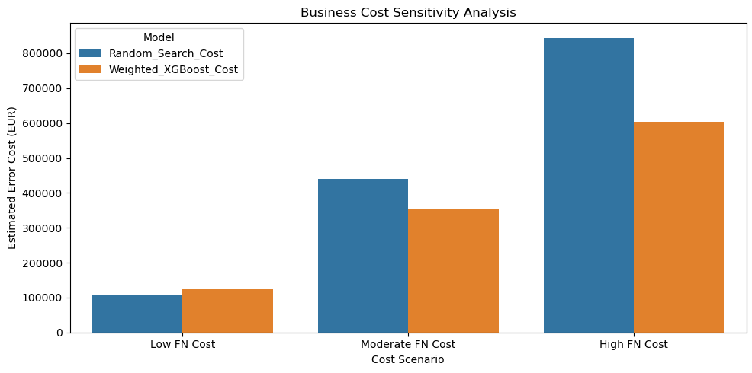
Business Impact
+263
Cost assumptions
€240.6k
Additional actual defaults found
Missed default (FN): €1,000
Illustrative lower error cost
False alarm (FP): €50
COST COMPARISON
SENSITIVITY TEST
Illustrative simulation — not observed financial savings.

Slide 9
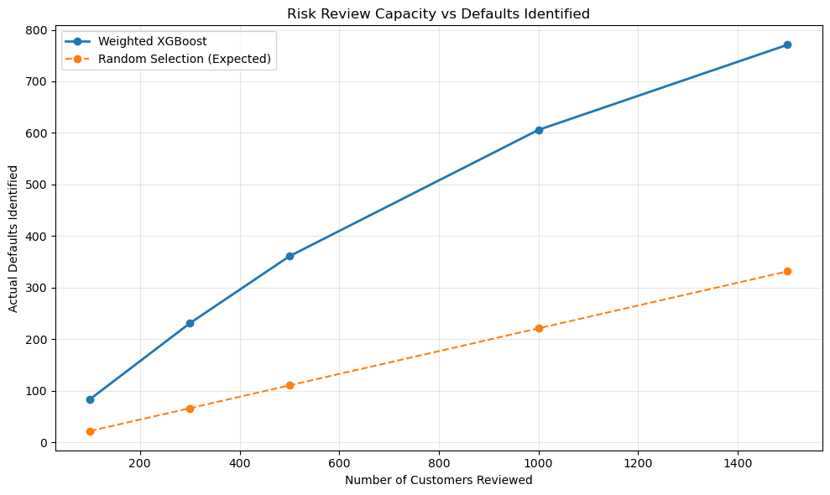
Risk Management
LOW RISK
MEDIUM RISK
HIGH RISK
51.05% clients
31.70% clients
17.25% clients
9.37% default rate
21.77% default rate
60.48% default rate
Operational strategy
HIGH RISK
Prioritize manual review and targeted interventions.
MEDIUM RISK
Send automated reminders and monitor repayment behavior.
RESOURCE EFFICIENCY
Top 500 ranked clients: 72.2% actual defaults — approximately 3.3× the random-selection baseline.
Top 500 ranked clients: 361 actual defaults identified vs 111 expected from random selection.

Slide 10
CONCLUSION & FUTURE WORK
KEY FINDINGS
Toward real-world credit risk decisions
1. Predictive Performance
Weighted XGBoost achieved an F1-score of 0.5457, Recall of 57.12%, and ROC-AUC of 0.7818.
2. Business Impact
Class weighting identified 263 additional actual defaults, reducing illustrative error costs by €240.6k under the stated assumptions.
3. Risk Management
Risk-based ranking identified 361 actual defaults among the top 500 customers, improving review prioritization.
External validation with more recent, representative data
Probability calibration, threshold optimization, and fairness assessment.
Model monitoring and pilot interventions to evaluate real-world outcomes.
THANK YOU
Questions?

