Slide 1
Student Performance Prediction Using Machine learning
CS422 Final Project
Ely Sidibe
Ryan Sands
Professor: Zuobin Xiong
Spring 2026

Slide 2
Introduction
Academic performance prediction is important
Early intervention for struggling students
Education data mining application
Machine learning can help predict outcomes

Slide 3

Problem Statement
Predict students' final mathematics grades (G3)
Using demographic, social, and academic features
Supervised learning problem
Regression task

Slide 4

Data set Description
Source: UCI Machine Learning Repository | Student performance data
Attribute | Value
Student | 395
Features | 33
Target | G3
Missing Values | 0

Slide 5
DATA Pre-PROCESSING
Feature-target split
One-hot encoding
Feature scaling
Train-test split

Slide 6
Machine learning Models
Model used:
Model | Type
Baseline | Average prediction
Linear Regression | Linear Model
Ridge Regression | Regularized regression
KNN Regression | Distance based model

Slide 7
Baseline Model Results
Served performance benchmark
Predicted approximately 10.33, for all students
RMSE of 4.58
R-square score of 0
Weak performance advance machine learning methods are necessary

Slide 8
Linear Regression results
Significantly improves the prediction
RMSE of 2.38
R-square score 0.72
The result shows that linear relationships exist between characteristics and academic performance

Slide 9
Ridge Regression results
Ridge regression produced slight better that linear regression
RMSE 0F 2.38
R-squared score of 0.72
The slight improvement suggest that regularization helped stabilize the model and reduce overfitting

Slide 10
KNN rEGRESSION rESULTS
KNN performed better than the baselin2 model by worse that the linear model.
RMSE of 3.38
R-squared score of 0.44
One likely reason is that KNN struggles with high dimensional dataset because distance calculations become less effective as dimensionality increases

Slide 11
PCA Analysis
Reduce dimensionality while preserving maximum variance
Principal Components = 2
Explained Variance Ratio = [0.091, 0.065]
Total Explained Variance = 15.55%

Slide 12
Model Performance Comparison
Model | RMSE | R-square Score
Baseline | 4.58 | 0.00
Linear Regression | 2.38 | 0.72
Ridge Regression | 2.38 | 0.72
KNN Regression | 3.38 | 0.44

Slide 13
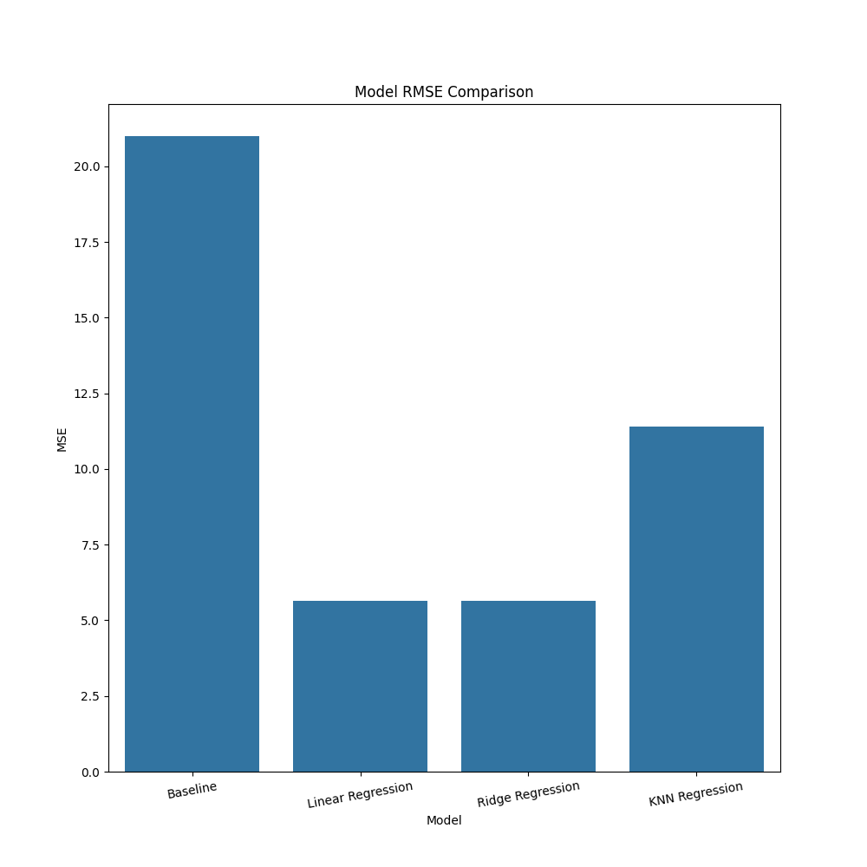
Visualization Regression

Slide 14
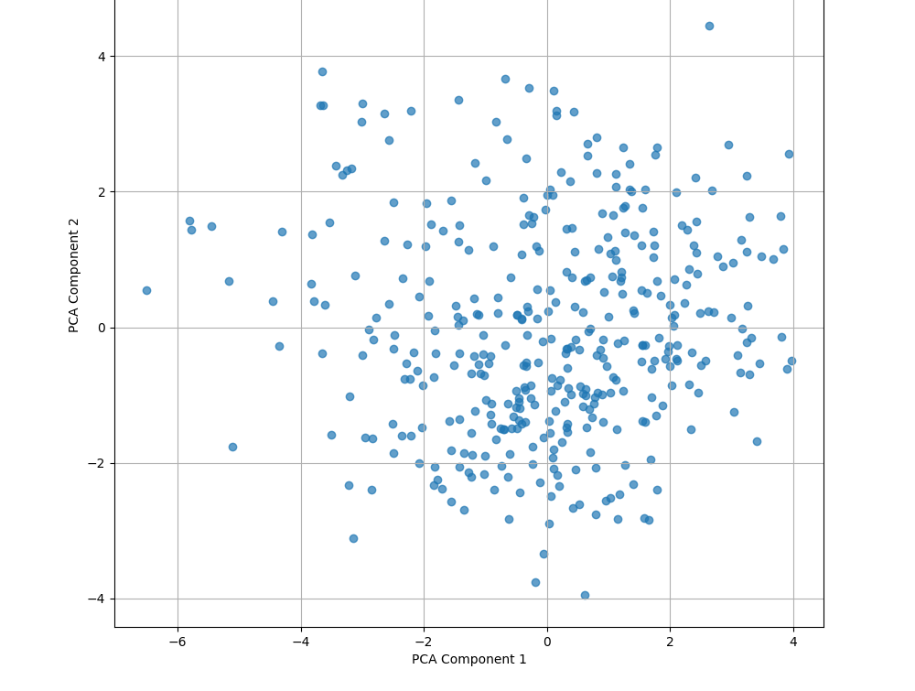
Scattered Plot

Slide 15
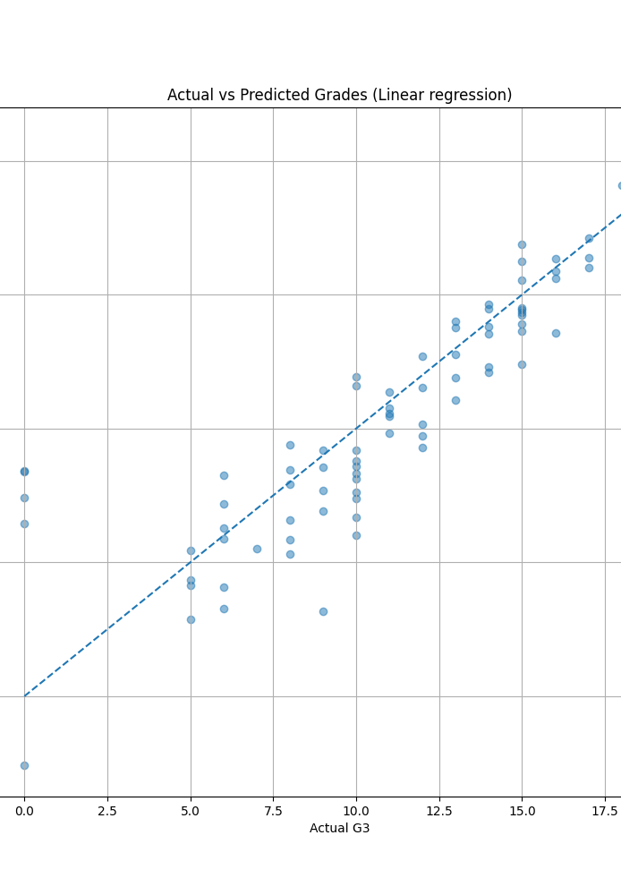
Linear regression prediction

Slide 16
Insights
Effectively predicted student grades
Linear and Ridge Regression achieved strong performance
Ridge Regression slightly outperformed Linear Regression
KNN struggled with high dimensional data
PCA provided useful dimensionality reduction insights

Slide 17
Thank you

