Slide 1
Maximizing Profit for UdaPeople
By Nwanwobi, Samuel Chukwuemeke

Slide 2
Introduction – The Story
Okon is the CEO of telesmatic company.
Product: They own a social media platform that helps connect loved ones and business partners together.
Operations: After the lunch of the platform, telesmatic company would love to fix any bug users may experience as well as add more features to the software in the future without having to take down the platform.
Why? This is important so as to eliminate cost of taking the platform down and putting it up. It also saves the company from downtime and the time used in setting up and configuring the platform thereby saving cost.
Solution: This is where CI/CD comes into play.

Slide 3
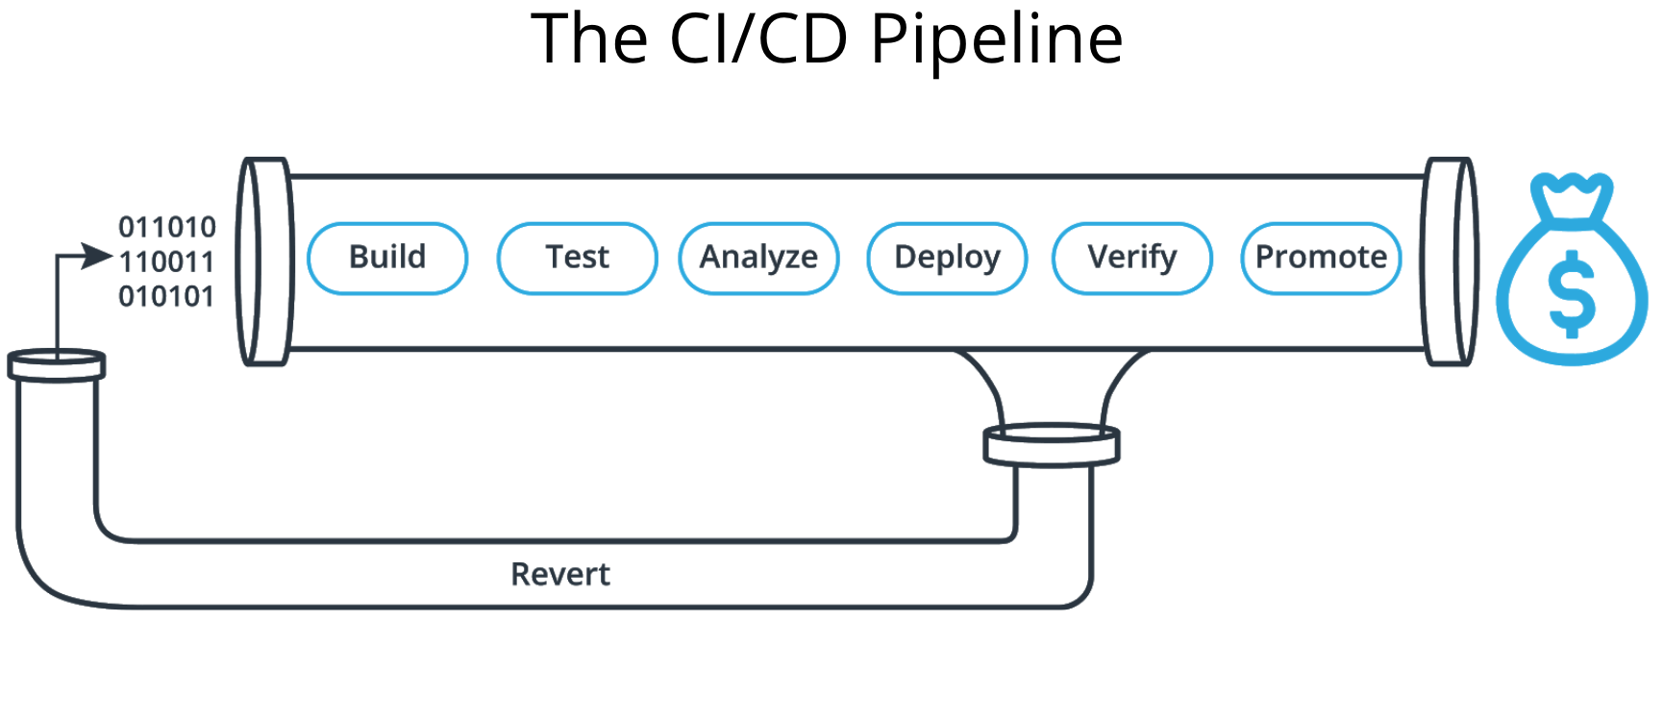
What is CI/CD?
A software engineering approach in which the value is delivered frequently through automated deployments i.e little and more frequent updates can be made faster and without shutting down the product.

Slide 4
What it means for the Udapeople project
REDUCE COST
Less time fixing bugs.
We don’t have to pay for resources we don’t use.
AVOID COST
Less bugs and less testing time.
Less human error; faster deployments.
Prevents costly security issues.
INCREASE PROFIT
New features enter the market quickly.
Less time for the product to penetrate our target users.
PROTECT PROFIT
Reduced downtime from a major bug.
Quickly return to the most recent working state of the application.

Slide 5
Conclusion
Company’s that have adopted this model of software development have been able to make more than 33% profit.
This would be a game changer for us and the only thing we would be missing is adopting something new and innovative

