Slide 1

Microsoft MOVIE STUDIO
Presented by:
Nduta Tabitha Elsie

Slide 2
Problem statement
Microsoft sees all the big companies creating original video content and they want to get in on the fun. They have decided to create a new movie studio, but they don’t know anything about creating movies. I explored what types of films are currently doing the best at the box office. And came up with findings translatable into actionable insights that the head of Microsoft’s new movie studio can use to help decide what type of films to create.

Slide 3
Lead questions
What are some of the most common studios used to narrow down from all those available?
What are the top popular genres ?
Does the number of votes and ratings correlate ?
Does the domestic gross(budget) affect the ratings ?
What are the correlations of different genres and other attributes ?

Slide 4
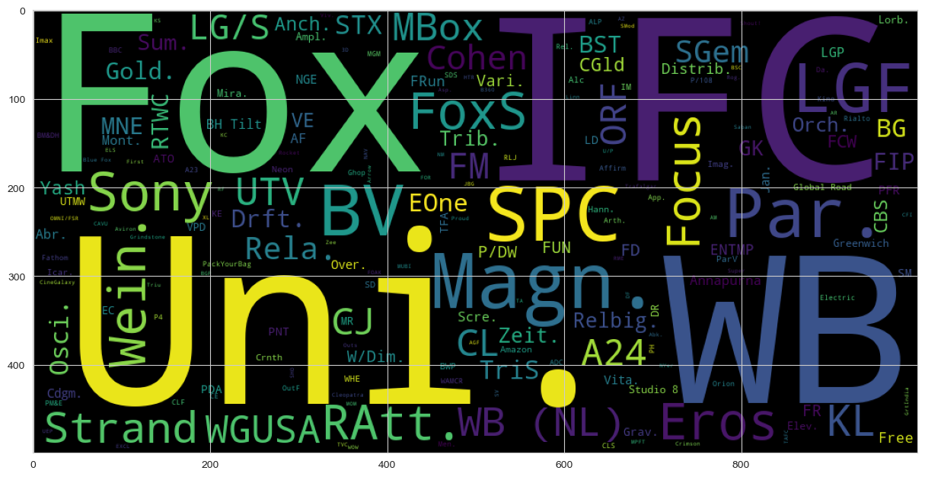
Word cloud
The size of the font is proportional to the number of times a studio appears in the dataset. From the word cloud some of the most common studios include; Fox, Uni, WB, IFC among others.

Slide 5
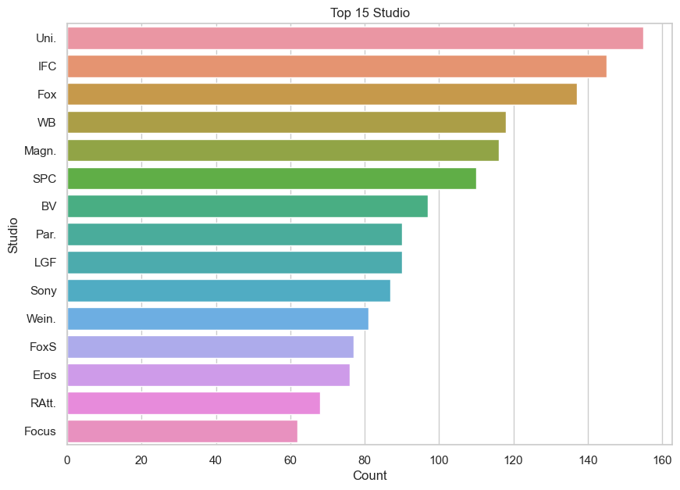
Top studios

Slide 6
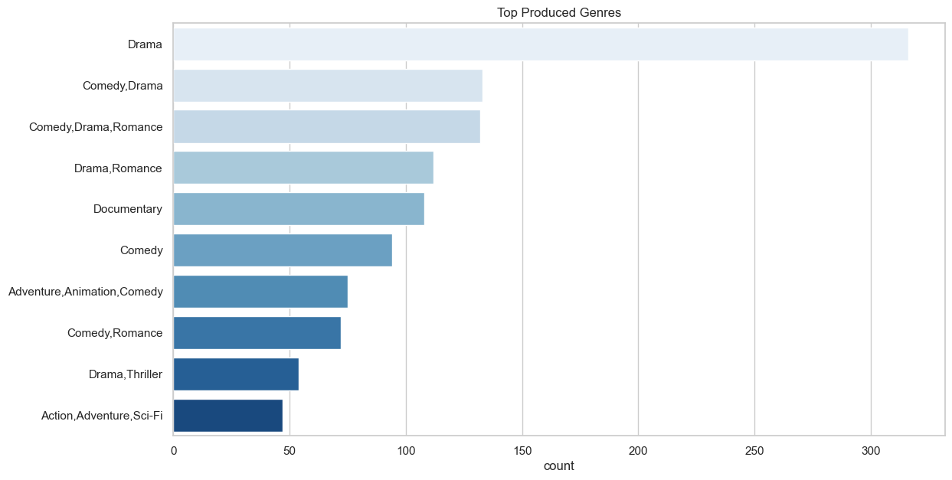
Top popular genres
Displayed are the top 10 genres produced .

Slide 7
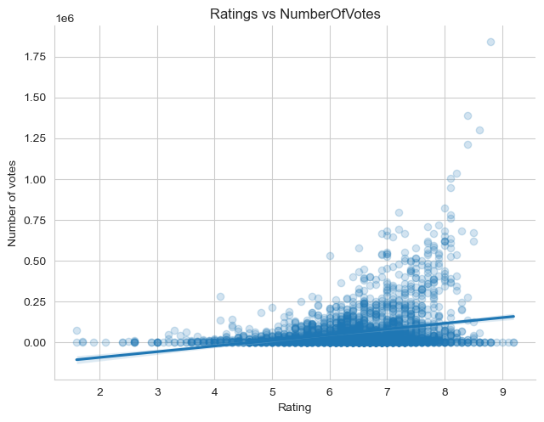
No. of votes vs Ratings
There is a positive relationship between the two elements

Slide 8
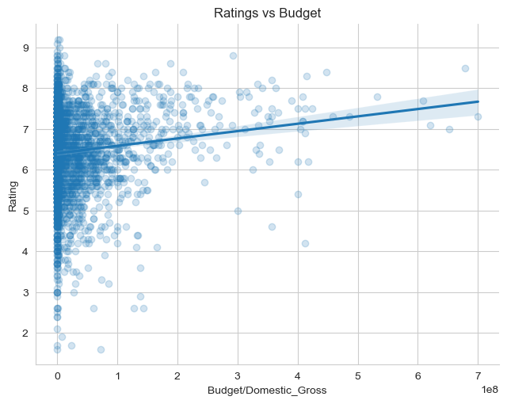
Effect of domestic gross on ratings
Positive domestic gross impacts positively on ratings.

Slide 9
Recommendations
The studios that should be invested in should be either Fox, Uni, WB or IFC
The company should consider starting with the production of drama genre movies.
A team to engage with the viewers should be put in order to engage with them by creating polls to get their views and understand their target audience well enough.

