Slide 1

OS 2021
Homework 3: thread scheduler
(Due date 12/21 00:00:00)
GitHub Classroom
TA: Tsen-En, Chou 周岑恩
Email: p76091234@gs.ncku.edu.tw
Notes:
Hw3 作業的主題是 scheduling simulation。

Slide 2
Overview
This homework will require students to create multiple threads and schedule these threads according to the homework requirements.
Time out or
Wait event/time
Thread
Select a thread to enter the running state
Scheduler
Reschedule
Notes:
本次的作業會建立 multiple threads ，並建立 scheduler 對這些 threads 做排程。一次只會有一條 thread 在 running。

Slide 3
Overview
Scheduler
The scheduler will select a thread to enter the running state according to the scheduling algorithm.
Threads
Each thread has its priority, name, entry function, and cancellation mode.
Notes:
Scheduler 會根據 scheduling algorithm，來選擇 thread 進入 running state.
Thread 會有自己的 priority, name, entry function, and cancellation mode.

Slide 4
Objectives
Understand how to implement a user-level thread scheduler
Understand how to implement signal handler
Understand how to realize asy./deferred thread cancellation

Slide 5
Requirements (1/4)
Create threads
Initial user threads are specified in a static thread configuration file.
The name of the thread configuration file must be init_threads.json.
You should implement a function that can parse init_threads.json and generate the corresponding thread to the ready queue.
The JSON format
name
A descriptive name for the thread. It is included purely as a debugging aid.
entry function
One of the five functions: Function1 to Function5
Function implementations are provided by the TAs and included in function_library.c. All function implementations can not be changed.
priority
Three priority levels, H, M, L.
You can decide the priority of the thread yourself.
cancel mode
Can be 1 or 0.
If setting 1 means that the thread is deferred cancellation type.
If setting 0 means that the thread is asynchronous cancellation type.
Notes:
那開始 schedule 之前，需要先配置有多少條 thread 會被 schedule，所以我們要設定 thread 相關的 info。
thread configuration file 必須設定 init_threads.json
你應該會設計一個 function 來 init_threads.json，並將相應的 thread 放入 ready queue
entry function: 我有提供一些 function，定義在 function_library.c 請不用更改它，等等也會介紹一下 function 的內容。

Slide 6
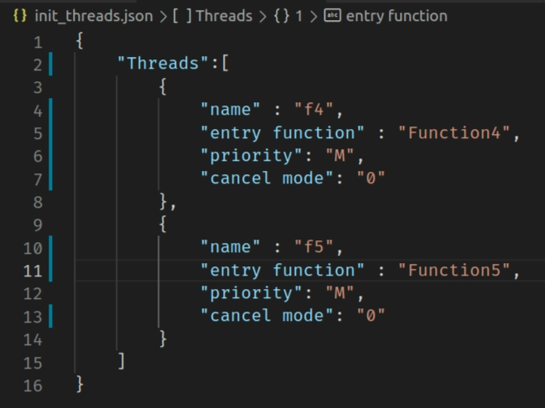
Requirements (1/4)
A 2-thread example of the thread configuration file

Slide 7
Requirements (2/4)
Scheduler
Use ucontext and related APIs to implement context switch
See the References slide (slide 27)
Implement Multilevel Feedback Queue (在tq內run到一半waiting
，再回來會升級；run超過tq會降級)
More detailed requirements will be described in slide 13.
There should be a timer that sends a signal (SIGALRM) every 10ms.
Calculate all thread-related time.
Check if any threads need to switch state.
Decide whether you need to wake up the scheduler.
e.g.,
The thread currently in the running state has 30ms left in time quantum(TQ). There is no need to switch thread states, also no need to wake up the scheduler.
The waiting time for a thread in the waiting queue has expired and needs to be switched to the READY state. Wake up the scheduler according to the scheduling algorithm.
Notes:
context switch 請使用 ucontext 以及相關的 API 來實作。這些 API 的資訊我有放在最後一頁投影片。
本次作業的 scheduling algorithms 是採用 Multilevel Feedback Queue，更加詳細的要求會在第 13 頁說明。
再來，還需要註冊一個 timer ，它每 10ms 會發送一次 SIGALRM。 用意在於每 1ms
計算所有線程相關的時間
檢查是否有線程需要切換狀態
決定是否需要喚醒 Scheduler
例如
TQ 剩 30ms 不需要切換狀態也不會喚醒 Scheduler
等待隊列中某個線程的等待時間已經到了，需要切換到READY狀態，根據 scheduling algorithm 喚醒 Scheduler.

Slide 8
Requirements (2/4)
An additional thread must be created before the system starts scheduling.
name: reclaimer
entry function: ResourceReclaim(Defined in function_library.c)
priority: L
cancel mode: 1
Reclaimer can not be included in init_threads.json.
Reclaimer will not enter the terminated state.
Notes:
請注意，除了先前已經設置 threads 之外，在開始 schedule 之前，還需要建立一條 thread。它不可以包含在 init_threads.json 也不會進入 terminated state。
所以假設 init_threads.json 總共配置兩條 thread，則系統會總共會有 3 條 thread

Slide 9
Requirements (3/4)
Report
Use ctrl + z to report threads information on the terminal.
Base priority
Thread priority configuration in init_threads.json.
Current priority
The priority of the thread after the change according to the scheduling algorithm.
Queueing time
The total time the thread stays in the ready state during all the simulation period.
Waiting time
The total time the thread stays in the waiting state during all the simulation period.
TID | Name | Thread state (in slide 12) | Base Priority | Current Priority | Queueing time | Waiting time
1 | P_Hello | WAITING | L | M | 120 | 20
2 | CalcAvg | RUNNING | H | M | 0 | 0
3 | IdleTask | READY | L | L | 120 | 0
Notes:
當開始 schedule，每當按下 ctrl + z 時，都需要回報當前所有 threads 的相關資訊。

Slide 10
Requirements (4/4)
Implement APIs that can be used by threads(described in slide 16)
int OS2021_ThreadCreate(char *name, char * p_function, char *priority, int cancel_mode);
int OS2021_ThreadCancel(char *name);
void OS2021_ThreadWaitEvent(int event_id);
void OS2021_ThreadSetEvent(int event_id);
void OS2021_ThreadWaitTime(int 10msec);
void OS2021_DeallocateThreadResource();
void OS2021_TestCancel();
Notes:
設計以下 API ，詳細要求會在 slide 16 說明

Slide 11







Architecture
User application scheduling_simulator
Start simulation
Parse json file
Simulation
Static config thread flow
Simulation
Parse init_threads.json
Parse to end of file(EOF)
Start simulation
Select one thread to run
Scheduling
Thread running
Run out of time quantum or
Wait event/time
Notes:
這是這次作業的總體架構

Slide 12




Thread state diagram
Thread finishes
TERMINATED
New thread
Scheduler dispatch
READY
RUNNING
Run out of time quantum
event complete
or
Waiting time is up
Waiting for event or time
WAITING

Slide 13
Multilevel Feedback Queue
3-level Non-preemptive Priority Feedback Queue
H – Round Robin(RR) with Time Quantum(TQ) 100ms
M – RR with TQ 200ms
L – RR with TQ 300ms
Scheduling
Non-preemptive (rule1:即便有更高priority的process出現，仍須run完當前的process)
If a thread with a priority higher than the currently running thread enters the ready queue, it must wait for the running thread to run out of TQ or give up the CPU before switching to a higher thread.
Adjust priority (rule2: 沒有run完tq會升級)
If the thread gives up the CPU without running out of its TQ (Wait time or event), it increases its priority by one level.
If the thread runs out of its TQ, it decrease its priority by one level.
If the priority of the thread is changed, please print the information on the terminal.
e.g., The priority of thread xxx is changed form M to H.
Enter
Quantum 100ms
Leave
H
Adjust priority
Quantum 200ms
M
Quantum 300ms
L
Notes:
如果 ready queue 中出現一個 thread 的 priority 高於當前 running 的 thread，則必須等待 running 的 thread 用完 TQ 或放棄 CPU，然後再切換到 priority更高的線程。
如果線程自動放棄 CPU 則提升一級 priority，反之則降低一級 priority
如果線程的 priority 被更換了，請將資訊印在 terminal.

Slide 14
Multilevel Feedback Queue
Example1(Non-preemptive)
Thread1(T1) initial priority is M. Enter M queue.
T1 is running.
Thread2(T2) initial priority is H. Enter H queue.
T1 runs out of TQ in the M queue(200ms).
T2 is running.
p.s. Green: ready, Orange: running
T2
T2
T2
Quantum 100ms
H
runs out of TQ
T1
T1
T1
Quantum 200ms
M
Quantum 300ms
S

Slide 15
Multilevel Feedback Queue
Event complete
Example2(Adjust priority)
The initial priority of Thread1(T1) is M. Enter the M queue.
T1 calls OS2021_ThreadWaitEvent() to make it enter the waiting state before running out of its TQ.
The event is completed and is awakened by another thread.
T1 enters H queue.
T1 runs out of TQ in the H queue(100ms), and then enters the M queue when it returns to the ready state.
p.s. Green: ready, Orange: running
runs out of TQ
T1
T1
Quantum 100ms
H
Wait event
T1
T1
T1
Quantum 200ms
M
Quantum 300ms
S

Slide 16
API Description(1/3)
int OS2021_ThreadCreate(char *name, char *p_function, char *priority, int cancel_mode); ->5function
Create a thread named name and set its priority to priority.
If function_libary.c doesn’t have a function named p_function, API returns -1.
The cancellation type of the thread is marked according to the cancel_mode.
Return (Thread ID)TID of the created thread.
void OS2021_ThreadCancel(char *name);
Cancel the thread named name according to the cancel mode of the thread.
If the cancel mode is 0, change the thread status to TERMINATED, and then the resource memory block will be reclaimed by the reclaimer.
If the cancel mode is 1, please inform the thread named name that another thread wants to cancel it.
Then name thread will be terminated when it enters the cancellation point
Notes:
ThreadCreate
建立名為 name 的 thread 並賦予它 priority
如果 function_libary.c 沒有名為 p_function，則 return -1，建立成功就回傳 TID
根據 cancel_mode 標記 thread 的 cancellation type
ThreadCancel
根據 thread 的取消方式取消名為 name 的 thread。
cancellation mode = 0，將 thread 的狀態改為TERMINATED，然後資源內存塊就會被回收者回收。
cancellation mode = 1，請通知名為 name 的 thread 另一個 thread 要取消它。
之後名為 x 的 thread 進入 cancellation point ，再將其取消

Slide 17
API Description(2/3)
A total of 8 types of events, use numbers 0~7 to number the events.
void OS2021_threadWaitEvent(int event_id); (設定我要等哪種event:0~7，如果此ID存在就會進到waiting state)
The running thread changes its state to WAITING and enters the event waiting queue corresponding to the event_id.
Reschedule if needed.
The thread calling this API must print the event it wants to wait for on the terminal.
e.g., xxx wants to wait for event 2.
void OS2021_threadSetEvent(int event_id); (喚起想等某個event的thread)
If there is currently a thread waiting for an event, the API will move the state of the thread from WAITING to READY and remove the thread from the event waiting queue corresponding to the event_id.
If no threads are waiting for the event, nothing is done.
If a thread is awakened, the wake-up information must be printed on the terminal.
e.g., xxx1 changes the status of xxx2 to READY.
Notes:
threadWaitEvnet
將正在運行的 thread 將狀態改為WAITING，並根據 event_id 進入 event waiting state。
調用此 API 的 thread 必須在 terminal 上打印它想要等待的事件。
例如，xxx 想等待事件 2。
threadSetEvnet
如果當前有 thread 在等待 event id 則將其 state 改為 READY，沒有人在等，就不做任何事情。意思是如果先 Set 再 Wait ，想 wait 的 thread 還是要 wait
如果一個 thread 被喚醒，喚醒信息必須打印在 terminal 上。
例如，xxx1 將 xxx2 的狀態更改為 READY。

Slide 18
API Description(2/3)
Notice
If multiple threads are waiting for the same event, the thread with the highest priority will be awakened first.
If the priority is the same, it will be served according to the first-come, first-served (FCFS) algorithm.

Slide 19
Event example
Job Thread
T_No.
Ready queue Orange: running
Event0 Waiting queue
T_1
T_1
T_2
H
T_2
T_1
T_2
T_1 wait event0
T_2 wait event0
T_3 wait event0
T_4 set event0
T_3
T_3
T_4
M
T_4
T_3
L

Slide 20
API Description(3/3)
void OS2021_ThreadWaitTime(int 10msec); (設定要在waiting等多久)
The running task change its state to WAITING.
Change the state of the suspended task to READY after 10msec * 10ms.(傳入參數在function裡要乘以10)
Reschedule (schedule next thread to run).
void OS2021_DeallocateThreadResource(); （回收在terminate state的記憶體）
This API will be used by ResourceReclaim().
Deallocate the memory of the thread that has been terminated.
void OS2021_TestCancel();
Allows a thread to be cancelled in a safe point(cancellation point).

Slide 21
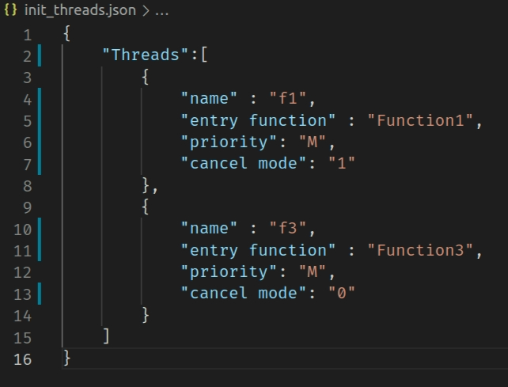
Hw3 Example1

Slide 22
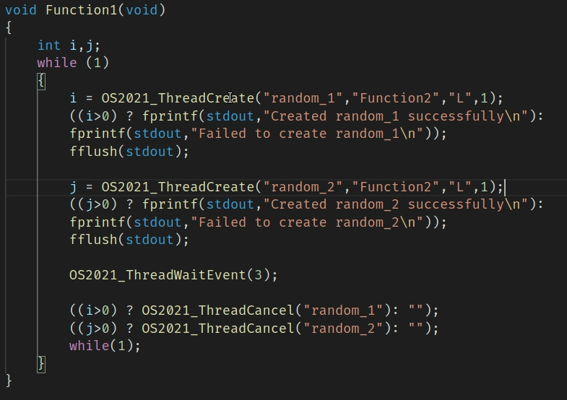
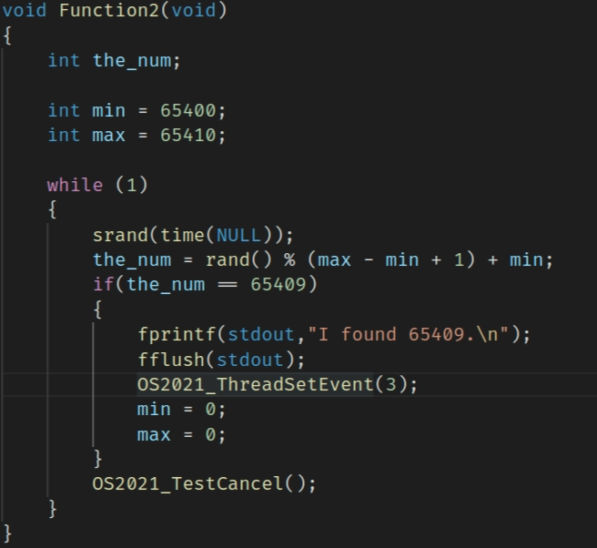
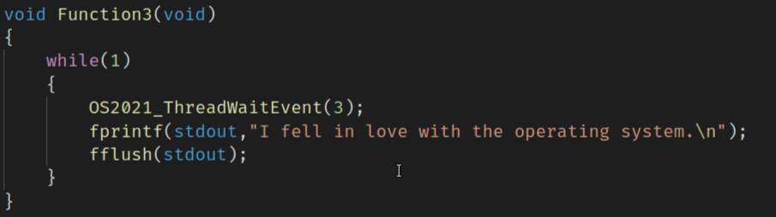
Hw3 Example1

Slide 23
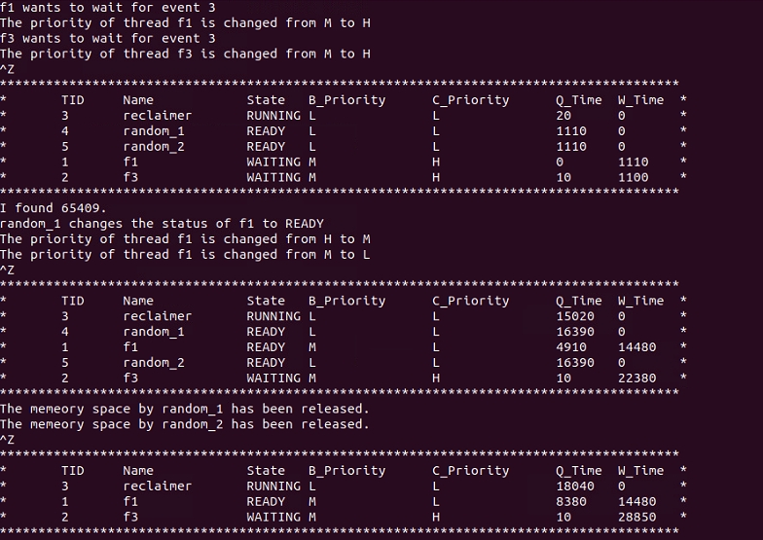
Hw3 Example1

Slide 24
Hw3 Example2

Slide 25
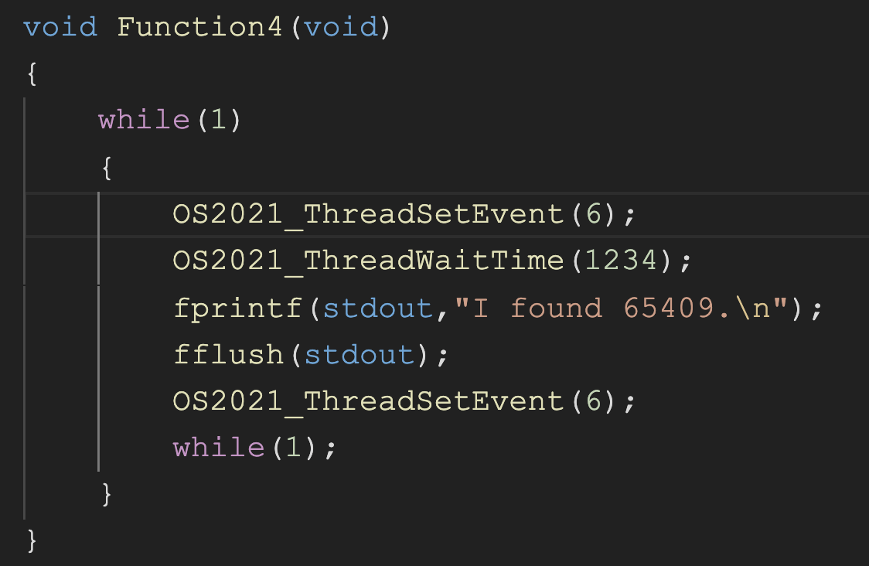
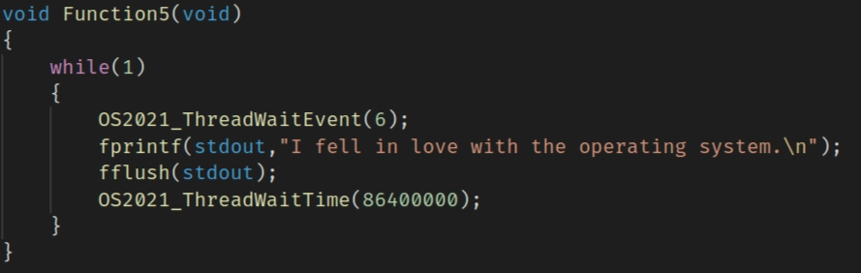
Hw3 Example2

Slide 26
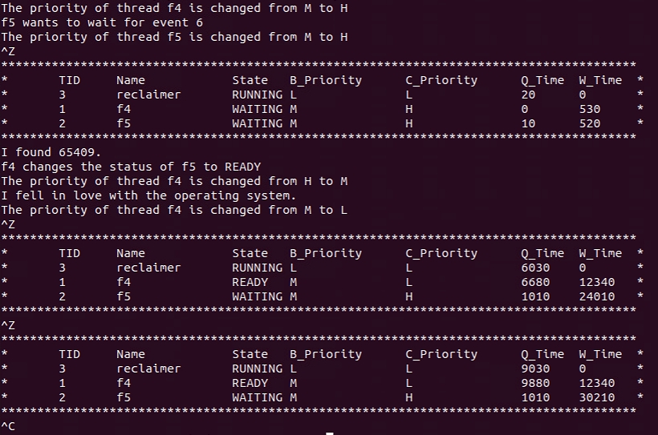
Hw3 Example2

Slide 27
References
ucontext
The Open Group Library
IBM® IBM Knowledge Center
getcontext()
setcontext()
makecontext()
swapcontext()
signal handler
Gitbook
Linux manual page
timer
Linux manual page
IBM® IBM Knowledge Center
.json
JSON Introduction

