Slide 1
AutoComplete com Trie
Bacharelado em Ciência da Computação
Universidade Federal do ABC
Algoritmos e Estruturas de Dados II
Allan Holanda Targino
RA: 11061112
Elsio Antunes
RA: 11097612
Dezembro de 2016

Slide 2
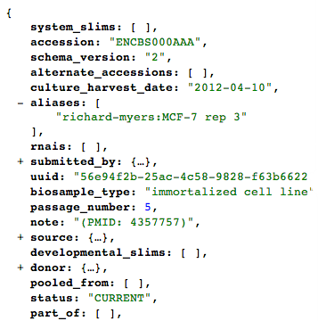
Motivação

Slide 3
Metodologia
Linguagem: Javascript
Estrutura: Trie
Compactação: LZW

Slide 4
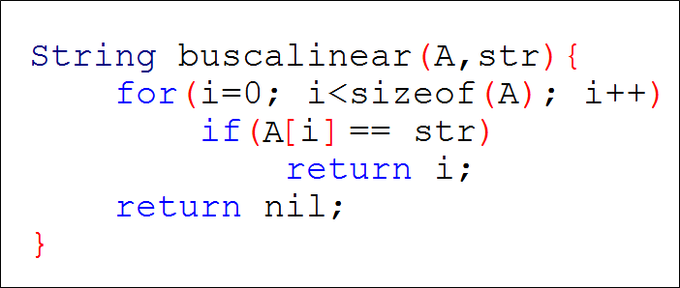
try,
trunk,
trie,
tree,
tray,
tram,
traitor,
trait,
trainee,
train,
tap,
datum,
date,
data
trainee

Slide 5
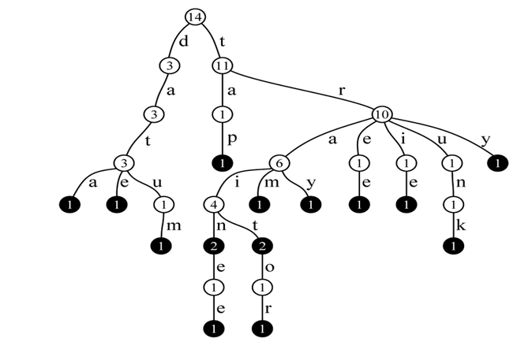
try,
trunk,
trie,
tree,
tray,
tram,
traitor,
trait,
trainee,
train,
tap,
datum,
date,
date
trainee

Slide 6
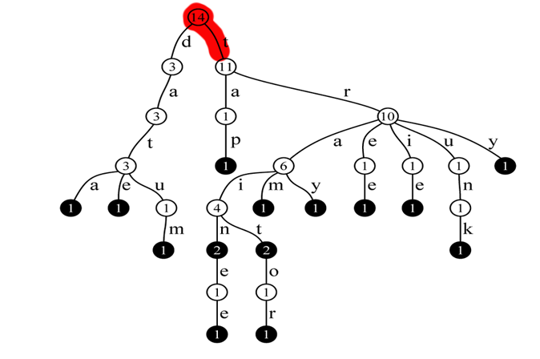
try,
trunk,
trie,
tree,
tray,
tram,
traitor,
trait,
trainee,
train,
tap,
datum,
date,
data
trainee

Slide 7
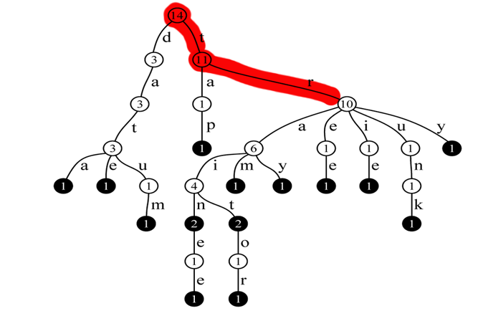
try,
trunk,
trie,
tree,
tray,
tram,
traitor,
trait,
trainee,
train,
tap,
datum,
date,
data
trainee

Slide 8
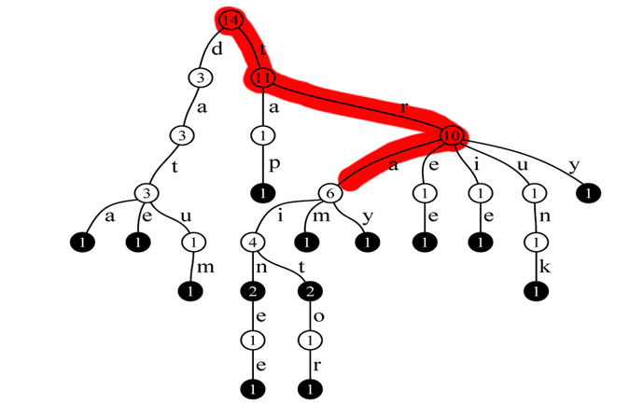
try,
trunk,
trie,
tree,
tray,
tram,
traitor,
trait,
trainee,
train,
tap,
datum,
date,
data
trainee

Slide 9
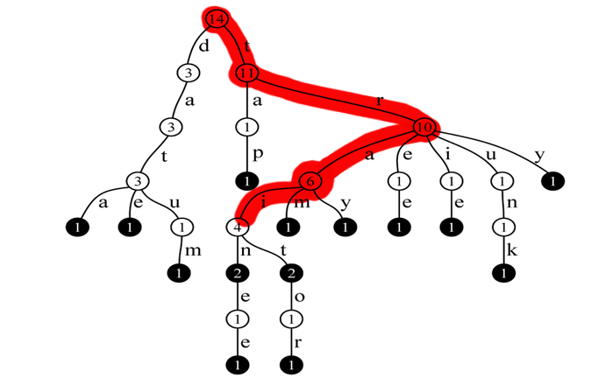
try,
trunk,
trie,
tree,
tray,
tram,
traitor,
trait,
trainee,
train,
tap,
datum,
date,
data
trainee

Slide 10
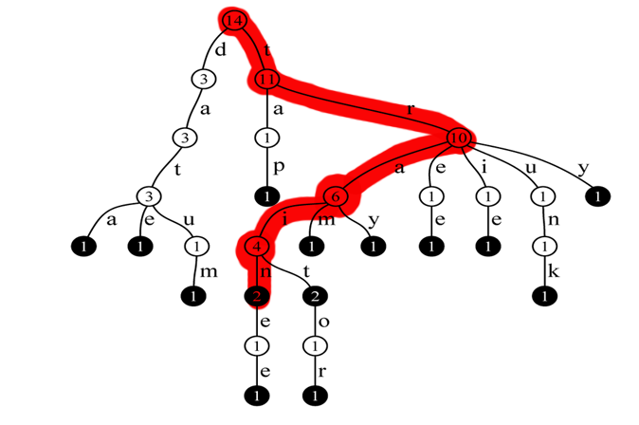
try,
trunk,
trie,
tree,
tray,
tram,
traitor,
trait,
trainee,
train,
tap,
datum,
date,
data
trainee

Slide 11
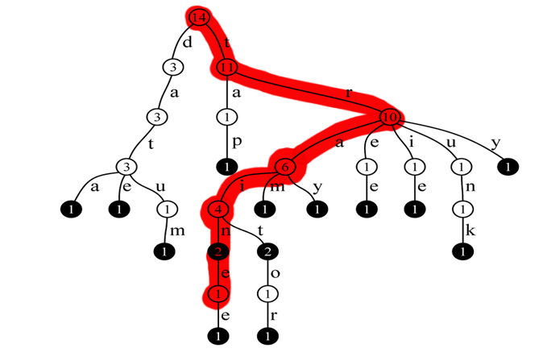
try,
trunk,
trie,
tree,
tray,
tram,
traitor,
trait,
trainee,
train,
tap,
datum,
date,
data
trainee

Slide 12
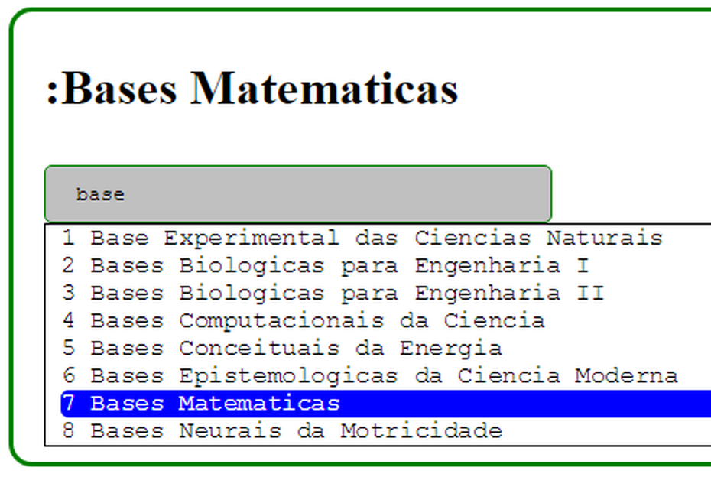

Slide 13
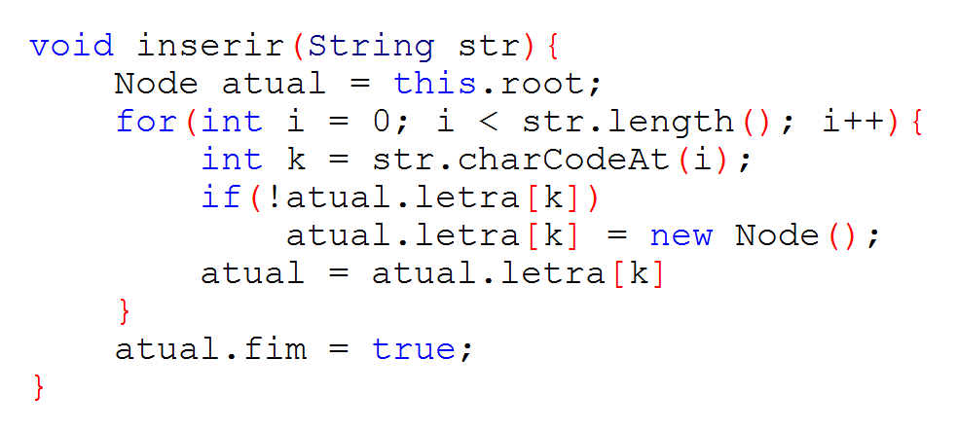

Slide 14
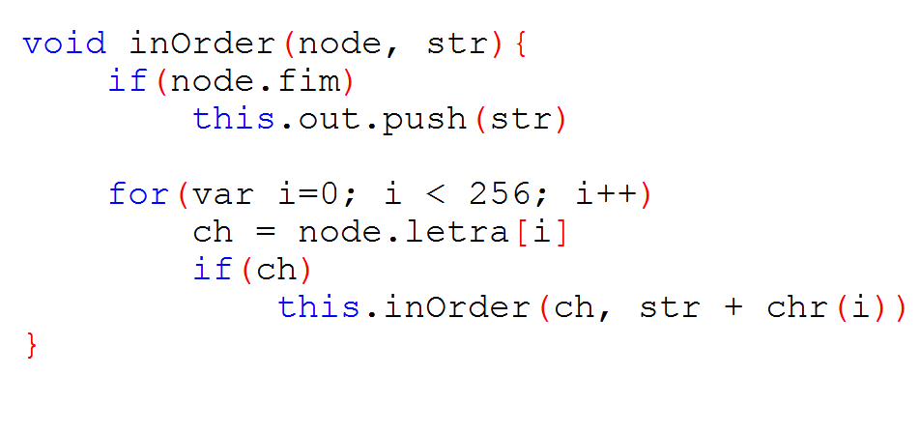

Slide 15
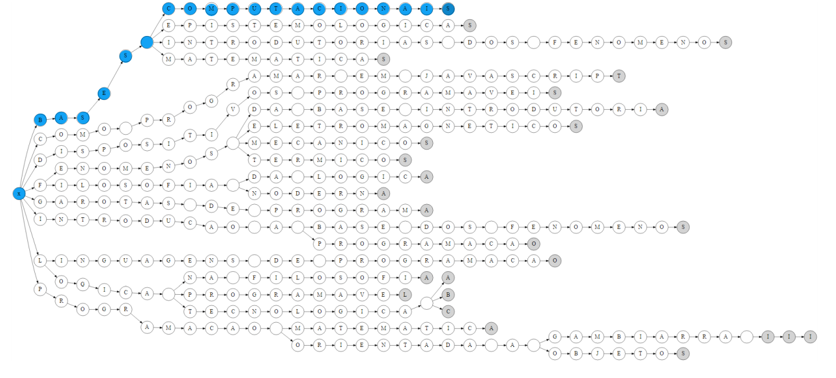
Trie Modificada

Slide 16
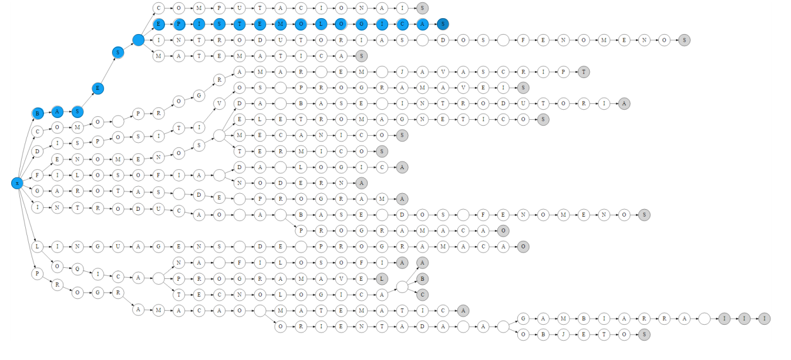
Trie Modificada

Slide 17
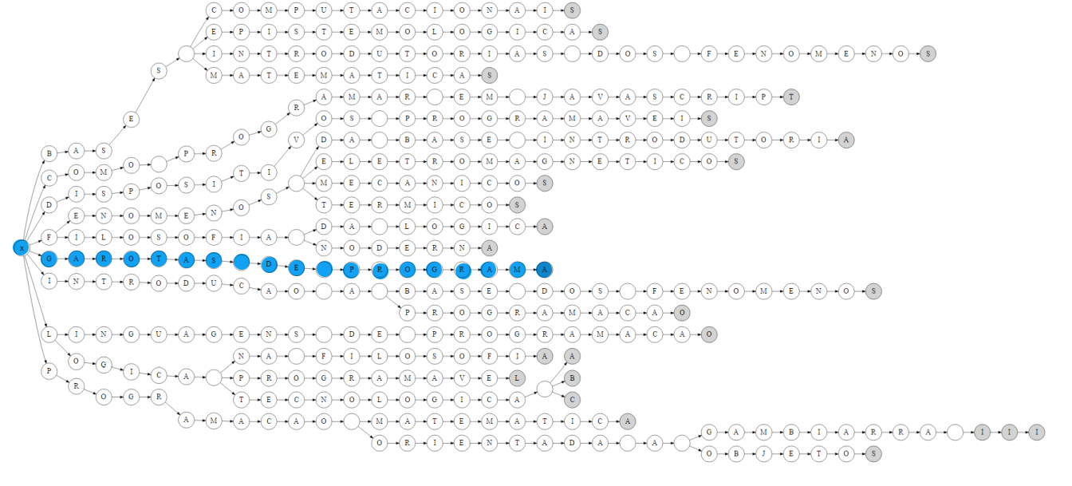
Trie Modificada

Slide 18
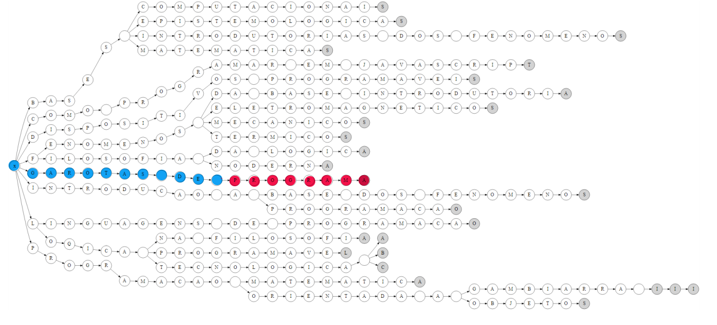
Trie Modificada

Slide 19
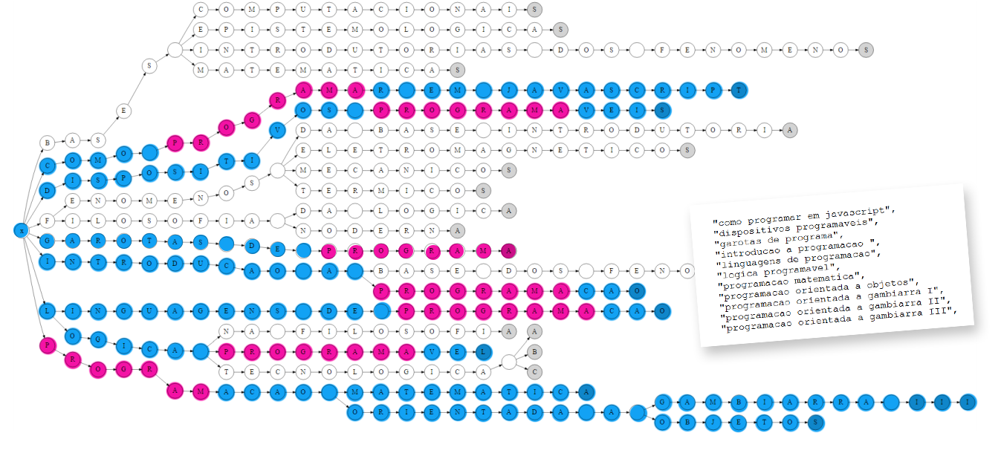
Trie Modificada

Slide 20
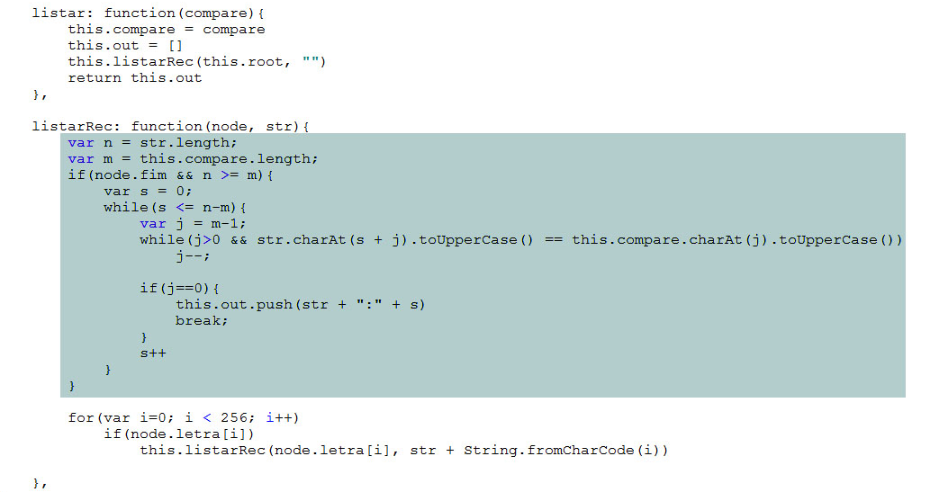
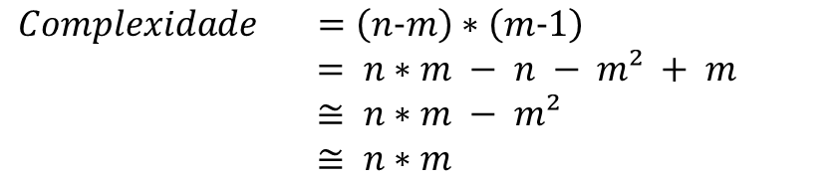
Trie Modificada
Palavra Completa
Palavra de Busca
$$Complexidade =\left(n-m\right)∗\left(m-1\right)$$
$= n∗m − n − m² + m$
$≅ n∗m − m²$
$≅ n∗m$
n = 17 (Bases matemáticas)
m = 4 (Base)

Slide 21
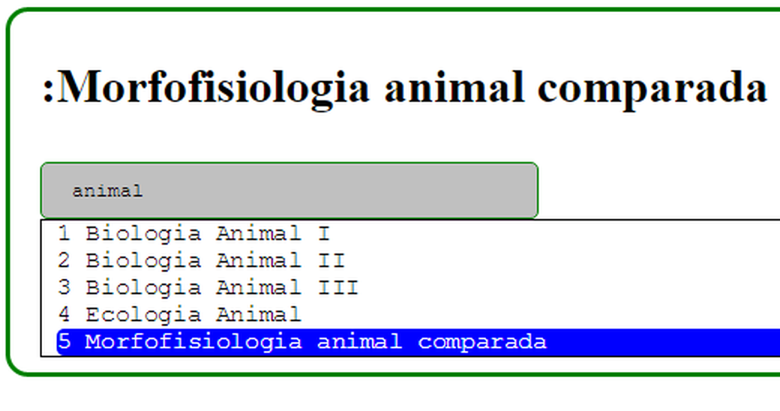

Slide 22
Demo
bit.ly/melhortrie

Slide 23
Considerações Finais
github.com/elsio/Trie

Slide 24
Obrigado!!!

