Slide 1
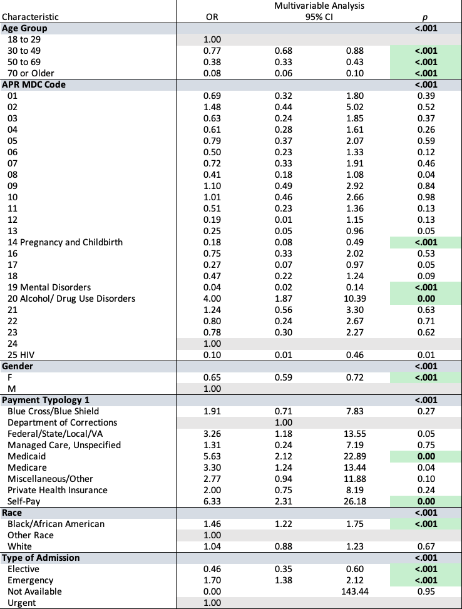
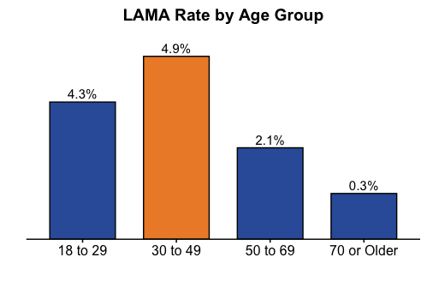
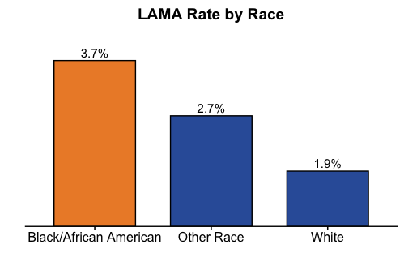
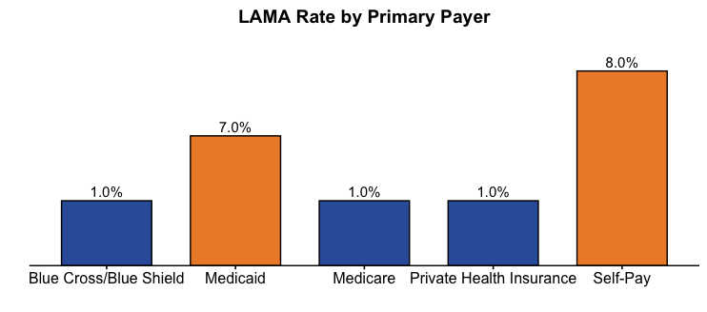
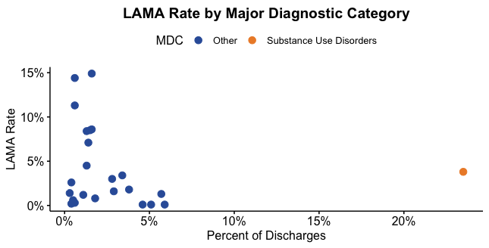
Predictors of Leaving Against Medical Advice from the Inpatient Acute Setting in Erie County, NY
Erica Smith, RN, MS, MBA, PhD Student and Chin-Shang Li, PhD
Introduction
The purpose of this study was to identify predictors of leaving against medical advice (LAMA) from inpatient hospitals in Erie County, NY. Understanding risk factors can help nurses develop person-centered mitigation strategies that improve outcomes and reduce health disparities.
Data Analysis
Using statistical software R and R Studio, we acquired deidentified data on all adult inpatient acute discharges in Erie County, NY during 2019 (n=105115) from the Open Health NY API.² While the overall LAMA rate was 2.3%, rates varied significantly by predictor.
Analysis of Logistic Regression Output
The odds for LAMA among patients with Medicaid and Self-Pay payment sources was more than 5 times that of the reference group.
Pregnancy/childbirth was associated with lower odds of LAMA.
Alcohol, drug use, and drug-induced mental disorders was the only major diagnostic category significantly associated with an increased risk of LAMA, with the odds 4 times that of the reference group..
Theoretical Framework
The study was inspired and guided by the Planetary Health-Related Quality of Life model, a conceptual framework developed by nursing experts to identify how ‘social determinants of health can be affected by nursing roles and actions at the individual, family, and population levels with a particular focus on the role of health policy’.¹
Conclusion
While the overall incidence is low, the variability in LAMA rate based on patient characteristics suggests health disparities in this important hospital-related outcome. This analysis identified important clinical, demographic, and social factors associated with increased risk for leaving against medical advice; these can inform strategic, person-centered planning.
Methods
We developed a multivariable logistic regression model to test the null hypothesis that there is no relationship between potential predictor variables and LAMA events using LAMA as the binary dependent and age group, gender, race, type of admission, primary payment source, and major diagnosis group as the independent variables.
References
Kuehnert, P.,, E., Killion, C., Maliski, S., Maughan, E. D., Meade, C., Murray, T., SchenFawcett, J., DePriest, K., Chinn, P., Cousin, L., Ervin, N., Flanagan, J., Fry-Bowersk, B., & Waite, R. (2022). Defining the social determinants of health for nursing action to achieve health equity: A consensus paper from the American Academy of Nursing. Nursing Outlook, 70(1), 10-27.
New York State Department of Health (Office of Patient Safety and Quality). (2019). Hospital inpatient discharges (SPARCS De-Identified): 2019. Center for Applied Research and Evaluation. Retrieved November 9, 2022 from https://health.data.ny.gov/Health/Hospital-Inpatient-Discharges-SPARCS-De-Identified/4ny4-j5zv
Results
Older age, female gender, and elective admission type were consistent with lower LAMA rates.
African American race, emergency admission type, and government-funded insurance were observed as having increased risk.
School of Nursing
Graduate Programs
buffalo.edu

