Slide 1
Opening Chinese restaurant in toronto
By Elshan Kazimov

Slide 2
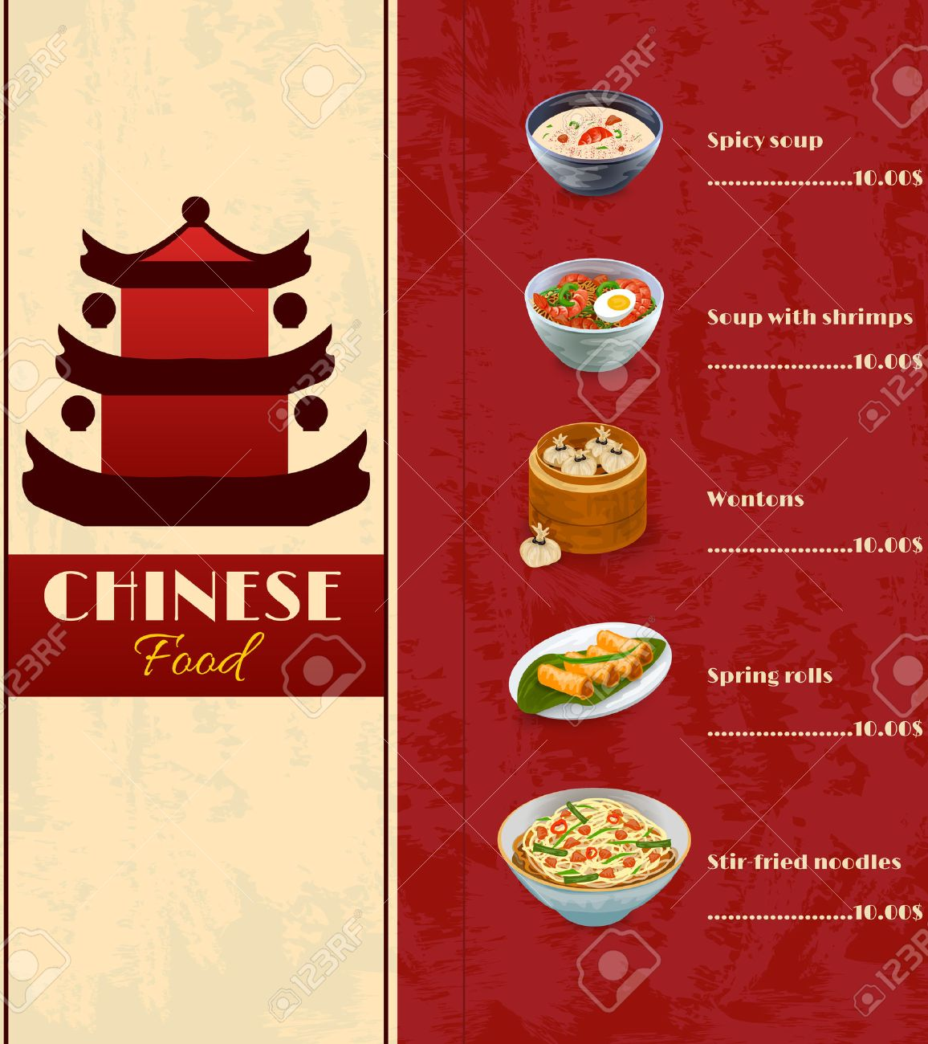
Business problem
Toronto is crowded, multicultural and touristic city. According to 2017 data provided by United Nations population of Toronto is approximately 2.93 million which is high enough. That’s why opening restaurant in Toronto can be very profitable for restaurant owner. But where to open this restaurant in Toronto?

Slide 3
Data&sources
Official website of Toronto city
Geopy.geocoders
Foursquare API

Slide 4
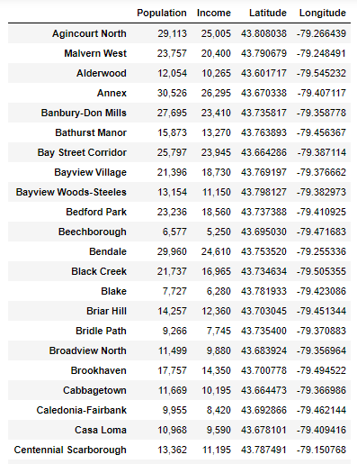
Methodology
We combined datasets that we have got from first and second sources (Population and income data is for 2016) and the we used Foursquare API to get locations of restaurants and then we created final dataframe. Firstly, we visualized data with the help of horizontal bar chart provided by Matplotlib library and at the end, we created map provided by Folium library.

Slide 5
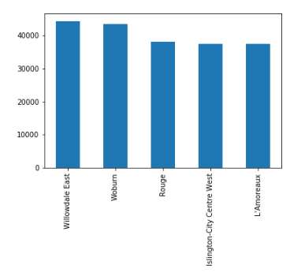
Results – bar chart
Horizontal bar chart created opportunity for us to see top 5 neighborhoods by individual income ranking. But we also need to get data about locations of other Chinese restaurants.

Slide 6
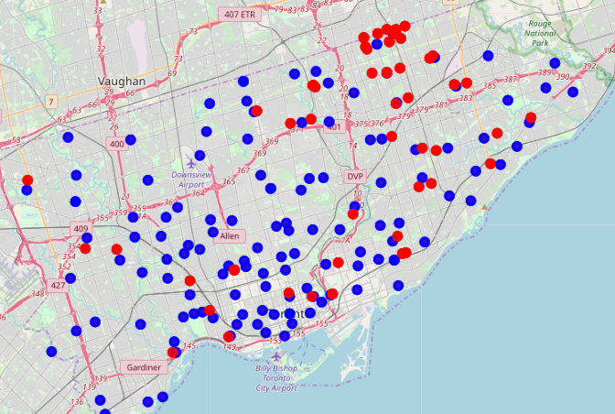
Results – map
Because of problem I mentioned in previous slide we need to get these data on map. In this map blue points show neighborhoods and red points show other Chinese restaurants. We can easily see from these where is the good places for new opening restaurant. We should, also, take into account income and population data. There are, already, enough Chinese restaurants in Wilowdale East and Woburn neighborhoods which is the first and the second in ranking by income. But Rouge(3rd in ranking) neighborhood has not any Chinese restaurant yet, that’s why this area can be better places for opening restaurant.

Slide 7
Thank you for
your attention

