Slide 1
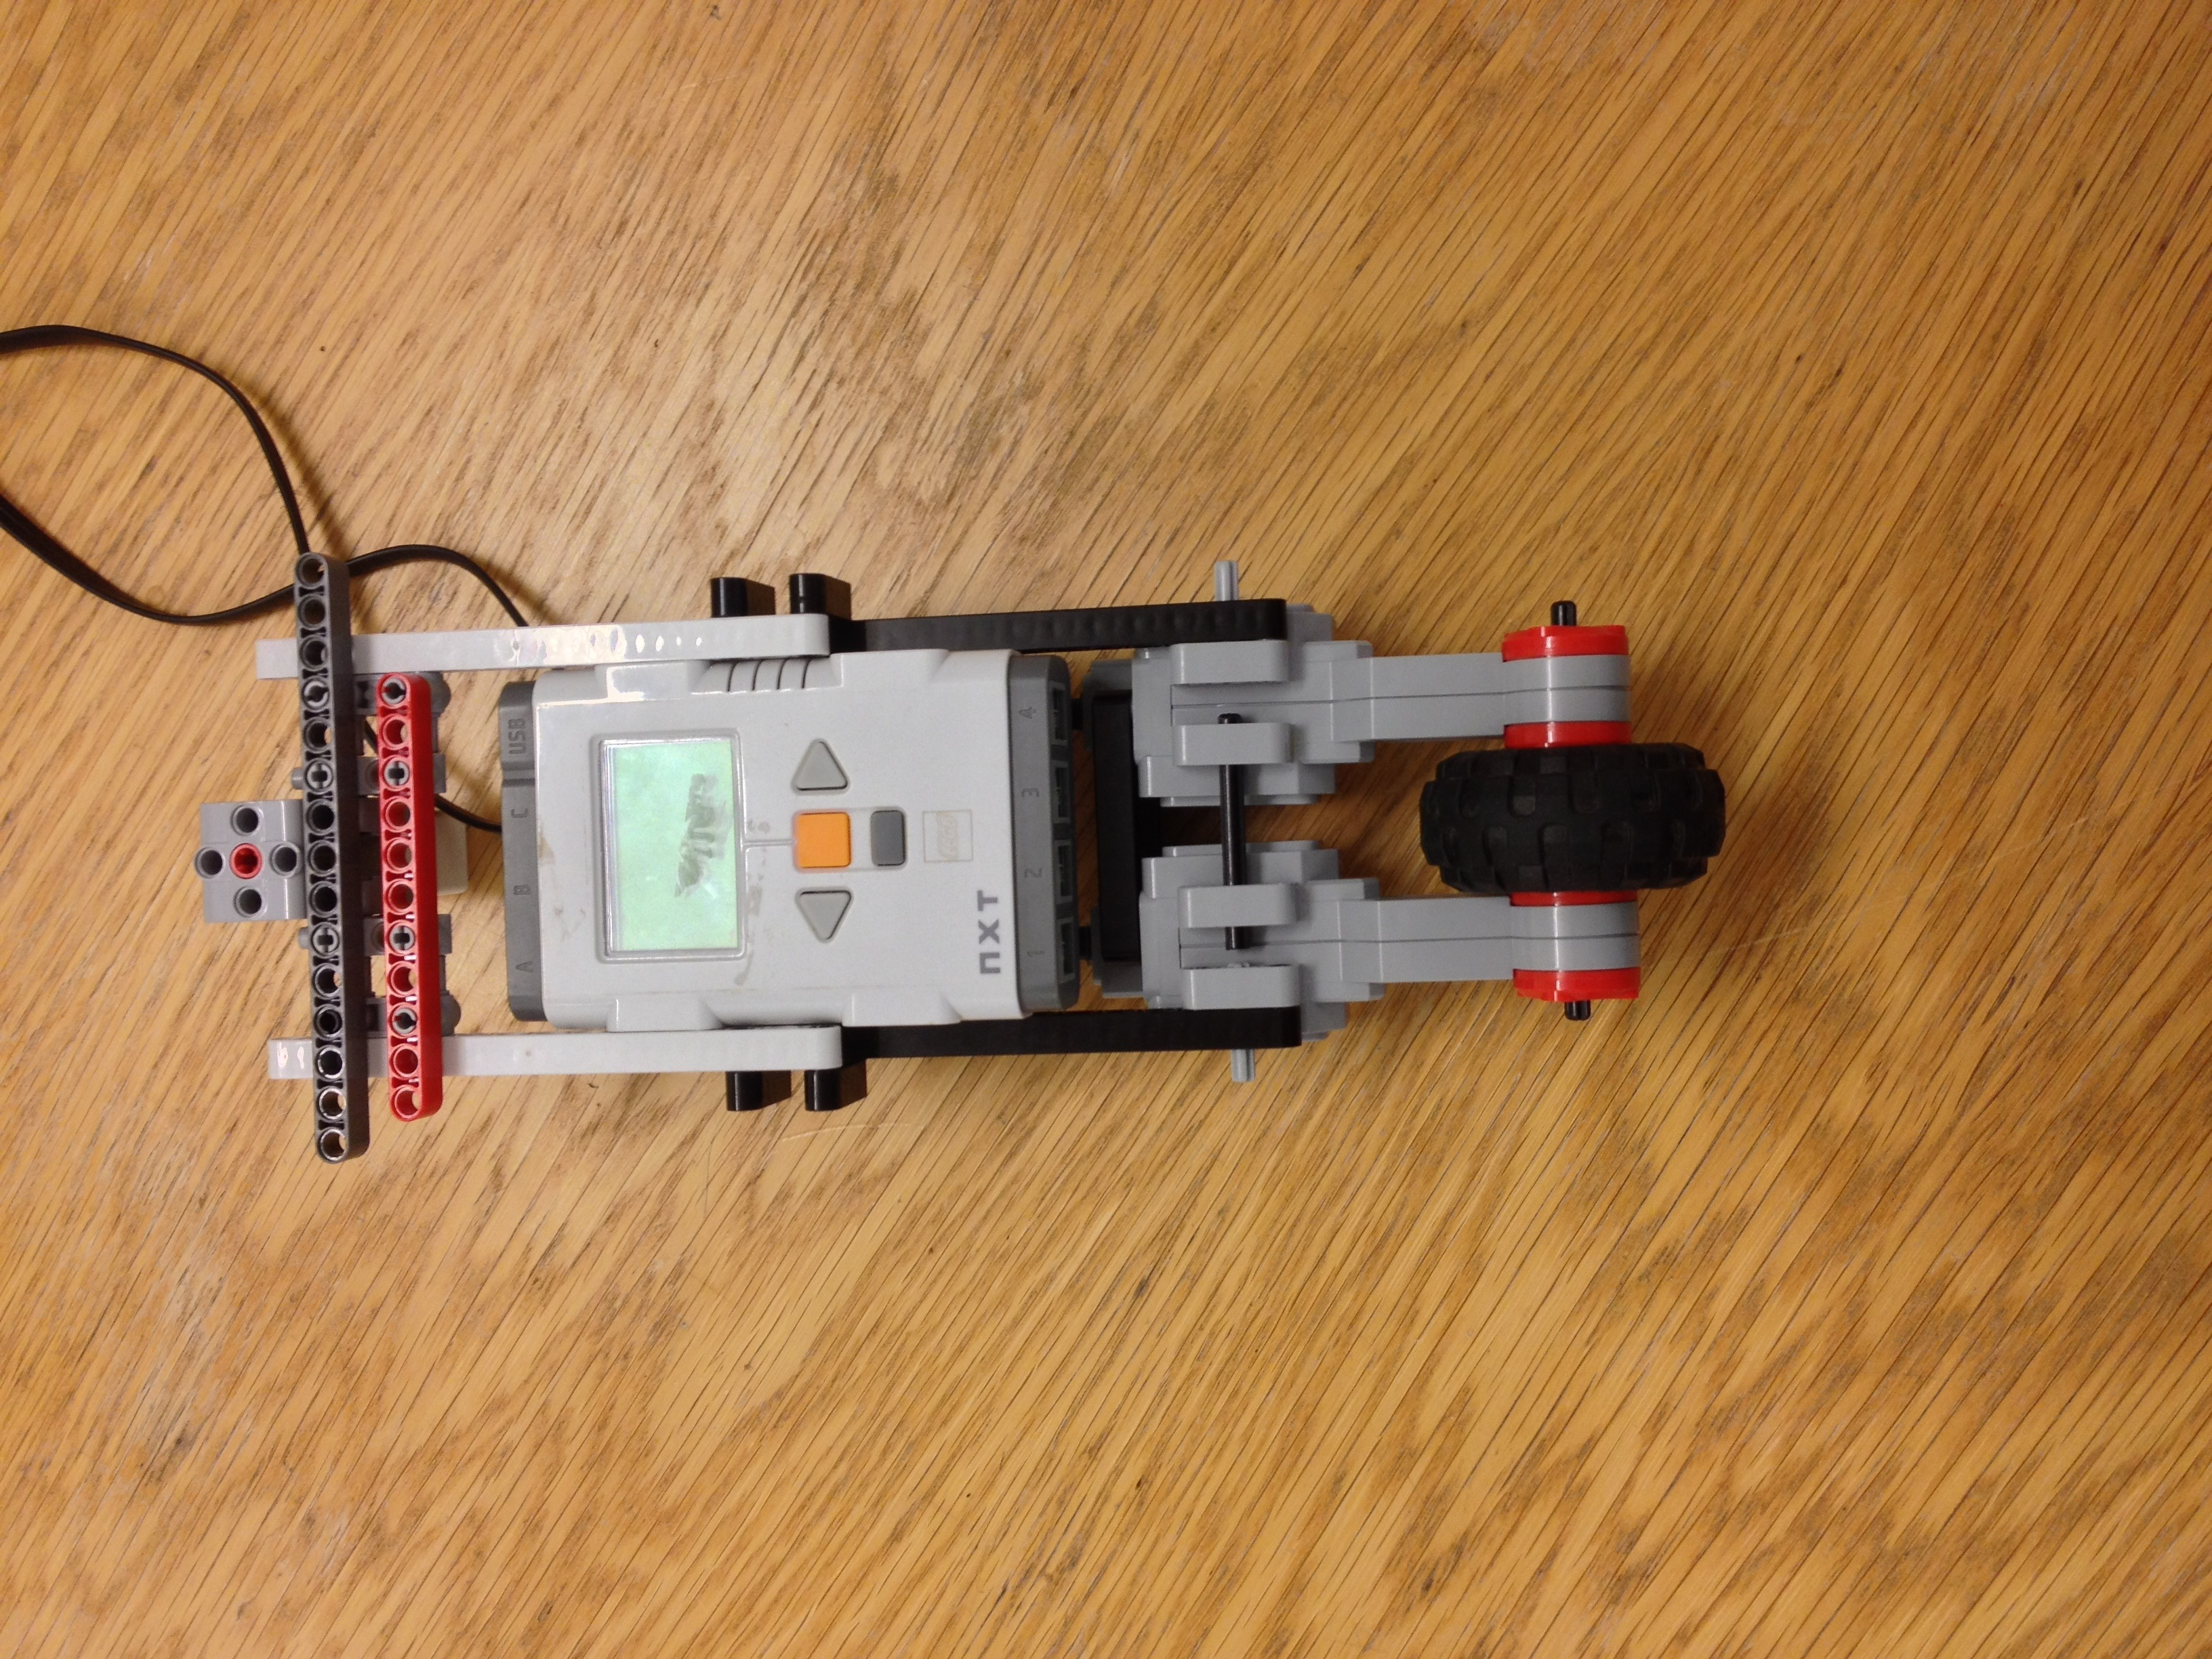
Lego unicyle with a inertia wheel
FRT090
November 17
Group B

Slide 2
Overview, objectives
Maintain balance in forward and backward and left, right directions
Withstand disturbances e.g. pushes at the robot
Inverted pendulum & inertia wheel
Inverted pendulum & wheel at bottom

Slide 3
Why modeling ?!?
Essential to understand the process and its physical quantitative parameters
Investigate the stability of the process, robustness
Which regulator is suited for this specific process
Stability of the model

Slide 4
Model quality of the process
Thru simulation and reason (if the model is not to complex)
Make use of prior knowledge to similar processes

Slide 5
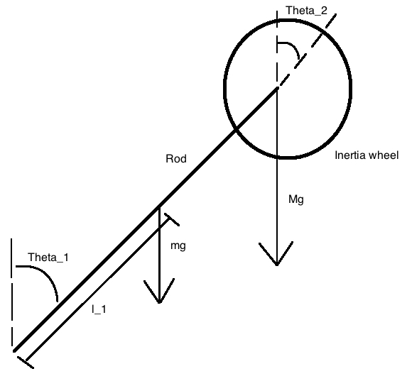
Our model so far
The model equation so far
“Picture the problem”, answer by all physics teachers

Slide 6
Choice of model, motivation
The choice went to Newton’s equations & torque equations instead of Lagrange equations
Prior knowledge of Newton & torques

Slide 7
Design approach, motivation
Handwritten solutions (transfer function, closed loop analysis)
Matlab & Simulink simulation for analysis
PID regulator as G_{R} (regulator)
Build in software => parameters of the regulator

Slide 8
Experience, modeling
Research of possible solution models
Simulink & Matlab
Research of software for the implementation for further analysis

Slide 9
Experience, design

