Slide 1
Motamyz
Engineering Projects Management
Motamyz.Com
Supervised by / Dr. Ragab El Sehiemy

Slide 2
Main Points
01
Introduction to project
02
What is HTML ?
03
CSS & JS
04
Bootstrap 4

Slide 3

Section One
Introduction to project

Slide 4
Motamyz
What is project ?
Teams
Tools
 | Roadmaps & Timing diagrams
 | Posts & Articles
 | Tasks Area
 | Events & Meetings
 | Courses
 | Notes & Files area
And more….
User Account
Features
 | Multi teams
 | Create team
 | Join team
Time Management
Features
 | Timing diagrams
 | Notes
 | Tasks area
 | Roadmaps
Tools & Techniques
It’s a website and mobile application to help you managing your time, and ending your projects.
It’s a workspace to help you to communicate with your teams.
It’s more than work. It’s a way of working together.
Customize and expand with more features as your teamwork grows.
Manage projects, organize tasks, and build team spirit.
All in one place…..
Front end Techniques
Html
CSS & JS
Bootstrap 4
Back end Techniques
PHP
MYSQL
Laravel 8
APIS
mobile application
Flutter
Sqflite
firebase

Slide 5
Skills To Learn
1. Search First Before Asking
search
2. Have A Target And Focus On It
3. Try To Get A lot Of Ideas
Possible
Target
4. Never Say I Can't Or That’s
Impossible
Ideas

Slide 6
What is HTML ?

Slide 7
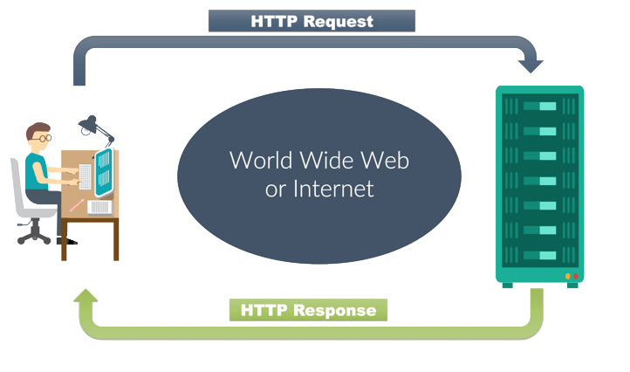
How The Website Works ?

Slide 8


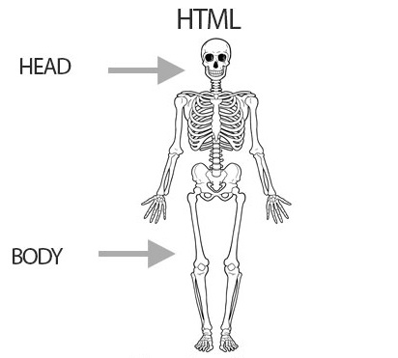


Introduction
START
What is HTML?
Structural Layer
HTML Elements
HTML describes the structure of a Web page
HTML elements tell the browser how to display the content
HTML elements label pieces of content such as "this is a heading", "this is a paragraph", etc.....
HTML stands for Hypertext Markup Language. Since HTML consists of a head and body you can also add a variety of things that makeup the webpage. In HTML you can add tables, paragraphs of text , headlines, images, videos , links , and more.
The HTML element is everything from the start tag to the end tag:
< tagname >
Content goes here
</ tagname >
Examples of some HTML elements:
<h1>This Is Header</h1>

Slide 9
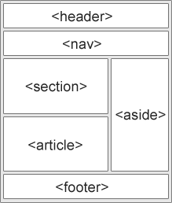
parts of a web page
non-semantic
semantic
Many web sites contain HTML code like:
<div id="nav">
<div class="header">
<div id="footer">
to indicate navigation, header, and footer.
In HTML there are some semantic elements that can be used to define different parts of a web page like
<article>
<aside>
<footer>
<header>
main
<nav>
<section>
parts of a web page

Slide 10
CSS & JS

Slide 11
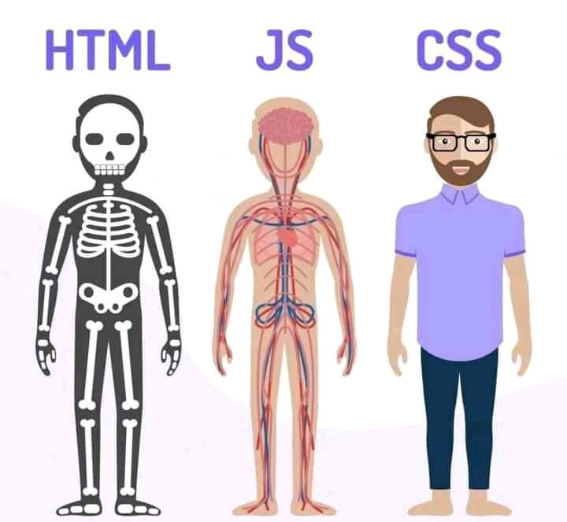

Slide 12
CSS Syntax
Combinators & Pseudo Classes
CSS Selectors
Media Queries
CSS
CSS stands for Cascading Style Sheets.
CSS describes how HTML elements are to be displayed on screen, paper, or in other media.
CSS Properties
CSS Variables

Slide 13
JS Variables
Data Types
JS Operators
Conditional Statements
JS
JavaScript is programming or scripting language of the Web.
JavaScript is to program the behavior of web pages
Loop
Functions

Slide 14
THANK YOU
Insert the Sub Title of Your Presentation

