Slide 1

Formal verification of the 5G AKA protocol using the Tamarin Prover
Cybersecurity Lab I
PRESENTED BY:
NOUR HMEEDAN
SUPERVISOR :
DR. MOHAMMED ALSHAWKI
23 June 2025

Slide 2
Lab Summary & Context
• Goal: Formally verification of the 5G AKA authentication protocol.
• Tool: Tamarin Prover 1.11.0 on WSL2 (Ubuntu 24.04).
• Model: Adapted 5G_AKA_fix.spthy from Tamarin's example models
• Focus Areas:
Injective agreement on K_seaf.
Simulation of SUPI leakage and prevention.
Tamarin-based security lemma validation.
• Objective:
Ensure security properties: confidentiality, authentication, replay protection.
1

Slide 3
Related Work
• CCS 2018: "A Formal Analysis of 5G Authentication"
D. Basin et al., Proceedings of ACM CCS (https://doi.org/10.1145/3243734.3243846)
Provided the original Tamarin model used in this Lab.
• Additional Foundations
3GPP TS 33.501: 5G Security Architecture Standard.
Research on SUPI leakage and anonymity attacks in 5G/LTE.
Public Protocol Model Source
GitHub Repository:
github.com/tamarin-prover/tamarin-prover/blob/develop/examples/ccs18-5G/5G_AKA_fix.spthy
2

Slide 4
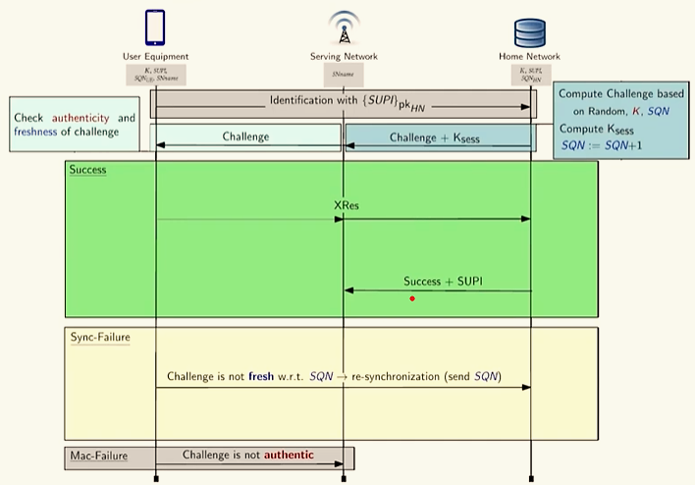
5G AKA Protocol Steps:
Goal: Authenticate the UE with the HN via the SN and establish a session key (Kₛₑₛₛ) securely.
Phases:
Identification: UE sends encrypted SUPI using pk_HN to begin authentication.
Challenge: HN generates challenge using key K, sequence number SQN, and random value R.
Verification: UE checks freshness and authenticity, Responds with XRes if valid.
Paths:
Success
Sync-Failure.
MAC-Failure.
This flow highlights the robustness of 5G AKA while showing points where attacks (like SUPI leakage) may occur under altered assumptions.
2

Slide 5

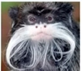
5G Authentication and Motivation
Over 4.8 billion users rely on secure mobile communication(60% of global population).
Challenge: Determining which security guarantees are actually met in 5G AKA under formal modeling assumptions.
📘 The original 5G specification, written by 3GPP, is very long (around 700 pages) and written in natural language which may include ambiguities or lack formal precision.
Translation
Dolev-Yao model: assumes an attacker with full control of the network, enabling worst-case scenario analysis.
Challenges: encoding protocol logic, managing state complexity, and guiding automated proof search.
Tamarin Prover

Slide 6
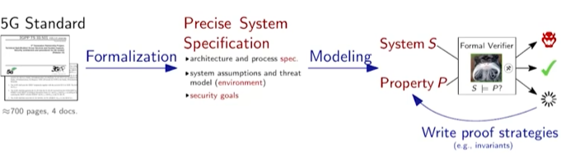
Formal Verification Workflow in 5G AKA:
Formalization: Extract precise security goals and threat models from natural language specification.
Modeling: Build formal protocol models in Tamarin Prover, including cryptographic functions and actor behaviors.
Proof Construction: Prove key properties like secrecy, agreement, (e.x. lemma injective_commit_to_running using custom strategies)
Lab Focus: Custom rule injection, lemma extension, and trace validation under attack scenarios.
2

Slide 7
Researchers contribution VS my contribution:
 | CCS18 Researchers work | My work
Goal | Comprehensive formal analysis of 5G AKA under various threat models | Explore targeted vulnerabilities and validate SUPI leakage behaviour.
Used model | Full formal Tamarin model with symbolic attacker and full AKA state machine. | Adapted CCS18 model to test custom leak and agreement conditions
Main verified lemmas | Authentication, secrecy, binding channel assumptions. | Leak of SUPI under certain conditions(trace simulation with/without rules)
Custom rule insertion | No new rules: official 3GPP assumptions | OutSupi rule for simulating leakage conditions.
2

Slide 8
My Contribution: Formal Verification and Attack Simulation using Tamarin
Model Adjustments Adapted CCS18 Tamarin model and assumptions to match lab goals.
New Lemma Added Implemented injective_commit_to_running to verify session uniqueness.
Attack Simulation Enabled init_supi and leak_supi rules → SUPI leakage observed.
Fix & Re-verification Disabled leak rules → model restored, no_leak_of_supi passed.
2

Slide 9


Injective agreement lemma
Injective_commit_to_running_agreement:
A property that each "commit“ action at UE corresponds to a unique "running" session at SN.
prevents attacks like:
replay attacks.
session duplication.
parallel sessions.
Existing CCS18 lemmas ensure agreement but not injectivity.
Prevents cases where multiple commit actions could match a single running session (violates uniqueness).
Why I Added This Lemma??
Verification Outcome:
The lemma was successfully verified using Tamarin confirms that for each session at UE, there’s a unique corresponding session at SN.
2

Slide 10
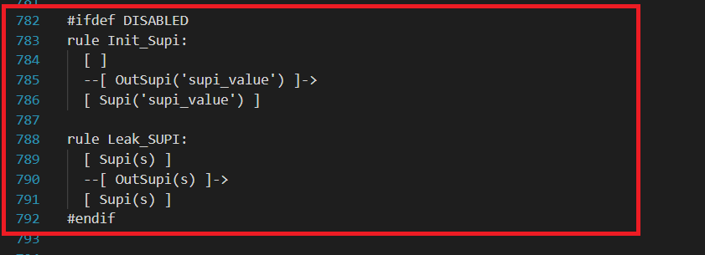
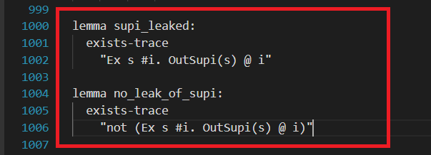
Enabling Attack Traces: Rules and Lemmas for SUPI Exposure
To enable trace generation that simulates privacy violation (SUPI leakage):
Added rules | init_supi | leak_supi
Description | A rule to initialize a session by the user equipment (UE) including the SUPI. | A rule to represent if an attacker has compromised such SUPI value
Objective | Allowing me to simulate an active session from UE to the network | To simulate security breach where this sensitive identifier is exposed.
Added lemmas | supi_leaked | no_leak_of supi
Description | A lemma that proves SUPI could be exposed in loose security settings | A lemma that proves SUPI remains secretin strict security settings
Objective | This validates the ability of SUPI to be accessed under certain conditions | This demonstrates the capability to protect the SUPI from leaked
2

Slide 11

Attack Injection and Privacy Violation:
Adding a leak rule is a common formal verification technique to evaluate if the protocol's privacy guarantees depend solely on ideal assumptions.
Attack Injection :
Enabled "init_supi" and "leak_supi" rules to simulate an attack.
Proved the lemma "supi_leaked " holds and the lemma "no_leak_of_supi" fails.
Why This Test?
Demonstrates how an attack can lead to the compromise of the SUPI value under certain rule activations.
Commented rules = ideal world → SUPI is safe
Uncommented rules = realistic test → SUPI can leak
Conclusion: SUPI secrecy is not guaranteed without stricter assumptions.
2

Slide 12
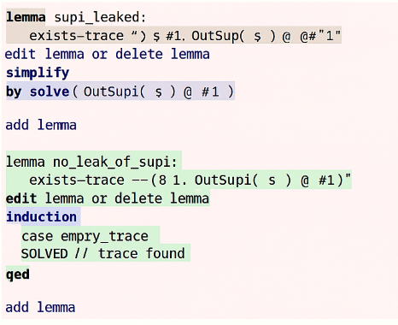
Fixes and Re-verification:
Fix Applied:(Commented rules = ideal world → SUPI is safe)
Re-commented the init_supi and leak_supi rules to restore the original model assumptions.
Re-Verification Outcome:
Supi_leaked = unsatisfied → SUPI is not leaked
no_leak_of_supi= successfully solved→ SUPI is secure
4

Slide 13

Conclusion
Realistic model exposed privacy weaknesses by showing leakage of SUPI.
Ideal model, with stricter assumptions, prevented SUPI leakage.
Adding a 'leak' rule helped demonstrate protocol's reliance on specific assumptions.
Injective agreement lemma shows potential necessity of adopting injective lemmas to strengthen protocol verification.
3

Slide 14
Future work
Introduce key-confirmation before a session is initialized.
Refine the init_supi rule with stricter conditions to prevent SUPI leakage
Develop stronger cryptographic bindings between SN and HN to ensure injective agreement.
5

Slide 15

Thank you!
NOUR HMEEDAN
7

