Slide 1
Formation
Collective Intelligence - Second Assignment
Contributors: Márk Róbert Baricz, Richard Sipos

Slide 2
Key elements from previous semester
PPO Clip as the main algorithm
CTDE paradigm
Hydra config setup, logging to WandB
Visualizer script to export GIFs (improvement needed)

Slide 3
Main features introduced in our version
SDF interface with support for 3 shapes (circle, polygon, star)
Observation and reward redesign
Assignment strategies (hungarian, greedy)
Multi-shape scenes
Dynamic reconfiguration mid-episode
Metrics (boundary error, uniformity, collision rate)
Improved visualizer script
Extended and fixed unit tests
Hydra support for sweeps
Added multirun support
Ablation & Analysis feature
Created comparison charts for ablation run
Dockerization fixes
Descriptive README file

Slide 4
Shape Model and Scenarios

Slide 5
SDF interface
although there is support for 3 shapes (circle, polygon, star), there are only two shape families (Circle, Polygon), because Polygon class is generalized in a way that it can compute the signed distance for non-convex polygons also => basically defining a polygon shape is done by defining the coordinates of the vertices, and those vertices can also form non-convex shapes too
signed_distance() method of the shapes returns the signed distance, negative inside, zero on boundary

Slide 6
Multi-shape scenes
there is support in the config files to define multiple shapes in one scene
shapes can also overlap each other
it should be specified how many agents should target the shapes (e.g. 4 agents to shape A, 6 agents to shape B)

Slide 7
Dynamic Reconfiguration
in the config file the shapes can also be changed by defining the reconfiguration_step and the reconfiguration_shape
the new shape can be defined in a similar way, just nested under a specific key
agents automatically move towards the new shape when it has changed
dynamic reconfiguration also supports multi-shape scenes (e.g. a variation of a multi-shape scene changes to another variation of it/or with totally new shapes)

Slide 8
Assignment strategies

Slide 9
Assignment strategies
there is support for two different assignment strategies:
  hungarian: each agent gets a unique target position, so they will evenly occupy the perimeter of the targeted shape; the computation of the target positions happens in an optimized way
  greedy: each agent targets the closest target position to his current/starting position -> multiple agents can target the same position

Slide 10
Observation and reward redesign

Slide 11
Observation and reward redesign
the signed distance and the target positions are also taken into consideration in the case of observations and the computation of the reward
there is a reward given based on the signed distance (exp(-5*ɸ(x_i)**2), but also based on the distance to the target position (exp(-2*dist_to_target(x_i)**2)
future improvement ideas:
  penalty for high velocity when close to target => reduce “jittering”
  tweaking with the alpha values of the rewards above => possible achievement of faster convergence
failed attempts:
  there has been an issue of getting infinity values, causing the calculations to “deteriorate” the done progress, the final model ending to contain NaN weights => solution: safety check both in calculations and while training (skipping epochs where we get wrong weight updates)

Slide 12
visualize.py

Slide 13
visualize.py
the visualizer script also needed an update for a better experience of development and testing
on the exported GIF now there is also shown the target shape(s) (with dashed lines) and the target positions (with crosses)
some export settings have also been changed, so now the agents move “faster” and their movement is more smooth, caused by increasing the fps
there was an error in the initial version (from previous semester) that the processed location of the agents wasn’t the real location, so the exported GIFs never displayed the true movement of the agents

Slide 14
Metrics

Slide 15
Metrics
we introduced three metrics to help evaluate the trained model:
  Boundary Error: Measures how close agents are to the target shape boundary using the signed distance (SDF)
  Uniformity: Measures how evenly agents are distributed along the target shape
  Collision Rate: Measures how often agents collide with each other
the metrics are printed to the CLI and logged to W&B after each training run
the metrics for further analysis of the models, for example ablation studies
a known limitation is that episodes are capped at 500 steps for performance reasons

Slide 16
Multirun

Slide 17
Multirun
we introduced a multirun feature that allows training multiple models in a single execution
we added two Hydra sweep configuration files:
  sweep_lr: sweeps the learning rate
  sweep_assign: sweeps the assignment strategy
to improve storage and space management, we implemented a dedicated multirun directory with a clear folder structure for organizing outputs (date + time)
finally, we introduced seed parameters to ensure experiment reproducibility

Slide 18
Ablation & Analysis

Slide 19
Ablation & Analysis process
to run the ablation analysis, you first need to configure and execute a multirun (you can use sweep_assign and/or sweep_lr)
the analysis script then aggregates results across seeds and prints the mean and standard deviation for each configuration among the models trained in the same multirun
you must provide a sweep_id to the ablation analyzer so it can filter and evaluate only the models produced within that specific multirun
finally, the analyzer generates a CSV file containing the key properties and metrics of the analyzed models

Slide 20
Example of generated CSV file row
Run | Learning Rate | Seed | Boundary Error (mean) | Boundary Error (max) | Uniformity (coeff) | Collision Rate
run-20251220_232632-894dzw7w | 0.01 | 1 | 3.520 | 6.937 | 0.803 | 0.352

Slide 21
Chart creation

Slide 22
Chart Generation for ablation
we store the aggregated ablation results
the /scripts/plot_runs_csv.py script generates charts from the CSV file produced by analyze_ablations.py
we aggregate metrics across different seed runs using the provided where filter, and then compare the aggregated configurations visually in the resulting charts
a possible future improvement is to introduce other chart types and make this code reusable for other features as well

Slide 23
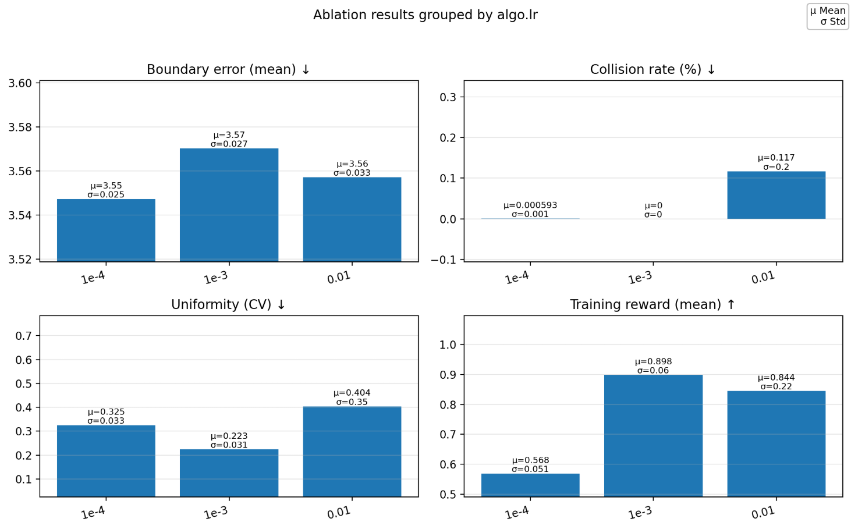
Ablation run chart comparison
our chart compares the three core metrics and the training reward
each column value is computed from the mean and standard deviation of runs that share the same configuration but use different seeds
all charts are generated from this previously aggregated data.

Slide 24
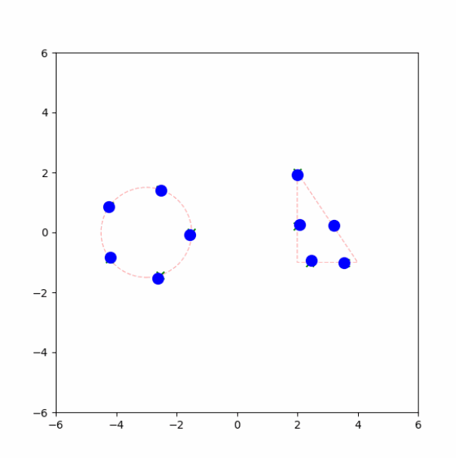
Generated GIF
generated by running the default_exp.yaml experiment
the GIF is included in the repository as formation.gif file

Slide 25
Thank you!
More information about the project can be found in the README file.
https://github.com/elte-collective-intelligence/student-formation/tree/2025/26/1
Contributors:
Márk Róbert Baricz
Richard Sipos

